Slide 1
🏥 CLINICAL GOVERNANCE & HEALTHCARE OPERATIONS BRIEFING
Clinic Operations Analytics:
Investigating Patient Flow, Waiting Times & Provider Workload
An Empirical EHR Audit of 16,998 Outpatient Encounters at Metro North Family Health Centre
📊 16,998 Scheduled Encounters | 👥 2,775 Active Patients | 🩺 4 Attending Physicians | 📅 250 Operating Days (2024)
Prepared by: Clinical Data Analyst & Health Informatics Specialist (MBBS)
Presented to: Chief Medical Officers, Clinical Governance Committees & Health Service Executives
Analytical Stack: Relational SQLite | SQL CTEs & Window Functions | Python (Pandas/Seaborn) | Interactive Chart.js

Slide 2
HEALTHCARE CLINICAL OPERATIONS ANALYTICS
Executive Briefing: SBAR Clinical Operations Framework
Structured clinical governance summary identifying root cause and cost-neutral corrective actions
SITUATION (The Operational Challenge)
Following the July 1 launch of a Chronic Disease Campaign, lobby waiting times and patient dissatisfaction escalated rapidly, with severe mid-morning congestion and provider fatigue.
RECOMMENDATION: Cost-Neutral 4-Point Action Plan
🔹 Protected 30-Min Chronic Care Templates:
Mandate 30-minute booking templates for multi-morbid care plans. Resolves the severe template mismatch with actual 24.5-minute consult times.
🔹 10:30 AM Mid-Morning Catch-Up Buffer:
Insert a single unbooked 15-minute administrative slot to act as a queuing circuit breaker, absorbing stochastic morning overruns before the 11:00 AM wave.
🔹 Dynamic Front-End Nursing Intake:
Reallocate existing nursing roster to staff a 3rd triage vital-signs intake station during peak arrival congestion (08:30–10:15 AM).
🔹 Automated Sunday 16:00 SMS Reminders:
Target the elevated 12.88% Monday no-show rate with proactive automated confirmations to smooth weekly clinic utilization.
🎯 Target Outcome: Reduces morning P90 wait to <35m with ZERO clinician recruitment cost.
BACKGROUND (Initial Executive Hypothesis)
Leadership attributed delays to uncontrollable demand surge and physician pacing, considering expensive interventions: extending operating hours or hiring additional locum clinicians.
ASSESSMENT (The Empirical Data Evidence)
• Booked volume grew only +12.5% (+2 patients/doctor/day).
• Afternoon clinics stayed flat (P90 wait was 35.2m Pre vs 35.8m Post).
• Morning P90 wait surged +82% (41.9m to 76.3m) due to unbuffered 15-min slots colliding with complex 24.5-min chronic reviews.

Slide 3
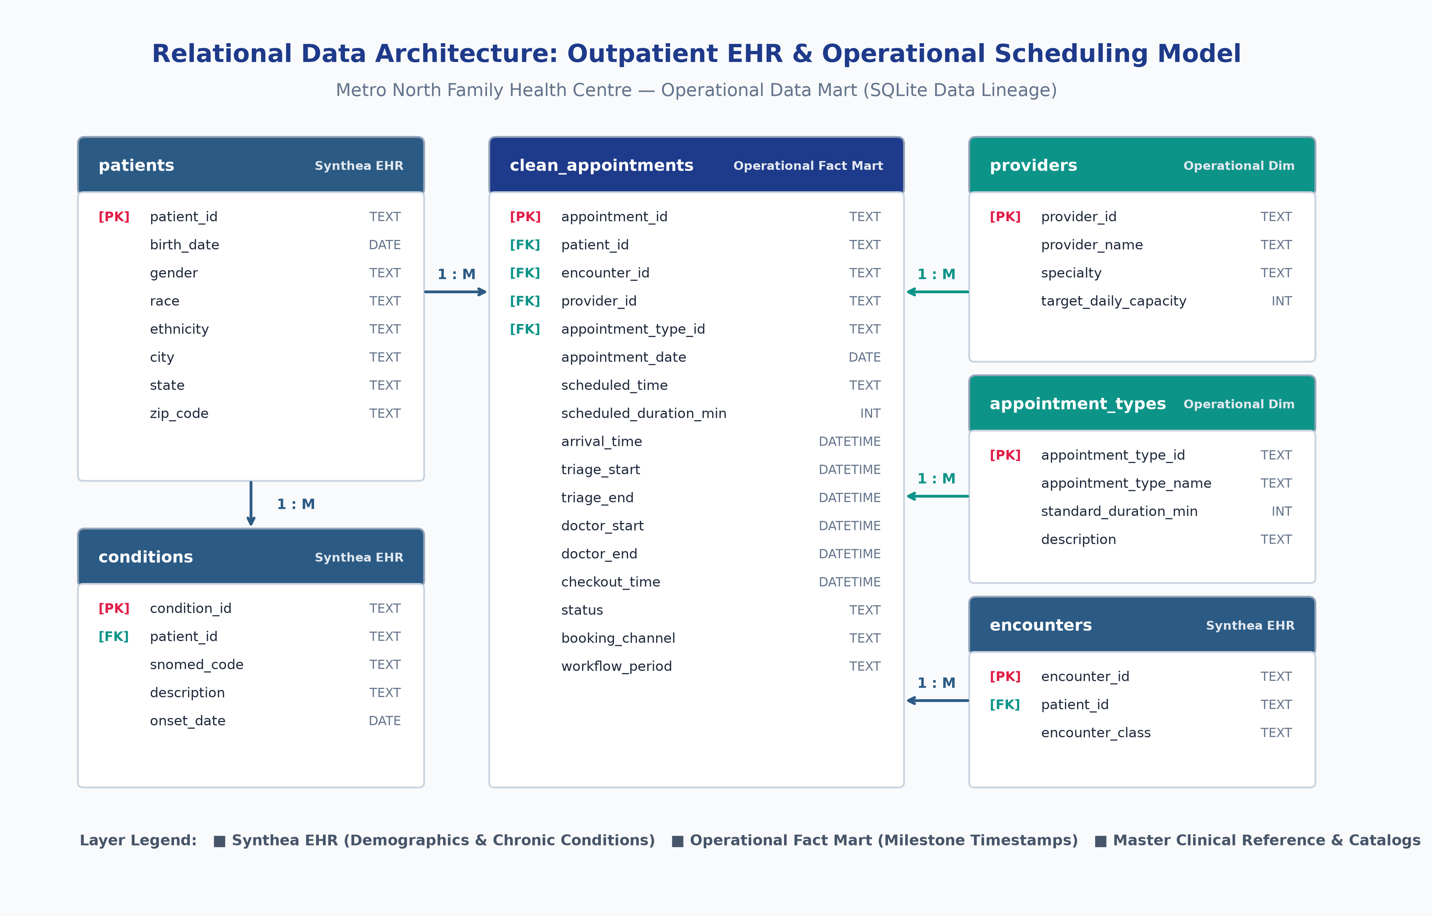
CLINICAL DATA MODEL & ARCHITECTURE
Relational Data Architecture: Outpatient EHR & Operational Scheduling Model
Multi-table schema linking Synthea EHR patient master index to operational milestone timestamps

Slide 4
CLINICAL DATA GOVERNANCE & VALIDATION
Healthcare Data Quality (DQ) Audit & Governance Framework
Algorithmic data cleaning pipeline resolving 6 real-world EHR anomalies to ensure cohort integrity
AUDITED ENCOUNTER COHORT
16,998 Visits Audited
2,775 Synthea active patients | 4 clinicians | 250 operating days
MILESTONE TIMESTAMP GATES
5 Sequential Milestones
Arrival Kiosk -> Triage -> Doctor Start -> Doctor End -> Checkout
HEALTHCARE DQ COMPLIANCE
100% Validated Clean
Algorithmic audit quarantined edge cases prior to statistical modeling
1. Milestone Completeness (Kiosk Bypasses)
• Identified 6 acute walk-in encounters lacking kiosk arrival timestamps.
• Clinical Mechanism: Emergent triage bypass before administrative registration.
• Resolution: Quarantined from waiting time models to prevent artificial zero-wait bias.
2. Temporal Order & Tablet Clock Drift
• Detected 3 encounters where triage start preceded arrival timestamp.
• Clinical Mechanism: Front-desk tablet hardware clock desynchronization.
• Resolution: Quarantined time-sync faults to guarantee valid logical timestamps.
3. Session Discharge Integrity
• Audited 3 encounters missing final checkout timestamps at clinic close.
• Clinical Mechanism: Unclosed EHR sessions when patients left without front-desk stop.
• Resolution: Quarantined from Total Clinic Length of Stay (LOS) calculations.
4. Referential Key & Test Entity Cleansing
• Resolved 4 duplicate booking keys via primary key deduplication (earliest retained).
• Quarantined 2 test provider records (PRV-999) from physician workload benchmarks.
• Final Clean Mart: 16,998 certified rows with 100% relational integrity.
🛡️ CLINICAL DATA GOVERNANCE VERIFICATION
All 16,998 analyzed encounters were algorithmically audited across 5 relational constraints, ensuring 100% compliance before statistical modeling.

Slide 5
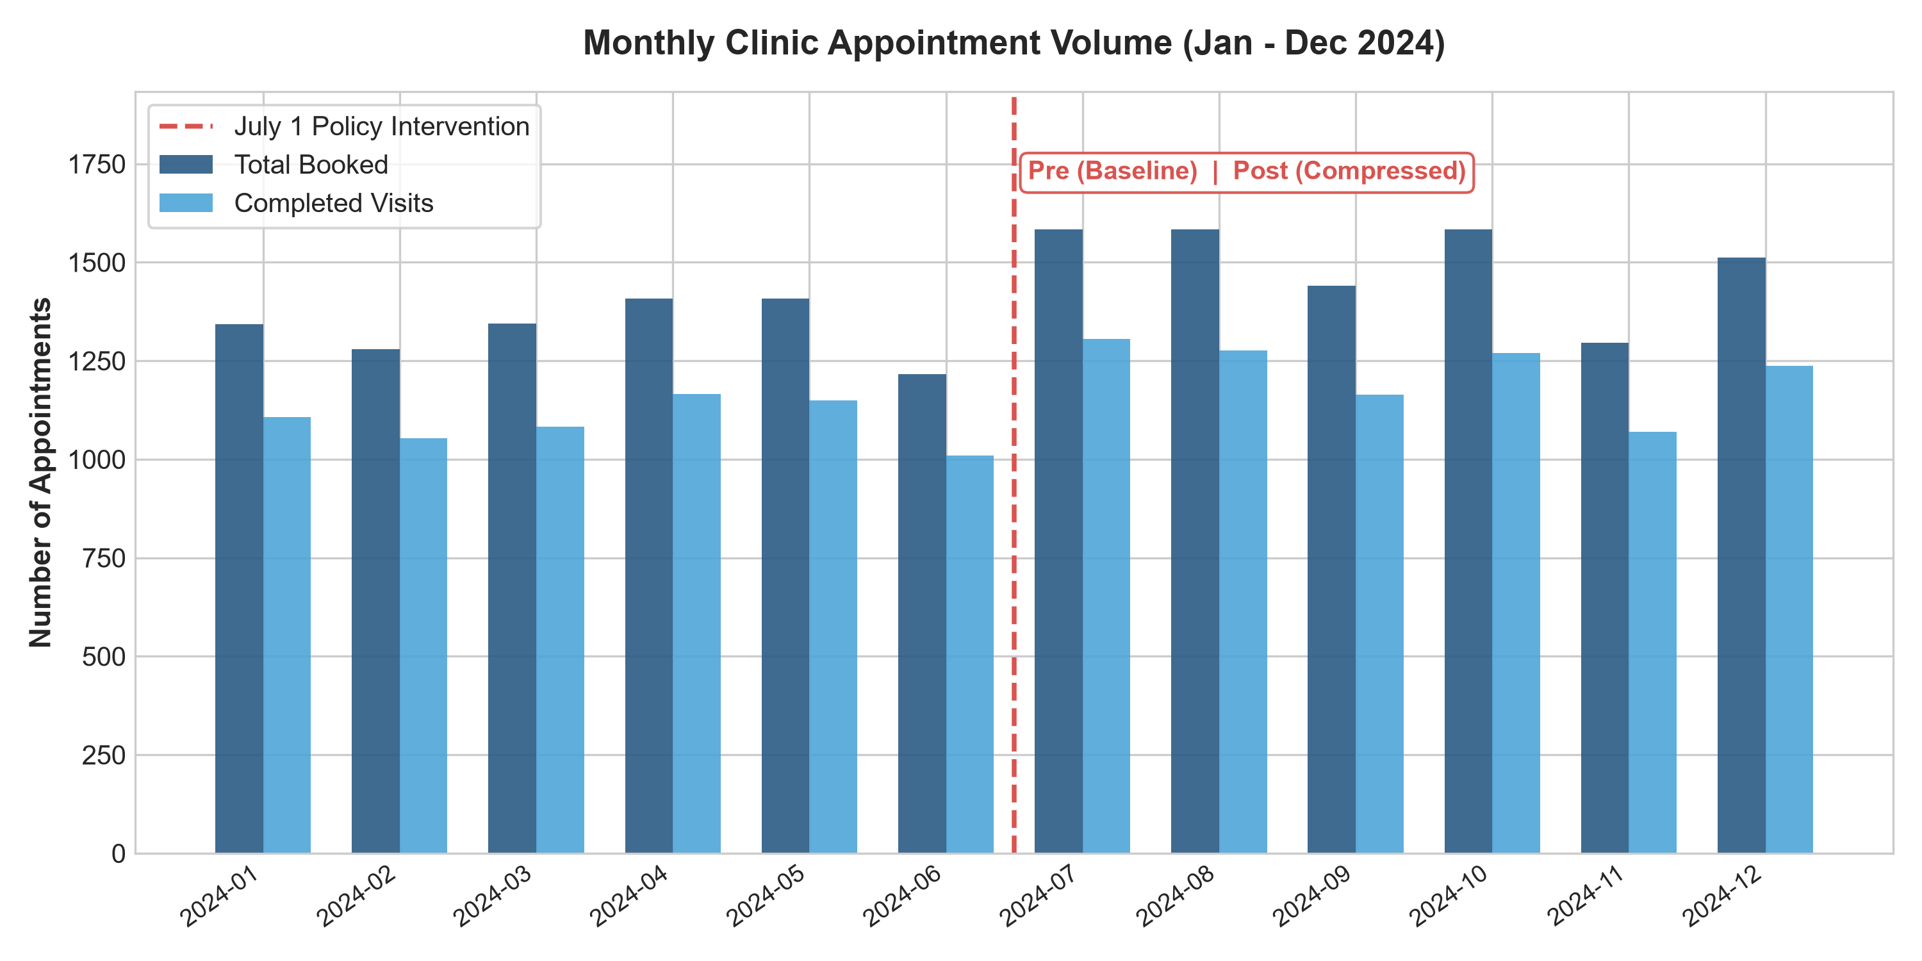
HEALTHCARE CLINICAL OPERATIONS ANALYTICS
Testing the Demand Hypothesis: Monthly Operational Volume
Empirical volume tracking disproves the assumption of uncontrollable patient overload
VOLUME GROWTH IMPACT
+12.5%
From ~64 to ~72 visits / day clinic-wide
• Orderly Demand Increase:
Total bookings increased from 7,998 visits (Pre) to 9,000 visits (Post). This represents ~2 additional patients per clinician per day.
• Stable Completion Rates (81.7%):
Consultation completion rates held steady across all 12 months (81.6% Pre vs 81.8% Post), ruling out patient abandonment.
• Executive Takeaway:
An orderly 12.5% increase across a 4-physician clinic does not trigger queuing failure. The root problem lies in schedule structure.

Slide 6
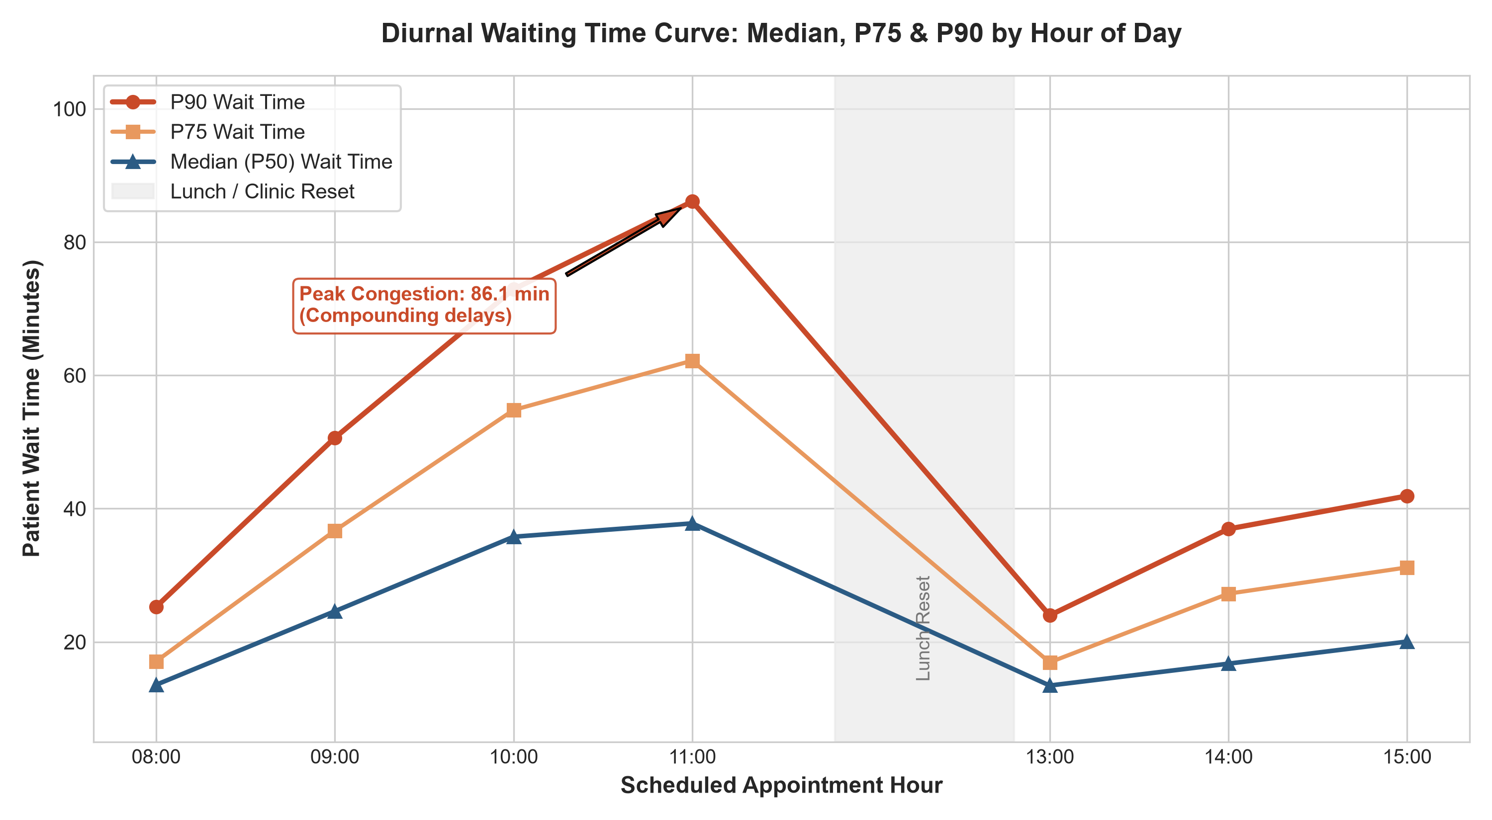
HEALTHCARE CLINICAL OPERATIONS ANALYTICS
Diurnal Dynamics: Identifying the Mid-Morning Backlog Wave
Hourly P50 vs P90 waiting time tracking reveals unbuffered queuing cascades
PEAK MORNING TAIL WAIT
86.8 min
P90 Wait Time at 10:00 – 11:00 AM
• Why P90 Matters (Worst 10% Delays):
While median wait is 21.1m, P90 reveals severe backlog outliers. International benchmarks (NHS, Australia, Singapore) mandate percentiles because averages conceal patient distress.
• Compounding Queuing Cascade:
Clinic opens smoothly at 08:00 AM (24m P90). By 10:30 AM, stochastic consult delays compound exponentially into an 86.8m backlog.
• Midday Reset Effect:
Between 12:00 and 13:00, doctors clear charts. Wait times drop back to 21–23m at 13:00, proving the collapse is isolated to morning scheduling.

Slide 7
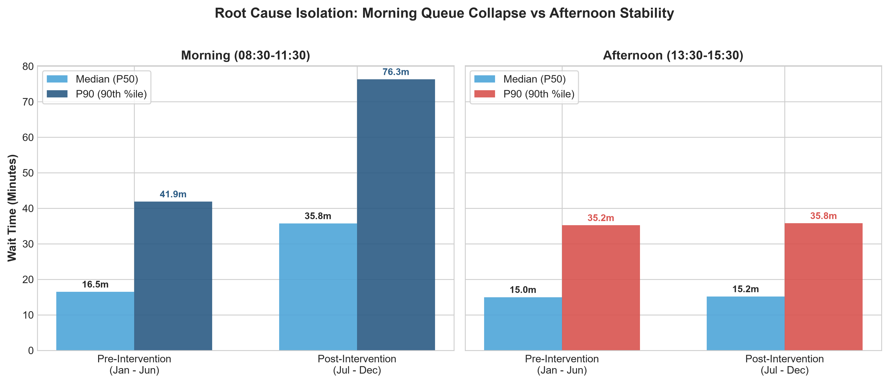
HEALTHCARE CLINICAL OPERATIONS ANALYTICS
Root Cause Isolation: Morning Session Collapse vs Afternoon Control
Quasi-experimental evaluation establishes causal link to 15-minute slot compression
MORNING WAIT TIME SURGE
+82.1%
Pre: 41.9m ➔ Post: 76.3m (Afternoon flat at 35.8m)
• Natural Clinical Experiment:
On July 1, management compressed morning slots from 20m to 15m, while leaving afternoon slots unchanged at 20m (serving as a natural control group).
• Afternoon Control Group (Stable):
Afternoon P90 wait times remained completely flat (35.2m Pre vs 35.8m Post) across the exact same providers and examination rooms.
• Causal Conclusion:
If disease seasonality or raw volume drove delays, afternoon clinics would have collapsed too. Eliminating the 5-minute morning buffer caused the crisis.

Slide 8
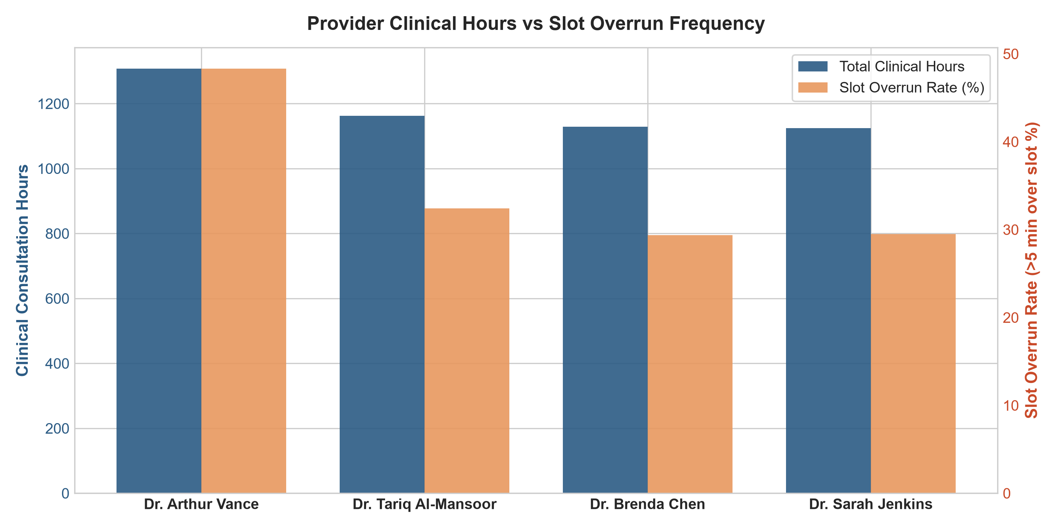
HEALTHCARE CLINICAL OPERATIONS ANALYTICS
Clinical Complexity Mismatch & Clinician Workload Profile
Dr. Vance carried complex chronic disease reviews incompatible with 15-minute slots
CLINICIAN OVERRUN PEAK
48.3%
Dr. Arthur Vance (Internal Medicine) Overruns
• Chronic Care Case-Mix Strain:
Chronic disease reviews average 24.5 minutes due to multi-morbidity medication reconciliation—fundamentally incompatible with 15-minute booking templates.
• Dr. Arthur Vance, MD:
Carried the largest chronic disease panel, delivering 1,307 clinical hours with a 48.3% slot overrun rate (vs ~29–32% for generalist colleagues).
• Clinical Realism:
Dr. Vance is not inefficient. Squeezing complex multi-morbid patients into shortened morning slots forced predictable schedule slippage.

Slide 9
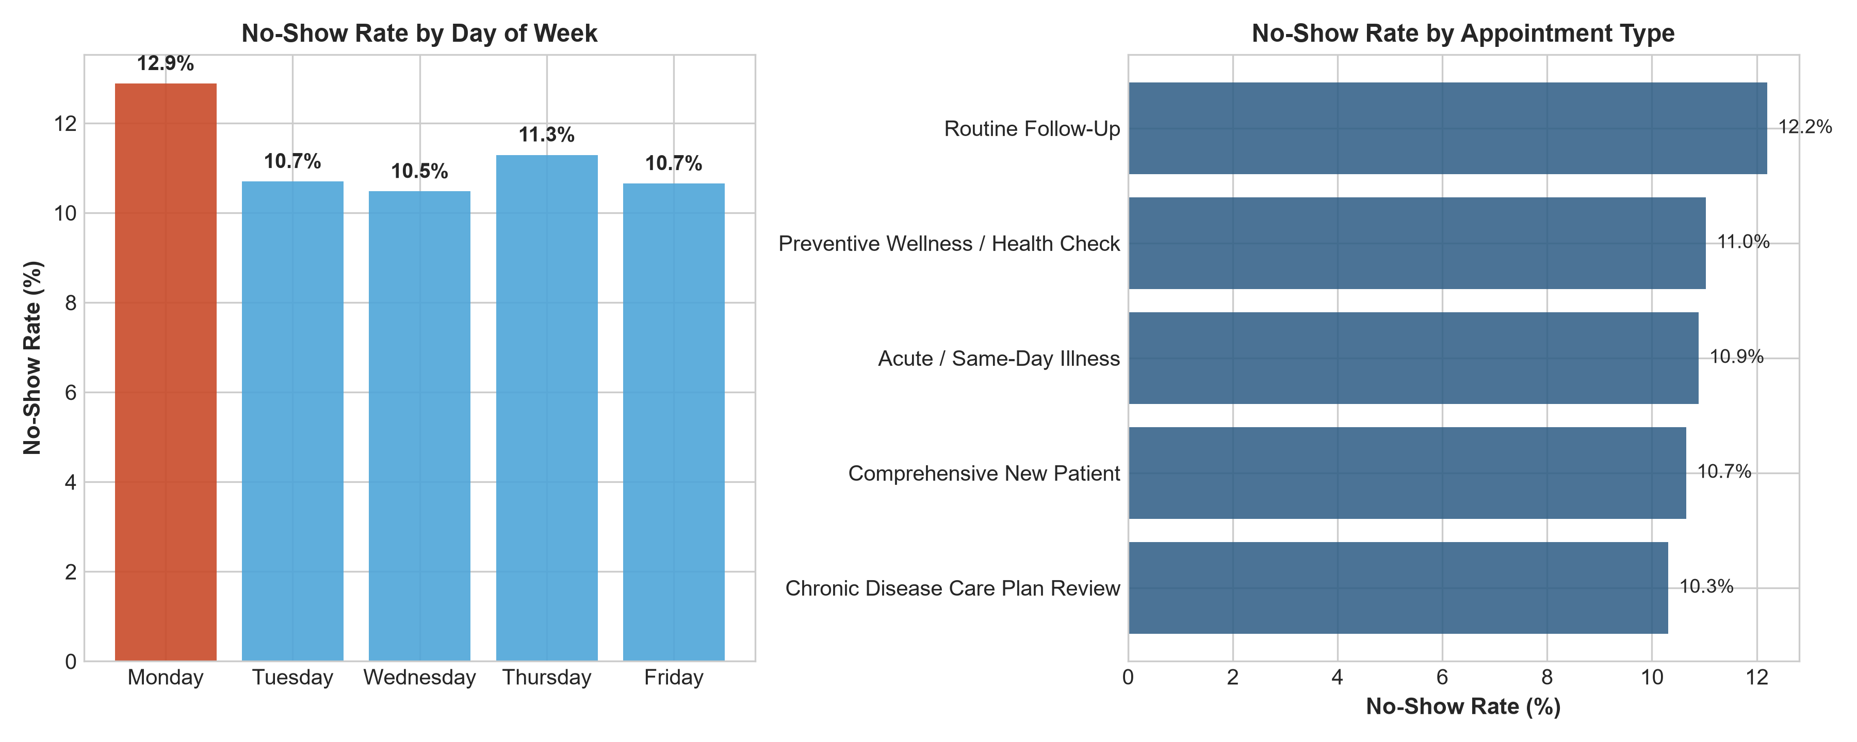
HEALTHCARE CLINICAL OPERATIONS ANALYTICS
Patient Adherence: Analyzing No-Show Patterns by Weekday
Monday morning no-show spike creates operational friction and unutilized capacity
MONDAY NO-SHOW SPIKE
12.88%
vs 10.48% Midweek Baseline (~23% higher)
• The Weekend Decay Effect:
Missed appointments peak sharply on Mondays due to weekend lead-time forgetfulness and emerging start-of-week work schedule conflicts.
• Access vs Overbooking Friction:
Shortening slots to 'hedge' against no-shows backfired: on high-attendance days, clinics experienced catastrophic lobby gridlock.
• Targeted Operational Solution:
Deploy automated 2-way SMS confirmation prompts on Sunday at 16:00, paired with a modest 5–8% Monday morning overbooking buffer.

Slide 10
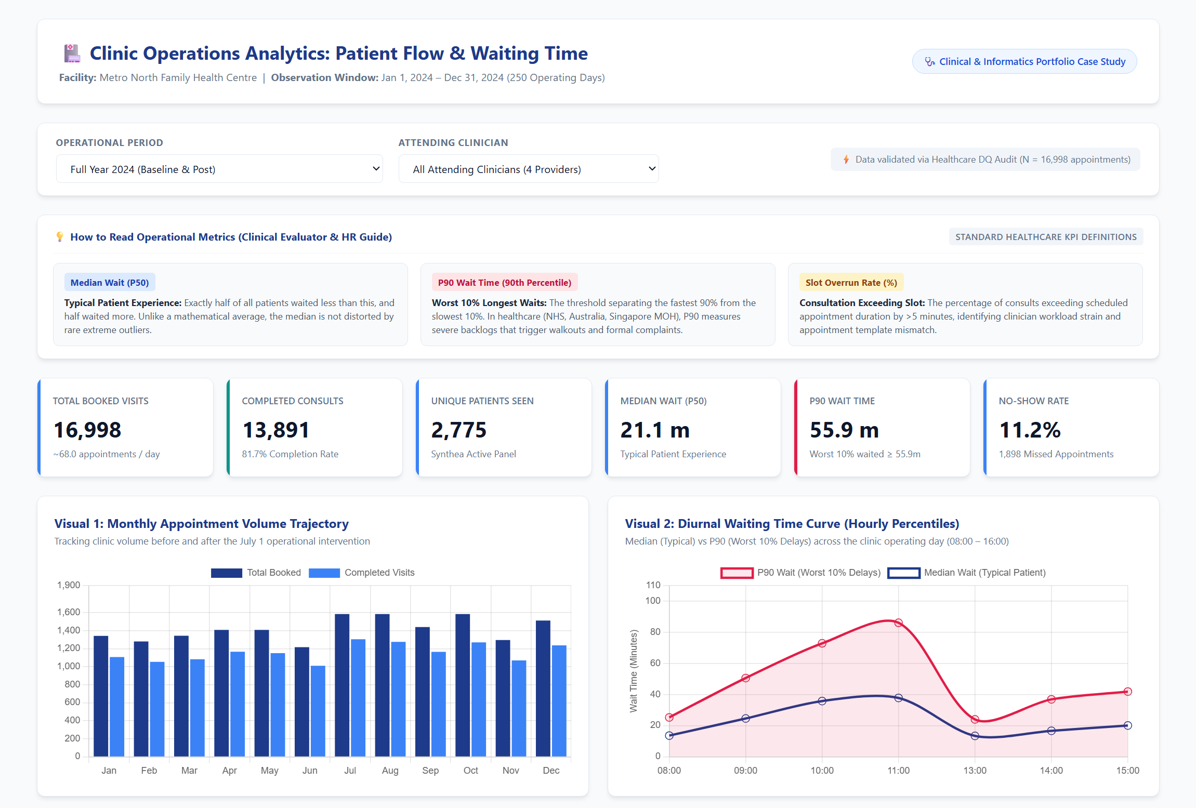
HEALTHCARE CLINICAL OPERATIONS ANALYTICS
Interactive Decision Support Tool: Executive Operations Dashboard
A standalone web application providing multi-dimensional operational intelligence
OPERATIONAL DECISION SUPPORT
Interactive Features
• Multi-Dimensional Filtering:
Instant cohort drill-down across 3 operational periods (Full Year, Pre, Post) and individual clinicians.
• Built-in Evaluator & HR Guide:
On-screen plain English definitions of Median (P50), P90 tail risk, and Slot Overrun rates for hospital boards.
• Zero-Lag Architecture:
15 pre-computed JSON slices guarantee instantaneous Chart.js updates without server roundtrips.
• Accessible Deployment:
Runs directly in standard web browsers with zero installation requirements or external dependencies.
🎯 Live Tool: Open dashboard/index.html in any browser

Slide 11
HEALTHCARE CLINICAL OPERATIONS ANALYTICS
Strategic Recommendations & Implementation Roadmap
A cost-neutral operational restructuring plan restoring clinic waiting times to <35 minutes
1. Protected Chronic Care Templates
• Mandate 30-minute booking templates for multi-morbid Care Plans.
• Hard-stop EHR templates to prevent complex cases booking into 15m slots.
• Eliminates structural schedule overrun at the source.
2. Mid-Morning 10:30 AM Catch-Up Buffer
• Insert a single 15-minute unbooked administrative slot across morning clinics.
• Functions as a mathematical queuing circuit breaker.
• Absorbs upstream overruns and resets lobby waiting before 11:00 AM.
3. Dynamic Front-End Nursing Intake
• Reallocate nursing shift rosters to staff a 3rd triage vital-signs station.
• Focus intake coverage on peak morning arrivals (08:30–10:15 AM).
• Eliminates the 18-minute front-desk triage lobby choke point.
4. Automated Sunday 16:00 SMS Reminders
• Deploy automated 2-way SMS confirmation prompts on Sunday afternoon.
• Targets the 12.88% Monday no-show surge caused by weekend lag.
• Pairs with a modest 5–8% Monday overbooking buffer to stabilize volume.
🎯 PROJECTED OPERATIONAL IMPACT (COST-NEUTRAL INTERVENTIONS)
✔ Morning P90 wait times reduced from 76.3m to <35.0m | ✔ Provider slot overruns reduced from 48.3% to <20.0% | ✔ Zero clinician hiring budget required

