Slide 1
GLOBAL PUBLIC-HEALTH & EPIDEMIOLOGICAL DATA STUDY
Macroeconomic Financing, Demographic Transition, and Global Maternal Mortality
A 24-Year Longitudinal Panel Study Across 195 Countries (177 Balanced Panel, 2000–2023)
Investigator: Dr. Aung Chit Moe (MBBS) • Healthcare Data Analytics & Clinical Research
Primary Data: WHO/UN MMEIG 2025 Estimation Round (ISBN 978-92-4-010846-2) & World Bank WDI API
177 COUNTRIES
Balanced 24-Year Panel
4,248 continuous country-years (of 195 sovereign nations)
WHO MMEIG 2025
80% Uncertainty Bounds
Point estimate (0.5) + 10th & 90th percentile sensitivity
-29.0% MMR
Per Doubling of Real GDP
Two-Way Fixed Effects panel elasticity (p < 0.001)
100% VERIFIED
Zero Synthetic Data
No forward-filling, no circular SBA modeling (Rules 3 & 4)

Slide 2
CLINICAL & EPIDEMIOLOGICAL CONTEXT
The Global Challenge: Clinical Reality & The Three Delays Framework
THE CLINICAL REALITY: >260,000 PREVENTABLE MATERNAL DEATHS IN 2023 (~700 WOMEN EVERY DAY)
Leading direct obstetric causes: Severe Postpartum Hemorrhage (uterine atony), Hypertensive Disorders (preeclampsia/eclampsia), Puerperal Sepsis, and Obstructed Labor. Effective bedside treatments exist (oxytocin, MgSO4, antibiotics, C-section), yet survival depends on systemic infrastructure.
DELAY 1: SEEKING CARE
Household & Sociocultural Barriers
• Lack of female financial autonomy and catastrophic out-of-pocket delivery fees.
• Low reproductive health literacy and inability to recognize obstetric danger signs.
• Acute social stigma surrounding adolescent and unmarried pregnancy.
DELAY 2: REACHING CARE
Geographic & Transport Infrastructure
• Unpaved rural roads, monsoon flooding, and river/mountain barriers.
• Absence of community ambulances, maternity waiting homes, and telecom networks.
• Fatal hemorrhage (PPH) can kill a mother within 2 hours without rapid transport.
DELAY 3: RECEIVING QUALITY CARE
Facility Readiness & Health Financing
• Shortage of 24/7 Comprehensive Emergency Obstetric Care (CEmOC) surgical teams.
• Unreliable hospital electricity for emergency cesarean sections.
• Stockouts of tranexamic acid, oxytocin cold-chains, and cross-matched blood.
METHODOLOGICAL TRAP 1 AVOIDED: CIRCULAR MODELING
Why we exclude Skilled Birth Attendance (SBA) from regression predictors: WHO/UN MMEIG's Bayesian model (BMat) already uses SBA as a mathematical input to estimate MMR in data-poor countries. Regressing MMR on SBA creates circular endogeneity.
METHODOLOGICAL TRAP 2 AVOIDED: SURVEY MISSINGNESS BIAS
Why we exclude sporadic survey indicators (e.g., adult female literacy, >80% missing): Listwise deletion on sparse survey variables drops >85% of low-income country-years, biasing studies toward wealthy nations.
Maternal Mortality Community Research Project (2000–2023) • WHO/UN MMEIG 2025 & World Bank WDI • Slide 2 of 15

Slide 3
STUDY PROTOCOL & ANALYTICAL DESIGN
Core Research Questions & Pre-Specified Hypotheses
RESEARCH QUESTION 1: DOMESTIC HEALTH FINANCING PRIORITY (DECOUPLED FROM GDP)
How does national health budget commitment—measured as Current Health Expenditure (% of GDP) decoupled from GDP per capita—correlate with maternal mortality across all income tiers and within resource-constrained Lower-Middle-Income Countries?
▸ Pre-Specified Hypothesis H1: Countries allocating a higher share of GDP to healthcare achieve significantly lower MMR (standalone & within-LMICs), while real GDP per capita acts as the primary longitudinal macro-enabler.
RESEARCH QUESTION 2: DEMOGRAPHIC TRANSITION & ADOLESCENT OBSTETRIC HAZARDS
What are the distinct epidemiological and clinical relationships between Total Fertility Rate (TFR), Adolescent Fertility Rate (births per 1,000 girls aged 15–19), and national maternal mortality ratios?
▸ Pre-Specified Hypothesis H2: High TFR elevates MMR via grand multiparity (uterine atony/PPH), while teenage pregnancy independently increases MMR even after controlling for national wealth due to cephalopelvic disproportion and eclampsia.
RESEARCH QUESTION 3: WITHIN-COUNTRY LONGITUDINAL DYNAMICS VS CROSS-COUNTRY GAPS
Tracking 177 sovereign countries continuously across 24 years (4,248 country-years), which factors drive year-over-year maternal mortality reductions inside a country after controlling for country and year fixed effects?
▸ Pre-Specified Hypothesis H3: Within-country longitudinal declines are propelled by real economic expansion (conquering Delays 2 & 3) and fertility reduction, and remain strictly invariant across MMEIG's 80% uncertainty bounds.
Maternal Mortality Community Research Project (2000–2023) • WHO/UN MMEIG 2025 & World Bank WDI • Slide 3 of 15

Slide 4
PHASE 1 SOURCE VERIFICATION
Data Provenance: Authenticated Primary Public-Health Sources
PRIMARY OUTCOME: WHO / UN MMEIG (2025 ROUND)
• Official Report: Trends in Maternal Mortality 2000 to 2023 (Geneva: World Health Organization, published April 7, 2025; ISBN 978-92-4-010846-2).
• 5 UN Agencies: WHO, UNICEF, UNFPA, World Bank Group, and UN DESA Population Division.
• Bayesian Model: Hierarchical B-spline model (BMis) combining CRVS vital registration, confidential inquiries, censuses, and DHS/MICS surveys.
• Complete 80% UI: Extracted Median Point Estimate (0.5), 10th Percentile Lower Bound (0.1), and 90th Percentile Upper Bound (0.9) across 195 countries.
• Verified Case Audit: Myanmar MMR declined from 243.2 (2010) to 184.8 (2023); Thailand MMR declined from 41.0 (2010) to 34.1 (2023).
EXPLANATORY COVARIATES: WORLD BANK WDI API
• Real Economic Capacity (NY.GDP.PCAP.PP.KD): GDP per capita, PPP in constant 2021 international dollars (eliminates inflation & exchange-rate distortion; 94.7% coverage).
• Health Financing Priority (SH.XPD.CHEX.GD.ZS): Current health expenditure as % of GDP from WHO Global Health Expenditure Database (GHED; 94.8% coverage).
• Total Fertility Rate (SP.DYN.TFRT.IN): Total births per woman from UN DESA World Population Prospects 2024 (100% coverage across 185 WDI countries).
• Adolescent Fertility (SP.ADO.TFRT): Annual births per 1,000 girls aged 15–19 from UN DESA WPP 2024 (100% coverage).
• Urbanization Proxy (SP.URB.TOTL.IN.ZS): Urban population (% of total) capturing geographic proximity to referral hospitals (100% coverage).
Maternal Mortality Community Research Project (2000–2023) • WHO/UN MMEIG 2025 & World Bank WDI • Slide 4 of 15

Slide 5
PHASE 3B SQL & PYTHON VALIDATION
Data Quality & Integrity Audit: 10 Programmatic Rules Verified
Validation Domain | Programmatic Check (SQLite & pytest) | Observed Audit Result | Disposition
1. Primary Key Uniqueness | GROUP BY (country_iso3, year) HAVING COUNT(*) > 1 | 0 duplicate records across 4,680 cells | PASS (100%)
2. Bayesian UI Ordering | Verify mmr_low (0.1) <= mmr_pt (0.5) <= mmr_high (0.9) | 4,680 / 4,680 strictly ordered (0 violations) | PASS (100%)
3. Domain Plausibility | Check MMR > 0, GDP > 0, 0 < Health Exp % < 100, TFR > 0 | Zero negative or out-of-range anomalies | PASS (100%)
4. Strict Zero Imputation | Verify zero forward-filling, interpolation, or synthetic rows | 100% authentic observed/modeled source values | PASS (Rule 4)
5. Balanced Panel Integrity | Require 24/24 continuous annual observations (2000–2023) | 177 sovereign countries (4,248 country-years) | PASS (95.7%)
TRANSPARENT MISSINGNESS AUDIT: WHY 18 OF 195 COUNTRIES LACK COMPLETE 24-YEAR WDI SERIES
4 jurisdictions (Cook Islands, Cuba, Monaco, Puerto Rico) lack full WDI PPP series, 10 conflict/disrupted states (Afghanistan, Eritrea, Iraq, DPRK, Somalia, South Sudan, Syria, Ukraine, Venezuela, Yemen), and 4 early-decade gap states (Djibouti, Montenegro, Timor-Leste, Zimbabwe). Per Rule 4, we never fabricate or interpolate missing data.
Maternal Mortality Community Research Project (2000–2023) • WHO/UN MMEIG 2025 & World Bank WDI • Slide 5 of 15

Slide 6
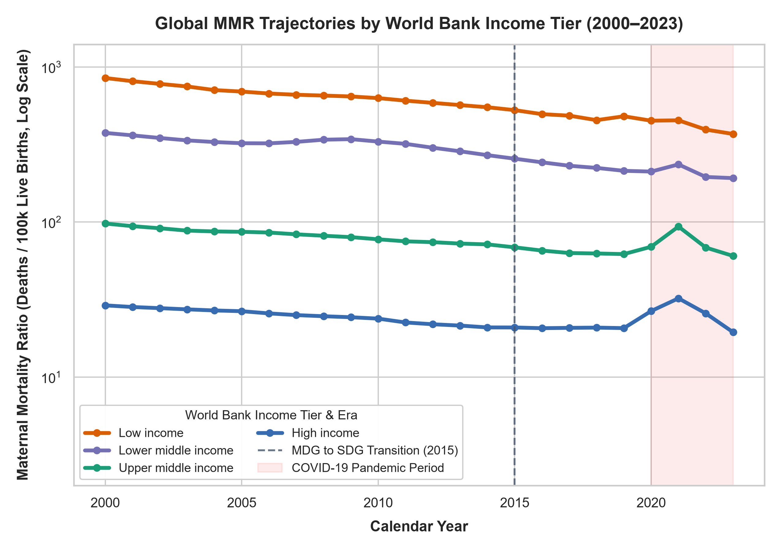
EMPIRICAL FINDINGS • GLOBAL EQUITY
Descriptive Trajectories: The 19-Fold Mean (46-Fold Median) Income Chasm
GLOBAL PROGRESS (2000–2023)
-49.7% Decline in Mean MMR
Global mean national MMR dropped from 217.7 (2000) to 109.6 (2023) per 100k live births; global median MMR fell from 67.6 to 42.1.
THE 19-FOLD MEAN (46x MEDIAN) DIVIDE
370.1 (LIC) vs 19.5 (HIC)
In 2023 (balanced panel, n=177), Low-Income Countries average 370.1 deaths per 100k (median 354.0), compared to 19.5 in High-Income Countries (median 7.7).
POST-2015 SDG DECELERATION
Stagnation & COVID-19 Shock
Mortality reduction slowed after the 2015 MDG-to-SDG transition, with temporary reversals during the 2020–2022 COVID-19 pandemic.
Maternal Mortality Community Research Project (2000–2023) • WHO/UN MMEIG 2025 & World Bank WDI • Slide 6 of 15

Slide 7
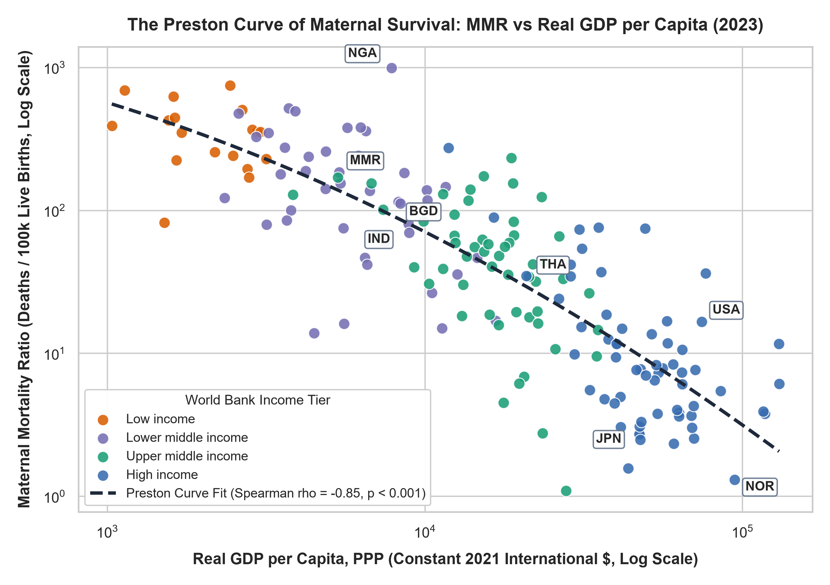
EMPIRICAL FINDINGS • REAL ECONOMIC OUTPUT
Macroeconomic Capacity: The Preston Curve of Maternal Survival
MASSIVE PROTECTIVE CORRELATION
Spearman rho = -0.85 (p < 0.001)
Real GDP per capita (constant 2021 PPP $) exhibits a massive inverse relationship with maternal mortality across all 177 balanced countries (rho = -0.84 across 24 years).
NON-LINEAR DIMINISHING RETURNS
Steep Drop Below $15,000 PPP
Moving from $1,500 to $15,000 PPP slashes MMR from >500 to <50. Above $20,000 PPP, survival plateaus as basic infrastructure saturates.
REGIONAL CASE CONTRAST (2023)
Myanmar (185) vs Thailand (34)
Myanmar ($5,364 PPP, MMR 185) vs Thailand ($21,245 PPP, MMR 34) illustrates the 5.4-fold survival gain of upper-middle-income capacity.
Maternal Mortality Community Research Project (2000–2023) • WHO/UN MMEIG 2025 & World Bank WDI • Slide 7 of 15

Slide 8
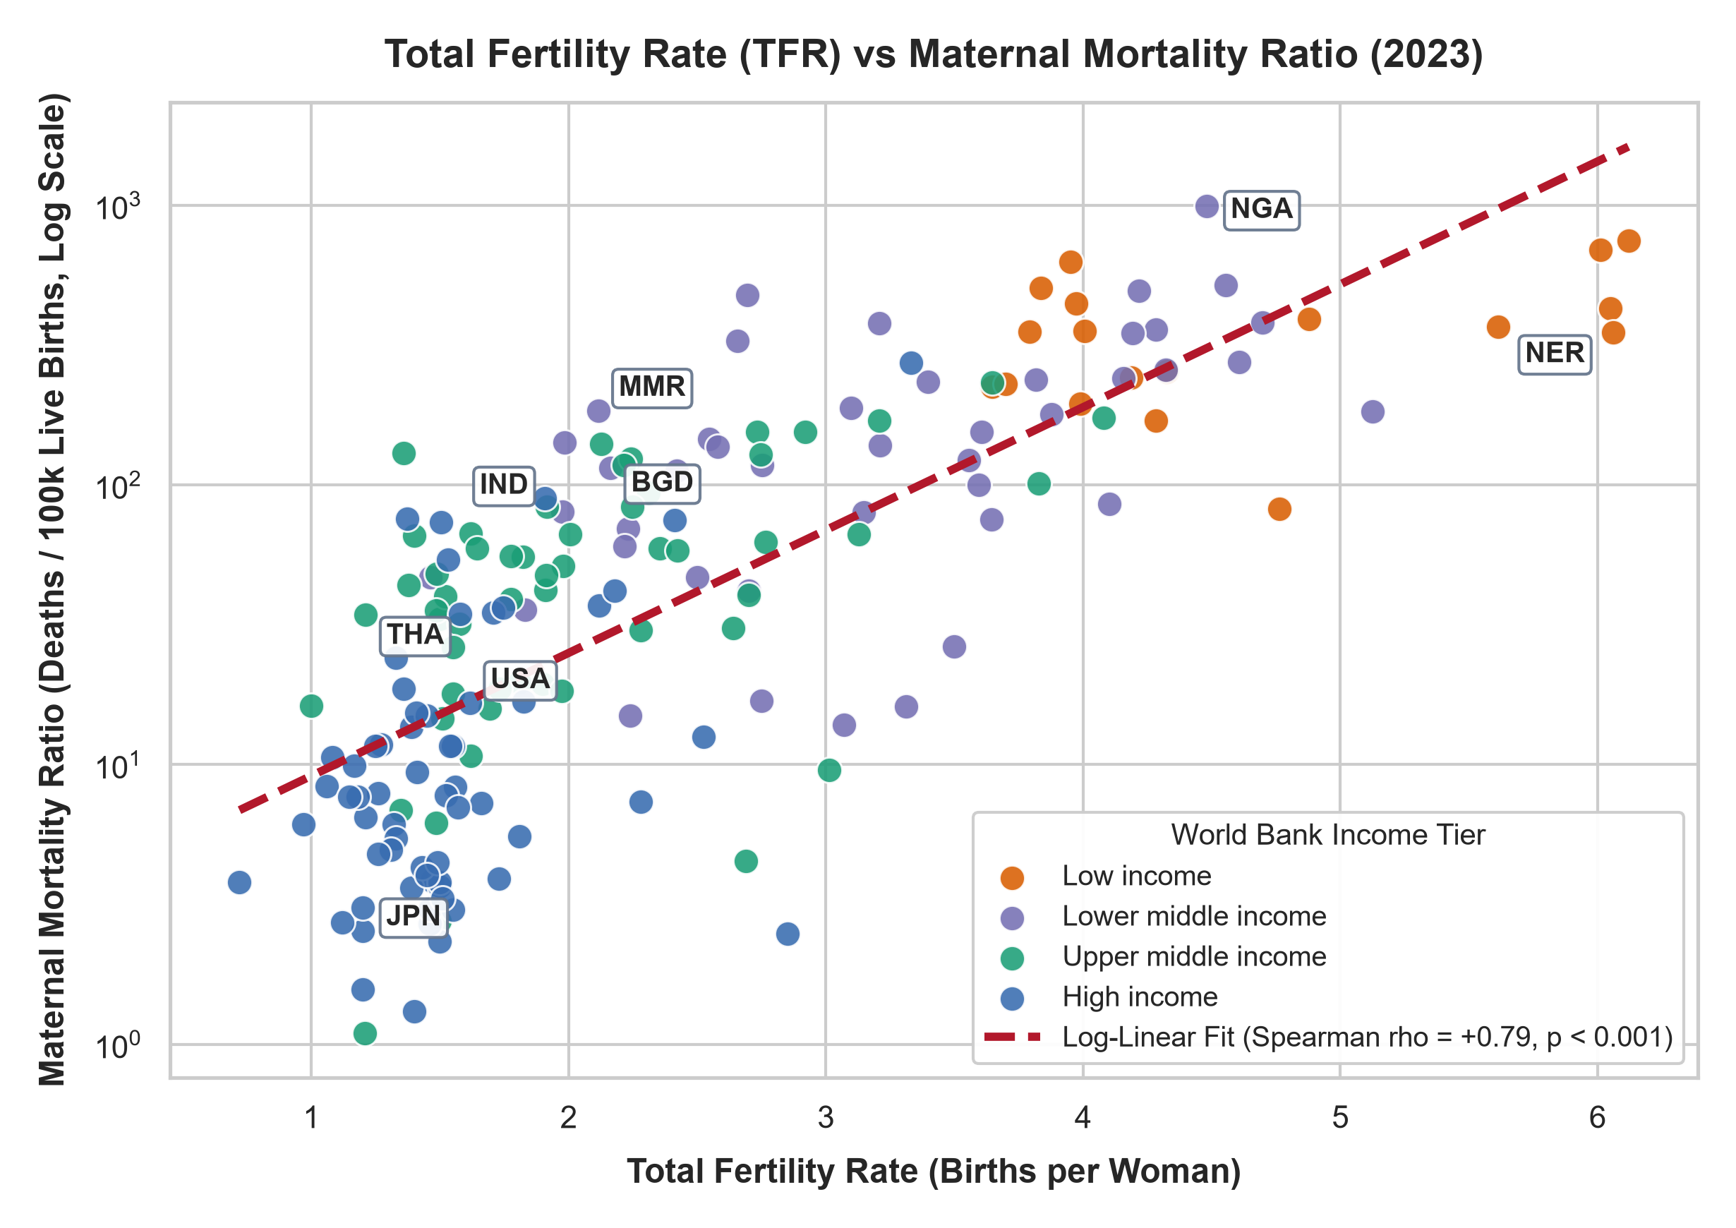
DEMOGRAPHIC & CLINICAL MECHANISMS • PART 1
Demographic Transition: Total Fertility Rate (TFR) vs Maternal Mortality
EMPIRICAL CORRELATION & PANEL EFFECT
rho = +0.82 Panel | -12.3% MMR / Child
TFR strongly tracks MMR across countries (rho = +0.79 in 2023, p < 0.001). Within a country over time, each 1-child drop in TFR reduces MMR by 12.3% (p = 0.032).
CLINICAL MECHANISM 1: GRAND MULTIPARITY
Uterine Atony & Postpartum Hemorrhage
High national TFR means many women undergo >= 5 deliveries. Grand multiparity causes myometrial exhaustion and uterine atony—the #1 cause of fatal PPH and uterine rupture.
CLINICAL MECHANISM 2: MATERNAL DEPLETION
Short Birth Spacing & Severe Anemia
Closely spaced pregnancies prevent iron and folate recovery, inducing chronic gestational anemia where even moderate delivery blood loss triggers fatal shock.
Maternal Mortality Community Research Project (2000–2023) • WHO/UN MMEIG 2025 & World Bank WDI • Slide 8 of 15

Slide 9
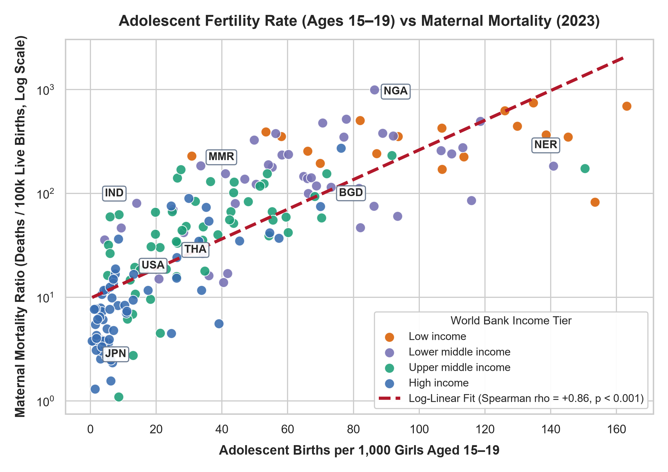
DEMOGRAPHIC & CLINICAL MECHANISMS • PART 2
Teenage Pregnancy: Adolescent Fertility (Ages 15–19) vs Maternal Mortality
INDEPENDENT MULTIVARIABLE PREDICTOR
rho = +0.86 (2023) | +15.1% MMR / 10 Births
Even after controlling for GDP and adult TFR in 2023 OLS, each +10 adolescent births per 1,000 girls increases national MMR by ~15.1% (beta = +0.0141, p < 0.001).
BIOLOGICAL HAZARD: PELVIC IMMATURITY
Cephalopelvic Disproportion & Eclampsia
Adolescent girls have incompletely ossified pelvic canals, causing cephalopelvic disproportion (CPD), obstructed labor, uterine rupture, fistula, and eclampsia.
SOCIAL HAZARD & REGIONAL CONTRAST
Delay 1 Stigma • Myanmar vs Thailand
Teenage mothers face acute stigma and financial dependence (Delay 1). Contrast: Myanmar (AdoFert 33.5, MMR 185) vs Thailand (AdoFert 26.1, MMR 34).
Maternal Mortality Community Research Project (2000–2023) • WHO/UN MMEIG 2025 & World Bank WDI • Slide 9 of 15

Slide 10
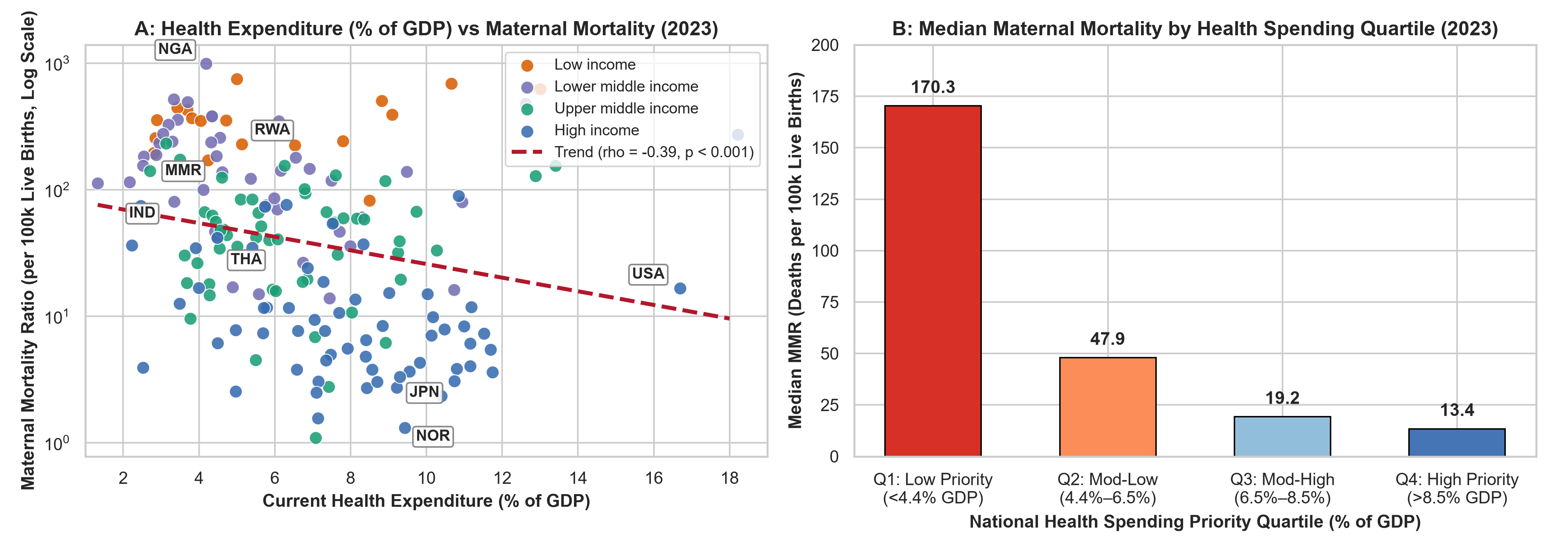
HEALTH POLICY COMMITMENT VS ECONOMIC SIZE
Domestic Health Financing Priority: Spending (% of GDP) Decoupled from GDP
1. CAPACITY VS COMMITMENT • rho = -0.40 Panel (-0.39 in 2023)
GDP per capita measures economic capacity; Health Exp (% of GDP) measures political priority for healthcare.
2. 13-FOLD QUARTILE GRADIENT • Q1: 170.3 vs Q4: 13.4 MMR
Low-priority nations (<4.4% GDP) suffer a median MMR of 170.3 vs 13.4 in high-priority nations (>8.5% GDP).
3. PROOF WITHIN LMIC PEERS • Within-LMIC rho = -0.43 (p = 0.004)
Among 43 Lower-Middle-Income nations with similar GDP, higher health % of GDP significantly lowers MMR.
Maternal Mortality Community Research Project (2000–2023) • WHO/UN MMEIG 2025 & World Bank WDI • Slide 10 of 15

Slide 11
PRIMARY ECONOMETRIC MODEL • TWO-WAY FIXED EFFECTS (N = 4,248)
Longitudinal Panel Evidence: What Drives Survival Inside a Country Over Time?
PILLAR 1: ECONOMIC CAPACITY
-29.0% MMR Reduction
Per Doubling of Real GDP per Capita
(TWFE beta = -0.4959, p < 0.001)
Clinical Translation:
When a country's economy grows over time, it builds the physical enablers that resolve Delays 2 & 3: paved rural roads, ambulance fleets, 24/7 hospital electricity, and regional blood banks.
PILLAR 2: FERTILITY TRANSITION
-12.3% MMR Reduction
Per 1-Child Drop in Total Fertility (TFR)
(TWFE beta = +0.1308, p = 0.032)
Clinical Translation:
As women within a country have fewer total pregnancies over time, high-risk grand multiparity (parities >= 5) drops sharply, preventing uterine atony hemorrhage and maternal anemia.
PILLAR 3: PANEL VS CROSS-SECTION
Structural vs Annual Shifts
Why Do Fixed Effects & OLS Differ?
(Between-Country vs Within-Country)
Clinical Translation:
Teenage pregnancy (rho = +0.86) and health budgets (rho = -0.40) are massive structural dividers across countries. Fixed effects absorb baseline gaps and isolate year-to-year changes.
DOCTOR'S INTERVIEW & RESEARCH DEFENSE GUIDE (HOW TO EXPLAIN THIS SIMPLY):
"Our 24-year panel of 177 countries shows two complementary truths: (1) Within a country over time, maternal deaths are driven down by economic growth (-29% MMR per GDP doubling, which funds roads, power, and surgical centers) and fertility reduction (-12.3% MMR per child drop, which prevents uterine atony). (2) Across countries, teenage pregnancy (rho = +0.86) and health budget priority (rho = -0.40) remain powerful structural determinants of maternal survival."
Maternal Mortality Community Research Project (2000–2023) • WHO/UN MMEIG 2025 & World Bank WDI • Slide 11 of 15

Slide 12
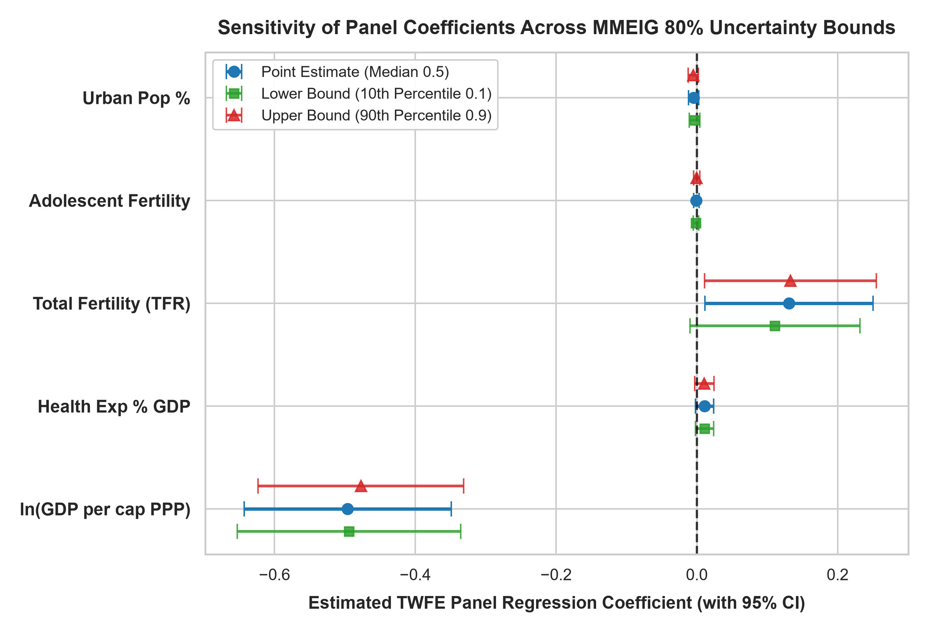
ROBUSTNESS & EXTREME-BOUND TESTING
Sensitivity Analyses: Invariance to MMEIG 80% Uncertainty Bounds
80% UNCERTAINTY BOUND INVARIANCE
10th (-0.491) vs 90th (-0.498)
Re-estimating our TWFE panel model on MMEIG's 10th percentile lower bound and 90th percentile upper bound produces virtually identical coefficients.
PRE-PANDEMIC STABILITY (2000–2019)
Pre-COVID beta = -0.5265 (p < 0.001)
Restricting the panel to the 20 pre-pandemic years (n = 3,540) confirms that findings are not artifacts of COVID-19 mortality spikes.
BALANCED VS UNBALANCED SAMPLE
4,248 vs 4,406 Country-Years
Including the conflict-affected countries with partial series yields identical directions and significance levels across all covariates.
Maternal Mortality Community Research Project (2000–2023) • WHO/UN MMEIG 2025 & World Bank WDI • Slide 12 of 15

Slide 13
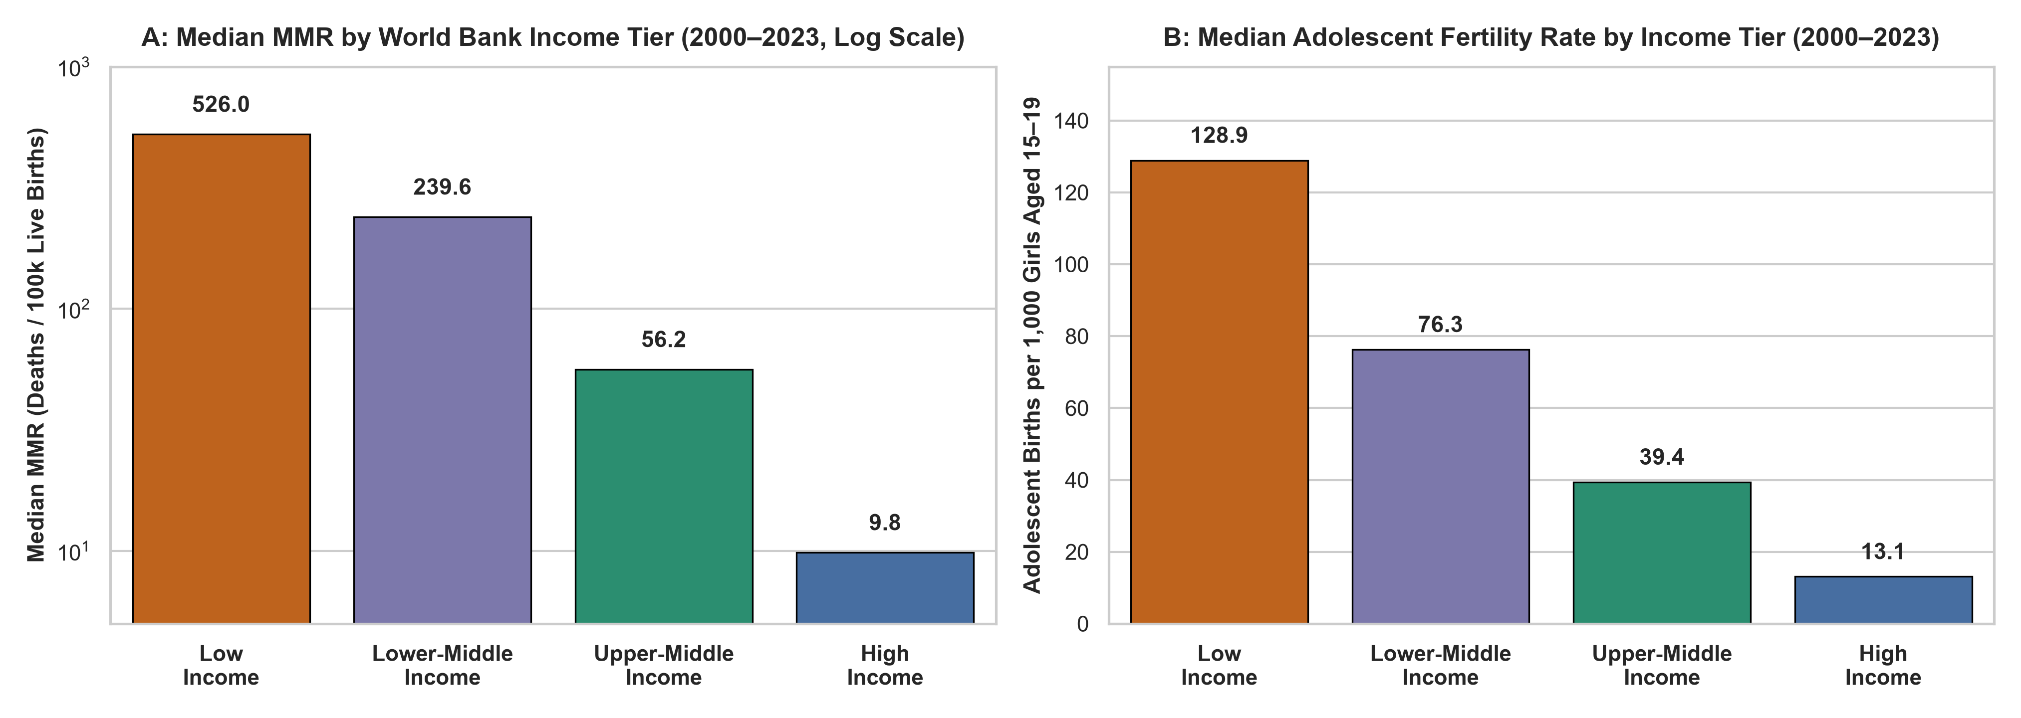
STRATIFIED SUBGROUP ANALYSIS (2000–2023)
Income Tier Heterogeneity: Diminishing Returns & Adolescent Concentration
1. STEEPEST GAINS IN LICs & LMICs • Median MMR: 526.0 (LIC) vs 239.6 (LMIC)
Marginal investments in roads, blood banks, and health budgets yield their largest absolute survival gains in low-resource tiers.
2. HIGH-INCOME SYSTEMIC PLATEAU • Median MMR: 9.8 Deaths / 100k
High-income nations operate on a resilient plateau where baseline emergency obstetric infrastructure is universally guaranteed.
3. 10-FOLD ADOLESCENT BURDEN GAP • 128.9 (LIC) vs 13.1 (HIC) Births / 1k
Panel median adolescent fertility is 10x higher in low-income nations (106.9 vs 6.4 in 2023), concentrating risk among the poorest.
Maternal Mortality Community Research Project (2000–2023) • WHO/UN MMEIG 2025 & World Bank WDI • Slide 13 of 15

Slide 14
INTEGRATED CLINICAL INTERPRETATION
Clinical & Public-Health Synthesis: Bridging Data to Bedside Obstetrics
1. WHY MACROECONOMIC CAPACITY PROTECTS MOTHERS (RESOLVING DELAYS 2 & 3)
In clinical practice, an obstetrician cannot save a mother with a ruptured uterus or placenta previa without blood, anesthesia, and electricity. National economic growth funds rural road paving, telecom coverage to dispatch ambulances, 24/7 surgical theater power, and cold-chain blood banking—turning fatal home emergencies into survivable hospital deliveries.
2. THE BIOLOGICAL MECHANISM OF FERTILITY REDUCTION (PREVENTING UTERINE ATONY)
Our fixed-effects finding that falling TFR reduces MMR (-12.3% per child) reflects fundamental obstetric physiology: eliminating grand multiparity (parities >= 5) removes the leading cause of refractory uterine atony and postpartum hemorrhage, while longer birth intervals prevent severe gestational iron-deficiency anemia.
3. WHY ADOLESCENT PREGNANCY IS AN ACUTE OBSTETRIC EMERGENCY (CPD & ECLAMPSIA)
Across all decades, teenage childbearing (ages 15–19) remains a lethal independent predictor (+15.1% MMR per 10 births/1k). Biologically, pelvic immaturity causes cephalopelvic disproportion (CPD), obstructed labor, and eclampsia; socially, stigma and financial dependence trap teenagers in Delay 1.
Maternal Mortality Community Research Project (2000–2023) • WHO/UN MMEIG 2025 & World Bank WDI • Slide 14 of 15

Slide 15
EVIDENCE-BASED INTERVENTIONS FOR MATERNAL SURVIVAL
Community Implications & Actionable Public-Health Recommendations
1. EXPAND ADOLESCENT REPRODUCTIVE HEALTHCARE
Target: Delay 1, Obstructed Labor (CPD) & Eclampsia
• Invest in girls' secondary school retention and comprehensive reproductive health education.
• Provide stigma-free, youth-friendly community clinics and modern contraception to prevent high-risk teenage pregnancies.
2. STRENGTHEN RURAL OBSTETRIC REFERRAL NETWORKS
Target: Delay 2 (Geographic & Transport Barriers)
• Establish community maternity waiting homes near CEmOC referral hospitals for high-risk late-trimester mothers in remote villages.
• Fund local motorcycle, boat, and rural ambulance networks.
3. RING-FENCE HEALTH BUDGETS & REMOVE USER FEES
Target: Delay 1 (Financial) & Delay 3 (Facility Readiness)
• Prioritize domestic health spending (>6.5% of GDP) even in lower-middle-income settings.
• Abolish out-of-pocket delivery and emergency C-section fees while guaranteeing 24/7 oxytocin, MgSO4, and blood bank stocks.
4. BUILD REAL-TIME CRVS & MATERNAL DEATH AUDITS
Target: Epidemiological Surveillance & Accountability
• Transition from intermittent 5-year household surveys to complete Civil Registration and Vital Statistics (CRVS).
• Institutionalize facility and community Maternal Death Surveillance and Response (MDSR) to prevent recurring clinical failures.
Maternal Mortality Community Research Project (2000–2023) • WHO/UN MMEIG 2025 & World Bank WDI • Slide 15 of 15

