Slide 1
FastPres
Create presentations fast

Slide 2

How it works
Write a simple text file
Run the program
Get a formatted .pptx file ready to present

Slide 3
How it was built
Python
Django
React

Slide 4
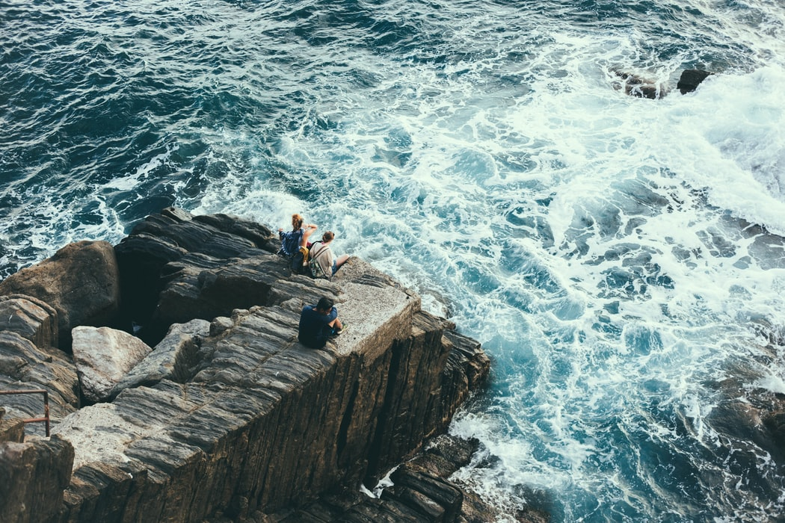
Image Slide

Slide 5
Notes
You must have a title slide
The other slides must have a title; everything else is optional

Slide 6
Current version's limitations
Currently, images only work with the local python script

Slide 7
What's Next
Graphs
More customizability: option to set font size, color, etc
Save templates to user account

