Slide 1
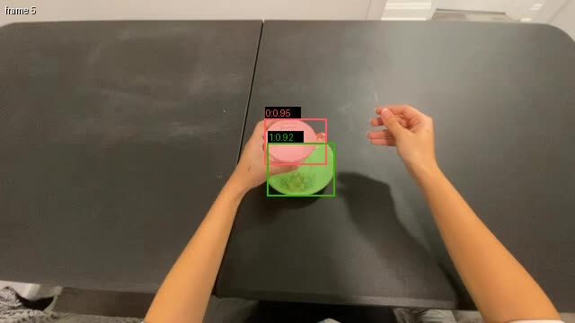
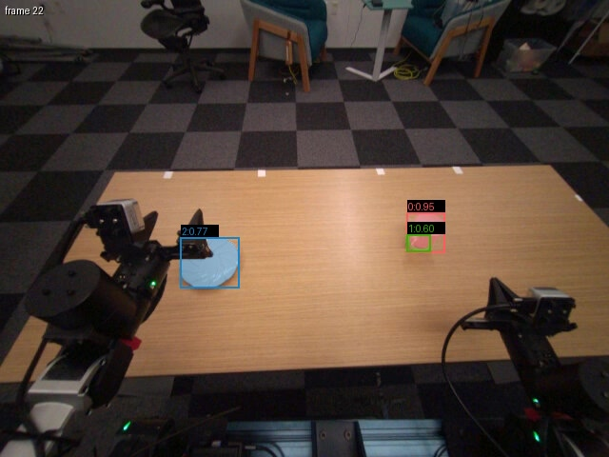
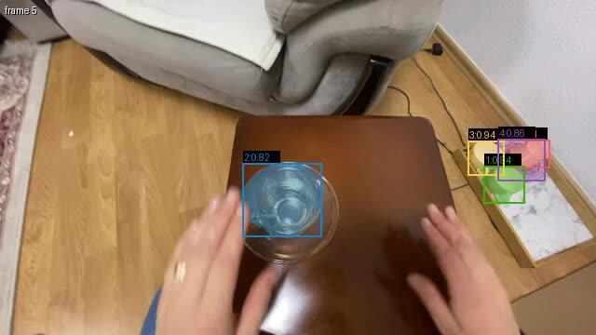
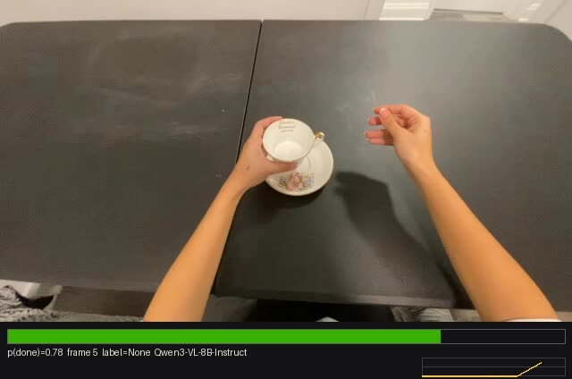
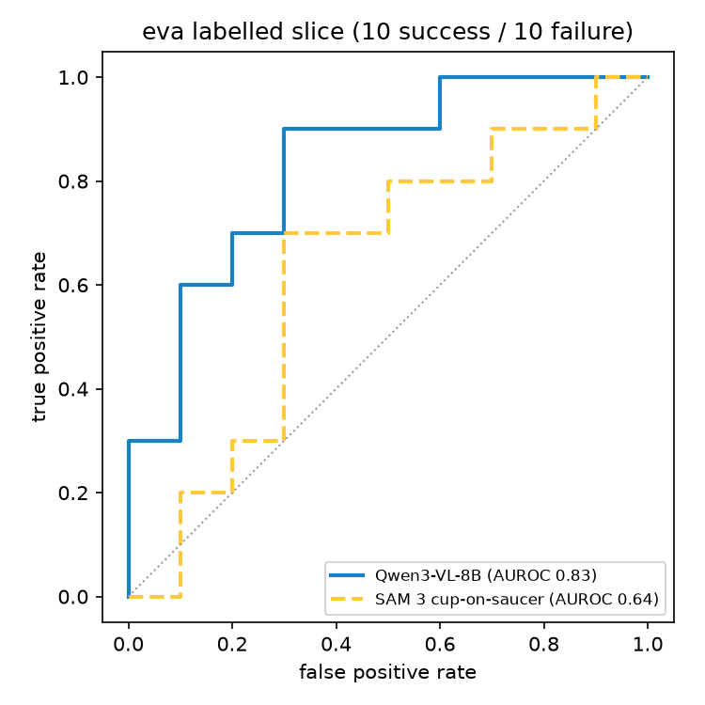
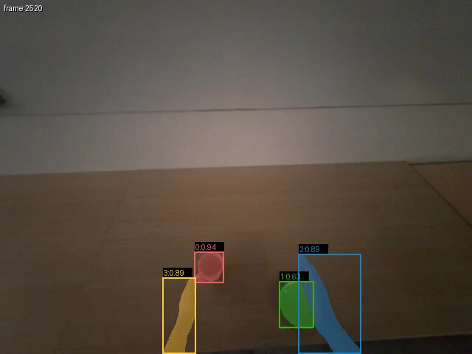
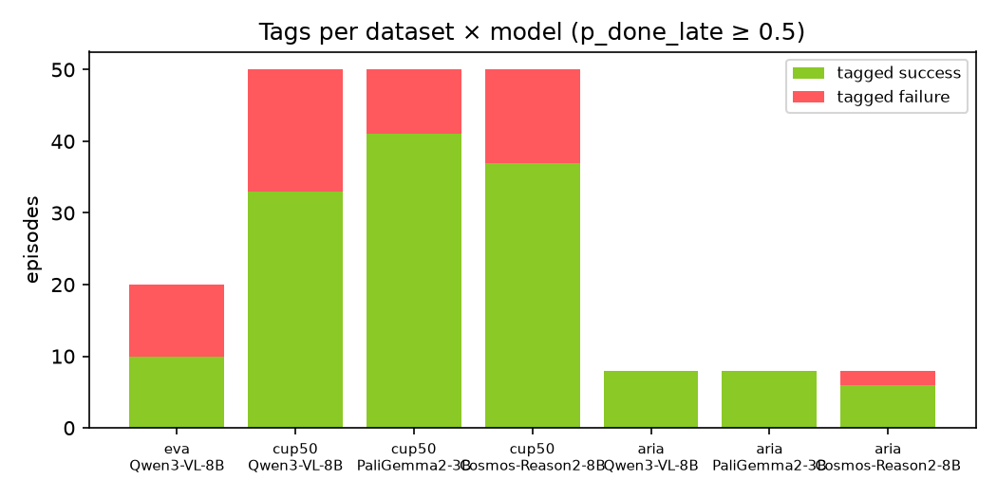
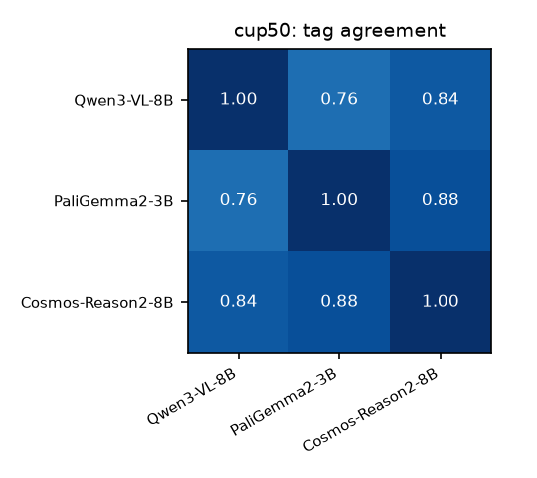
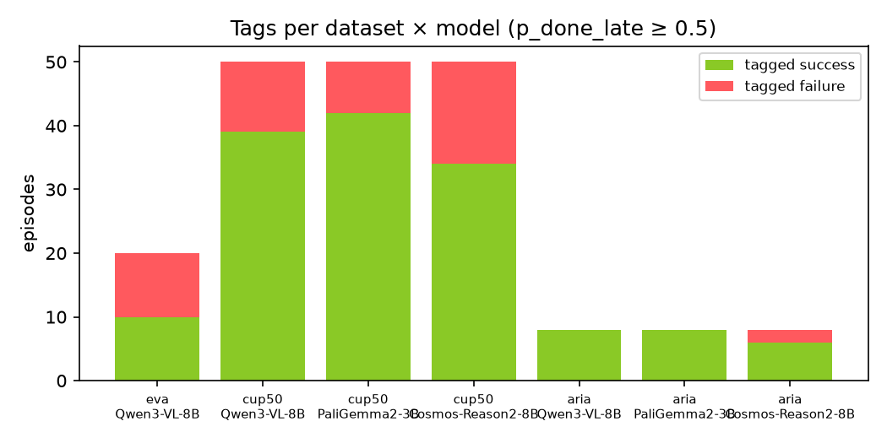
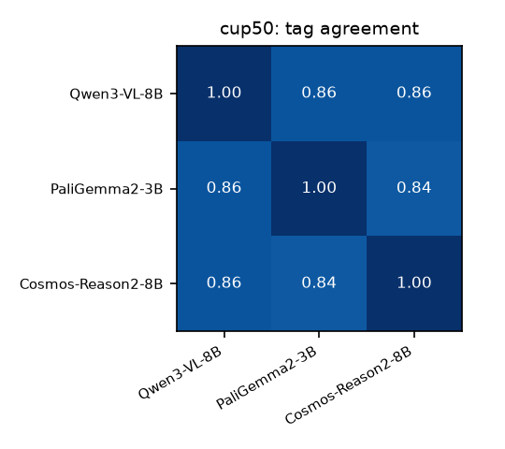
Human Reward Model — Track 3 Does the demo succeed? Ask the VLM's logits, not its words — and check it against geometry.
MAIN RESULT — A FAILURE AUDIT OF 50 HUMAN CUP-ON-SAUCER DEMOS
JUDGING CRITERIA
Success = the cup ends up on the saucer. No labels exist for these clips: four independent signals, every one run on every clip, fused per episode. Zero training, zero new labels, all on Modal.
✅ Does it run?
Every number here came out of a modal run in the repo today: 5 Modal apps, 3 VLMs × all 50 human clips, 20 robot episodes, 20 aria episodes. Overlay & meter videos in demo/; graphs, ROC, per-episode verdicts regenerated by one script in results/.
✅ Is it defensible?
Every choice has a check: gripper polarity verified on the wrist cam; arm frames verified by projecting onto the image; the model's actual top-5 tokens logged on every trace; thresholds fixed at 0.5, AUROC threshold-free; both scoring windows shown; disputed clips published, not hidden.
Signal | How | Success | Failure prev.
SAM 3 geometry | text-prompted cup/saucer masks; cup centroid in saucer box at the end | 36/50 | 28%
Qwen3-VL-8B · PaliGemma2-3B · Cosmos-R2-8B | p("Yes") from logits to "is the cup resting on the saucer?", last quarter, 3 fps | 33 · 41 · 37 | 34 · 18 · 26%
Fused = mean(SEG, mean of VLMs) | geometry and language weighted equally | 34/50 | 32%
26/50 unanimous across all four signals · 37/50 with ≥3 of 4 · 6 split 2–2. Geometry (28%) and language (32%) land on the same prevalence; 1 fps vs 3 fps sampling changes 1 verdict of 50.
WHAT WE LEARNED (AND CAN PROVE)
1. Ask about the goal state, not "was the task completed?" Unanswerable from one frame — p(yes) sat at 10⁻⁴ everywhere while the ranking still worked (AUROC 0.73 → 0.83 after the fix). Smaller model, more literal question: PaliGemma hedged (0.28–0.65) on the generic prompt, decisive (0.07–0.97) on "is the cup resting on the saucer?". Only visible because we read logits.
2. Geometry and language disagree in useful ways. The two clips split at 1 fps both resolved toward the geometry at 3 fps — sampling density matters for the VLMs, not for SEG. Equal weighting means neither signal can outvote the other alone.
3. The unit of evaluation must match the video. A cup50 clip is one attempt — score its end. An aria episode is 25 attempts — segment first (cup speed relative to the saucer), then score each.
✅ unanimous — SEG 1.00 · VLMs .87/.81/.96. SAM 3 tracks hand, cup, saucer at 10 fps.
❌ unanimous — SEG 0.00 · VLMs .00/.07/.00
SEG 1.00, VLMs .74/.46/.63 → ✅ 3/4 — a 2–2 split at 1 fps that 3 fps resolved toward geometry
the confidence meter: p(cup on saucer) per frame from Qwen logits, bar + sparkline
SIDE EXPERIMENT · LABELLED ROBOT SLICE (VALIDATION)
SIDE EXPERIMENT · ONE 2-MIN EGOCENTRIC VIDEO, SPLIT
eva 10/10 | acc | AUROC
VLM p(done) | 0.70 | 0.83
SAM 3 cup-in-saucer | 0.70 | 0.64
Fused + gripper veto | 0.70 | 0.74
Aria head-cam: both hands, cup, saucer tracked by SAM 3. Segment on cup rests relative to the saucer (head motion cancels): 25 attempts → 16 success / 9 failure, 16 returns not counted.
Why it scales to the prevalence problem
SAM 3 is text-prompted from the task description — no per-episode human seeding. VLM is one batched forward pass per sampled frame (16/pass, H100): 50 clips × 3 models in minutes. A full-dataset sweep is a .map() with per-stage GPUs.
Gripper proprioception too: zero slips in all 10 failures — failures are hesitation, not drops.
github.com/AungKMin/modal-robotics-hackathon · README → results/ → demo/
SAM 3 · Qwen3-VL-8B · Cosmos-Reason2-8B · PaliGemma 2 · Modal

