Slide 1
Let start GIT

Slide 2
Git basics
- a free and open-source version control system,
- originally created by Linus Torvalds in 2005.
- Unlike older centralized version control systems such as SVN and CVS,
- distributed: every developer has the full history of their code repository locally.
- makes the initial clone of the repository slower,
- subsequent operations such as commit, blame, diff, merge, and log dramatically faster.

Slide 3
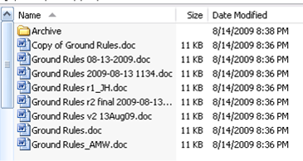
Without VCS

Slide 4
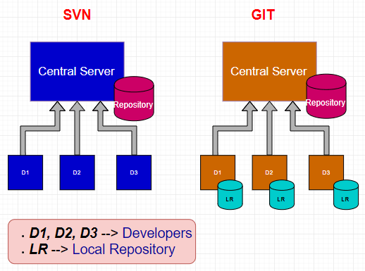

Slide 5
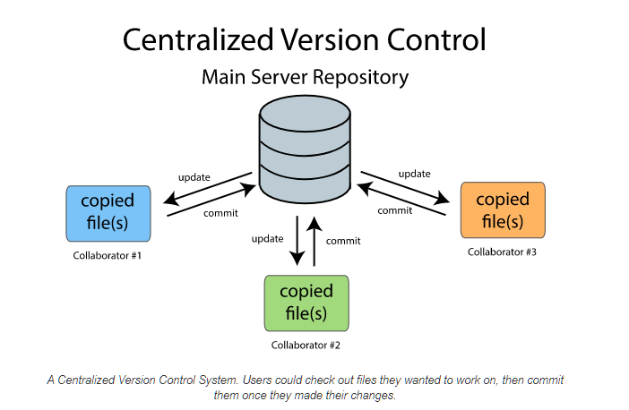

Slide 6
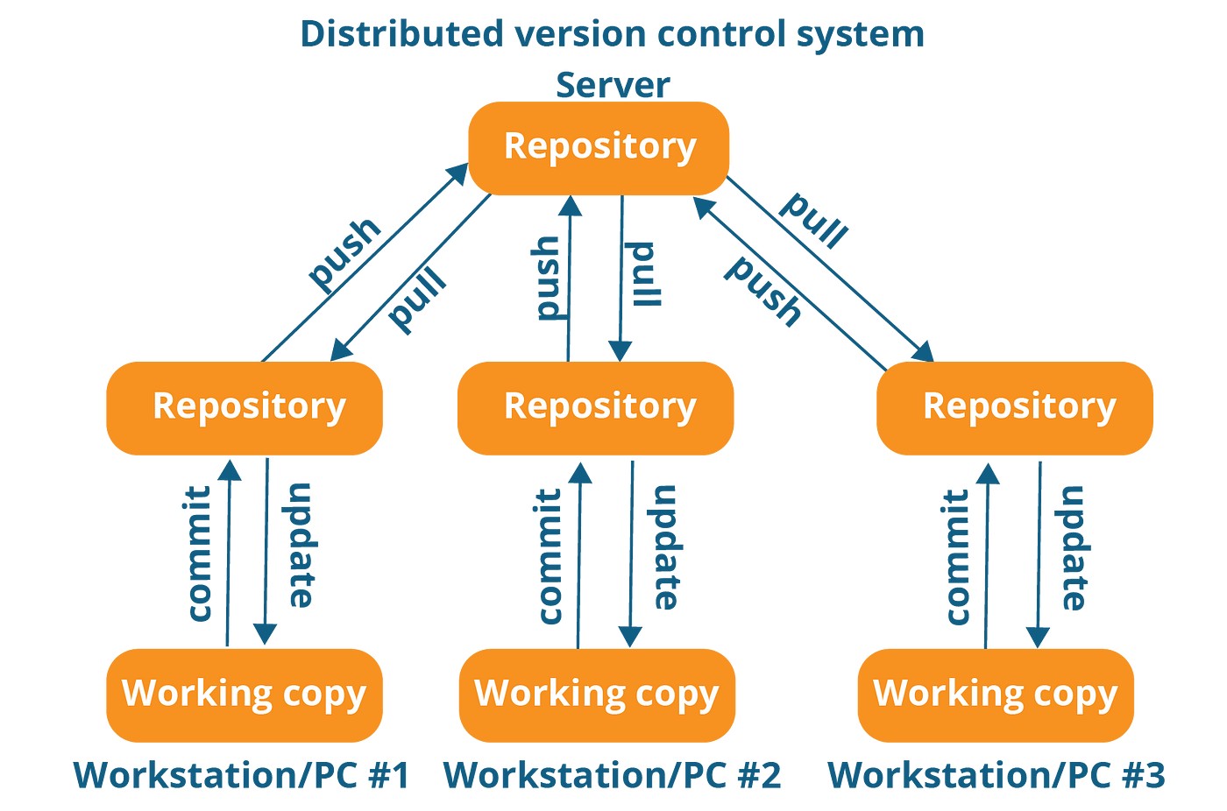

Slide 7
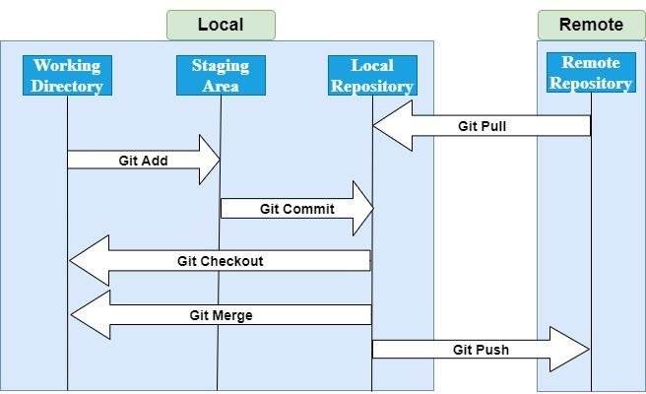

Slide 8
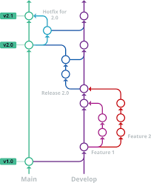

Slide 9
How Git works
Create a "repository" (project) with a git hosting tool (like github)
Copy (or clone) the repository to your local machine
Add a file to your local repo and "commit" (save) the changes
"Push" your changes to your main branch
Make a change to your file with a git hosting tool and commit
"Pull" the changes to your local machine
Create a "branch" (version), make a change, commit the change
Open a "pull request" (propose changes to the main branch)
"Merge" your branch to the main branch

Slide 10
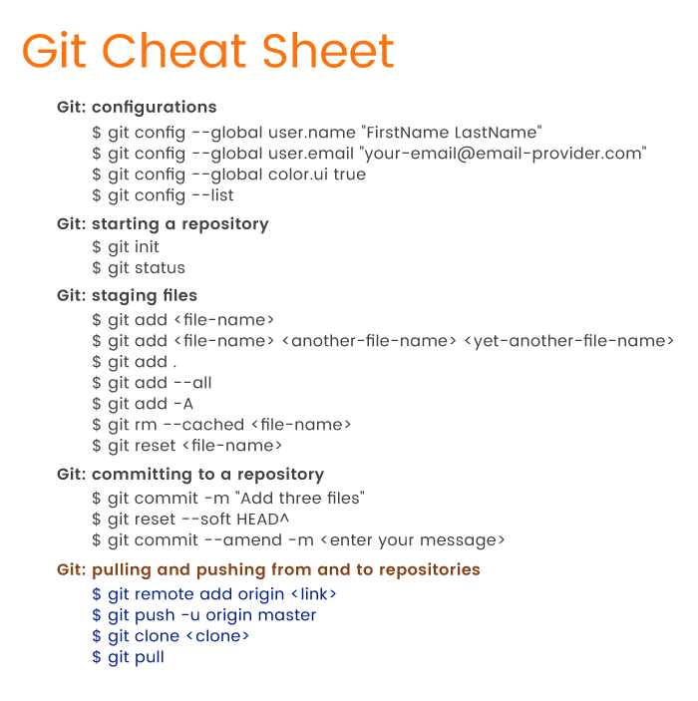

Slide 11
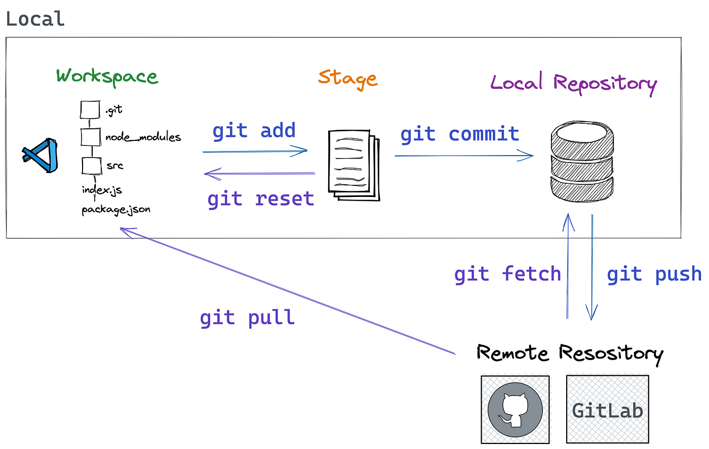

Slide 12
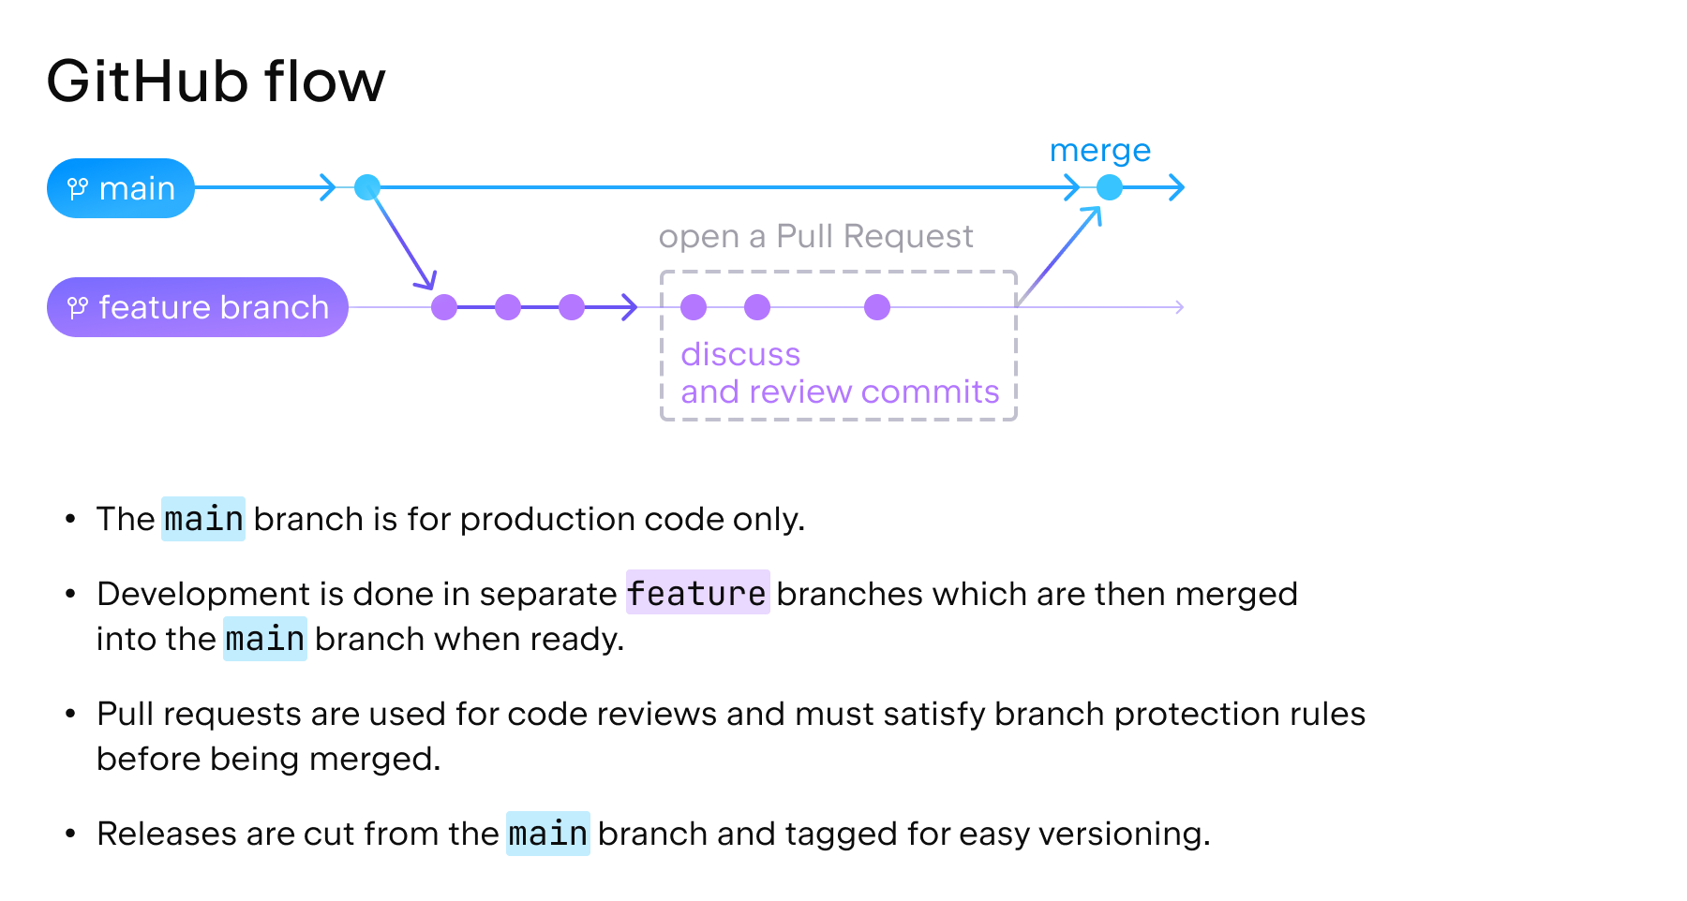

Slide 14
Tutorials
git clone
git init
git remote
git pull
git add
git commit
git checkout
git status
git restore
git reset
git diff
git rm
git push
git log

Slide 15
Thank You

