Slide 1

Local Brand
Online Shop System

Slide 2
Functions of Admin
Login
Add Category
Add Product
Manage Order
Give Discount
Logout

Slide 3
Functions of User
Register new account if new user
Login user
Update Register Data
Search Product
View Product
Buy Product Add to Cart
Order Product
Logout

Slide 4
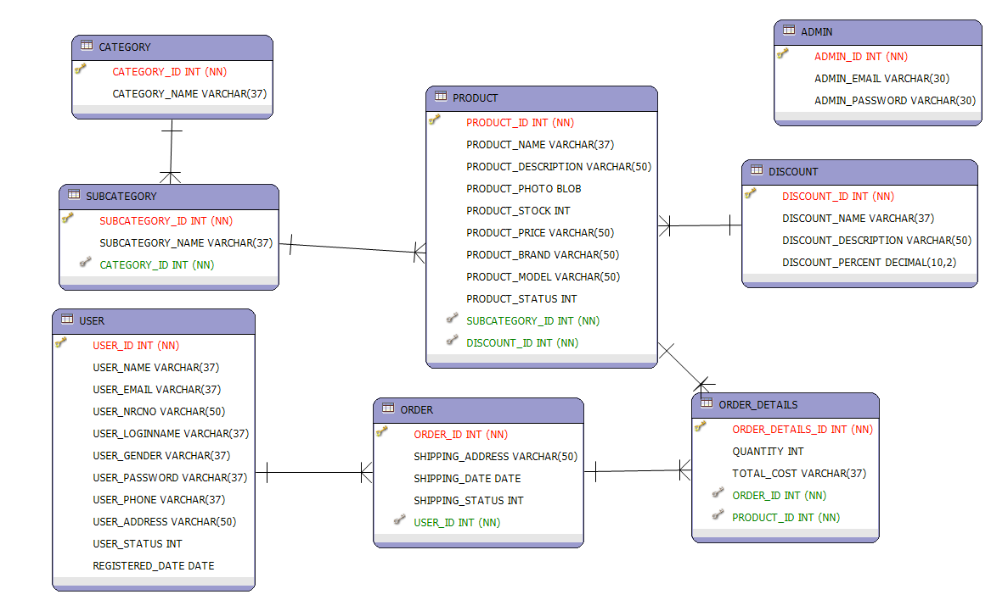
Database Design

Slide 5
Screen Design

Slide 6
Thank You For Your Attention

