Slide 1
Software Quality assurance (SQA) SWE 333
Software Quality Metrics
Dr Khalid Alnafjan
kalnafjan@ksu.edu.sa

Slide 2
If you can’t measure it, you can’t manage it Tom DeMarco, 1982

Slide 3
Measurement, Measures, Metrics
Measurement
is the act of obtaining a measure
Measure
provides a quantitative indication of the size of some product or process attribute, E.g., Number of errors
Metric
is a quantitative measure of the degree to which a system, component, or process possesses a given attribute (IEEE Software Engineering Standards 1993) : Software Quality - E.g., Number of errors found per person hours expended

Slide 4
What to measure
Process
Measure the efficacy of processes. What works, what doesn't.
Project
Assess the status of projects. Track risk. Identify problem areas. Adjust work flow.
Product
Measure predefined product attributes

Slide 5
What to measure
Process
Measure the efficacy of processes. What works, what doesn't.
Code quality
Programmer productivity
Software engineer productivity
Requirements,
design,
testing
and all other tasks done by software engineers
Software
Maintainability
Usability
And all other quality factors
Management
Cost estimation
Schedule estimation, Duration, time
Staffing

Slide 6
Process Metrics
Process metrics are measures of the software development process, such as
Overall development time
Type of methodology used
Process metrics are collected across all projects and over long periods of time.
Their intent is to provide indicators that lead to long-term software process improvement.

Slide 7
Project Metrics
Project Metrics are the measures of Software Project and are used to monitor and control the project. Project metrics usually show how project manager is able to estimate schedule and cost
They enable a software project manager to:
Minimize the development time by making the adjustments necessary to avoid delays and potential problems and risks.
Assess product cost on an ongoing basis & modify the technical approach to improve cost estimation.

Slide 8
Product metrics
Product metrics are measures of the software product at any stage of its development, from requirements to installed system. Product metrics may measure:
How easy is the software to use
How easy is the user to maintain
The quality of software documentation
And more ..

Slide 9
Why do we measure?
Determine quality of piece of software or documentation
Determine the quality work of people such software engineers, programmers, database admin, and most importantly MANAGERS
Improve quality of a product/project/ process

Slide 10
Why Do We Measure?
To assess the benefits derived from new software engineering methods and tools
To close the gap of any problems (E.g training)
To help justify requests for new tools or additional training

Slide 11
Examples of Metrics Usage
Measure estimation skills of project managers (Schedule/ Budget)
Measure software engineers requirements/analysis/design skills
Measure Programmers work quality
Measure testing quality
And much more …

Slide 12
IEEE definitions of
software quality metrics
(1) A quantitative measure of the degree to which an item possesses a given quality attribute.
(2) A function whose inputs are software data and whose output is a single numerical value that can be interpreted as the degree to which the software possesses a given quality attribute.

Slide 13
Main objectives of
software quality metrics
1. Facilitate management control, planning and managerial intervention. Based on:
· Deviations of actual from planned performance.
· Deviations of actual timetable and budget performance from planned.
2. Identify situations for development or maintenance process improvement (preventive or corrective actions). Based on:
· Accumulation of metrics information regarding the performance of teams, units, etc.

Slide 14
Software quality
metrics — Requirements
General requirements
Relevant
Valid
Reliable
Comprehensive
Mutually exclusive
Operative requirements
Easy and simple
Does not require independent data collection
Immune to biased interventions by interested parties

Slide 15
Classifications of
software quality metrics
Classification by phases of software system
Process metrics – metrics related to the software development process
Product metrics – metrics related to software maintenance
Classification by subjects of measuements
Quality
Timetable
Effectiveness (of error removal and maintenance services)
Productivity

Slide 16
Software size (volume) measures
KLOC — classic metric that measures the size of software by thousands of code lines.
Number of function points (NFP) — a measure of the development resources (human resources) required to develop a program, based on the functionality specified for the software system.

Slide 17
Process metrics categories
Process metrics categories
Software process quality metrics
Error density metrics
Error severity metrics
Software process timetable metrics
Software process error removal effectiveness metrics
Software process productivity metrics

Slide 18
Is KLOC enough ?
What about number of errors (error density)?
What about types of errors (error severity) ?
A mixture of KLOC, density, and severity is an ideal quality metric to programmers quality of work and performance

Slide 19
An example
2 different project teams are working to record errors in a software process
Team A – Finds 342 errors during software process before release
Team B- Finds 184 errors
Which team do you think is more effective in finding errors?

Slide 20
An example
It really depends on the types of errors found (severity) and not only the number of errors (Density)
One error of high severity might be more important than hundreds of other types of errors

Slide 21
Error density metrics
Code | Name | Calculation formula
CED | Code Error Density | NCE CED = ----------- KLOC
DED | Development Error Density | NDE DED = ----------- KLOC
WCED | Weighted Code Error Density | WCE WCDE = --------- KLOC
WDED | Weighted Development Error Density | WDE WDED = --------- KLOC
WCEF | Weighted Code Errors per Function Point | WCE WCEF = ---------- NFP
WDEF | Weighted Development Errors per Function Point | WDE WDEF = ---------- NFP
NCE = The number of code errors detected by code inspections and testing.
NDE = total number of development (design and code) errors) detected in the development process.
WCE = weighted total code errors detected by code inspections and testing.
WDE = total weighted development (design and code) errors detected in development process.

Slide 22
Error severity metrics
Code | Name | Calculation formula
ASCE | Average Severity of Code Errors | WCE ASCE = ----------- NCE
ASDE | Average Severity of Development Errors | WDE ASDE = ----------- NDE
NCE = The number of code errors detected by code inspections and testing.
NDE = total number of development (design and code) errors detected in the development process.
WCE = weighted total code errors detected by code inspections and testing.
WDE = total weighted development (design and code) errors detected in development process.

Slide 23
Software process
timetable metrics
Code | Name | Calculation formula
TTO | Time Table Observance | MSOT TTO = ----------- MS
ADMC | Average Delay of Milestone Completion | TCDAM ADMC = ----------- MS
MSOT = Milestones completed on time.
MS = Total number of milestones.
TCDAM = Total Completion Delays (days, weeks, etc.) for all milestones.

Slide 24
Error removal
effectiveness metrics
Code | Name | Calculation formula
DERE | Development Errors Removal Effectiveness | NDE DERE = ---------------- NDE + NYF
DWERE | Development Weighted Errors Removal Effectiveness | WDE DWERE = ------------------ WDE+WYF
NDE = total number of development (design and code) errors) detected in the development process.
WCE = weighted total code errors detected by code inspections and testing.
WDE = total weighted development (design and code) errors detected in development process.
NYF = number software failures detected during a year of maintenance service.
WYF = weighted number of software failures detected during a year of maintenance service.

Slide 25
Process productivity
metrics
Code | Name | Calculation formula
DevP | Development Productivity | DevH DevP = ---------- KLOC
FDevP | Function point Development Productivity | DevH FDevP = ---------- NFP
CRe | Code Reuse | ReKLOC Cre = -------------- KLOC
DocRe | Documentation Reuse | ReDoc DocRe = ----------- NDoc
DevH = Total working hours invested in the development of the software system.
ReKLOC = Number of thousands of reused lines of code.
ReDoc = Number of reused pages of documentation.
NDoc = Number of pages of documentation.

Slide 26
Product metrics
categories
* HD quality metrics:
* HD calls density metrics - measured by the number of calls.
* HD calls severity metrics - the severity of the HD issues raised.
* HD success metrics – the level of success in responding to HD calls.
* HD productivity metrics.
* HD effectiveness metrics.
* Corrective maintenance quality metrics.
* Software system failures density metrics
* Software system failures severity metrics
* Failures of maintenance services metrics
* Software system availability metrics
* Corrective maintenance productivity and effectiveness metrics.

Slide 27
HD calls density metrics
Code | Name | Calculation Formula
HDD | HD calls density | NHYC HDD = -------------- KLMC
WHDD | Weighted HD calls density | WHYC WHYC = ------------ KLMC
WHDF | Weighted HD calls per function point | WHYC WHDF = ------------ NMFP
NHYC = the number of HD calls during a year of service.
KLMC = Thousands of lines of maintained software code.
WHYC = weighted HD calls received during one year of service.
NMFP = number of function points to be maintained.

Slide 28
Severity of HD calls metrics
Code | Name | Calculation Formula
ASHC | Average severity of HD calls | WHYC ASHC = -------------- NHYC
NHYC = the number of HD calls during a year of service.
WHYC = weighted HD calls received during one year of service.

Slide 29
HD success metrics
Code | Name | Calculation Formula
HDS | HD service success | NHYOT HDS = -------------- NHYC
NHYNOT = Number of yearly HD calls completed on time during one year of service.
NHYC = the number of HD calls during a year of service.

Slide 30
HD productivity and
effectiveness metrics
Code | Name | Calculation Formula
HDP | HD Productivity | HDYH HDP= -------------- KLNC
FHDP | Function Point HD Productivity | HDYH FHDP = ---------- NMFP
HDE | HD effectiveness | HDYH HDE = -------------- NHYC
HDYH = Total yearly working hours invested in HD servicing of the software system.
KLMC = Thousands of lines of maintained software code.
NMFP = number of function points to be maintained.
NHYC = the number of HD calls during a year of service.

Slide 31
Software system
failures density metrics
Code | Name | Calculation Formula
SSFD | Software System Failure Density | NYF SSFD = -------------- KLMC
WSSFD | Weighted Software System Failure Density | WYF WFFFD = --------- KLMC
WSSFF | Weighted Software System Failures per Function point | WYF WSSFF = ---------- NMFP
NYF = number of software failures detected during a year of maintenance service.
WYF = weighted number of yearly software failures detected during one year of maintenance service.
NMFP = number of function points designated for the maintained software.
KLMC = Thousands of lines of maintained software code.

Slide 32
Failures of maintenance
services metrics
Code | Name | Calculation Formula
MRepF | Maintenance Repeated repair Failure metric - | RepYF MRepF = -------------- NYF
NYF = number of software failures detected during a year of maintenance service.
RepYF = Number of repeated software failure calls (service failures).

Slide 33
Software system
availability metrics
Code | Name | Calculation Formula
FA | Full Availability | NYSerH - NYFH FA = ----------------------- NYSerH
VitA | Vital Availability | NYSerH - NYVitFH VitA = ----------------------------- NYSerH
TUA | Total Unavailability | NYTFH TUA = ------------ NYSerH
NYSerH = Number of hours software system is in service during one year.
NYFH = Number of hours where at least one function is unavailable (failed) during one year, including total failure of the software system.
NYVitFH = Number of hours when at least one vital function is unavailable (failed) during one year, including total failure of the software system.
NYTFH = Number of hours of total failure (all system functions failed) during one year.
NYFH ≥ NYVitFH ≥ NYTFH.
1 – TUA ≥ VitA ≥FA

Slide 34
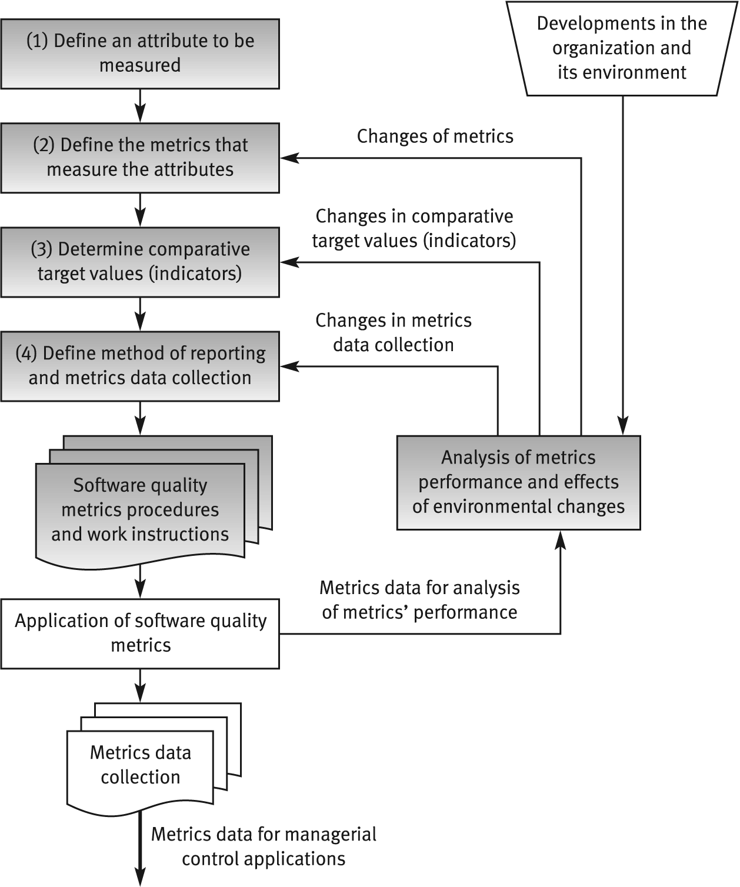
The process of
defining software quality metrics

Slide 35
General limitations of
quality metrics
* Budget constraints in allocating the necessary resources.
* Human factors, especially opposition of employees to evaluation of their activities.
* Validity Uncertainty regarding the data's, partial and biased reporting.

Slide 36
Examples of metrics
Requirements
Number of requirements that change during the rest of the software development process
if a large number changed during specification, design, …, something is wrong in the requirements phase and the quality of requirements engineers work

Slide 37
Examples of metrics
Inspection
number of faults found during inspection can be used as a metric to the quality of inspection process

Slide 38
Examples of metrics
Testing
Number of test cases executed
Number of bugs found per thousand of code
And more possible metrics

Slide 39
Examples of metrics
Maintainability metrics
total number of faults reported
classifications by severity, fault type
status of fault reports (reported/fixed)
Detection and correction times

Slide 40
Examples of metrics
Reliability quality factor
Count of number of system failure (System down)
Total of minutes/hours per week or month

Slide 41
An example
Programmers productivity using error severity and density
We will consider error density and error severity
Assume that we have three levels of severity
Low severity errors Wight is 1
Medium Severity Error Wight is 3
High Severity Error Wight is 15
Two Programmers produced 3 KLOC per day
After inspection, we found 100 low severity error, 20 medium severity errors and 10 High severity errors in the code of Programmer 1
And 300 low severity error, 10 medium severity errors and 2 High severity errors in the code of Programmer 2
Which programmer has the highest code quality ?

Slide 42
Other Metrics
Understanding
Learning time: Time for new user to gain basic understanding of features of the software
Ease of learning
Learning time: Time for new user to learn how to perform basic functions of the software
Operability
Operation time: Time required for a user to perform operation(s) of the software
Usability
Human factors: Number of negative comments from new users regarding ergonomics, human factors, etc.

Slide 43
Other Metrics
Number and type of defects found during requirements, design, code, and test inspections
Number of pages of documentation delivered
Number of new source lines of code created
Number of source lines of code delivered
Total number or source lines of code delivered
Average complexity of all modules delivered
Average size of modules
Total number of modules
Total number of bugs found as a result of unit testing
Total number of bugs found as a result of integration testing
Total number of bugs found as a result of validation testing
Productivity, as measured by KLOC per person-hour

Slide 44
Examples..continued
Metrics for the analysis model
Metrics for the design model
Metrics for the source code
Average find-fix cycle time
Number of person-hours per inspection
Number of person-hours per KLOC
Average number of defects found per inspection

Slide 45
Process Metrics
Average find-fix cycle time
Number of person-hours per inspection
Number of person-hours per KLOC
Average number of defects found per inspection
Number of defects found during inspections in each defect category
Average amount of rework time
Percentage of modules that were inspected

Slide 46
Exercise
How can you measure the quality of:
Project manager skills.
Requirements Document
Software development plan
User manuals
Programmer coding skills
Design specification

