Slide 1
Type Of SQL Commands
Data Definition Language (DDL)
Data Minipulation Language (DML)
Data Control Language (DCL)
Transaction control Language (TCL)
Create
Commit
Select
Grant
Alter
Update
Revoke
Rollback
Drop
Truncate
Delete
Insert

Slide 2
SQL Commands Structure
Select column1, column2…. From tbl_name
Where condition 1, condition 2 ….
Group by column1, column 2 …
Having condition 1 , condition 2 …
Order by column1, column2

Slide 3
SQL DATA TYPE
Exact Numeric
Approximate
Numeric
Date and Time
String
Binary
Int
Small int
Bit
decimal
Float
real
Date
Time
timestamp
char
varchar
Text
Binary
varbinary
image

Slide 4
SQL Operator
Arithmetic
Logic
Comparison
+
-
*
/
%
All
And
Any
Between
exists
=
!=, <>
>, <, >= <=
!>, !<

Slide 5
Group by in SQL
The Group By Statement groups records into summary rows and returns one record for each Group
SQL Syntax:
Select column_name from table_name
Where condition Group By column_names
Order by column_names

Slide 6
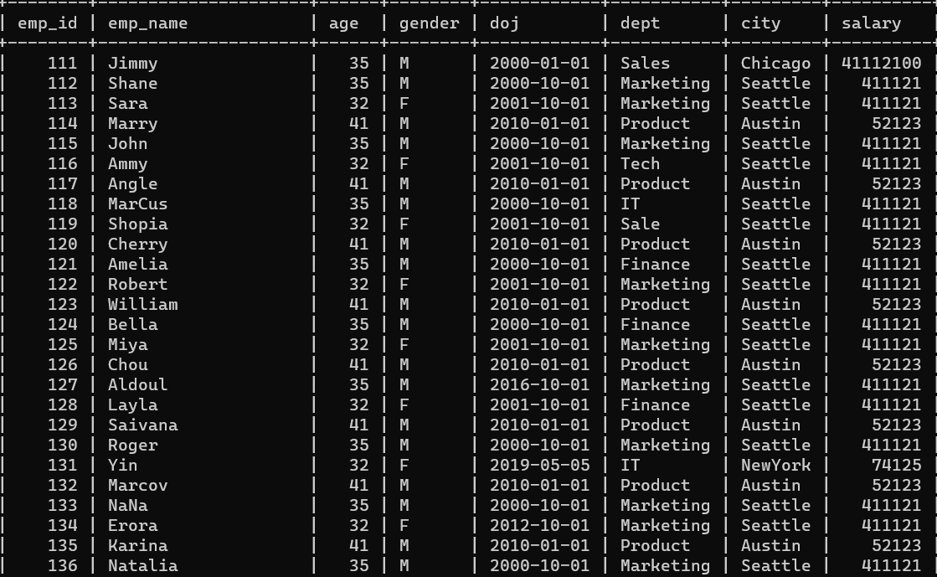
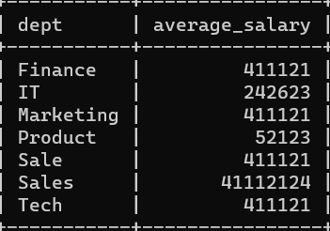
Group By in SQL
create table employees(emp_id int, emp_name varchar(50), age int, gender char(1), doj date, dept varchar(50), city varchar(50), salary float);
Find the average Salary of Employees in each department
Employees Table
Select dept, avg(salary) as average_salary from employees group by dept;
Output

Slide 7
Having in SQL
The Having clause in SQL operates on grouped records and returns rows where aggregate function results matched with given conditions only
Syntax:
Select column_name from table_name
Where condition
Group by column_names
Having condition
Order by column_names

Slide 8
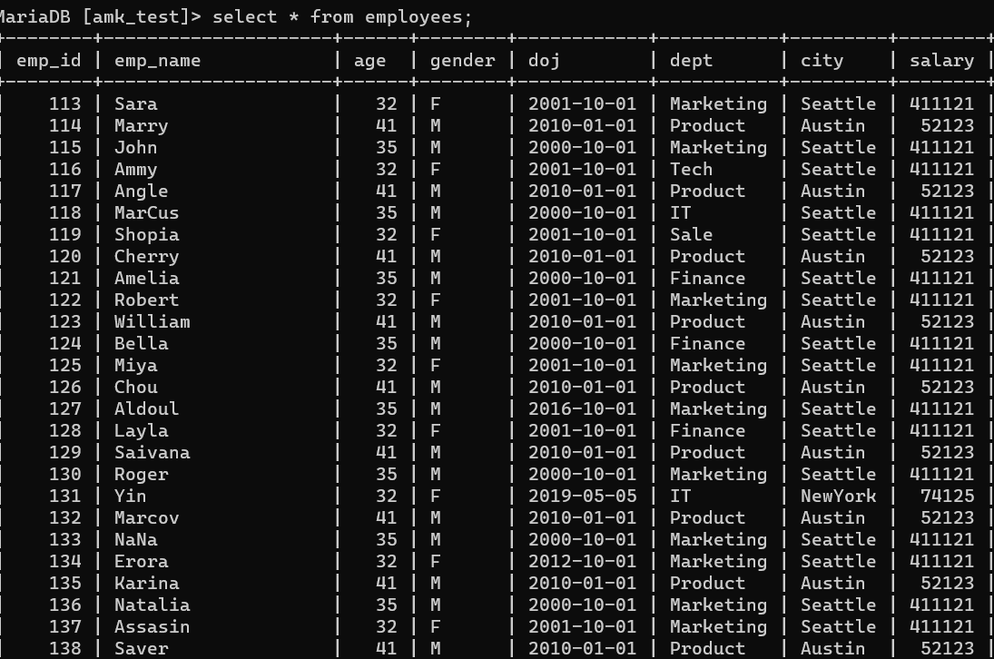
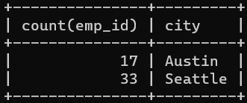
Having in SQL
Find the cities where there are more than 2 employees.
select count(emp_id), city from employees group by city
having count(emp_id) > 2;
Output

Slide 9
What are joined in SQL?
Orders
order_id
Order_date
Shipped_date
Status_of_delivery
Quantity
Price_of_product
A
B
SQL JOIN statement is used to combine rows of data from two or more tables based on a common column (field) between them
Customers
order_id
customer_id
Phone_no
Customer_name
address

