Slide 1
CSE 153/253 Assignment 2
Symbolic Music Generation
from Nottingham Folk Tunes
Recording plan
0-4 min
Setup, data, preprocessing
4-8:45
Modeling and baseline proof
Task 1: unconditioned melody generation
Task 2: chord-conditioned melody generation
8:45-12
Task 1 walkthrough
12-16:35
Task 2 walkthrough
16:35-19:45
Presented by: [Group member names]
Related work, limits, close
Sources: assignment instructions, workbook.html, README.md
1/18
Notes:
Timing: 0:00-0:40
Open with the task and deliverables
Introduce this as CSE 153/253 Assignment 2: two symbolic music generation tasks trained from scratch on Nottingham folk tunes.
Point out that names are placeholders on this slide. Say the final submitted artifacts are workbook.html plus symbolic_unconditioned.mid and symbolic_conditioned.mid.
Set expectations: the video is structured to follow the peer-grading rubric, with music playback saved for the end if there is time.

Slide 2
RUBRIC MAP
The deck is structured around the four sections peer graders score.
Exploratory analysis
Modeling
Evaluation
Related work
dataset origin
preprocessing
statistics and plots
ML formulation
model tradeoffs
architecture/code
baselines
perplexity
musical sanity checks
Nottingham uses
symbolic RNNs
long-range models
2 pts per task
2 pts per task
2 pts per task
2 pts per task
Timing discipline
Slides target about 19:45 of narration. Music playback is queued after the rubric content and should not push the video beyond 21:00.
Submission alignment: workbook.html + video_url.txt + symbolic_unconditioned.mid + symbolic_conditioned.mid.
Sources: workbook.html, README.md, src/, figures/
2/18
Notes:
Timing: 0:40-1:35
Map the deck to the grading rubric
Explain that the assignment asks for exploratory analysis, modeling, evaluation, and related work for each task.
Say the dataset and model slides are shared because both tasks use the same symbolic pipeline, then the deck splits into Task 1 and Task 2 results.
This makes it easy for peer graders to connect the presentation to the notebook and code.

Slide 3
SYSTEM VIEW
Both tasks share one symbolic pipeline, then diverge at conditioning.
Nottingham ABC
music21 parse
Token streams
Models
MIDI outputs
folk melodies
with chord symbols
first melody part
measure-level chords
NOTE_pitch_duration
REST, BAR, CHORD
trigram baseline
GRU next-token model
unconditioned MIDI
conditioned MIDI
Task 1
Unconditioned generation estimates p(x) and samples from only <START>.
Task 2
Conditioned generation estimates p(melody | chords) from supplied chord tokens.
Sources: workbook.html, README.md, src/, figures/
3/18
Notes:
Timing: 1:35-2:45
Summarize the project pipeline
Walk left to right: Nottingham ABC files are parsed with music21, converted into symbolic tokens, split into train and validation sets, then used for GRU and trigram models.
Emphasize the difference between the tasks: Task 1 only predicts melody tokens, while Task 2 inserts chord tokens as conditioning context.
Both outputs are rendered as MIDI files so the final result can be heard.

Slide 4
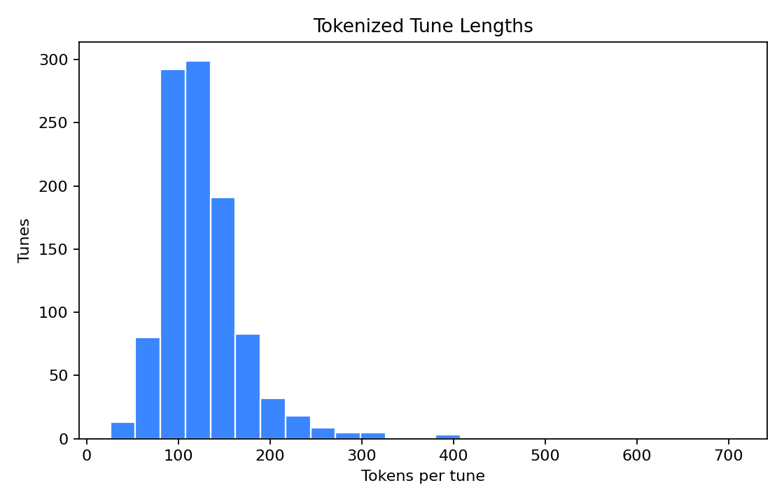
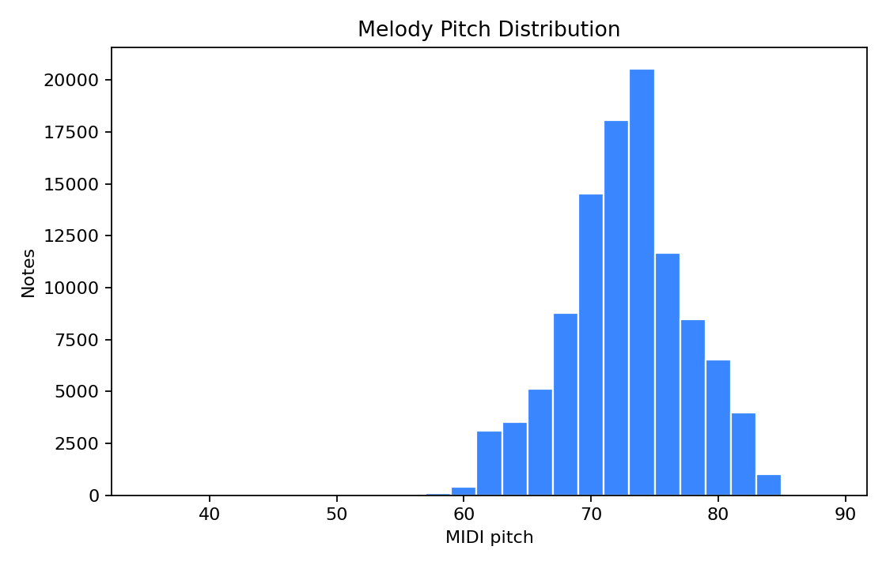
DATA AND EDA
The same 1,033 tunes become two train/validation views.
split
tunes
tokens
vocab
avg len
chords
train uncond.
879
111,937
213
127.3
0
val uncond.
154
19,610
169
127.3
0
train cond.
879
131,778
294
149.9
81
val cond.
154
23,103
211
150
42
Why this dataset fits
ABC is already symbolic and compact. Nottingham has monophonic melody plus chord labels, so one corpus supports both selected tasks.
What preprocessing adds
Durations are quantized to sixteenth-note units; chord symbols become CHORD_* tokens; train/validation splits are written as JSONL sequences.
Sources: workbook.html, README.md, src/, figures/
4/18
Notes:
Timing: 2:45-4:00
Explain dataset scale and shape
Use the table first: there are 879 training tunes and 154 validation tunes in both views of the data.
The conditioned representation has more tokens and a larger vocabulary because chord tokens are included before measures.
Use the figures to show the dataset is mostly short folk tunes with a stable pitch range, which fits symbolic melody modeling.

Slide 5
REPRESENTATION
The model sees notes, durations, bars, and chords as one token language.
Source tune: data/raw/nottingham/abc/nottingham_database/morris.abc::X15
src/preprocessing/tokenize_nottingham.py
1
2
3
4
5
6
7
8
9
10
def pitch_token(element, grid=4):
units = duration_units(element.duration, grid=grid)
if isinstance(element, note.Rest):
return f"REST_{units}"
if isinstance(element, note.Note):
return f"NOTE_{int(element.pitch.midi)}_{units}"
conditioned.append(chord)
conditioned.extend(measure_tokens)
conditioned.append(BAR_TOKEN)
pos
token
Interpretation
0
<START>
NOTE_67_4 means MIDI pitch 67 for four sixteenth-note units. BAR preserves phrase boundaries. CHORD_G sets harmonic context for the following melody events.
1
CHORD_NC
2
NOTE_62_2
3
<BAR>
4
CHORD_G
5
NOTE_67_4
6
NOTE_69_2
7
NOTE_71_4
8
NOTE_72_2
Shape
Conditioned sequences average 149.9 tokens because they include one chord token per measure. Unconditioned sequences average 127.3 tokens.
Why show tokens
This is the bridge between the notebook/code and the generated MIDI files.
Sources: workbook.html, README.md, src/, figures/
5/18
Notes:
Timing: 4:00-5:10
Explain the token representation
This is the concrete data example graders can compare to the notebook. Notes encode MIDI pitch and duration in sixteenth-note units.
CHORD tokens carry harmonic context and BAR tokens preserve measure boundaries.
Mention the source tune morris.abc::X15 and explain that the conditioned and unconditioned views share the same melody events.

Slide 6
MODELING
A small GRU gives learned context without hiding the implementation.
src/models/gru_model.py
approach
strength
weakness
1
2
3
4
5
6
7
8
9
self.embedding = nn.Embedding(vocab_size, 128, padding_idx=pad_idx)
self.gru = nn.GRU(
input_size=128,
hidden_size=256,
num_layers=2,
dropout=0.2,
batch_first=True,
)
self.output = nn.Linear(256, vocab_size)
trigram
simple, fair baseline
only two-token context
GRU
hidden state over phrases
limited global form
transformer
longer-range structure
more compute and tuning
Objective
For both tasks the model minimizes cross-entropy for p(x_t | x_<t). Validation perplexity is exp(validation loss).
Sampling
Generation uses temperature 0.9 and top-k 12 sampling to avoid both deterministic loops and extremely unlikely notes.
Sources: workbook.html, README.md, src/, figures/
6/18
Notes:
Timing: 5:10-6:25
Explain why the GRU is the main model
Frame both tasks as next-token prediction. The GRU learns a hidden state over prior events; the trigram baseline only sees the previous two tokens.
Point out the model is intentionally modest: it trains from scratch on this dataset and is easier to explain than a transformer.
The architecture code is small: embedding, two-layer GRU, and linear output layer.

Slide 7
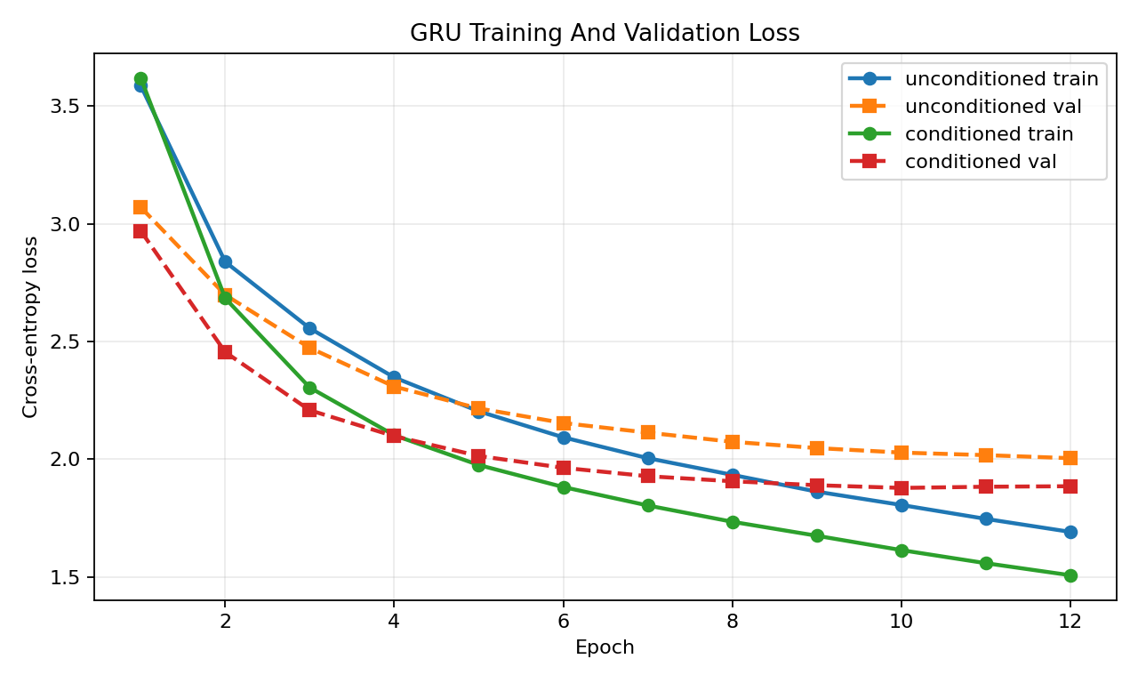
TRAINING
Loss drops quickly and then flattens, which is the expected compact-dataset pattern.
12
10
epochs run for both GRU models
best validation epoch for the conditioned GRU
0.313
0.378
final val-train gap for Task 1
final val-train gap for Task 2
Reading the curves
Both models learn the frequent melodic syntax early. After that, validation loss improves slowly, so more epochs would likely give diminishing returns.
Sources: workbook.html, README.md, src/, figures/
7/18
Notes:
Timing: 6:25-7:35
Describe training behavior
The training and validation losses drop quickly in the first few epochs and then flatten.
This is good for the assignment because it shows learning without requiring a large run. The final validation-train gaps are moderate, not evidence of total memorization.
Mention that both GRUs were trained for 12 epochs and the conditioned model's best validation epoch was 10.

Slide 8
BASELINE COMPARISON
Validation perplexity shows the learned hidden state matters.
3.39x lower
4.43x lower
task
n-gram
GRU
ratio
29.0
unconditioned
25.200
7.424
3.39x
25.2
conditioned
28.991
6.543
4.43x
7.4
6.5
Interpretation
The GRU is about 3.4x lower perplexity for unconditioned generation and about 4.4x lower for chord-conditioned generation.
Task 1
Task 2
validation perplexity
Why this baseline is useful
A trigram model captures local token transitions, so beating it shows the recurrent state is contributing more than short local counts.
Sources: workbook.html, README.md, src/, figures/
8/18
Notes:
Timing: 7:35-8:45
Compare against the baseline
The clearest quantitative result is validation perplexity. The unconditioned GRU gets 7.424 vs 25.200 for the trigram baseline.
The conditioned GRU gets 6.543 vs 28.991 for the trigram baseline.
Say this supports the modeling choice: longer learned context is more useful than short local counts alone.

Slide 9
TASK 1
Unconditioned generation learns p(x) and samples from START only.
Input
Model
Output
<START>
GRU
next-token
sampler
symbolic_
unconditioned.mid
No melody prefix, chord prompt, or audio prompt.
Autoregressively samples until END or max length.
44.0 sec
158 note_on events
Evaluation goals
Plausible register, low immediate repetition, varied pitch/duration tokens, mostly singable melodic motion.
Sources: workbook.html, README.md, src/, figures/
9/18
Notes:
Timing: 8:45-9:40
Introduce Task 1
Task 1 is symbolic unconditioned generation. At generation time the model receives only START and samples a full melody.
The ML objective is cross-entropy next-token prediction, which estimates p(x_t | x_<t).
A good output should stay in a plausible register, avoid immediate loops, and have some rhythmic and pitch variety.

Slide 10
TASK 1 EVALUATION
The generated melody is plausible, but rhythm variety is conservative.
source
notes
pitches
range
durations
entropy
repeat
large leaps
158
0.065
generated GRU
158
14
[66, 83]
4
2.79
0.065
0.083
generated GRU notes
immediate repeat rate
generated n-gram
97
16
[59, 79]
7
2.985
0.032
0.052
4 vs 8
validation reference
102.6
30
[55, 86]
8
3.146
n/a
n/a
unique durations: GRU vs validation
What sounds likely
Mostly stepwise motion, moderate pitch variety, and little exact token repetition.
What to mention while listening
Decide whether repeated common pitches sound like folk-style consistency or like model overconfidence.
Sources: workbook.html, README.md, src/, figures/
10/18
Notes:
Timing: 9:40-11:10
Evaluate Task 1
Start with the generated GRU row. It produces 158 notes, 14 unique pitches, and a pitch range of 66 to 83.
The repeat rate is low at 0.065 and the large leap rate is 0.083, so the sample should be mostly stepwise.
The limitation is duration diversity: the generated sample has 4 unique durations compared with 8 in the validation reference.

Slide 11
CODE WALKTHROUGH
Task 1 generation is a hidden-state loop with controlled sampling.
src/generation/sample_gru.py
Architectural choice
1
2
3
4
5
6
7
8
9
10
11
12
13
generated = [START_TOKEN]
input_id = torch.tensor([[vocab.token_to_id[START_TOKEN]]])
hidden = None
for _ in range(max_tokens):
logits, hidden = model(input_id, hidden)
note_count = sum(t.startswith("NOTE_") for t in generated)
blocked = [END_TOKEN] if note_count < min_note_tokens else []
next_id = sample_next(logits[0, -1], vocab,
temperature=0.9, top_k=12,
blocked_tokens=blocked)
token = vocab.id_to_token[next_id]
generated.append(token)
The GRU hidden state carries phrase context across all previously generated events.
Sampling choice
Temperature and top-k sampling keep the output from becoming either deterministic or too random.
Practical guardrail
END is blocked until the sample has enough notes, avoiding empty or extremely short MIDI files.
Sources: workbook.html, README.md, src/, figures/
11/18
Notes:
Timing: 11:10-12:05
Walk through Task 1 code
Use this as the code walkthrough slide for Task 1. The loop keeps a hidden state and feeds the last sampled token back into the model.
The code blocks END until the minimum note count is reached, then uses temperature and top-k sampling.
Tie this back to the generated MIDI file symbolic_unconditioned.mid.

Slide 12
TASK 2
Conditioned generation changes the target to p(melody | chords).
Input chord context
Model objective
Output
CHORD_G
NOTE_67_4
NOTE_69_2
<BAR>
p(melody token
| prior tokens,
active chord)
symbolic_
conditioned.mid
32.0 sec
63 note_on events
Chord token appears before measure-level melody events.
Extra evaluation target
The melody should fit the supplied harmony, but non-chord tones can still be musically valid as passing tones or suspensions.
Sources: workbook.html, README.md, src/, figures/
12/18
Notes:
Timing: 12:05-13:00
Introduce Task 2
Task 2 is symbolic conditioned generation. The model learns p(melody | chords) by seeing chord tokens before measures during training.
At generation time, the chord progression is supplied and the model samples melody events under each active chord.
The extra evaluation question is whether generated notes align with the active chord while still sounding melodic.

Slide 13
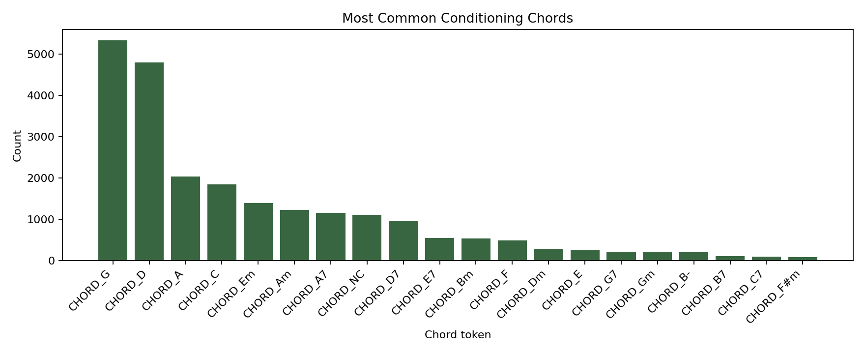
TASK 2 EDA
Chord conditioning is meaningful, but the distribution is heavily skewed.
81
unique chord tokens in the conditioned training split
42
unique chord tokens in the conditioned validation split
Modeling implication
Common chords such as G and D are well represented. Rare chords may be harder to condition on reliably without more data.
Sources: workbook.html, README.md, src/, figures/
13/18
Notes:
Timing: 13:00-14:00
Explain chord data
The chord vocabulary is not uniform. G and D are the most common, followed by A, C, Em, and Am.
The training split contains 81 unique chord tokens, while the validation split contains 42.
This means conditioning is meaningful, but the model sees some chords much more often than others.

Slide 14
TASK 2 EVALUATION
The conditioned GRU aligns with chords while keeping leaps lower than the baseline.
source
notes
chords
pitches
range
chord-tone
large leaps
Chord-tone rate by active chord
generated GRU
63
16
12
[59, 79]
0.714
0.048
C
0.545
generated n-gram
63
18
15
[64, 83]
0.698
0.145
D
0.706
Em
0.500
validation reference
102.6
3493
30
[55, 86]
n/a
n/a
G
0.806
0.714
0.048
overall generated GRU chord-tone rate
large leap rate, lower than n-gram's 0.145
Interpretation
The chord-tone metric is a sanity check, not a final quality score. It captures simple triad alignment but not passing tones, suspensions, or phrase-level intent.
Sources: workbook.html, README.md, src/, figures/
14/18
Notes:
Timing: 14:00-15:35
Evaluate Task 2
The generated conditioned GRU sample has 63 notes and 16 chord tokens. Its chord-tone rate is 0.714.
The n-gram baseline is close at 0.698, but the GRU has a much lower large leap rate: 0.048 vs 0.145.
Use the per-chord bars carefully: G is strongest at 0.806, D is 0.706, while C and Em leave more non-chord tones or mismatches.

Slide 15
CODE WALKTHROUGH
Task 2 feeds chord tokens first, then samples melody until the next bar.
src/generation/sample_gru.py
1
2
3
4
5
6
7
8
9
10
11
12
13
14
15
for chord in chords:
chord = chord if chord.startswith("CHORD_") else f"CHORD_{chord}"
generated.append(chord)
logits = feed(chord)
for _ in range(max_tokens_per_chord):
next_id = sample_next(logits, vocab,
temperature=0.9, top_k=12)
token = vocab.id_to_token[next_id]
if token == END_TOKEN:
token = BAR_TOKEN
generated.append(token)
logits = feed(token)
if token == BAR_TOKEN:
break
src/evaluation/metrics.py
1
2
3
4
5
6
7
if token.startswith("CHORD_"):
active_chord = token
elif token.startswith("NOTE_") and active_chord:
allowed = chord_pitch_classes(active_chord)
checked += 1
if pitch % 12 in allowed:
matching += 1
What to say
The sampler controls harmony externally, while the evaluator checks whether generated notes fit the current chord.
Sources: workbook.html, README.md, src/, figures/
15/18
Notes:
Timing: 15:35-16:35
Walk through Task 2 code
This code is the main difference from Task 1. The sampler explicitly feeds a chord token, then samples melody tokens until a BAR.
The model is not allowed to randomly generate new chord tokens in the melody segment.
Connect this to the chord-tone metric: the evaluator tracks the active chord and checks whether note pitch classes belong to the chord.

Slide 16
RELATED WORK
The project follows symbolic music language modeling at an assignment-sized scale.
reference area
what it contributes
how this project differs
Nottingham ABC
folk-tune corpus with symbolic melody and chords
used directly for two task views
Eck & Schmidhuber
recurrent networks can learn musical temporal structure
GRU is smaller and trained from scratch
Boulanger-Lewandowski et al.
probabilistic symbolic sequence modeling
monophonic folk melody, not polyphonic piano
Music Transformer
attention improves long-range musical structure
not used because compute/complexity is higher
Positioning
The contribution is not a new state-of-the-art model. It is a complete, auditable pipeline that fits the assignment requirement to train model weights on a selected dataset.
Sources: workbook.html, README.md, src/, figures/
16/18
Notes:
Timing: 16:35-17:45
Discuss related work
Keep this concise. Nottingham is a standard symbolic folk-tune source, and this project uses the ABC representation directly.
Eck and Schmidhuber show recurrent networks can learn musical temporal structure. Boulanger-Lewandowski et al. frame symbolic music as probabilistic sequence modeling.
Music Transformer is a stronger long-range model, but for this assignment the GRU is appropriate because it is trained from scratch and easy to audit.

Slide 17
LIMITS AND EXTENSIONS
The main gap is between token prediction and musical form.
Perplexity
Useful for held-out token likelihood; weak proxy for beauty.
Next steps
Chord-tone rate
- add phrase-level constraints or section tokens
- evaluate with listener ratings
- try transformer/self-attention for longer form
- condition on meter, key, or style tags
- compare against generated MIDI playback directly
Good sanity check; can penalize valid passing tones.
Duration diversity
Task 1 favors common short durations.
Global form
Samples are phrase-length, not full compositions with development.
Sources: workbook.html, README.md, src/, figures/
17/18
Notes:
Timing: 17:45-18:45
State limitations and next steps
Be honest about what the metrics do and do not prove. Perplexity measures held-out token prediction, not musical beauty.
Chord-tone rate is a sanity check, but non-chord tones can be musically correct as passing tones or suspensions.
Future work would add phrase-level structure, stronger conditioning controls, and subjective listening evaluation.

Slide 18
CLOSE
Play the music after the rubric content, but keep the total recording under 21 minutes.
Three takeaways
Playback cue
1
Tokenization makes notes, rhythms, bars, and chords explicit.
1. symbolic_unconditioned.mid
44.0 sec, 158 note_on events
2. symbolic_conditioned.mid
32.0 sec, 63 note_on events
2
The GRU beats a trigram baseline on validation perplexity.
3
The conditioned model shows measurable harmonic alignment.
Suggested recording move: play 15-20 seconds of each file, then tell graders the full files are submitted separately.
Final files: workbook.html, video_url.txt, symbolic_unconditioned.mid, symbolic_conditioned.mid
18/18
Notes:
Timing: 18:45-19:45
Close and cue playback
Summarize the three takeaways: the tokenization supports both tasks, the GRU beats the trigram baseline, and the conditioned task shows measurable harmonic alignment.
Then cue the music files. Play symbolic_unconditioned.mid first, then symbolic_conditioned.mid if the recording still has time.
Do not let playback push the total video past 21 minutes; the assignment says playback can be at the end in case graders have trouble with files.

