Slide 1


Slide 2
What is Smart City?
A Smart city has
*basic infrastructure,
*Uses ‘smart’ solution to make infrastructure and services better,and
*relies on Area based development.

Slide 3
Class Diagram
Admin *
-name:String -phone no:String -gender:String -id:String
+getname():String +getphone no():String +getgender():String +getid():String Admin(name:String,phone no:String,gender:String,id:String) dataentry(ob:info.type):void *studentinfo(ob:localStudent):String *touristinfo(ob:foreigntourist):String
Student *
-name:String -phone no:String -institute:String -gender:String -id:String
+getname():String +getphone no():String +getinstitute():String +getgender():String +getid():String Student(name:String,phone no:String,institute:String,gender:String,id:String) *Businessmaninfo(ob:foreignbusinessman):String
Tourist
-name:String -phone no:String -Address:String -gender:String -id:String
+getname():String +getphone no():String +getAddress():String +getgender():String +getid():String Tourist(name:String,phone no:String,Address:String,gender:String,id:String) userlist(Sql:String):ArrayList<info.type>
Businessman
-name:String -phone no:String -company name:String -Address:String -gender:String -id:String
+getname():String +getphone no():String +getcompany name():String +getAddress():String +getgender():String +getid():String Businessman(name:String,phone no:String,company name:String,Address:String,gender:String,id:String) userlist(Sql:String):ArrayList<info.type>
local tourist
localtourist(name:String,phone no:String,Address:String,gender:String,id:String) +studentinfo(ob:foreignstudent):String
Sub Admin
SubAdmin(name:String,phone no:String,gender:String,id:String) studentinfo(ob:localStudent):String touristinfo(ob:foreigntourist):String
Local student
localstudent(name:String,phone no:String,institute:String,gender:String,id:String)
local businessman
localbusinessman(name:String,phone no:String,company name:String,Address:String,gender:String,id:String)
Foreign student
-country:String
+getcountry():String foreignstudent(name:String,phone no:String,institute:String,gender:String,id:String)
foreign tourist
-country:String
+getcountry():String foreigntourist(name:String,phone no:String,Address:String,gender:String,id:String)
Super Admin
-experience:int
+getexperience():int SuperAdmin(name:String,phone no:String,gender:String,id:String)
foreign businessman
-country:String
+getcountry():String foreignbusinessman(name:String,phone no:String,company name:String,Address:String,gender:String,id:String)
<<Iinfo>>
Studentinfo(ob:foreignstudent):String

Slide 4
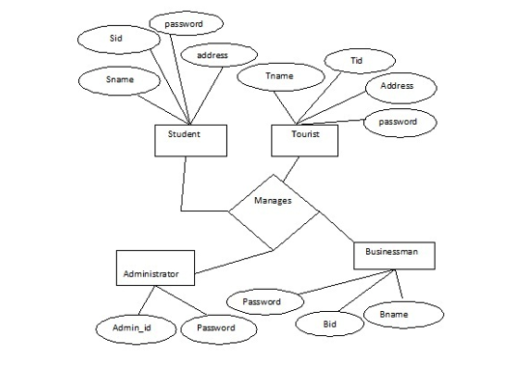
E-R Diagram

Slide 5
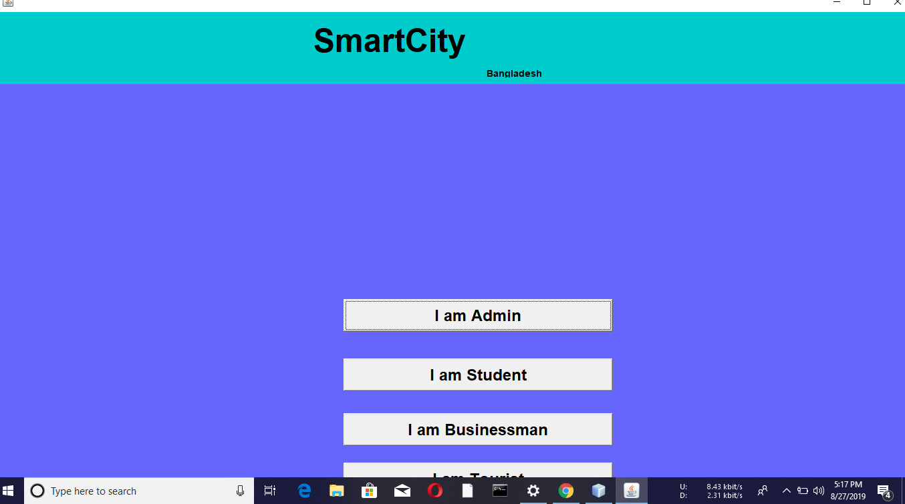
Welcome to City Guide

Slide 6
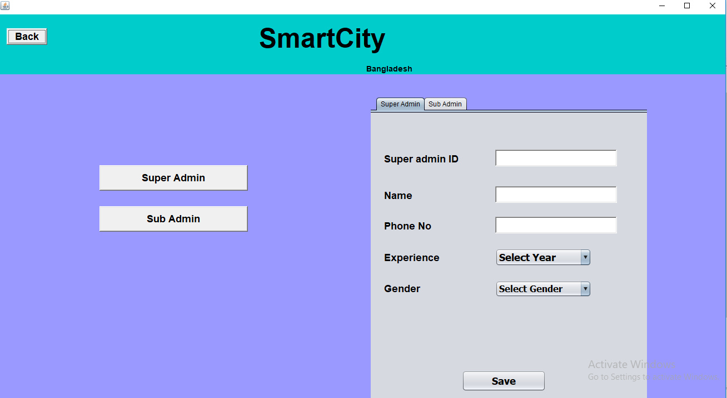

Slide 7
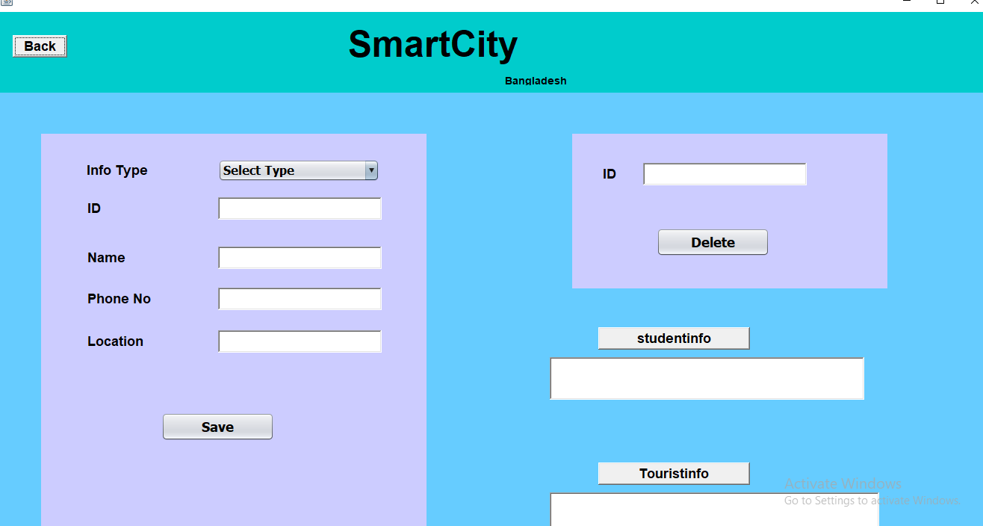

Slide 8
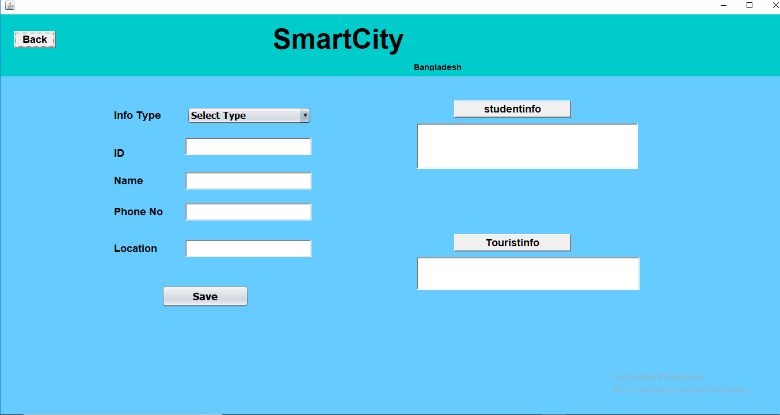

Slide 9
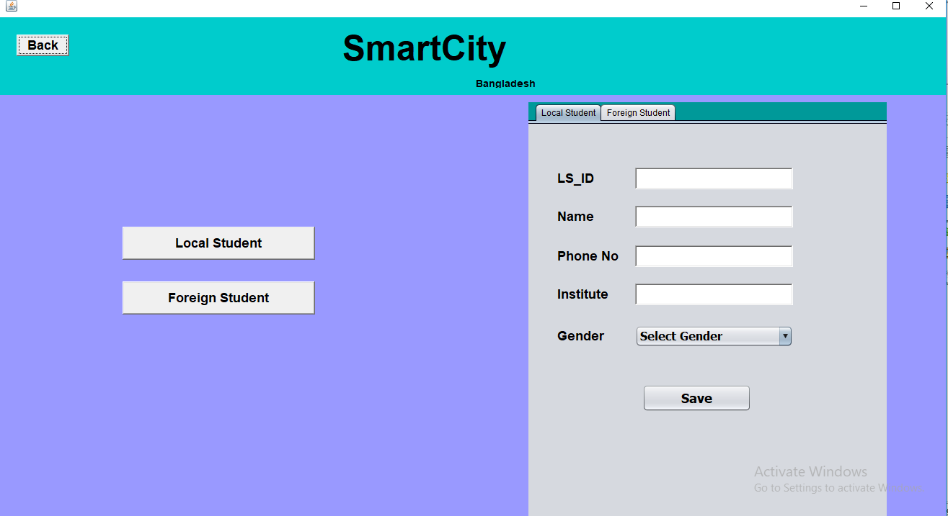

Slide 10
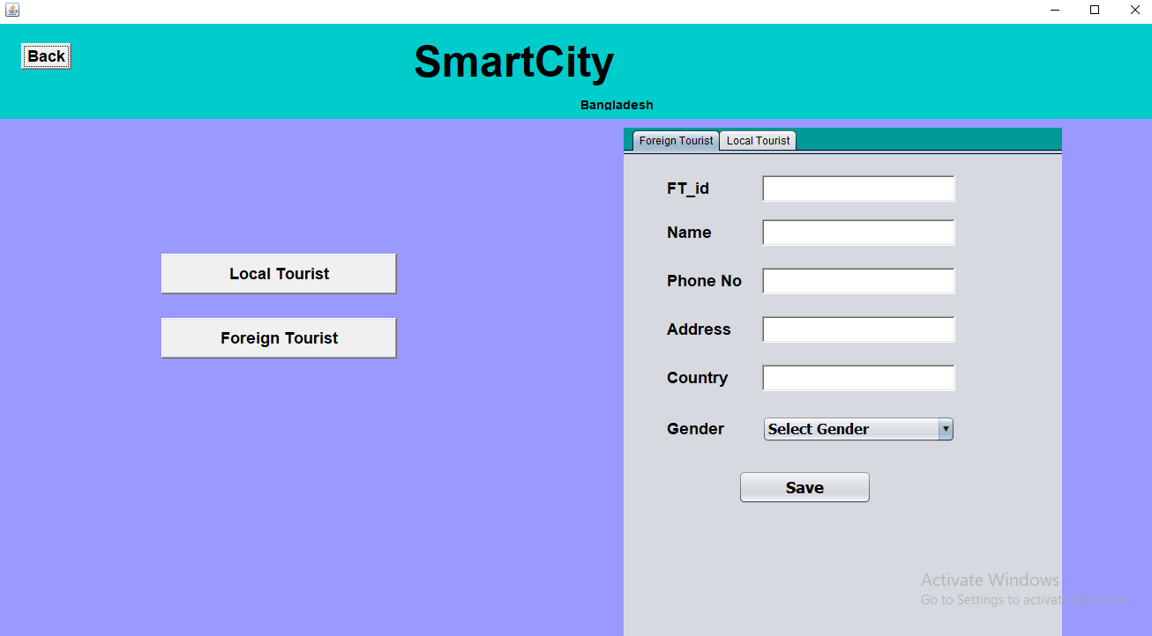

Slide 11
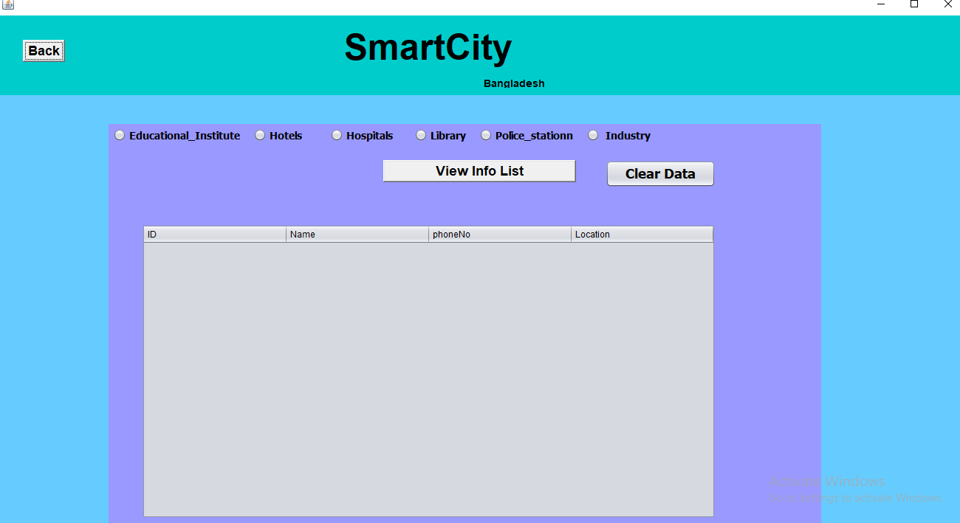

Slide 12
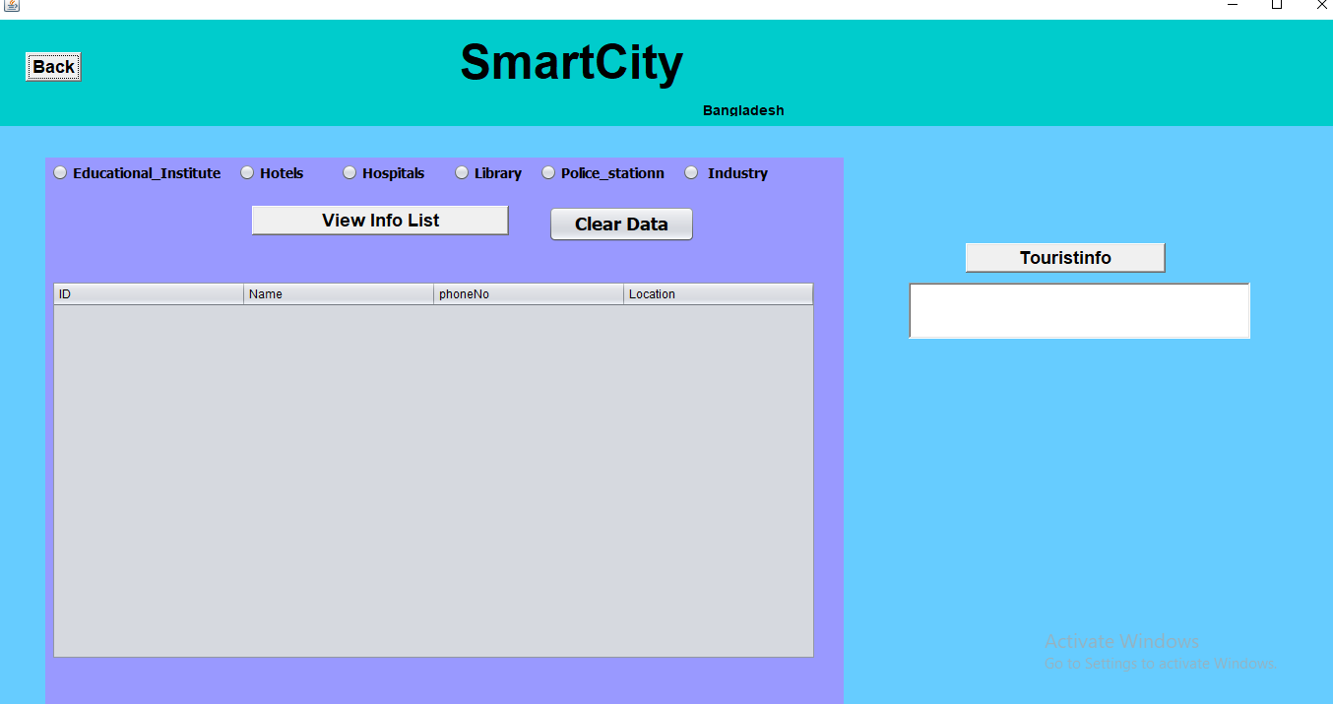

Slide 13
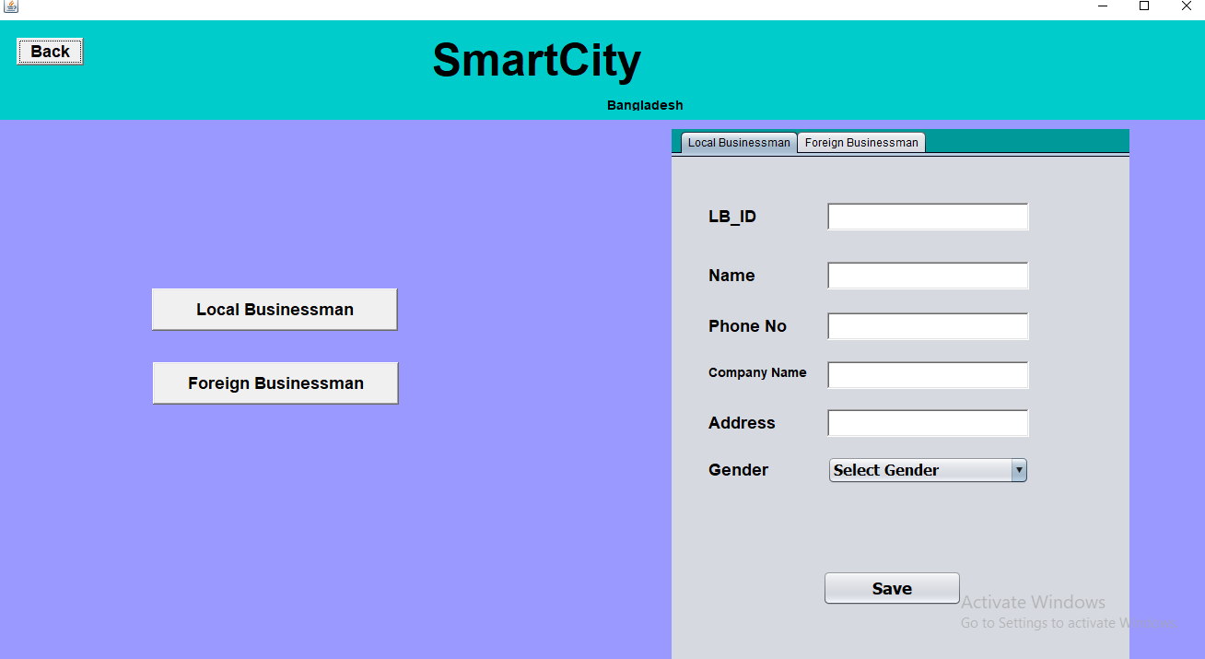

Slide 14
Thank you!

