Slide 1

Home task for position of Quality Lead
Aurelija Putramentaite

Slide 2
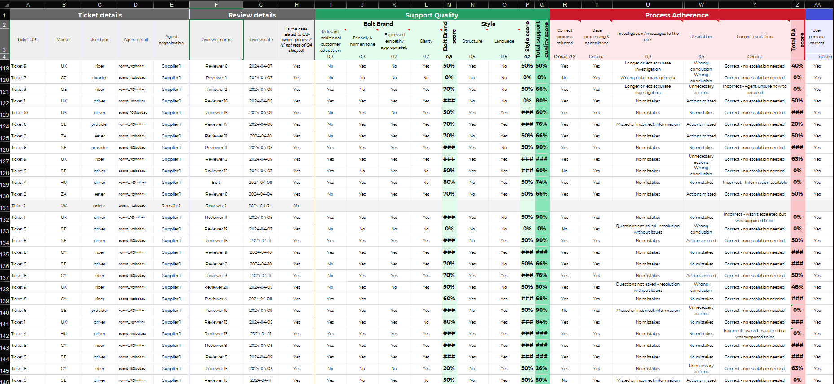
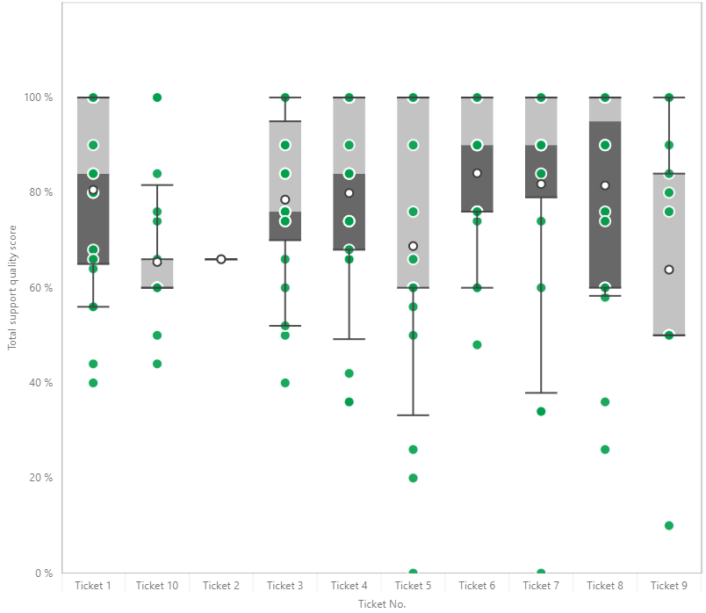
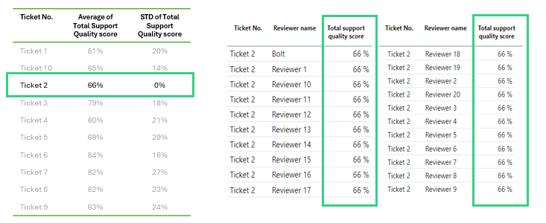

Approach of the task
Step 1: Context review
Step 2: Data overview
Step 3: Outliers deep dive
Step 4: Limitations & Action points
Review data
Understand general concept of the company’s processes
Data visualization
Applying statistical analysis to identify the outliers
Analysis of outliers (deep dive into the identified outliers)
Address limitations
propose actionable recommendations

Slide 3
Step 1: Context review | General approach, goal of the task and questions needed to answer
Bolt provides mobility services to its customers. Customer support services for Bolt are provided by external companies (suppliers), whose employees (agents) address important questions/issues for customers. Within Bolt, there is an internal group called Supplier Quality (reviewers), whose responsibility is to conduct periodic evaluations of agents based on feedback left by customers. Upon identifying significant discrepancies between previous and current evaluations, a calibration session with the reviewer is conducted, followed by an investigation to identify the root causes of discrepancies.
Questions:
Which of the reviewers would you consider outlier(s)? Provide reasoning for your answer.
If you could only select 2 tickets for calibration with the supplier, which ones would it be and why?
Based on the context provided below, are there any more data points you find needed to do this exercise? Any actions you would take aside from gathering the ratings from reviewers?
Goal:
To ensure consistency and alignment in the evaluation of agents and to improve customer satisfaction and service quality.

Slide 4
Step 1: Context review | Vocabulary
Supplier : external company which provides customer support (CS) service
Ticket : set of reviews of a specific agent
Agent : CS specialist (external)
Reviewer : internal Bolt QA person who is responsible for evaluation of agent‘s performance
Calibration : process of aligning and standardizing the evaluations of agents between different reviewers

Slide 5
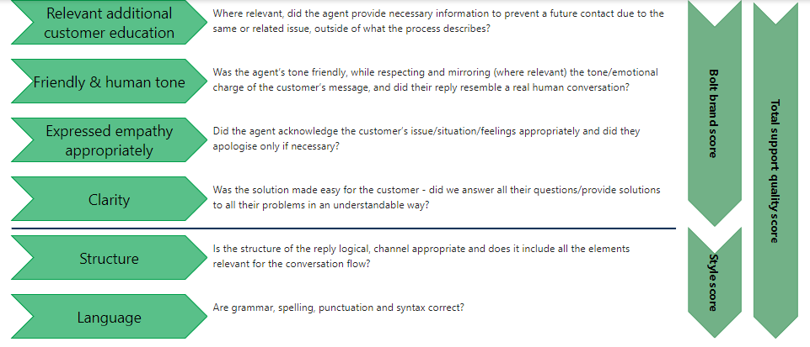
Step 1. Context review | Total Q score is derived from 2 elements: Bolt Brand Score (0.8 weight) and Style score (0.2 weight)
0.3
0.3
0.2
0.2
0.8
0.5
0.5
0.2

Slide 6
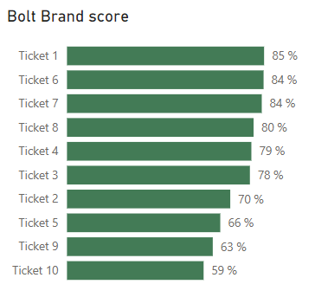
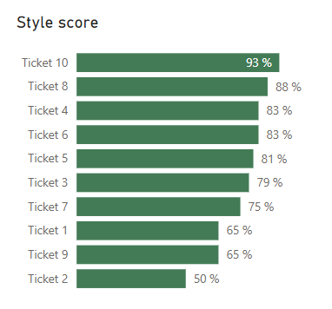
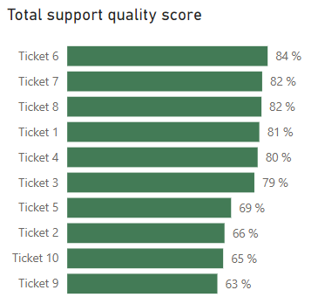
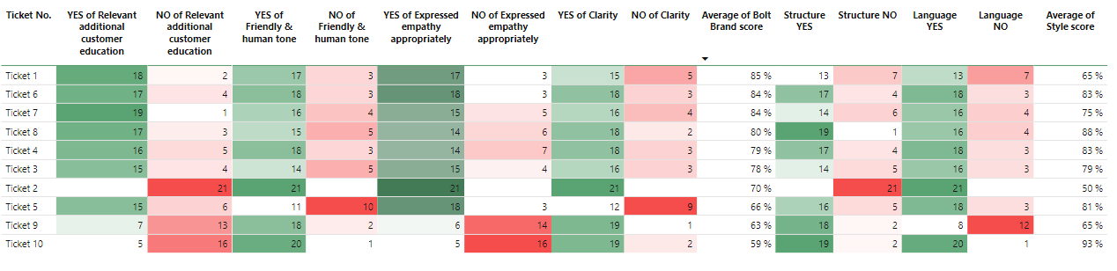
Step 2. Data overview | Based on initial data overview, Tickets 5, 2, 9 and 10 seem to be the concerning ones
weight
0.8
weight
0.2
INITIAL INSIGHTS
Tickets 5, 2, 9, and 10 show total support quality scores below the 70% threshold, with a relatively low Brand Bolt score.
All mentioned tickets feature a significant number of negative ratings across multiple evaluation elements, suggesting the need for a deeper analysis.

Slide 7
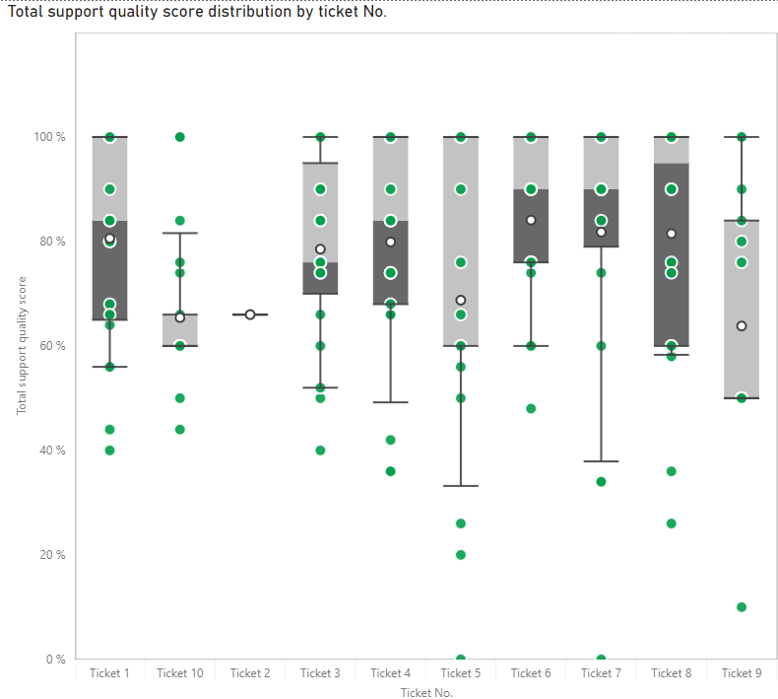
Step 2. Data overview | boxplot charts were used to reveal outliers of each ticket by using standard deviation (STD)
Ticket No. | Average of Total Support Quality score | STD of Total Support Quality score
Ticket 1 | 81% | 20%
Ticket 10 | 65% | 14%
Ticket 2 | 66% | 0%
Ticket 3 | 79% | 18%
Ticket 4 | 80% | 21%
Ticket 5 | 69% | 29%
Ticket 6 | 84% | 16%
Ticket 7 | 82% | 27%
Ticket 8 | 82% | 23%
Ticket 9 | 63% | 24%
INITIAL INSIGHTS
Ticket 2 lacks data distribution and has a 0% STD.
Tickets 5 and 9 exhibit a relatively wide STD range and a total support quality score below 70%.
Although Ticket 7 has a relatively high total support quality score, its STD is notably wide.
All of these tickets are recommended for deeper analysis.
Notes:
The examination of the "Total Support Quality Score" column, representing the final score of supplier reviews, involved several steps. Initially, the average score for each review ticket was computed, followed by the calculation of the standard deviation (STD). The purpose of this analysis was to identify outliers within the dataset.
In determining outliers, the intention was to exclude points that significantly deviated from the established ranges based on STD. However, considering the relatively small size of the data sample per ticket, the decision was made to only discard those points that shows clear deviations from the average score.

Slide 8
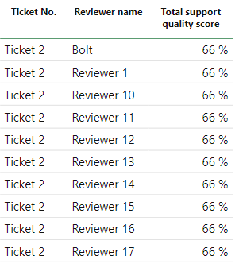
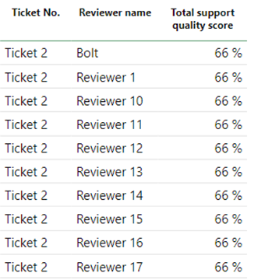
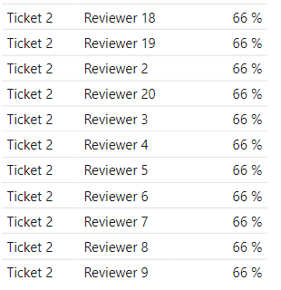
Step 3. Outliers deep dive | Ticket No. 2 indicates that there is no data distribution present as all data points are identical
Ticket No. | Average of Total Support Quality score | STD of Total Support Quality score
Ticket 1 | 81% | 20%
Ticket 10 | 65% | 14%
Ticket 2 | 66% | 0%
Ticket 3 | 79% | 18%
Ticket 4 | 80% | 21%
Ticket 5 | 69% | 29%
Ticket 6 | 84% | 16%
Ticket 7 | 82% | 27%
Ticket 8 | 82% | 23%
Ticket 9 | 63% | 24%
INITIAL INSIGHTS
There are a total of 21 reviewers; however, all evaluations are identical.
Due to the identical ratings, there is no data distribution, resulting in an STD of 0.
Calibration is necessary for Ticket 2.

Slide 9
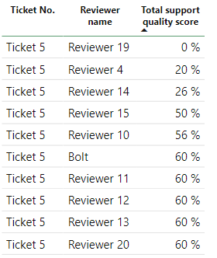
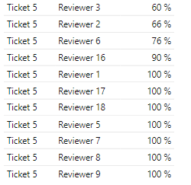
Step 3. Outliers deep dive | Ticket No. 5 exhibit a relatively wide STD range, and a Total support quality score is below 70%
Ticket No. | Average of Total Support Quality score | STD of Total Support Quality score
Ticket 1 | 81% | 20%
Ticket 10 | 65% | 14%
Ticket 2 | 66% | 0%
Ticket 3 | 79% | 18%
Ticket 4 | 80% | 21%
Ticket 5 | 69% | 29%
Ticket 6 | 84% | 16%
Ticket 7 | 82% | 27%
Ticket 8 | 82% | 23%
Ticket 9 | 63% | 24%
INITIAL INSIGHTS
The STD is 29, as the Total support quality score ratings fluctuate from 0% to 100%.
Evaluating this agent's "Friendly & Human tone" element, there are quite a few negative ratings, similar to the "Clarity" element.
It is recommended to conduct a more detailed investigation and implement corrective actions.
Recommendation is to perform calibration

Slide 10
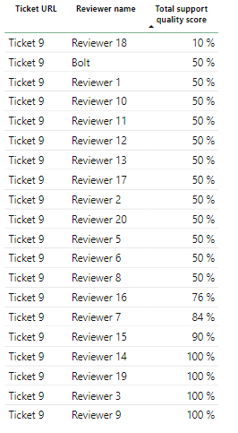
Step 3. Outliers deep dive | Ticket No. 9 exhibit a relatively wide STD range, and a Total support quality score is below 70%
Ticket No. | Average of Total Support Quality score | STD of Total Support Quality score
Ticket 1 | 81% | 20%
Ticket 10 | 65% | 14%
Ticket 2 | 66% | 0%
Ticket 3 | 79% | 18%
Ticket 4 | 80% | 21%
Ticket 5 | 69% | 29%
Ticket 6 | 84% | 16%
Ticket 7 | 82% | 27%
Ticket 8 | 82% | 23%
Ticket 9 | 63% | 24%
INITIAL INSIGHTS
The STD is 24, indicating a relatively wide range
Upon evaluating each element of this agent, there are several negative ratings associated with empathy, language, and education
It is recommended to conduct a more detailed investigation and implement corrective actions.

Slide 11
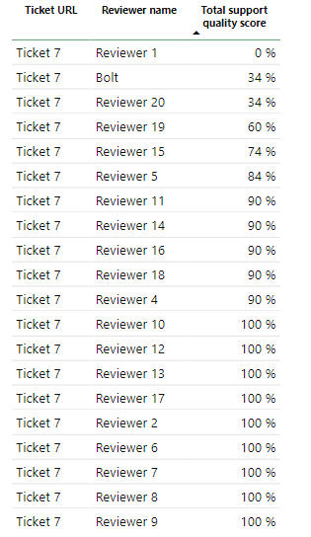
Step 3. Outliers deep dive | Ticket No. 7 has a relatively high total support quality score, its STD is notably wide
Ticket No. | Average of Total Support Quality score | STD of Total Support Quality score
Ticket 1 | 81% | 20%
Ticket 10 | 65% | 14%
Ticket 2 | 66% | 0%
Ticket 3 | 79% | 18%
Ticket 4 | 80% | 21%
Ticket 5 | 69% | 29%
Ticket 6 | 84% | 16%
Ticket 7 | 82% | 27%
Ticket 8 | 82% | 23%
Ticket 9 | 63% | 24%
INITIAL INSIGHTS
The STD is 27, signifying a relatively wide range, primarily due to several significantly low evaluations.

Slide 12
Step 3. Outliers deep dive | Ticket No. 10 STD not showing any abnormalities, but several elements are showing significant result of negative answers
Ticket No. | Average of Total Support Quality score | STD of Total Support Quality score
Ticket 1 | 81% | 20%
Ticket 10 | 65% | 14%
Ticket 2 | 66% | 0%
Ticket 3 | 79% | 18%
Ticket 4 | 80% | 21%
Ticket 5 | 69% | 29%
Ticket 6 | 84% | 16%
Ticket 7 | 82% | 27%
Ticket 8 | 82% | 23%
Ticket 9 | 63% | 24%
INITIAL INSIGHTS
Deep dive analysis reveals discrepancies that could impact overall service quality and customer satisfaction due to increased negative evaluations in several elements.
The overall support quality score has fallen below the 70% threshold in most of the cases.
RECOMMENDATION:
To do an investigation find root cause analysis and implement corrective actions enhance service quality and mitigate potential risks.
Notes:
While the absence of abnormalities in Ticket No. 10 STD may seem reassuring, the prevalence of negative responses in various elements warrants attention.
Deep dive analysis reveals discrepancies that could impact overall service quality and customer satisfaction.

Slide 13
Step 4: Limitations & Action points | Total
Review and analyse historical data of each agent

Slide 14




Automated solution approach | Dashboard for any future calibrations
Automated data input
Data integration directly from the supplier data base
Automated outliers' identification
Default template for outliers' identification
Data output
Outliers' identification and deep dive / recommended actions

