Slide 1
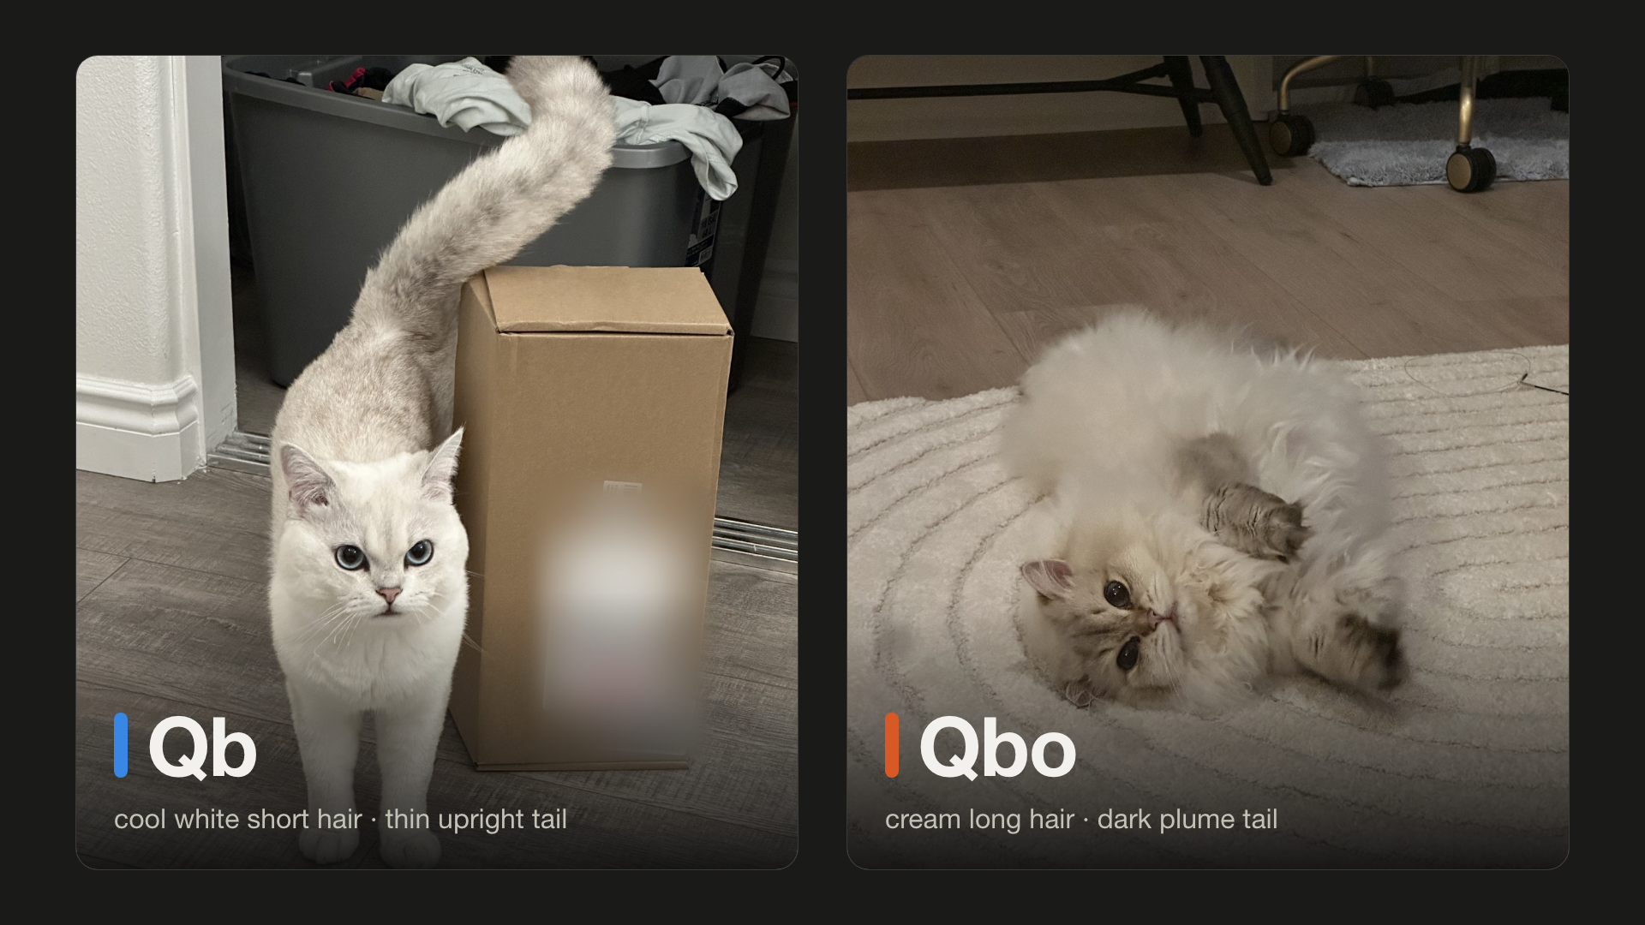
Notes:
Beat 1 · My pain point
VO: These are Qb and Qbo. My camera can't tell them apart.

Slide 2
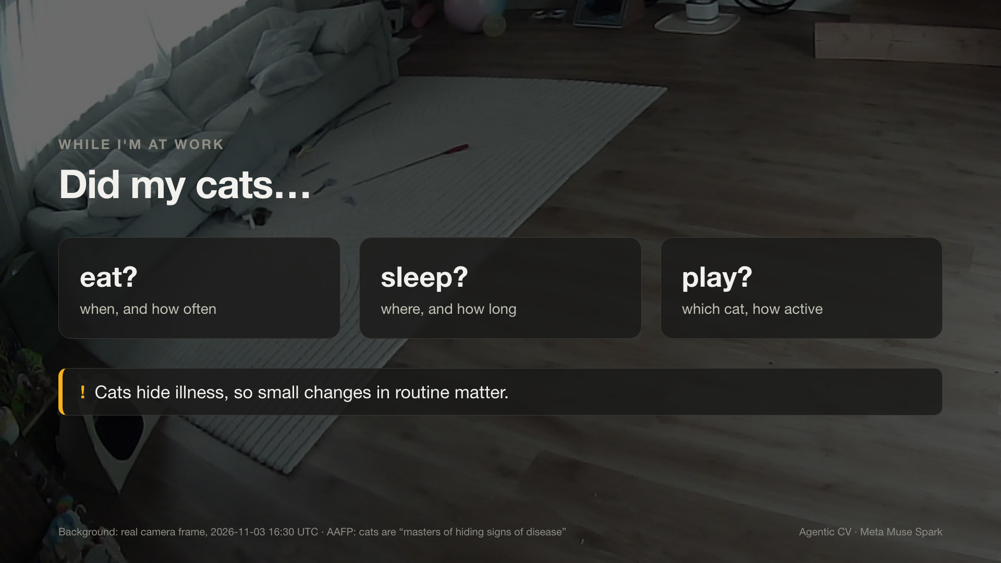
Notes:
Beat 2 · My pain point
VO: I work all day. I just want to know simple things: did my cats eat, sleep, play? Cats hide illness, so small changes matter.
Source: Background: real camera frame, 2026-11-03 16:30 UTC · AAFP: cats are “masters of hiding signs of disease”

Slide 3
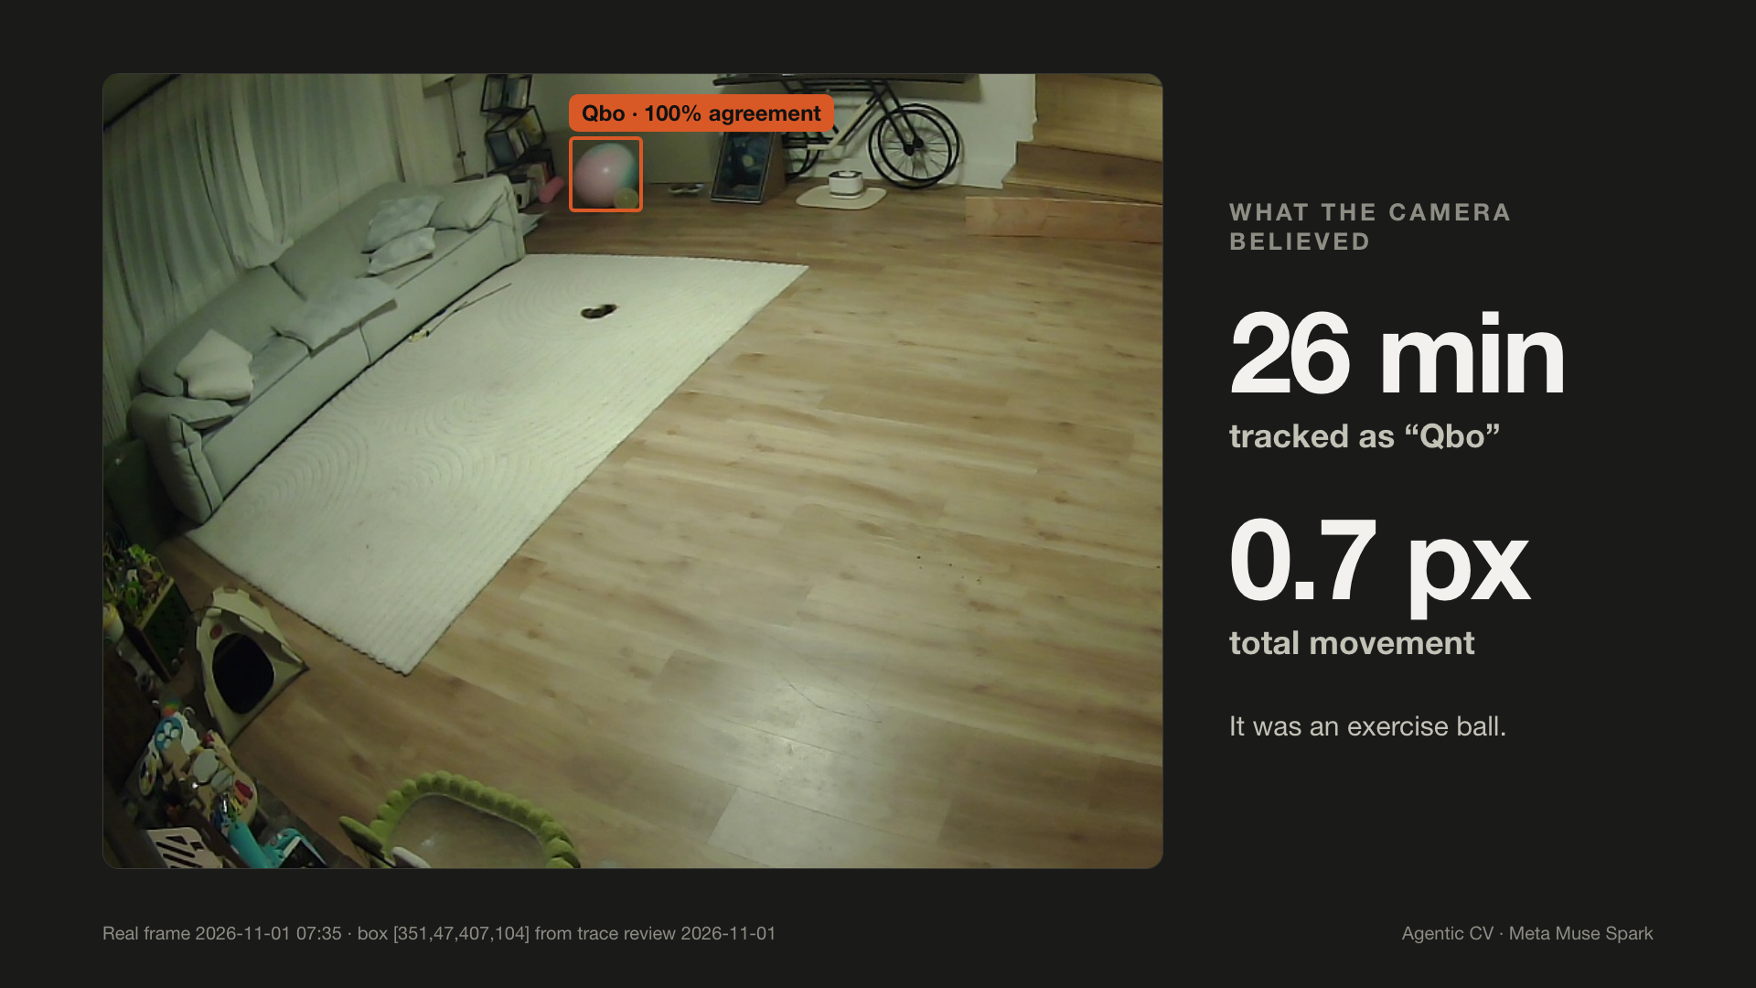
Notes:
Beat 3 · The technical barrier
VO: Last week, it decided this ball was Qbo, for twenty-six minutes.
Source: Real frame 2026-11-01 07:35 · box [351,47,407,104] from trace review 2026-11-01

Slide 4
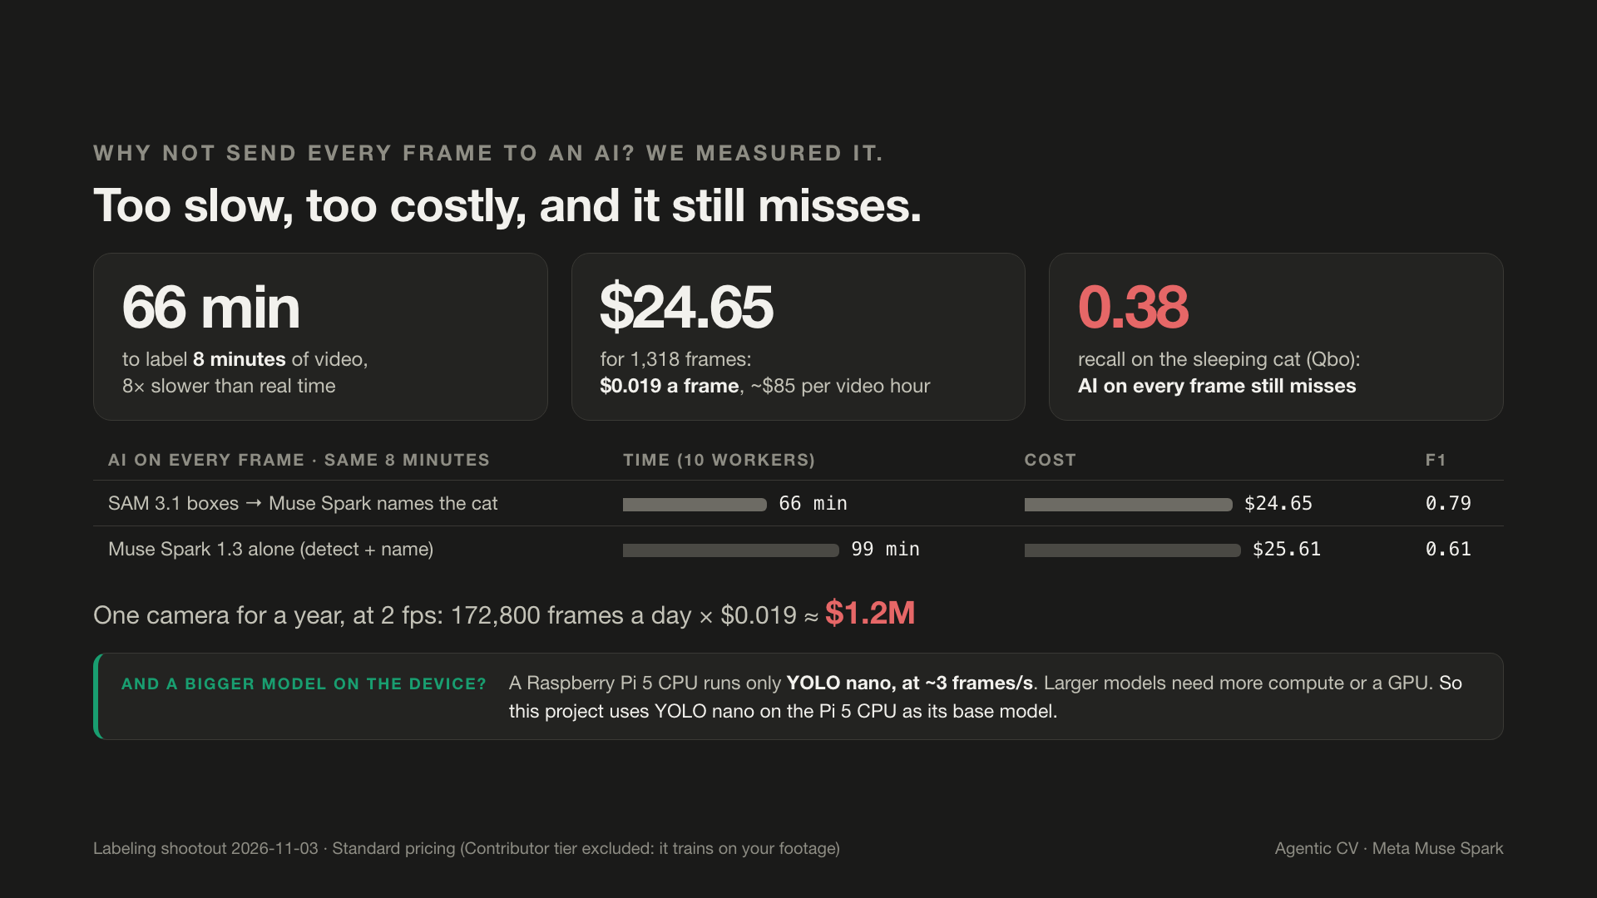
Notes:
Beat 4 · The technical barrier
VO: Why not send every frame to an AI? We tried: eight minutes of video took over an hour and twenty-five dollars, and it still missed a cat.
Source: Labeling shootout 2026-11-03 · Standard pricing (Contributor tier excluded: it trains on your footage)

Slide 5
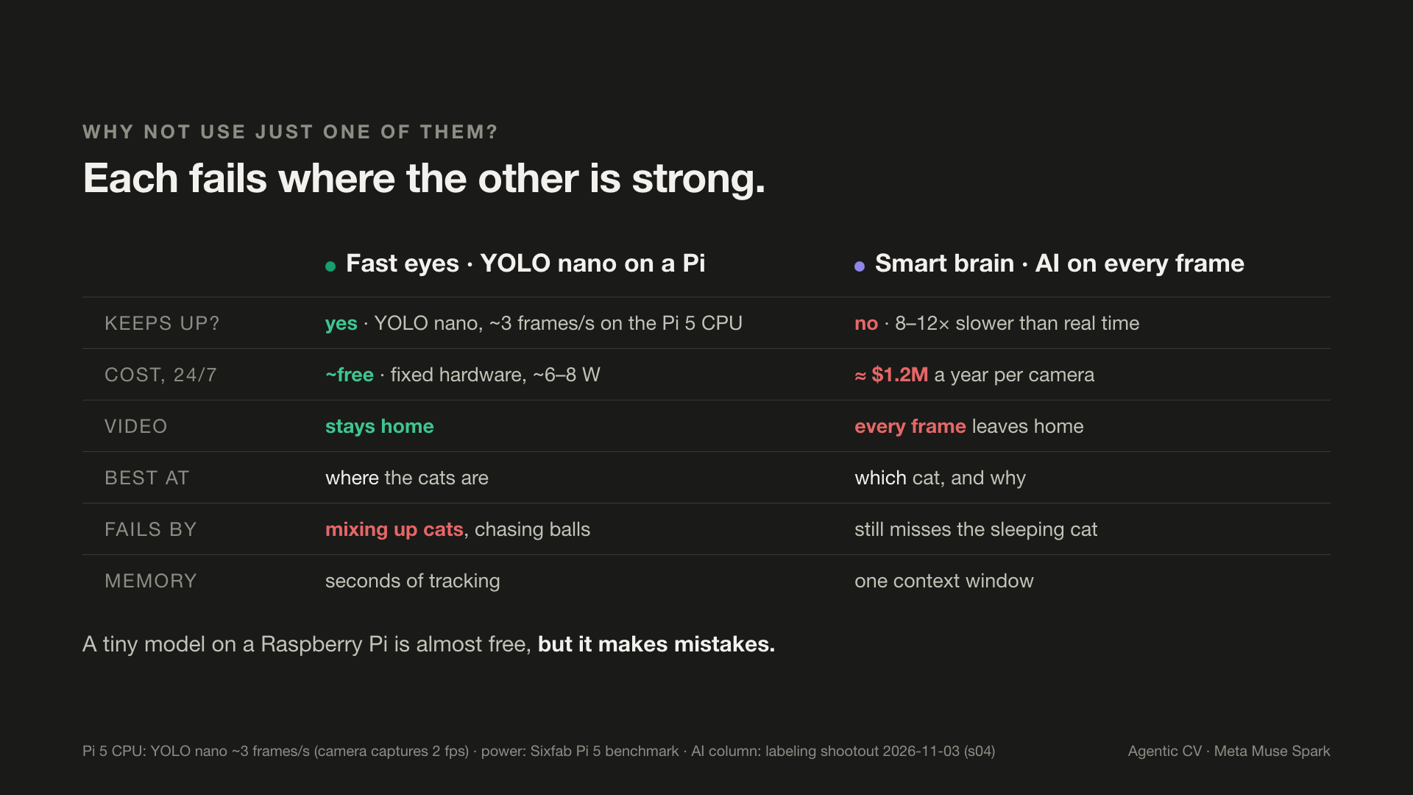
Notes:
Beat 5 · The technical barrier
VO: We built this for small, local hardware that keeps video private. A tiny model on a Raspberry Pi is almost free, but it makes mistakes.
Source: Pi 5 CPU: YOLO nano ~3 frames/s (camera captures 2 fps) · power: Sixfab Pi 5 benchmark · AI column: labeling shootout 2026-11-03 (s04)

Slide 6
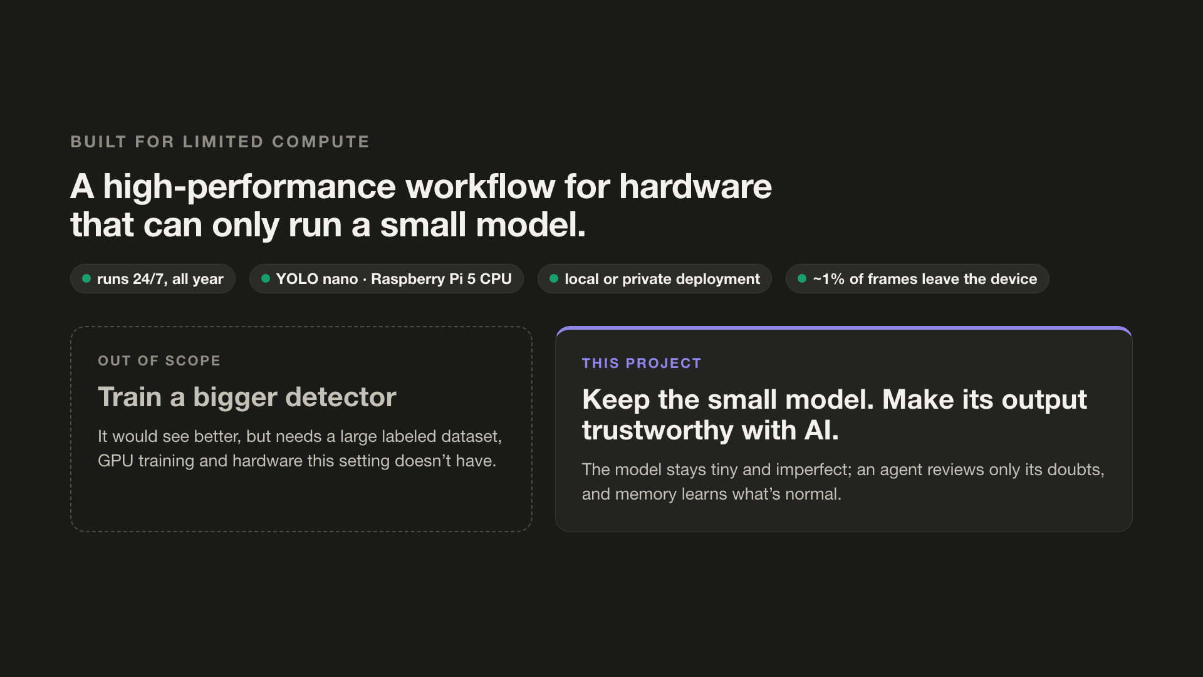
Notes:
Beat 6 · What we built
VO: A bigger, retrained model would see better, but that's out of scope. We keep the small model and make it smarter with AI. So we built both.

Slide 7
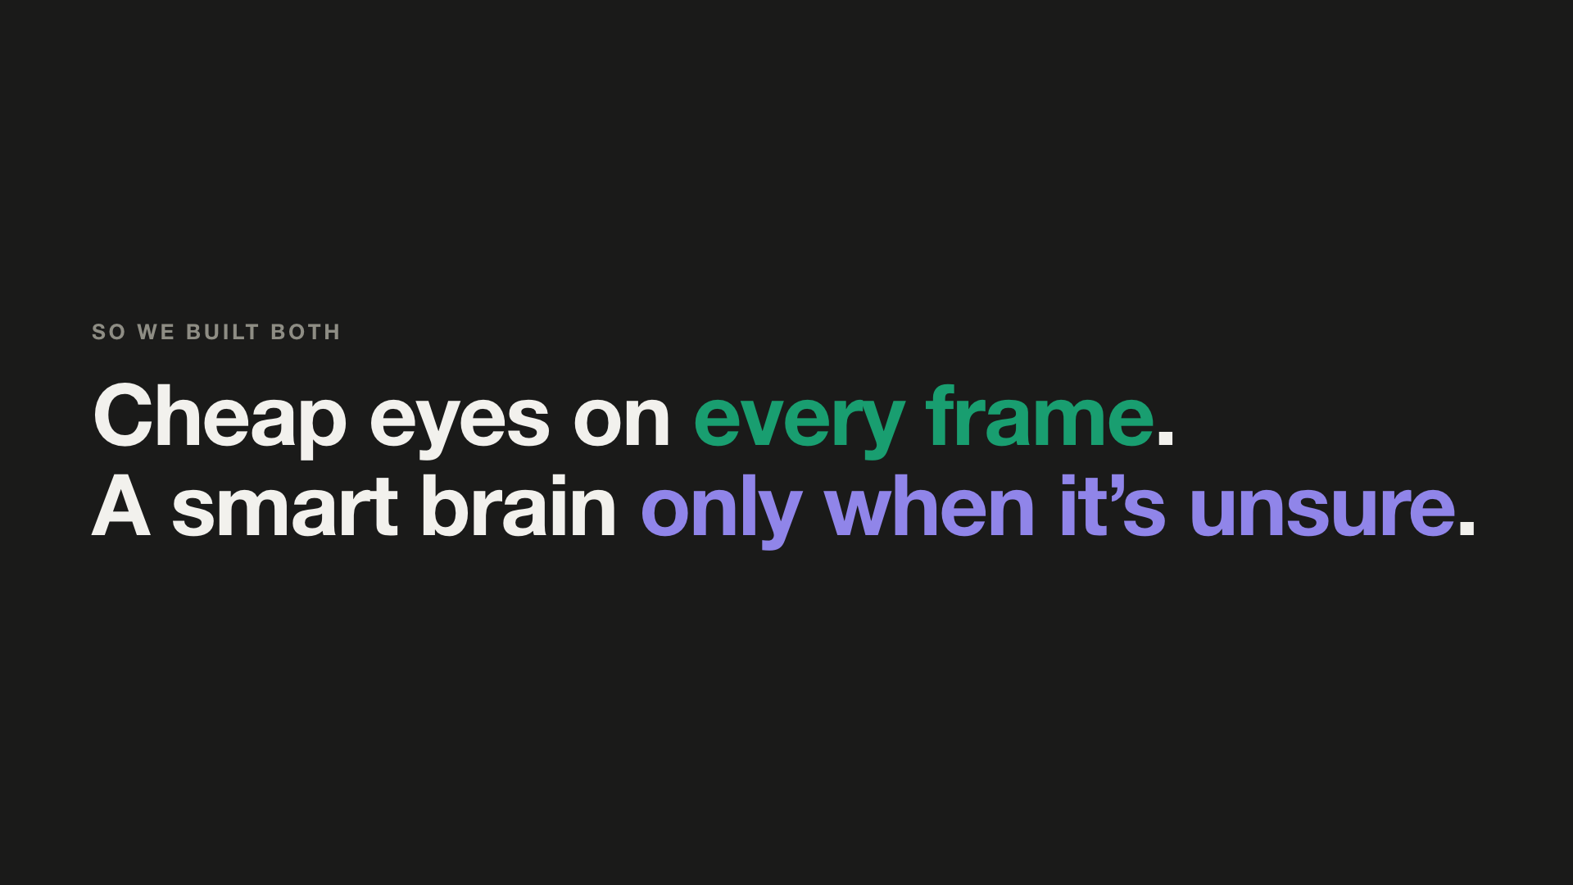
Notes:
Beat 6 · What we built
VO: (narration continues from the previous slide)

Slide 8
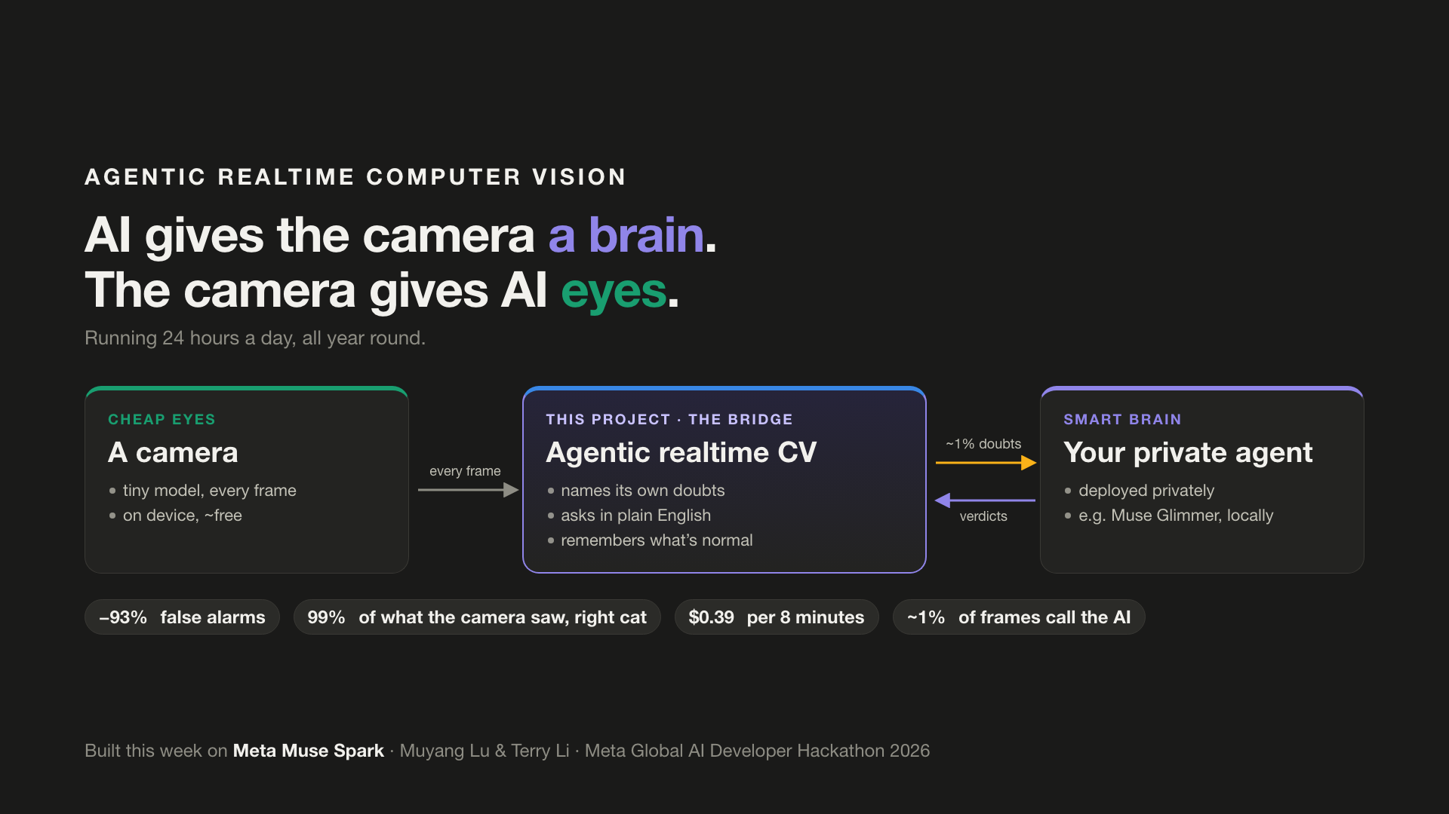
Notes:
Beat 7 · What we built
VO: Agentic realtime computer vision: the AI gives the camera a brain, and the camera gives the AI eyes.

Slide 9
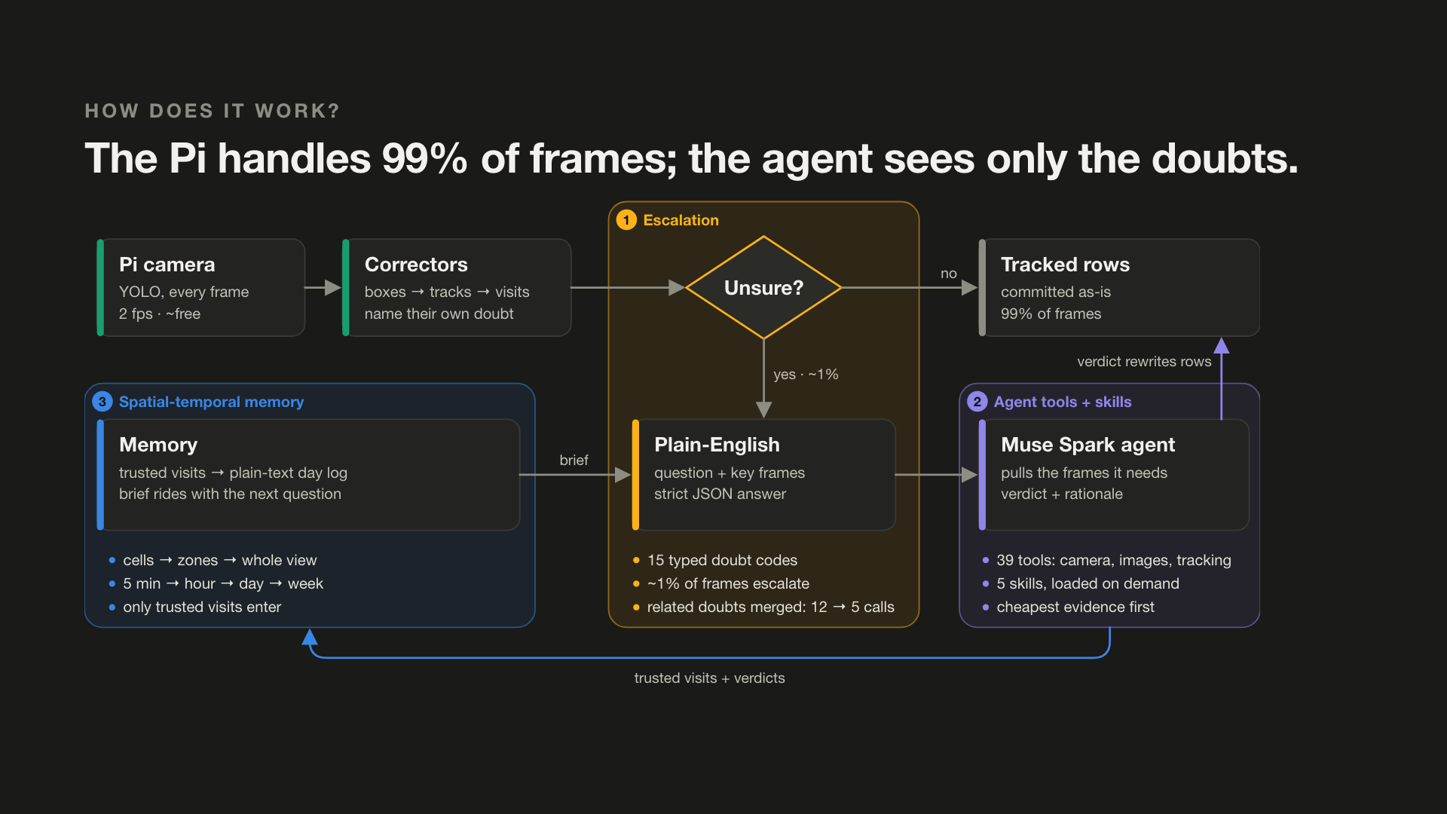
Notes:
Beat 8 · Architecture
VO: Here's how it works. The Pi watches every frame. Our bridge names its doubts, asks Muse Spark only about those, and remembers what's normal.

Slide 10
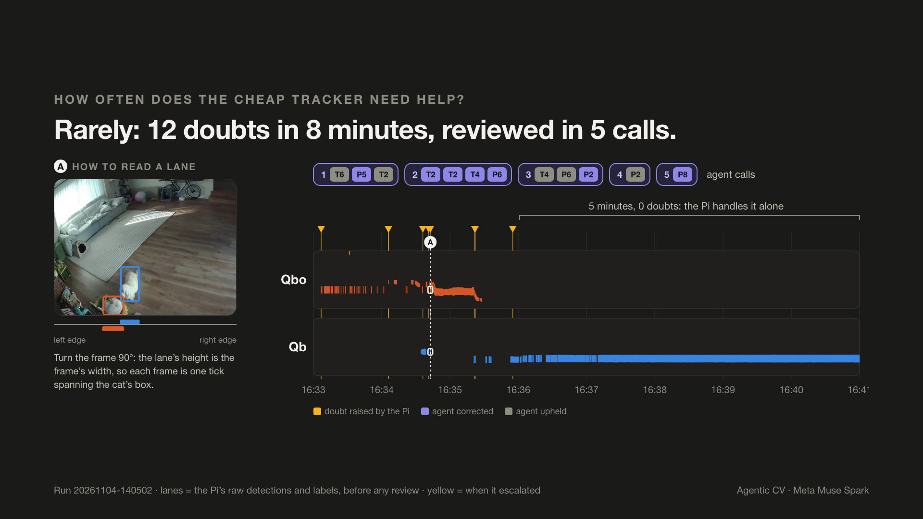
Notes:
Beat 9 · How it works: escalation
VO: The Pi watches every frame. When it's unsure, it says exactly why.
Source: Run 20261104-140502 · lanes = the Pi’s raw detections and labels, before any review · yellow = when it escalated

Slide 11
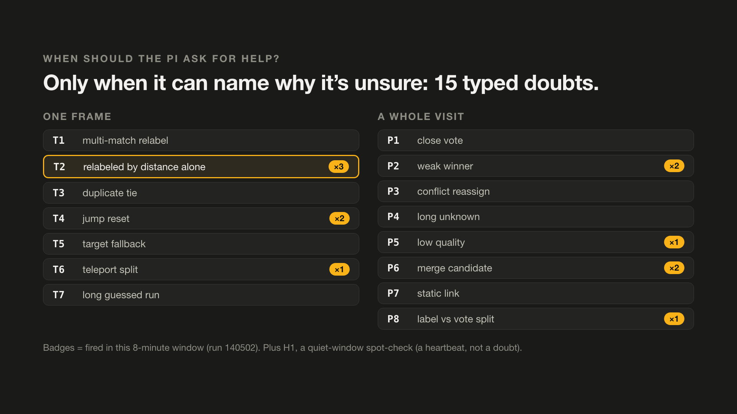
Notes:
Beat 10 · How it works: escalation
VO: It knows fifteen kinds of doubt, like: I relabeled this cat by distance alone.

Slide 12
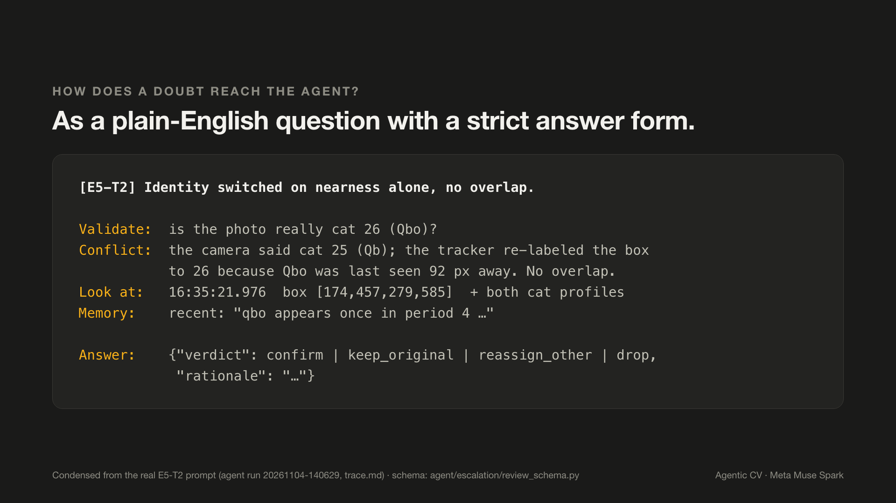
Notes:
Beat 11 · How it works: escalation
VO: That doubt becomes a plain-English question for Meta's Muse Spark.
Source: Condensed from the real E5-T2 prompt (agent run 20261104-140629, trace.md) · schema: agent/escalation/review_schema.py

Slide 13
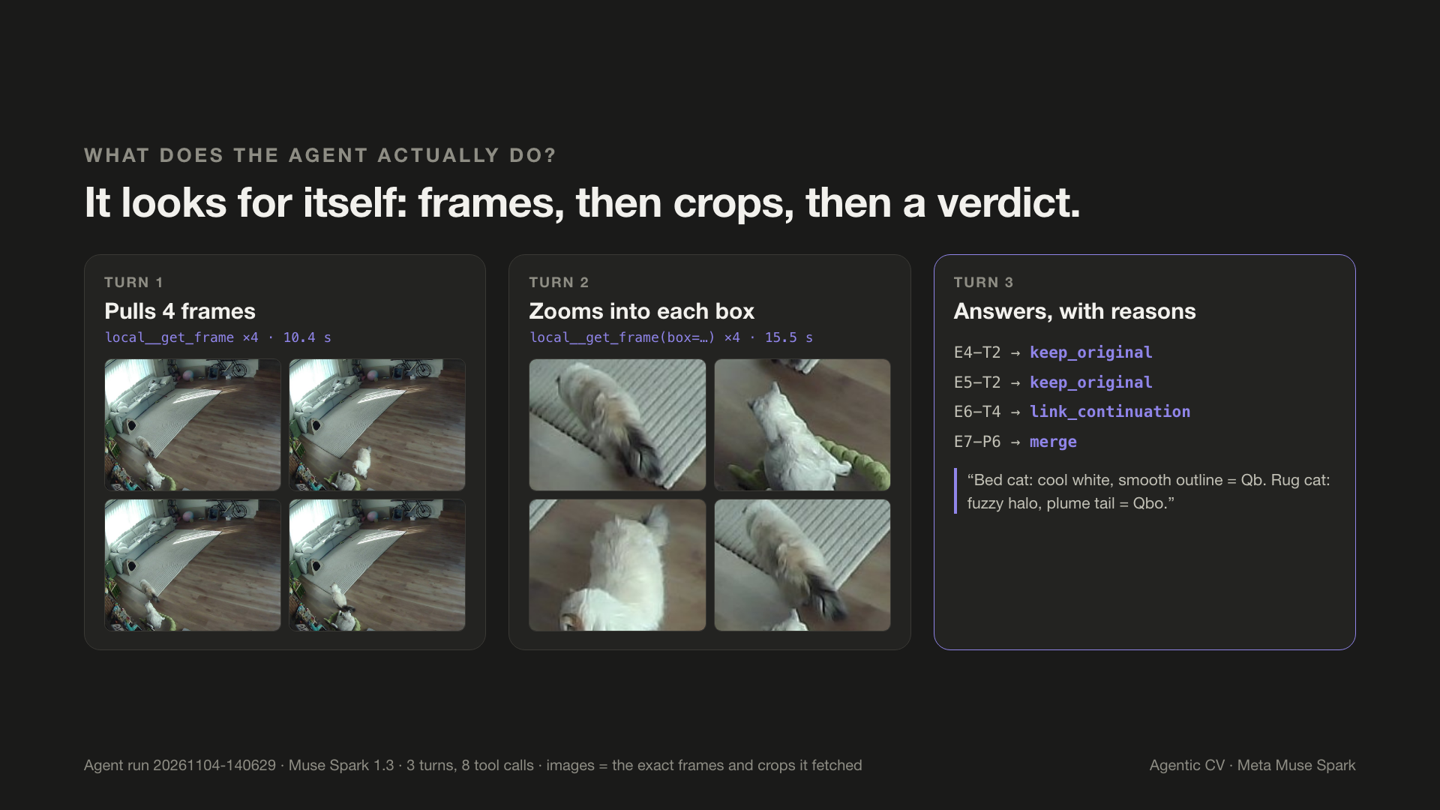
Notes:
Beat 12 · How it works: the agent
VO: The agent pulls the frames it needs, compares the cats, and answers with a reason.
Source: Agent run 20261104-140629 · Muse Spark 1.3 · 3 turns, 8 tool calls · images = the exact frames and crops it fetched

Slide 14
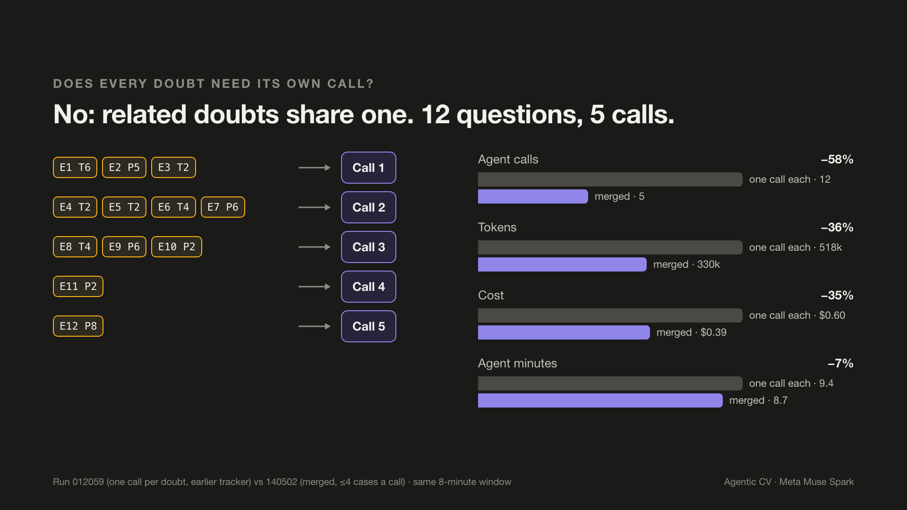
Notes:
Beat 13 · How it works: the agent
VO: Related doubts get reviewed together, in one call. Twelve questions, five calls.
Source: Run 012059 (one call per doubt, earlier tracker) vs 140502 (merged, ≤4 cases a call) · same 8-minute window

Slide 15
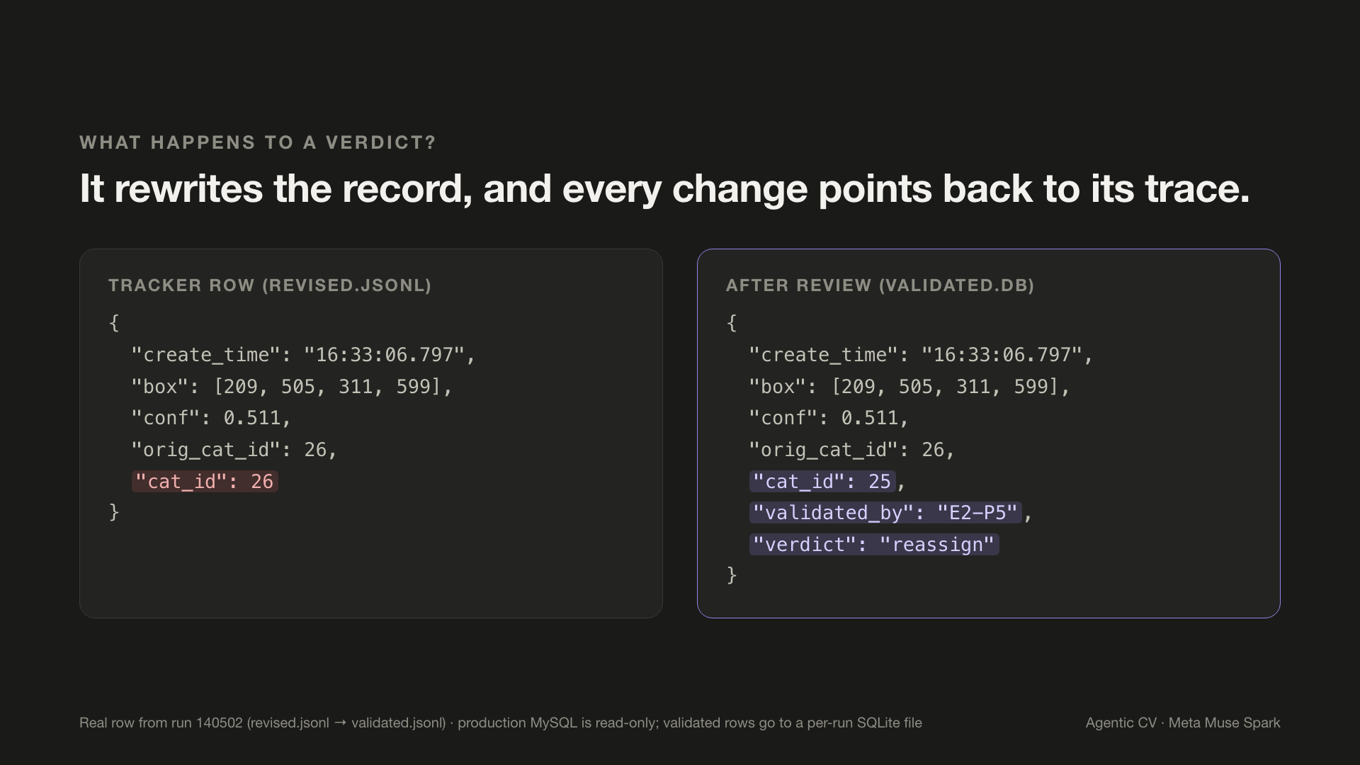
Notes:
Beat 14 · How it works: the agent
VO: Every verdict rewrites the record, and every change is traceable.
Source: Real row from run 140502 (revised.jsonl → validated.jsonl) · production MySQL is read-only; validated rows go to a per-run SQLite file

Slide 16
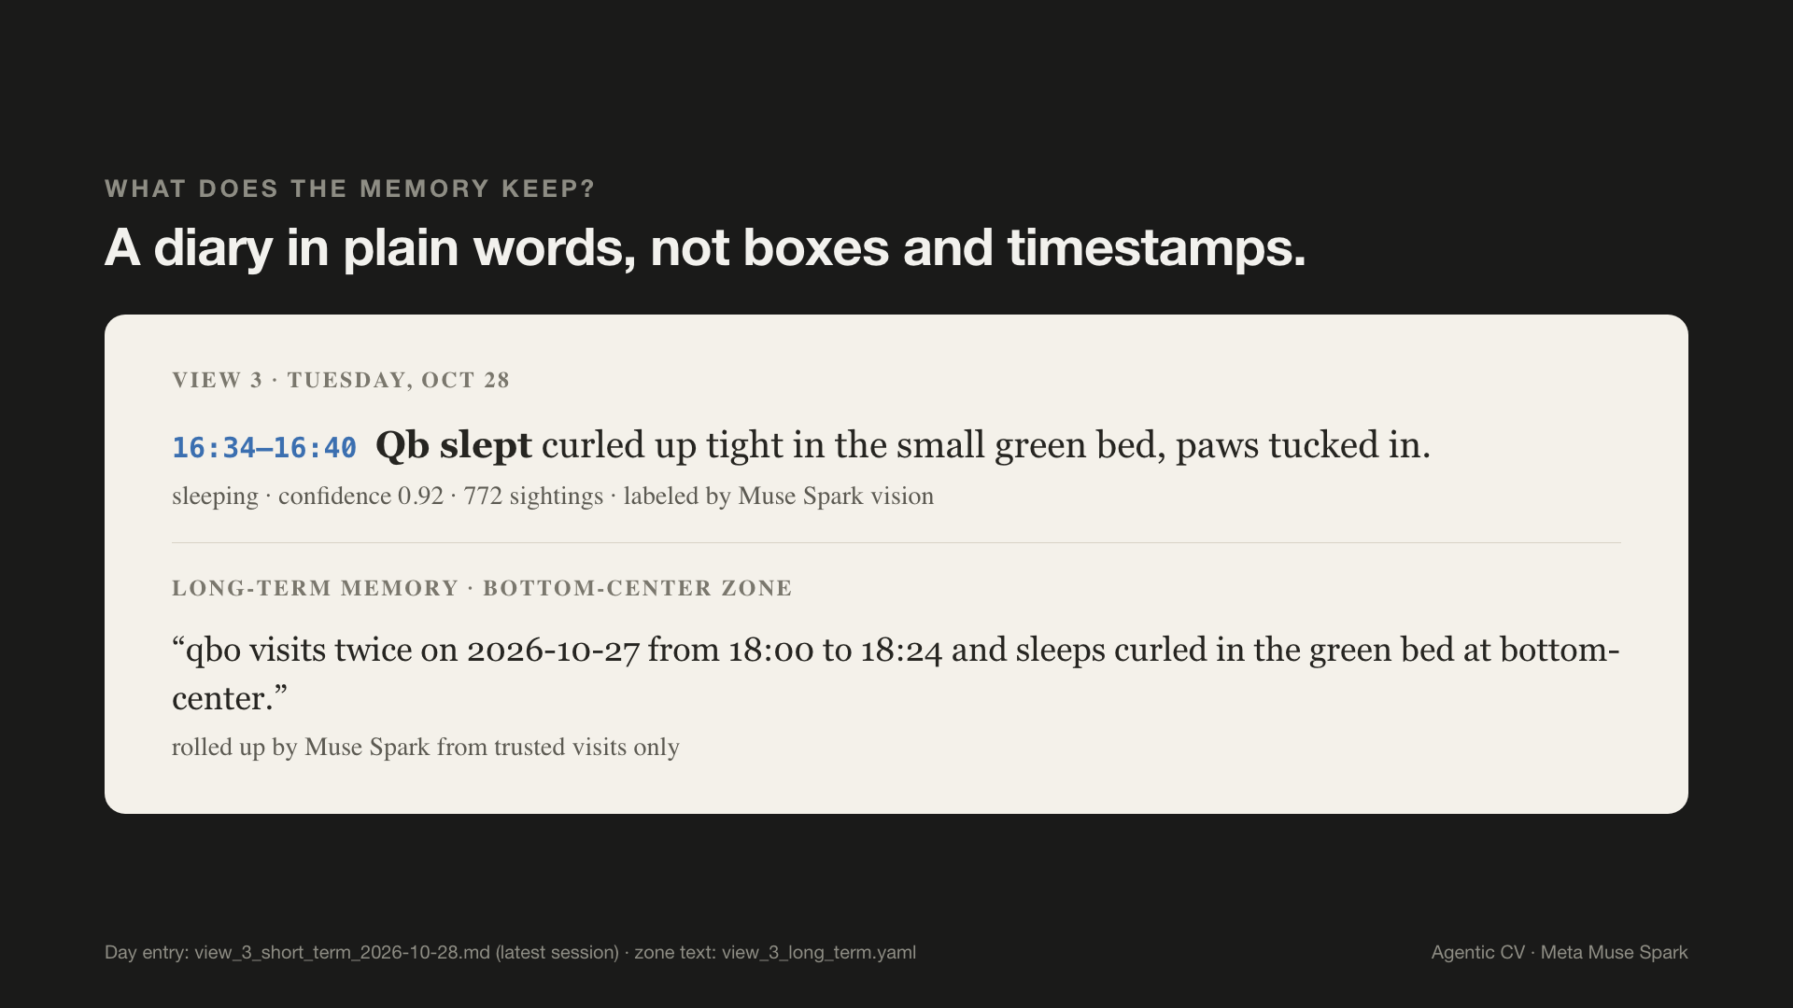
Notes:
Beat 15 · How it works: memory
VO: Then memory. Not boxes and timestamps, but a diary: Qb slept in the green bed, four thirty-four to four forty.
Source: Day entry: view_3_short_term_2026-10-28.md (latest session) · zone text: view_3_long_term.yaml

Slide 17
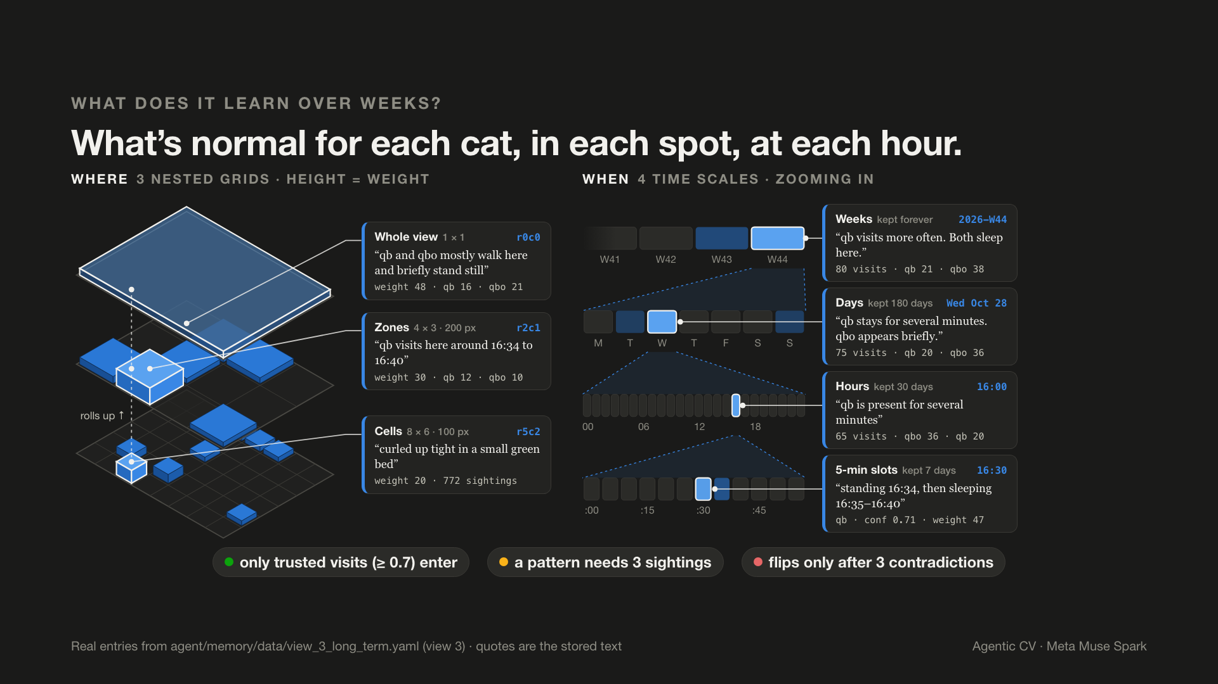
Notes:
Beat 16 · How it works: memory
VO: Over weeks, it learns what normal looks like for each cat, in each spot.
Source: Real entries from agent/memory/data/view_3_long_term.yaml (view 3) · quotes are the stored text

Slide 18
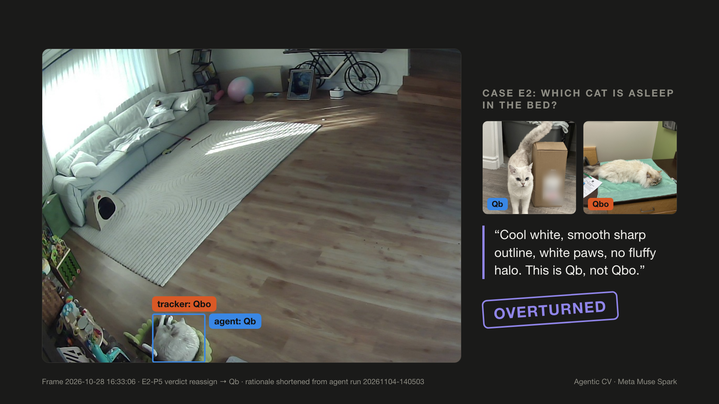
Notes:
Beat 17 · Evaluation
VO: Does it work? Cool white, smooth outline, white paws: Qb, not Qbo. Overturned.
Source: Frame 2026-10-28 16:33:06 · E2-P5 verdict reassign → Qb · rationale shortened from agent run 20261104-140503

Slide 19
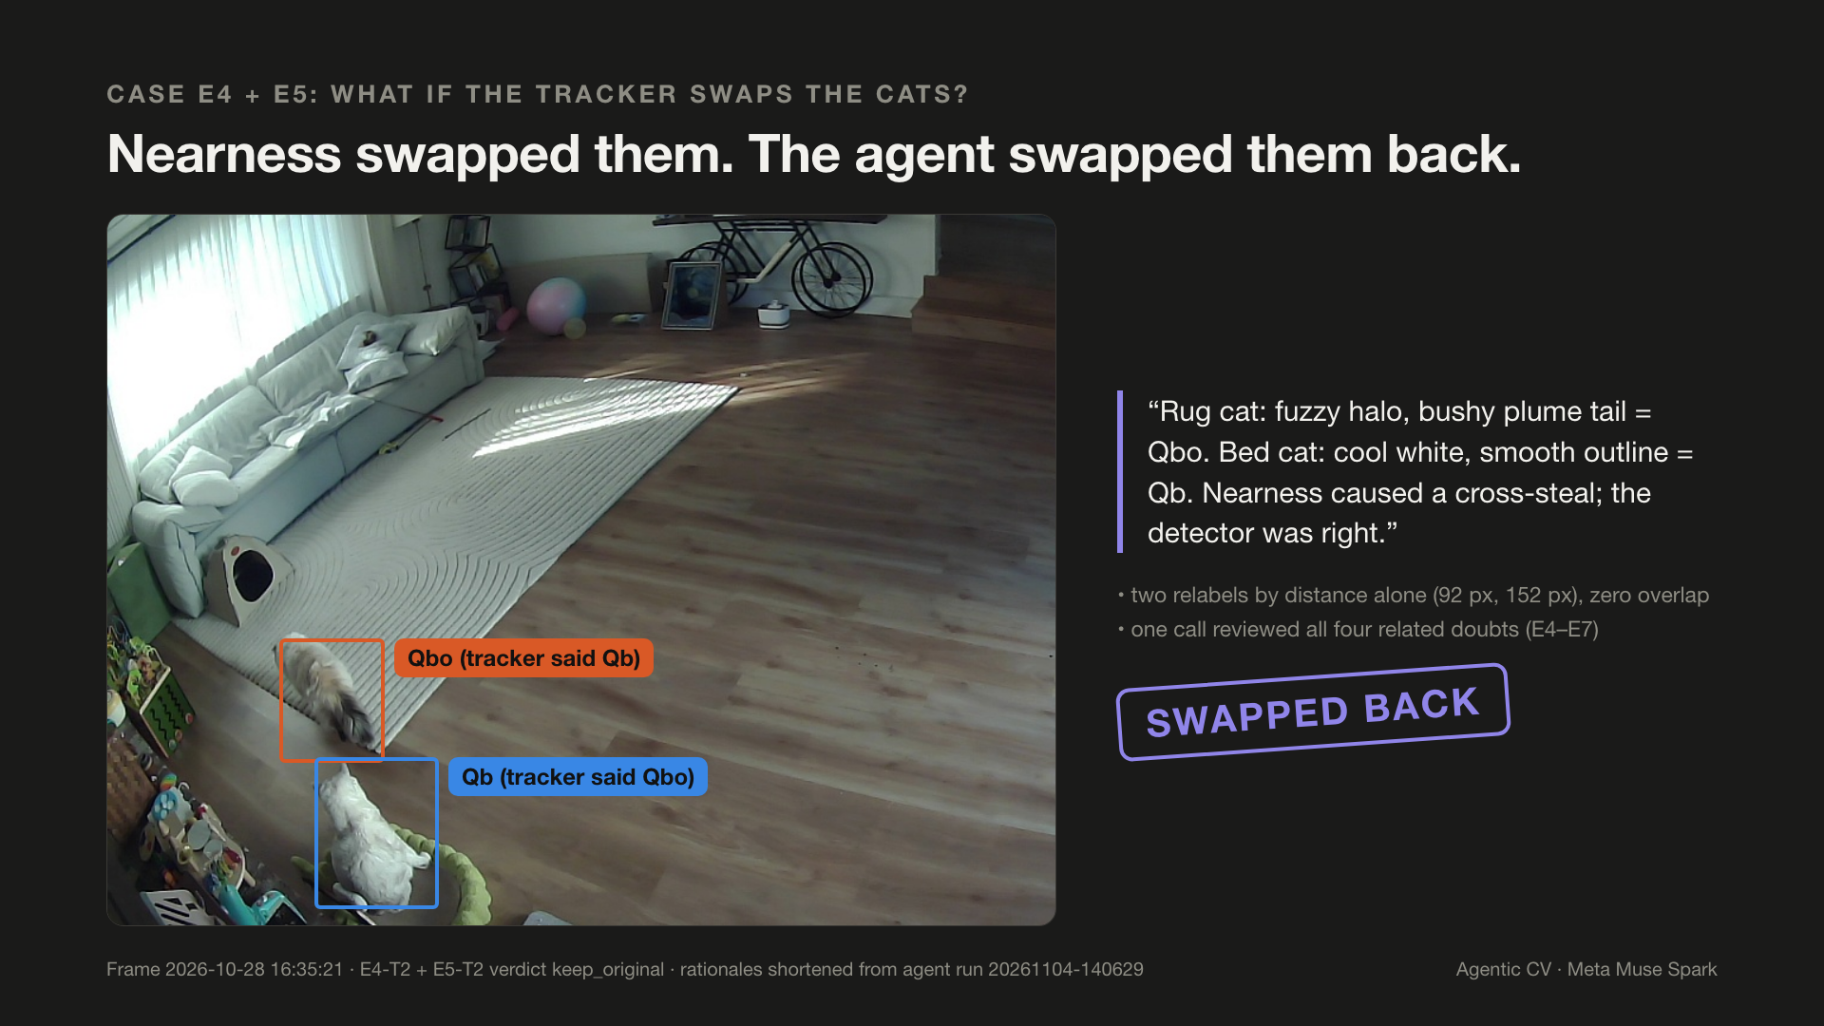
Notes:
Beat 18 · Evaluation
VO: Here, nearness made the tracker swap the two cats. The agent checked both, and swapped them back.
Source: Frame 2026-10-28 16:35:21 · E4-T2 + E5-T2 verdict keep_original · rationales shortened from agent run 20261104-140629

Slide 20
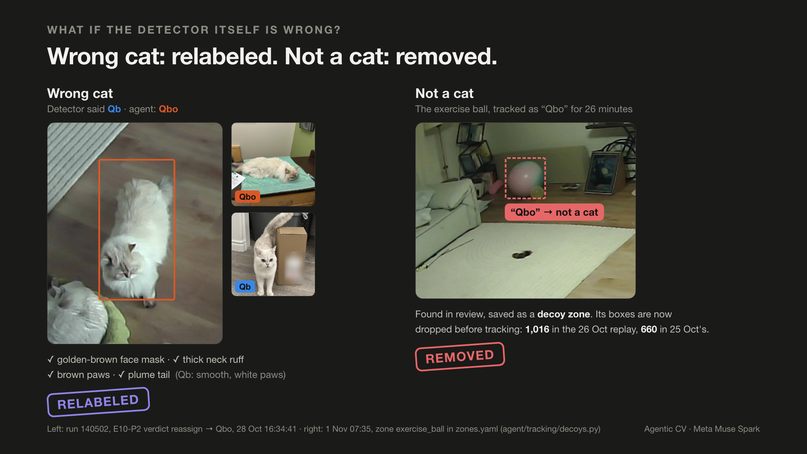
Notes:
Beat 19 · Evaluation
VO: If the detector is wrong, the cat is relabeled, and the ball becomes a decoy.
Source: Left: run 140502, E10-P2 verdict reassign → Qbo, 28 Oct 16:34:41 · right: 1 Nov 07:35, zone exercise_ball in zones.yaml (agent/tracking/decoys.py)

Slide 21
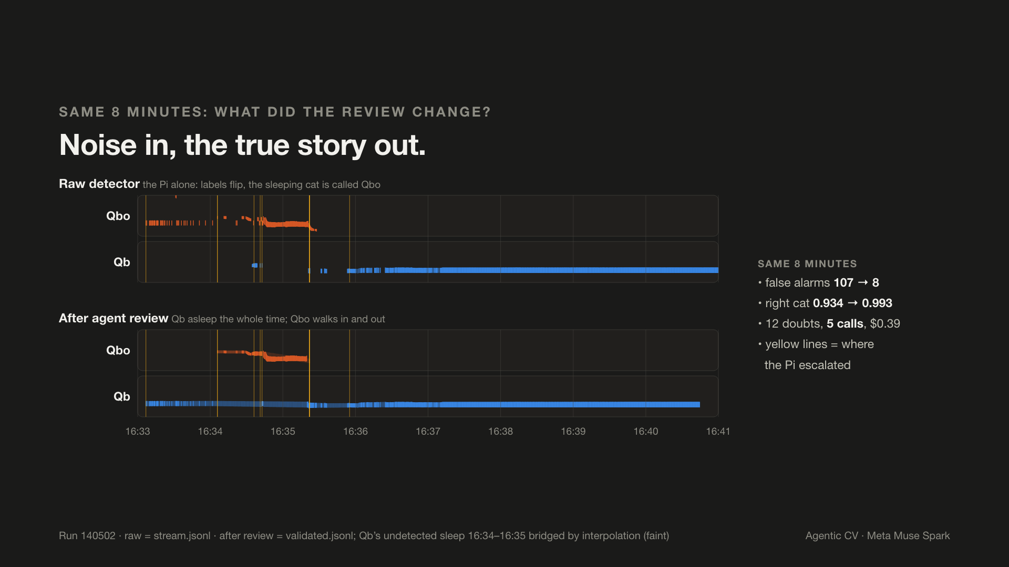
Notes:
Beat 20 · Evaluation
VO: Before and after, same eight minutes: Qb slept the whole time, and Qbo walked in and out.
Source: Run 140502 · raw = stream.jsonl · after review = validated.jsonl; Qb’s undetected sleep 16:34–16:35 bridged by interpolation (faint)

Slide 22
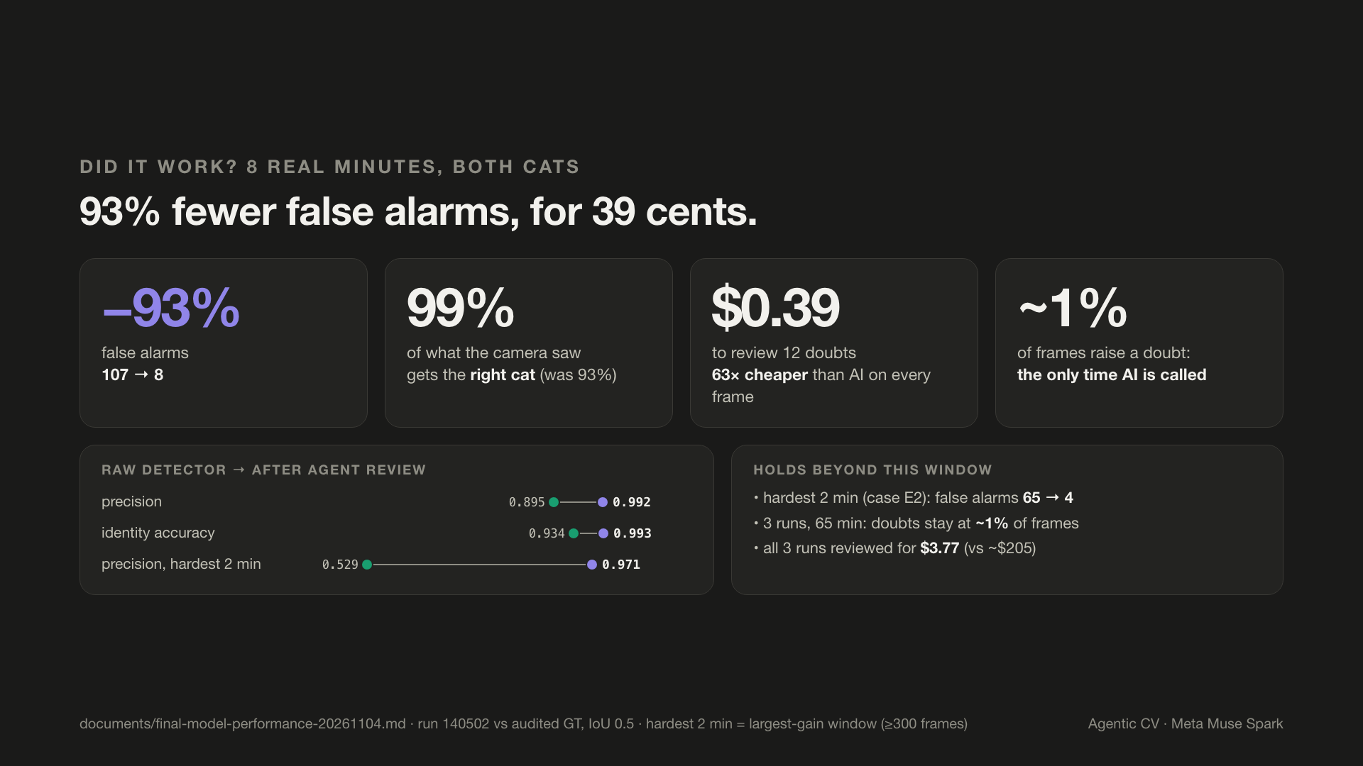
Notes:
Beat 21 · Evaluation
VO: The numbers: the Pi doubts about one percent of frames, and the agent cuts false alarms by ninety-three percent. Ninety-nine percent of what the camera saw gets the right cat. All for thirty-nine cents.
Source: documents/final-model-performance-20261104.md · run 140502 vs audited GT, IoU 0.5 · hardest 2 min = largest-gain window (≥300 frames)

Slide 23
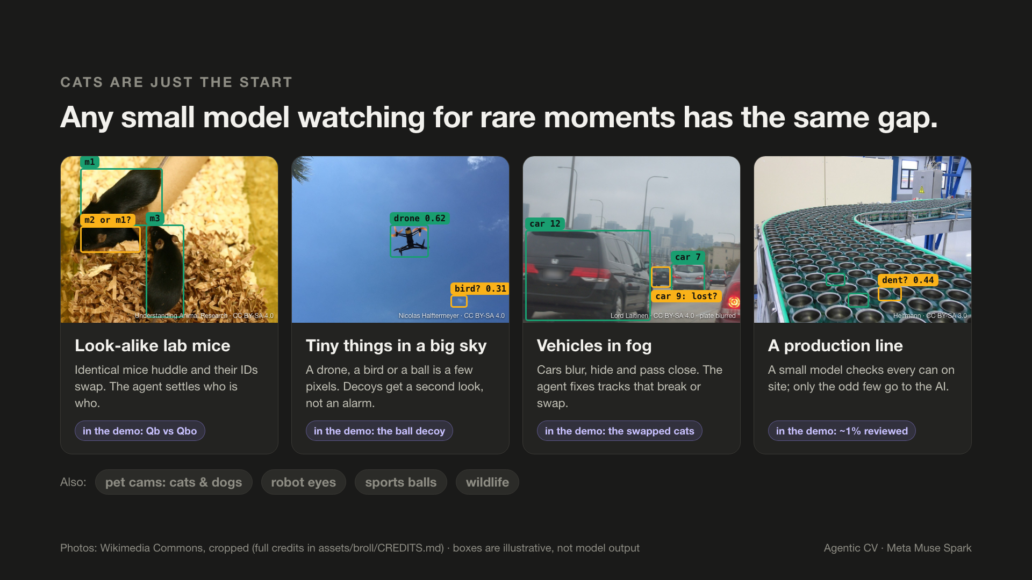
Notes:
Beat 22 · Beyond cats, and what's next
VO: Cats are just the start. Look-alike lab mice, tiny drones, cars in fog, a production line: every small model watching for rare moments has the same gap.
Source: Photos: Wikimedia Commons, cropped (full credits in assets/broll/CREDITS.md) · boxes are illustrative, not model output

Slide 24
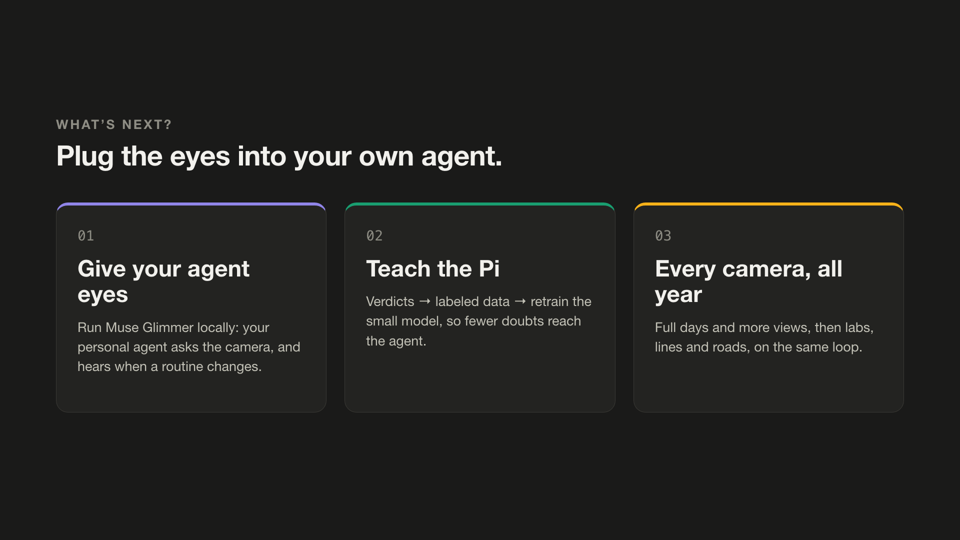
Notes:
Beat 23 · Beyond cats, and what's next
VO: Next: run Muse Glimmer locally and give your own agent these eyes, and let its verdicts teach the Pi.

Slide 25
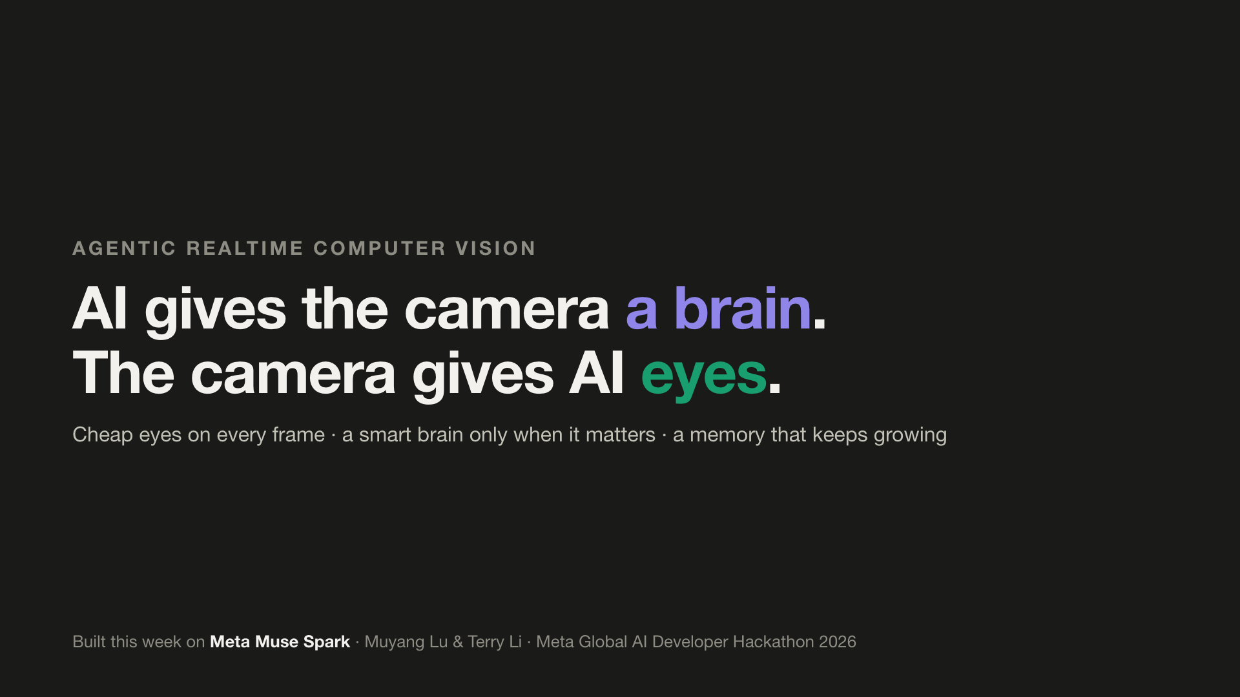
Notes:
Beat 24 · Beyond cats, and what's next
VO: Agentic realtime computer vision. Built this week, on Meta's Muse Spark.

