Slide 1
Q3 Regional Review

Slide 2

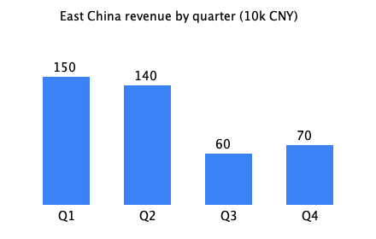
Regional performance

