Slide 1
THEMATIC ASSESSMENT
ADHOC & WIRELESS SENSOR NETWORKS
Real-Time Anomaly &
Fault Detection in a WSN
using Machine Learning · simulation-validated
TEAM MEMBERS
Angel Suri
Pratishtha
Himanshu Singh
Roll no. 231302156
Roll no. 231302058
Roll no. 231302024
Notes:
Introduce the project in one line: a wireless sensor network that detects silent faults with ML, validated in simulation because hardware procurement slipped.

Slide 2
INTRODUCTION & MOTIVATION
The problem: WSNs fail silently
What goes wrong
EXAMPLE: A SERVER ROOM AC FAILING SLOWLY
▪ A sensor sticks on one value, drifts, spikes or returns garbage
▪ A node runs out of battery, or its relay dies and it is cut off
▪ Data is lost or corrupted in transit
10:00
11:30
13:00
19.8 °C
ML flags drift
Threshold fires
Why thresholds are not enough
▪ A fixed rule only fires on obviously wrong numbers
▪ Drift and stuck values stay inside the “safe” range
▪ Nobody notices until the damage is done
Temperature crept from 19.8 °C to 28.3 °C, always under a 30 °C cutoff. The threshold system stays silent.
≈ 90 minutes earlier warning from ML
Adhoc & Wireless Sensor Networks · Thematic Assessment
2 / 17
Notes:
Use the AC example. The threshold never fires because 28.3 C is under 30 C, but the room has been drifting for two hours.

Slide 3
OBJECTIVES
Objectives and what we delivered
01
Build a 5-node WSN with sink, 2-hop routing and an energy model
✓ Done (sim)
Simulated: DHT22, PIR, LDR data, battery, loss, latency
02
Collect, clean and store sensor readings through MQTT
✓ Done (sim)
Publisher → Mosquitto broker → collector, 15,000 / 15,000 messages
03
Detect sensor and network faults with machine learning
✓ Done (sim)
Isolation Forest + Random Forest + rule / watchdog layer
04
Compare ML against threshold detection
✓ Done (sim)
Precision, Recall, F1, FPR, per-fault recall and detection latency
05
Live dashboard for fault status, battery and network health
✓ Done (sim)
Streamlit, 3 tabs: faults, battery and delivery, latency
Adhoc & Wireless Sensor Networks · Thematic Assessment
3 / 17
Notes:
Each objective maps to a module we built and tested. Hardware deployment is the one item deliberately moved to Phase 2.

Slide 4
METHODOLOGY
Approach: simulation first, hardware next
Why simulate? Hardware procurement slipped, so we validated the full pipeline in software. Simulation also gives perfect fault labels and thousands of faults in minutes. Real ESP32 nodes only replace the data source.
M1
M2
M3
M4
Normal data
Fault injection
Detectors
Dashboard
5 nodes, daily patterns
5 fault types, labels
Threshold, IF, RF
Streamlit
M5
M7
M8
M10
MQTT layer
Network layer
Hybrid + latency
Robustness
Broker + collector
Energy, relays, loss
Rules + ML
Noise, cutoff sweeps
Plus: Wokwi ESP32 firmware (DHT22, PIR, LDR) publishing the same JSON schema over MQTT.
Adhoc & Wireless Sensor Networks · Thematic Assessment
4 / 17
Notes:
Be upfront: the ESP32 boards were not ordered in time. We chose to validate the entire software pipeline in simulation. The same pipeline accepts real nodes by swapping the data source.

Slide 5
ARCHITECTURE
System architecture
DATA FLOW
Sensor nodes
Sink + MQTT
Collector
Features
Detection
Dashboard
N1–N5
DHT22 · PIR · LDR
▸
Mosquitto broker
wsn/+/data
▸
Clean · store
CSV
▸
Daily residuals
Rolling stats
▸
Rules + watchdog
Isolation Forest
▸
Faults · battery
Latency
NETWORK MODEL (SIMULATED)
HARDWARE PATH (PHASE 2)
▪ N1, N2, N3 send directly to the sink
▪ N4 relays through N2, N5 through N3
▪ Relays pay extra energy to forward packets
▪ 2% random packet loss, ~45 ms per hop
▪ ESP32 firmware verified in Wokwi
▪ Same JSON schema over MQTT
▪ Swap the simulated publisher for real nodes
▪ No change to collector, ML or dashboard
Adhoc & Wireless Sensor Networks · Thematic Assessment
5 / 17
Notes:
Walk left to right. The Wokwi node at the bottom shows the real firmware speaking the same schema, so only the data source changes in Phase 2.

Slide 6
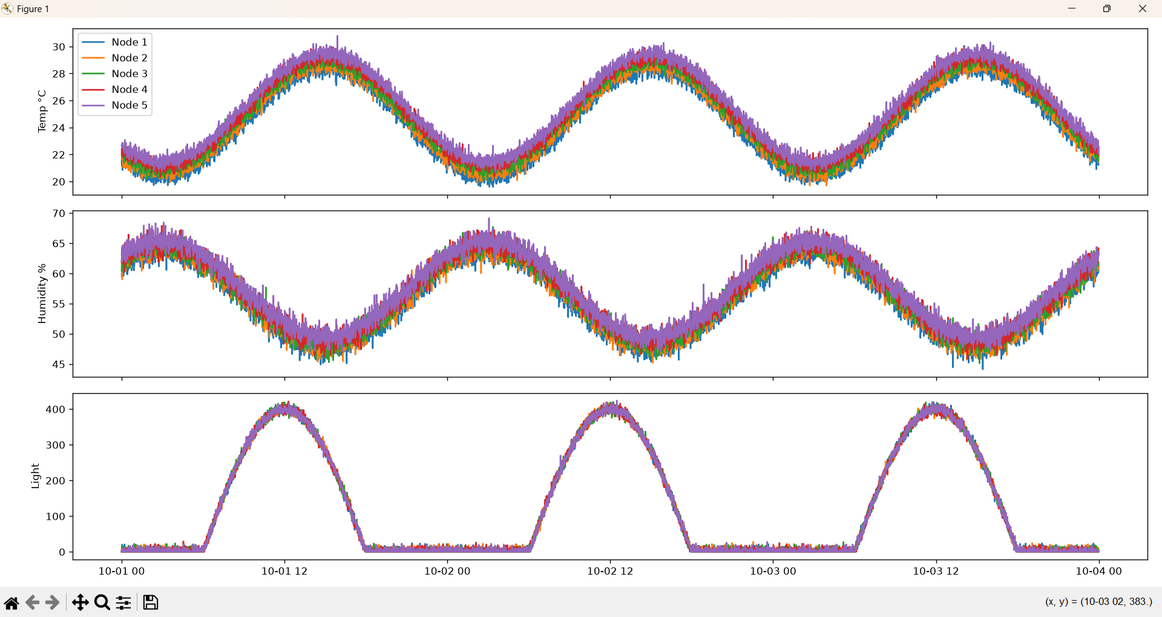
DATA GENERATION (M1)
Simulated WSN data
Generated per node
▪ 7 days, 1 reading per minute
▪ 50,400 readings in total
▪ Temperature, humidity, light, PIR motion
Why it is realistic
▪ Daily wave, warmest mid-afternoon
▪ Humidity moves opposite to temperature
▪ Per-node offsets and sensor noise
▪ Fixed seed: results reproducible
Normal data: 5 nodes, temperature, humidity and light (first 3 days)
Adhoc & Wireless Sensor Networks · Thematic Assessment
6 / 17
Notes:
Say why it is realistic: daily periodicity, per-node offsets, sensor noise, and temperature and humidity moving in opposite directions, like real DHT22 data.

Slide 7
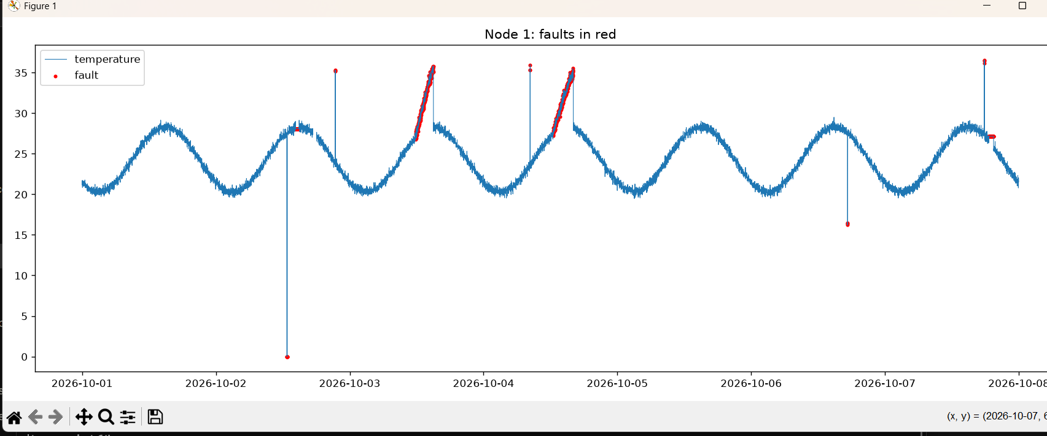
FAULTS (M2)
Fault injection with ground-truth labels
Fault | What it looks like | Real cause
Stuck | Frozen value | Sensor hang
Spike | Sudden jump | Interference
Drift | Slow creep up | Ageing, AC failure
Dropout | Missing values | Dead node
Corrupt | -999 / 255 | Packet corruption
Node 1 temperature: faults in red (drift ramps, spikes, corrupt)
DATASET
Why drift is the star
3,712 faulty rows = 7.38% of data
Drift is the majority (2,625 rows); spike (33) and corrupt (49) are small samples
▪ Stays under the 35 °C rule for a long time
▪ Threshold misses it, ML catches it
Adhoc & Wireless Sensor Networks · Thematic Assessment
7 / 17
Notes:
We log is_fault for every reading. Drift dominates because its episodes are long. Spike and corrupt are small samples, so we headline overall metrics.

Slide 8
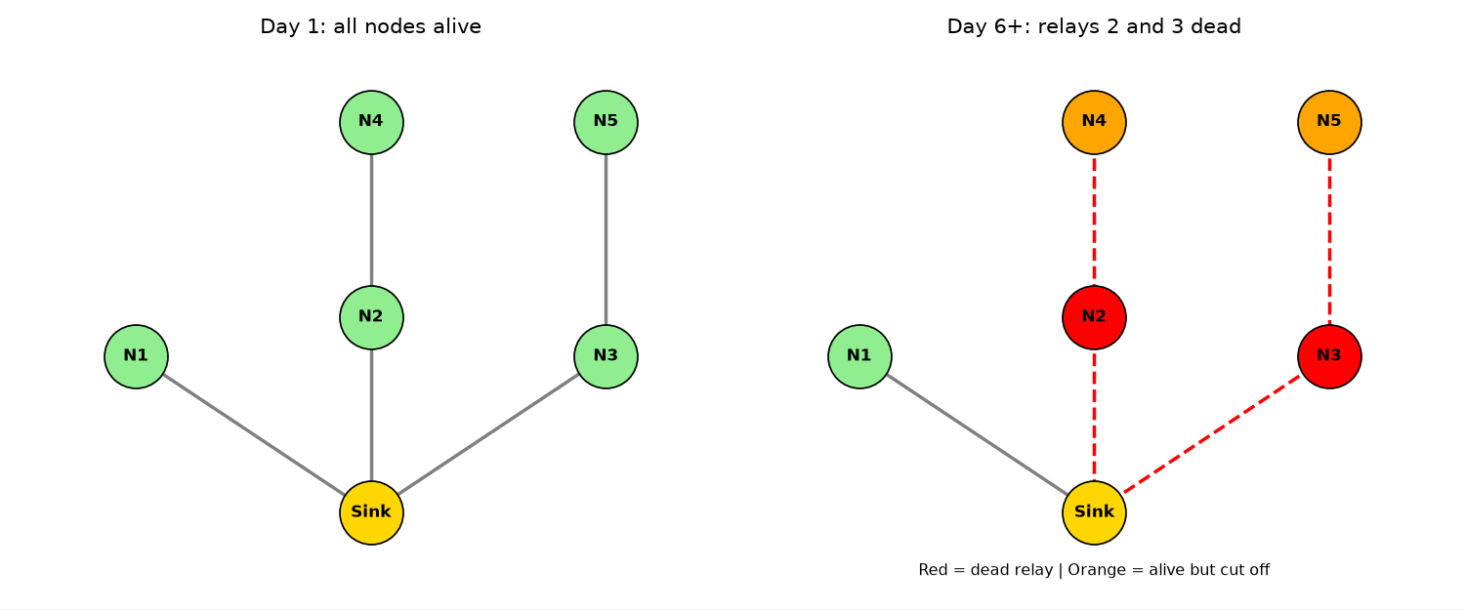
NETWORK MODEL (M7)
Network layer: topology, energy and links
Parameter | Value
Battery | 1200 mAh
Per transmit | 0.083 mAh
Per forward | 0.060 mAh
Random loss | 2%
Latency / hop | 30 ms + exp(15)
Sample rate | 1 / min
Left: healthy network. Right: relays N2 and N3 dead, N4 and N5 cut off
Parameterised from typical ESP32 transmit and sleep figures. These are modelled values, not measurements.
Energy-hole effect: relays carry their own traffic and forward for others, so they drain faster and die first. Their children lose the path to the sink.
Adhoc & Wireless Sensor Networks · Thematic Assessment
8 / 17
Notes:
This is the networking content: energy, multi-hop routing, packet loss and latency. Relays die first, which is the classic energy-hole problem.

Slide 9
ML & BASELINES (M3, M8)
Detection methods
Threshold baseline
Isolation Forest
Random Forest
▪ Temp outside 15–35 °C
▪ Humidity outside 20–90%
▪ Missing value = alarm
▪ Fair, realistic cutoffs
▪ Trained on normal data only
▪ No labels needed
▪ Features: residual from expected daily pattern, rolling mean, std, diffs
▪ Cutoff set from normal scores (1st percentile)
▪ Supervised, needs labels
▪ Rolling-window features
▪ Class-balanced
▪ Time-based 60 / 40 split
Hybrid system: classical rules + a watchdog (alarm after 5 consecutive missing readings) catch the loud faults; Isolation Forest on top catches the quiet ones, stuck values and drift.
Adhoc & Wireless Sensor Networks · Thematic Assessment
9 / 17
Notes:
Threshold is rigid. Isolation Forest needs no labels, which is the real-world advantage. Random Forest needs labels. The hybrid combines rules for loud faults and ML for quiet ones.

Slide 10
EVALUATION (HELD-OUT 40% TEST SPLIT)
Results: ML vs threshold
Method | Precision | Recall | F1 | FPR | Labels?
Threshold | 1.000 | 0.064 | 0.120 | 0.000 | No
Isolation Forest v1 | 0.297 | 0.243 | 0.267 | 0.068 | No
Isolation Forest v2 | 0.817 | 0.743 | 0.778 | 0.020 | No
Random Forest | 0.981 | 0.611 | 0.753 | 0.001 | Yes
HOW TO READ IT
▪ Threshold: perfect precision, but 94% of faults slip through
▪ Isolation Forest v2: F1 0.778 with no labels
▪ Fixing features (daily residuals) lifted F1 from 0.267 to 0.778
▪ Random Forest: best precision, but needs labels
Adhoc & Wireless Sensor Networks · Thematic Assessment
10 / 17
Notes:
Threshold is perfectly precise but catches only 6.4% of faults. Our first Isolation Forest was weak (F1 0.267); we diagnosed the daily cycle and forced contamination, fixed it with residual features, and report both.

Slide 11
HYBRID EVALUATION (M8)
Results: sensor faults and detection speed
System | Precision | Recall | F1 | FPR
Classical (rules + watchdog) | 1.000 | 0.041 | 0.079 | 0.000
Classical + Isolation Forest | 0.825 | 0.751 | 0.786 | 0.019
EPISODES CAUGHT AND MEDIAN MINUTES TO FIRST ALARM
Fault | Episodes | Classical | Combined
Drift | 6 | 1 caught (209 min) | 6 caught (30 min)
Stuck | 3 | 0 caught | 3 caught (11 min)
Spike | 3 | 2 caught (0 min) | 3 caught (0 min)
Dropout / link loss | 5 | 5 caught (4 min) | 5 caught (4 min)
Battery death | 2 | 2 caught (4 min) | 2 caught (4 min)
Sensor-fault-only, test split. Excludes battery and link faults.
Cost of the gain: 236 false alarms over about 12,000 healthy readings (1.9%). Hybrid insight: simple rules for loud faults, ML for quiet ones.
Adhoc & Wireless Sensor Networks · Thematic Assessment
11 / 17
Notes:
Lead with the sensor-fault-only numbers. Battery death and link loss are long runs of empty readings that any watchdog catches, so they inflate the overall F1. Sample sizes are small, so say in our test run.

Slide 12
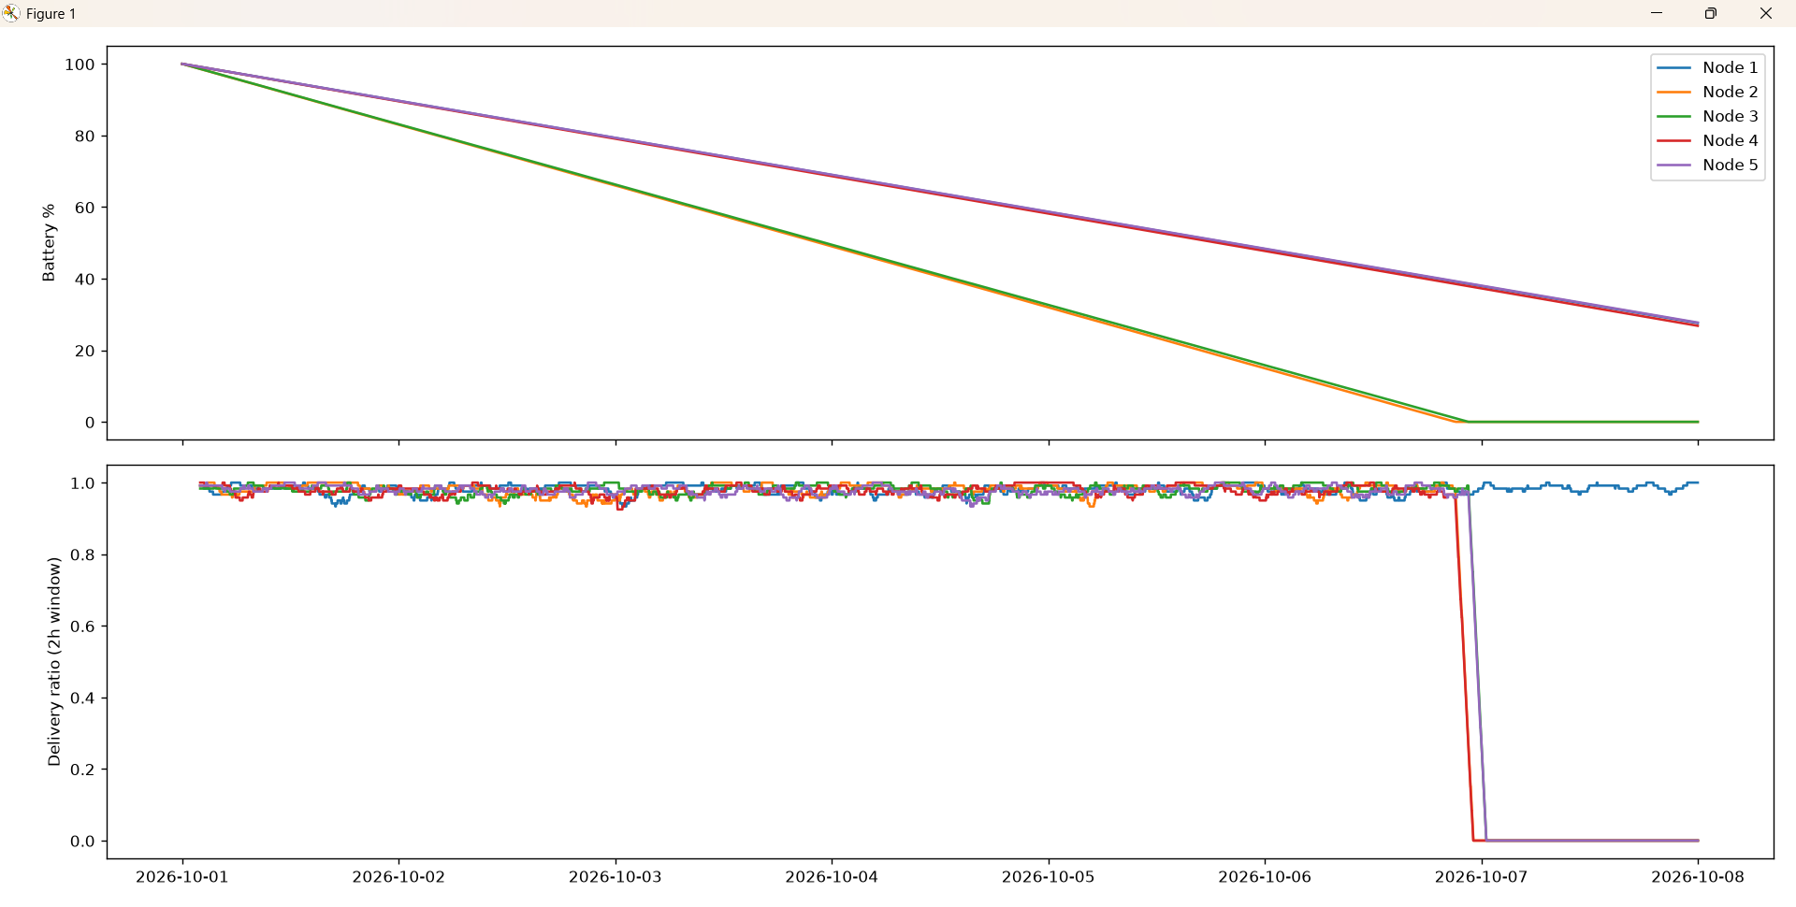
NETWORK RESULTS
Network results: energy, links and latency
~5.9 d
~14 h
RELAY DEATH
EARLY WARNING
N2 day 5.88, N3 day 5.94
Low-battery alert at 10%
4 min
45 / 90
WATCHDOG ALARM
LATENCY (MS)
5 missing readings in a row
1-hop / 2-hop mean
▪ Delivery ≈ 0.98 while all nodes alive
▪ N4 and N5 drop to 0 when relays die
▪ Node 1 (direct) unaffected
Top: battery per node. Bottom: delivery ratio (2 h window)
Adhoc & Wireless Sensor Networks · Thematic Assessment
12 / 17
Notes:
Relays N2 and N3 die near day 5.9; at that moment N4 and N5 drop to zero delivery. The low-battery warning fires about 14 hours before death, based on a linear drain model in simulation.

Slide 13
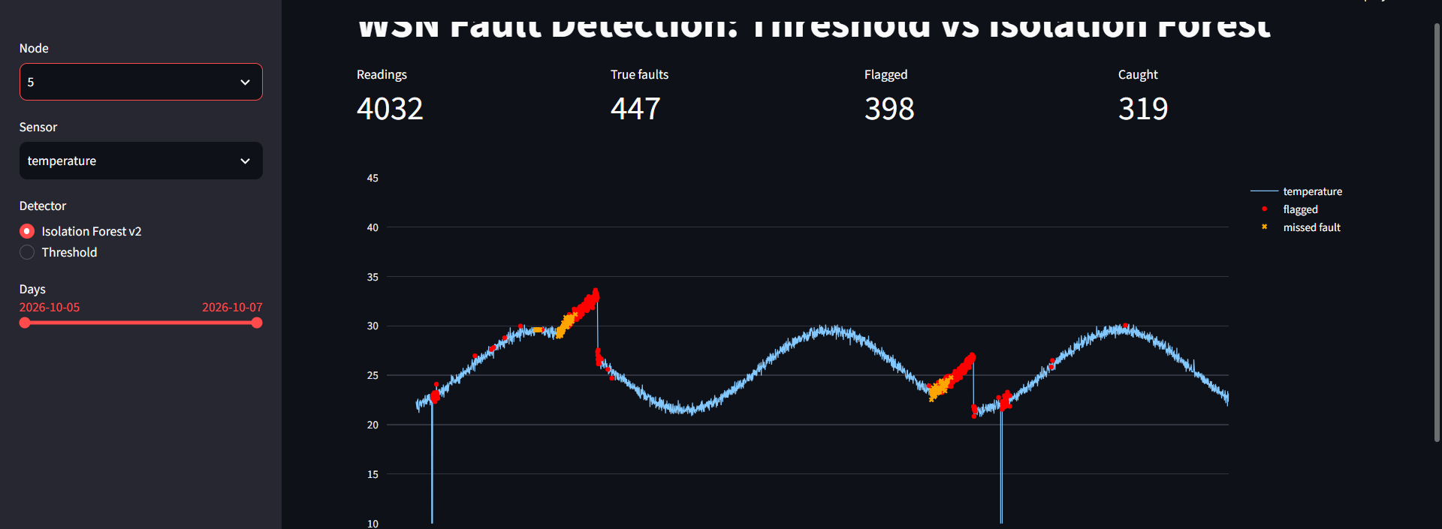
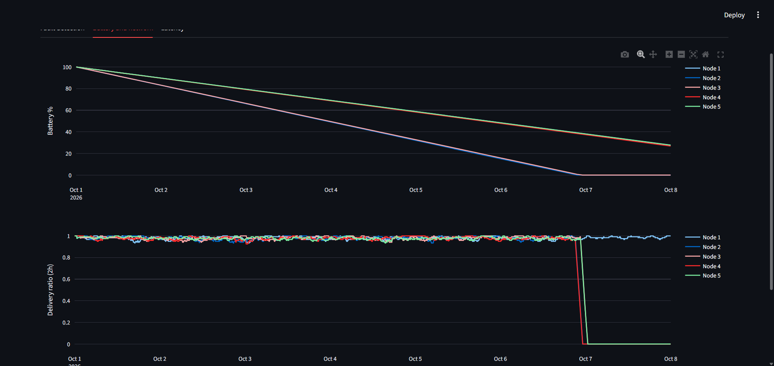
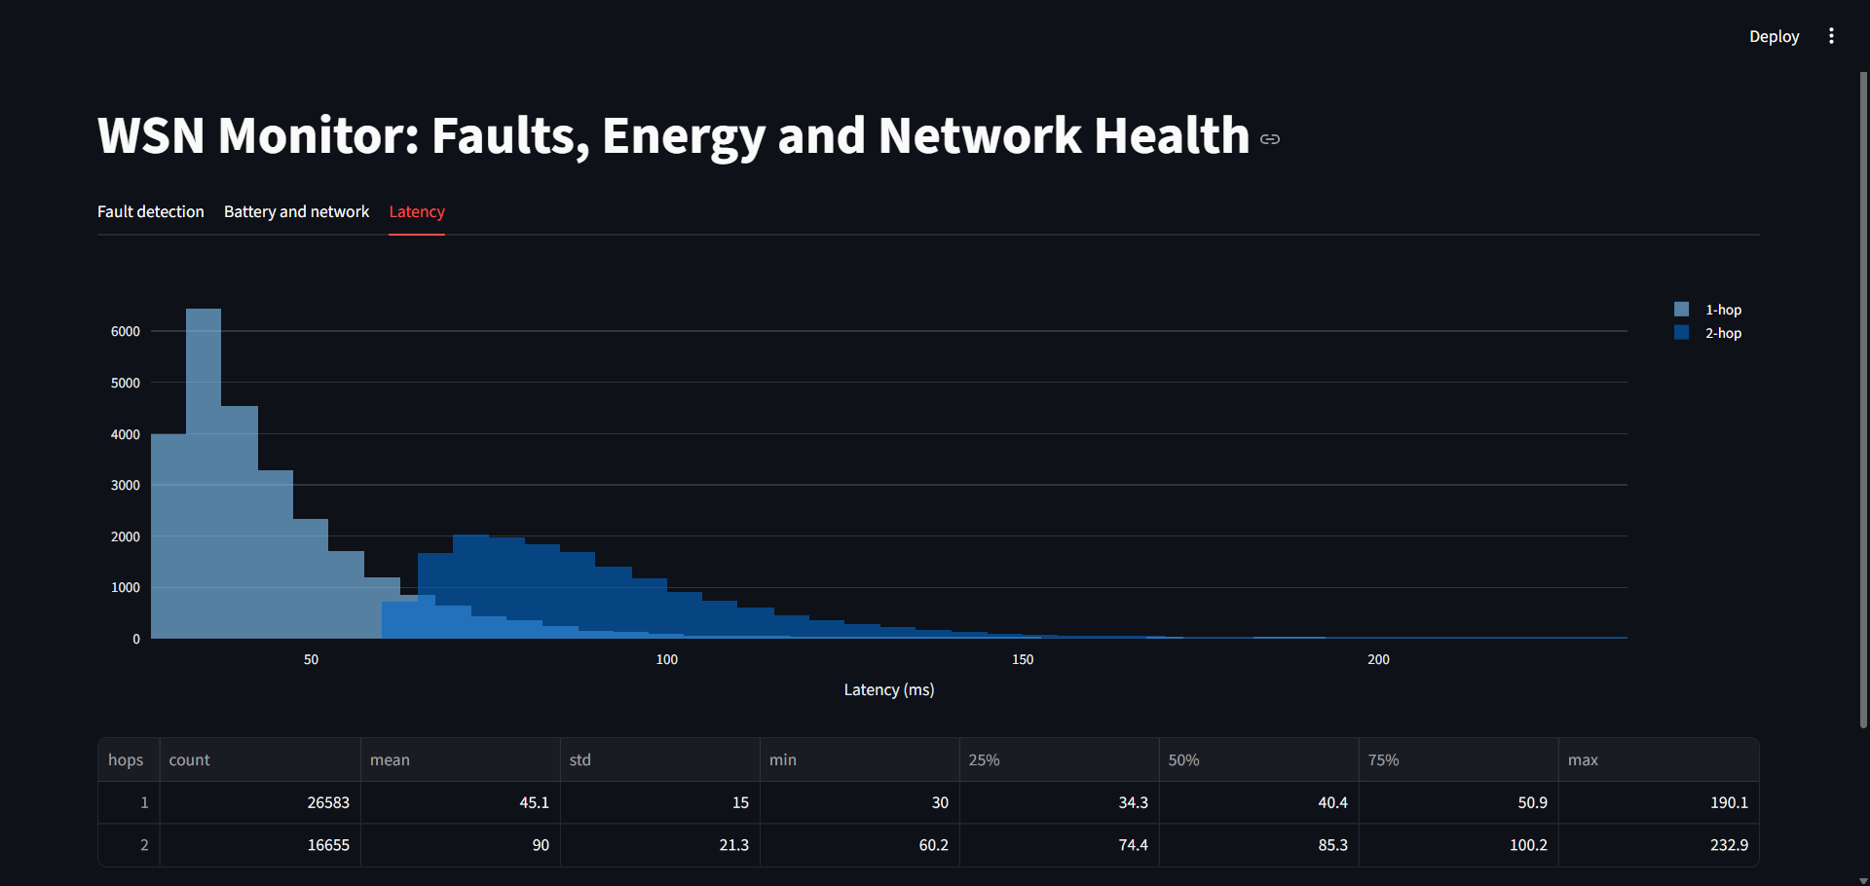
VISUALISATION (M4, M9)
Live dashboard
Fault detection: flagged (red) and missed (orange) readings
Battery and network health
▢
Add: Classical vs Combined on one node
Screenshot of tab 1 (v3), drift stretch
Latency distribution, 1-hop vs 2-hop
Adhoc & Wireless Sensor Networks · Thematic Assessment
13 / 17
Notes:
Demo flow: pick a drift-heavy node, show Threshold with many orange missed-fault marks, flip to Isolation Forest and the marks turn red. Then show the battery and latency tabs.

Slide 14
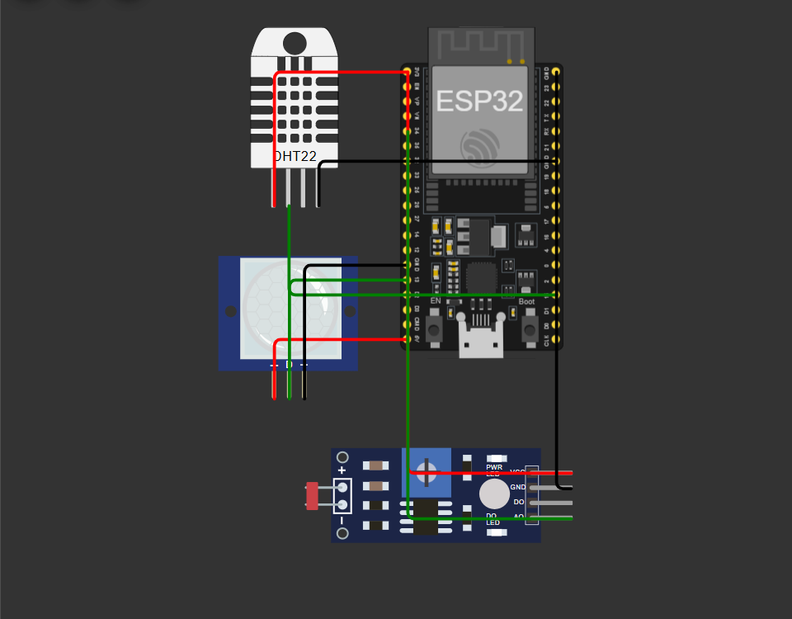
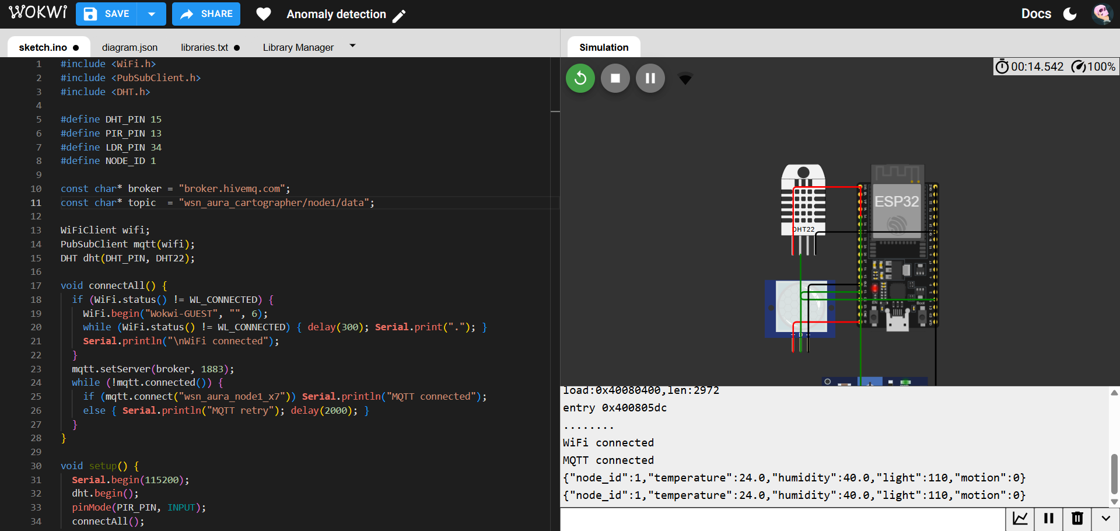
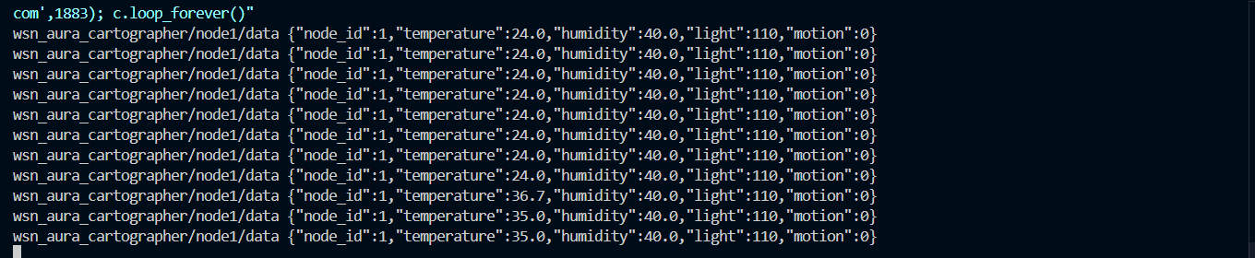
TRANSPORT & HARDWARE PATH
MQTT pipeline and ESP32 firmware in Wokwi
15,000
MQTT MESSAGES
Simulated pipeline: 15,000 of 15,000 delivered, zero loss
ESP32 + DHT22 + PIR + LDR (Wokwi)
Firmware log: WiFi and MQTT connected, JSON every 2 s
Fault injected at the Wokwi node, delivered over MQTT and received by an independent Python subscriber.
Subscriber terminal: injected fault, temperature 24.0 → 35.0
Adhoc & Wireless Sensor Networks · Thematic Assessment
14 / 17
Notes:
Two proofs: the simulated pipeline delivered 15,000 of 15,000 messages, and a Wokwi ESP32 with DHT22, PIR and LDR published the same JSON over MQTT. A Python subscriber received the injected 35 C fault.

Slide 15
STRESS TESTS (M10)
Robustness checks
Noise
Cutoff
F1 0.78 → 0.47 at 5× normal noise. False alarms stay near 2%.
1% gives best F1. 2% trades FPR 4.6% for recall 0.85.
Adhoc & Wireless Sensor Networks · Thematic Assessment
15 / 17
Notes:
F1 degrades gracefully with noise and false alarms stay flat near 2 percent because the cutoff is calibrated on healthy data. We did not retrain at higher noise, so this is a worst-case. The cutoff is a tunable operating point.

Slide 16
TOOLS
Tools and technologies
Hardware path
Connectivity
▪ ESP32 + DHT22, PIR, LDR
▪ Firmware verified in Wokwi
▪ Physical build: Phase 2
▪ MQTT, Mosquitto broker
▪ paho-mqtt publisher + collector
▪ Topics: wsn/node/data
Data & ML
Dashboard
▪ Python, pandas, NumPy
▪ scikit-learn: Isolation Forest, Random Forest
▪ matplotlib for analysis
▪ Streamlit + Plotly
▪ Fault, battery, latency tabs
▪ Detector toggle for demo
Adhoc & Wireless Sensor Networks · Thematic Assessment
16 / 17
Notes:
Everything runs on free tools: Python, scikit-learn, Mosquitto and Wokwi.

Slide 17
CONCLUSION
Conclusion, limitations and next steps
WHAT WE SHOWED
LIMITATIONS (STATED UPFRONT)
▪ Threshold + watchdog: sensor-fault F1 0.079
▪ Adding Isolation Forest: F1 0.786, no labels
▪ Drift caught in 6 / 6 episodes (30 min median)
▪ Relay death cuts off children; watchdog alarms in 4 min
▪ All ML results use simulated data
▪ Small episode counts (6 drift, 3 stuck)
▪ Battery model is parameterised, not measured
▪ Not retrained at higher noise
PHASE 2 TIMELINE
Done
Done
Done
Next
Next
▢
Simulator, faults, ML
MQTT + network layer
Dashboard + Wokwi
Order ESP32 + sensors
Deploy and validate
Add: photo of hardware
Optional, when available
Angel Suri · Pratishtha · Himanshu Singh
Adhoc & Wireless Sensor Networks · Thematic Assessment
17 / 17
Notes:
End on the message: the software side is complete and validated; the only remaining piece is physical deployment. State limitations yourselves before they are asked.

