Slide 1
Introduction unit 1
BIOL221T: Advanced Bioinformatics for Biotechnology
Irene Gabashvili, PhD
igabashvili@yahoo.com

Slide 2
Course availability
Lectures & Lab: every Wednesday, Duncan Hall, Room 550, 6:00 pm to 9:45 pm
Office hours: Wednesday, 4pm-6pm (Room 554, phone: 92404831) and by appointment
Lecture notes will be posted at: http://home.comcast.net/~igabashvili/221T.htm

Slide 3
DATES | Units | B&O | Topic | Due
Jan23-30 | 1-4 | Foreword, Intro, chapter3, lecture notes | Introduction: information, databases, programming | Survey PS0
Feb-March |  | 1,2,5,11,12 | Sequence informatics | PS1 PS2
March-April |  | 14, 16, Lecture Notes | Network informatics | PS3
April |  | 8-10, 17 | Structure informatics | Projects
May |  |  | Review | PS4 Exam

Slide 4
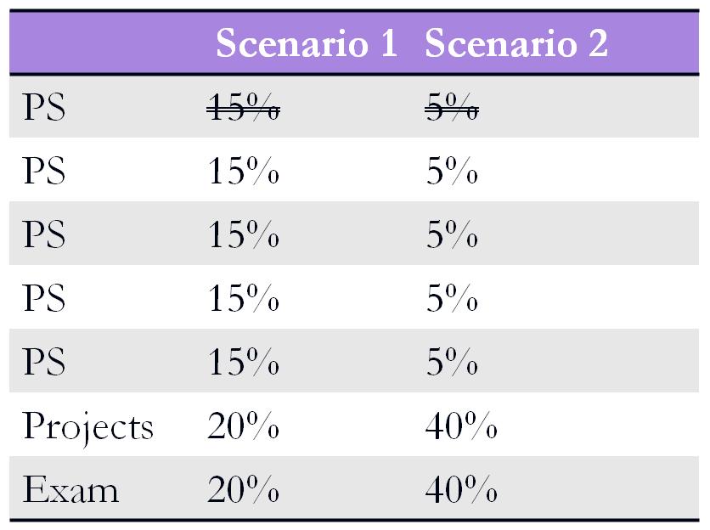
Final Grading
Voted for Voted against

Slide 5
Survey
Compose a short message introducing yourself, your science background, bioinformatics interests and what you hope to learn from taking this course.
  What bioinformatics databases and tools have you used in your previous courses/projects?
  How familiar are you with resources/tools mentioned in this lecture and listed in the Survey? (? = not aware of / 0 = aware of, but never use / 1 = seldom use / 2 = weekly / 3 = daily )
  If you were to start a company, what bioinformatics service would you provide or need for the development of your solution?

Slide 6
The bioinformatics project
An opportunity to use the tools and approaches taught in this course to research an area of personal interest.

Slide 7
Example 1
Choose a nucleotide or protein sequence with some presumed functional or structural importance, at least 140 residues in length.
Define the problem or question, for example:
  Detection of distantly related (divergent) sequences.
  Detection of sequence homologs in various species.
  Detection of homologous motifs in proteins of varied function.

Slide 8
Example 1
Abstract
Introduction: define the problem
Materials and Methods.
Multiple sequence alignment figure.
Phylogenetic tree.
Discussion.

Slide 9
Example 1
cctgttaaaaatggtaaaattactaatgat →PVKNGKITND→EC 2.7.2.3
Nucleic acid translator → Owl protein db → function & structure → drugs
    Q– how many protein sequences?
BLAST (blastn, blastp?) → clustalw
BLAT → SNPdb

Slide 10
Example 2
Choose a disease. Find genes responsible or predisposing to this disease. Hypothesize on the disease pathway. Or find genes expressed in diseased tissue, compare to normal, research and report findings
  OMIM, biol. literature, even google → NCBI Gene → KEGG
  IPA
  Unigene DDD or GEO DB → Pathway tools

Slide 11
Example 2: in the news
six more gene regions associated with the severest form of lupus reported last Sunday
    ITGAM, located on Chromosome 16;
    BLK, on Chromosome 8;
    KIAA1542, on Chromosome 11;
    rs10798269, on Chromosome 1;
    PXK on Chromosome 3; and
    BANK1, on Chromosome 4.
Genes Linked to Height Also Tied to Osteoarthritis
Genes Stacked Against Weight Loss?

Slide 12
Example 3
Assay on New and Notable
Personal Genome Services: workflow, shortcomings, future trends (Decode Genetics, 23andMe, Knome, Navigenics)
Inexpensive whole-genome sequencing technologies

Slide 13
Projects: more ideas
http://biochem218.stanford.edu/Projects.html
Comparing bioinformatics tools: Pathway Analysis
Research with Matlab
HCE, TreeView, SAM
VectorNTI
Visualization: Chimera, CN3D, Pymol
R and other statistics tools

Slide 14
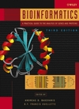
Bioinformatics: A Practical Guide to the Analysis of Genes and Proteins, 3rd Edition
Andreas D. Baxevanis (Editor), B. F. Francis Ouellette (Editor)
Previously chosen for this course, still the main book

Slide 15
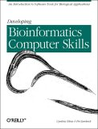
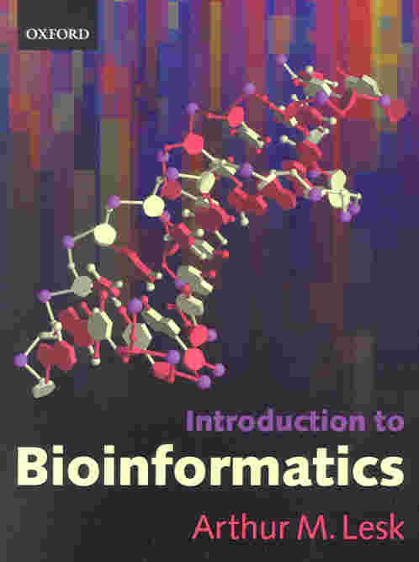
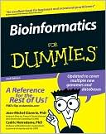
Developing Bioinformatics Computer Skills by Cynthia Gibas, Per Jambeck
Introduction to Bioinformatics by Arthur M. Lesk
Bioinformatics for dummies by Jean-Michel D. Claverie, etc

Slide 16

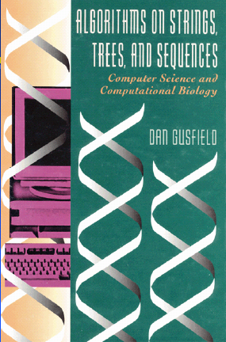

Other good books
More computational

Slide 17
Online lectures and resources
http://www.ebi.ac.uk/2can/tutorials/
http://www.ncbi.nlm.nih.gov/About/
http://lectures.molgen.mpg.de/online_lectures.html
http://zlab.bu.edu/zlab/links.shtml
http://www.nslij-genetics.org/bioinfotraining/
http://learn.perl.org/
More links at the course page

Slide 18
Databases & Online Resources:
NCBI databases: http://www.ncbi.nlm.nih.gov/
The Protein Data Bank: http://www.rcsb.org/pdb/
Proteomics Software tools from ExPASy (Expert Protein Analysis System). http://www.expasy.org/tools/
NCBI BLAST can be used and downloaded from this site. http://www.ncbi.nlm.nih.gov/
UCSC Genome Browser: http://genome.ucsc.edu/
EBI http://www.ebi.ac.uk/clustalw/
Tree of Life: http://itol.embl.de/
KEGG: http://www.genome.jp/kegg/
More on the course website

Slide 19
Software:
Perl. Perl is open source software and may be downloaded for free from several sites. http://www.activestate.com/Products/activeperl/ http://www.perl.com/download.csp#stable
Unix/Linux (Mac OS X)
MATLAB. Will be available in the Lab
http://www.mathworks.com/products/bioinfo/demos.html
IPA – trial version available for free, account in March
R, Treeview, HCA, SAM – can be downloaded for free
Visualization: Rasmol, Chimera, VND, Cn3d, Pymol

Slide 20
Why these choices?
Why BLAST? Because you can learn a lot by comparing sequences, and BLAST is the standard program for this task.
Why Unix? Because most bioinformatics applications were originally developed in Unix.
Why Perl? Because Perl (and BioPerl) is the most popular programming language in bioinformatics.

Slide 21
Other Programming Languages
Python (bioPython) also popular in Bioinformatics
Ruby is another scripting language with a rapid development cycle.
Java, C++, and the like can be overkill for bioinformatics (vs hardcore coding/software development)

Slide 22
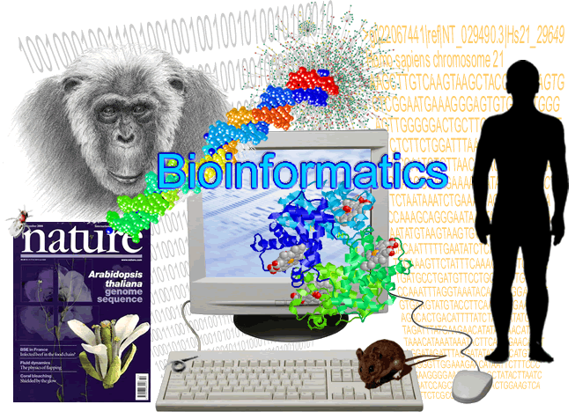
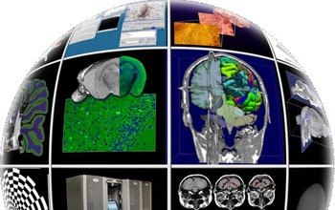

biomedical informatics?
What is
Definitions may differ, but objectives are the same

Slide 23
What is bioinformatics?
Biologists using computers, or the other way around
Twenty-First Century Rocket Science
The science of Blast searches
Writing bioinformatics software is tougher and very competitive. You probably won’t get rich in this arena, but…

Slide 24
End of Unit 1
Please fill out the Survey
Demo for Problem Set 0 (Jan.30)
(to be continued after the break)

