Slide 1
Pathway analysis of –omics data
Unit 21
BIOL221T: Advanced Bioinformatics for Biotechnology
Irene Gabashvili, PhD

Slide 2
PS4 & Exam:
No additional time will be allowed, if returned after the deadline – 0 points
Projects

Slide 3
Jennifer:
Abstract
Brief Introduction to Pharmacogenetics
Molecular techniques available
Bioinformatics tools available
Current market state
Ethical Concerns
Conclusion
See http://www.nigms.nih.gov/Initiatives/NIH-RFI
NIH wants to hear suggestions about how to address needs and challenges

Slide 4
Nancy:
Abstract
Brief Introduction to Molecular Cytogenetics
Materials and Methods: data, software tools: Genotyping Console 2.1 for Cytogenetics & Partek
Results
Conclusion

Slide 5
Annie
Exploring the royal disease with IPA and other bioinformatics tools

Slide 6
Tanzeema
Investigating drug-protein interactions by structure visualization tools

Slide 7
Dahn
Research on heart valve disease

Slide 8
Projects
Jyoti
Studying the characteristics of psoriatic arthritis genes and common genetic control for Crohn’s disease and psoriatic arthritis in the pathway.
Chris:
On humans, chimps and mitochondrial Eve

Slide 9
Projects
Harshal
Exploring genetic resistance to HIV and the Black Death
http://home.comcast.net/~igabashvili/hiv.htm
Priyanka:
Designing Cloning Strategies with Commercial Tools and Freeware

Slide 10
-Omes & -Omics:
Genome - all the genes of an organism
Transcriptome – all the transcripts (mRNAs) of an organism
Proteome – all the proteins of an organism
Metabolome – all metabolites (low molecular weight molecules participating in general metabolic reactions required for the maintenance, growth) of an organism

Slide 11
Genomics to Proteomics
transcription
translation
Gene
mRNA
Protein
Genome
Transcriptome
Proteome
static
dynamic
One gene
Many transcripts
Many proteins
(alternative splicing)
(post-translational
modifications)

Slide 12
Systems Biology
Human Genome = 30,000 to 60,000 genes
Human Proteome = 300,000 to 1,200,000 protein variants
Human Metabalome = metabolic products of the organism (lipids, carbohydrates, amino acids, peptides, prostaglandins, etc)

Slide 13
Proteins
Exhibit far more sequence and chemical complexity than DNA or RNA
Properties and structure are defined by the sequence and side chains of their constituent amino acids
The “engines” of life
>95% of all drugs targets are proteins
Favorite topic of post-genomic era

Slide 14
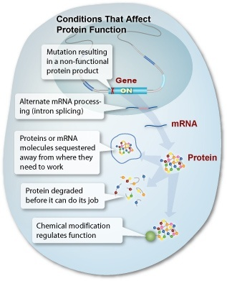
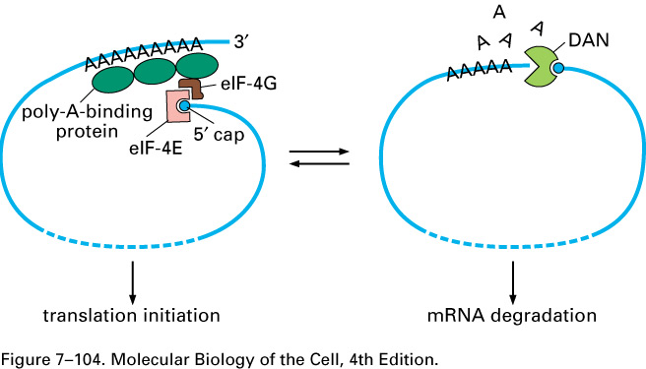
mRNA Doesn't Mean You Have Protein
Storage
Decay
Transport

Slide 15
Protein Complex Discovery
Who: identity of proteins in complex?
What: biological process involved?
Where: is the complex localized?
When: are proteins involved in the complex?
How much: stoichiometry of proteins in complex, quantity- relative vs absolute
Regulation: modifications (kinase,etc) proteolysis (protease)

Slide 16
Post Translational Regulation
  What structural changes occur to create an active protein, alternate splicing, proteolytic processing?
  How is a protein’s activity regulated?
  Are modifications involved in regulation?

Slide 17
The Post-genomic Challenge
How to rapidly identify a protein?
How to rapidly purify a protein?
How to identify post-trans modification?
How to find information about function?
How to find information about activity?
How to find information about location?
How to find information about structure?
Answer: Look at Protein Features

Slide 18
Examples of Protein Features
Composition Features
  Mass, pI, Absorptivity, Rg
Sequence Features
  Active sites, Binding Sites, Targeting, Location, Property Profiles, 2º structure
Structure Features
  Super-Secondary Structure, Global Fold, Volume
http://www.expasy.org/tools/

Slide 19
Molecular Weight
Useful for SDS PAGE and 2D gel analysis
Useful for deciding on SEC matrix
Useful for deciding on MWC for dialysis
Essential in synthetic peptide analysis
Essential in peptide sequencing (classical or mass-spectrometry based)
Essential in proteomics and high throughput protein characterization

Slide 20
What is Proteomics?
The study of the proteome, which is the protein complement of the genome
Everything post-genomic, “protein chemistry on an unprecedented, high-throughput scale”, including structure, function and interactions of proteins
As coined in 1994 by Marc Wilkins: the functional study of proteins using Mass Spectrometry

Slide 21
Proteomics
The Proteome is the complete set of proteins in the cell under a set of conditions. It is dynamic and complex, and characterized in terms of:
  Structure – shape, electrostatics
  Abundance – protein expression
  Localization - subcellular location
  Modifications – post translational modifications
  Interactions – protein-protein interactions (interactome)

Slide 22
Components of Classical Proteomics
Protein
Separation
Mass
Spectroscopy
Mass
Spectrometry
Bioinformatics

Slide 23
Challenges facing Proteomic Technologies
Limited sample material – no PCR!
Sample degradation (occurs rapidly, even during sample preparation)
Post-translational modifications (often skew results)
Specificity among tissue, developmental and temporal stages
Perturbations by environmental (disease/drugs) conditions
Dynamics

Slide 24
Analytical Challenges
Cell biology techniques to isolate structures
Sensitivity
Dynamic range: low affinity binders
Throughput
  Biochemical Throughput
  Analytical Throughput
Direct measurement of intact complex
Quantitation of components and modifications

Slide 25
Basic Proteomic Analysis Scheme
Separation
Protein Mixture
Individual Proteins
2D-SDS-PAGE
Spot Cutting
Digestion
Trypsin
Mass Spectroscopy
Peptide Mass
Peptides
MALDI-TOF
Database
Search
Protein Identification

Slide 26
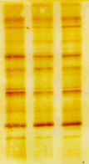

General Strategy for Protein Characterization
Purification/
Enrichment
1-DE
2-DE
Solution
Protein
or
Peptides
Measurement
Mass Spectrometry
Identification
Sequencing
Analysis

Slide 27
Protein Separation methods for Proteomics
Dynamic range is central issue for separations
Gel Electrophoresis
  1 and 2-Dimensional Separations
  Native and Denaturing
  Detection- stains
Chromatographic or Electrophoretic
  Liquid Chromatography
  Capillary Electrophoresis
  Affinity Chromatography
  Multi-Dimensional Separations
  Detection

Slide 28
2D PAGE
2-D gel electrophoresis is a multi-step procedure that can be used to separate hundreds to thousands of proteins with extremely high resolution.
It works by separation of proteins by their pI's in one dimension using an immobilized pH gradient (first dimension: isoelectric focusing) and then by their MW's in the second dimension.

Slide 29
2D PAGE
2-D gel electrophoresis process consists of these steps:
Sample preparation
First dimension: isoelectric focusing
Second dimension: gel electrophoresis
Staining
Imaging analysis via software

Slide 30
Bioinformatics tools for PAGE:
http://world-2dpage.expasy.org/repository/
(database)
http://expasy.org/melanie/
http://www.2d-gel-analysis.com/

Slide 31
Drawbacks of 2D PAGE
Technique precision lacks reliable reproduction.
Spots often overlap, making identifications difficult.
More of “an art” than “a science.”
Slow and tedious.
Process contains may “open” phases where contamination is possible.

Slide 32
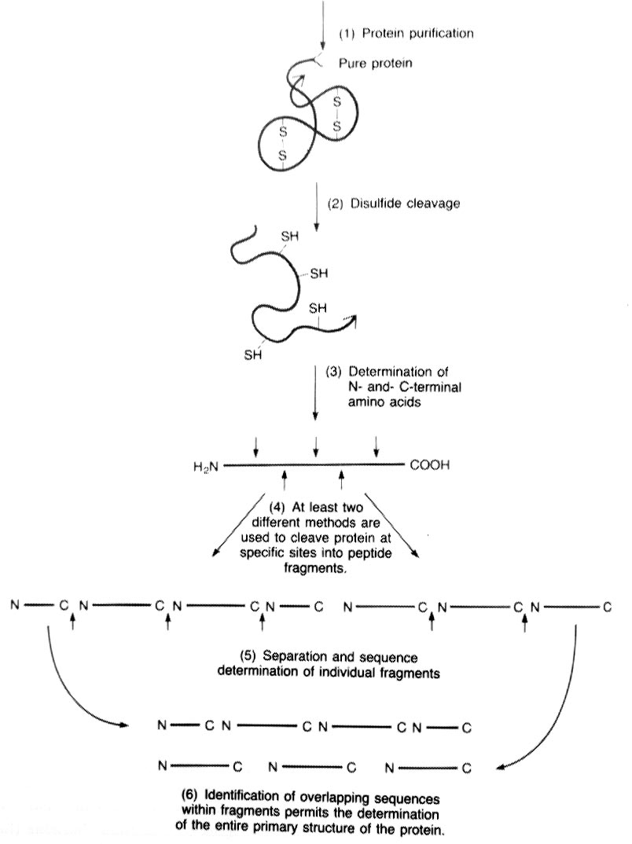
Protein Sequencing: fragmenting into peptides

Slide 33
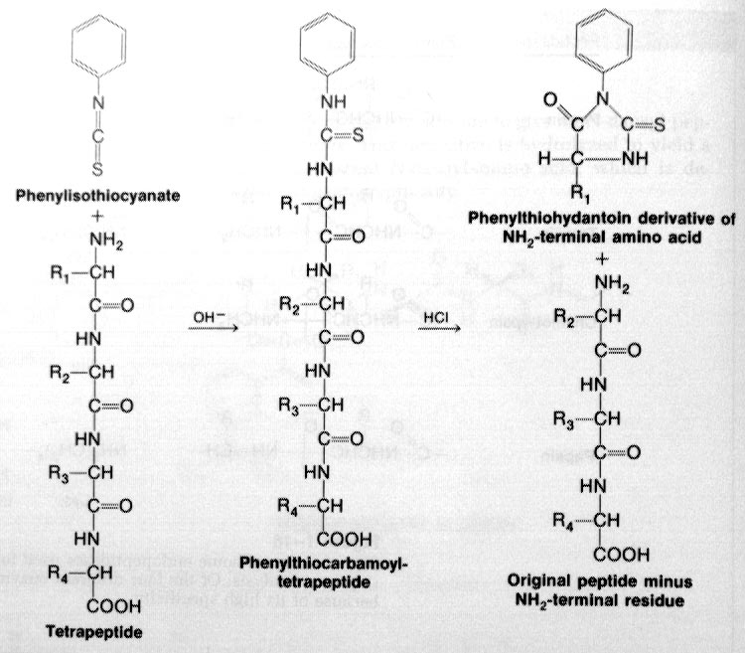
Protein Sequencing: by Edmund degradation.
Separation by HPLC and detect by absorbance at 269nm.

Slide 34
Array-based Proteomics
Employ two-hybrid assays
Use GFP, FRET, and GST
  GFP = green florescent protein
  FRET = florescence resonance energy transfer
  GST = glutathione S-transferase, a well characterized protein used as a marker protein.

Slide 35
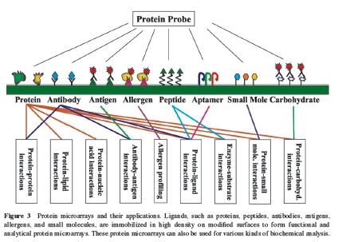
Array-based Proteomics

Slide 36
Array-based Proteomics
Offer a high-throughput technique for proteome analysis.
These small plates are able to hold many different samples at a time.

Slide 37
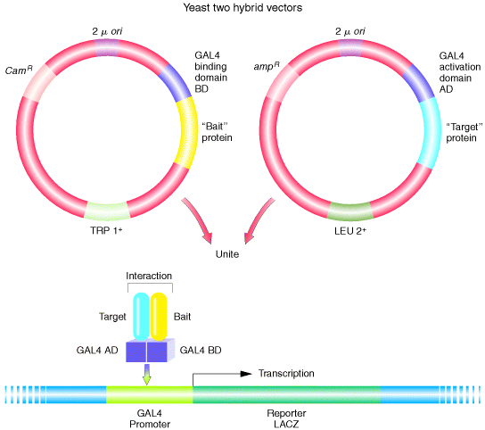
Two-Hybrid Assay
Figure 12-35. Griffiths et. al. Modern Genetic Analysis.

Slide 38
Structural Proteomics
Current techniques are not considered “high throughput” within the structural realm.
Work is undergoing to significantly reduce the amount of painstaking labor in the crystallization of proteins.
Novel solutions combine current technologies, such as NMR and XRC.
Next Lecture : More about protein structures

Slide 39
Clinical Proteomics
This area of proteomics focuses on accelerating drug development for diseases through the systematic identification of potential drug targets.
More specific information on proteins, instead of raw genes will make computational analysis simpler in the coming years.

Slide 40
Mass Spectrometry
Another tool to analyze the proteome.
In general a Mass Spectrometer consists of:
  Ion Source
  Mass Analyzer
  Detector
Mass Spectrometers are used to quantify the mass-to-charge (m/z) ratios of substances.
From this quantification, a mass is determined, proteins are identified, and further analysis is performed.
MS is an analytical technique used to measure the mass-to-charge ratio of ions, used to find the composition of a physical sample by generating a mass spectrum representing the masses of sample components.

Slide 41
“Mass Spec” Analyses can be run in Tandem
MS/MS refers to two MS experiments performed “in tandem.”
Among other things, MS/MS allows for the determination of sequence information, usually in the form of peptides (small parts of a protein).
This information is used by algorithms to identify a protein on the basis of mass of a constituent peptide.

Slide 42
Other Proteomics Abbreviations
MALDI, Matrix-Assisted Laser Desorption Ionization
TOF, Time Of Flight
ESI, Electrospray Ionization
MS/MS, tandem
FTICR, Fourier Transform Ion Cyclotron Resonance Mass Spectrometry, a high resolution sensitivity MS technique

Slide 43
Mass Spectrometry Analysis of Proteins
Analysis of Peptides – digested proteins & mixtures of proteins (“Bottom Up” Approach)
  ESI – Tandem Mass Spectrometers (QIT, LIT, Q-TOFs, TSQs)
  MALDI-Tandem Mass Spectrometers (LIT, QIT, Q-TOFs, TOF/TOFs)
  ESI-FTMS
  MALDI-FTMS
Analysis of Intact Proteins (“Top Down” Approach)
  FTMS
  ESI-TOF
  MALDI-TOF
Analysis of Protein Complexes
  Ion Mobility mass spectrometers
  GEMMA
Mass Spectrometry technology evolves at a constant rate
  Product cycles are 18-24 months

Slide 44
If you are lost….
Consider an example: calculating a person’s weight, without them knowing.
If we have a backpack that we know is 10 pounds, we could have them put it on.
Then, walk the subject over a hidden scale in the floor.
The weight of the person could be obtained by subtracting the weight of the backpack.

Slide 45

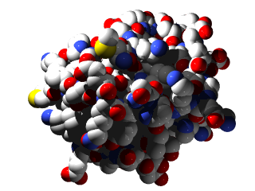
Mass Spectrometry*
Analytical method to measure the molecular or atomic weight of samples

Slide 46
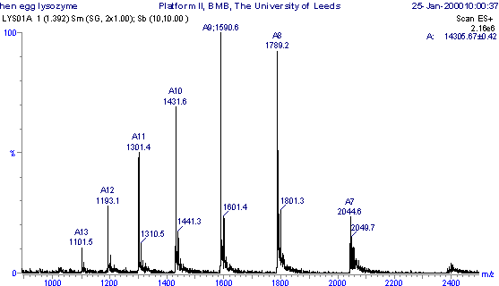
Typical Mass Spectrum

Slide 47
In a similar manner:
Mass spectrometers allow the determination of a mass-to-charge ratio of the analyte.
By knowing the charged state of the analyte through the addition of protons (the backpack in the example), the mass can be calculated after deconvolution of the spectrum.

Slide 48
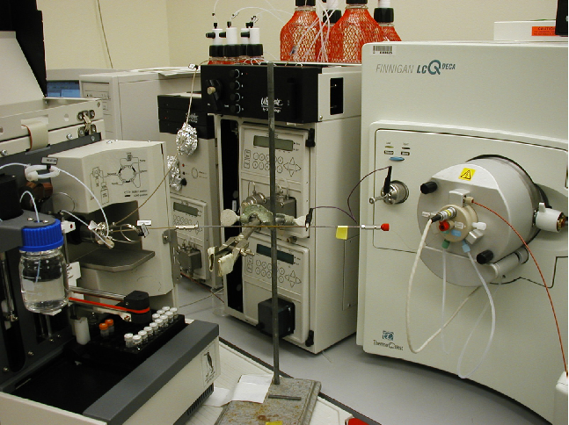
LCQ Mass Spectrometer

Slide 49

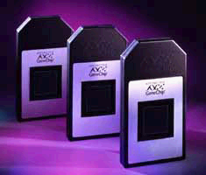
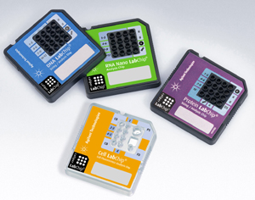
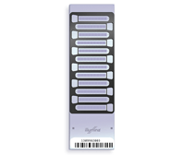

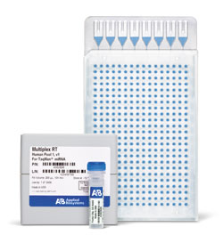
Compare to Microarrays…

Slide 50
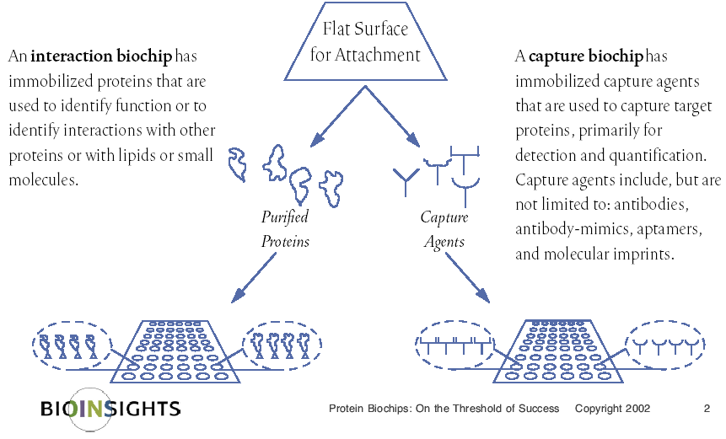
…and other biochips

Slide 51
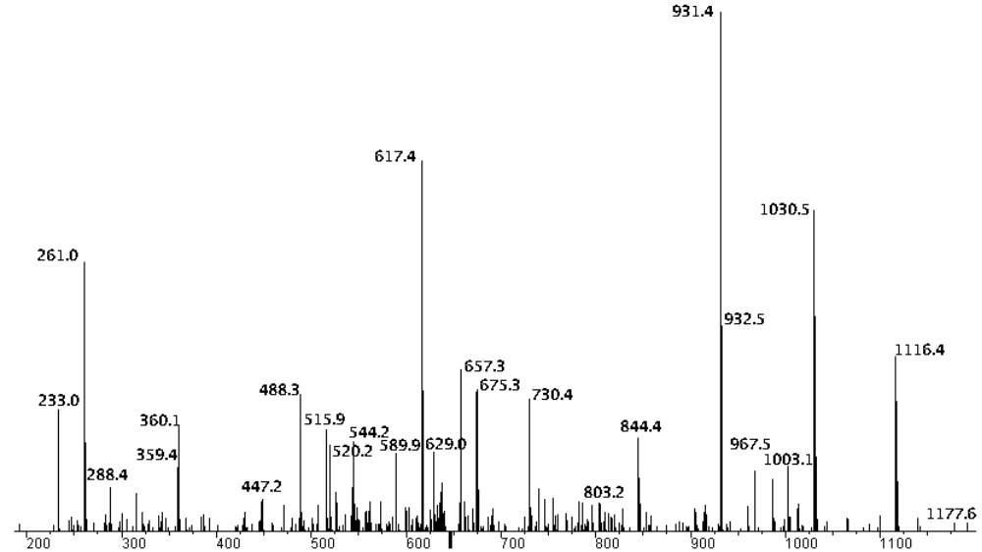
Example MS/MS Spectrum
This spectrum shows the fragmentation of a peptide, which is used to determine the sequence of the peptide, via a search algorithm.

Slide 52
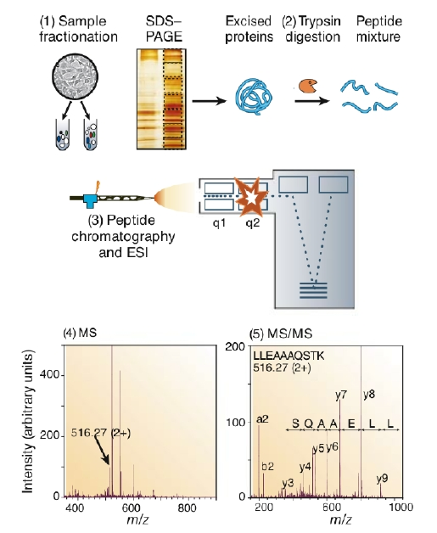
Typical MS experiment:

Slide 53
Comprehensive Analysis of Protein-Protein Interactions
Agarose
GST
Protein
C
Agarose
Ig-G
TEV
Agarose
L
Ig-G
Protein Interaction
Chromatography
Co-immunoprecipitation
Multiprotein Complex
TAP-Tagged Proteins
Proteolysis
LC/MS/MS
LC/LC/MS/MS
Identification of Protein Components
Identification of Modifications
Dynamics of components and modifications
Cell Biology/
Genetics

Slide 54
Second Generation Proteomics Technology
Shotgun Proteomics
Identification of Proteins in Mixtures
LC
Digestion
Separation
Complex Peptide
Mixture
MS/MS
SEQUEST
ymr154
ymr201
ymr130
ymr142
Protein Identification data acquired at ~1 peptide per 1-3 secs
Eng, McCormack, Yates, JASMS 1994

Slide 55
836.4362
1406.7220
766.4868
904.4685
1209.5710
40000
997.5691
1570.6782
2061.1366
Counts
30000
1697.8175
20000
1221.7473
1800.9144
1890.9643
10000
0
800
1000
1200
1400
1600
1800
2000
Mass (m/z)
Molecular Weight
…PPGTGKTLLAK AVANESGANFISVK FYVINGPEIM...
Fragmentation
100
922.4
90
80
70
835.4
60
Relative Abundance
50
40
30
778.5
1051.6
20
333.1
468.1
619.0
1074.5
1236.7
10
961.4
0
200
300
400
500
600
700
800
900
1000
1200
1400
m/z

Slide 56
MS videos
http://video.google.com/videoplay?docid=-6140373375438015688&q=mass+spectrometry&hl=en (Berkeley lecture, 2006)
http://video.google.com/videoplay?docid=4083728878452715101 (short, 2007)

Slide 57
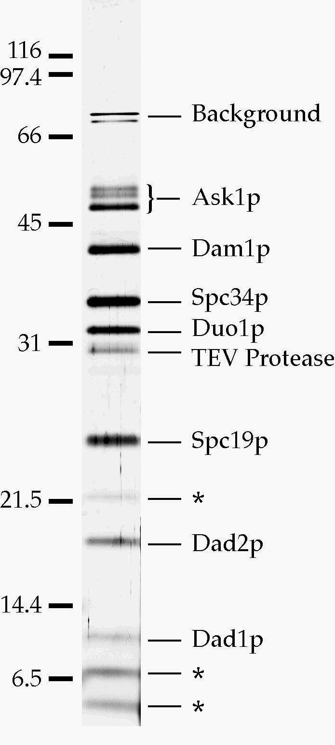
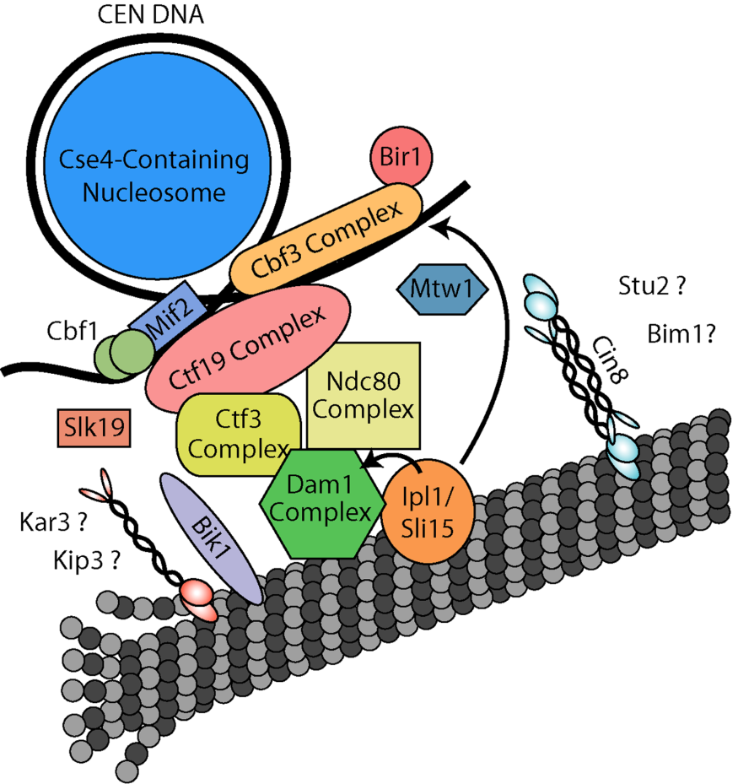
Example: Kinetochore
Ctf19p
Mcm21p
Cheeseman et al. 2001
Janke et al. 2002
Li et al. 2002
Okp1p
Ortiz et al. 1999
Chl4p
Mcm19p
Mcm16p
Mcm22p
Ghosh et al. 2001
Ctf3p
Measday et al. 2002
** Defined by 2-hybrid and co-immunoprecipitation **
Notes:
In looking around the rest of the kinetochore, we noticed three additional groups of proteins that had been identified in genetic screens. Various groups have identified interactions between these proteins that have placed them in the boxes shown here. However, these interactions are based primarily on 2-hybrid and co-IP data, and none of these proteins had ever been purified from yeast extracts. Therefore, I tagged one protein in each of these groups.

