Slide 1
Computational Proteomics & Metabolomics
Unit 21
BIOL221T: Advanced Bioinformatics for Biotechnology
Irene Gabashvili, PhD

Slide 2
Computational Biology
Genomics
  Fragment assembly
  Sequence analysis, etc.
  Lots of string algorithms
Transcriptomics
  Microarray clustering & analysis
Proteomics
  Structural comparisons
  NMR and Mass Spec analysis, Mass-Informatics
Phylogenetics
Literature mining
etc

Slide 3
Computational Biology
Gene promotion and inhibition
  Strings and learning theory
Multi-atom interactions
  Protein complexes
  Regulatory networks
  Geometry, topology and graphs
Biological systems
  Whole cell modeling
  Ecological models
  Topology and graph analysis

Slide 4
Proteomics Informatics: standards
EBI and HUPO have come together to promote uniform data storage and analysis:
  http://www.psidev.info/
The main organizational unit of the Proteomics Standards Initiative is the work group. Currently, there are the following work groups:
  Gel Electrophoresis (GEL)
  Mass Spectrometry (MS)
  Molecular Interactions (MI)
  Protein Modifications (MOD)
  Proteomics Informatics (PI)
  Sample Processing (SP)

Slide 5
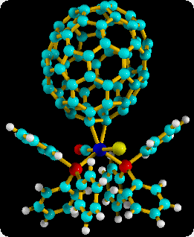
Cheminformatics
Categorizing molecules by graph properties
  Various topological invariants, graph properties
  Used to screen molecules for desired properties
Combinatorics of polymers
  Geometric and graph properties
Statistically correct ensembles
  Graph enumeration and sampling
Notes:
Cayley coined “graph” in this context.

Slide 6
Proteomics
The study of the proteome, which is the protein complement of the genome
Everything post-genomic, “protein chemistry on an unprecedented, high-throughput scale”, including structure, function and interactions of proteins
As coined in 1994 by Marc Wilkins: the functional study of proteins using Mass Spectrometry

Slide 7
Bioinformatics tools for PAGE:
http://world-2dpage.expasy.org/repository/
(database)
http://expasy.org/melanie/
http://www.2d-gel-analysis.com/
(image processing tools)

Slide 8


Computational Proteomics
Mass Spectrometry (MS/MS) data pre-processing
  Sequence Signatures
  Modification Signatures
  Spectral quality
Protein and Modification Identification
  Well established methods exists
    Faster, More Sensitive, More Accurate
  High throughput and large scale de novo analysis
Global Quantification Software
  Software is needed based on established rules for isotopomer analysis
Statistical Significance of Matches
  Empirical v. Non-empirical methods

Slide 9

Database
GGILAQSPFLIIK
1410.6
IIGHFYDDWCPLK
AFDSLPDDIHEK
SPAFDSIMAETLK
100
x8
1007.4
80
1155.5
real spectrum Cross-
Correlated with model
spectrum
60
662.3
805.5
892.6
1226.8
255.7
40
360.9
403.0
519.1
20
185.3
1324.8
250
500
m/z
750
1000
1250

Slide 10
Algorithmic approaches to “tag” identification
Peptide sequence tags (Mann): extract and unambiguous sequence tag for ID.
Cross Correlation (Eng et al. - SEQUEST): comparison between observed and theoretically generated spectra.
Probability-based matching (Perkins, and the proprietary Mascot by Matrix Science): takes into statistical significance of fragmentation.
Spectrum Mill: unique algorithms that minimize false positives
Could DP be employed in the searching for post-translational modifications in future designs?
Could it be done in advance in order to factor account for PTMs to speed up the time of the search?

Slide 11
De novo algorithms
Infer sequences directly from spectra
Employ “spectrum graph” to identify peptide breakpoints
Use scoring function to determine most likely sequence
Depend more heavily on spectral quality than database identifiers

Slide 12
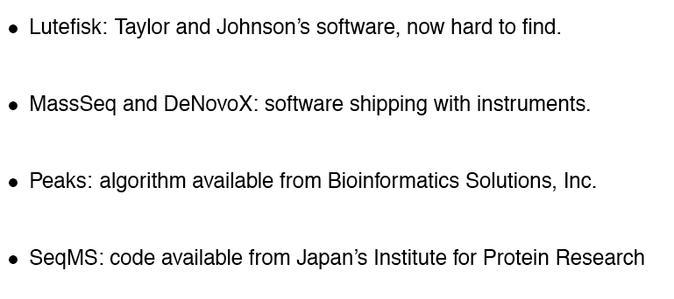
De novo algorithms
Spectrum Mill also includes de novo spectral interpretation for proteins not found in any database.

Slide 13
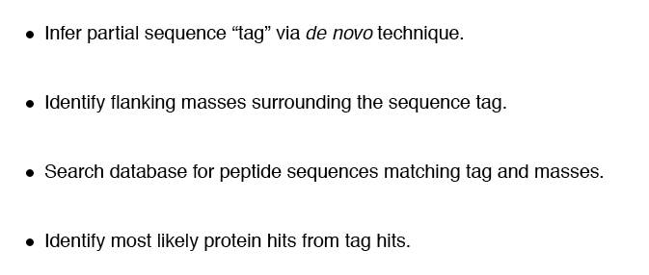
Sequence tagging Algorithms

Slide 14
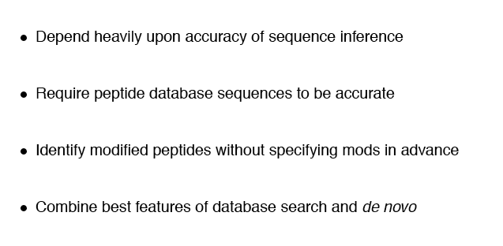
+/- Sequence Tagging Algorithms

Slide 15
Computational Proteomics & Metabolomics in IPA
IPA – looks for significant functional associations, literature based, GO- and manually curated associations, canonical pathways, predefined and custom gene lists, creates networks, reconstructs significant processes, finds biomarkers
Accepts multiple protein and chemical identifiers

Slide 16
Applications of Proteomics
Protein Mining – catalog all the proteins present in a tissue, cell, organelle, etc.
Differential Expression Profiling – Identification of proteins in a sample as a function of a particular state: differentiation, stage of development, disease state, response to drug or stimulus
Network Mapping – Identification of proteins in functional networks: biosynthetic pathways, signal transduction pathways, multiprotein complexes
Mapping Protein Modifications – Characterization of posttranslational modifications: phosphorylation, glycosylation, oxidation, etc.

Slide 17

Differential Expression
Nondifferentiated CAD
Cell Proteome
Differentiated CAD
Cell Proteome
Common proteins
Proteins unique to
nondifferentiated cells
Proteins unique to
Differentiated cells

Slide 18
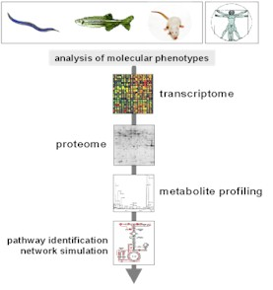
Metabolic Profiling
Definition:
Metabolic Profiling is the systemic estimation of low molecular weight compounds (metabolome) from an organism or a range of organism.
Metabolic profiling is also called as “Metabolomics”.

Slide 19
Metabolomics
the systematic study of the unique chemical fingerprints that specific cellular processes leave behind - specifically, the study of their small-molecule metabolite profiles. Metabolomic research can assist in the elucidation of biological pathways, networks and systems biology. This research has direct implications in improving disease detection, diagnosis, risk assessment, prognosis, and prediction of therapeutic responses

Slide 20
Metabolic Profiling
Introduction
  Metabolomics is basically the study of differences.
  It gives us a better understanding of how an organism responds or a tissue works.
  It is a product of the genome of the organism , the expression of that genome and the operation of the metabolism in a particular part of the organism in a particular environment.
This estimation involves a range of analytical techniques & chemometric methods including GC-MS, LC-MS, NMR , FT-IR, 2DLC-DAD, HPLC, etc.

Slide 21
Metabolic Profiling: History
  The discovery of the glycolysis pathway and TCA cycle
  Liebig and Wohler (1828) - Produced organic chemicals such as urea under laboratory conditions.
  Berzellius (1830s-1840s) - proposed that fermentation involved catalysis and that yeast were the catalysts.
  Pasteur (1856) - shows fermentation carried out by micro-organisms
  Eduard and Hans Buchner (1897) - Discovered by chance that ground up yeast cells (yeast extract) fermented sugars to ethanol and CO₂ (i.e. in the absence of any cellular structure).
  Harden and Young (1905) studied the process of fermentation by yeast extract using manometers to measure the volume change in closed vessels due to the production of CO₂. Their first approach was to see if any compounds apart from sugar (sugar=sucrose – a disaccharide of glucose + fructose) could lead to the release of CO₂ and ethanol production. The following compounds were all found to be very effective: Glucose, glucose-6-phosphate, fructose-6-phosphate, fructose-1,6- bisphosphate, with the obvious conclusion that they were all part of the fermentation pathway, probably sequential intermediates.

Slide 22
Metabolic Profiling
  The metabolome includes lipid soluble chemicals that are found on the membranes.
  Polar chemicals from aqueous cellular extracts.
  Acidic, basic, stable and highly unstable compounds which oxidise very easily.
  There is no universal machine to measure all these diverse group of compounds.
  Makes metabolic profiling a competitive task.

Slide 23
Metabolic Profiling
Instrumentation for metabolomics
  Commonly used analytical instruments like Gas chromatographs, HPLC coupled with Mass spectrphotometer are used.
  NMR (Nuclear Magnetic Resonance) Spectroscopy.
  ESI – MS ( Electrospray ionisation – Mass Spectroscopy)
These are the commonly used techniques for Metabolomics.

Slide 24
Metabolic Profiling
Recent technologies:
  FT-IR (Fourier Transform infrared) Spectroscopy
  Two Dimensional gas chromatography coupled with high speed TOF-MS (Time of flight – Mass Spectroscopy)
  PACE – ES – MS (Pressure Assisted Chemical electrphoresis)
  In vivo NMR
  HILIC (Hydrophilic interaction chromatography)

Slide 25
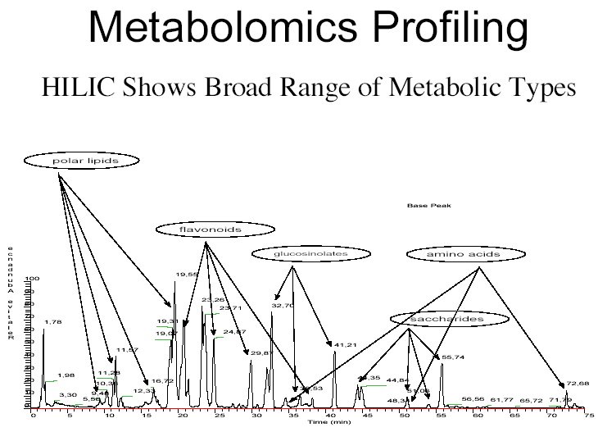

Slide 26
Metabolic Profiling
Data Analysis
  Metabolomics projects generate a large sets of data .
  Analysis of these large data sets are done using multivariate tools PCA (principal component analysis) or PLS ( Partial least squares projections to latent structures).
  This gives the possibility to interpret differences between samples is dependent on describing metabolic differences in visually simple ways, relating relative differences with known metabolic pathways to pinpoint impacted steps.

Slide 27
Molecular Profiling
PCA
  Unsupervised method
  No prior knowledge of the samples needed.
  Analysis based on calculation of latent variables
  Shows best representation of metabolic variation, to be described in a limited number of dimensions
PLS
  Supervised method
  Independent data set can be predicted on the basis of series of models that are derived.
  Maximizes separation between classes enable data validation.

Slide 28
Overview
Features of Metabolomic datasets
Pre-learning procedures
  Experimental design
  Data preprocess and sample validation
  Metabolite selection
Unsupervised learning
  Profile clustering
  SVD/RSVD
Supervised learning
Software

Slide 29
Why metabolomics?
Discover new disease biomarkers for screening and therapy progression
  A small subsets of metabolites can indicate an early disease stage or predict a therapy efficiency
Associate metobolites (functions) with transcripts (genes)
  Metobolites are downstream results of gene expression

Slide 30
Metabolomics datasets
Advantages
  Metabolomics are not organism specific => make cross-platform analysis possible
  Changes are usually large
  Closer to phenotype
  Metabolites are well known (900-1000)
Disadvantages
  Lots of missing data and mismatches (like Proteomics)
  Expensive (about 2-10 more expensive than Affymetrix)

Slide 31
Experimental design
Traditional experimental design still apply
  Blocking
  Randomization
  Enough replicates
Design the experiment based on the expectation
  A two-group design will not lead to a complete profiling (if samples in groups are homogenous)
  A multiple-group design may have difficulty for supervised learning (if group number is large and data is noisy)

Slide 32
Data preprocessing
Perform transformation
  Log-2 transformation is a common choice
Normalization: use simple ones
Summarization is needed for technical replicates
Filter variables by missing patterns
What to do with the missing data?

Slide 33
“Curse of missing data”
Missing can be due to multiple causes
  Informative missing
  Inconsistency / mismatch
  Unknown missing (we recently identified a suppression effect in Proteomics)
What to do?
  Replace with the detection limit (naïve)
  Leave as it is and let the algorithm to deal with it (we may ignore important missing patterns)
  Single imputation (KNN, SVD. Not easy for a data with > 20% missing)
  Multiple imputation (How to impute? Not easy to apply)
What’s needed?
  Theory support for univariate modeling incorporating missing values/censored values

Slide 34
NCI dataset
58 cells and 300 metabolites, no replicates
These cells are the majorities of the famous NCI-60 cancer cell lines
27% missing data. Can not replace missing values with a low value. Why?
Notes:
Analyze the datasets. Mention that I have limited time to get the approval of the datasets so can only demo the method.

Slide 35
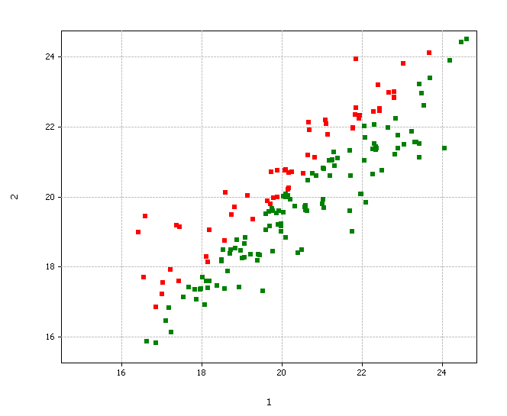
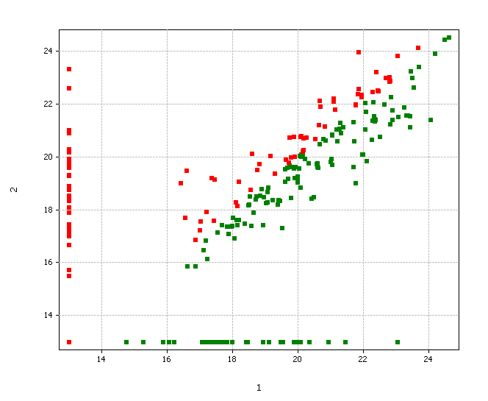
Missing value replacement: does it always work?
Before replacement
Correlation = 0.88
After replacement
Correlation = 0.68
Note: use pair-wise deletion to compute correlation; replace with value 13.
Cell 1 and 2 are both breast cancer cell types

Slide 36
Sample validation
Objective
  After we do the experiment, how do we decide if a sample has passed QC and is not an outlier?
Solutions
  Technical QC measures
  PCA: visual approach. Accepting or not is arbitrary
  Correlation-based method: formal and quantitative approach; based on all the data; has been taken by GSK as the formal procedure
  Sample validation is a cost-saving procedure

Slide 37
Metabolite selection
Objective
  Filter metabolites and assign significance
Outcome
  Least square means
  Fold change estimates and p-values
High dimensional linear modeling
  All the variables share the same X matrix and the same decomposition
  Implemented in PowerArray
  100 faster than SAS
Multivariate approach
  Cross-metabolite error model: not recommended unless n is very small (df < 10)
  PCA/PLS method: useful if no replicates

Slide 38
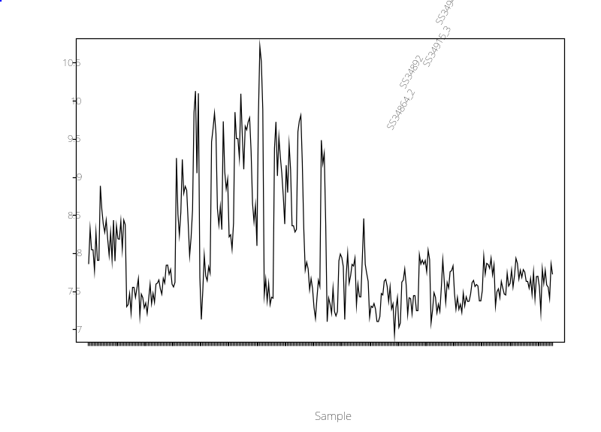
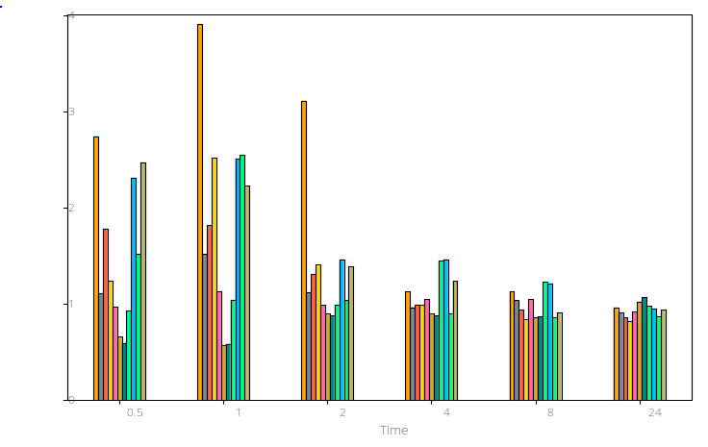
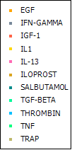
Metabolite selection: example
ANOVA Modeling
Two-way ANOVA
Consider block effects
Specify interesting contrasts
ANOVA modeling results
Significant metabolites
Means for each conditions
Fold changes

Slide 39
Unsupervised learning
Clustering
  Hierarchical clustering
  K-means/K-medians (partitioning)
  Profile clustering
SVD/RSVD
  Ordination/segmentation for heatmaps
  Plots based on scores/loadings
  Gene shaving (iterative SVD)

Slide 40
Profile clustering
Clustering based on profiles
Different from K-means or hierarchical clustering
  No need to specify K
  Does not cluster all the observations – only extract those with close neighbors
  Guarantee the quality of each cluster
  Works on a graph instead of a matrix

Slide 41
Profile clustering - NCI
Use correlation cutoff 0.90
Revealed 9 tight clusters. Most of the clusters include cell lines with the same cancer type.
Unexpected clusters?
MALME-3M (melanoma) are strongly correlated with other three renal cancers
HS-578T (breast cancer), SF-268 (CNS cancer), HOP-92 (non small cell lung cancer) are totally different cell lines but they share similar metabolic profiles

Slide 42
Robust singular value decomposition
Advantages:
  Robust to outliers
  Automatically deals with missing entries
Different versions of approaches
  L2-ALS: Gabriel and Zamir (1979)
  L1-ALS: Hawkins, Li Liu and Young (2002)
  LTS-ALS: Jack Liu and Young (2004)

Slide 43
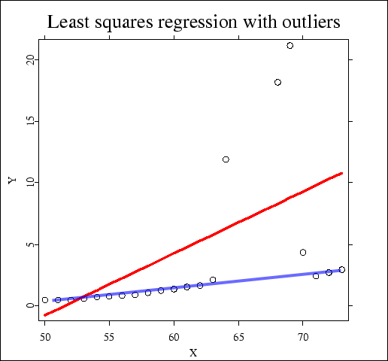
Alternating least trimmed squares
Least trimmed squares:
  Solves by
Estimation
  General: genetic algorithm
  Single-variate has much better solutions
  We used Brent’s search

Slide 44
Supervised learning: GSK use
Regression
  PLS
  Stepwise regression
  LARS/LASSO
Classification
  PLS-DA / SIMCA
  SVM

Slide 45
Supervised learning: what’s useful for drug discovery?
A model will not be particularly useful if it involves thousands of variables
A model will not be useful it is not interpretable
Therefore, a model is useful if is
  Easy to interpret
  Easy to apply prediction
  Better than empirical guess
Variable selection for regression or classification has attracted a lot of interest

Slide 46
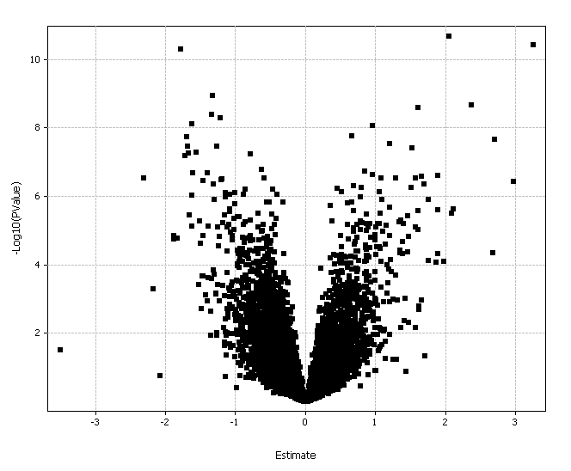
Volcano plots

Slide 47
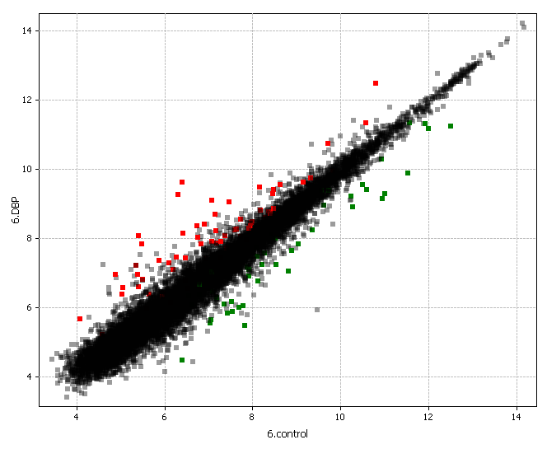
Scatter plots

Slide 48
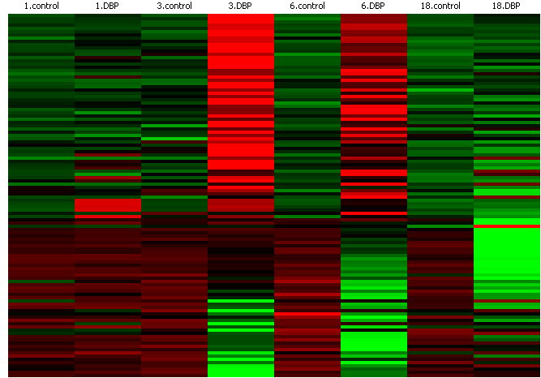
Heatmaps

Slide 49
Simca (Soft Independent Modeling of Class Analogy)
Analyses
  PCA
  PLS
  PLS-DA / SIMCA
Advantages
  Takes cares of missing data
  Good job on model validation

Slide 50
Useful Links
Several search engines are available that use their own individual search algorithms and scoring systems
http://www.matrixscience.com/
A powerful search engine that uses mass spectrometry data to identify proteins from primary sequence databases
http://fields.scripps.edu/sequest/
determines the aa sequence, the protein(s) and organism(s) that correspond to the mass spectrum being analyzed.
http://www.chem.agilent.com/Scripts/PDS.asp?lPage=7771
identifies proteins & peptides via fast database searches, unique algorithms that minimize false positives.
http://www.metabolomics.ca/ - Metabolomics Database

