Slide 1
Predictive Methods Using Protein Sequences
Unit 23
BIOL221T: Advanced Bioinformatics for Biotechnology
Irene Gabashvili, PhD

Slide 2
Introduction
Each protein starts its life as a shapeless string of amino acids – more exactly, residues
Primary > Secondary > 3D Structure
Function depends on 3D structure
3D structure can be “guessed” from Sequence, but more info is needed – folding environment, chaperonines, etc
Partial structural predictions can be also helpful

Slide 3
Amino Acid versus Residue
R
R
C
C
H2N
COOH
N
CO
H
H
H
Amino Acid Residue
--- next lecture: all on structures ---

Slide 4
From previous lecture:
Often, it’s enough to knowing the sequence of the first 6 amino acids to identify the protein
“Terminal sequence identification” approach: a “label” (“backpack”) is chemically attached to the end.
label-AA₁-AA₂- …Aa_{n}
  label-AA₁
  label-AA₁-AA₂-AA₃
  …

Slide 5
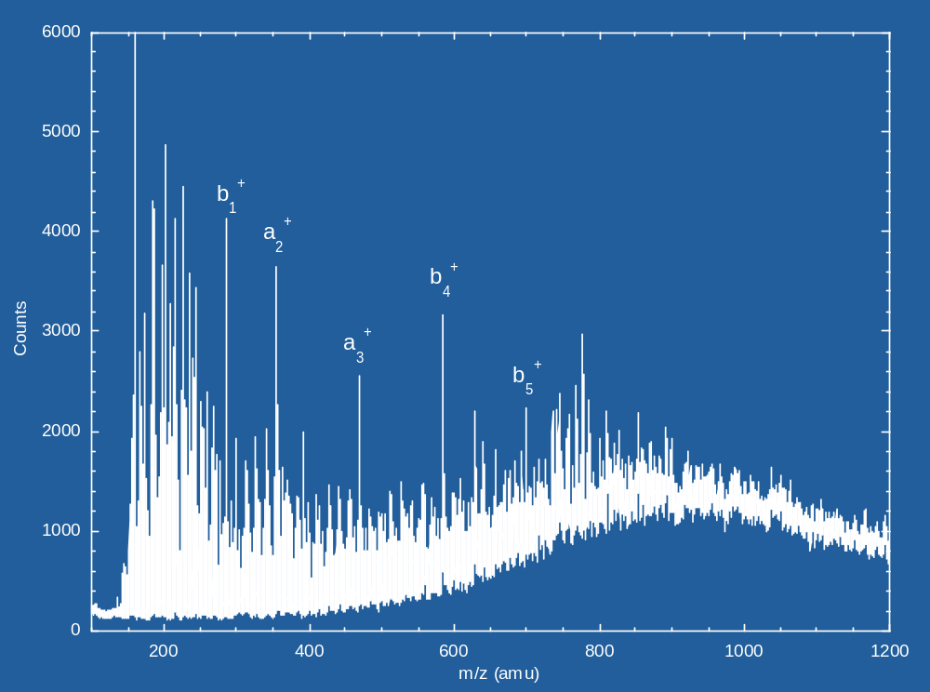
Riptide Algorithm (D.Carter et al)
Mass spec data from an unknown protein
label
M
label+
MQ
label+
MQI
Occurrence counts
label+
MQIF
label+
MQIFV
label+
Terminal Amino Acid Sequence Prediction, e.g. MQIFVK
MQIFVK
label+
Riptide Sequencing Algorithm
mass_{F}
mass/charge
(e.g. protein shown is ubiquitin whose amino acid sequence starts from MQIFVK…)
See e.g., >gi|37571|emb|CAA44911.1| ubiquitin [Homo sapiens]
Notes:
LIfe Sciences Activites at CRL
The Riptide algorithm seeks to identify an unknown protein from its fragmentation mass spectrum.
Unlike other slower experimental approaches where the protein is first broken down into smaller peptides which are then completely sequenced, Riptide seeks to determine only some number n of terminal amino acids from the fragments of a labeled intact protein.
The value n is referred to as the sequencing depth.
Note that in 90% of the cases, knowledge of the first 6 amino acids is sufficient to identify the protein from a database of known proteins.
The Riptide algorithm duplicates the result of an algorithm put forth by Target Discovery Inc. (to be called the prior art), but does so much faster.

Slide 6
Simple algorithm
  Calculates a score value for each of the 20³ amino acid sequences in a nested loop fashion. Suppose there are only 3 amino acids (0, 1 and 2) with masses m₀, m₁ and m₂ (3³= 27 permutations), no attached label. For the x-y-z sequence, the scoring function rewards the presence of the likely molecular fragments x, x-y and x-y-z.
do x = 0 to 2
do y = 0 to 2
do z = 0 to 2
P_{xyz} = MS(m_{x}) + MS(m_{x}+m_{y}) + MS(m_{x} +m_{y}+m_{z})
The sequence generating the highest scoring P_{xyz} is reported as the most likely sequence for the unknown protein.
Notes:
LIfe Sciences Activites at CRL
In the 19th century and before, engineering (the application of scientific and mathematical principles to practical ends such as the design, manufacture, and operation of efficient and economical structures, machines, processes, and systems) consisted largely of mechanical systems, levers, gears, belts, and in the 19th century (steam) engines.
In the later half of the 20th century a new technology was introduced into the

Slide 7
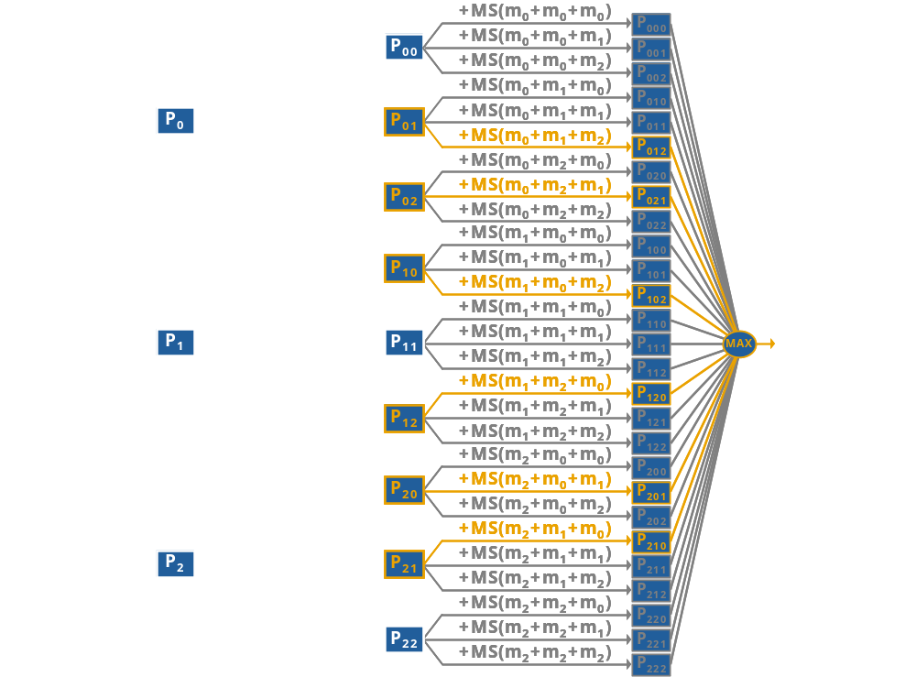
Redundant lookups
Notes:
LIfe Sciences Activites at CRL
In the 19th century and before, engineering (the application of scientific and mathematical principles to practical ends such as the design, manufacture, and operation of efficient and economical structures, machines, processes, and systems) consisted largely of mechanical systems, levers, gears, belts, and in the 19th century (steam) engines.
In the later half of the 20th century a new technology was introduced into the

Slide 8
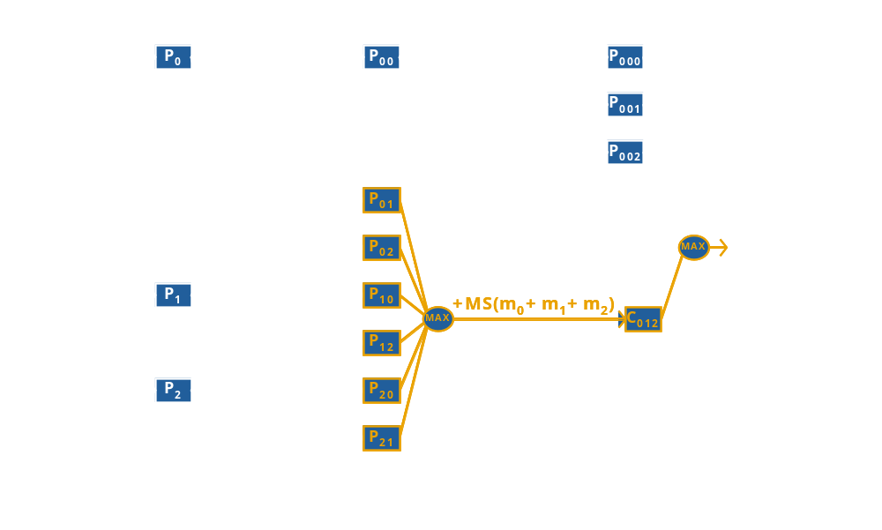
Need combinations
Notes:
LIfe Sciences Activites at CRL
In the 19th century and before, engineering (the application of scientific and mathematical principles to practical ends such as the design, manufacture, and operation of efficient and economical structures, machines, processes, and systems) consisted largely of mechanical systems, levers, gears, belts, and in the 19th century (steam) engines.
In the later half of the 20th century a new technology was introduced into the

Slide 9
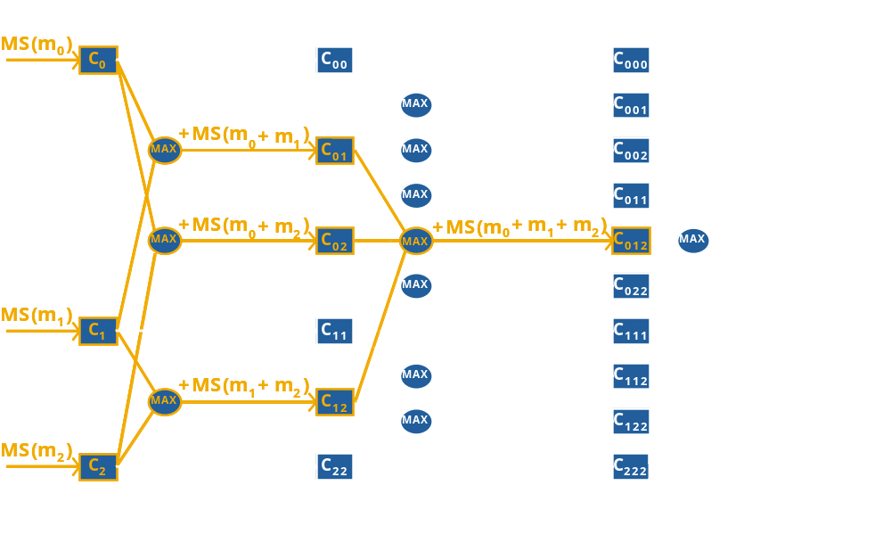
Riptide “combination space” sequencing
Notes:
LIfe Sciences Activites at CRL
In the 19th century and before, engineering (the application of scientific and mathematical principles to practical ends such as the design, manufacture, and operation of efficient and economical structures, machines, processes, and systems) consisted largely of mechanical systems, levers, gears, belts, and in the 19th century (steam) engines.
In the later half of the 20th century a new technology was introduced into the

Slide 10
Crash course on biostatistics
Statistics – analyzing data sets in terms of the relationships between the individual points
Variance & Standard Deviation; Co-variance
Machine Learning approaches (supervised & unsupervised)
Clustering vs Classificaion, PCA
P-values & E-values, Scores via False positives, negatives

Slide 11
PCA
principal components analysis (PCA) is a technique that can be used to simplify a dataset
It is a linear transformation that chooses a new coordinate system for the data set such that
  greatest variance by any projection of the data set comes to lie on the first axis (then called the first principal component),
  the second greatest variance on the second axis, and so on.
PCA can be used for reducing dimensionality by eliminating the later principal components.
Applications: face recognition, patterns findings

Slide 12
What is Cluster Analysis?
Cluster: a collection of data objects
  Similar to the objects in the same cluster (Intraclass similarity)
  Dissimilar to the objects in other clusters (Interclass dissimilarity)
Cluster analysis
  Statistical method for grouping a set of data objects into clusters
  A good clustering method produces high quality clusters with high intraclass similarity and low interclass similarity
Clustering is unsupervised classification
Can be a stand-alone tool or as a preprocessing step for other algorithms

Slide 13
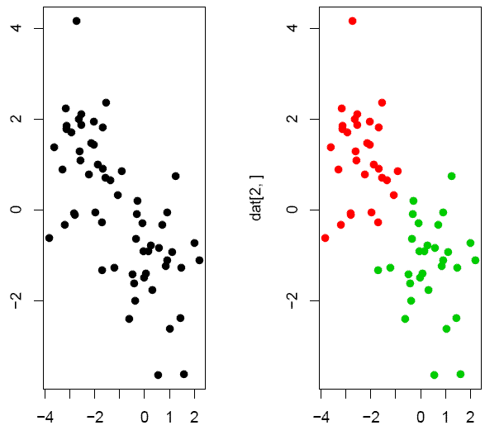
Group objects according to their similarity
Cluster:
a set of objects
that are similar
to each other
and separated
from the other
objects.
Example: green/
red data points
were generated
from two different
normal distributions

Slide 14
K-Means Clustering
The meaning of ‘K-means’
  Why it is called ‘K-means’ clustering: K points are used to represent the clustering result; each point corresponds to the centre (mean) of a cluster
Each point is assigned to the cluster with the closest center point
The number K, must be specified
Basic algorithm

Slide 15
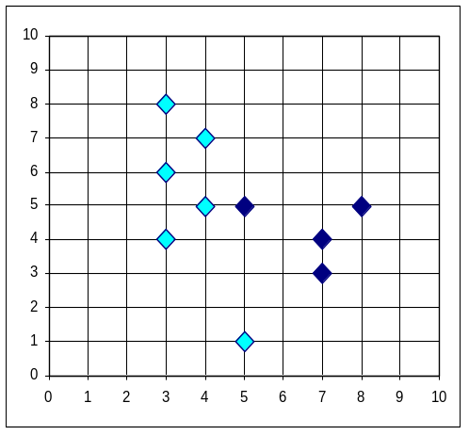


K-means clustering
10
10
9
9
8
8
7
7
6
6
5
5
4
Assign each objects to most similar center
Update the cluster means
4
3
3
2
2
1
1
0
0
0
1
2
3
4
5
6
7
8
9
10
0
1
2
3
4
5
6
7
8
9
10
reassign
reassign
K=2
Arbitrarily choose K object as initial cluster center
Update the cluster means

Slide 16
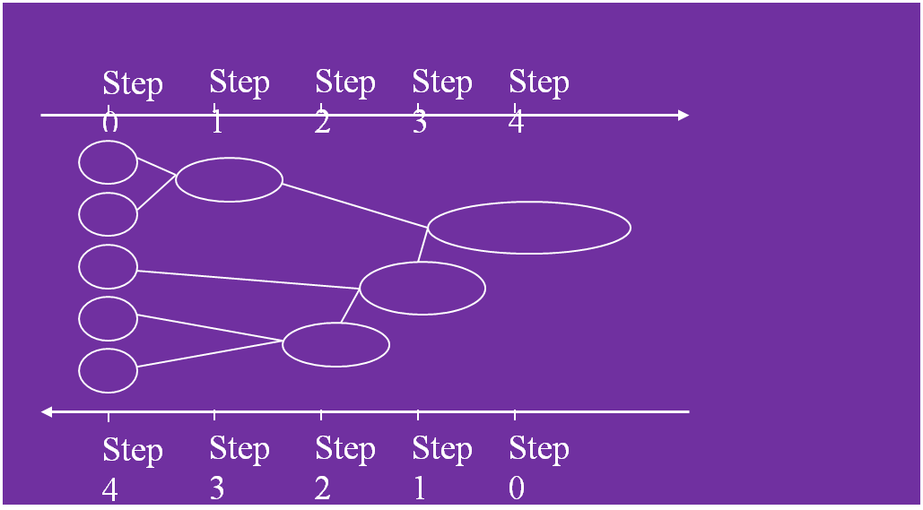
Hierarchical clustering
Protocol
Calculate pairwise distance matrix
Find the two most similar genes or clusters
Merge the two selected clusters to produce a new cluster
Calculate pairwise distance matrix involving the new cluster
Repeat steps 2-4 until all objects are in one cluster
The clustering sequence is represented by a hierarchical tree – dendrogram.

Slide 17
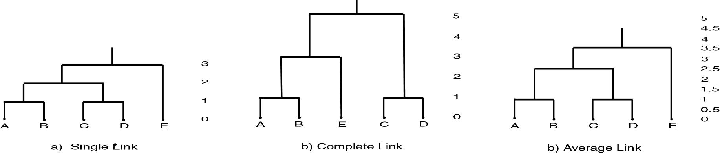
EXAMPLE
 | A | B | C | D | E
A | 0 | 1 | 2 | 2 | 3
B | 1 | 0 | 2 | 4 | 3
C | 2 | 2 | 0 | 1 | 5
D | 2 | 4 | 1 | 0 | 3
E | 3 | 3 | 5 | 3 | 0

Slide 18
(M)ANOVA
The analysis of variance technique in One-Way Analysis of Variance (ANOVA) takes a set of grouped data and determine whether the mean of a variable differs significantly between groups
Often there are multiple variables and you are interested in determining whether the entire set of means is different from one group to the next
  There is a multivariate version of analysis of variance that can address that problem (MANOVA)

Slide 19
What is a Biomarker?
NCI: (Srinivas et Sirvastava., Cancer Biomarker Research Group, review article, Vol. 8, 1160-69, 2002)
Biomarkers are biological molecules that are indicators of physiologic state and also change during a disease process. The utility of a biomarker lies in its ability to provide an early indication of a disease, to monitor disease progression, to provide ease of detection, and to provide a factor measurable across populations.

Slide 20
What Types of Biomarkers Exist?
Genomic
  DNA (e.g., BRCA-I gene mutations)
  RNA (gene expression, up/down regulation)
Proteomic
  Peptides (e.g., PIF)
  Proteins (e.g., HER2/neu, PSA, CA-125)
Metabonomic
  Small molecules, metabolites (e.g., glucose, cholesterol, cortisol)
MS-based

Slide 21
Bioinformatics tools can predict:
Secondary Structure
3D Structure
Interaction Sites
Solvent Accessibility
Transmembrane Segments
Subcellular Localization
Function

Slide 22
What Can Be Predicted?
O-Glycosylation Sites
Phosphorylation Sites
Protease Cut Sites
Nuclear Targeting Sites
Mitochondrial Target Sites
Chloroplast Target Sites
Signal Sequences
Signal Sequence Cleav.
Peroxisome Target Sites
ER Targeting Sites
Transmembrane Sites
Tyrosine Sulfation Sites
GPInositol Anchor Sites
PEST sites
Coil-Coil Sites
T-Cell/MHC Epitopes
Protein Lifetime
And a lot more….

Slide 23
Sequence Feature Servers
T-Cell Epitope Prediction – no longer exists
  http://syfpeithi.bmi-heidelberg.com/scripts/MHCServer.dll/home.htm
B cell epitope prediction from 3D structures:
  http://www.cbs.dtu.dk/services/DiscoTope/
Predictions of promiscous MHCI-restricted epitopes:
  http://immunax.dfci.harvard.edu/PEPVAC/
O-Glycosylation Prediction
  http://www.cbs.dtu.dk/services/NetOGlyc/
Phosphorylation Prediction
  http://www.cbs.dtu.dk/services/NetPhos/

Slide 24
Secondary Structure
PHDsec: http://www.predictprotein.org
Workbench: http://workbench.sdsc.edu/
NGWB: www.ngbw.org
PROFsec: http://cubic.bioc.columbia.edu/predictprotein/
PSIPRED (http://bioinf.cs.ucl.ac.uk/psipred/ )
Jpred (http://www.compbio.dundee.ac.uk/~www-jpred/)

Slide 25
History of secondary structure prediction:
The 1st generation: physicochemical principles, expert rules, and statistics (1970s, 50% accuracy)
The 2nd generation methods: sliding window that walked through the entire sequence. (1980s into the 1990s, ~60% accuracy).
The 3rd generation methods use multiple sequence alignments, take advantage of the evolutionary information (~75% accuracy).

Slide 26
Tutorials/Description:
PredictProtein : sequence analysis, prediction of protein function and structure
The PredictProtein Server. Nucleic Acids Research 32(Web Server issue):W321-W326.

Slide 27
Interaction sites
http://cubic.bioc.columbia.edu/services/
See also:
http://bioinformatics.ca/links_directory/narweb2007/ (same for 2006-2003)
http://gemdock.life.nctu.edu.tw/3D-partner/vers1/index.php (predicts interaction partners)
http://ef-site.hgc.jp/eF-seek/index.jsp

Slide 28
Solvent Accessibility
PHDacc (http://www.predictprotein.org/
PROFacc (http://cubic.bioc.columbia.edu/predictprotein/ )
Jpred (http://www.compbio.dundee.ac.uk/~www-jpred/ )

Slide 29
Transmembrane Segments
TopPred (http://bioweb.pasteur.fr/seqanal/interfaces/toppred.html )
TMHMM (http://www.cbs.dtu.dk/services/TMHMM/ )
Membrane Helix Prediction
  http://www.cbs.dtu.dk/services/TMHMM-2.0/

Slide 30
Subcellular Localization
PSORT: http://psort.ims.u-tokyo.ac.jp/
TargetP: http://www.cbs.dtu.dk/services/TargetP/
http://cubic.bioc.columbia.edu/db/LOC3d/index.html

