Slide 1
Protein structures, databases and servers
Unit 24
BIOL221T: Advanced Bioinformatics for Biotechnology
Irene Gabashvili, PhD

Slide 2
Protein structure
Primary structure (Amino acid sequence)
↓
Secondary structure （α-helix, β-sheet）
↓
Tertiary structure （Three-dimensional structure formed by assembly of secondary structures）
↓
Quaternary structure （Structure formed by more than one polypeptide chain）

Slide 3
The DSSP code
"Dictionary of Protein Secondary Structure"
G = 3-turn helix (3₁₀ helix). Min length 3 residues.
H = 4-turn helix (alpha helix). Min length 4 residues.
I = 5-turn helix (pi helix). Min length 5 residues.
T = hydrogen bonded turn (3, 4 or 5 turn)
E = beta sheet in parallel and/or anti-parallel sheet conformation (extended strand). Min length 2 residues.
B = residue in isolated beta-bridge (single pair beta-sheet hydrogen bond formation)
S = bend (the only non-hydrogen-bond based assignment)

Slide 4
Databases
PDB: www.rcsb.org/
MSD: http://www.ebi.ac.uk/msd/
MMDB: http://www.ncbi.nlm.nih.gov/Structure/MMDB
PDBSum: www.biochem.ucl.ak.uk
TargetDB: targetdb.pdb.org/

Slide 5
Prediction
Homology Modeling
Threading
Ab initio structure prediction
Similarities & Differences

Slide 6
Validation
DSSP
PROCHEK
VADAR
Verify3D

Slide 7
Visualization
Cn3D
UCSF Chimera (Midas)
Rasmol → ProteinExplorer http://www.umass.edu/microbio/rasmol/

Slide 8
Cn3D
Cn3D is a visualization tool for biomolecular structures retrieved by NCBI's Entrez. Cn3D simultaneously displays structure, sequence, and alignment, and has annotation and alignment editing features (Windows, Macintosh, and Unix).

Slide 9
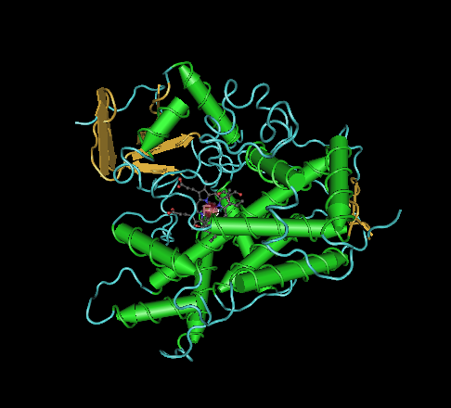
Cn3D

Slide 10
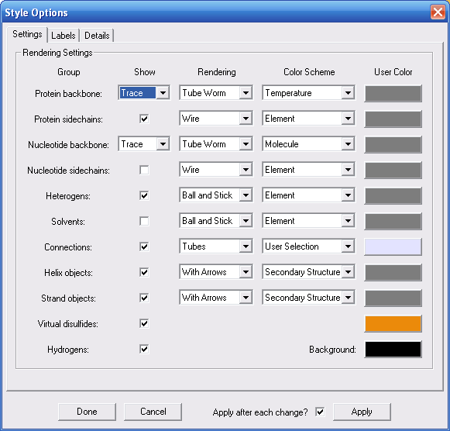
Style → Edit Global Style

Slide 11
CHIMERA MOLECULAR MODELING SYSTEM
http://www.cgl.ucsf.edu/chimera/
Chimera is an interactive molecular graphics program.
More advanced than Cn3D or Rasmol, Python scripts

Slide 12
Chimera demo
Tools > Structural analysis > distances

