Slide 1
Cheminformatics, QSAR and drug design
Unit 24
BIOL221T: Advanced Bioinformatics for Biotechnology
Irene Gabashvili, PhD

Slide 2
References
Special Thanks to Tobias Kind - UC Davis Genome Center - Fiehnlab Metabolomics and other cheminformatics/metabolomics experts – for their slides used in this lecture

Slide 3
What is it?
Cheminformatics, application of informatics to problems in the field of chemistry, for chemical screening and analysis in drug discovery
<Structure-Based> Drug design, the design of a drug molecule based on knowledge of the target protein (or nucleic acid) structure
QSAR, Quantitative Structure Activity Relationship, the relationship between the structure of a chemical and its pharmacological activity

Slide 4
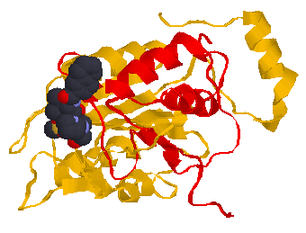
SELECTING THE BEST TARGETS
Disease-association doesn’t make a protein a target - requires validation as point of intervention in pathway
Having good biological rationale doesn’t make a protein tractable to chemistry (druggable)
Target Validation Process
Drug Discovery Process
Target
Selection
Disease
Target
Leads
Clinic
Bioinformatics
Cheminformatics

Slide 5

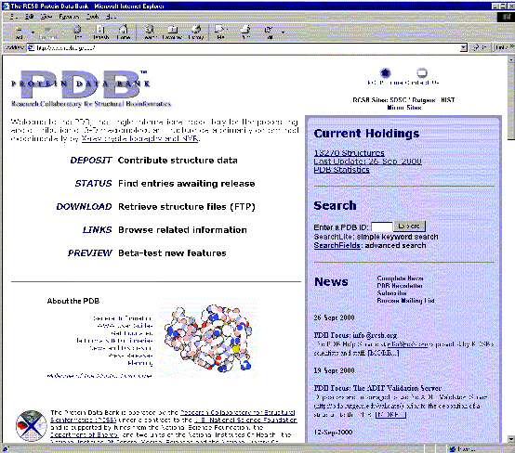
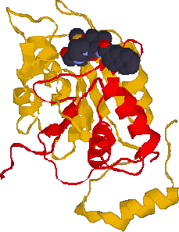
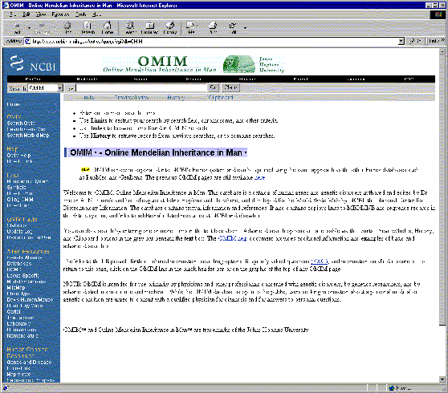
Cheminformatics
ctgacaagtatgaaaacaacaagctgattg tccgcagagggcagtctttctatgtgcaga
ttgacctcagtcgtc
Genome Data Target Structure Lead Hypotheses

Slide 6
Cheminformatics
Identify chemical compounds → establish compound-IDs
Identify the various structures which a given compound can adopt in various chemical environments (add structure IDs)
Associate and store computational and experimental data/results with corresponding compounds
Map and analyze in IPA or any Cheminformatics software:
http://www.netsci.org/Resources/Software/Cheminfo/
http://www.akosgmbh.de/chemoinformatics_software.htm
http://www.rdchemicals.com/chemistry-software/
http://www.chemaxon.com/

Slide 7
Dealing with compounds in “Nature’s Way”
it’s not just about ligands and docking !
  although that’s still what garners most of the attention
and it’s not just about “tautomers” !
  must also consider protonation state
  must also consider stereochemical issues
  must also consider conformational issues
it’s about being able to automatically use the same structures in silico as Mother Nature uses for a compound in the real world

Slide 8
Stereochemical Issues: Proto-Invertible Atoms & Bonds
Tautomeric transforms can change stereochemistry
Protonation/deprotonation can change stereochemistry
Protomeric transforms can change stereochemistry

Slide 9
Terminology for some “new” concepts
two types of stereo-centers: truly chiral atoms and bonds
stereomers: different stereochemical isomers (hence, different chemical compounds)
two types of proto-centers: acid/base & tautomeric D/A pairs
protomers: different protonation states and/or tautomeric states of a single given compound
protomeric state: refers to both protonation state and tautomeric state of a given protomer
protomeric transform: protomeric-state_{i} → protomeric-state_{j}
proto-stereomers: different stereomers of protomers of a given compound which differ ONLY with respect to chiralities of invertible or proto-invertible (pseudo-chiral) centers
proto-stereo-conformers: different 3D conformations of the proto-stereomers of a given compound

Slide 10
Terminology for some “new” concepts
proto-stereomers: different stereomers of protomers of a given compound which differ ONLY with respect to chiralities of invertible or proto-invertible (pseudo-chiral) centers
proto-stereo-conformers: different 3D conformations of the proto-stereomers of a given compound
2D-MetaStructure of a compound: the set of all proto-stereomers of a given compound; i.e., set of all 2.5D connection tables which could be achieved by and which should be associated with a given compound
3D-MetaStructure of a compound: the set of all proto-stereo-conformers of a given compound; i.e., set of all 3D conformations of all 2.5D connection tables which could be achieved by and which should be associated with a given compound

Slide 11
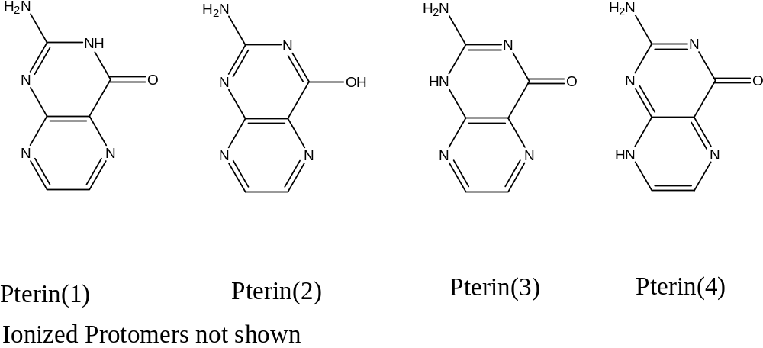
Example: Ricin Inhibitors - Pterins
ProtoPlex generates 4 neutral tautomeric forms
(plus additional charged protomers)
receptor-bound tautomer (protomer) may not be the protomer most prevalent in solution

Slide 12
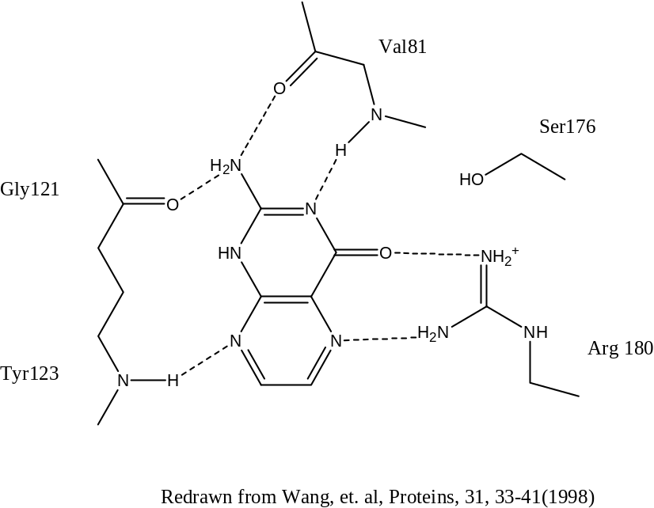

Example: Ricin Inhibitors - Pterins
“A tautomer of pterin that is not in the low energy form in either the gas phase or in aqueous solution has the best interaction with the enzyme.”
S. Wang, et. al., Proteins, 31, 33-41 (1998)
Pterin(1) protomer is preferred in both gas and aqueous soln
Pterin(3) protomer is preferred in receptor binding site

Slide 13
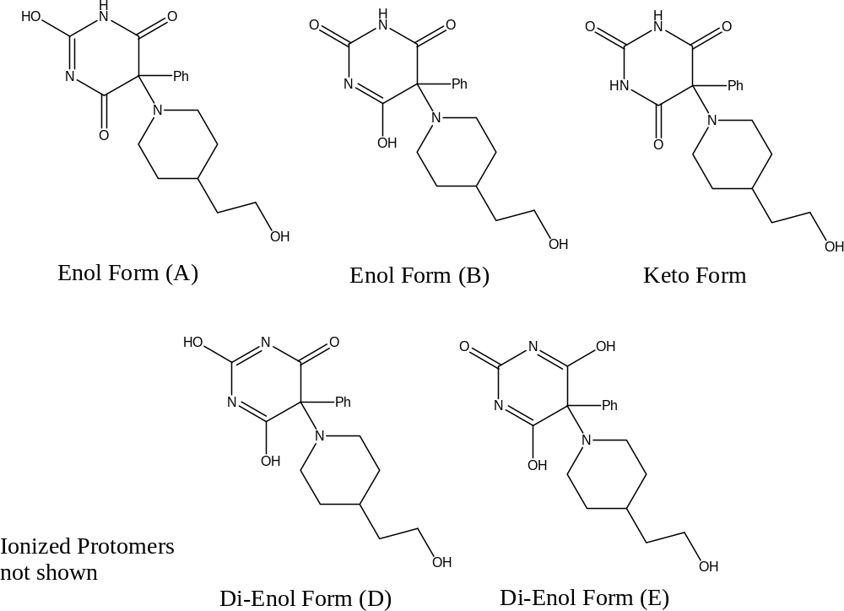
Example: Barbiturate Matrix Metalloproteinase Inhibitors
ProtoPlex generates 5 neutral tautomeric forms
(plus additional charged protomers)
the receptor-bound tautomer (protomer) might not be the keto protomer which is most prevalent in aqueous solution
which protomer does the receptor prefer?
which protomer(s) will be used for vHTS???

Slide 14
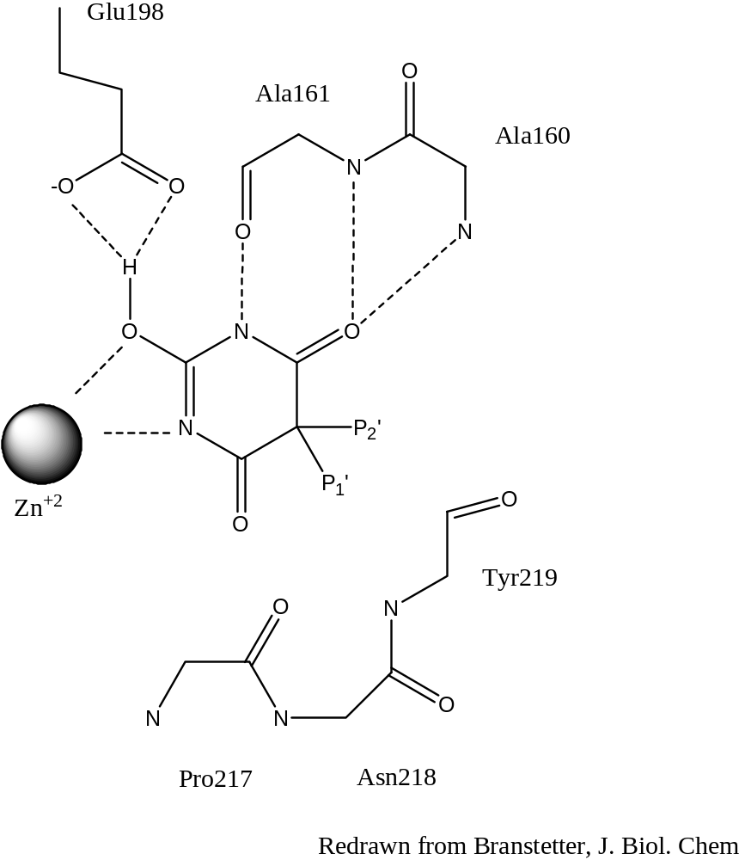
Example: Barbiturate Matrix Metalloproteinase Inhibitors
“The enol form (A) of the barbiturate is thus favored by the protein matrix over the tautomeric keto form, which dominates in solution.”
H. Brandstetter, et. al., J. Biol. Chem., 276(20), 17405-17412 (2001)

Slide 15
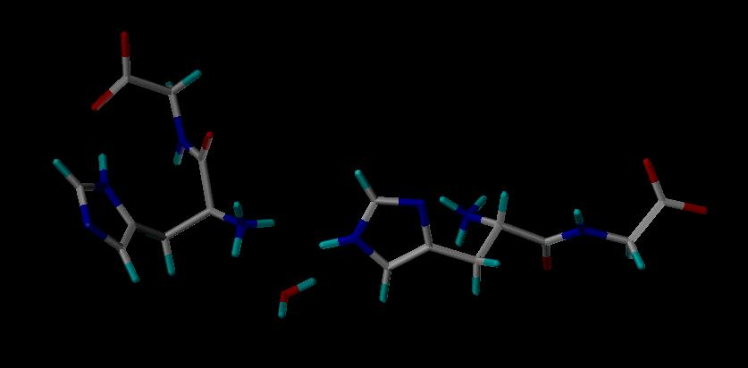
Example: effect of crystal environment
Two different protomers observed in the SAME unit cell!
“Coexistence of both histidine tautomers in the solid state and stabilisation of the unfavoured Nδ-H form by intramolecular hydrogen bonding: crystalline L-His-Gly hemihydrate” T. Steiner and G. Koellner, Chem. Commun., 1997, 1207.
Protomeric transform was induced by intramolecular interaction which was induced by a conformational change which was induced by intermolecular interactions.

Slide 16
QSPR motives for adopting “Nature’s Way”
better ADME and other SPR and QSPR models
  protomeric state of a “solute” depends on the chemical potential presented by the surrounding “solvent” or molecular environment (often different than aqueous soln)
  partition coefficients (two solvent environments to consider)
  permeability coefficients (depend on donor-phase and membrane)
  solubilities (depend on crystalline and solvent environments)
  melting points (crystal packing can favor unusual protomeric forms)
  need to “select” protomeric forms according to user-specs
better models ⇒ better decisions
  about what to screen
  about which “hits” to promote to “leads”
  about route of administration and/or formulation
  about which leads to promote to candidacy

Slide 17
Cheminformatic motives for adopting “Nature’s Way”
better storage of data
  measured properties of compound should be associated with the compound (with notations re: experimental conditions)
  predicted properties “of a compound” should be associated with (stored under) the particular structure used for the prediction
  that structure, in turn, should be associated with the compound
  need a unique identifier that can tie any proto-stereomeric structure to the compound to which it corresponds
better use of data
  enable “data-mining” of both measured and computed data
    discard wet HTS data? save for future “data-mining?”
    discard virtual HTS data? save for future “data-mining?”
better (more robust) results when searching for compounds, data, structures, and substructures

Slide 18
Business & IP motives
companies must
be able to recognize when
two different structures correspond
to the same compound!
need a canonically unique identifier that can tie
any proto-stereomeric structure
to the compound to which it corresponds

Slide 19
Business & IP motives for adopting “Nature’s Way”
companies allocate resources for compounds, not structures
  resource-related decisions (what should we purchase, synthesize, screen?) should be based on compounds, not structures
    to properly manage corporate inventories
    to avoid costly, unintended duplications (acquisitions and screening)
    to avoid far more costly failure to screen active compounds for which the representative (DB) structures were predicted to be inactive
companies own & intend to patent cmpds, not structures
  offensive and defensive “Freedom To Operate” strategies are far stronger when all structures of patented compouds are considered
  failure to realize that a competitor’s “novel compound” is merely a different structure of your patented compound can cost $billions
    at least one acknowledged example already exists!!

Slide 20
Example Nature’s Way Protocol
Raw, 2D
Input
Filtered, 2D Input
Multiple, 2D Protomers
Multiple, 2.5D
Proto-Stereomers
Multiple, 3D
Proto-Stereo-Conformers
Database
CompoundFilter
ProtoPlex
StereoPlex
Confort
vHTS
For each compound …
  many Proto-Stereomers
  One 2D-MetaStructure
  Many Proto-Stereo-Conformers
  One 3D-MetaStructure
2D App.
associate structure-based data with corresponding structure of each compound pulled from DB

Slide 21
StereoPlex
for general purposes, provides user-controlled “multiplexing” of all truly chiral, invertible, and proto-invertible stereocenters
  addresses atom-centered (R/S) and bond-centered (E/Z) chirality
  automatically excludes “stereochemical junk” (e.g., 254 out of 256 combinations of R’s and S’s for chiral, substituted cubane)
  outputs a user-specified number of stereomers selected according to a user-specified priority rule
    multiplexing unspecified stereocenters ensures that CADD results don’t suffer due to (necessarily) “random” stereochemistry introduced when converting from 2D to 3D -- -- a concept we introduced in 1986
    multiplexing specified stereocenters provides “stereochemical diversity” for vHTS applications – just as important as “structural diversity”
for “Nature’s Way” purposes, provides user-controlled “multiplexing” of all invertible & proto-invertible stereocenters
  yields proto-stereomers

Slide 22
ProtoPlex
identifies and ensures that invertible and proto-invertible (pseudo-chiral) atoms and bonds are not labeled as chiral
  essential for canonically unique compound identification
can output a “normalized” protomer based on a user-specified selection rule
  useful for generating input for certain CADD or QSPR applications
  useful for implementing corporate “drawing rules” for preferred representation at registration time
can output a user-specified number of protomers selected according to a user-specified priority rule
  useful for limiting the types as well as the numbers of protomers considered and used for various CADD purposes
offers rational protomer-naming options

Slide 23
ProtoPlex
under development since 1999
  achieving chemical and cheminformatic robustness is not easy!
  benefited from feedback received from large pharma Collaborators
can generate all plausible protomers by exhaustively “multiplexing” the corresponding protomeric transforms
  simultaneously addresses all acid/base and tautomeric transforms
    simultaneity is critically important for cheminformatic robustness
  automatically excludes implausible “protochemical junk”
generates output in a canonically unique protomer-order and each protomer is expressed in a canonically unique atom-order
can output canonically unique protomer selected/based on an Optive Standard canonical Normalization rule
  resulting OSN protomer yields canonically unique compound ID

Slide 24
Protomer enumeration is a non-trivial task!
don’t want to enumerate “implausible” protomers
don’t want to miss any “plausible” protomers
we must adjust our preconceptions regarding “plausible” but … we must still consider the energy required for the protomeric transforms; i.e., we must not consider energetically implausible protomers
we need to consider protomers within a user-specified E-window, analogous to the E-window concept used when considering conformers
meanwhile, use heuristics (rules)
  most programs use relatively simple heuristics
  ProtoPlex uses very detailed heuristics

Slide 25
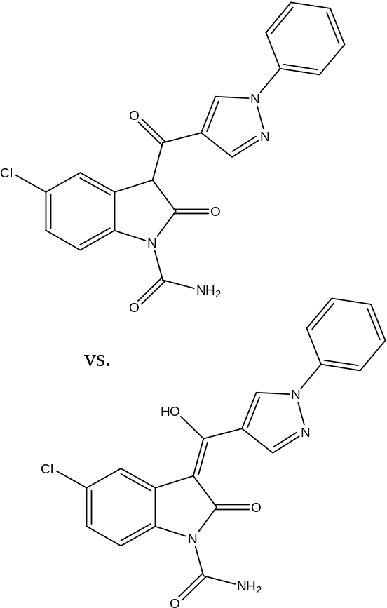
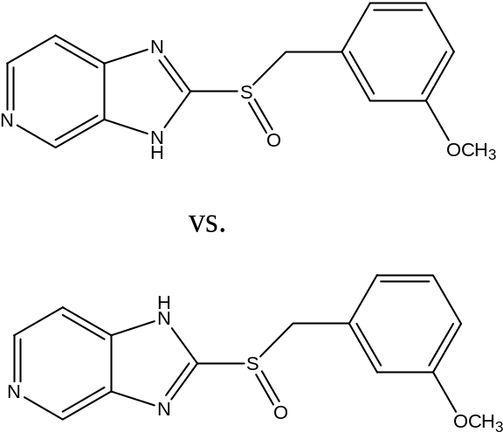
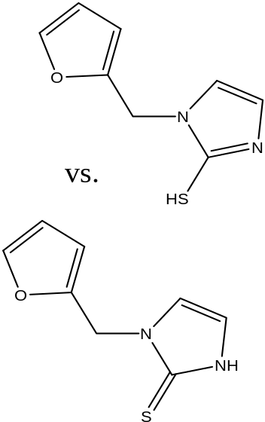
Example duplicates found via OSN representation
tautomeric duplicates:

Slide 26
Computer Aided Molecular Design (CAMD) software:
it seems so obvious ...
  if CAMD doesn’t use same structures as used by Mother Nature, we greatly reduce the chance of making reliable predictions
  if we go to the trouble of performing calculations and predictions based on structures, it seems silly not to store the results in an easily retrievable manner
the fundamental technology required already exists
pharmaceutical industry is already moving in this direction
  increasing emphasis and reliance on vHTS and QSAR methods
  increasing concern regarding IP issues and competitive strategies
former Optive collaborators already using NW components
some barriers to broad adoption/implementation but those barriers are certainly not insurmountable

Slide 27
How is cheminformatics related to other topics of this course?
ChemInformatics & Mass Spectrometry
Cheminformatics & Protein Structure
Metabolomics

Slide 28

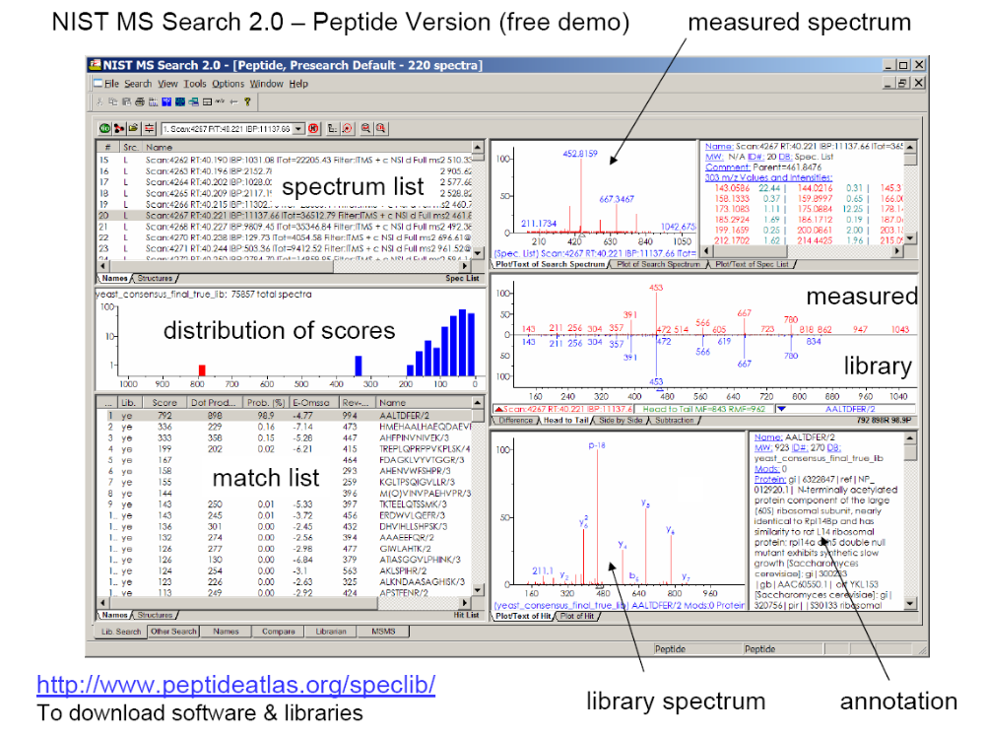
http://www.peptideatlas.org/ :
Mass spectral search of peptides
For example, search for IPI00645064 (also supported in IPA) or VSFLSALEEYTK
Notes:
http://www.pubmedcentral.nih.gov/articlerender.fcgi?artid=1933459
http://msig.ncifcrf.gov/abstract-0907.pdf
Online see promex DB from MPIMP Golm
protein/peptide database

Slide 29
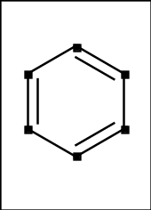
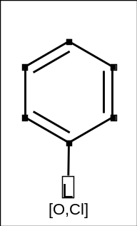
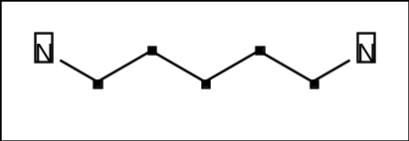
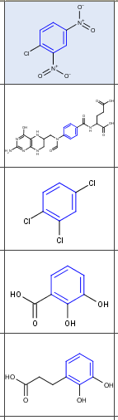
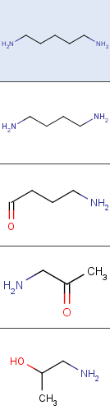
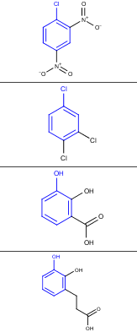
How to search molecules
Exact search
Substructure search
Similarity search
Ligand search
Notes:
http://www.chemaxon.com/jchem/doc/user/Query.html#rgroupquery
R group and Markush search (in CAS, Beilstein ua)
Good for patent or synthesis search
See Tanimoto and fingerprints for similarity/ substructure search

Slide 30
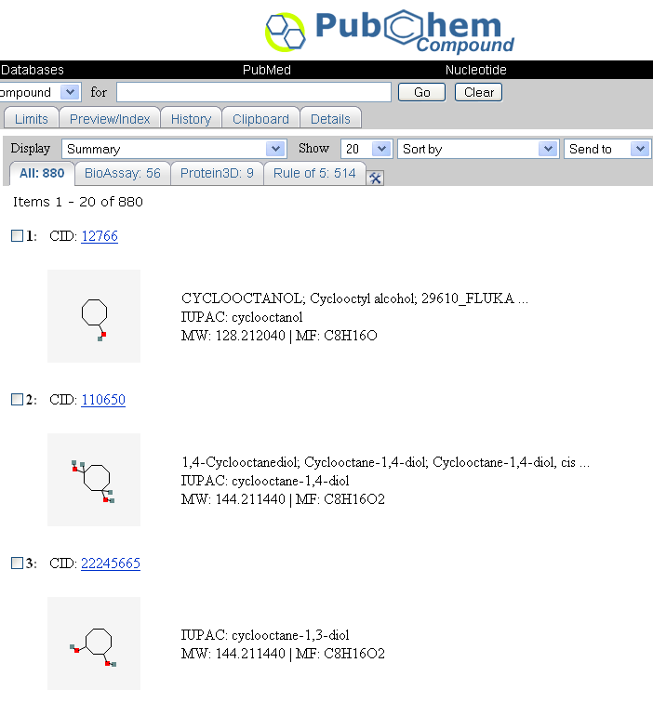
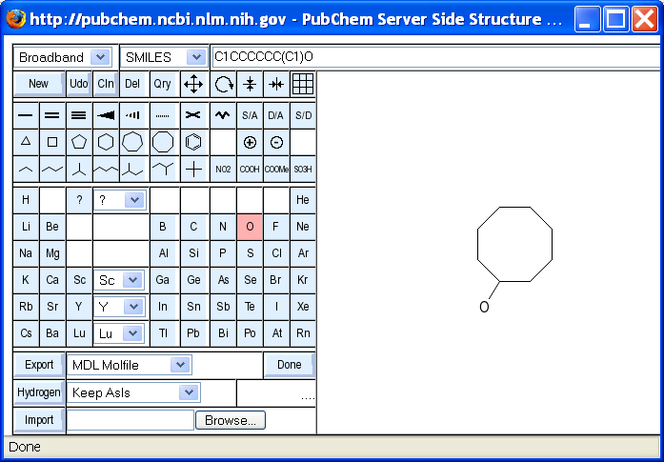
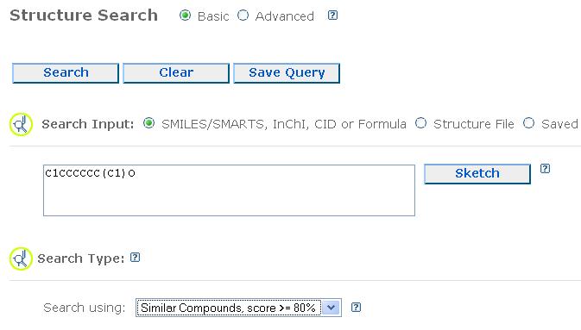
Searching Molecules on PubChem
18 million compound DB (++)
Goto PubChem Structure Search
Notes:
See also Chemspider (first lecture)

Slide 31
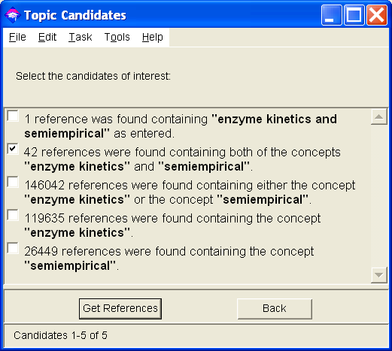
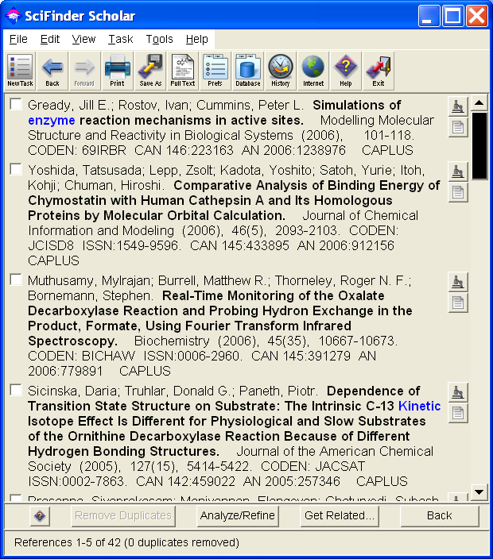
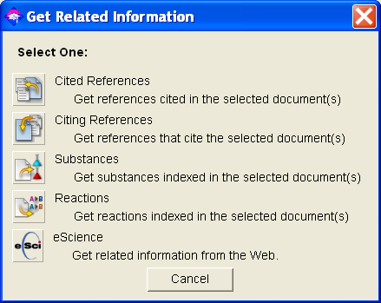
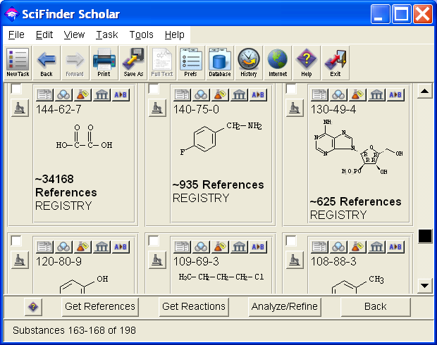

CAS SciFinder
33 million molecules and 60 million peptides/proteins
largest reaction DB (14 million reactions) and literature DB
substructure and similarity search of structures
a must for chemists and biochemists/biologists
no bulk download, no good Import/ Export, no Link outs
Notes:
Beilstein. GMELIN

Slide 32
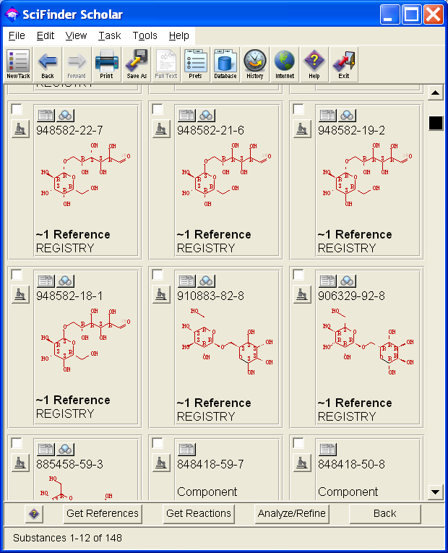
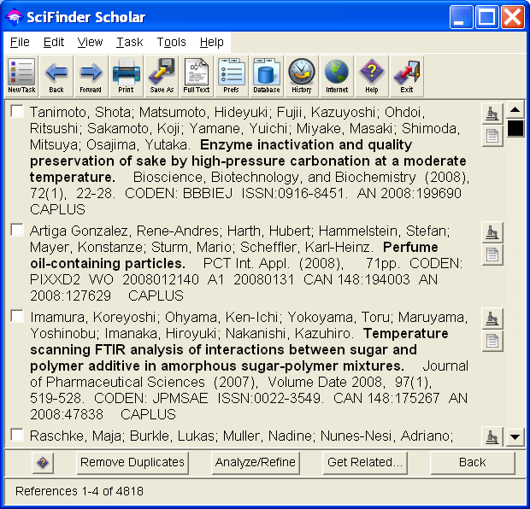
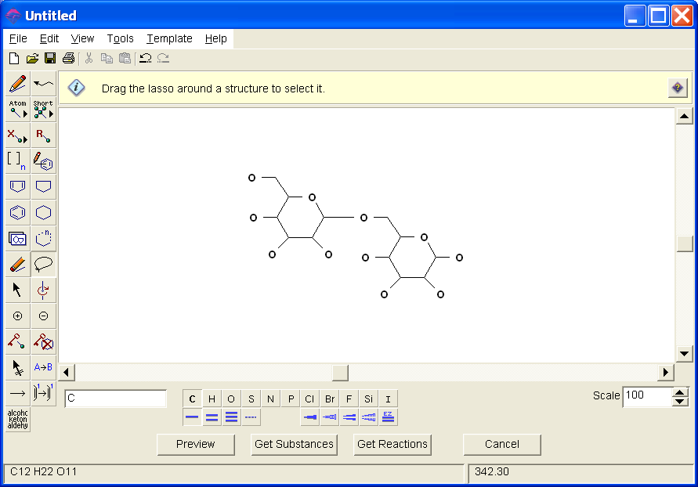
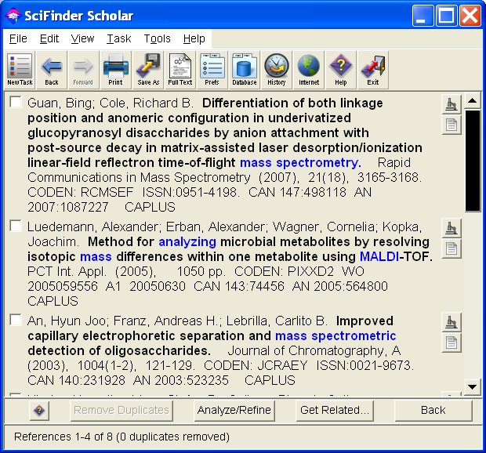
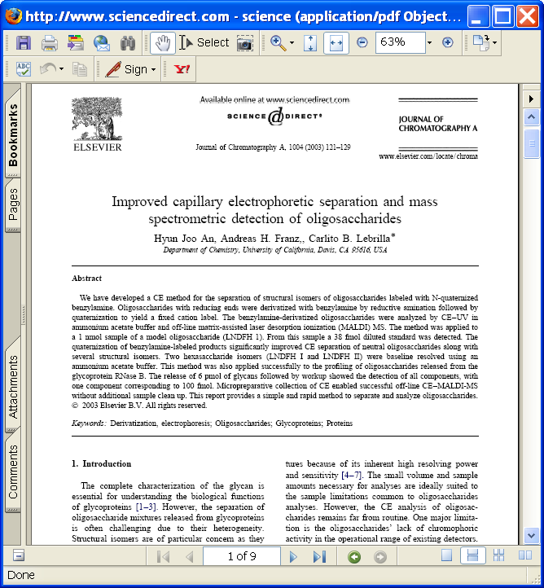
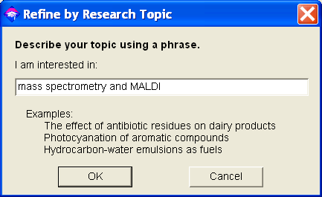
Structure search in SciFinder
Retrieved 4000 papers
(refine search only MS and MALDI)
Notes:
There are many more neat tricks, however we will cover this in our next course.

Slide 33
MS Cheminformatics Notes
There are different search types for mass spectral data
→ similarity search, reverse search, neutral loss search, MS/MS search
There are large libraries for electron impact spectra (EI) from GC-MS
There are no large open/commercial libraries for spectra from LC-MS
For creation of mass spectral libraries a holistic approach is important
Mass spectral trees can give further information (MS^{E} or MS^{n})
There are different types of searching structures
Exact search, similarity search, substructure search
Before you start a research project, create target lists of possible candidates
→ Collect mass spectra or structures in libraries with references

Slide 34
MS- cheminformatics Links
High-resolution mass spectral database http://www.massbank.jp/
http://fields.scripps.edu/sequest/
http://allured.stores.yahoo.net/idofesoilbyg.html
(fragrances, terpenoid mass spectra SE-52 column + RIs)
http://kanaya.naist.jp/DrDMASS/DrDMASSInstruction.pdf
http://mmass.biographics.cz/
http://pubchem.ncbi.nlm.nih.gov/omssa/
Notes:
Check pnnl → proteomics
Carbohydrate sequencing
http://www.pubmedcentral.nih.gov/articlerender.fcgi?artid=1435829
Check with DB approaches, see NM article
http://www.mcponline.org/cgi/content/full/6/9/1599/T4

Slide 35
Sample exercises:
Goto PubChem or Chemspider [and perform the 3 different
structure searches using benzene; report on the number of results
(use the sketch function to draw benzene (6 ring with 3 aromatic bonds))
2) Download NIST MS Search and perform the 3 different
mass spectral searches on cocaine
(download JAMP-DX from NIST)
3) Use Instant-JChem [from last course session and create a local demo
database with PubChem data.
Perform 3 different structure searches with benzene by double-clicking
on the structure search field. Report number of results.
Additional task for proteomics candidates:
4) Download the NIST peptide search and perform a search on the given examples
Notes:
Check with Paul:
http://msig.ncifcrf.gov/abstract-0907.html
http://msig.ncifcrf.gov/abstract-0907.pdf

Slide 36
Example Chemical Informatics Topics
  representation of chemical compounds
  representation of chemical reactions
  chemical data, databases, and data sources
  searching chemical structures
  calculation of structure descriptors
  methods for chemical data analysis
“Molecular Informatics, the Data Grid, and an Introduction to eScience”
“Bridging Bioinformatics and Chemical Informatics”

Slide 37
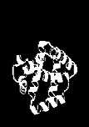
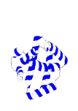









Next lecture: STRUCTURE-BASED METHODS FIND MANY HOMOLOGUES (AND PUTATIVE TARGETS) NOT DETECTABLE FROM SEQUENCE SIMILARITY
Biochemical function and drugability defined by 3D structure, not sequence - structure is better conserved
AHHLDRPGHNMCEAGFWQPILL
Test Sequence
100%
% SEQUENCE ID
Standard Approaches
30%
Advanced
Approaches
0

