Slide 1
Structure Modeling and Bioimage informatics
Unit 26
BIOL221T: Advanced Bioinformatics for Biotechnology
Irene Gabashvili, PhD

Slide 2
Abstracts – approximate guidelines
Motivation:
Why do we care?(importance, difficulty, impact).
Problem statement:
What problem are you trying to solve? What is the scope of your work?
Approach:
How did you go about solving or making progress on the problem? What was the extent of your work?
Results:
What's the answer?

Slide 3
Abstracts
Limits: paragraph, ~150-200 words, one double-spaced page… More to include:
Numbers – if possible: How many genes, SNPs, sequence identity.. xx percent faster, cheaper, smaller, better
Conclusions: What are the implications? Have you found a path to change the world, was it a nice hack, or a road sign indicating that this path is a waste of time (all is useful!). Can you generalize?

Slide 4
How will projects be graded?
Originality, structure, and scope
No copy/paste from the web – but it’s Ok to reference the source - publications & websites

Slide 5
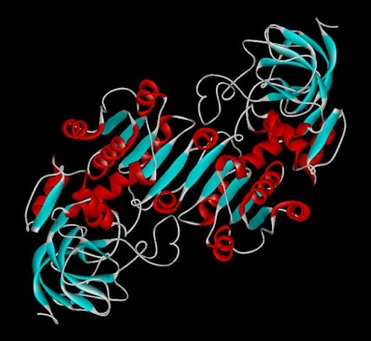
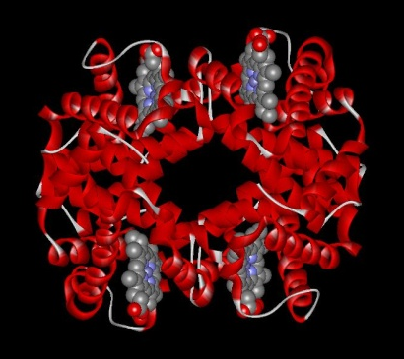
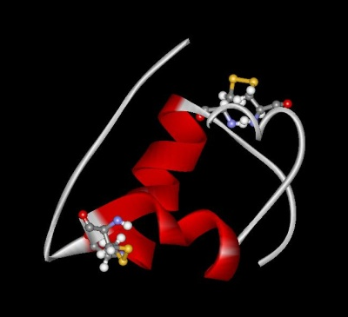
Proteins play key roles in a living system
Three examples of protein functions
  Catalysis:
  Almost all chemical reactions in a living cell are catalyzed by protein enzymes.
  Transport:
  Some proteins transports various substances, such as oxygen, ions, and so on.
  Information transfer:
  For example, hormones.
Alcohol dehydrogenase oxidizes alcohols to aldehydes or ketones
Haemoglobin carries oxygen
Insulin controls the amount of sugar in the blood

Slide 6
Amino Acid versus Residue
R
R
C
C
H2N
COOH
N
CO
H
H
H
Amino Acid Residue

Slide 7
Amino acid: Basic unit of protein
R
Different side chains, R, determin the properties of 20 amino acids.
NH₃⁺
C
COO⁻
Amino group
Carboxylic
acid group
H
An amino acid

Slide 8
The DSSP code
"Dictionary of Protein Secondary Structure"
G = 3-turn helix (3_{10 helix}). Min length 3 residues.
H = 4-turn helix (alpha helix). Min length 4 residues.
I = 5-turn helix (pi helix). Min length 5 residues.
T = hydrogen bonded turn (3, 4 or 5 turn)
E = beta sheet in parallel and/or anti-parallel sheet conformation (extended strand). Min length 2 residues.
B = residue in isolated beta-bridge (single pair beta-sheet hydrogen bond formation)
S = bend (the only non-hydrogen-bond based assignment)

Slide 9
Protein structure
Primary structure (Amino acid sequence)
↓
Secondary structure （α-helix, β-sheet）
↓
Tertiary structure （Three-dimensional structure formed by assembly of secondary structures）
↓
Quaternary structure （Structure formed by more than one polypeptide chain）

Slide 10
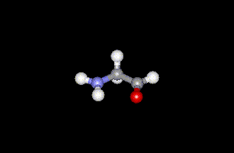
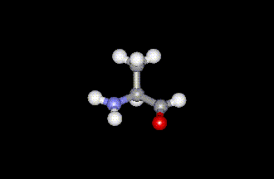
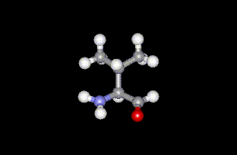
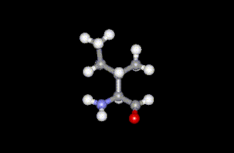
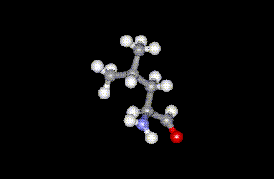
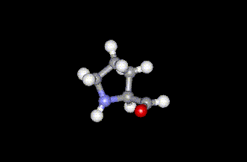
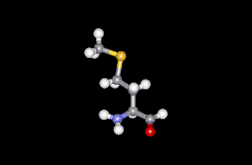
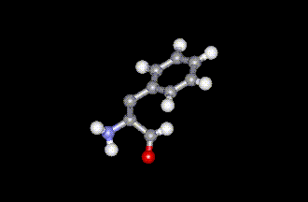
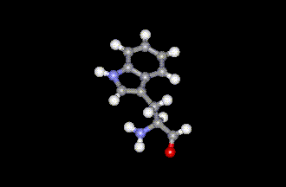
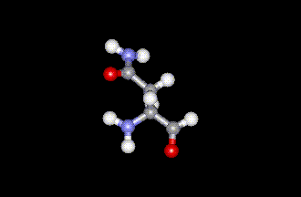
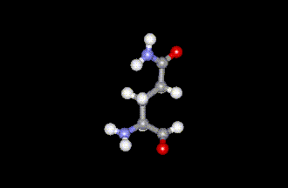
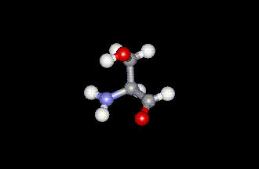
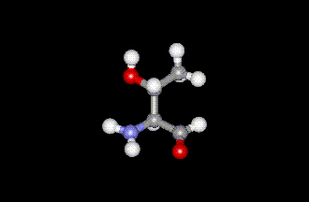
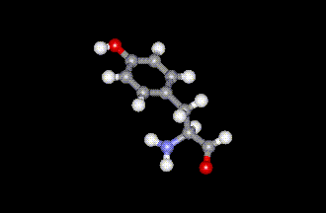
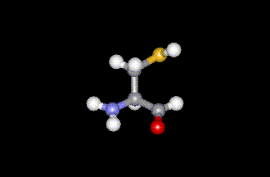
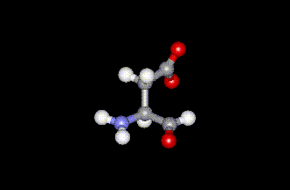
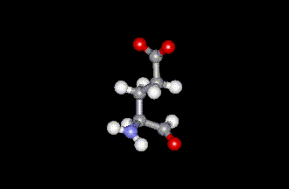
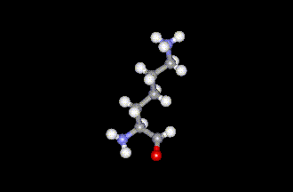
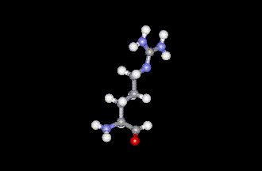
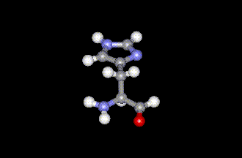
20 Amino acids
Glycine (G)
Alanine (A)
Valine (V)
Isoleucine (I)
Leucine (L)
Proline (P)
Methionine (M)
Phenylalanine (F)
Tryptophan (W)
Asparagine (N)
Glutamine (Q)
Serine (S)
Threonine (T)
Tyrosine (Y)
Cysteine (C)
Asparatic acid (D)
Glutamic acid (E)
Lysine (K)
Arginine (R)
Histidine (H)
Yellow: Hydrophobic, Green: Hydrophilic, Red: Acidic, Blue: Basic

Slide 11
Proteins are linear polymers of amino acids
R₁
R₂
NH₃＋
C
COO^{ー}
＋
NH₃＋
C
COO^{ー}
＋
H
H
A carboxylic acid condenses with an amino group with the release of a water
H₂O
H₂O
R₁
R₂
R₃
NH₃＋
C
CO
NH
C
CO
NH
C
CO
H
Peptide bond
H
Peptide bond
H
The amino acid sequence is called as primary structure
A
F
G
S
T
D
K
A
N
G
S

Slide 12
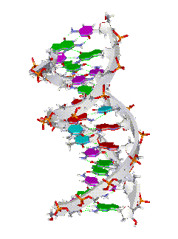
Amino acid sequence is encoded by DNA base sequence in a gene
DNA molecule
DNA base sequence
・
G
C
G
C
T
T
A
A
G
C
G
C
・
・
C
G
C
G
A
A
T
T
C
G
C
G
・
＝

Slide 13
Amino acid sequence is encoded by DNA base sequence in a gene
 |  | Second letter
 |  | T |  | C |  | A |  | G
First letter | T | TTT | Phe | TCT | Ser | TAT | Tyr | TGT | Cys | T | Third letter
 |  | TTC |  | TCC |  | TAC |  | TGC |  | C
 |  | TTA | Leu | TCA |  | TAA | Stop | TGA | Stop | A
 |  | TTG |  | TCG |  | TAG |  | TGG | Trp | G
 | C | CTT | Leu | CCT | Pro | CAT | His | CGT | Arg | T
 |  | CTC |  | CCC |  | CAC |  | CGC |  | C
 |  | CTA |  | CCA |  | CAA | Gln | CGA |  | A
 |  | CTG |  | CCG |  | CAG |  | CGG |  | G
 | A | ATT | Ile | ACT | Thr | AAT | Asn | AGT | Ser | T
 |  | ATC |  | ACC |  | AAC |  | AGC |  | C
 |  | ATA |  | ACA |  | AAA | Lys | AGA | Arg | A
 |  | ATG | Met | ACG |  | AAG |  | AGG |  | G
 | G | GTT | Val | GCT | Ala | GAT | Asp | GGT | Gly | T
 |  | GTC |  | GCC |  | GAC |  | GGC |  | C
 |  | GTA |  | GCA |  | GAA | Glu | GGA |  | A
 |  | GTG |  | GCG |  | GAG |  | GGG |  | G

Slide 14
Gene is protein’s blueprint, genome is life’s blueprint
DNA
Genome
Gene
Gene
Gene
Gene
Gene
Gene
Gene
Gene
Gene
Gene
Gene
Gene
Gene
Gene
Protein
Gene
Protein
Protein
Protein
Protein
Protein
Protein
Protein
Protein
Protein
Protein
Protein
Protein
Protein
Protein

Slide 15
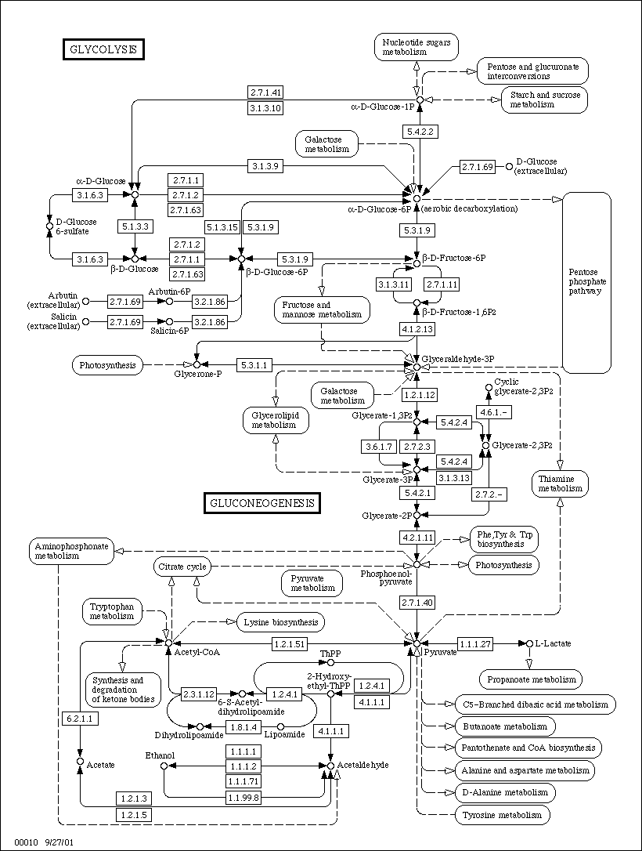
Gene is protein’s blueprint, genome is life’s blueprint
Glycolysis network
Genome
Gene
Gene
Gene
Gene
Gene
Gene
Gene
Gene
Gene
Gene
Gene
Gene
Gene
Gene
Protein
Protein
Protein
Protein
Protein
Protein
Protein
Protein
Protein
Protein
Protein
Protein
Protein
Protein

Slide 16
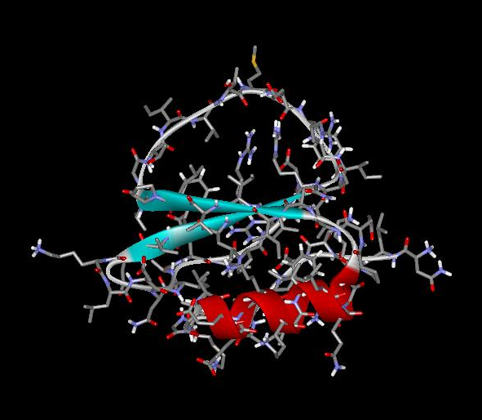
Each Protein has a unique structure
Amino acid sequence
NLKTEWPELVGKSVEEAKKVILQDKPEAQIIVLPVGTIVTMEYRIDRVRLFVDKLDNIAEVPRVG
Folding!

Slide 17
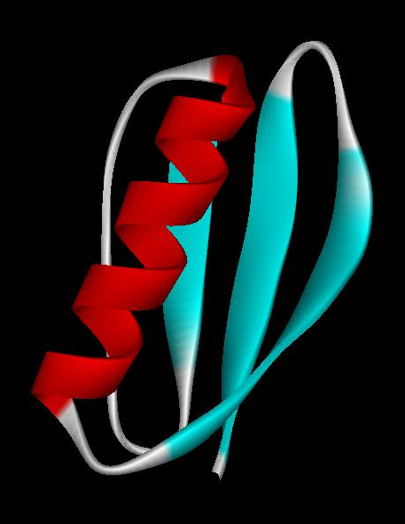
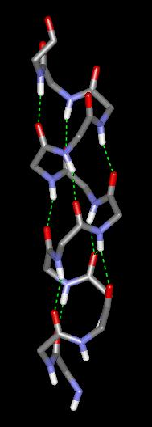
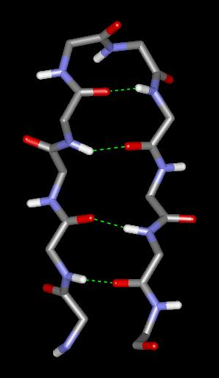
Basic structural units of proteins: Secondary structure
α-helix
β-sheet
Secondary structures, α-helix and β-sheet, have regular hydrogen-bonding patterns.

Slide 18
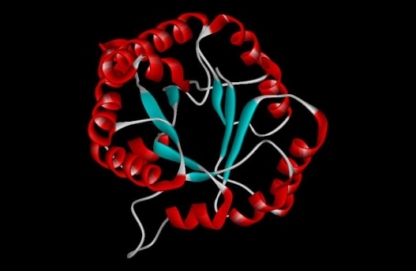
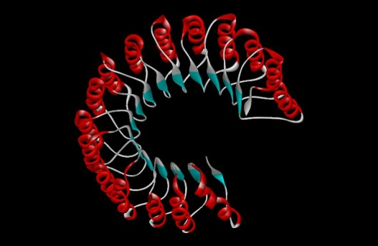
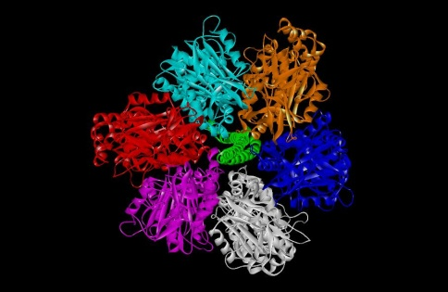
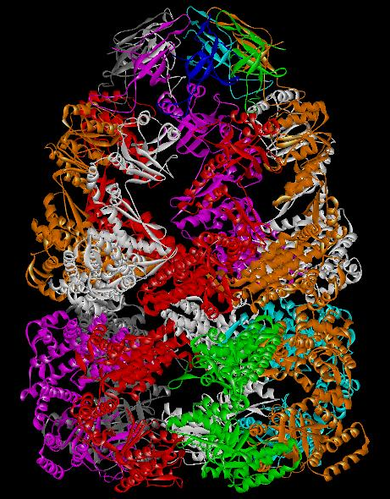
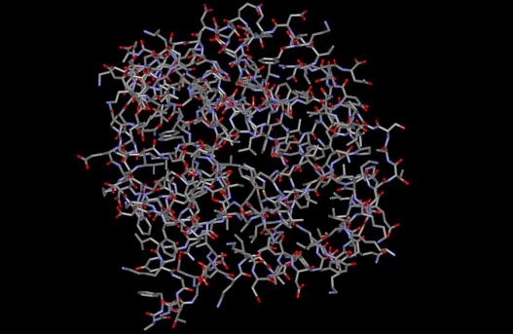
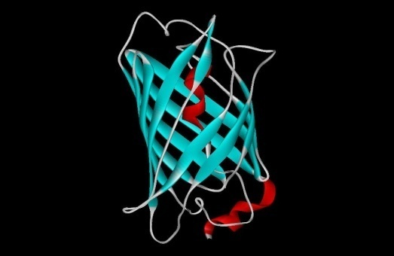
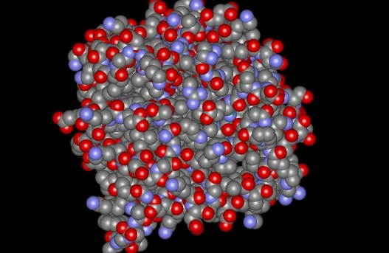
Three-dimensional structure of proteins
Tertiary structure
Quaternary structure

Slide 19
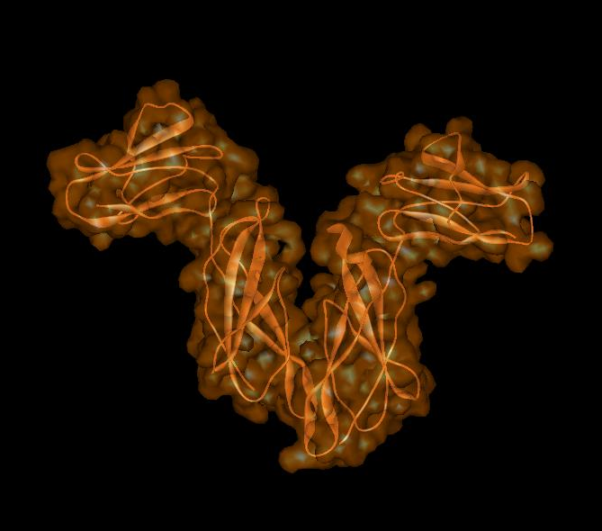
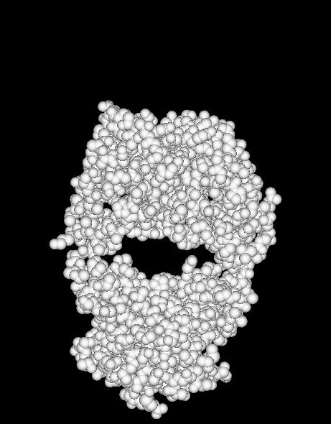
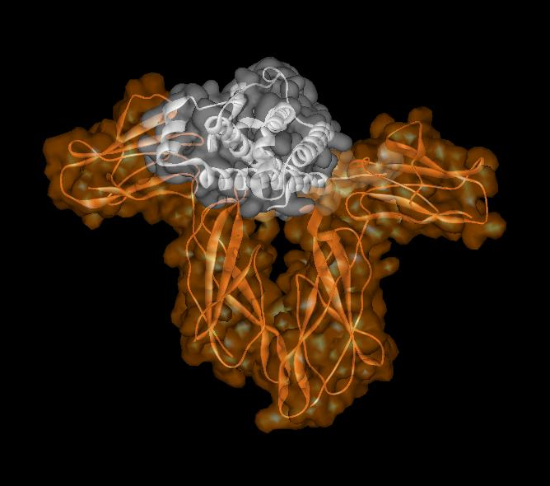
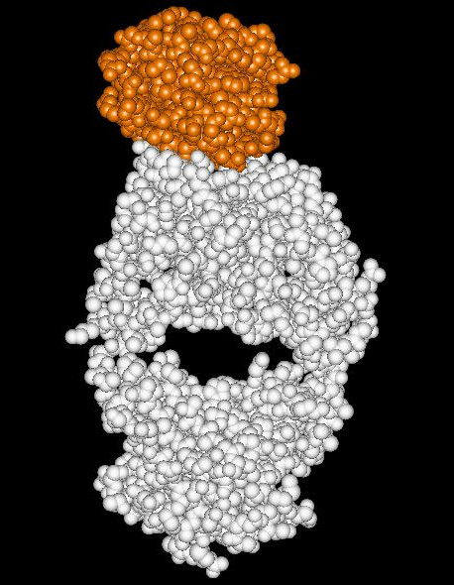
Close relationship between protein structure and its function
Example of enzyme reaction
Hormone receptor
Antibody
substrates
enzyme
A
enzyme
B
Matching the shape to A
Digestion of A!
enzyme
A
Binding to A

Slide 20
More Links
BLOCKS: http://blocks.fhcrc.org/
www.sbc.su.se/~miklos/DAS
www.pdg.cnb.uam.es/EUCLID/Full_Paper/homepage.html
Eva: Cubic.bioc.columbia.edu/eva
Jpred: www.compbio.dundee.ac.uk/~www-jpred/
LOC3D: cubic.bioc.columbia.edu/db/LOC3D
Pfam: http://www.sanger.ac.uk/Software/Pfam/

Slide 21
More Links
PredictProtein www.predictprotein.org
ProfTMB: http://www.predictprotein.org/cgi-bin/var/bigelow/proftmb/query
PROSITE: http://expasy.org/prosite/
ProtFun: http://www.cbs.dtu.dk/services/ProtFun/
PSIPRED: http://bioinf.cs.ucl.ac.uk/psipred/
PSORT: http://psort.nibb.ac.jp/
SAM-T99 - discontinued
SOSUI: http://bp.nuap.nagoya-u.ac.jp/sosui/sosui_submit.html
TargetP: http://www.cbs.dtu.dk/services/TargetP/

Slide 22
Databases
PDB: www.rcsb.org/
MSD: http://www.ebi.ac.uk/msd/
MMDB: http://www.ncbi.nlm.nih.gov/Structure/MMDB
PDBSum: www.ebi.ac.uk/pdbsum/
TargetDB: targetdb.pdb.org/

Slide 23
PDBsum
provides an at-a-glance overview of every macromolecular structure deposited in the Protein Data Bank (PDB), giving schematic diagrams of the molecules in each structure and of the interactions between them.
http://www.ebi.ac.uk/thornton-srv/databases/pdbsum/
GetPage.pl

Slide 24
More links
AbCheck - Antibody Sequence Test
http://www.bioinf.org.uk/abs/seqtest.html
Atlas of protein Side chain interactions
http://www.biochem.ucl.ac.uk/bsm/sidechains/index.html#
The beta-turn prediction server:
http://www.biochem.ucl.ac.uk/bsm/btpred/index.html

Slide 25
More links
CATH – protein structure classification:
http://www.cathdb.info/latest/index.html
Protein Ligand Interactions:
http://www.biochem.ucl.ac.uk/bsm/proLig/

Slide 26
More links
DB Browser, including protein sequence/structure DBs
http://www.bioinf.man.ac.uk/dbbrowser/
Dictionary of Homologous superfamilies:
http://www.biochem.ucl.ac.uk/bsm/dhs/
PROCAT – a DB of 3D enzyme active site templates:
http://www.biochem.ucl.ac.uk/bsm/PROCAT/PROCAT.html

Slide 27
More links
DOMPLOT – annotation by ligands:
http://www.biochem.ucl.ac.uk/bsm/domplot/
Enzymes Structure database:
http://www.biochem.ucl.ac.uk/bsm/enzymes/index.html
Gene3D
http://gene3d.biochem.ucl.ac.uk/Gene3D/

Slide 28
More links
The Scorecons Server (scores residue conservation in a multiple sequence alignment)
http://www.ebi.ac.uk/thornton-srv/databases/cgi-bin/valdar/scorecons_server.pl

Slide 29
3D enzyme active site templates
PROCAT: http://www.biochem.ucl.ac.uk/bsm/PROCAT/PROCAT.html
PROCAT has now been superseded by the Catalytic Site Atlas: http://www.ebi.ac.uk/thornton-srv/databases/CSA/

Slide 30
More Links
Protein Nucleic Acid interaction Server
http://www.biochem.ucl.ac.uk/bsm/DNA/server/
Protein DNA interaction, tax
http://www.biochem.ucl.ac.uk/bsm/prot_dna/prot_dna.html
SAS (Sequences Annotated by Structure)
http://www.ebi.ac.uk/thornton-srv/databases/sas/

Slide 31
More Links
NACCESS – calculates residue accessibilities
http://www.bioinf.manchester.ac.uk/naccess/
The SURFNET program generates surfaces and void regions between surfaces from coordinate data supplied in a PDB file
http://www.biochem.ucl.ac.uk/~roman/surfnet/surfnet.html

Slide 32
Prediction
Homology Modeling: >30%
Threading – picks up where homology leaves off
Ab initio structure prediction

Slide 33
Validation
DSSP
PROCHEK: http://www.biochem.ucl.ac.uk/~roman/procheck/procheck.html
VADAR
Verify3D: http://nihserver.mbi.ucla.edu/Verify_3D/

Slide 34
Visualization
Cn3D
UCSF Chimera (MidasPlus)
Rasmol → ProteinExplorer

Slide 35
Bioimaging
NIH sites for image processing software:
http://www.cc.nih.gov/cip/visualization/vis_packages.html
NIH IMAGE
http://rsb.info.nih.gov/nih-image/
Spider & Web: http://www.wadsworth.org/spider_doc/spider/docs/spider.html
EMAN : http://blake.bcm.tmc.edu/eman/eman1/

Slide 36
DICOM
The Digital Imaging and Communications in Medicine standard
For all medical imaging modalities, such as CT scans, MRIs, and ultrasound.
All image files which are compliant with Part 10 of the DICOM standard (available in DocSharing) are DICOM format files

Slide 37
Mutant Gene
Mutant or missing Protein
Mutant Phenotype
(disease)
Disease models
Humans
Animal models
Mutant Gene
Mutant or missing Protein
Mutant Phenotype
(disease model)

Slide 38
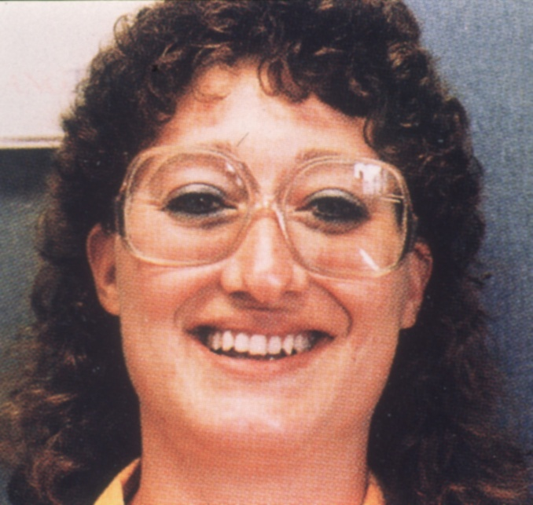
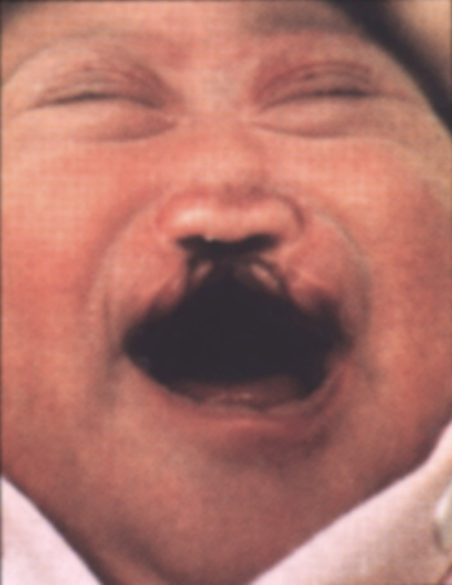
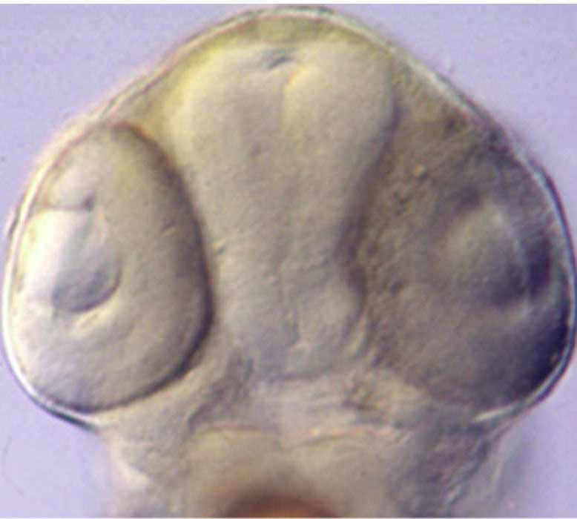
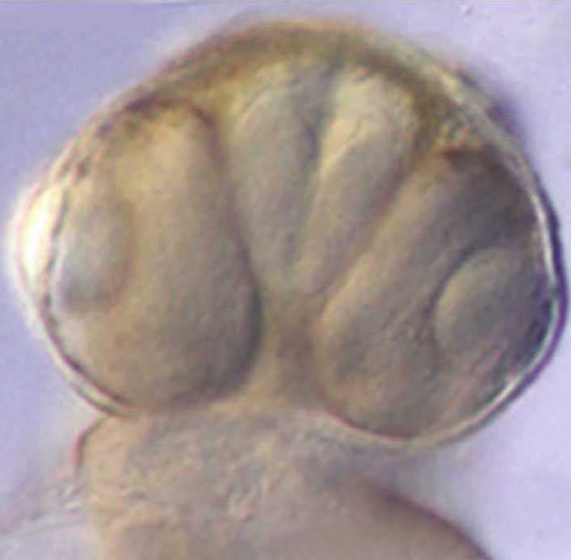
SHH^{-/+}
SHH^{-/-}
shh^{-/+}
shh^{-/-}

