Slide 1
Final Review. Translational bioinformatics and medical informatics.
Unit 29
BIOL221T: Advanced Bioinformatics for Biotechnology
Irene Gabashvili, PhD

Slide 2
Projects: 20 points max
Originality - 7
Structure - 6
Scope - 7
Penalty points: paper not submitted on time – 1 point off for each day starting May 4 (Official deadline was April 30, 4 day grace period)

Slide 3
ProblemSet 4
Questions from topics since PS3: proteomics, metabolomics, protein predictive methods (seqs & structure) - 15 points max
Exam: computers off, 40 questions, 2 hr limit → 20 points max
Exam Results added to 4 best problem sets (60 points max) and project (20 pts max), 100 max.

Slide 4
Translational Bioinformatics & BioMedical Informatics
Translating science into health gains
The use of information sciences to improve health care, biomedical & clinical research
Latest meeting:
http://www.amia.org/meetings/stb08/
Disease informatics. Information management, Semantic web, data integration and mining tools

Slide 5
Biomedical/Health Informaticians are:
A) Knowledge Trackers & Sorters, ‘Info-magicians’
B) Decision-support tacticians
C) Complex Adaptive Systems & Process Designers
D) Specialized Generalists
E) Intelligent, Altruistic Realists
F) Agents of Change
G) All of the above, plus other good things?
(Answer: G -- Bet you didn’t guess.)
Don Detmer

Slide 6
Informatics
Bioinformatics
  Really biomolecular informatics
Medical informatics
  Really clinical informatics
Biomedical informatics
  Covers both and more

Slide 7
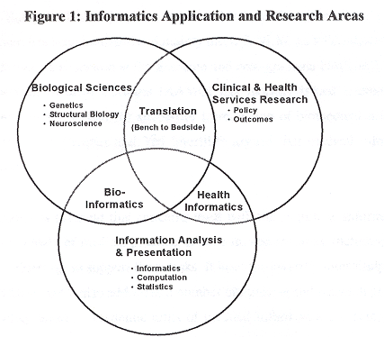
Biomedical informatics:
    Public health (population) informatics
      CDC, Health Information Management
    Consumer Health informatics
    Clinical informatics
    Nursing informatics
    Imaging informatics
    Dental informatics
    Clinical Research informatics
    Veterinary informatics
    Pharmacy informatics
    Bioinformatics

Slide 8
Informatics in Perspective
Medical Informatics Methods, Techniques, and Theories
Basic
Research
Biological
Foundations
Health Care
Systems
Applied
Research
Imaging Informatics
Clinical Informatics
Public Health Informatics
Bioinformatics
Molecular and
Cellular
Processes
Tissues and
Organs
Individuals
(Patients)
Populations
And Society
Notes:
From this perspective, the application of informatics methods techniques and theories to public health are distinguished from the other application areas by basic principles that flow directly from the field. These basic principles define, guide, and provide the context for the types of activities that comprise the field of public health informatics.

Slide 9
You might be a public health professional if you are….
looking to control the most basic of human functions, e.g., lobbying the Federal Trade Commission to investigate snack-food and soft-drink marketing or promoting a “twinkie tax."
worrying about eating, smoking, HIV/AIDS, bioterrorism, health literacy and hand washing all in one day.
spending hours per day trying to define yourself, your work, and explaining your work to others.

Slide 10
Efforts to Implement Health Information Technology in UK & USA
U.S. U.K.
Initial year of national IT effort
2006 2002
Expected year of complete implementation
2016 2014
Estimate of total investment (as of 2005)*
$125M $11.5B
Total investment per capita (as of 2005)**
$0.43 $192.79
* In U.S. dollars. Exchange rates as of September 2005: $1 U.S. = $1.31 AUS; $1.19 CAN; $0.80 EURO; $6.21 NOR; $0.54 U.K.
** In U.S. dollars. Per capita is based on 2003 population numbers from the Organization for Economic Cooperation and Development (OECD).
‘Source: Adapted from G. F. Anderson et al, “Health Care Spending and Use of Information Technology in OECD Countries,”
Health Affairs, May/June 2006 25(3):819–31.

Slide 11
Medicine used to be simple, ineffective, & relatively safe.
Now it is complex, effective, & potentially dangerous.
- Sir Cyril Chantler

Slide 12
The future just isn’t what it used to be.
- Will Rogers

Slide 13
“… not what it used to be.”
Demographics
  Aging & Chronic Illness
Global Diseases/Awareness/Globalization
Knowledge Explosion
  Genomics, Proteomics & Epigenetics
  Data v. Intelligence (best evidence)
Social Dynamics
  Consumerism
Sustainability - $2 trillion/year & rising
Technology

Slide 14
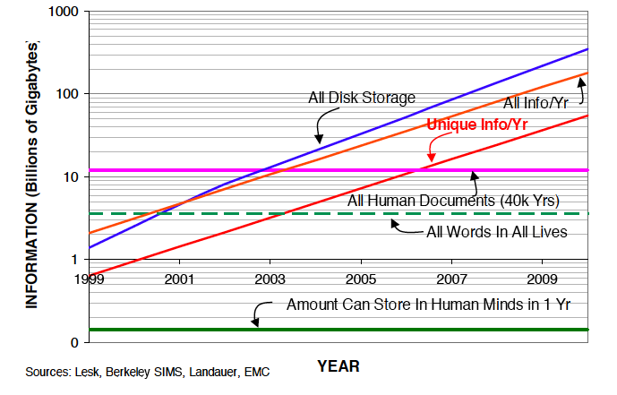
Information Big Bang

Slide 15
Medical Informatics
Expert Systems
Decision Support
Information Filtering / Aggregation
Medical Records (HL7)
Medical imaging (DICOM)

Slide 16
Medical informatics: Controlled Terminology
A finite, enumerated set of terms intended to convey information unambiguously
  Diagnostic Procedures
  Therapeutic Procedures
  Medications
  Diagnoses
  Findings
  Organisms
  Anatomy

Slide 17
What’s out there
ICD9-CM & ICD-10 (International Classification of Diseases, the standard for coding the diagnosis in MR)
SNOMED - Systematized Nomenclature of Medicine
NHS Clinical Terms (formerly READ Clinical Classification)
Nursing terminologies
LOINC: http://loinc.org/
MeSH, MedPix
UMLS

Slide 18
Classifying Disease based on Genomics
  Correlation of 11k gene ortholog families v. 75 diseases
  1) Breast Cancer similar to Endocrine disease
  2) Multiple Sclerosis close to Muscular Dystrophy & Myocardial Infarction
  3) Colon Polyps close to CA Colon
  4) SNOMED better than ICD

Slide 19
Genomics & Epigenetics

Slide 20
FINAL Review
Advanced Search in Entrez
  Boolean logic
  Terms & Fields
Definitions & key concepts of bioinformatics
Types of data and formats
Database management: key concepts
Programming languages used for R&D in the biological sciences; frequent tasks

Slide 21
Entrez Map Viewer
OMIM
dbSNP, type of variation, haplotypes
Sequence databases, formats, symbols, codes
Sequence analysis tools
Pharmacogenomics
Sequence Alignments: methods, software, algorithms
Similarity, homology
Scoring matrices

Slide 22
Types and elements of genomic maps, markers
Gene finding – what can be searched and found? Intrinsic & extrinsic methods. Models, measures of accuracy
Genome Organization (introns, repeats, UTRs)
Sensitivity, Specificity, Correlation, Score
RNA informatics – what can be predicted & why? Types of RNA genes
Dot plots, ROC curves

Slide 23
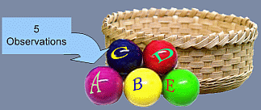
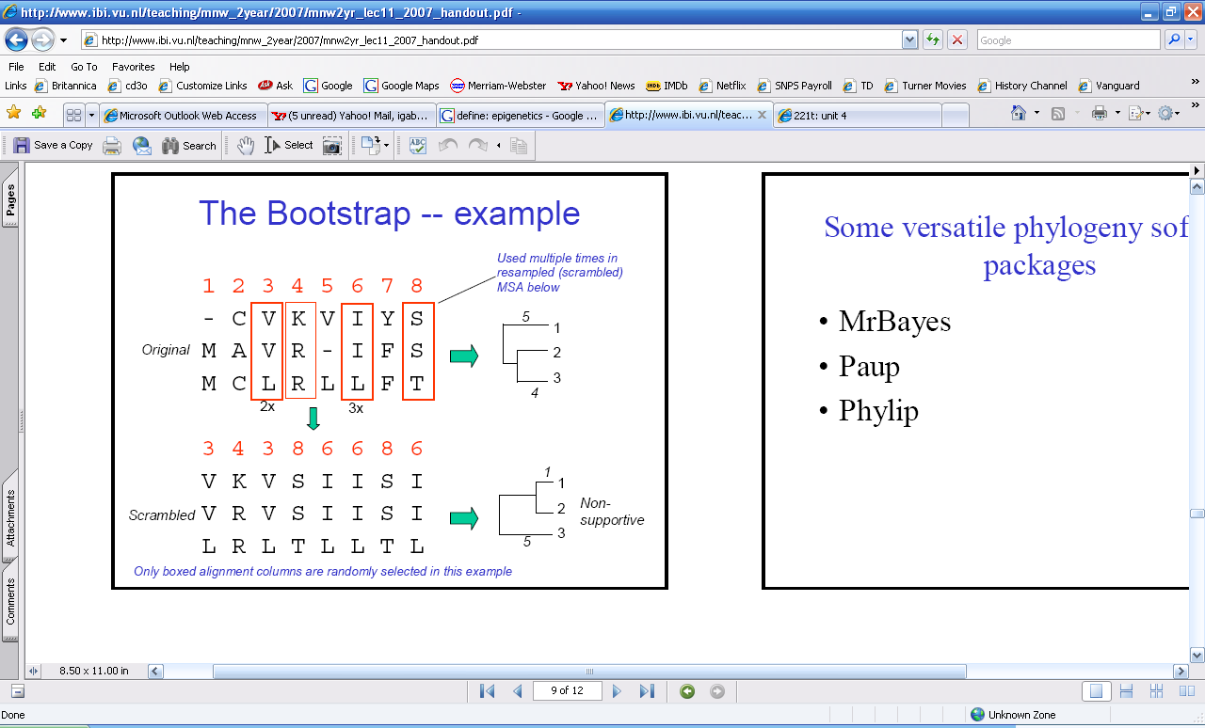
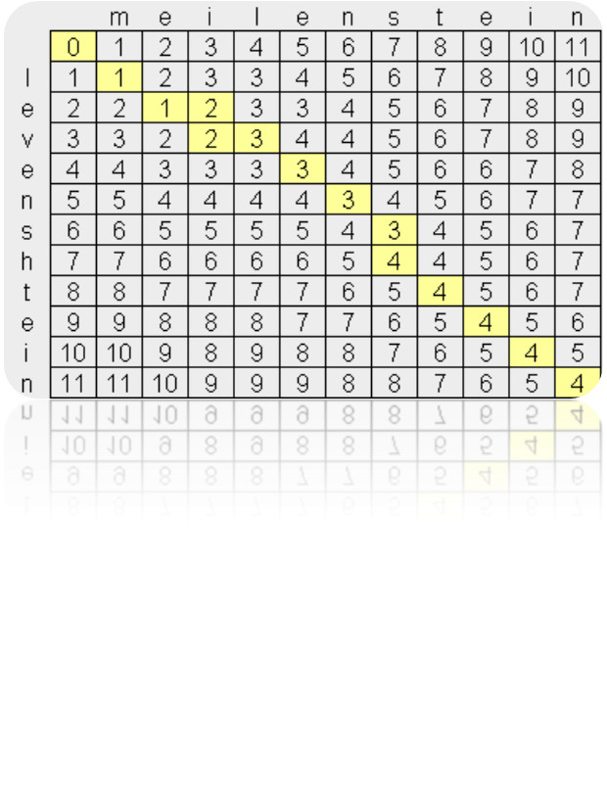

MSA, tools, approaches, applications
Phylogenetics concepts
  UPGMA, NJ, FM, ME ||MP, ML
  Bootstrap (scramble MSA)
  Hamming & Levenshtein distances
"=" Match; "o" Substitution;
"+" Insertion; "-" Deletion

Slide 24
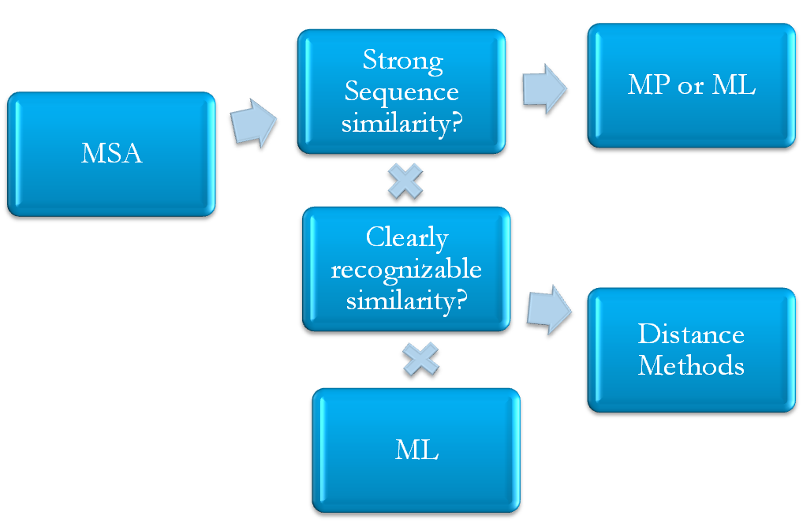
Maximum parsimony predicts the evolutionary tree or trees that minimize the number of steps required to generate the observed variation in the sequences from common ancestral sequences
-- Distance methods are based on genetic distances between sequence pairs in an MSA (e.g. NJ)
-- Maximum likelihood (ML) methods are especially useful when there is considerable variation among the sequences in MSA to be analyzed. The ML method is similar to the MP method.

Slide 25
-omics technologies, large scale sequencing, hybridization techniques
Top-down and bottom-up approaches for network reconstruction
Levels of abstraction in bioinformatics (central dogma, motifs, metabolic pathways, protein sequence motifs)
Types and elements of graphs, characteristics of biological networks (small world, hubs – conservation, interaction with other hubs)

Slide 26
Bioinformatics tools to design Primers, Probes & cloning strategies
Tools to annotate probes, map array data
Types of arrays; types of probes; sequencing platforms (oligo,spotted cDNA,TaqMAn,BeadChips,Exon,Tiling,SAGE…)
Microarray experiment databases
Tools to perform statistical analysis of microarray data
Major statistics concepts (PCA, k-means & 7 hierarchical clustering, t-tests, ANOVA, p-value)
    1 question in today’s PS4!

Slide 27
-omics & omes (definitions, experimental techniques, software tools)
2D PAGE vs Mass Spec, protein arrays: principles & typical results; software, applications
De novo and sequence tagging algorithms
Metabolomics: exp. techniques and data processing (and pre-processing) approaches
Supervised and unsupervised methods

Slide 28
Examples of Protein Features
Composition Features
  Mass, pI, Absorptivity, Rg
Sequence Features
  Active sites, Binding Sites, Targeting, Location, Property Profiles, 2º structure elements
Structure Features
  Super-Secondary Structure, Global Fold, Volume
http://www.expasy.org/tools/

Slide 29
Bioinformatics Tools & Servers
Protein structure databases
Protein structure prediction
Protein structure validation
Protein structure visualization
Homology vs Threading vs Ab initio prediction

