Slide 1

Digital Healing & Youth Feelings
Using Mentimeter | Inspired by Kazerne Dossin | Mr Aurangzeb

Slide 2
Why This Topic
Kazerne Dossin shows harm caused by political decisions.
Today youth also feel stress.
We explore feelings and calm.

Slide 3


Inquiry Question
How can digital tools help young people share feelings about political decisions?

Slide 4
Why It Matters
Politics affects school, safety, climate, mental health.
Young people feel stressed or worried.
Sharing feelings helps.

Slide 5
Today's Activity
Digital Exit Ticket (Mentimeter).
One question on phone.
Answers appear on screen.

Slide 6
Quiz Question
One word: How do political decisions make young people feel?

Slide 7
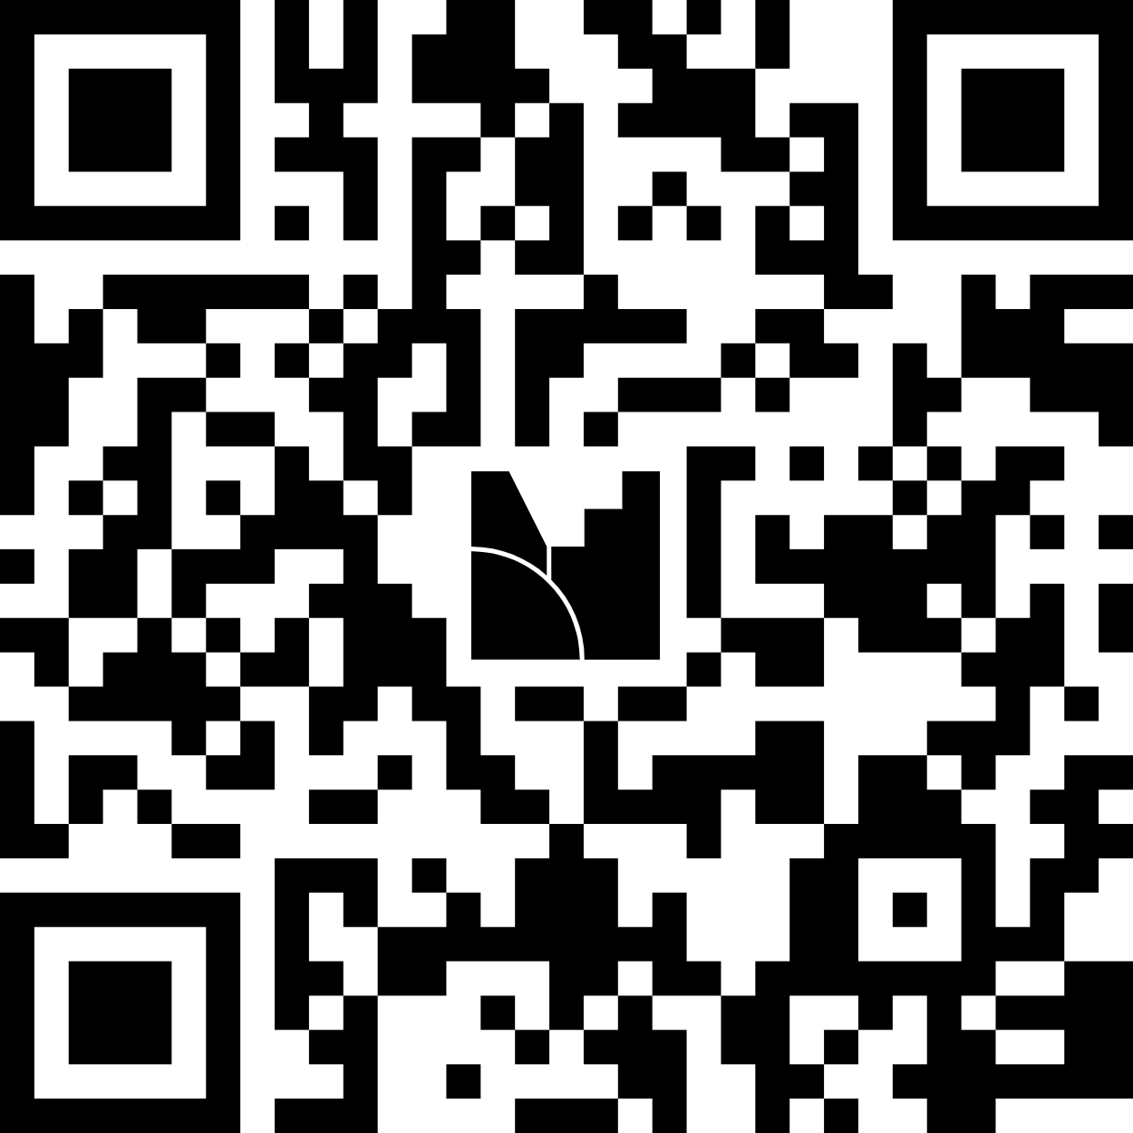
Join the Quiz
You just need to scan the QR code.

Slide 8
Live Answers
We will look at the word cloud together.

Slide 9

Talk
What emotions appear?
Why do youth feel this way?
What helps you feel calm?

Slide 10
Link to Healing
Digital tools help express feelings. Calm colours and art reduce stress.

Slide 11
Closing
A small digital check-in can help healing. Thank you.

