Slide 1


Slide 2


Slide 3


Slide 4
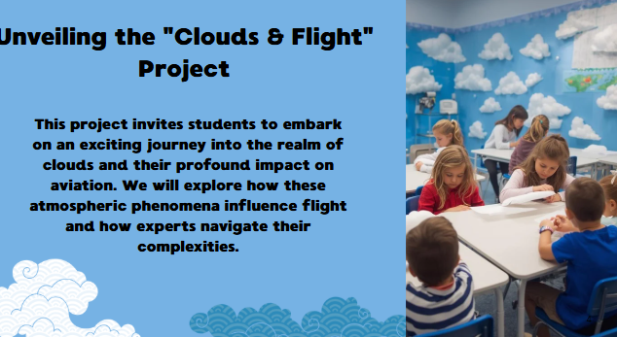

Slide 5
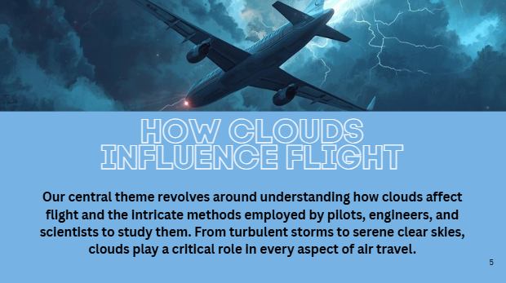

Slide 6
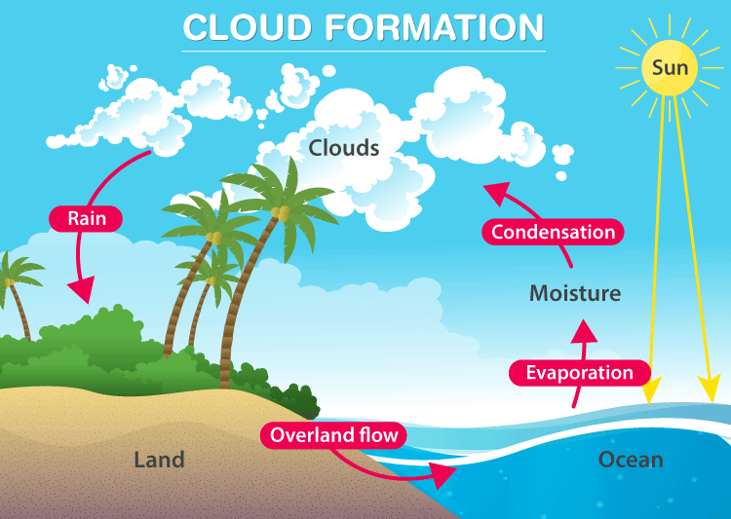

Slide 7
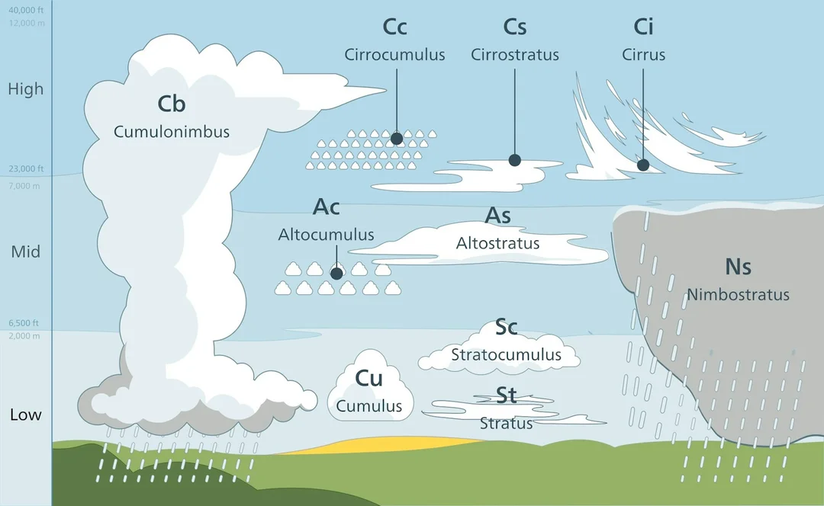

Slide 8
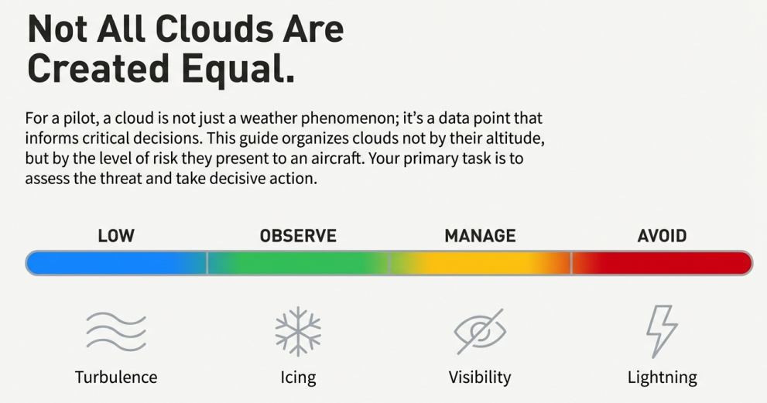

Slide 9
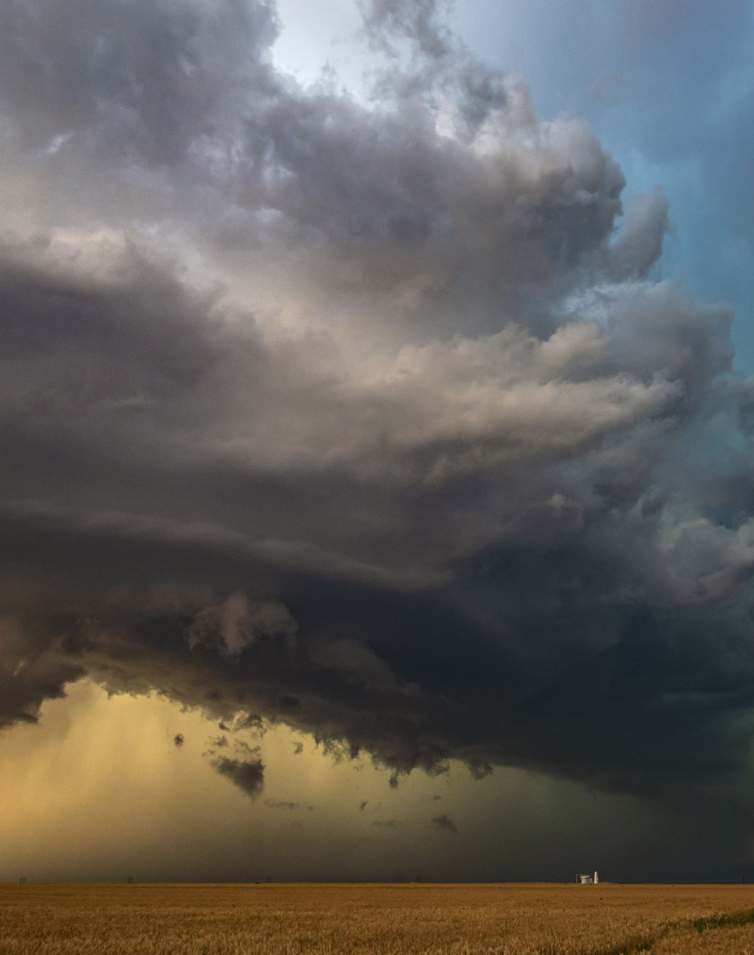
1. Critical Decision Making (Cumulonimbus Safety)
A pilot receives a weather briefing indicating the presence of a vertically developed cloud formation presenting severe turbulence, lightning, and hail.
• a. Which cloud type is the pilot most likely encountering?
• b. What mandatory action must the pilot take, and why is this action crucial considering the primary impacts of this specific cloud?

Slide 10

Hazard
2. Hazard Comparison and Altitude Zones
Contrast the flight challenge presented by Fog (Stratus on the ground) with the challenge presented by a Cumulus cloud.
• a. What is the primary impact on the aircraft for each cloud type?
• b. Explain how the difference in their typical altitude zones (Low to Mid-Level vs. on the ground) dictates the necessary pilot action for each situation

Slide 11

3. Interpreting Flight Conditions (Cumulus Turbulence)
A pilot reports experiencing "light but frequent bumps" during flight.
• a. Assuming this event occurred in a Cumulus cloud, what impact is causing the "bumps," and what does this suggest about the strength of the turbulence?
• b. According to the required pilot action for this cloud type, should the pilot attempt to fly around the cloud? Why or why not?

Slide 12

4. Identifying Safe Conditions
A flight path includes navigating through a high-level cloud zone where pilots report no turbulence and good visibility.
• a. Which cloud type is the pilot most likely flying through?
• b. What specific pilot action is required when operating in this altitude zone?

Slide 13

5. Application of Instrumentation
A pilot is preparing for takeoff under conditions of poor visibility due to a cloud hazard near the ground.
• a. Identify the cloud hazard responsible for this poor visibility.
• b. What specific reliance must the pilot employ to ensure safe takeoff and landing procedures under these conditions?

Slide 14


Slide 15
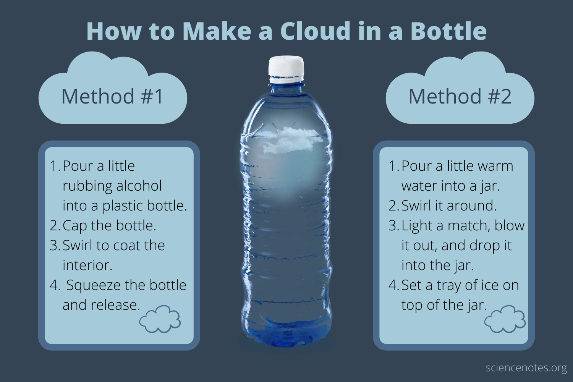

Slide 16
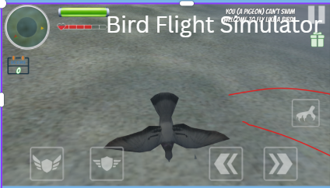
Bird flight simulator

