Slide 1
3D GRAPHICS & RENDERING
FINAL PROJECT:
STEREOSCOPIC 3D
CUBE MAPPING
CEL SHADING
Group:
Dustin Farris
Teng Lu
Andy Martin
Ajinkya Waghulde

Slide 2
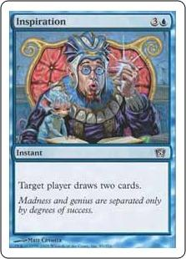
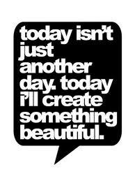
INSPIRATIONS
STEREOSCOPIC 3D - Who doesn't like 3D? Well I guess some people would get headaches.
CUBE MAPPING - Fast, cheap reflection and people can't even tell if I cheated by using cube mapping.
CEL SHADING - Realism is nice, but sometimes unrealism is pleasing to the eyes.

Slide 3
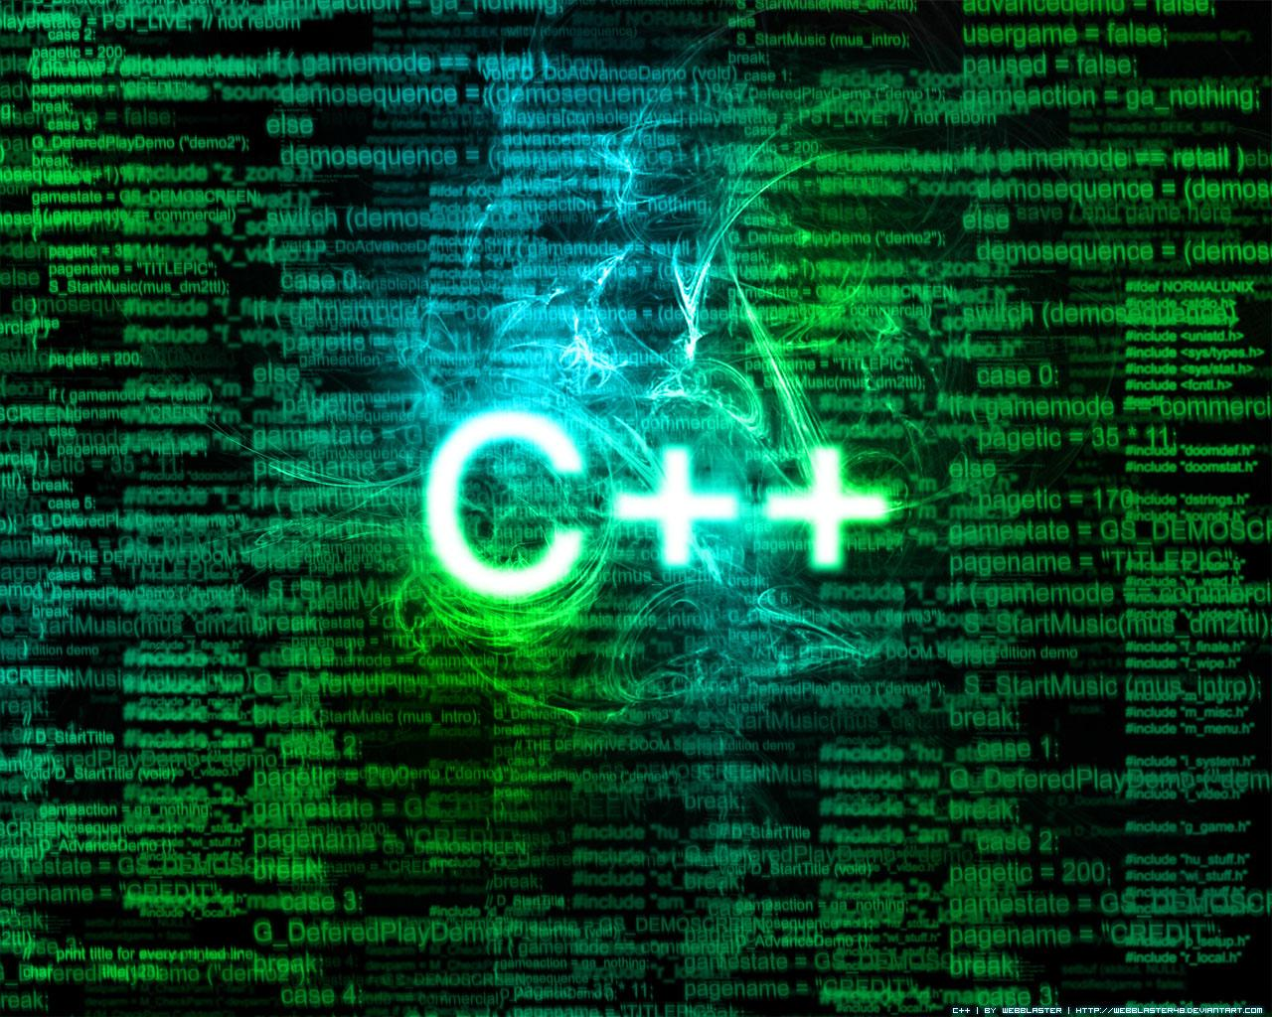

DESIGN
Used the default renderer because we had to. Really wished we could have done it in OpenGL.
Used Git (specifically Github) as source control.
Used HW5 as a starting ground (didn't want to mess with more buffers in HW6 since we had to do Stereoscopic 3D which used additional buffers in the first place).

Slide 4
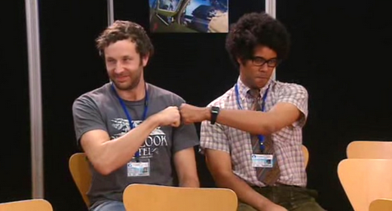
TEAMWORK
STEREOSCOPIC 3D - Everyone contributed.
CUBE MAPPING - Teng and Dustin.
CEL SHADING - Teng.

Slide 5
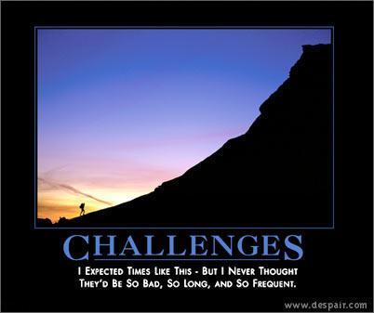
CHALLENGES
STEREOSCOPIC 3D - The teapot is a TERRIBLE MODEL.
CUBE MAPPING - Needed to angle the teapot just right to see what's going on. Ended up using a sphere for testing.
CEL SHADING - The edges can be done easily in OpenGL... not so much here.

Slide 6
FUTURE
For one we would definitely use OpenGL. You have to code every single little thing and it gets old. The concept to every small part is easy to understand but it takes time to code/debug. Easier to just build a feature when you have parts already.
Even if we have to build it from scratch, this code is too old. Converting from C to C++ means using classes and C++ features. Just because it builds with a C++ compiler does not mean it's good C++ code. Classes and operator overloading would be great for this project.

Slide 7
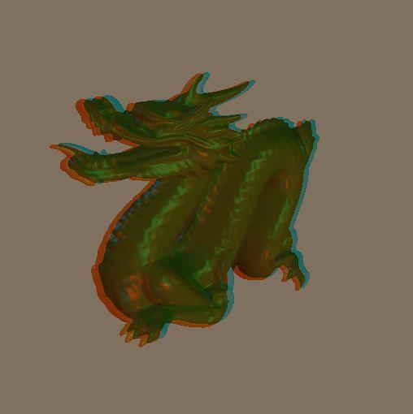
STEREOSCOPIC 3D

Slide 8
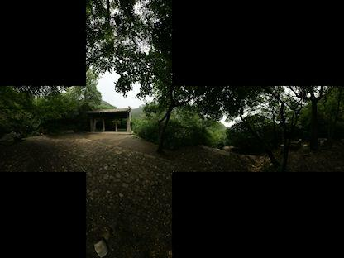
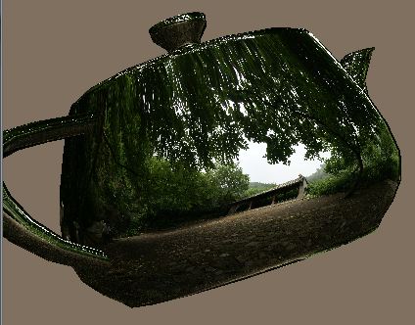
CUBE MAPPING

Slide 9
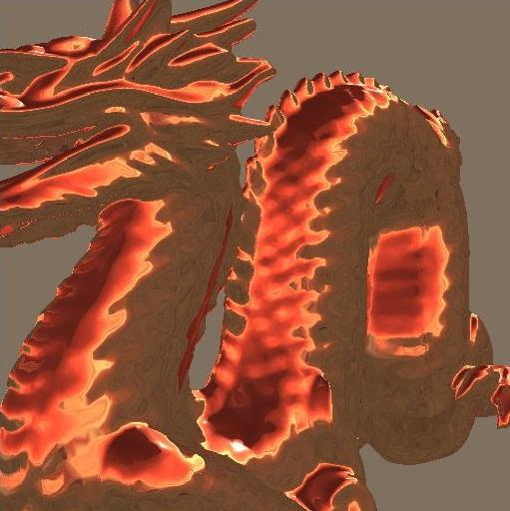
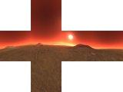
CUBE MAPPING
Fire dragon

Slide 10
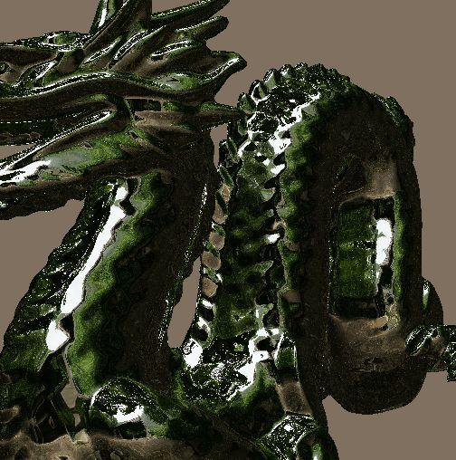
CUBE MAPPING
Garden dragon

Slide 11
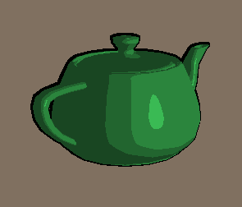
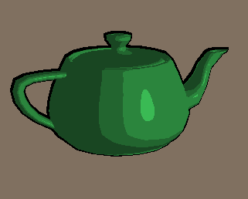
CEL SHADING

Slide 12
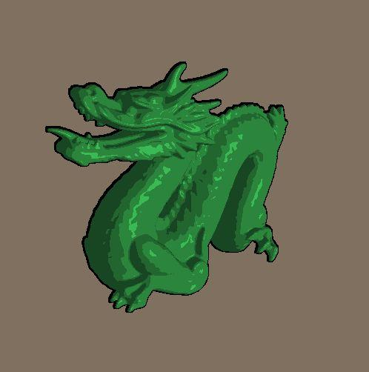
CEL SHADING

Slide 13
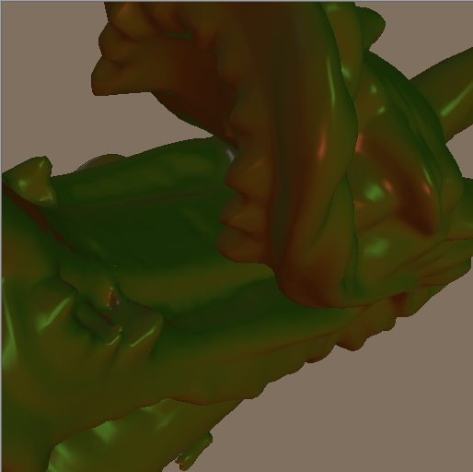
ANY QUESTIONS?

