Slide 1
CMSC424: Database Design Module: Database Implementation
Instructor: Amol Deshpande
amol@cs.umd.edu

Slide 2
Database Implementation
Shifting into discussing the internals of a DBMS
How data stored? How queries/transactions executed?
Topics:
Storage: How is data stored? Important features of the storage devices (RAM, Disks, SSDs, etc)
File Organization: How are tuples mapped to blocks
Indexes: How to quickly find specific tuples of interest (e.g., all ‘friends’ of ‘user0’)
Query processing: How to execute different relational operations? How to combine them to execute an SQL query?
Query optimization: How to choose the best way to execute a query?

Slide 3
Other Stuff
Midterm 2 will also be online
Final will be in person
Similar format as Midterm 1
We will finish up remaining Indexing stuff next week
Today’s focus:
Query processing basics
Discussion of the Iterator Model (Assignment 4)

Slide 4
Query Processing/Storage
user query
results
Given an input user query, decide how to “execute” it
Specify sequence of pages to be brought in memory
Operate upon the tuples to produce results
Query Processing Engine
page requests
pointers
to pages
Bringing pages from disk to memory
Managing the limited memory
Buffer Management
block requests
data
Space Management on Persistent Storage (e.g., Disks)
Storage hierarchy
How are relations mapped to files?
How are tuples mapped to disk blocks?

Slide 5
CMSC424: Database Design Module: Database Implementation
Query Processing: Overview, and Cost Measures
Instructor: Amol Deshpande
amol@umd.edu

Slide 6
Overview and Cost Measures
Book Chapters
12.1, 12.2
Key topics:
Main steps in Query Processing
How to measure the ”cost” of an operation so we can compare alternatives?

Slide 7
Getting Deeper into Query Processing
User
select *
from R, S
where …
Resolve the references,
Syntax errors etc.
Converts the query to an
internal format
relational algebra like
Query Parser
Query Optimizer
Results
Find the best way to evaluate
the query
Which index to use ?
What join method to use ?
…
Query Processor
Read the data from the files
Do the query processing
joins, selections, aggregates
…
R, B+Tree on R.a
S, Hash Index on S.a
…

Slide 8
Getting Deeper into Query Processing

Slide 9
“Cost”
Complicated to compute, but very important to decide early on
Need to know what you are “optimizing” for
Many competing factors in today’s computing environment
CPU Instructions
Disk I/Os
Network Usage – either peak or average (for distributed settings)
Memory Usage
Cache Misses
… and so on
Want to pick the one (or combination) that’s actually a bottleneck
No sense in optimizing for “memory usage” if you have a TB of memory and a single disk
Can do combinations by doing a weighted sum: e.g., 10 * Memory + 50 * Disk I/Os

Slide 10
“Cost”
We will focus on disk for simplicity:
Number of I/Os ?
Not sufficient
Number of seeks matters a lot… why ?
t_{T} – time to transfer one block
t_{S} – time for one seek
Cost for b block transfers plus S seeks b * t_{T} + S * t_{S}
Measured in seconds
Real systems do take CPU cost into account

Slide 11
“Cost” Example
t_{S} = 10 ms (seek time)
t_{T} = ?
Typical block size = 4kB
Say transfer rate = 200MB/s → 20kB/ms → 0.2ms per 4kB
If a plan makes 100 seeks, and transfer 100 blocks:
Cost = 100 * 10 + 0.2 * 100 = 1020ms
If a plan makes 1 seek, and transfer 5000 blocks:
Cost = 10 + 0.2 * 5000 = 1010ms
Transfer rates keep going up (through better hardware and parallelization), but seek times are constant
The gap keeps increasing

Slide 12
Next…
For each relational operation, we will discuss different techniques for doing them
The basic technique usually straightforward, adaptations more complex
For each technique, we will try to figure out roughly the number of seeks and I/Os
Try to focus on the abstract principles involved, and not the details
Very similar techniques used in data processing in other systems like Apache Spark, Hadoop, Python Pandas, etc.

Slide 13
CMSC424: Database Design Module: Query Processing
Selection Operation
Instructor: Amol Deshpande
amol@umd.edu

Slide 14
Selections
Book Chapters
12.3
Key topics:
Different ways to do a ”selection” operation (“where” clause) based on the properties of the predicates and the availability of indexes

Slide 15
Selection Operation
select * from person where SSN = “123”
Option 1: Sequential Scan
Read the relation start to end and look for “123”
Can always be used (not true for the other options)
Cost ?
Let b_{r} = Number of relation blocks
Then:
1 seek and b_{r} block transfers
So:
t_{S} + b_{r} * t_{T} sec
Improvements:
If SSN is a key, then can stop when found
So on average, b_{r}/2 blocks accessed

Slide 16
Selection Operation
select * from person where SSN = “123”
Option 2 : Use Index
Pre-condition:
An appropriate index must exist
Use the index
Find the first leaf page that contains the search key
Retrieve all the tuples that match by following the pointers
If primary index, the relation is sorted by the search key
Go to the relation and read blocks sequentially
If secondary index, must follow all pointers using the index

Slide 17
Selection w/ B+-Tree Indexes
cost of finding the first leaf
cost of retrieving the tuples
primary index, candidate key, equality
h_{i} * (t_{T} + t_{S})
1 * (t_{T} + t_{S})
primary index, not a key, equality
h_{i} * (t_{T} + t_{S})
1 * (t_{T} + t_{S}) + (b – 1) * t_{T}
Note: primary == sorted
b = number of pages that contain the matches
secondary index, candidate key, equality
h_{i} * (t_{T} + t_{S})
1 * (t_{T} + t_{S})
secondary index, not a key, equality
h_{i} * (t_{T} + t_{S})
n * (t_{T} + t_{S})
n = number of records that match
This can be bad
h_{i} = height of the index

Slide 18
Selection Operation
Selections involving ranges
select * from accounts where balance > 100000
select * from matches where matchdate between ’10/20/06’ and ’10/30/06’
Option 1: Sequential scan
Option 2: Using an appropriate index
Can’t use hash indexes for this purpose
Cost formulas:
Range queries == “equality” on “non-key” attributes
So rows 3 and 5 in the preceding page

Slide 19
Selection Operation
Complex selections
Conjunctive: select * from accounts where balance > 100000 and SSN = “123”
Disjunctive: select * from accounts where balance > 100000 or SSN = “123”
Option 1: Sequential scan
Option 2 (Conjunctive only): Using an appropriate index on one of the conditions
E.g. Use SSN index to evaluate SSN = “123”. Apply the second condtion to the tuples that match
Or do the other way around (if index on balance exists)
Which is better ?
Option 3 (Conjunctive only) : Choose a multi-key index
Not commonly available

Slide 20
Selection Operation
Complex selections
Conjunctive: select * from accounts where balance > 100000 and SSN = “123”
Disjunctive: select * from accounts where balance > 100000 or SSN = “123”
Option 4: Conjunction or disjunction of record identifiers
Use indexes to find all RIDs that match each of the conditions
Do an intersection (for conjunction) or a union (for disjunction)
Sort the records and fetch them in one shot
Called “Index-ANDing” or “Index-ORing”
Heavily used in commercial systems

Slide 21
CMSC424: Database Design Module: Query Processing
Joins
Instructor: Amol Deshpande
amol@umd.edu

Slide 22
Joins
Book Chapters
12.5.1, 12.5.2, 12.5.3, 12.5.5
Key topics:
Simplest way to do a join as a nested for loop
Block Nested Loops Joins
Using “indexes” for more efficient joins
Hash Joins
Sort-merge Joins

Slide 23
Join
select * from R, S where R.a = S.a
Called an “equi-join”
select * from R, S where |R.a – S.a | < 0.5
Not an “equi-join”
Goal: For each tuple r in R, find all “matching” tuples in S (or vice versa)
Simplest Algorithm (“nested loops” join)
for each tuple r in R
for each tuple s in S
check if r.a = s.a (or whether |r.a – s.a| < 0.5)
Complexity too high– also not disk efficient
e.g., imagine if |R| and |S| both in millions of tuples

Slide 24
Block Nested-loops Join
Simple modification to the basic “nested-loops join” that is disk efficient
Read a chunk of blocks of R from disk at a time; go through S for each chunk
for each k blocks of R
for each block B_{s} of S
for each tuple r in those k blocks of R
for each tuple s in Bs
check if r.a = s.a (or whether |r.a – s.a| < 0.5)
Cost?
Blocks Read of R: |Br| (every block read exactly once)
Blocks Read of S: |Bs| * |Br|/k (every block of S read |Br|/k times)
Seeks: 2 * |Br|/k
Choose k to be as large as possible (but can’t be more than M)
However: We are still comparing every R tuple with every S tuple → high CPU cost

Slide 25
Index Nested-loops Join
select * from R, S where R.a = S.a
Called an “equi-join”
Let’s say there is an “index” on S.a
for each tuple r in R
use the index to find S tuples with S.a = r.a
Blocks read of R: Br
Blocks read of S: depends on the index (see previous formulas)
Seeks: Br for R, but seeks for S depend on the index

Slide 26
Index Nested-loops Join
Restricted applicability
An appropriate index must exist
What about |R.a – S.a| < 5 ?
Great for queries with joins and selections
select *
from accounts, customers
where accounts.customer-SSN = customers.customer-SSN and
accounts.acct-number = “A-101”
Only need to access one SSN from the other relation

Slide 27
Hash Join
Case 1: Smaller relation (S) fits in memory
read S in memory and build a hash index on it
for each tuple r in R
use the hash index on S to find tuples such that S.a = r.a
Cost: b_{r} + b_{s} transfers, 2 seeks
Why good ?
CPU cost is much better (even though we technically don’t care about it in our cost function, in reality, it matters a lot)
Performs much better than nested-loops join when S doesn’t fit in memory (next)

Slide 28
Hash Join
Case 2: Smaller relation (S) doesn’t fit in memory
Two “phases”
Phase 1:
Read the relation R block by block and partition it using a hash function, h1(a)
Create one partition for each possible value of h1(a)
Write the partitions to disk
R gets partitioned into R1, R2, …, Rk
Similarly, read and partition S, and write partitions S1, S2, …, Sk to disk
Only requirement:
Each S partition fits in memory
Requires SQRT(Bs) Memory
Can do “recursive” partitioning if not enough memory – rarely the case today

Slide 29
Hash Join
Case 2: Smaller relation (S) doesn’t fit in memory
Two “phases”
Phase 2:
Read S1 into memory, and bulid a hash index on it (S1 fits in memory)
Using a different hash function, h₂(a)
Read R1 block by block, and use the hash index to find matches.
Repeat for S2, R2, and so on.

Slide 30
Hash Join
Case 2: Smaller relation (S) doesn’t fit in memory
Two “phases”:
Phase 1:
Partition the relations using one hash function, h₁(a)
Phase 2:
Read S_{i} into memory, and bulid a hash index on it (S_{i} fits in memory)
Read R_{i} block by block, and use the hash index to find matches.
Cost ?
3(b_{r} + b_{s}) +4 ∗ n_{h} block transfers + 2( ⎡b_{r} / b_{b}⎤ + ⎡b_{s} / b_{b}⎤) seeks
Where b_{b} is the size of each output buffer
Much better than Nested-loops join under the same conditions

Slide 31
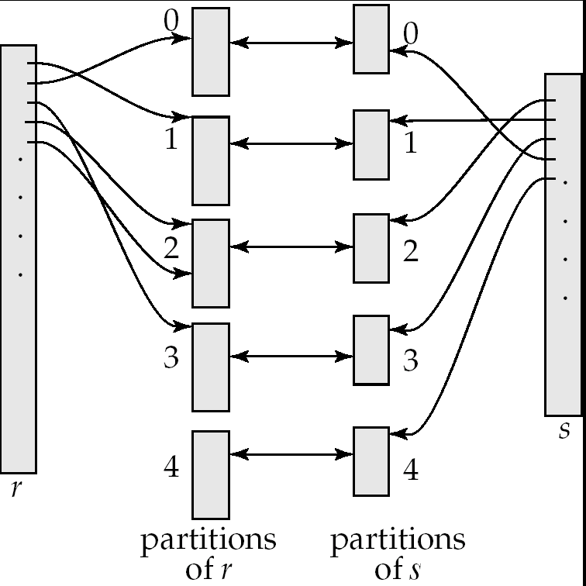
Hash Join

Slide 32
Hash Join: Issues
How to guarantee that the partitions of S all fit in memory ?
Say S = 10000 blocks, Memory = M = 100 blocks
Use a hash function that hashes to 100 different values ?
Eg. h1(a) = a % 100 ?
Problem: Impossible to guarantee uniform split
Some partitions will be larger than 100 blocks, some will be smaller
Use a hash function that hashes to 100*f different values
f is called fudge factor, typically around 1.2
So we may consider h1(a) = a % 120.
This is okay IF a is uniformly distributed
What if the hash function turns out to be bad ?
Repartition using a different hash function (at run time)

Slide 33
CMSC424: Database Design Module: Query Processing
Aggregates
Instructor: Amol Deshpande
amol@umd.edu

Slide 34
Group By and Aggregation
select a, count(b)
from R
group by a;
Hash-based algorithm
Steps:
Create a hash table on a, and keep the count(b) so far
Read R tuples one by one
For a new R tuple, “r”
Check if r.a exists in the hash table
If yes, increment the count
If not, insert a new value

Slide 35
Group By and Aggregation
select a, count(b)
from R
group by a;
Sort-based algorithm
Steps:
Sort R on a
Now all tuples in a single group are contigous
Read tuples of R (sorted) one by one and compute the aggregates

Slide 36
Group By and Aggregation
select a, AGGR(b) from R group by a;
sum(), count(), min(), max(): only need to maintain one value per group
Called “distributive”
average() : need to maintain the “sum” and “count” per group
Called “algebraic”
stddev(): algebraic, but need to maintain some more state
median(): can do efficiently with sort, but need two passes (called “holistic”)
First to find the number of tuples in each group, and then to find the median tuple in each group
count(distinct b): must do duplicate elimination before the count

Slide 37
CMSC424: Database Design Module: Query Processing
Sorting and Merge Joins; Some Other Operators
Instructor: Amol Deshpande
amol@umd.edu

Slide 38
Sorting; Merge Joins
Book Chapters
12.4, 12.5.4, 12.6
Key topics:
How to sort when data doesn’t fit in memory
Using sorting for joins
Duplicate elimination
Set operations
Outerjoins

Slide 39
Sorting
Commonly required for many operations
Duplicate elimination, group by’s, sort-merge join
Queries may have ASC or DSC in the query
One option:
Read the lowest level of the index
May be enough in many cases
But if relation not sorted, this leads to too many random accesses
If relation small enough…
Read in memory, use quick sort (qsort() in C)
What if relation too large to fit in memory ?
External sort-merge

Slide 40
External sort-merge
Divide and Conquer !!
Let M denote the memory size (in blocks)
Phase 1:
Read first M blocks of relation, sort, and write it to disk
Read the next M blocks, sort, and write to disk …
Say we have to do this “N” times
Result: N sorted runs of size M blocks each
Phase 2:
Merge the N runs (N-way merge)
Can do it in one shot if N < M

Slide 41
External sort-merge
Phase 1:
Create sorted runs of size M each
Result: N sorted runs of size M blocks each
Phase 2:
Merge the N runs (N-way merge)
Can do it in one shot if N < M
What if N > M ?
Do it recursively
Not expected to happen
If M = 1000 blocks = 4MB (assuming blocks of 4KB each)
Can sort: 4000MB = 4GB of data

Slide 42
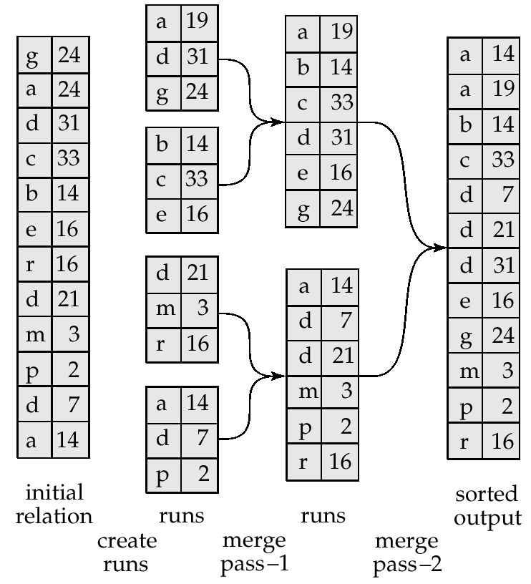
Example: External Sorting Using Sort-Merge

Slide 43
External Merge Sort (Cont.)
Cost analysis:
Total number of merge passes required: ⎡log_{M–1}(b_{r}/M)⎤.
Disk accesses for initial run creation as well as in each pass is 2b_{r}
for final pass, we don’t count write cost
we ignore final write cost for all operations since the output of an operation may be sent to the parent operation without being written to disk
Thus total number of disk accesses for external sorting:
b_{r} ( 2 ⎡log_{M–1}(b_{r} / M)⎤ + 1)
What about seeks?
More complicated

Slide 44
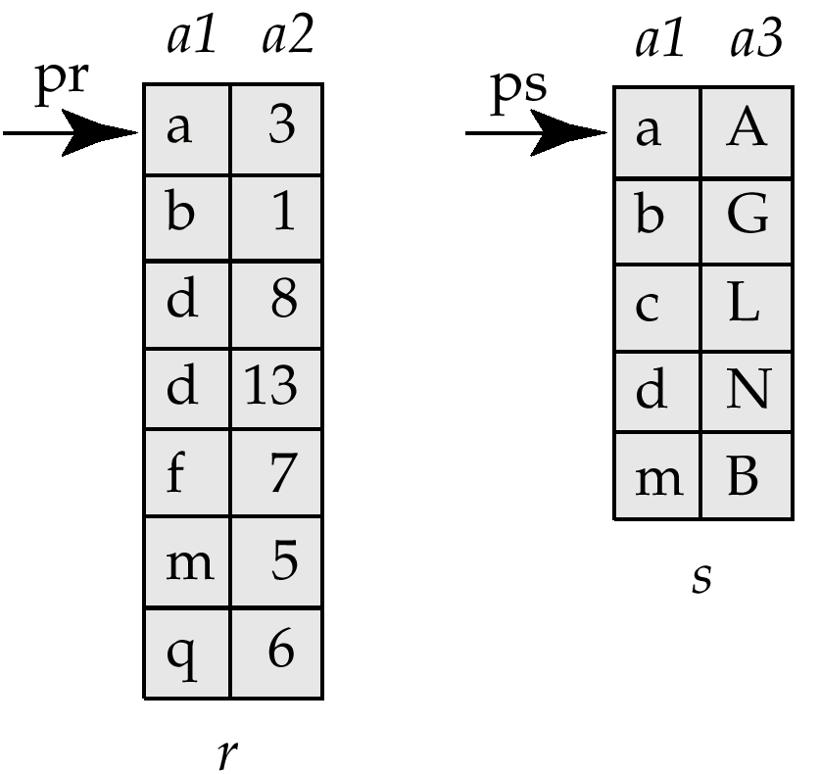
Merge-Join (Sort-merge join)
Pre-condition:
The relations must be sorted by the join attribute
If not sorted, can sort first, and then use this algorithms
Called “sort-merge join” sometimes
select *
from r, s
where r.a1 = s.a1
Step:
1. Compare the tuples at pr and ps
2. Move pointers down the list
- Depending on the join condition
3. Repeat

Slide 45
Merge-Join (Sort-merge join)
Cost:
If the relations sorted, then just
b_{r} + b_{s} block transfers, some seeks depending on memory size
What if not sorted ?
Then sort the relations first
In many cases, still very good performance
Typically comparable to hash join
Observation:
The final join result will also be sorted on a1
This might make further operations easier to do
E.g. duplicate elimination

Slide 46
Joins: Summary
Block Nested-loops join
Can always be applied irrespective of the join condition
Index Nested-loops join
Only applies if an appropriate index exists
Hash joins – only for equi-joins
Join algorithm of choice when the relations are large
Hybrid hash join
An optimization on hash join that is always implemented
Sort-merge join
Very commonly used – especially since relations are typically sorted
Sorted results commonly desired at the output
To answer group by queries, for duplicate elimination, because of ASC/DSC

Slide 47
Duplicate Elimination
select distinct a
from R ;
Best done using sorting – Can also be done using hashing
Steps:
Sort the relation R
Read tuples of R in sorted order
prev = null;
for each tuple r in R (sorted)
if r != prev then
Output r
prev = r
else
Skip r

Slide 48
Set operations
(select * from R) union (select * from S) ;
(select * from R) intersect (select * from S) ;
(select * from R) union all (select * from S) ;
(select * from R) intersect all (select * from S) ;
Remember the rules about duplicates
“union all”: just append the tuples of R and S
“union”: append the tuples of R and S, and do duplicate elimination
“intersection”: similar to joins
Find tuples of R and S that are identical on all attributes
Can use hash-based or sort-based algorithm

Slide 49
Outer Joins
Say: R FULL OUTER JOIN S, on R.a = S.a
Need to keep track of which tuples of R “do not match” any tuples from S, and vice versa
Hash-based, with a hash index on S:
For a tuple r in R, if the probe returns NULL, output r padded with NULLs
For each tuple s in S, maintain a Boolean variable (in the hash table) to track whether s was returned for any probes
At the end, go through the hash table, and look for S tuples that did not match anything
Merge join can also be adapted in a similar way

Slide 50
CMSC424: Database Design Module: Query Processing
Putting it All Together
Instructor: Amol Deshpande
amol@cs.umd.edu

Slide 51
Putting it all together
Book Chapters
12.7
Key topics:
How to put it all together in a query plan
Pipelining vs Materialization
Iterator Interface

Slide 52
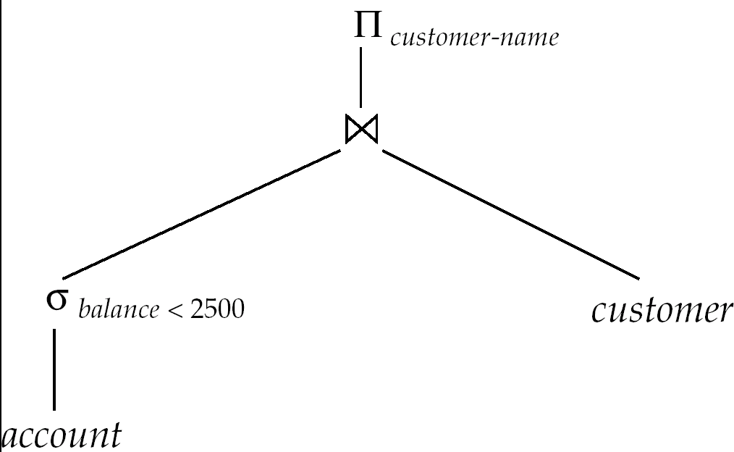
Evaluation of Expressions
select customer-name
from account a, customer c
where a.SSN = c.SSN and
a.balance < 2500
Two options:
Materialization
Pipelining

Slide 53
Evaluation of Expressions
Materialization
Evaluate each expression separately
Store its result on disk in temporary relations
Read it for next operation
Pipelining
Evaluate multiple operators simultaneously
Skip the step of going to disk
Usually faster, but requires more memory
Also not always possible..
E.g. Sort-Merge Join
Harder to reason about

Slide 54
Materialization
Materialized evaluation is always applicable
Cost of writing results to disk and reading them back can be quite high
Our cost formulas for operations ignore cost of writing results to disk, so
Overall cost = Sum of costs of individual operations + cost of writing intermediate results to disk
Double buffering: use two output buffers for each operation, when one is full write it to disk, while the other is getting filled
Allows overlap of disk writes with computation and reduces execution time

Slide 55
Pipelining
Evaluate several operations simultaneously, passing the results of one operation on to the next.
E.g., in previous expression tree, don’t store result of
instead, pass tuples directly to the join.. Similarly, don’t store result of join, pass tuples directly to projection.
Much cheaper: no need to store a temporary relation to disk.
Requires higher amount of memory
All operations are executing at the same time (say as processes)
Somewhat limited applicability
A “blocking” operation: An operation that has to consume entire input before it starts producing output tuples

Slide 56
Pipelining
Need operators that generate output tuples while receiving tuples from their inputs
Selection: Usually yes.
Sort: NO. The sort operation is blocking
Sort-merge join: The final (merge) phase can be pipelined
Hash join: The partitioning phase is blocking; the second phase can be pipelined
Aggregates: Typically no. Need to wait for the entire input before producing output
However, there are tricks you can play here
Duplicate elimination: Since it requires sort, the final merge phase could be pipelined
Set operations: see duplicate elimination

Slide 57
Pipelining: Demand-driven
Iterator Interface
Each operator implements:
init(): Initialize the state (sometimes called open())
get_next(): get the next tuple from the operator
close(): Finish and clean up
Sequential Scan:
init(): open the file
get_next(): get the next tuple from file
close(): close the file
Execute by repeatadly calling get_next() at the root
root calls get_next() on its children, the children call get_next() on their children etc…
The operators need to maintain internal state so they know what to do when the parent calls get_next()

Slide 58
Hash-Join Iterator Interface
open():
Call open() on the left and the right children
Decide if partitioning is needed (if size of smaller relation > allotted memory)
Create a hash table
get_next(): ((( assuming no partitioning needed )))
First call:
Get all tuples from the right child one by one (using get_next()), and insert them into the hash table
Read the first tuple from the left child (using get_next())
All calls:
Probe into the hash table using the “current” tuple from the left child
Read a new tuple from left child if needed
Return exactly “one result”
Must keep track if more results need to be returned for that tuple

Slide 59
Hash-Join Iterator Interface
close():
Call close() on the left and the right children
Delete the hash table, other intermediate state etc…
get_next(): (((partitioning needed )))
First call:
Get all tuples from both children and create the partitions on disk
Read the first partition for the right child and populate the hash table
Read the first tuple from the left child from appropriate partition
All calls:
Once a partition is finished, clear the hash table, read in a new partition from the right child, and re-populate the hash table
Not that much more complicated
Take a look at the postgreSQL codebase

Slide 60
Pipelining (Cont.)
In produce-driven or eager pipelining
Operators produce tuples eagerly and pass them up to their parents
Buffer maintained between operators, child puts tuples in buffer, parent removes tuples from buffer
if buffer is full, child waits till there is space in the buffer, and then generates more tuples
System schedules operations that have space in output buffer and can process more input tuples

Slide 61
Recap: Query Processing
Many, many ways to implement the relational operations
Numerous more used in practice
Especially in data warehouses which handles TBs (even PBs) of data
However, consider how complex SQL is and how much you can do
Compared to that, this isn’t much
Most of it is very nicely modular
Especially through use of the iterator() interface
Can plug in new operators quite easily
PostgreSQL query processing codebase very easy to read and modify
Having so many operators does complicate the codebase and the query optimizer though
But needed for performance

Slide 62
CMSC424: Database Design Module: Query Processing
Query Optimization
Instructor: Amol Deshpande
amol@umd.edu

Slide 63
Query Optimization: Overview
Key topics:
Why query optimization is so important?
Key steps in query optimization
High-level concepts

Slide 64
Getting Deeper into Query Processing
User
select *
from R, S
where …
Resolve the references,
Syntax errors etc.
Converts the query to an
internal format
relational algebra like
Query Parser
Query Optimizer
Results
Find the best way to evaluate
the query
Which index to use ?
What join method to use ?
…
Query Processor
Read the data from the files
Do the query processing
joins, selections, aggregates
…
R, B+Tree on R.a
S, Hash Index on S.a
…

Slide 65
Query Optimization
Why ?
Many different ways of executing a given query
Huge differences in cost
Example:
select * from person where ssn = “123”
Size of person = 1GB
Sequential Scan:
Takes 1GB / (20MB/s) = 50s
Use an index on SSN (assuming one exists):
Approx 4 Random I/Os = 40ms

Slide 66
Query Optimization
Many choices
Using indexes or not, which join method (hash, vs merge, vs NL)
What join order ?
Given a join query on R, S, T, should I join R with S first, or S with T first ?
This is an optimization problem
Similar to say traveling salesman problem
Number of different choices is very very large
Step 1: Figuring out the solution space
Step 2: Finding algorithms/heuristics to search through the solution space

Slide 67
Query Optimization: Goal
Find the best (or a good enough) execution plan
Execution plans = Evaluation expressions annotated with the methods used

Slide 68
Query Optimization
Steps:
Generate all possible execution plans for the query
Figure out the cost for each of them
Choose the best
Not done exactly as listed above
Too many different execution plans for that
Typically interleave all of these into a single efficient search algorithm

Slide 69
Equivalence of Expressions
Equivalent relational expressions
Drawn as a tree
List the operations and the order

Slide 70
Equivalence of Expressions
Two relational expressions equivalent iff:
Their result is identical on all legal databases
Equivalence rules:
Allow replacing one expression with another
Examples:
1.
2. Selections are commutative

Slide 71
Equivalence Rules
Examples:
3.
5. E_{1 θ} E₂ = E₂ _{θ} E₁
7(a). If θ₀ only involves attributes from E₁
σ_{θ0}(E₁ _{θ} E₂) = (σ_{θ0}(E₁)) _{θ} E₂
And so on…
Many rules of this type

Slide 72
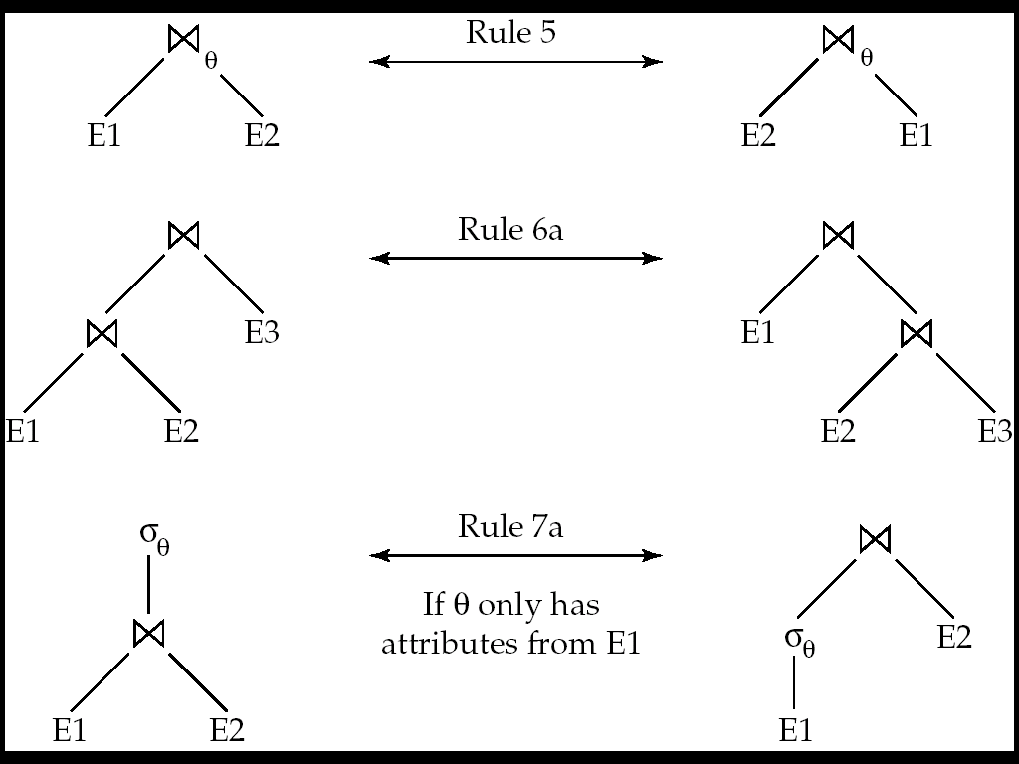
Pictorial Depiction

Slide 73
Equivalence of Expressions
The rules give us a way to enumerate all equivalent expressions
Note that the expressions don’t contain physical access methods, join methods etc…
Simple Algorithm:
Start with the original expression
Apply all possible applicable rules to get a new set of expressions
Repeat with this new set of expressions
Till no new expressions are generated

Slide 74
Equivalence of Expressions
Works, but is not feasible
Consider a simple case:
R1 (R2 (R3 (… Rn)))….)
Just join commutativity and associativity will give us:
At least:
n^2 * 2^n
At worst:
n! * 2^n
Typically the process of enumeration is combined with the search process

Slide 75
Evaluation Plans
We still need to choose the join methods etc..
Option 1: Choose for each operation separately
Usually okay, but sometimes the operators interact
Consider joining three relations on the same attribute:
R1 _{a} (R2 _{a} R3)
Best option for R2 join R3 might be hash-join
But if R1 is sorted on a, then sort-merge join is preferable
Because it produces the result in sorted order by a
Also, we need to decide whether to use pipelining or materialization
Such issues are typically taken into account when doing the optimization

Slide 76
Query Optimization
Steps:
Generate all possible execution plans for the query
First generate all equivalent expressions
Then consider all annotations for the operations
Figure out the cost for each of them
Compute cost for each operation
Using the formulas discussed before
One problem: How do we know the number of result tuples for, say,
Add them !
Choose the best

Slide 77
Cost estimation
Computing operator costs requires information like:
Primary key ?
Sorted or not, which attribute
So we can decide whether need to sort again
How many tuples in the relation, how many blocks ?
RAID ?? Which one ?
Read/write costs are quite different
How many tuples match a predicate like “age > 40” ?
E.g. Need to know how many index pages need to be read
Intermediate result sizes
E.g. (R JOIN S) is input to another join operation – need to know if it fits in memory
And so on…

Slide 78
Cost estimation
Some information is static and is maintained in the metadata
Primary key ?
Sorted or not, which attribute
So we can decide whether need to sort again
How many tuples in the relation, how many blocks ?
RAID ?? Which one ?
Read/write costs are quite different
Typically kept in some tables in the database
“all_tab_columns” in Oracle
Most systems have commands for updating them

Slide 79
Cost estimation
However, others need to be estimated somehow
How many tuples match a predicate like “age > 40” ?
E.g. Need to know how many index pages need to be read
Intermediate result sizes
The problem variously called:
“intermediate result size estimation”
“selectivity estimation”
Very important to estimate reasonably well
e.g. consider “select * from R where zipcode = 20742”
We estimate that there are 10 matches, and choose to use a secondary index (remember: random I/Os)
Turns out there are 10000 matches
Using a secondary index very bad idea
Optimizer also often choose Nested-loop joins if one relation very small… underestimation can result in very bad

Slide 80
Selectivity Estimation
Basic idea:
Maintain some information about the tables
More information → more accurate estimation
More information → higher storage cost, higher update cost
Make uniformity and randomness assumptions to fill in the gaps
Example:
For a relation “people”, we keep:
Total number of tuples = 100,000
Distinct “zipcode” values that appear in it = 100
Given a query: “zipcode = 20742”
We estimated the number of matching tuples as: 100,000/100 = 1000
What if I wanted more accurate information ?
Keep better statistics/summaries…

Slide 81
Examples
Consider a range query: x < R.a < y
Let Max(a, R) = maximum value of a in R
Let Min(a, R) = minimum value of a in R
Then: fraction of tuples that satisfy = (y – x) / (Max – Min)
Assuming all tuples are distributed uniformly and randomly
If y > Max or x < Min → adjust accordingly
Better summary statistics (like histograms) can help with refining these estimates

Slide 82
Example: Joins
R JOIN S: R.a = S.a
|R| = 10,000; |S| = 5000
CASE 1: a is key for S
Each tuple of R joins with exactly one tuple of S
So: |R JOIN S| = |R| = 10,000
Assumption: Referential integrity holds
What if there is a selection on R or S
Adjust accordingly
Say: S.b = 100, with selectivity 0.1
THEN: |R JOIN S| = |R| * 0.1 = 100
CASE 2: a is key for R
Similar

Slide 83
Joins
R JOIN S: R.a = S.a
|R| = 10,000; |S| = 5000
CASE 3: a is not a key for either
Reason with the distributions on a
Say: the domain of a: V(A, R) = 100 (the number of distinct values a can take)
THEN, assuming uniformity
For each value of a
We have 10,000/100 = 100 tuples of R with that value of a
We have 5000/100 = 50 tuples of S with that value of a
All of these will join with each other, and produce 100 *50 = 5000
So total number of results in the join:
5000 * 100 = 500000
We can improve the accuracy if we know the distributions on a better
Say using a histogram

Slide 84
Query Optimization
Steps:
Generate all possible execution plans for the query
First generate all equivalent expressions
Then consider all annotations for the operations
Figure out the cost for each of them
Compute cost for each operation
Using the formulas discussed before
One problem: How do we know the number of result tuples for, say,
Add them !
Choose the best

Slide 85
Optimization Algorithms
Two types:
Exhaustive: That attempt to find the best plan
Heuristical: That are simpler, but are not guaranteed to find the optimal plan
Consider a simple case
Join of the relations R1, …, Rn
No selections, no projections
Still very large plan space

Slide 86
Searching for the best plan
Option 1:
Enumerate all equivalent expressions for the original query expression
Using the rules outlined earlier
Estimate cost for each and choose the lowest
Too expensive !
Consider finding the best join-order for r₁ r₂ . . . r_{n}.
There are (2(n – 1))!/(n – 1)! different join orders for above expression. With n = 7, the number is 665280, with n = 10, the number is greater than 176 billion!

Slide 87
Searching for the best plan
Option 2:
Dynamic programming
There is too much commonality between the plans
Also, costs are additive
Caveat: Sort orders (also called “interesting orders”)
Reduces the cost down to O(n3^n) or O(n2^n) in most cases
Interesting orders increase this a little bit
Considered acceptable
Typically n < 10.
Switch to heuristic if not acceptable

Slide 88
Heuristic Optimization
Dynamic programming is expensive
Use heuristics to reduce the number of choices
Typically rule-based:
Perform selection early (reduces the number of tuples)
Perform projection early (reduces the number of attributes)
Perform most restrictive selection and join operations before other similar operations.
Some systems use only heuristics, others combine heuristics with partial cost-based optimization.

Slide 89
Summary
Integral component of query processing
Why ?
One of the most complex pieces of code in a database system
Active area of research
E.g. XML Query Optimization ?
What if you don’t know anything about the statistics
Better statistics
Etc …

