Slide 1
Group 03
CSE 428 - Image Processing
(Project Milestone 2)

Slide 2
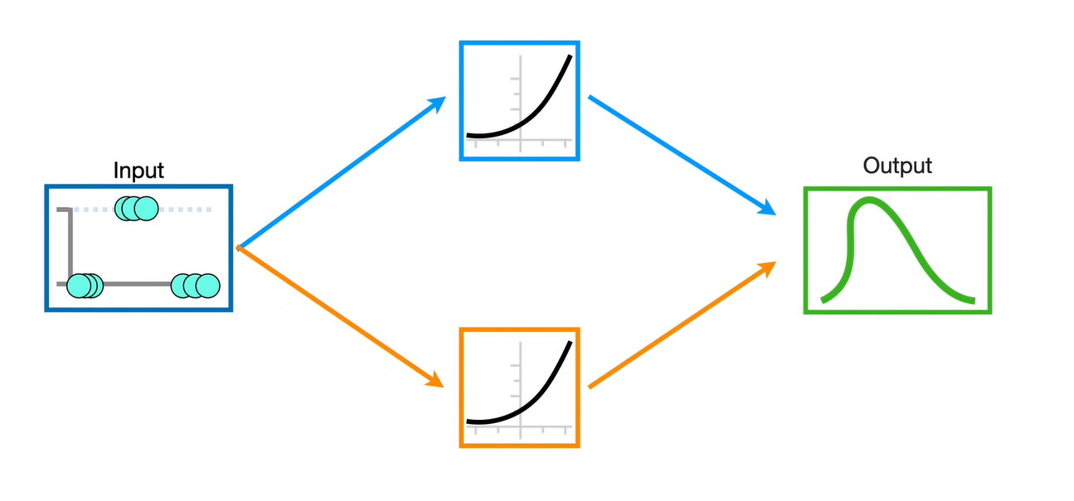
Complex feature extraction by NN

Slide 3
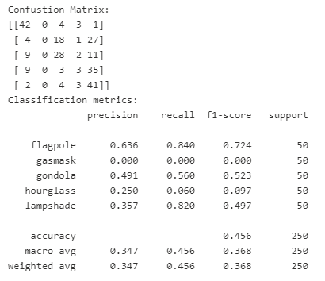
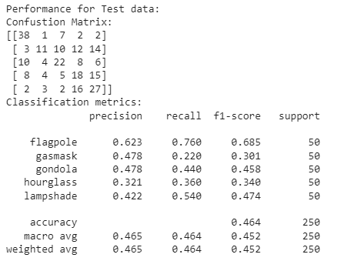
Comparison with Logistic Regression
Logistic Regression Model
Neural Network Model

Slide 4
Before and After Oversampling (SMOTE)
Before Oversampling
After Oversampling

Slide 5
Hyperparameters
Values are set before training process
Needs tuning (using Training and Validation data)

Slide 6
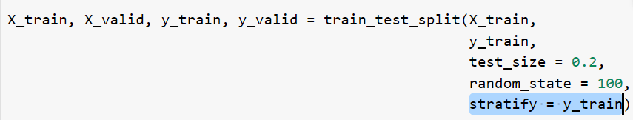
Train Validation Split
This stratify parameter makes a split so that the proportion of values in the sample produced will be the same as the proportion of values provided to parameter stratify.

Slide 7
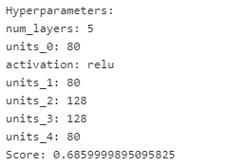
Keras Tuning
Parameter Choices:
Number of hidden layers = [2, 3, 4, 5]
Neurons in each hidden layer = [16, 32, 48, 64, 80, 96, 112, 128]
Activation function for hidden layers = [“relu”, “sigmoid”]
Trials Ran = ~120
Best score for these hyperparameter values ->

Slide 8
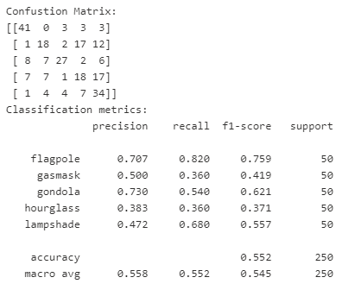
Before and After Hyperparameter Tuning
Before Tuning
After Tuning

Slide 9
Thank you

