Slide 1
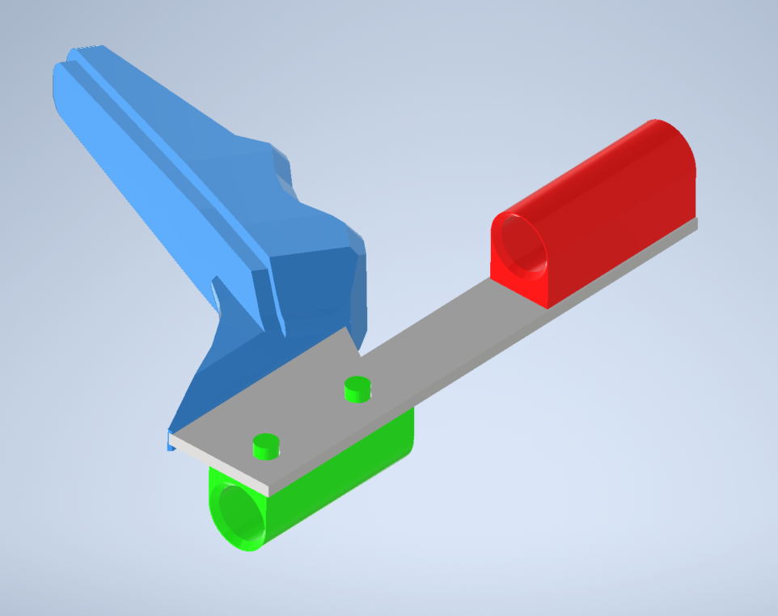
07-ChargeHandle
09-ChargeUpper
30ORCUT-ChargePlate
Assemble 09, 08, 07 to 30. Sand pegs flat.
08-ChargeLower

Slide 2
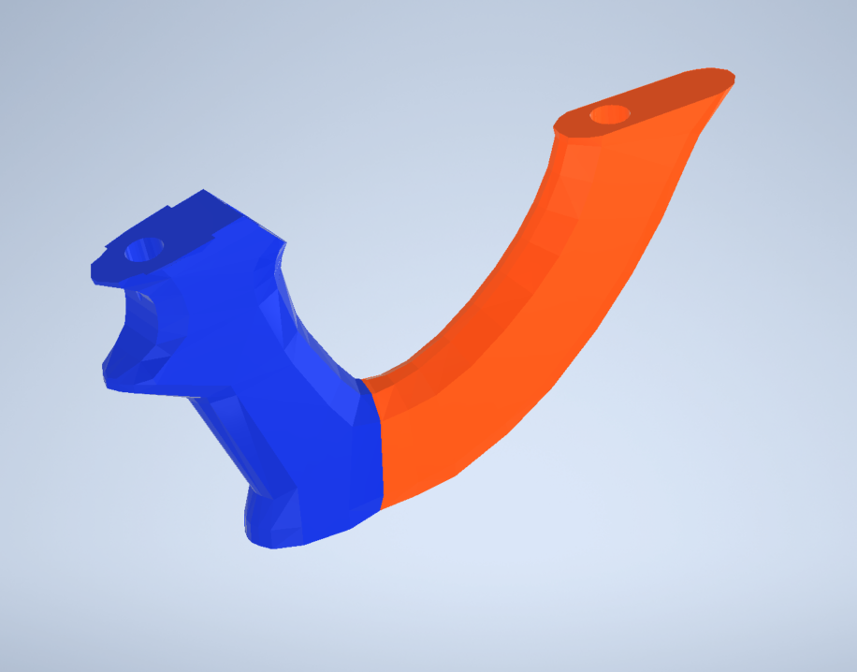
25-Grip
26-GripBack
Trigger Wiring Guide
Assemble using ½” aluminum tube as reinforcement

Slide 3
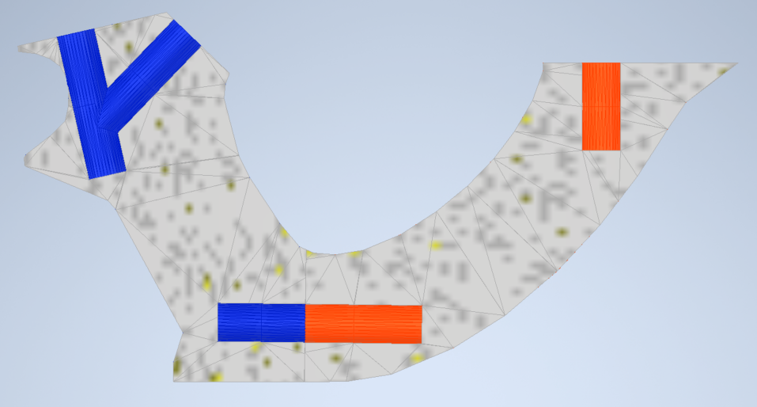
Wire to Control Board
Trigger-Button
Grip-Assembly

Slide 4
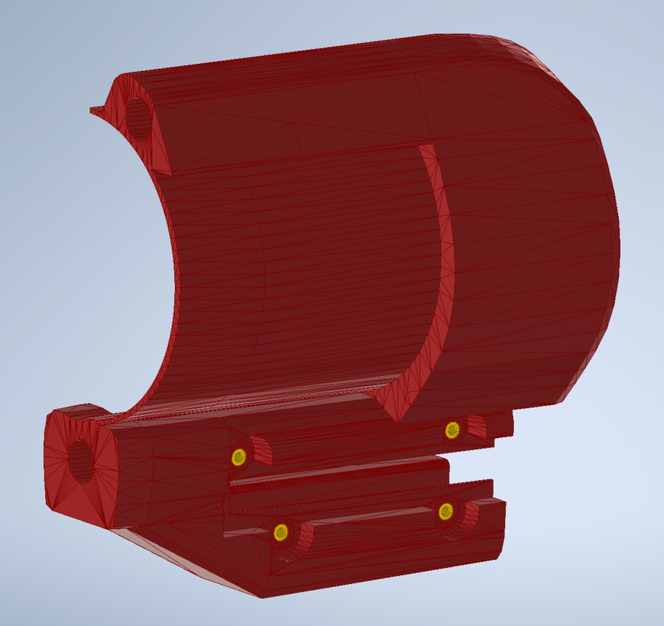
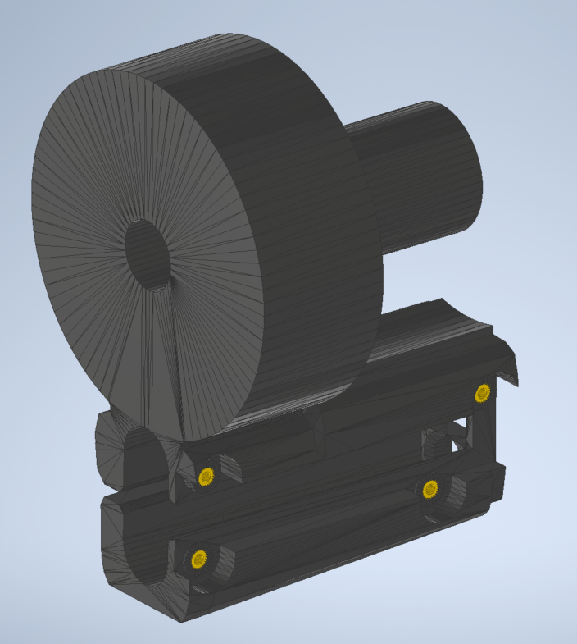
16-MagFront
05-Front
M3x0.5, 3.8mm Long Heat Set Inserts x8

Slide 5
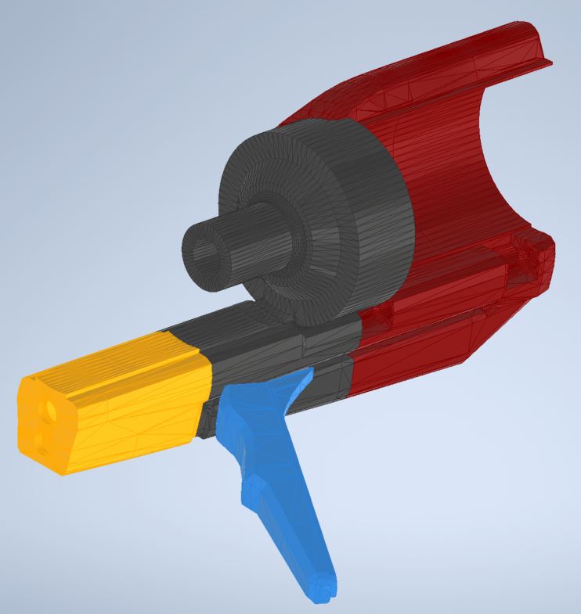
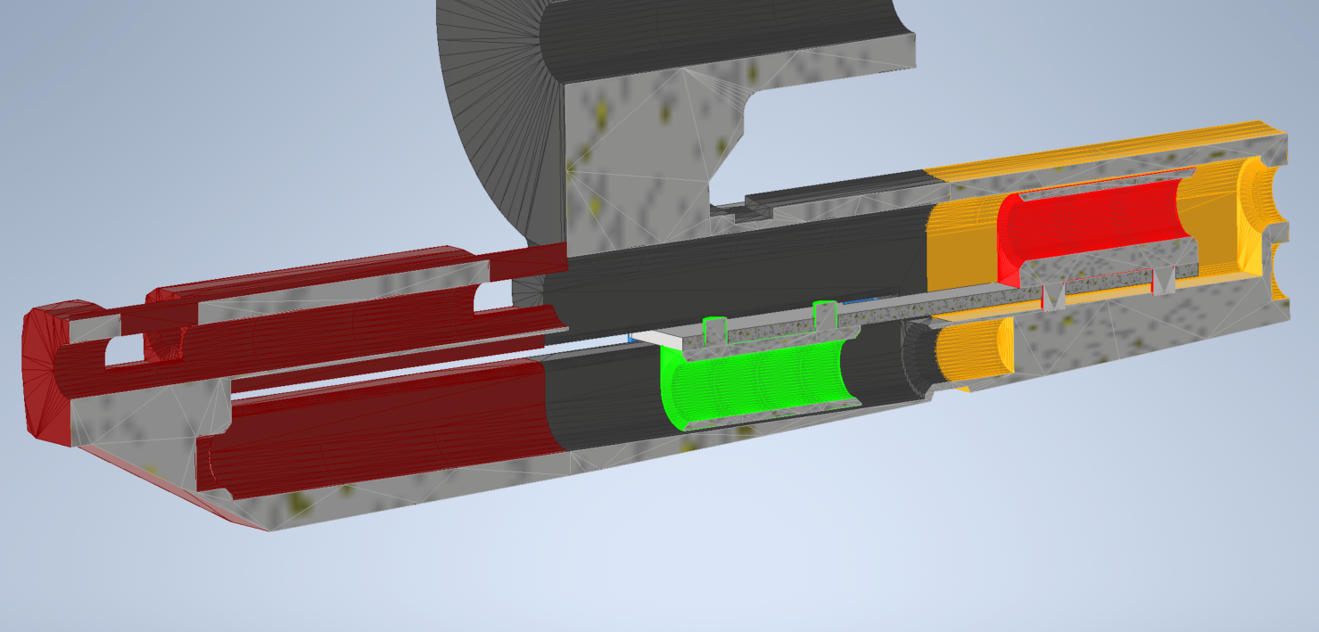
05-Front
Charge-Handle Assembly Diagram
- Charge Handle should slide “freely” on aluminum tubing
16-MagFront
ChargeHandle ASM
04-Front
½” Aluminum tubing (cut to necessary lengths

Slide 6
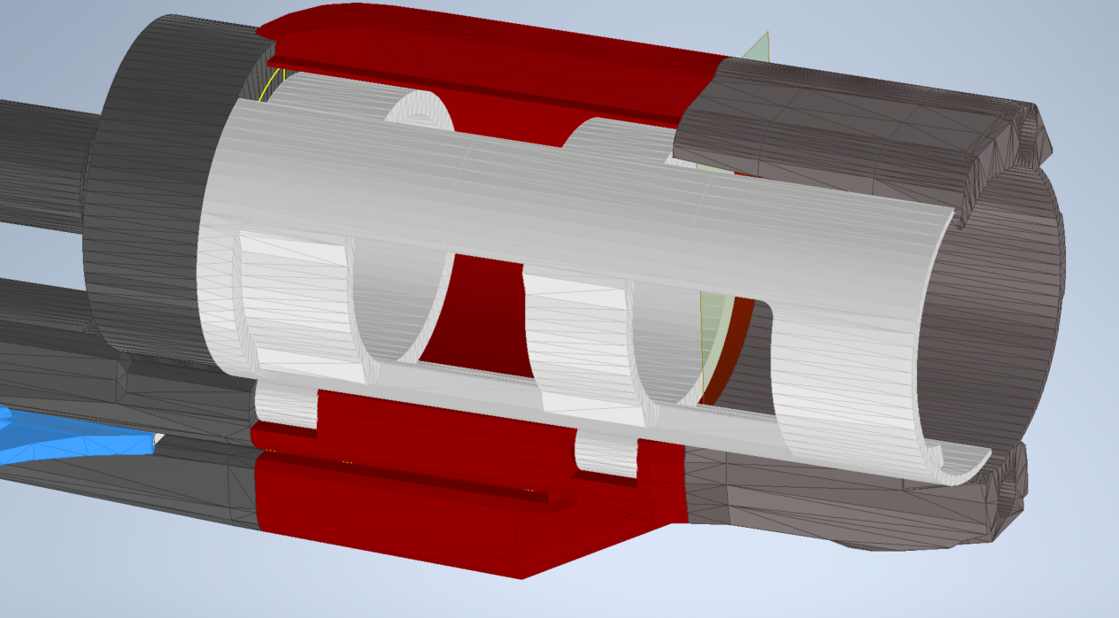
Body Assembly
Needs to be trimmed to close properly
27-MagCover
17-MagBack

Slide 7
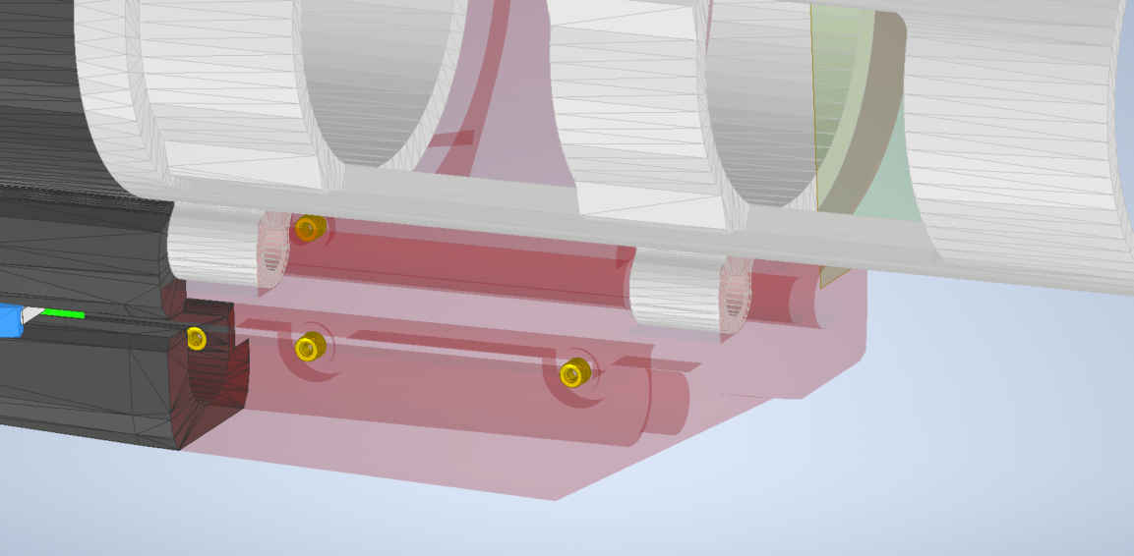
Insert 3/8” Aluminum Rod, cut to length
(should end at back end of 16-MagFront)

Slide 8
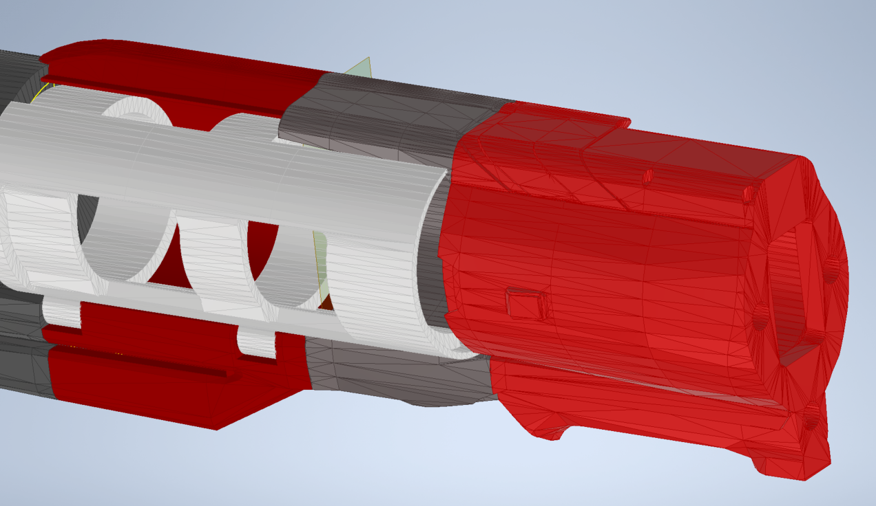
Assembly as of Step 005
18-StockFront

Slide 9
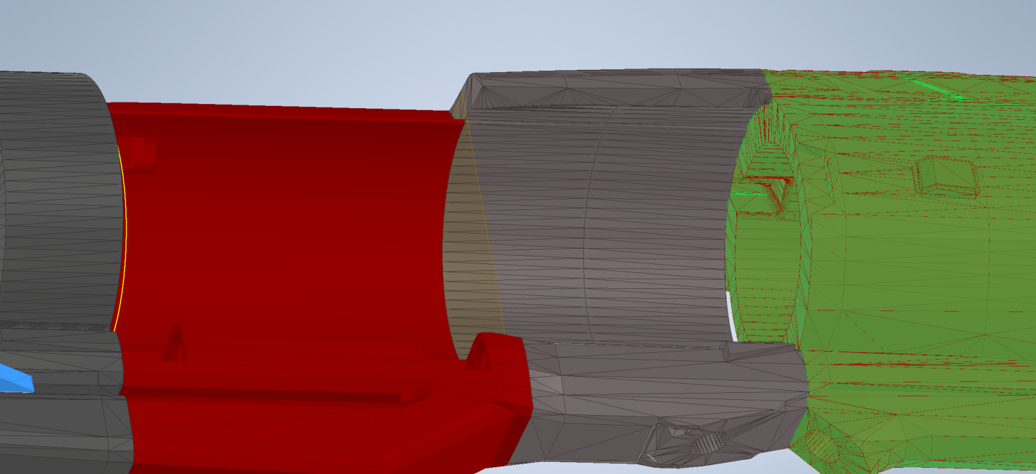
Route wires through this path

Slide 10
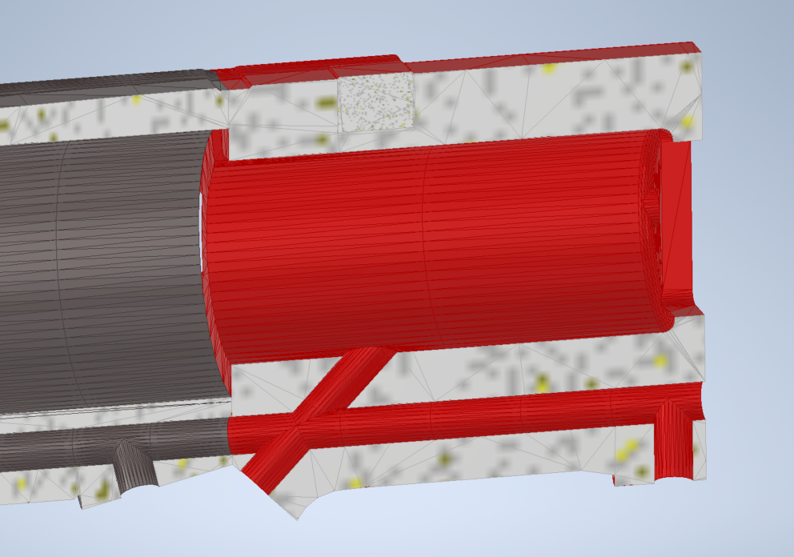
If Aluminum tube in this area, drill hole so trigger-wires can be routed through

Slide 11
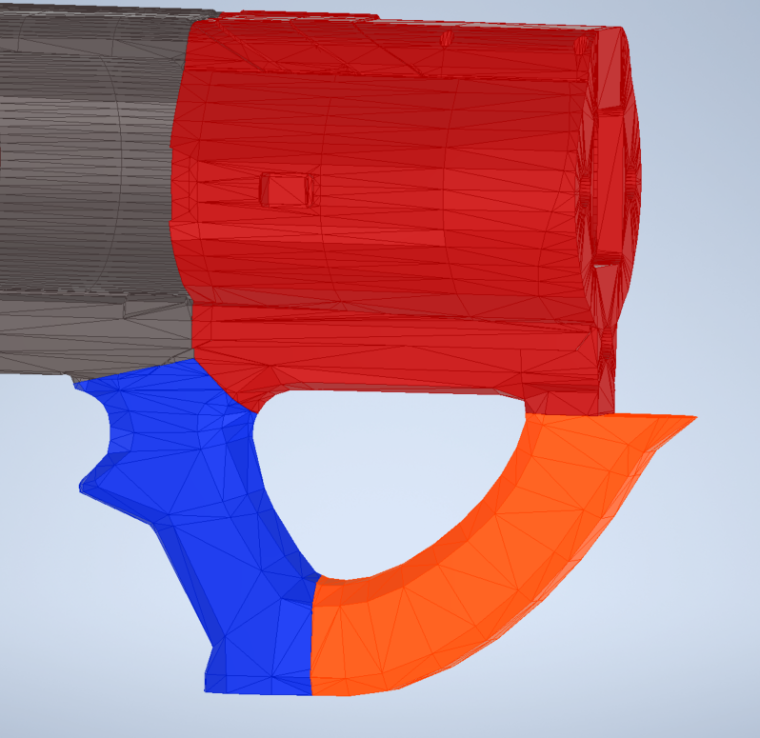
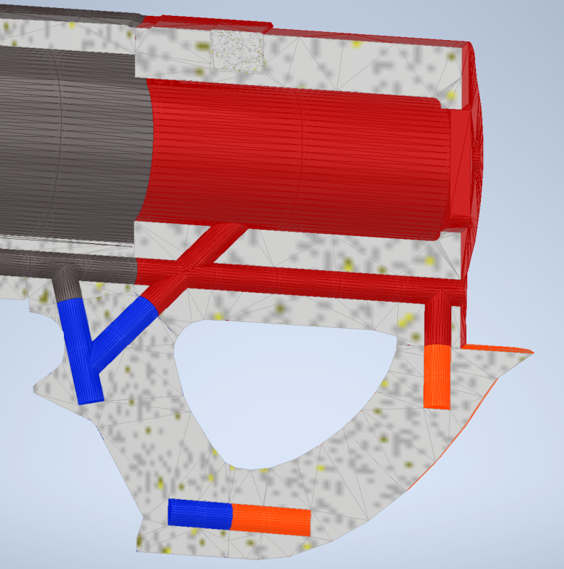
Route wire
Trigger button
Grip sub-Assembly from Step 002

Slide 12
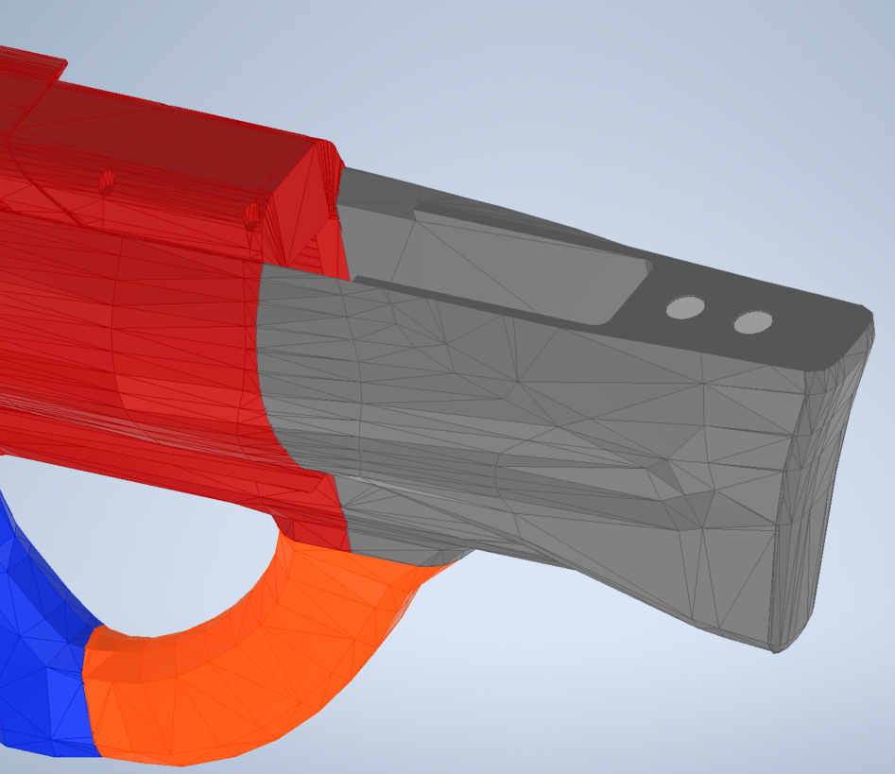
12mm x 3mm Neodymium Magnets x2
19-StockBack

Slide 13
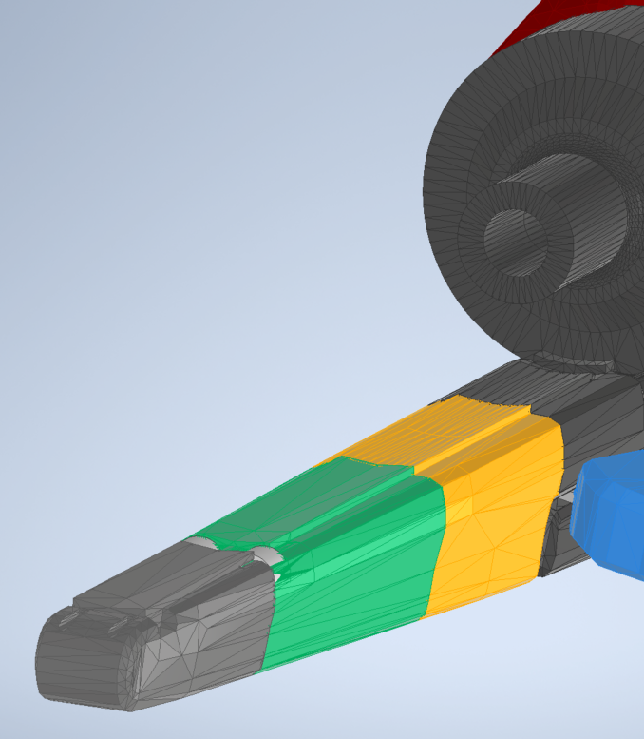
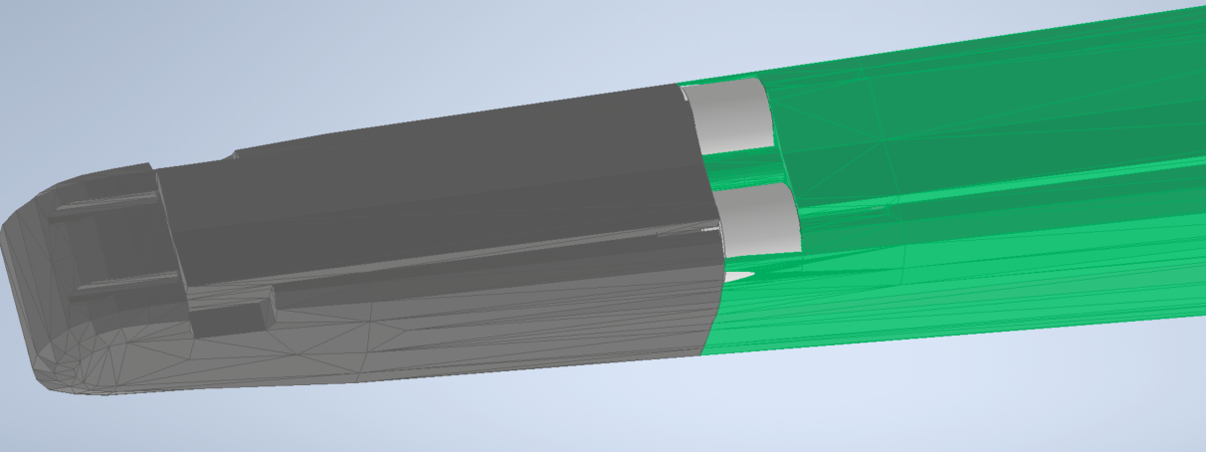
02-Front
½” ID, 5/8”OD, ½” Long Nylon Sleeve Bearings x2
01-Front

Slide 14
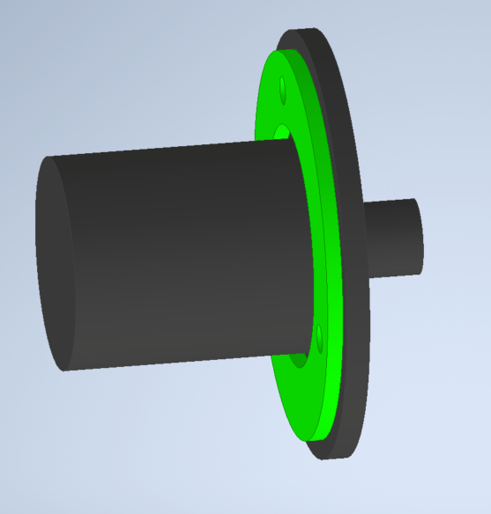
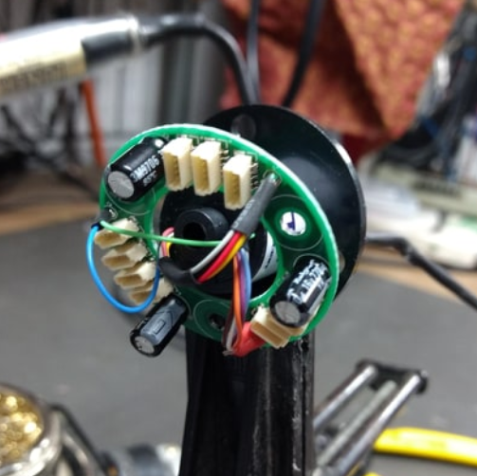
2 Wires to D_in
PCB
5 Wires to +5V
5 Wires to GND
Slip Ring

Slide 15
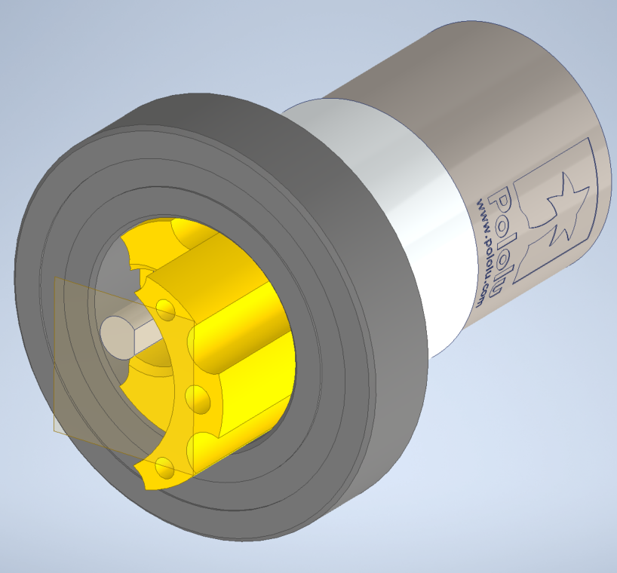
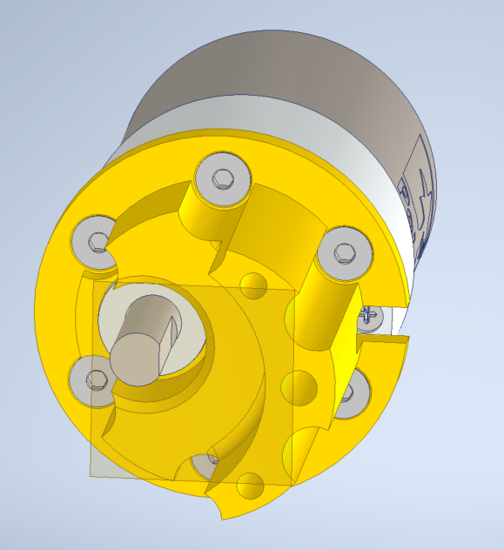
Pololu Gearmotor
21-MotorMount
Ball-Bearing
6x M3 x 6mm long Flathead

Slide 16
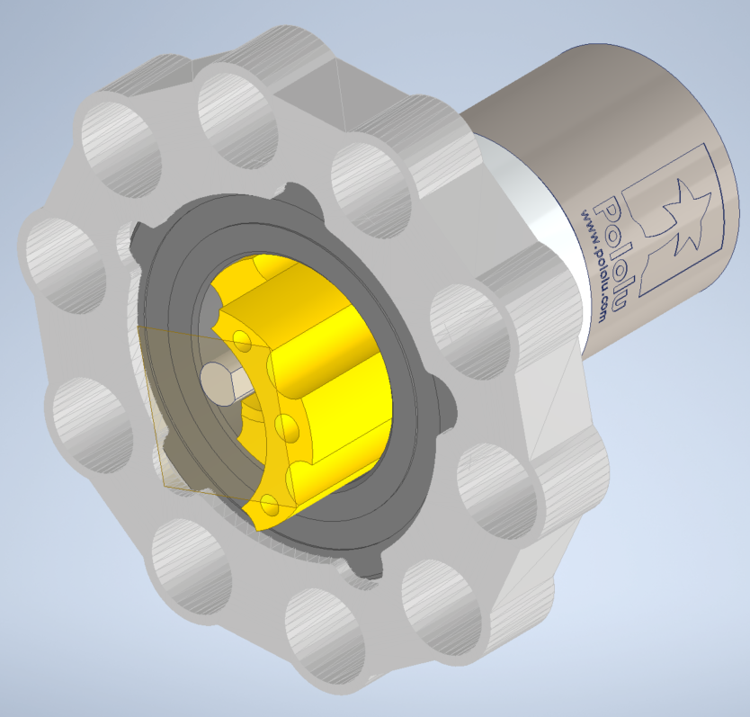
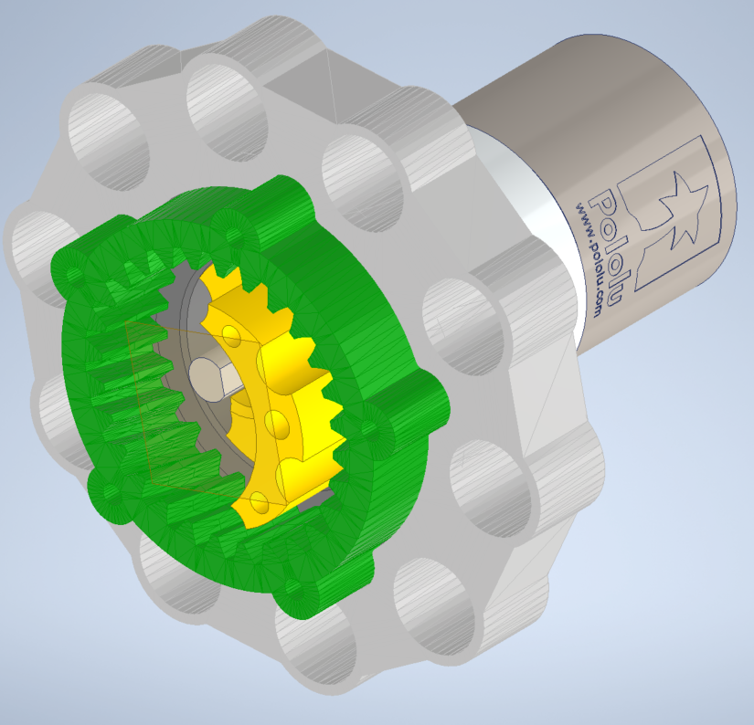
Motor ASM
Motor ASM
24-Ring1
22-GearRing

Slide 17
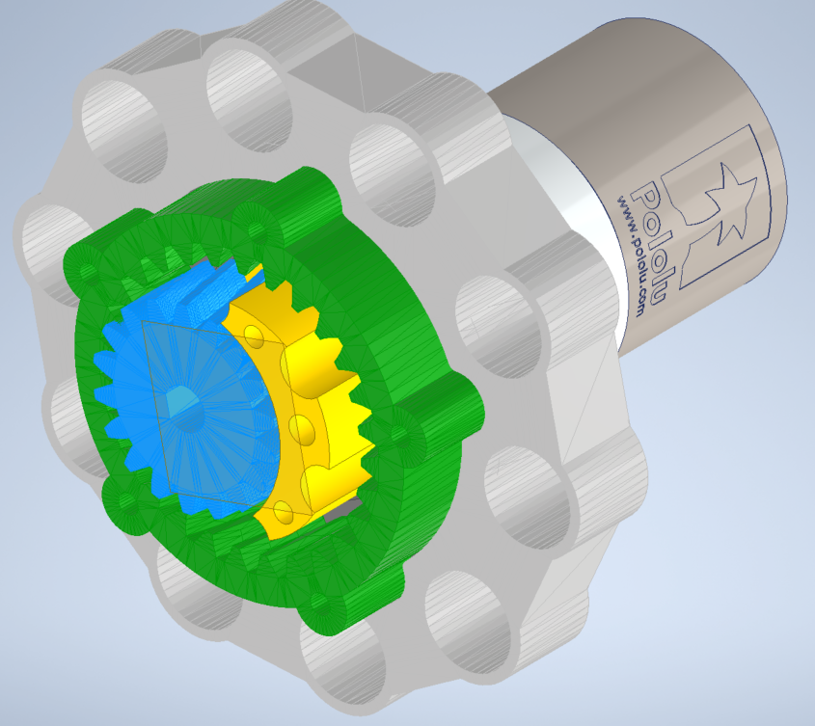
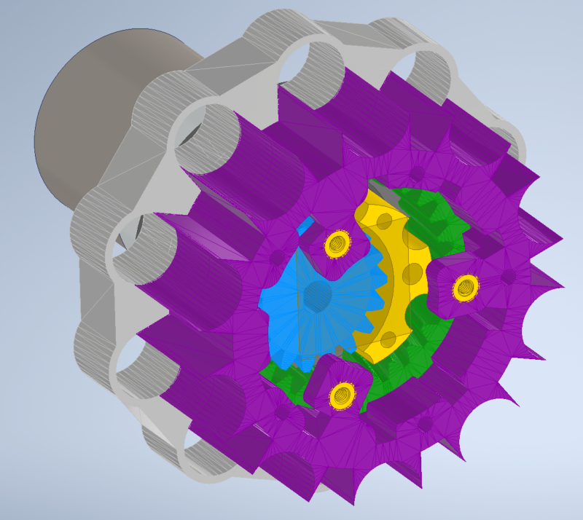
Motor ASM
Motor ASM
32-A
20-Gear
M3 Heat-set inserts 3x

Slide 18
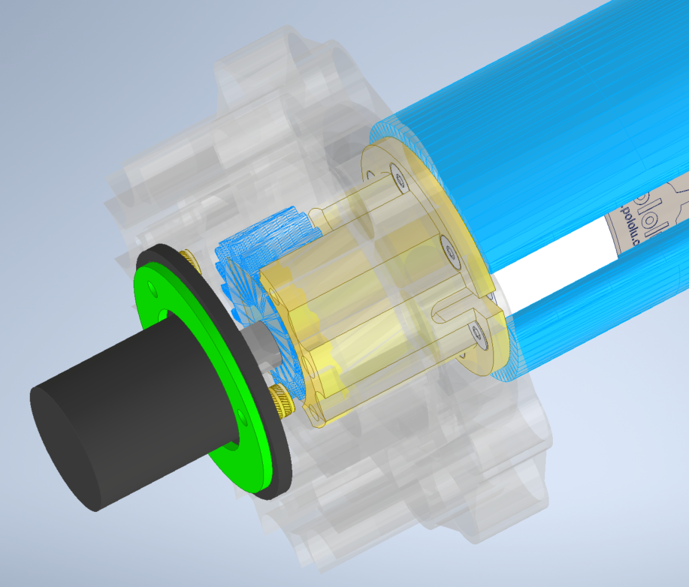
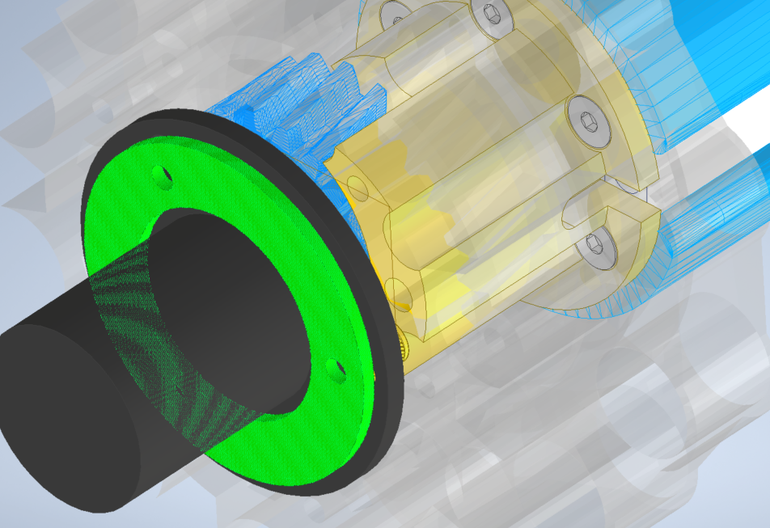
Wire outlet
Wire routing
Wire inlet

Slide 19
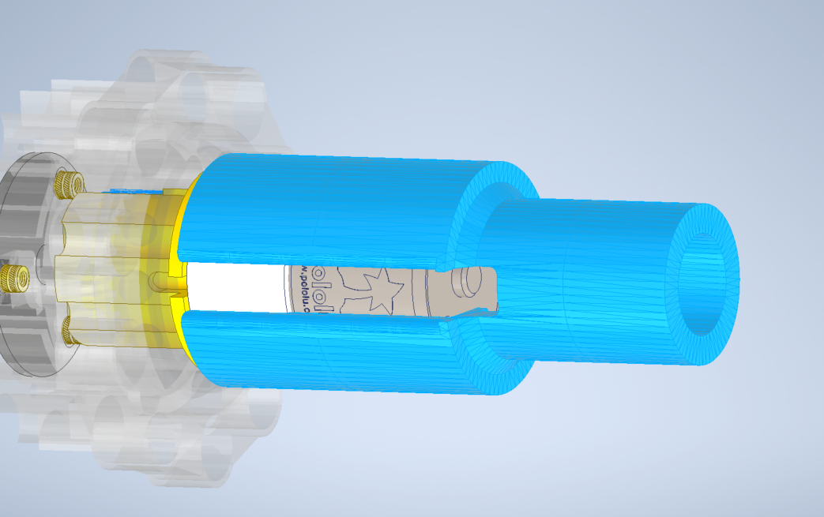
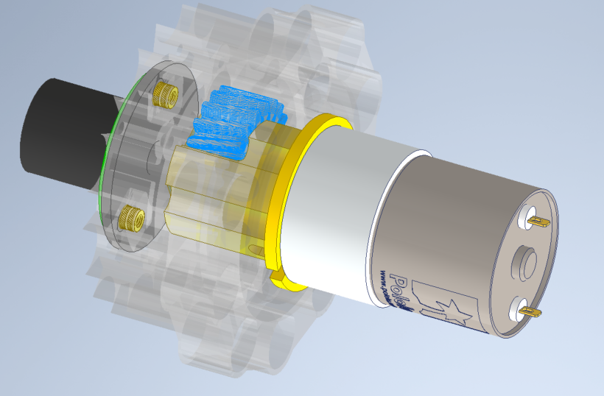
Motor Assembly
29-MotorSleeve
Route Wires through center of 29-MotorSleeve
Connect Motor Wires

Slide 20
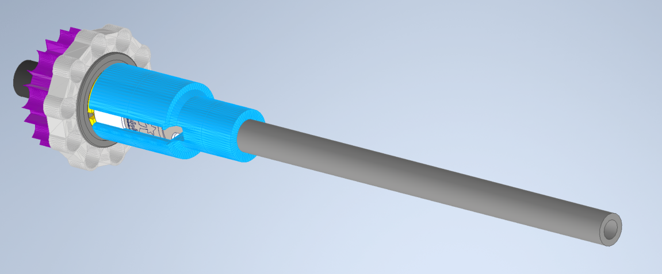
Motor Assembly
Cantilever Tube:
>325mm long, 20mm DIA
Wire Routing

Slide 21
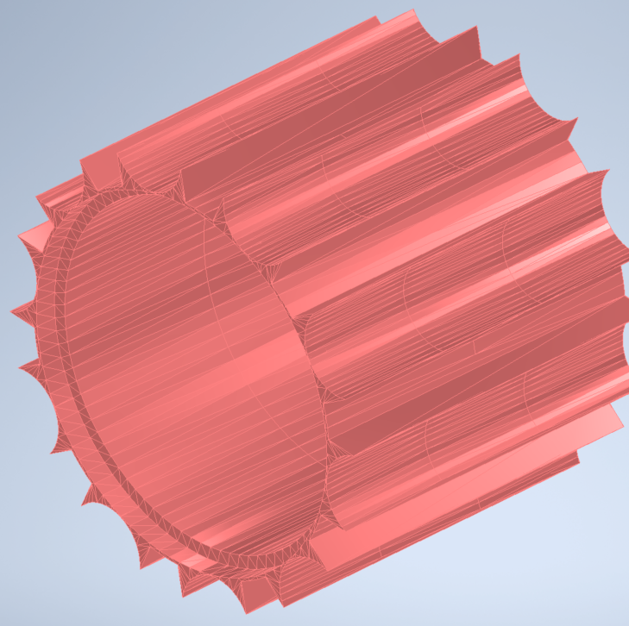
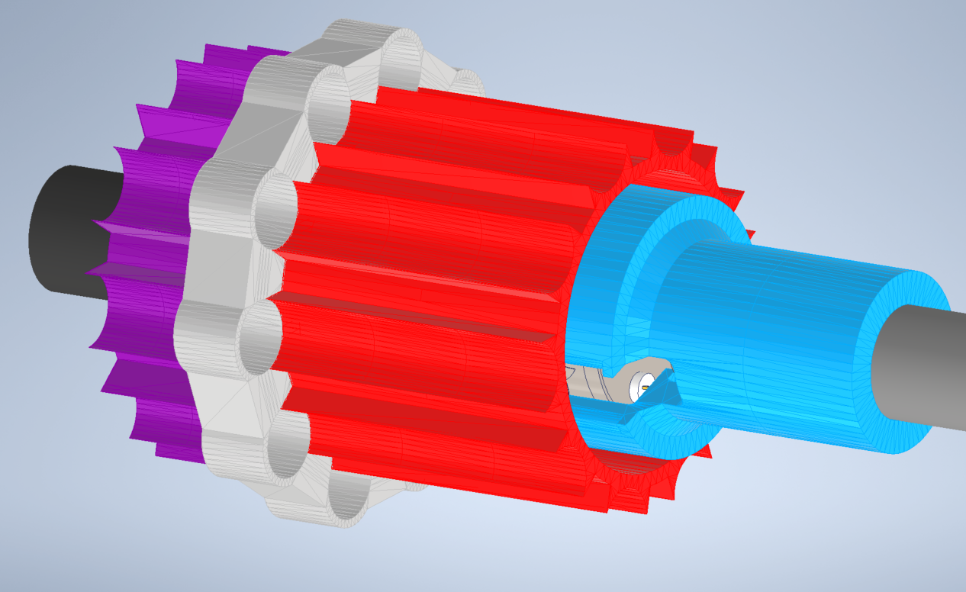
23-Cylinder
23-Cylinder
Motor Assembly
Flat End
Counter-Bored End

Slide 22
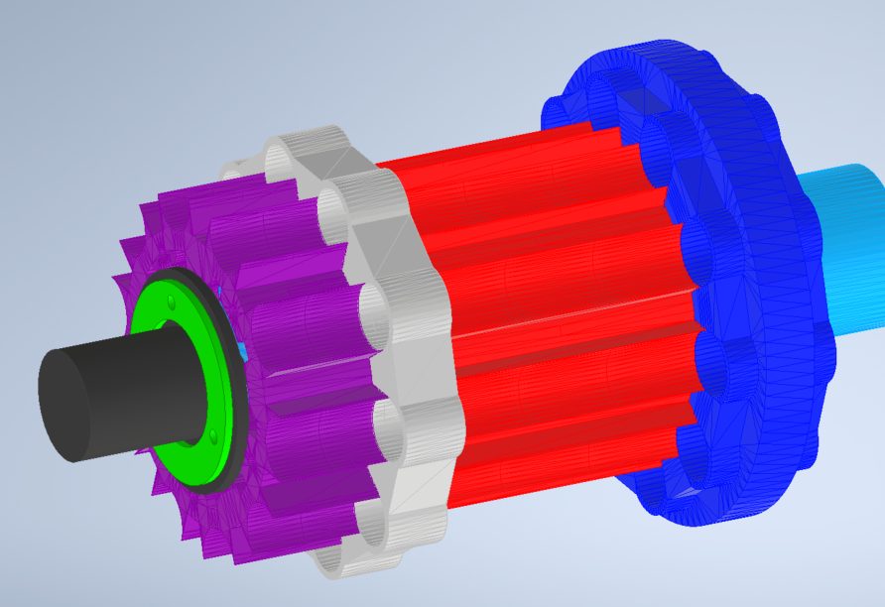
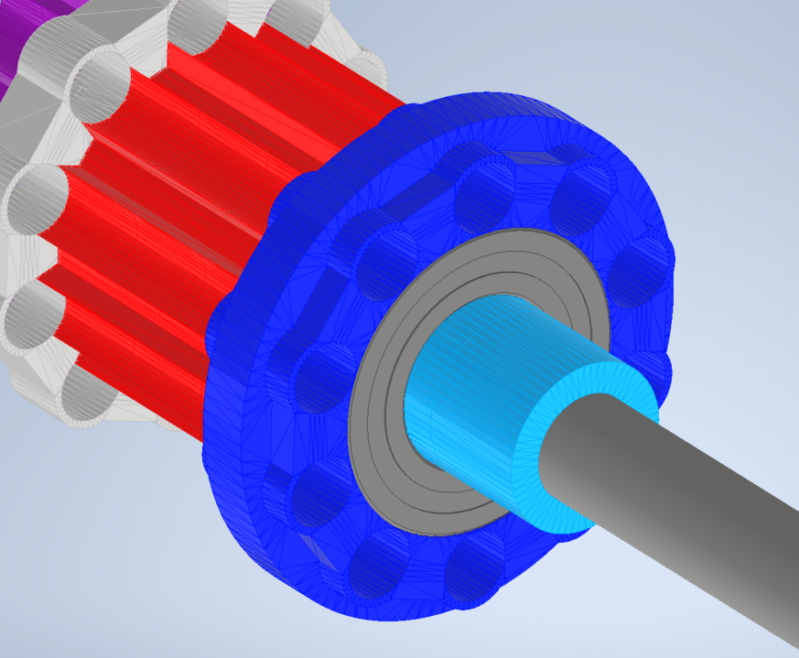
Motor Assembly
Ball Bearing
14-Ring2

Slide 23
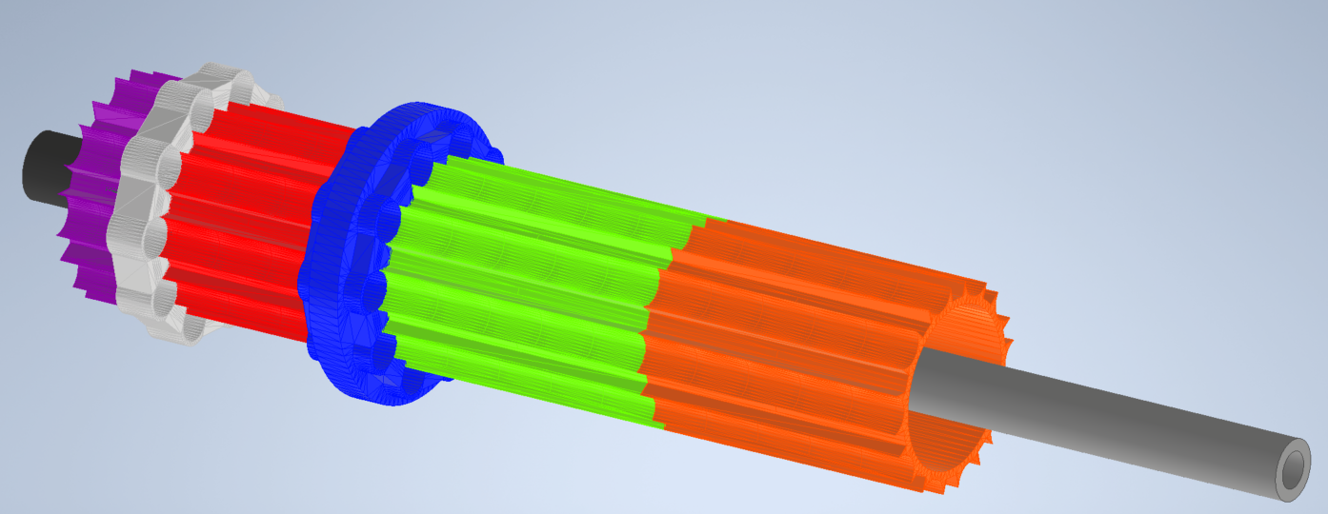
12-Cylinder
11-Cylinder

Slide 24
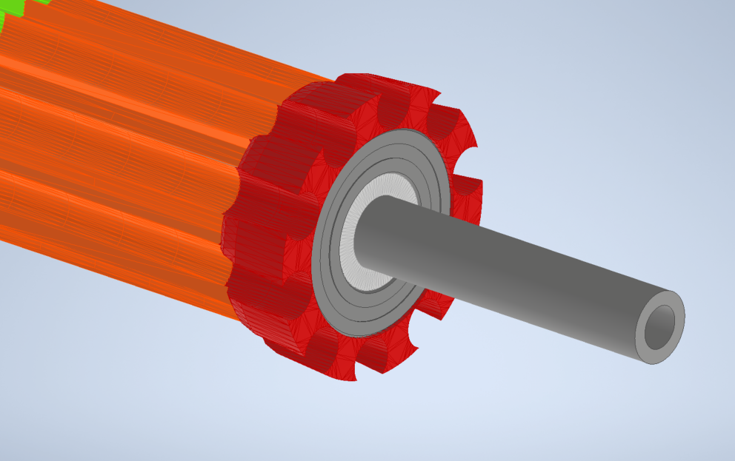
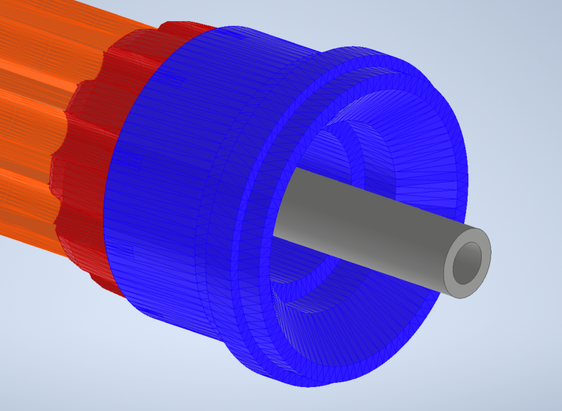
10-Ring3
Ball Bearing
13-Spacer
06-Ring4

Slide 25
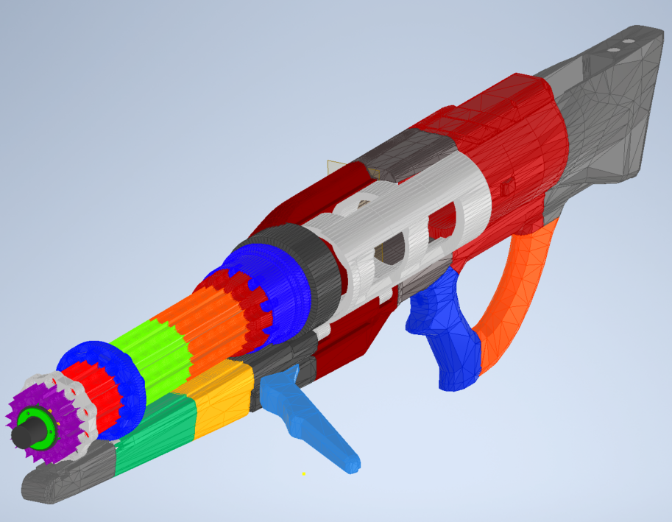
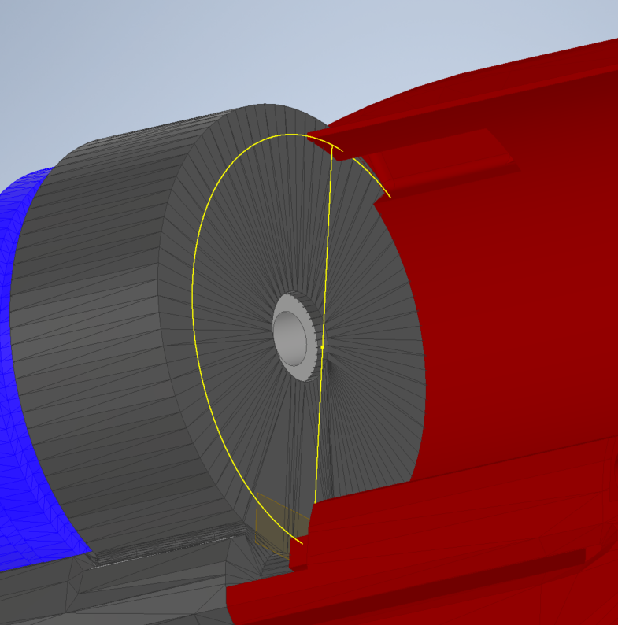
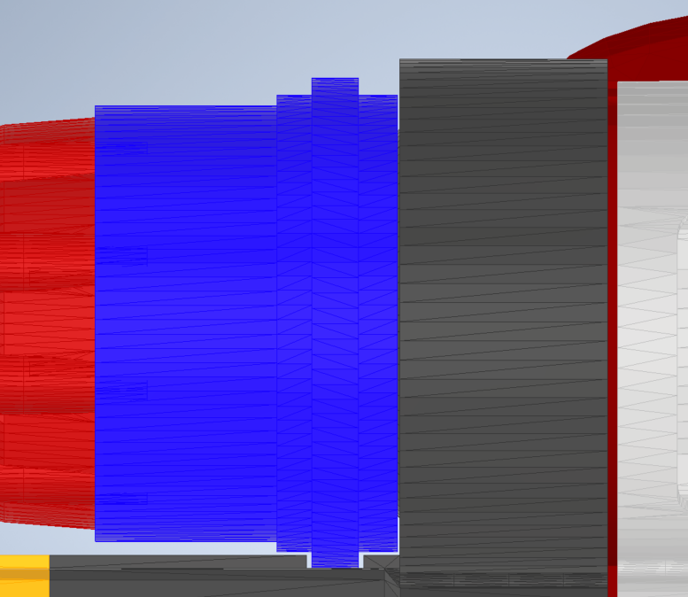
Barrel Assembly
Body Assembly
Wire Routing
>0.5mm Gap

Slide 26
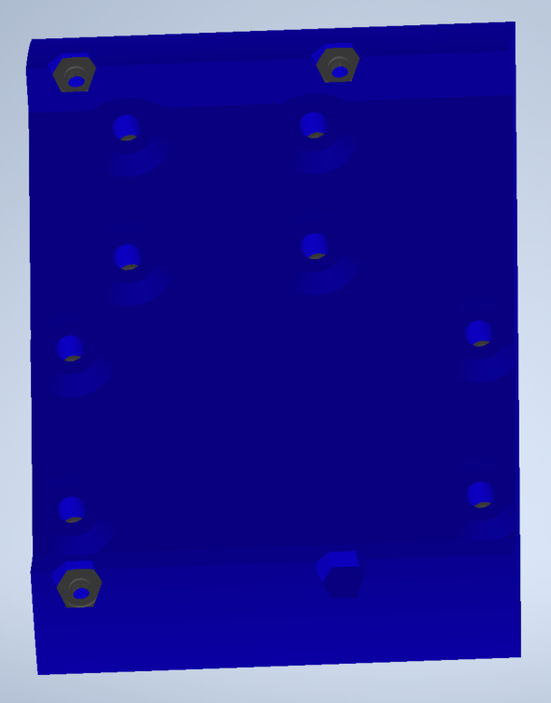
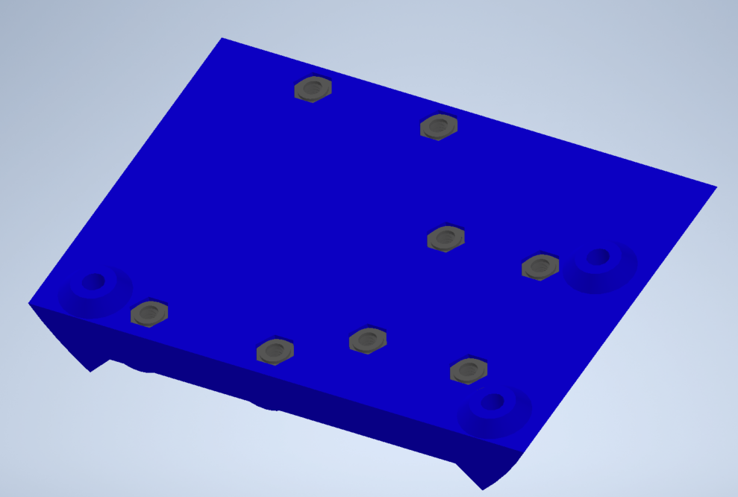
“Mount.stl”
11x M2 Hex Nuts

Slide 27
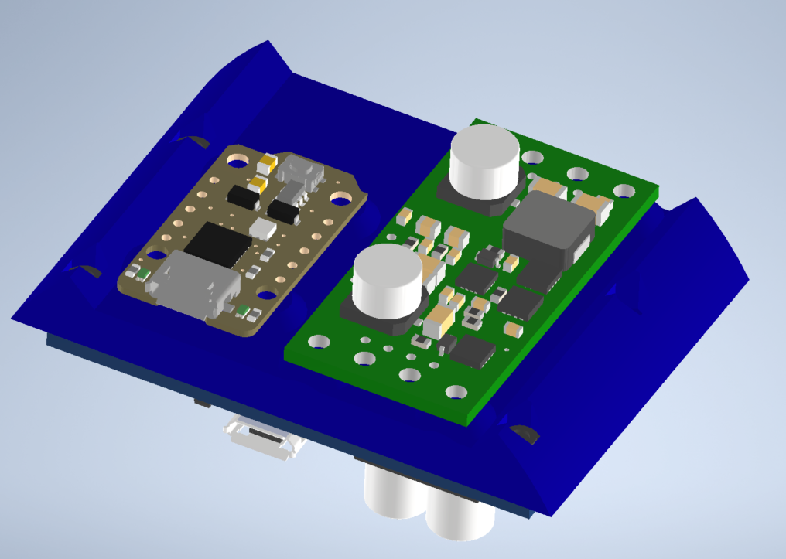
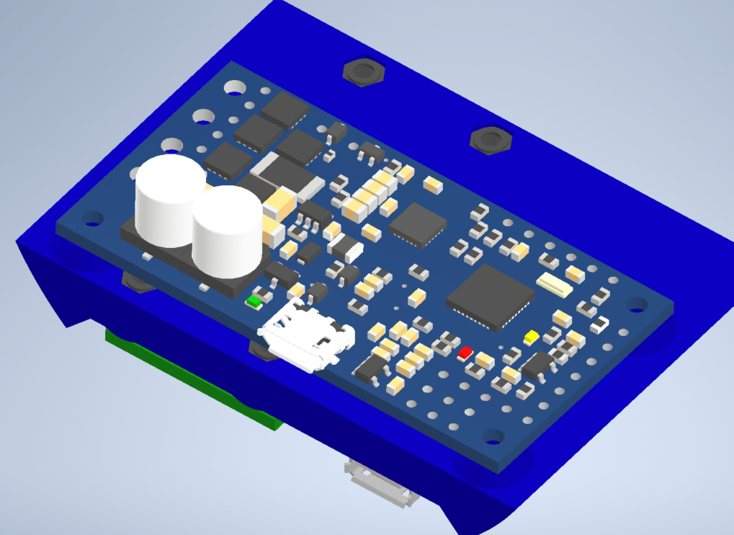
Adafruit Trinket M0
Pololu 5V Vreg
Pololu Motor Controller

Slide 28


