Slide 1
Block 3 — Intraspecific trait variability: the return of the variance
15:45–16:15 · The species mean is a choice · How much, and where, is the variance? · Why it matters: coexistence, environment, functioning · TPD and variance partitioning · A fish case study · Measuring ITV · ITV, extinction and conservation
Block 3 · Intraspecific trait variability

Slide 2
The species mean is a choice
“Any morphological, physiological or phenological feature measurable at the individual level…” — Violle et al. (2007)
Traits are properties of individuals; the species mean is a summary computed for convenience
Individuals of one species differ in size, shape, diet, thermal tolerance — sometimes as much as two species do
“The return of the variance” (Violle et al. 2012 TREE): two decades of tools built on means; the variance is being added back, one method at a time
This block: what the mean hides, and how to work without it
▲ species mean
Master FBE 2026 · Session 1 · Block 3 · Intraspecific trait variability
34

Slide 3
How much variation is there within species?
Fishes: if anything, more extreme
Indeterminate growth: one species spans 1–2 orders of magnitude in body mass from juvenile to adult — and size drives prey, predators, metabolism, habitat
A juvenile pike and an adult pike are not the same functional entity
Body shape varies with habitat within species: more streamlined in fast-flowing reaches; littoral vs pelagic morphs in lakes
Diet: individual specialisation documented in > 100 species, fishes prominent (Bolnick et al. 2003)
Plants: about a quarter of the variation within communities and a third among communities is intraspecific — the mean is not a bad summary, but a quarter is too much to ignore, especially along gradients.
Master FBE 2026 · Session 1 · Block 3 · Intraspecific trait variability
35

Slide 4
Where does the variance come from?
Among species
Ontogeny
Individuals change as they develop — the largest source for fish size, often for shape and diet
Among populations (rivers, lakes)
Phenotypic plasticity
Same genotype, different phenotypes in different environments — reversible within a generation (e.g. streamlining in current)
Among individuals within a population
Genetic differentiation
Local adaptation between populations, built over generations; persists in common-garden conditions
Within an individual over time (growth)
(+ sex)
A fourth axis in many species
Hierarchical structure (Messier et al. 2010): a large share of the variance sits at the lowest levels
All three produce structured, not random, variance: it tracks the environment and carries ecological information.
Master FBE 2026 · Session 1 · Block 3 · Intraspecific trait variability
36

Slide 5
Why it matters (1): coexistence and niche overlap
Overlap: species means overestimate functional distinctness → overestimate complementarity; wide distributions share resources and compete
Individual specialisation reduces competition within species — a route to coexistence that means cannot represent
Response to the environment: populations shift their distribution (plasticity, selection) before any species is replaced — the intraspecific part of a gradient response is invisible to species means
Assembly (Block 2): clustering/overdispersion computed on means tests a hypothesis about means
Bolnick et al. (2011) TREE 26: 183–192
Master FBE 2026 · Session 1 · Block 3 · Intraspecific trait variability
37

Slide 6
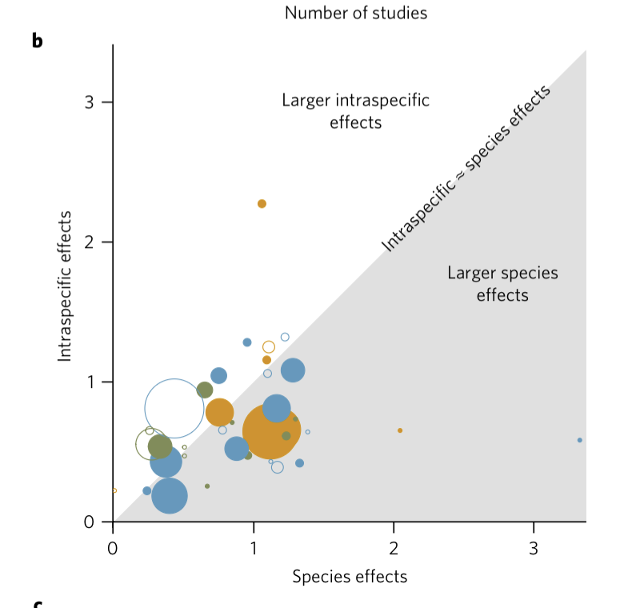
Why it matters (2): ecosystem functioning
Des Roches et al. 2018
Experiments manipulating populations / genotypes / phenotypes of one species vs species identity: intraspecific effects of the same order as species replacement, sometimes larger. Fish well represented (stickleback, guppy, alewife).
Raffard et al. 2019 (Toulouse)
Meta-analysis of intraspecific diversity (number of genotypes/phenotypes) → consistent positive effects on ecosystem functions, comparable to species diversity.
A species is not a functional unit: its populations do different things, and populations are lost long before species are.
Master FBE 2026 · Session 1 · Block 3 · Intraspecific trait variability
38

Slide 7
Incorporating ITV: from points to distributions (TPD)
Carmona, de Bello, Mason & Lepš (2016) TREE: a species = a probability density over the space (kernel from individuals, or normal from mean ± SD)
Community = abundance-weighted sum of species densities; richness, evenness, divergence recomputed on the density
Integrates ITV; no outlier sensitivity; any number of species; scales from individuals to regions and partitions FD across levels
R: package TPD; funspace uses the same logic (Group A extension)
Master FBE 2026 · Session 1 · Block 3 · Intraspecific trait variability
39

Slide 8
Partitioning the variance: within vs between species
Tool 1 — decompose FD itself (de Bello et al. 2011 MEE)
FD(individuals) = between-species + within-species + covariation → how much a mean-based analysis misses; trait-dependent (fish body size: within-species can dominate)
Tool 2 — hierarchical mixed model
lmer(trait ~ habitat + (1 | species / population), data = ind)
Random intercepts: species, population in species; residual = within population. Variance components = share at each level; fixed effects (habitat, temperature) ask which level responds. With several populations per species and ~12 individuals per population: does shape track habitat within species? In the same direction for all species?
Master FBE 2026 · Session 1 · Block 3 · Intraspecific trait variability
40

Slide 9
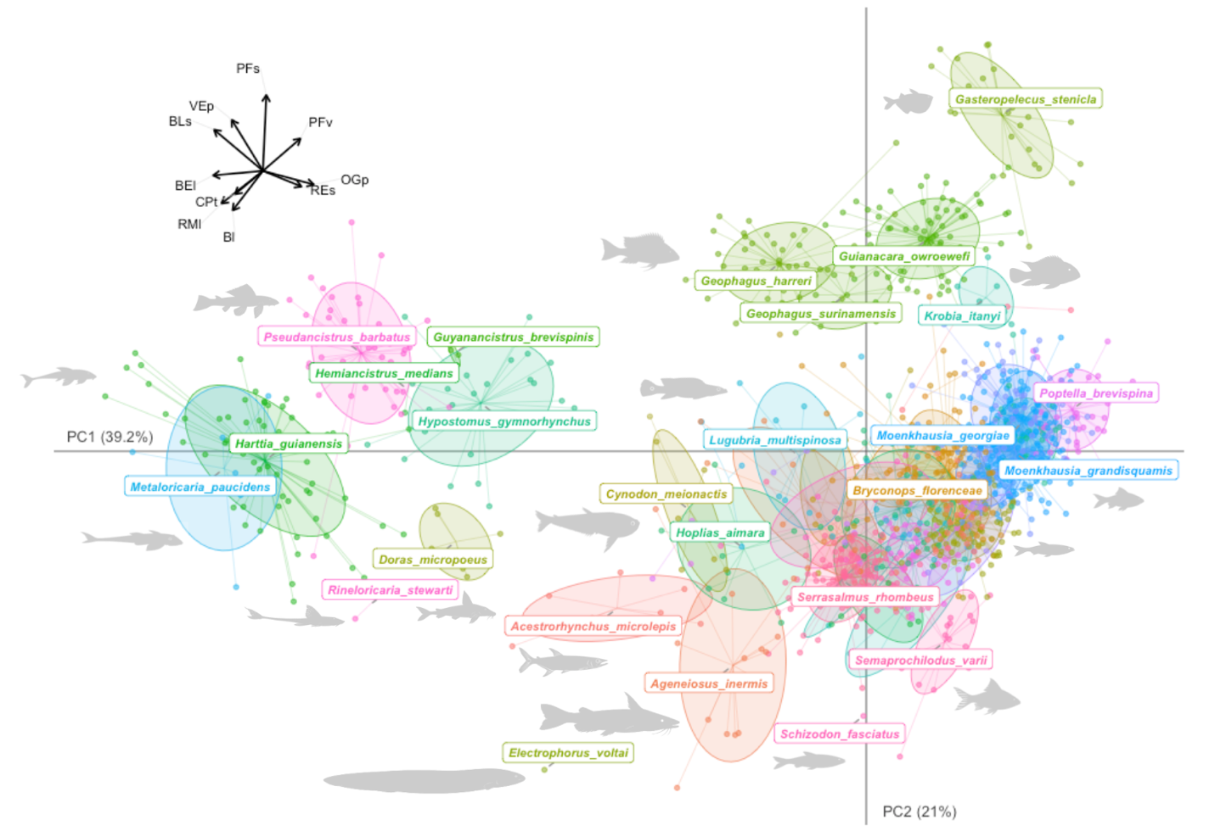
Fish case study: body shape varies within species along gradients
1
Wide clouds that overlap
Species that are distinct points in a mean-based space share regions of the individual-level space
2
Structured by habitat
Within a species, individuals from different habitats occupy different parts of the cloud
3
Shared direction
Fast-flowing habitats pull all species towards streamlined shapes — a common plastic or selective response
A community may look functionally stable on species means while its populations are shifting.
Master FBE 2026 · Session 1 · Block 3 · Intraspecific trait variability
41

Slide 10
Measuring ITV in practice: design and methods
Sampling design
Traits
10–15 individuals per population, several populations per species; stratify by size class; record sex
Size-related traits and diet vary most; use ratios or size-correct; geometric morphometrics separates size from shape
Measurement protocol
Analysis
Standardised photographs, scale bar, written landmark protocol; quantify operator error (repeat a subset, ICC)
Mixed models (variance partitioning, trait–environment at several levels); TPD / hypervolumes; geomorph for shape — all scripted in R
An effect of habitat on shape smaller than the difference between two operators is not a result.
Master FBE 2026 · Session 1 · Block 3 · Intraspecific trait variability
42

Slide 11
ITV, extinction and conservation: losing variance before losing species
Species lose populations first; their trait distributions narrow before they vanish
Fisheries: size-selective harvest → earlier, smaller maturation; the large individuals (large prey, most eggs, longest movements) are gone while the species is still on the list
Fragmentation and habitat loss remove the populations of the fast-flowing or large-river habitats — a part of the species’ functional range that the mean never showed
Block 2 asked which functions are lost with threatened species; add: which functions are already being lost within species that are not yet threatened
Freshwater fishes — indeterminate growth, population structure, harvesting, fragmentation — are an ideal system for this open question.
Master FBE 2026 · Session 1 · Block 3 · Intraspecific trait variability
43

Slide 12
Block 3 — take-home
1
Traits are properties of individuals; the species mean is a modelling choice with consequences
2
ITV is large (≈ a quarter of within-community variation in plants; more for fish size) and structured: ontogeny, plasticity, local adaptation
3
It changes overlap and coexistence, hides the intraspecific part of trait–environment responses, and affects functioning as much as species replacement
4
Tools exist — individual sampling, mixed models, TPD — and functional variance is lost within species long before species are lost
Master FBE 2026 · Session 1 · Block 3 · Intraspecific trait variability
44

