Slide 1

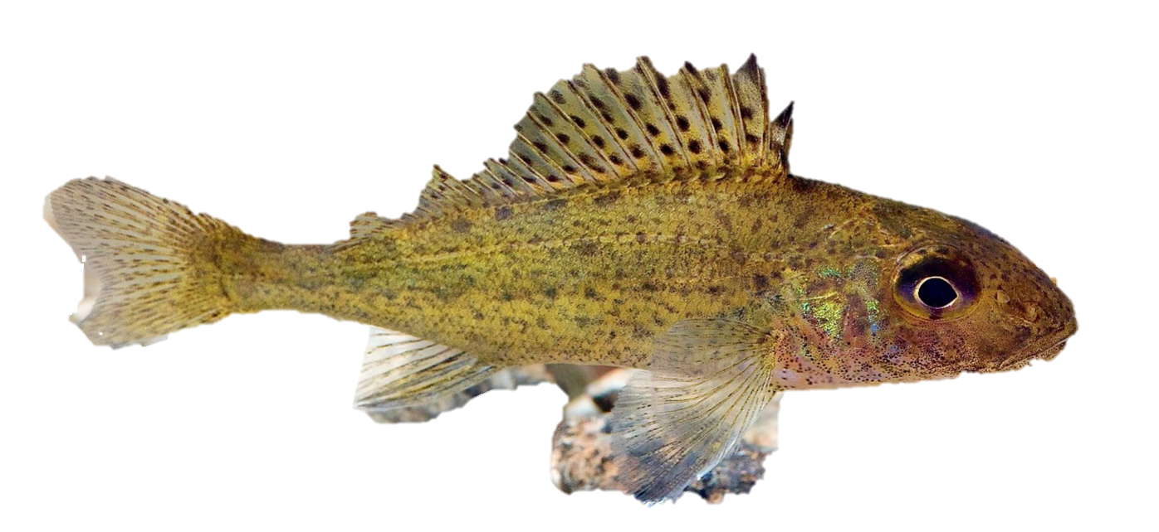
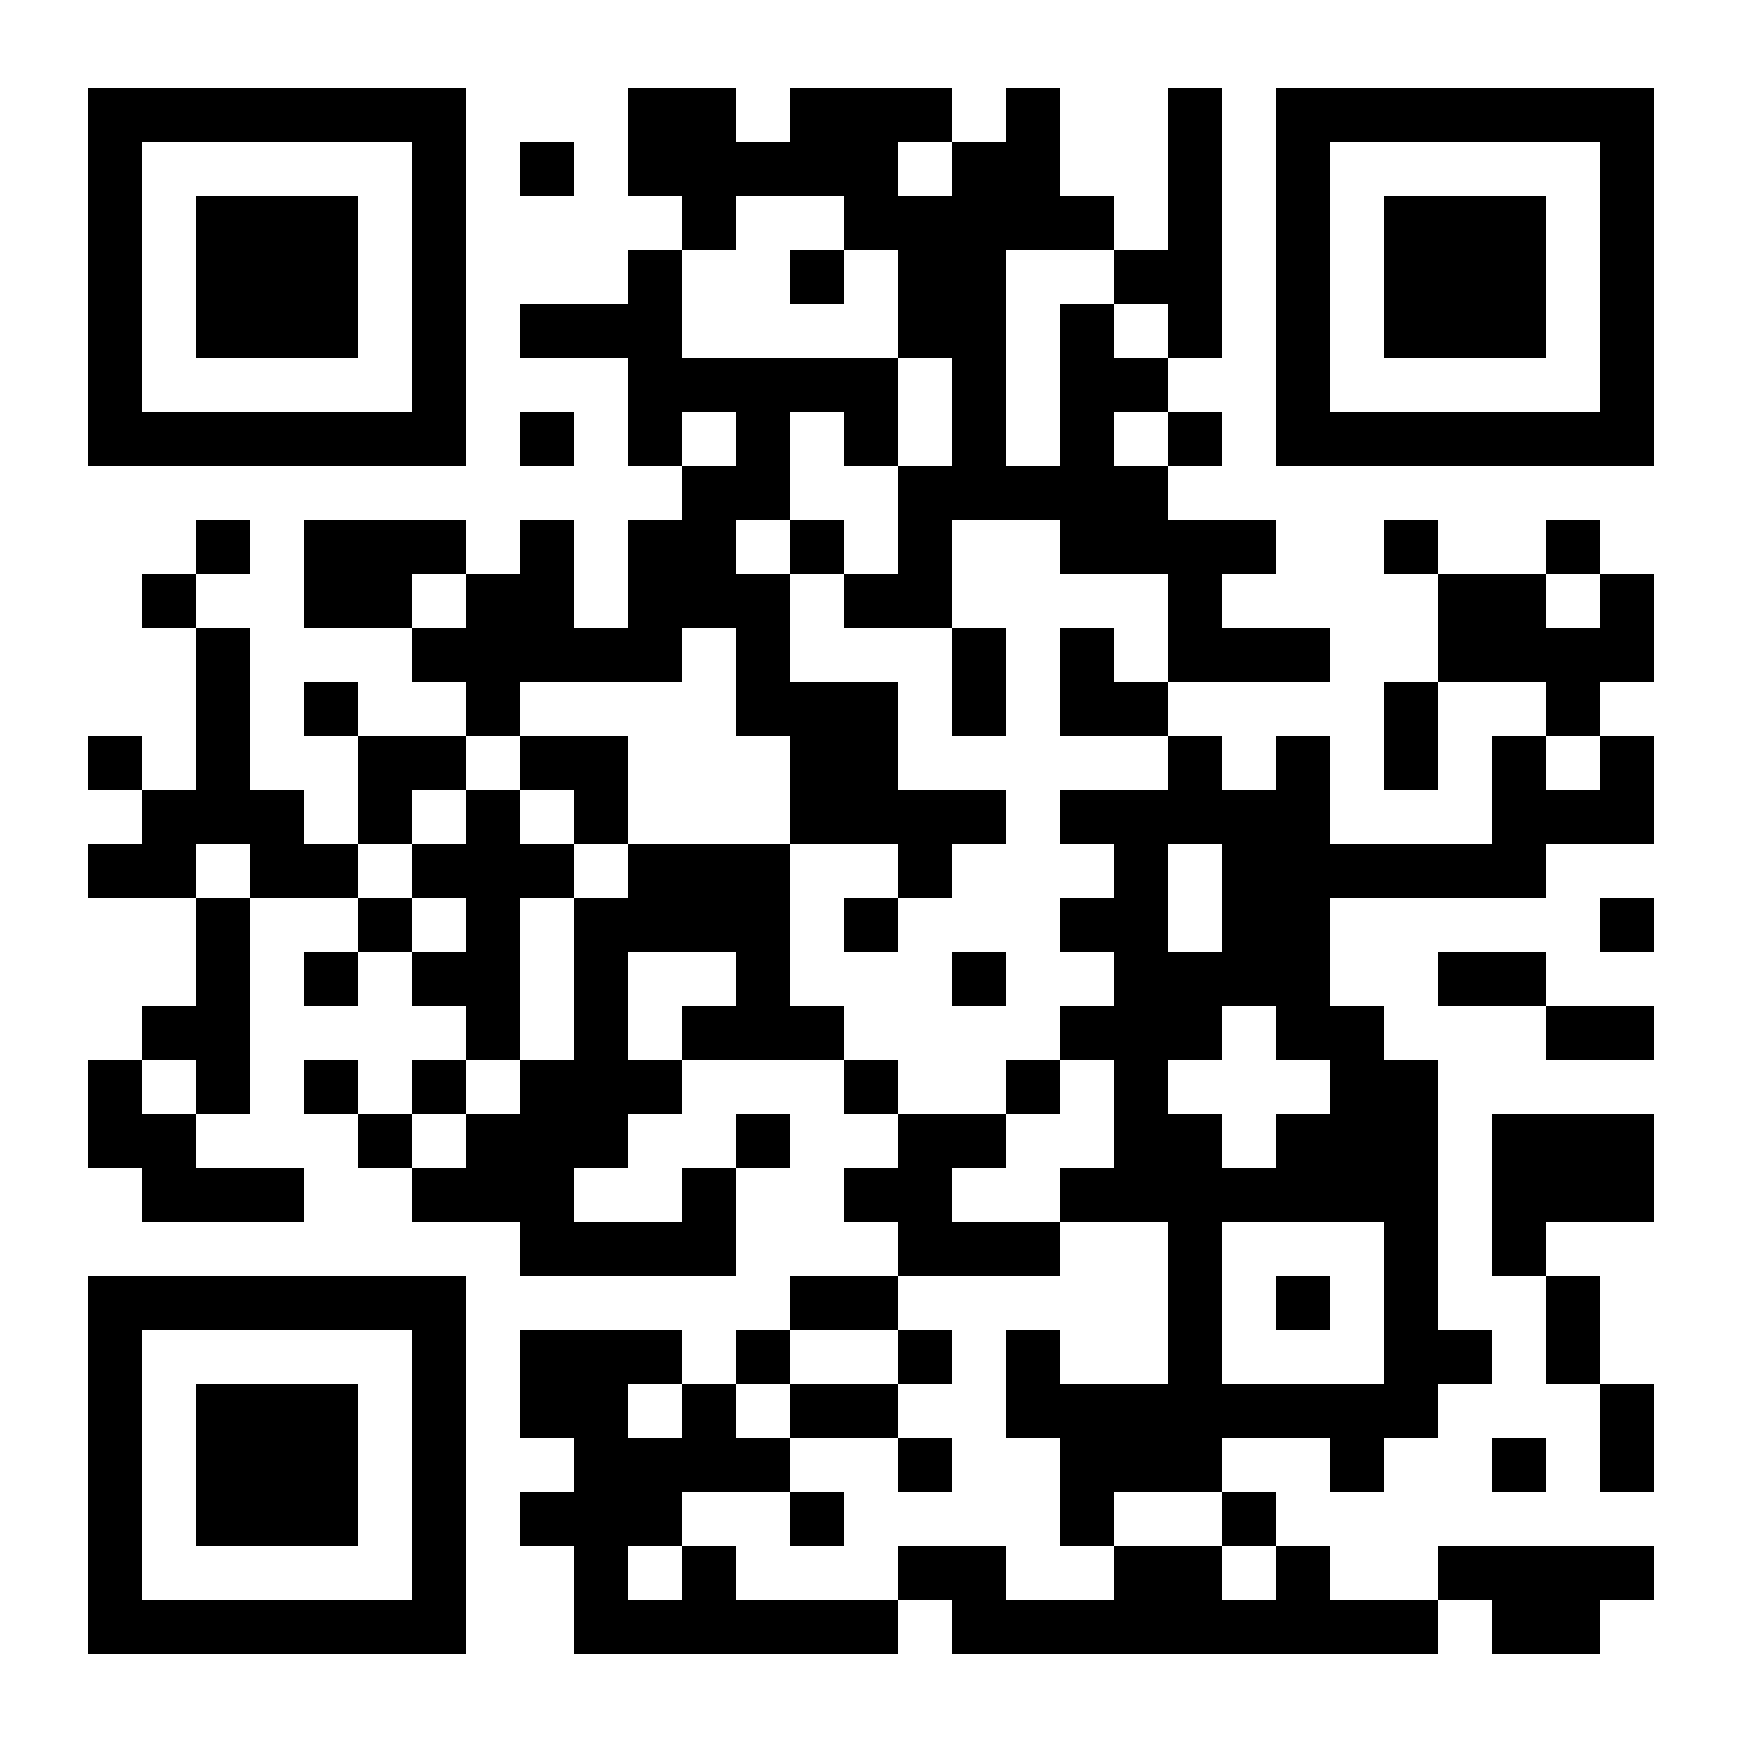
C’
F
s
P
i
i
h
Citizen science
Join us

