Slide 1

Trait-based approach
in community ecology
Day 1 — Foundations Belém, Pará · Amazon, Brazil UFPA / Trait-Based Ecology Course
Day 1 · Belém · 01 / 26

Slide 2




C.V.
Functional ecology, macroecology
Vertebrates, plants
Threatened/invasive species
Large databases, R programming
4R1 (Univ. Paul-Sabatier), room 29
aurele.toussaint@cnrs.fr

Slide 3
Course material
ID: AureleToussaint
Repository: Courses > Code > Download (Zip)
All analyses are made in R. The most popular language in ecology.
Other languages are also possible: PyThon, Julia, …

Slide 4
Day 1 — Overview
01
02
03
04
05
General Introduction
Historical Foundations
What is a Functional Trait?
Global Databases & ITV
R Practical Session
Biodiversity crisis · Pluralism · Why functional ecology?
Humboldt · Raunkiær · Grime CSR · r/K selection
Definitions · Typology · Response vs. Effect · LES
TRY · BIEN · Intraspecific variability
TRY import · Cleaning · LES visualisation
Day 1 · Belém · 02 / 26
Trait-Based Ecology — Day 1 · Belém, Brazil

Slide 5
Part 1
General Introduction
Biodiversity crisis · Pluralism · Why functional ecology?
Day 1 · Belém · 03 / 26

Slide 6
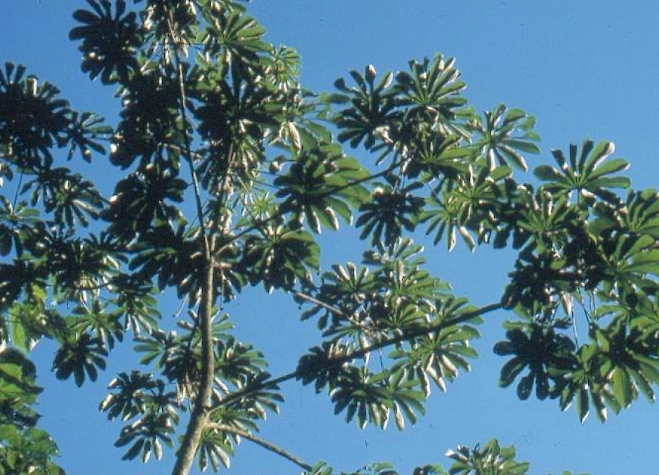
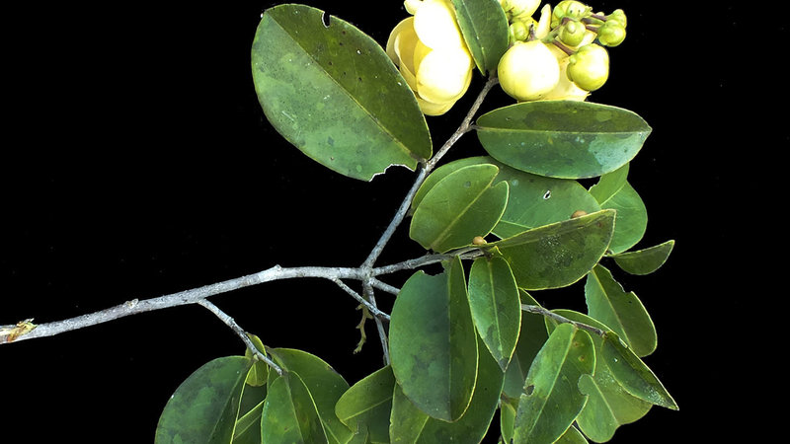
Before we start — a question from your backyard
You know Cecropia palmata (imbaúba) and Eschweilera coriacea (matamatá). Both grow in the várzea floodplain near Belém. After a 45-day flood, which species recovers its leaf canopy faster — and what information do you need to predict this, beyond knowing their names?
Eschweilera coriacea — Matamatá
Day 1 · Belém · 04 / 26
Trait-Based Ecology — Day 1 · Belém, Brazil

Slide 7
Before we start — a question from your backyard
You know Cecropia palmata (imbaúba) and Eschweilera coriacea (matamatá). Both grow in the várzea floodplain near Belém. After a 45-day flood, which species recovers its leaf canopy faster — and what information do you need to predict this, beyond knowing their names?
Cecropia palmata — Imbaúba
Eschweilera coriacea — Matamatá
SLA: ~28–38 mm² mg⁻¹
LDMC: ~120–160 mg g⁻¹
Leaf N: ~28–35 mg g⁻¹
Height: up to 20 m
Strategy: ACQUISITIVE (fast-return)
SLA: ~8–12 mm² mg⁻¹
LDMC: ~300–380 mg g⁻¹
Leaf N: ~12–18 mg g⁻¹
Height: up to 35 m
Strategy: CONSERVATIVE (slow-return)
Pioneer of gaps, secondary forest, deforested land. Grows >5 m/year. Leaves thin, light, short-lived.
Late-successional terra firme tree. Extremely slow growth. Leaves thick, tough, very long-lived.
Day 1 · Belém · 04 / 26
Trait-Based Ecology — Day 1 · Belém, Brazil

Slide 8

Why functional ecology?
THEORY
To overcome the well-known limitations of species-based approaches — and to build predictive, mechanistic understanding of ecosystems.
Functional ecology
Measure the roles or functions that species plays in the community
Day 1 · Belém · 06 / 26
Trait-Based Ecology — Day 1 · Belém, Brazil

Slide 9
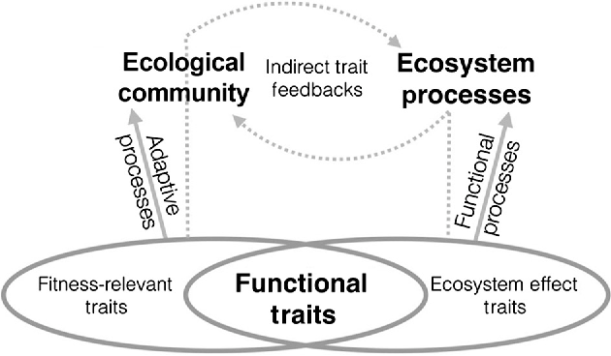
Why functional ecology?
THEORY
To overcome the well-known limitations of species-based approaches — and to build predictive, mechanistic understanding of ecosystems.
1
Connect community function to environmental change
2
Traits link species composition directly to ecosystem processes (carbon uptake, decomposition, water cycling) without requiring taxonomy
Address evolutionary processes
Day 1 · Belém · 06 / 26
Trait-Based Ecology — Day 1 · Belém, Brazil

Slide 10
Why functional ecology?
THEORY
To overcome the well-known limitations of species-based approaches — and to build predictive, mechanistic understanding of ecosystems.
1
Connect community function to environmental change
2
Address evolutionary processes
Traits link species composition directly to ecosystem processes (carbon uptake, decomposition, water cycling) without requiring taxonomy
Evolution selects on functions, not names.
Unrelated families independently evolved sclerified leaves, deep roots and thick bark under the same fire pressure.
Trait-based ecology captures convergence; taxonomy cannot.
3
4
Day 1 · Belém · 06 / 26
Trait-Based Ecology — Day 1 · Belém, Brazil

Slide 11
Why functional ecology?
THEORY
To overcome the well-known limitations of species-based approaches — and to build predictive, mechanistic understanding of ecosystems.
1
Connect community function to environmental change
2
Address evolutionary processes
Traits link species composition directly to ecosystem processes (carbon uptake, decomposition, water cycling) without requiring taxonomy
Evolution selects on functions, not names.
Unrelated families independently evolved sclerified leaves, deep roots and thick bark under the same fire pressure.
Trait-based ecology captures convergence; taxonomy cannot.
3
Generalise across taxonomic systems
4
An SLA-based model calibrated in the Cerrado applies in African savannas and Australian dry forests — because the Leaf Economics Spectrum is universal. A species-list model must be rebuilt for every new system.
Day 1 · Belém · 06 / 26
Trait-Based Ecology — Day 1 · Belém, Brazil

Slide 12
Why functional ecology?
THEORY
To overcome the well-known limitations of species-based approaches — and to build predictive, mechanistic understanding of ecosystems.
1
Connect community function to environmental change
2
Address evolutionary processes
Traits link species composition directly to ecosystem processes (carbon uptake, decomposition, water cycling) without requiring taxonomy
Evolution selects on functions, not names.
Unrelated families independently evolved sclerified leaves, deep roots and thick bark under the same fire pressure.
Trait-based ecology captures convergence; taxonomy cannot.
3
Generalise across taxonomic systems
4
Leverage the expansion of trait databases
An SLA-based model calibrated in the Cerrado applies in African savannas and Australian dry forests — because the Leaf Economics Spectrum is universal. A species-list model must be rebuilt for every new system.
TRY holds >15 million trait records for >300,000 species. This resource has no value without the framework to integrate it into community analyses. Trait-based approaches are the key to unlocking this treasure.
Day 1 · Belém · 06 / 26
Trait-Based Ecology — Day 1 · Belém, Brazil

Slide 13
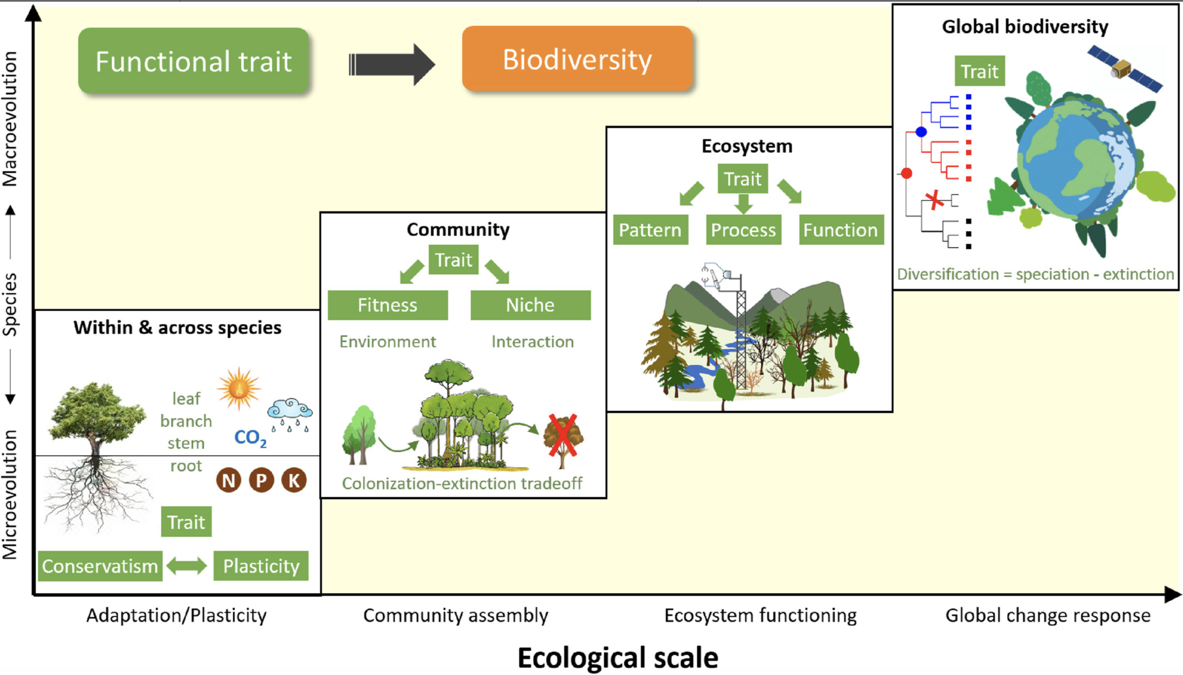
Why functional ecology?
Spatial and temporal scale
Day 1 · Belém · 06 / 26
Trait-Based Ecology — Day 1 · Belém, Brazil

Slide 14
Part 2
Historical &
Conceptual Foundations
From Humboldt to Violle — 200 years of functional ecology
Day 1 · Belém · 07 / 26

Slide 15
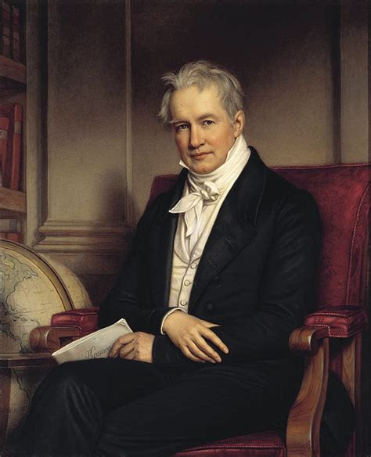
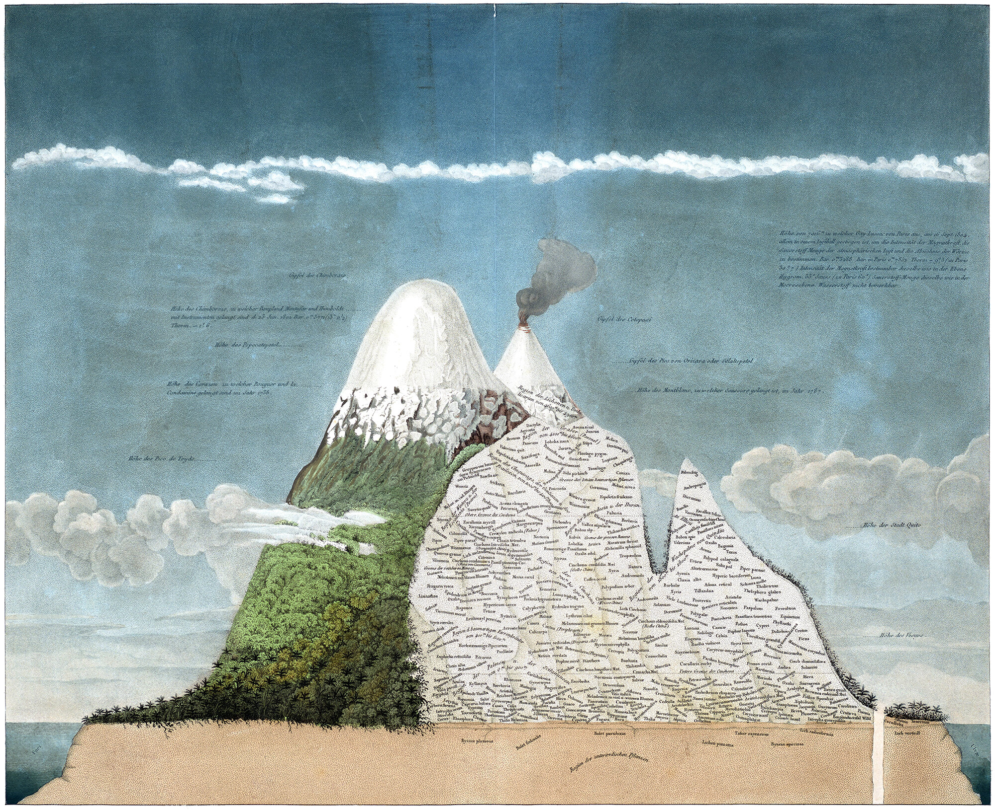
Traits in ecology — a 200-year intellectual project
1806
Humboldt
First altitudinal zonation of vegetation in tropical South America. Recognised that environment shapes which species occur where — but qualitatively.
Day 1 · Belém · 08 / 26
Trait-Based Ecology — Day 1 · Belém, Brazil

Slide 16
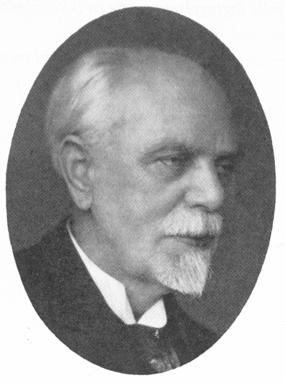
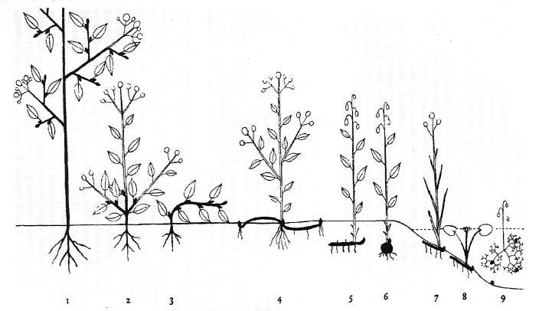
Traits in ecology — a 200-year intellectual project
1806
1934
Humboldt
Raunkiær
First altitudinal zonation of vegetation in tropical South America. Recognised that environment shapes which species occur where — but qualitatively.
Plant life-form classification (phanerophytes, geophytes…) — first quantitative, globally applicable functional classification. Still predicts macroclimate today.
Day 1 · Belém · 08 / 26
Trait-Based Ecology — Day 1 · Belém, Brazil

Slide 17
Traits in ecology — a 200-year intellectual project
1806
1934
1977
Humboldt
Raunkiær
Grime
First altitudinal zonation of vegetation in tropical South America. Recognised that environment shapes which species occur where — but qualitatively.
Plant life-form classification (phanerophytes, geophytes…) — first quantitative, globally applicable functional classification. Still predicts macroclimate today.
CSR triangle — Competitors, Stress-tolerators, Ruderals. First globally accepted functional strategy system.
Day 1 · Belém · 08 / 26
Trait-Based Ecology — Day 1 · Belém, Brazil

Slide 18
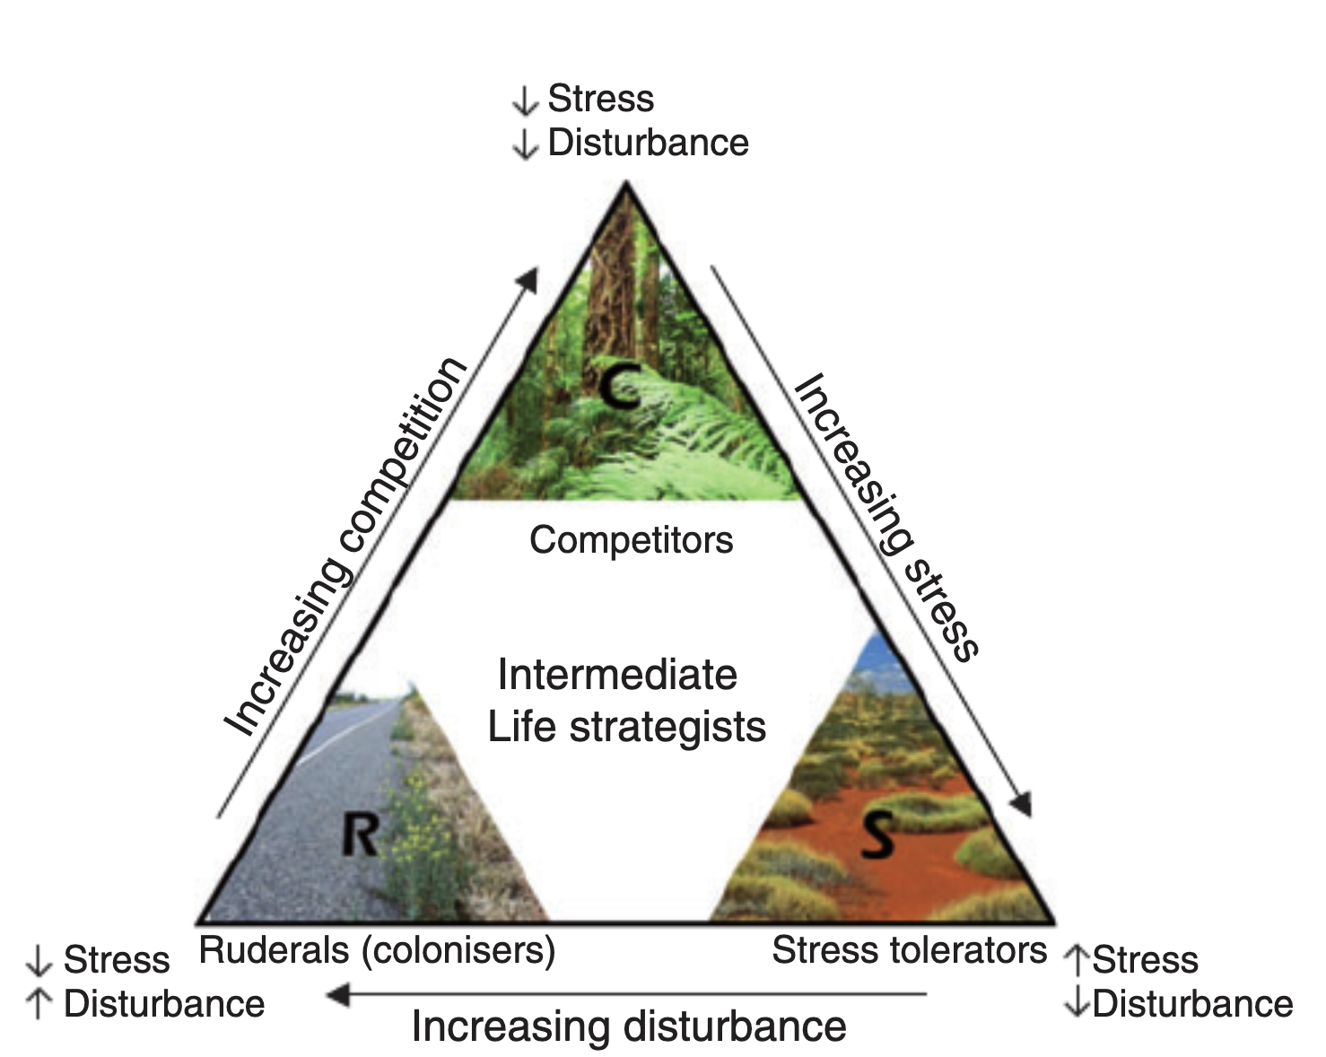
Grime's CSR triangle — visual
THEORY
The three primary plant strategies and their Brazilian biome representatives
Day 1 · Belém · 08 / 26
Trait-Based Ecology — Day 1 · Belém, Brazil

Slide 19
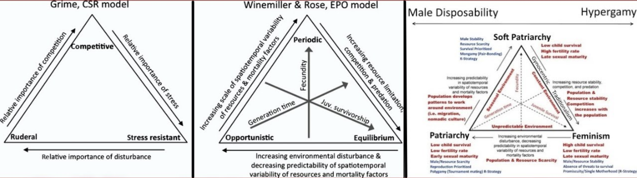
Grime's CSR triangle — visual
THEORY
Functional ecology shifted only much later from functional groups to functional traits and thus from species grouped because they use similar strategies to the similar characteristics underlying those strategies (Yang et al., 2015b).
Example: Intersex relations:
Day 1 · Belém · 08 / 26
Trait-Based Ecology — Day 1 · Belém, Brazil

Slide 20
Traits in ecology — a 200-year intellectual project
1806
1934
1977
2007
Humboldt
Raunkiær
Grime
Violle et al.
First altitudinal zonation of vegetation in tropical South America. Recognised that environment shapes which species occur where — but qualitatively.
Plant life-form classification (phanerophytes, geophytes…) — first quantitative, globally applicable functional classification. Still predicts macroclimate today.
CSR triangle — Competitors, Stress-tolerators, Ruderals. First globally accepted functional strategy system. Applied directly to Amazon and Cerrado plants.
Formal definition of functional trait. Paradigm shift from qualitative types to continuous, measurable, individual-level traits. Opens the database era.
Day 1 · Belém · 08 / 26
Trait-Based Ecology — Day 1 · Belém, Brazil

Slide 21
Part 3
What is a Functional Trait?
Formal definitions · Typology · Response vs. Effect · Trade-offs
Day 1 · Belém · 11 / 26

Slide 22
What is a (functional) trait? — Formal definitions
THEORY
TRAIT — general definition (Violle et al. 2007)
"Any morphological, physiological, phenological or behavioural feature measurable at the individual level (from cell to whole organism)."
Examples: stem height · leaf area (cm²) · LDMC (mg/g) · wood density (g/cm³) · mycorrhizal status
Day 1 · Belém · 12 / 26
Trait-Based Ecology — Day 1 · Belém, Brazil

Slide 23
What is a (functional) trait? — Formal definitions
THEORY
TRAIT — general definition (Violle et al. 2007)
"Any morphological, physiological, phenological or behavioural feature measurable at the individual level (from cell to whole organism)."
Examples: stem height · leaf area (cm²) · LDMC (mg/g) · wood density (g/cm³) · mycorrhizal status
FUNCTIONAL TRAIT — definition (Violle et al. 2007)
"Functional traits are morphological, physiological and phenological features that impact fitness indirectly via their effects on individual performance (growth, reproduction and survival) and interactions with the environment."
Day 1 · Belém · 12 / 26
Trait-Based Ecology — Day 1 · Belém, Brazil

Slide 24
What is a (functional) trait? — Formal definitions
THEORY
TRAIT — general definition (Violle et al. 2007)
"Any morphological, physiological, phenological or behavioural feature measurable at the individual level (from cell to whole organism)."
Examples: stem height · leaf area (cm²) · LDMC (mg/g) · wood density (g/cm³) · mycorrhizal status
FUNCTIONAL TRAIT — definition (Violle et al. 2007)
"Functional traits are morphological, physiological and phenological features that impact fitness indirectly via their effects on individual performance (growth, reproduction and survival) and interactions with the environment."
MEASURABLE
Requires a standardised protocol (Pérez-Harguindeguy et al. 2013). Without standardisation, values from different sources are not comparable — the primary source of noise in TRY.
Day 1 · Belém · 12 / 26
Trait-Based Ecology — Day 1 · Belém, Brazil

Slide 25
What is a (functional) trait? — Formal definitions
THEORY
TRAIT — general definition (Violle et al. 2007)
"Any morphological, physiological, phenological or behavioural feature measurable at the individual level (from cell to whole organism)."
Examples: stem height · leaf area (cm²) · LDMC (mg/g) · wood density (g/cm³) · mycorrhizal status
FUNCTIONAL TRAIT — definition (Violle et al. 2007)
"Functional traits are morphological, physiological and phenological features that impact fitness indirectly via their effects on individual performance (growth, reproduction and survival) and interactions with the environment."
MEASURABLE
INDIVIDUAL LEVEL
Requires a standardised protocol (Pérez-Harguindeguy et al. 2013). Without standardisation, values from different sources are not comparable — the primary source of noise in TRY.
You do not measure a trait 'of the species'. You measure the trait of one specific individual, in one specific environment, at one developmental stage. The species value is a statistic.
Day 1 · Belém · 12 / 26
Trait-Based Ecology — Day 1 · Belém, Brazil

Slide 26
What is a (functional) trait? — Formal definitions
THEORY
TRAIT — general definition (Violle et al. 2007)
"Any morphological, physiological, phenological or behavioural feature measurable at the individual level (from cell to whole organism)."
Examples: stem height · leaf area (cm²) · LDMC (mg/g) · wood density (g/cm³) · mycorrhizal status
FUNCTIONAL TRAIT — definition (Violle et al. 2007)
"Functional traits are morphological, physiological and phenological features that impact fitness indirectly via their effects on individual performance (growth, reproduction and survival) and interactions with the environment."
MEASURABLE
INDIVIDUAL LEVEL
INDIRECTLY
Requires a standardised protocol (Pérez-Harguindeguy et al. 2013). Without standardisation, values from different sources are not comparable — the primary source of noise in TRY.
You do not measure a trait 'of the species'. You measure the trait of one specific individual, in one specific environment, at one developmental stage. The species value is a statistic.
A functional trait is NOT a direct fitness component like seed number. It is a mediator. Wood density → hydraulic safety → drought survival. The indirection defines the functional trait.
Day 1 · Belém · 12 / 26
Trait-Based Ecology — Day 1 · Belém, Brazil

Slide 27
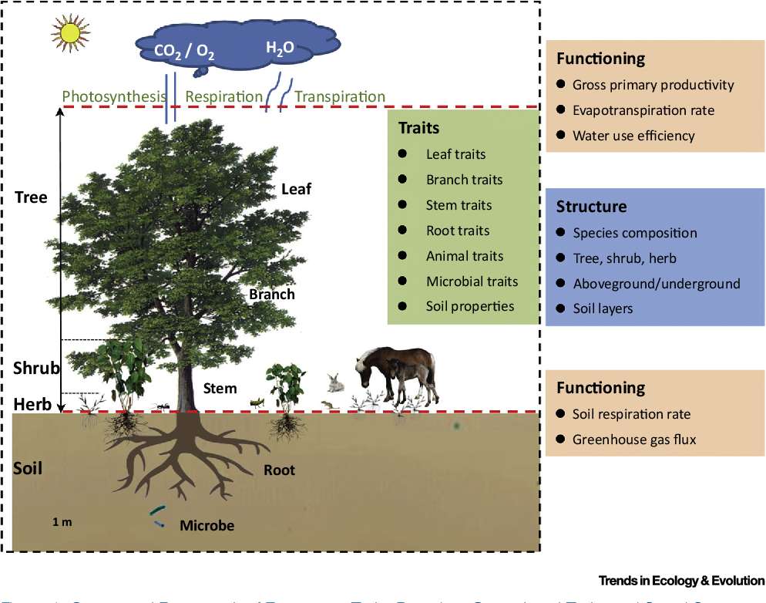

What is a (functional) trait? — Formal definitions
Any morphological, physiological, phenological or behavioural feature measurable at the individual level (cell to whole organism).
Height (5.5 m)
Leaf area (22 cm²)
…
Mycorrhizal status (M)
Day 1 · Belém · 12 / 26
Trait-Based Ecology — Day 1 · Belém, Brazil

Slide 28
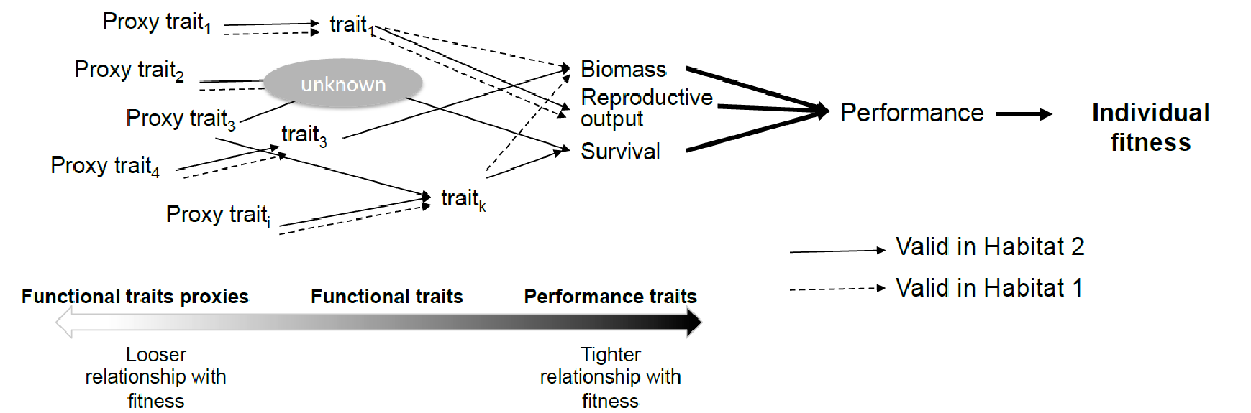
What is a (functional) trait? — Formal definitions
measurement difficulty
Day 1 · Belém · 12 / 26
Trait-Based Ecology — Day 1 · Belém, Brazil

Slide 29
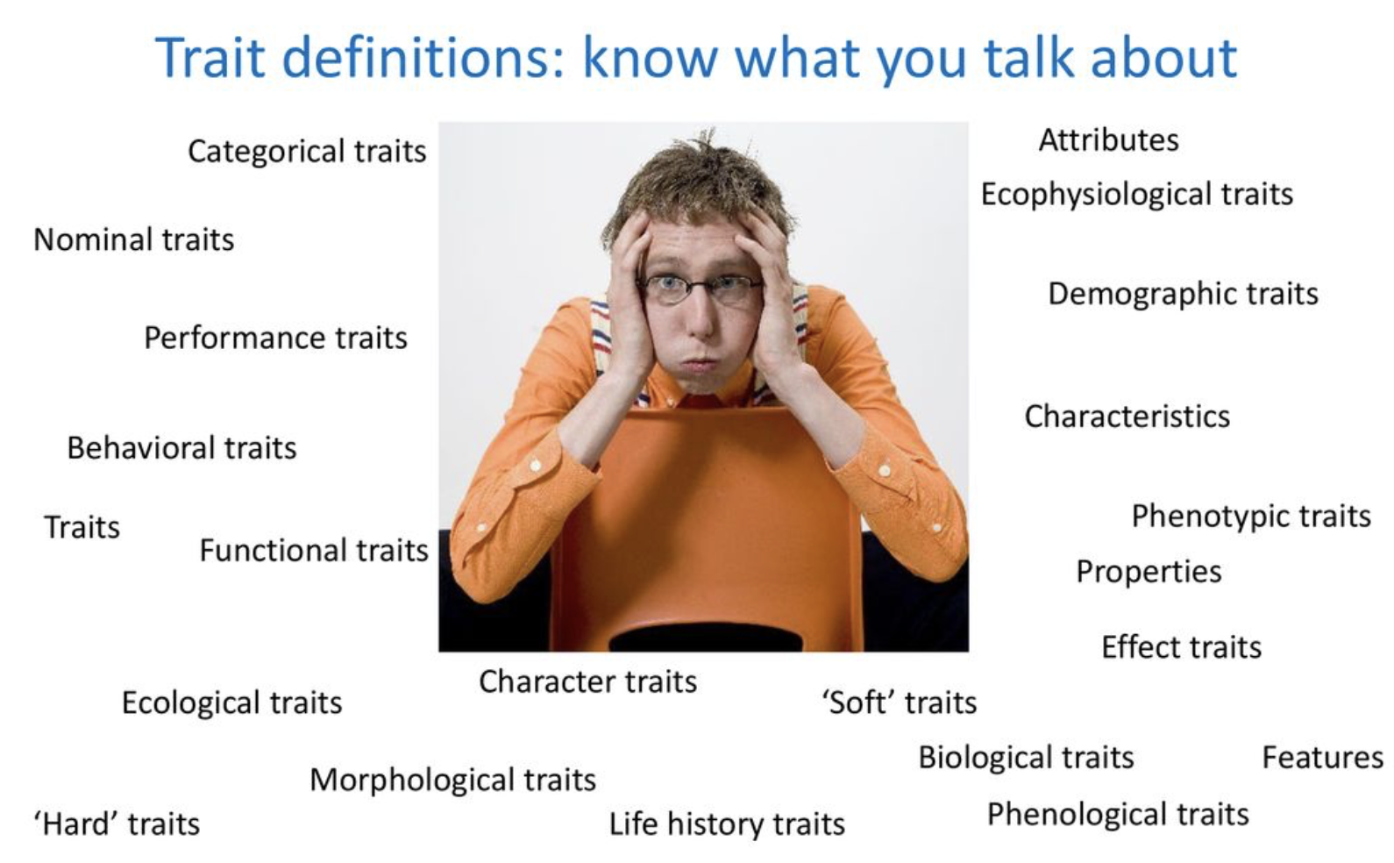
What is a (functional) trait? — Formal definitions
Day 1 · Belém · 12 / 26
Trait-Based Ecology — Day 1 · Belém, Brazil

Slide 30
A typology of functional traits
THEORY
Morphological
Physiological
Phenological
Behavioural
• Specific leaf area (SLA, mm² mg⁻¹)
• Leaf N content (mg g⁻¹)
• Leaf lifespan (days)
• Clonal growth capacity
• Leaf dry matter content (LDMC, mg g⁻¹)
• Leaf P content (mg g⁻¹)
• Onset of leaf flush
• Resprouting after fire
• Leaf area (cm²)
• Max. photosynthetic rate (Amax)
• Fruit production timing
• Dispersal mode (wind/animal)
• Plant height (m)
• Stomatal conductance (gs)
• Flowering period
• Root foraging plasticity
• Seed mass (mg)
• Water use efficiency (WUE)
• Growing season length
• N₂ fixation (Fabaceae)
• Wood density (g cm⁻³)
• Bark thickness (mm)
Day 1 · Belém · 13 / 26
Trait-Based Ecology — Day 1 · Belém, Brazil

Slide 31
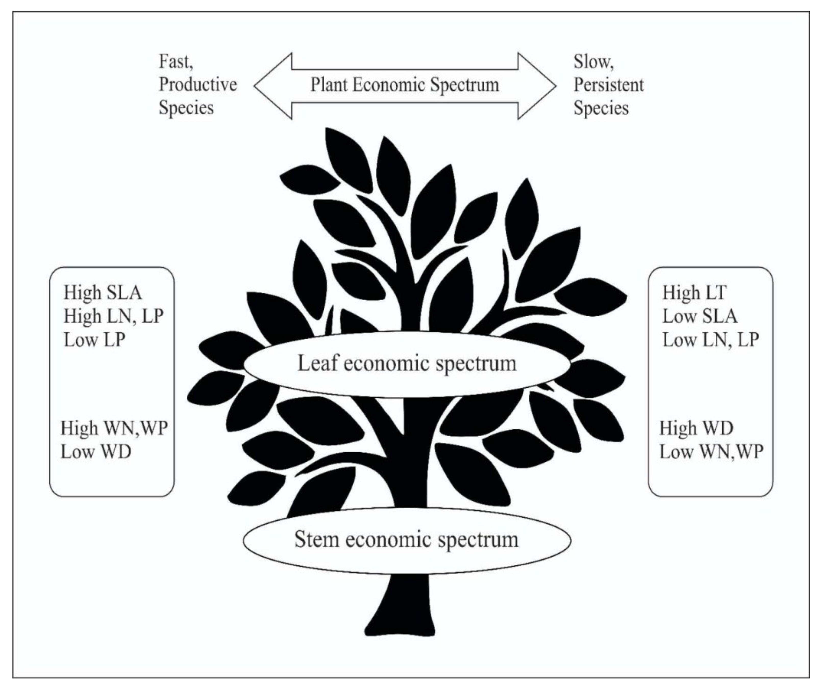
The Leaf Economics Spectrum (Wright et al. 2004 Nature)
LANDMARK
Why can't a plant be optimal for all traits simultaneously?
Day 1 · Belém · 16 / 26
Trait-Based Ecology — Day 1 · Belém, Brazil

Slide 32
The Leaf Economics Spectrum (Wright et al. 2004 Nature)
LANDMARK
← Acquisitive (fast-return)
Fast-return strategy
• LDMC < 150 mg g⁻¹
• SLA > 25 mm² mg⁻¹
• High leaf N & P
• Short leaf lifespan (weeks–months)
• High max photosynthesis (Amax)
• Low construction cost per unit area
🌿 Cecropia palmata (imbaúba)
Pistia stratiotes (floodplains)
Mimosa spp. (disturbed edges)
Pourouma spp. (secondary forest)
Day 1 · Belém · 16 / 26
Trait-Based Ecology — Day 1 · Belém, Brazil

Slide 33
The Leaf Economics Spectrum (Wright et al. 2004 Nature)
LANDMARK
← Acquisitive (fast-return)
Conservative (slow-return) →
Fast-return strategy
Slow-return strategy
• LDMC < 150 mg g⁻¹
• LDMC > 280 mg g⁻¹
• SLA > 25 mm² mg⁻¹
• SLA < 12 mm² mg⁻¹
• High leaf N & P
• Low leaf N & P
• Short leaf lifespan (weeks–months)
• Long leaf lifespan (months–years)
• High max photosynthesis (Amax)
• Low max photosynthesis (Amax)
• Low construction cost per unit area
• High construction cost per unit area
🌿 Cecropia palmata (imbaúba)
Pistia stratiotes (floodplains)
Mimosa spp. (disturbed edges)
Pourouma spp. (secondary forest)
🌿 Eschweilera coriacea (matamatá)
Vellozia spp. (campos rupestres)
Clusia spp. (white-sand campinas)
Qualea grandiflora (Cerrado)
Day 1 · Belém · 16 / 26
Trait-Based Ecology — Day 1 · Belém, Brazil

Slide 34
The Leaf Economics Spectrum (Wright et al. 2004 Nature)
THEORY
Why can't a plant be optimal for all traits simultaneously?
A high-SLA leaf is cheap to build (low carbon investment per unit area) but expensive to maintain — it is short-lived, easily consumed by herbivores, and quickly decomposed.
A high-LDMC leaf is expensive to build (high investment in structural compounds, cell walls, defence chemicals) but profitable long-term — it lasts much longer.
You cannot optimise both simultaneously. This economic trade-off generates the LES.
Day 1 · Belém · 18 / 26
Trait-Based Ecology — Day 1 · Belém, Brazil

Slide 35
Part 4
Global Databases
TRY · BIEN · Data quality ·
Day 1 · Belém · 19 / 26

Slide 36
Global trait databases — resources and limitations
DATA
TRY
BIEN
GIFT
FLORA DO BRASIL + TRY-BR
try-db.org
biendata.org
gift.uni-goettingen.de
floradobrasil.jbrj.gov.br
>15M records · >300K species · >2,800 traits · CC BY
Americas flora · Geo-referenced · Compatible with TRY
Global floristic inventories + traits · Macroecological scale
All Brazilian vascular plants · ≈47,000 species · Curated taxonomy
Kattge et al. (2020) Global Change Biology
Enquist et al. — Botanical Information and Ecology Network
Weigelt et al. (2020) Journal of Biogeography
Brazilian Flora Group (2022) — JBRJ, Rio de Janeiro
Contains substantial Amazon and Cerrado data from Brazilian research groups (PPBio, REFLORA). Coverage of Caatinga and Cerrado endemics still patchy.
More relevant to Neotropical ecology than European databases. Covers Brazil, Colombia, Peru, Central America with trait and distribution data.
Links Brazilian biome checklists (FLORA DO BRASIL) to trait data. Useful for comparing Amazon, Cerrado and Atlantic Forest functional composition.
The reference for Brazilian plant taxonomy. When crossed with TRY, provides trait coverage for ≈12,000–15,000 Brazilian species — an underused resource.
⚠ Heterogeneous protocols. No quality guarantee. User must validate. Geographic bias toward temperate regions.
⚠ Trait coverage less complete than TRY. Focus on the Americas only.
⚠ Derived from multiple sources. Incomplete for many tropical regions.
⚠ Trait data largely absent — must cross with TRY/BIEN. Mostly distribution and taxonomy.
★ Quality control is YOUR responsibility. TRY provides raw data. Always visualise distributions, check units, and remove outliers BEFORE analysis. Never trust a single TRY observation.
Day 1 · Belém · 20 / 26
Trait-Based Ecology — Day 1 · Belém, Brazil

Slide 37
R Practical Session
Trait data: import,
cleaning & exploration
Day 1 · Belém · 22 / 26

Slide 38
R Practical — Step-by-step workflow
The leaf economic logic
A high-SLA leaf is cheap to build (low carbon investment per unit area) but expensive to maintain — it is short-lived, easily consumed by herbivores, and quickly decomposed.
A high-LDMC leaf is expensive to build (high investment in structural compounds, cell walls, defence chemicals) but profitable long-term — it lasts much longer.
You cannot optimise both simultaneously. This economic trade-off generates the LES.
TRY
try-db.org
>15M records · >300K species · >2,800 traits · CC BY
Kattge et al. (2020) Global Change Biology
Day 1 · Belém · 13 / 26
Day 1 · Belém · 23 / 26
Trait-Based Ecology — Day 1 · Belém, Brazil

Slide 39
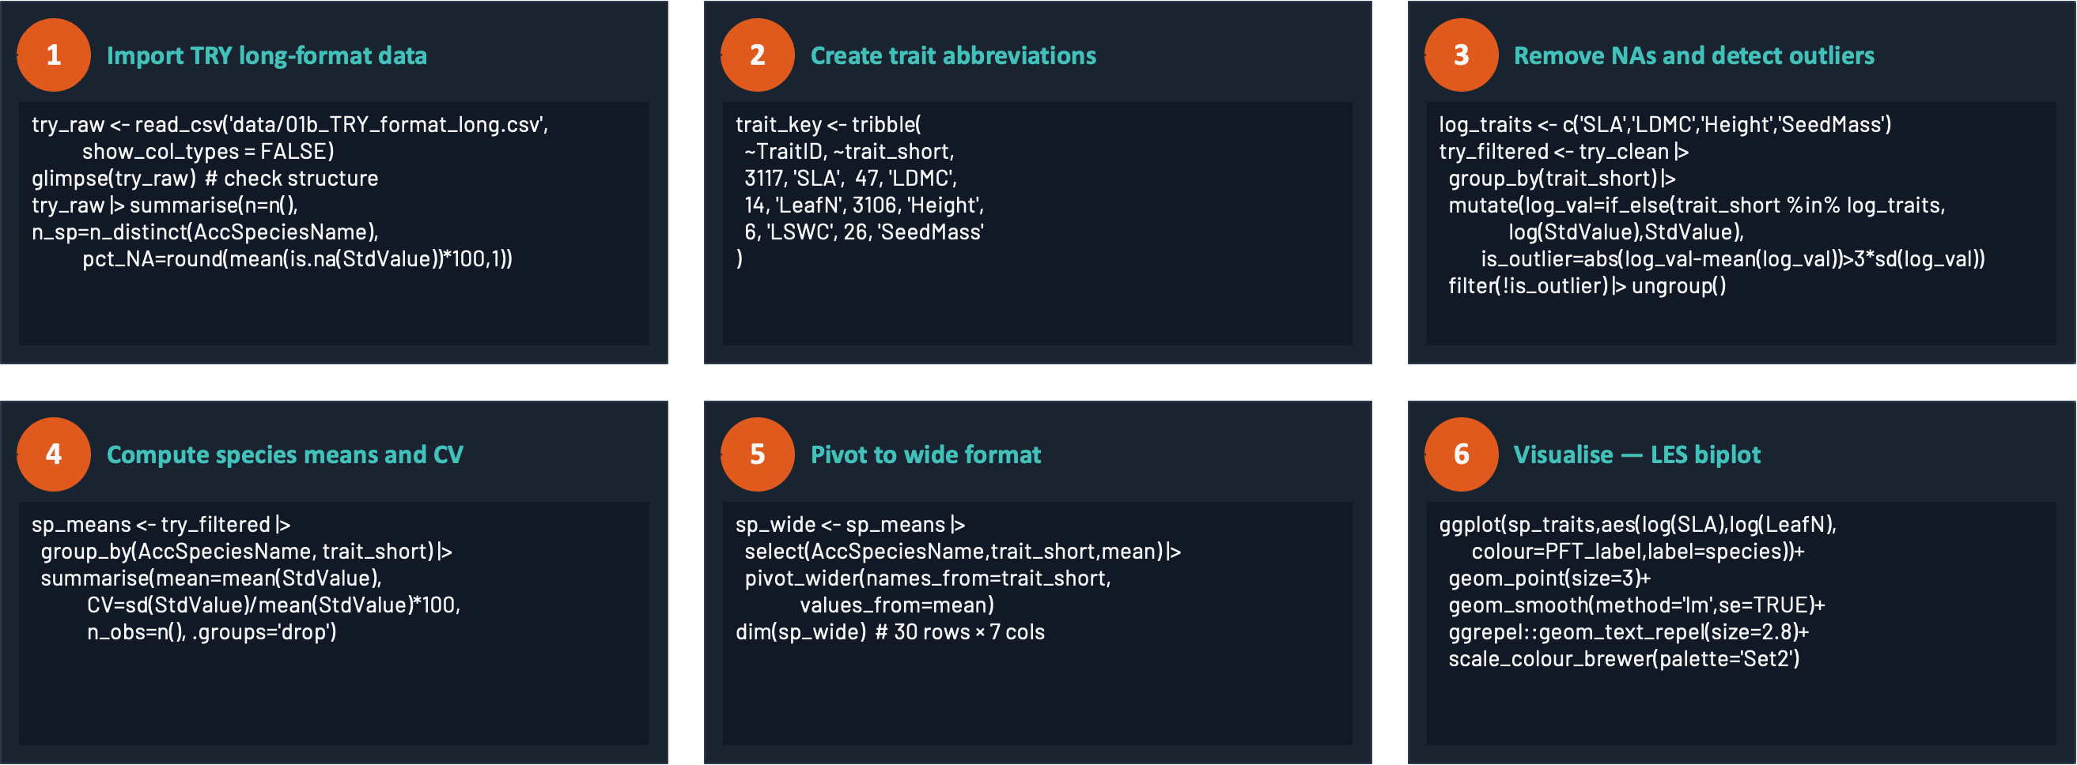
R Practical — Step-by-step workflow
3
4
5
Day 1 · Belém · 13 / 26
Day 1 · Belém · 23 / 26
Trait-Based Ecology — Day 1 · Belém, Brazil

Slide 40
The LES — correlations, logic and Amazonian evidence
THEORY
The leaf economic logic
Amazonian evidence
A high-SLA leaf is cheap to build (low carbon investment per unit area) but expensive to maintain — it is short-lived, easily consumed by herbivores, and quickly decomposed.
A high-LDMC leaf is expensive to build (high investment in structural compounds, cell walls, defence chemicals) but profitable long-term — it lasts much longer.
You cannot optimise both simultaneously. This economic trade-off generates the LES.
Amazonian tree communities are distributed along a fast–slow spectrum. Eastern Amazonia (Pará) tends toward slower-strategy communities than western Amazonia, driven by soil fertility gradients — poor lateritic oxisols in the east vs. younger, richer soils in the west.
— Communications Biology 2025, 812 genera · 5,211 species
Practical implication for your research:
Global correlations (Wright et al. 2004, n = 2,548 species):
1
SLA and LDMC measured in Pará forests will follow the global LES — you can compare them to worldwide databases
r (SLA × Leaf N) = +0.62
2
The soil P gradient across Amazonia predicts SLA gradients — SLA is higher on fertile western soils
r (SLA × LDMC) = −0.59
3
Fire events preferentially kill high-SLA, low-wood-density trees — functional trait data predicts post-fire recovery
r (SLA × Amax) = +0.55
4
Remote sensing of leaf N and SLA from satellites is now possible — TRY training data is essential
Day 1 · Belém · 18 / 26
Trait-Based Ecology — Day 1 · Belém, Brazil

Slide 41
Take-Home Messages — Day 1
1
A functional trait is measurable at the individual level and impacts fitness INDIRECTLY via growth, reproduction or survival — not directly. The word 'indirectly' is critical.
2
Response traits = how a species reacts to its environment. Effect traits = its impact on ecosystem processes. The same trait (SLA, wood density) can be BOTH.
3
The LES is a universal biophysical constraint: r(SLA, LDMC) ≈ −0.59 across 2,548 species worldwide — and fully applies in Amazonian forests.
4
ITV represents 25–50% of total community trait variance. A TRY species mean hides this. Cecropia SLA in a full-sun gap ≠ Cecropia SLA in understory.
5
TRY is raw data. Quality control (outliers, missing values, unit harmonisation) is entirely the analyst's responsibility. Always visualise BEFORE filtering.
Day 2 → Community-Weighted Means and Functional Diversity Indices (FRic, FEve, FDiv, FDis)
Day 1 · Belém · 25 / 26

Slide 42
Key References — Day 1
1
Violle C. et al. (2007) Let the concept of trait be functional! Oikos 116: 882–892 — formal definition of functional trait
2
Wright I.J. et al. (2004) The worldwide leaf economics spectrum. Nature 428: 821–827 — LES, 2,548 species, 6 continents
3
Lavorel S. & Garnier E. (2002) Predicting changes in community composition from plant traits. Functional Ecology 16: 545–556 — response–effect framework
4
Kattge J. et al. (2020) TRY plant trait database — enhanced coverage and open access. Global Change Biology 26: 119–188 — TRY database v5
5
Díaz S. et al. (2016) The global spectrum of plant form and function. Nature 529: 167–171 — 46,000 species, 6 traits
6
Carmona C.P. et al. (2021) Erosion of global functional diversity across the tree of life. Science Advances 7: eabf2675 — threatened species and traits
7
Violle C. et al. (2012) The return of the variance: intraspecific variability in community ecology. TREE 27: 146–153 — ITV and community ecology
8
Ter Steege H. et al. (2020) Biased-corrected richness estimates for the Amazonian tree flora. Scientific Reports 10: 10130 — Amazonian functional composition
9
Brando P.M. et al. (2014) Abrupt increases in Amazonian tree mortality due to drought-fire interactions. PNAS 111: 6347–6352 — wood density and fire in Amazon
10
Pérez-Harguindeguy N. et al. (2013) New handbook for standardised measurement of plant functional traits. Australian Journal of Botany 61: 167–234 — measurement protocols
Day 1 · Belém · 26 / 26

Slide 43
Exercises
EXERCISES
Q1 — SLA and IUCN conservation status
Q2 — Allometry: seed mass × plant height
a) Compute % species with status VU, EN or CR · Display breakdown by category (LC→CR)
a) Compute r(SeedMass, Height) on raw AND log-transformed values · comment the difference
b) Violin + boxplot + jitter comparing SLA between threatened vs. non-threatened · colour by PFT
b) Scatter plot log–log with overall regression + per-PFT lines · label 3 extreme species
c) Wilcoxon test · compute medians and IQR by group
c) Justify log-transformation statistically (shapiro.test / Q-Q) AND biologically (allometric power law)
c) Wilcoxon test · compute medians and IQR by group
d) lm(log(Height) ~ log(SeedMass) * PFT_label) · test interaction · compare AIC ± interaction
Q3 — Extreme species and acquisitive score
Q4 — CV of SLA and limits of ITV from TRY
a) Identify 3 species with lowest SLA and 3 with highest · display all trait values
a) From cleaned TRY long-format, compute CV of SLA per species (n_obs ≥ 2) · rank species
b) Position extreme species in LES space (SLA × LeafN AND SLA × LDMC) with distinct labels
b) Violin + boxplot of CV by PFT · which PFT shows greatest intraspecific variability?
c) Does highest-SLA species also have lowest SeedMass and tallest Height? Discuss why not necessarily
c) Correlate SLA CV with species mean SLA (cor.test log-scale) · do acquisitive spp vary more?
d) Compute composite score = rank(SLA) + rank(LeafN) + (n+1 − rank(LDMC)) · ranked bar chart
d) Written discussion (≥150 words): does TRY CV measure real ITV? Identify 3 concrete limitations
Full annotated solutions in: jour1_exercices_corriges.R (Part B) — run after reading the guide
Day 1 · Belém · 24 / 26
Trait-Based Ecology — Day 1 · Belém, Brazil

