Slide 1
Trait-based approach
in community ecology
Day 2 — Community-Weighted Means, Functional Diversity Indices & Functional Trait Space CWM · FRic · FEve · FDis · funspace · Brazil Belém, Pará · Amazon, Brazil
Day 2 · Belém · 01 / 38

Slide 2
Day 2 — Programme overview
01
02
03
04
05
Community-Weighted Mean (CWM)
Functional Diversity Indices
Functional Trait Space
{funspace} — Probabilistic trait spaces
R Practical
Mass-ratio hypothesis · Weighted mean formula · Interpretation · Amazon examples
FRic · FEve · FDiv · FDis · RaoQ — definitions, geometry, and ecological meaning
PCoA-based space · Convex hull · Species packing · Functional rarity
TPD · kernel density · funspaceGAM · funspaceNull — theory and R workflow
dbFD() · functcomp() · funspace() · funspaceGAM() · full Amazon dataset
Day 2 · Belém · 02 / 38
Trait-Based Ecology — Day 2 · CWM · FD Indices · Functional Space · Belém, Brazil

Slide 3
General principles in community ecology
THEORY
Why do we observe a certain variety of species ?
Why are some communities more species-rich than others?
Why are some species present in a particular community but not in others ?
Global environment
?
Strong context dependant due to taxonomic approach
Species composition
Day 2 · Belém · 02 / 38
Trait-Based Ecology — Day 2 · CWM · FD Indices · Functional Space · Belém, Brazil

Slide 4
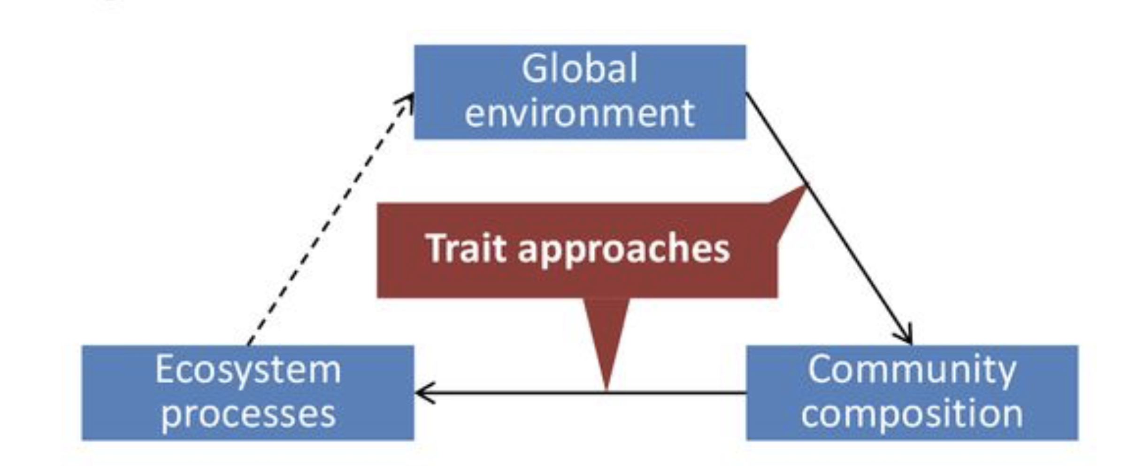
Community ecology and traits
THEORY
This understanding was traditionally mediated by species-based approaches.
More recently, such approaches were complemented by approaches based on traits.
Trait-based approaches are popular, because they allow the direct connection of organism performance to its functions and to the functions of higher levels of organization such as populations, communities and ecosystems.
Day 2 · Belém · 03 / 38
Trait-Based Ecology — Day 2 · CWM · FD Indices · Functional Space · Belém, Brazil

Slide 5
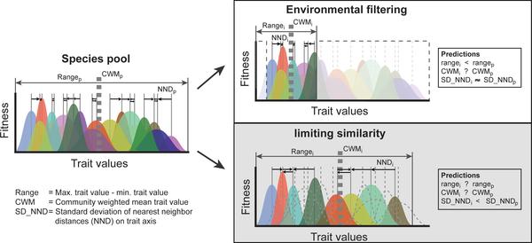
Filtering metaphor
THEORY
Day 2 · Belém · 03 / 38
Trait-Based Ecology — Day 2 · CWM · FD Indices · Functional Space · Belém, Brazil

Slide 6
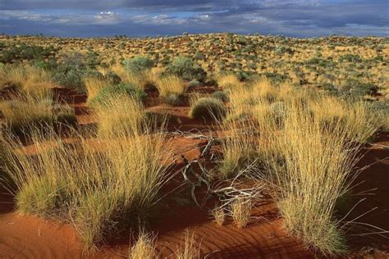
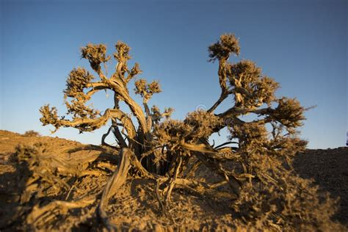
Community Assembly Theories
THEORY
Environmental Filtering:
Species with traits that match the local abiotic conditions (e.g., temperature, moisture) are more likely to establish and thrive.
Example: In arid regions, plants with traits like deep root systems or water storage capacities dominate.
Day 2 · Belém · 03 / 38
Trait-Based Ecology — Day 2 · CWM · FD Indices · Functional Space · Belém, Brazil

Slide 7
Community Assembly Theories
THEORY
Environmental Filtering:
Species with traits that match the local abiotic conditions (e.g., temperature, moisture) are more likely to establish and thrive.
Example: In arid regions, plants with traits like deep root systems or water storage capacities dominate.
Limiting similarity:
Coexistence is promoted by species occupying different niches (i.e., using different resources or traits that reduce competition).
Example: Two plant species in a forest might have different leaf area sizes that allow them to specialize in different light conditions.
Day 2 · Belém · 03 / 38
Trait-Based Ecology — Day 2 · CWM · FD Indices · Functional Space · Belém, Brazil

Slide 8
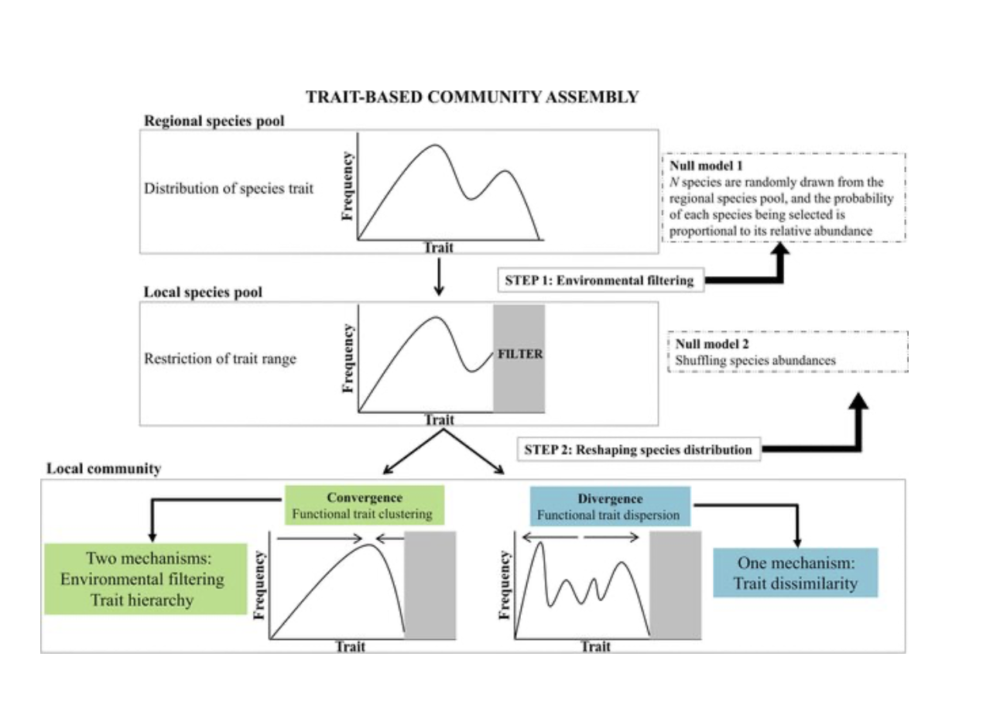
Patterns of community structure
THEORY
Day 2 · Belém · 03 / 38
Trait-Based Ecology — Day 2 · CWM · FD Indices · Functional Space · Belém, Brazil

Slide 9
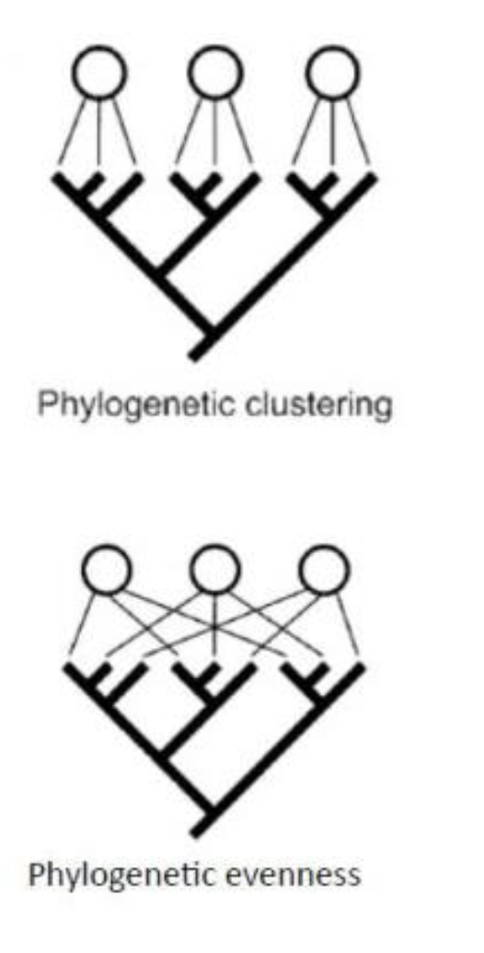
Patterns of community structure
THEORY
Ecological interpretation
Functional clustering
Co-occurring species are more closely related than expected by chance
Functional dispersion
Co-occuring species are more distantly related than expected by chance
Random patterns
Can be tested by using simulations and null models
Day 2 · Belém · 03 / 38
Trait-Based Ecology — Day 2 · CWM · FD Indices · Functional Space · Belém, Brazil

Slide 10
Part 1
Community-Weighted
Mean (CWM)
The mass-ratio hypothesis and dominant trait strategy
Day 2 · Belém · 10 / 38

Slide 11
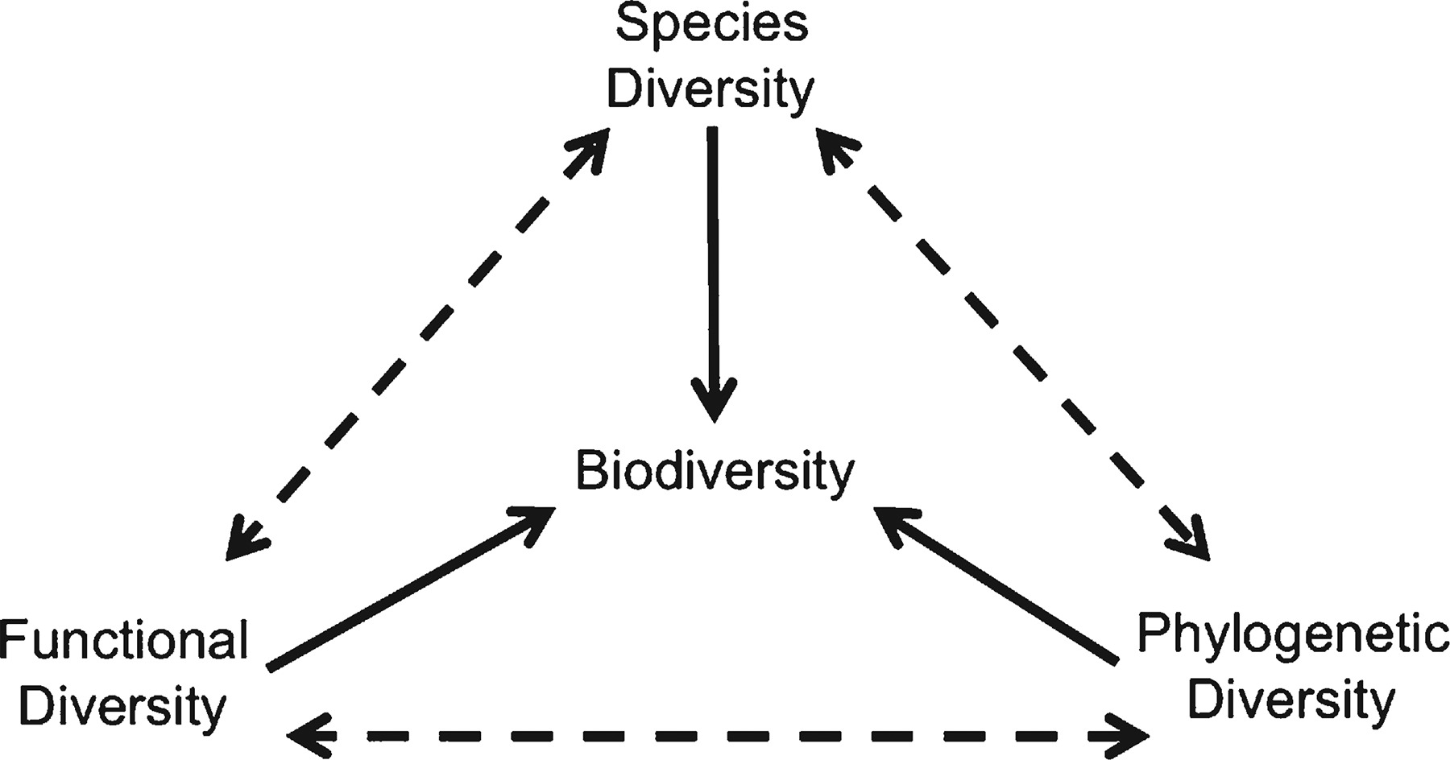
Understanding indices
THEORY
Definition of an Index: A quantitative measure that summarizes complex ecological data into a single value to assess biodiversity.
Purpose of Indices: Helps compare communities, understand ecological processes, and inform conservation strategies.
Types of Indices: Indices can be based on taxonomic, functional, or phylogenetic diversity.
Day 2 · Belém · 03 / 38
Trait-Based Ecology — Day 2 · CWM · FD Indices · Functional Space · Belém, Brazil

Slide 12
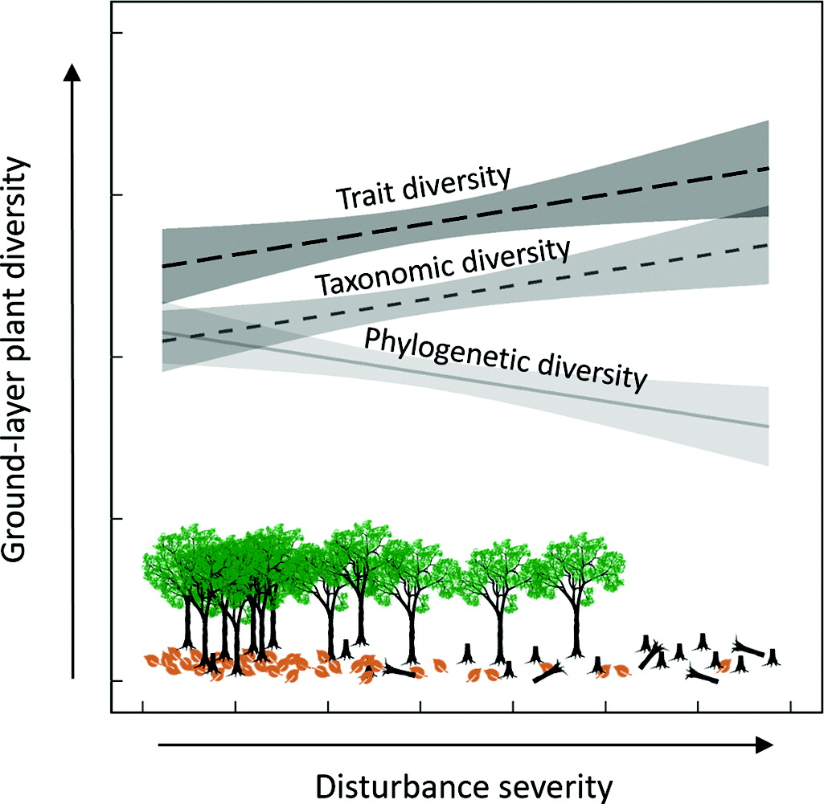
Example of indices
THEORY
Taxonomic Indices:Measure biodiversity based on species identity and counts (e.g., species richness, Shannon diversity). Taxonomic indices do not consider functional traits or ecosystem roles.
Functional Indices:Measure biodiversity based on the distribution and range of functional traits. Examples: Functional Richness (FRic), Functional Evenness (FEve), Functional Divergence (FDiv).
Comparison: Taxonomic indices reflect species presence, while functional indices reflect species' roles and contributions to ecosystem functions.
Day 2 · Belém · 03 / 38
Trait-Based Ecology — Day 2 · CWM · FD Indices · Functional Space · Belém, Brazil

Slide 13
Functional trait diversity
THEORY
Definition: Measures the range and distribution of functional traits within community
There is a family of indices intends to quantify how many kinds of species there are in a study unit
It can be quantify by various indices, called moment in mathematical terms
Example: first momment: mean; second moment: variance, etc ….
Similarly, in functional ecology, several indices corresponding to those moments can be used to characterize a community
Day 2 · Belém · 03 / 38
Trait-Based Ecology — Day 2 · CWM · FD Indices · Functional Space · Belém, Brazil

Slide 14
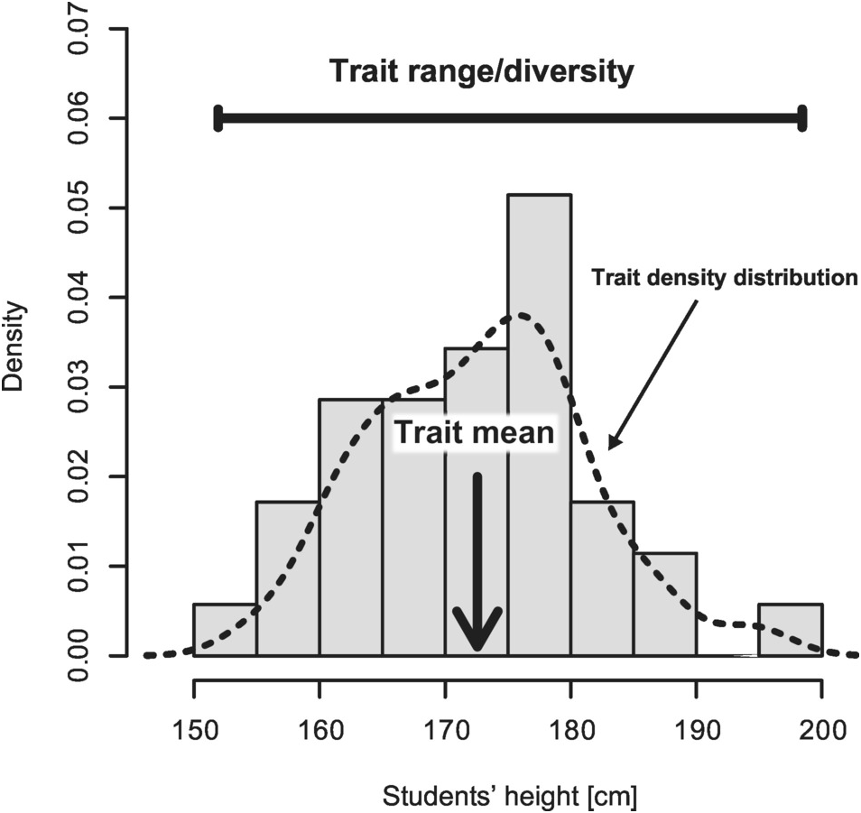
Community functional trait structure
THEORY
Two most intuitive parameters
Trait mean
Trait range
Day 2 · Belém · 03 / 38
Trait-Based Ecology — Day 2 · CWM · FD Indices · Functional Space · Belém, Brazil

Slide 15
Community-Weighted Mean — definition and the mass-ratio hypothesis
THEORY
CWM(t) = Σᵢ pᵢ × tᵢ where pᵢ = relative abundance of species i, tᵢ = trait value of species i
Mass-ratio hypothesis (Grime 1998): Ecosystem processes are predominantly controlled by the traits of the most abundant species. The trait value that dominates the community — weighted by abundance — is the best predictor of ecosystem functioning.
Day 2 · Belém · 15 / 38
Trait-Based Ecology — Day 2 · CWM · FD Indices · Functional Space · Belém, Brazil

Slide 16
Community-Weighted Mean — definition and the mass-ratio hypothesis
THEORY
CWM(t) = Σᵢ pᵢ × tᵢ where pᵢ = relative abundance of species i, tᵢ = trait value of species i
Mass-ratio hypothesis (Grime 1998): Ecosystem processes are predominantly controlled by the traits of the most abundant species. The trait value that dominates the community — weighted by abundance — is the best predictor of ecosystem functioning.
CWM predicts ecosystem processes
CWM(SLA) predicts decomposition rate, CWM(LDMC) predicts litter quality, CWM(Height) predicts primary productivity. The dominant species drives ecosystem function — not the rare ones.
Day 2 · Belém · 15 / 38
Trait-Based Ecology — Day 2 · CWM · FD Indices · Functional Space · Belém, Brazil

Slide 17
Community-Weighted Mean — definition and the mass-ratio hypothesis
THEORY
CWM(t) = Σᵢ pᵢ × tᵢ where pᵢ = relative abundance of species i, tᵢ = trait value of species i
Mass-ratio hypothesis (Grime 1998): Ecosystem processes are predominantly controlled by the traits of the most abundant species. The trait value that dominates the community — weighted by abundance — is the best predictor of ecosystem functioning.
CWM predicts ecosystem processes
CWM is not functional DIVERSITY
CWM(SLA) predicts decomposition rate, CWM(LDMC) predicts litter quality, CWM(Height) predicts primary productivity. The dominant species drives ecosystem function — not the rare ones.
CWM captures the central tendency of the trait distribution — the most common strategy. It says nothing about how spread out traits are, or whether extreme strategies exist.
Two communities can have identical CWM(SLA) but very different FRic: one with only intermediate-SLA species, one with a mix of very low and very high SLA species.
Day 2 · Belém · 15 / 38
Trait-Based Ecology — Day 2 · CWM · FD Indices · Functional Space · Belém, Brazil

Slide 18
Community-Weighted Mean — definition and the mass-ratio hypothesis
THEORY
CWM(t) = Σᵢ pᵢ × tᵢ where pᵢ = relative abundance of species i, tᵢ = trait value of species i
Mass-ratio hypothesis (Grime 1998): Ecosystem processes are predominantly controlled by the traits of the most abundant species. The trait value that dominates the community — weighted by abundance — is the best predictor of ecosystem functioning.
CWM predicts ecosystem processes
CWM is not functional DIVERSITY
Interpretation of CWM change
CWM(SLA) predicts decomposition rate, CWM(LDMC) predicts litter quality, CWM(Height) predicts primary productivity. The dominant species drives ecosystem function — not the rare ones.
CWM captures the central tendency of the trait distribution — the most common strategy. It says nothing about how spread out traits are, or whether extreme strategies exist.
Two communities can have identical CWM(SLA) but very different FRic: one with only intermediate-SLA species, one with a mix of very low and very high SLA species.
A decrease in CWM(SLA) along an elevation gradient means the community is shifting toward more conservative strategies — NOT that any single species changed.
Day 2 · Belém · 15 / 38
Trait-Based Ecology — Day 2 · CWM · FD Indices · Functional Space · Belém, Brazil

Slide 19
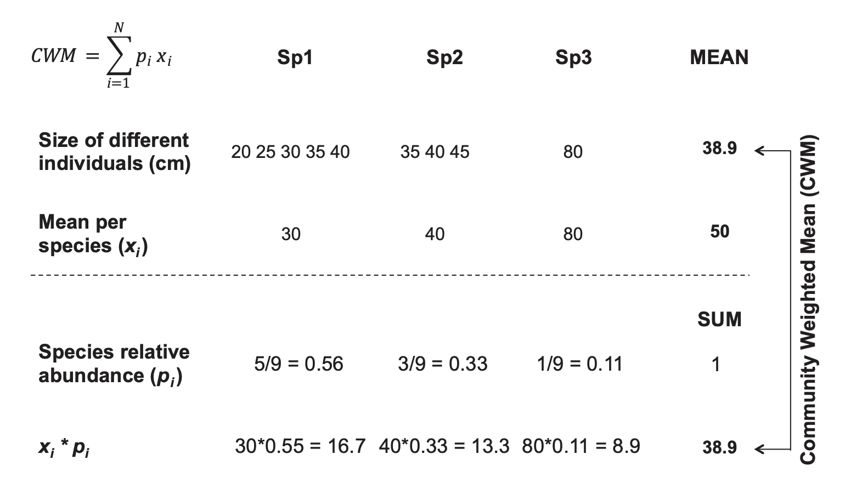
Community-Weighted Mean — definition and the mass-ratio hypothesis
THEORY
CWM(t) = Σᵢ pᵢ × tᵢ where pᵢ = relative abundance of species i, tᵢ = trait value of species i
Mass-ratio hypothesis (Grime 1998): Ecosystem processes are predominantly controlled by the traits of the most abundant species. The trait value that dominates the community — weighted by abundance — is the best predictor of ecosystem functioning.
CWM predicts ecosystem processes
CWM is not functional DIVERSITY
Interpretation of CWM change
CWM(SLA) predicts decomposition rate, CWM(LDMC) predicts litter quality, CWM(Height) predicts primary productivity. The dominant species drives ecosystem function — not the rare ones.
CWM captures the central tendency of the trait distribution — the most common strategy. It says nothing about how spread out traits are, or whether extreme strategies exist.
Two communities can have identical CWM(SLA) but very different FRic: one with only intermediate-SLA species, one with a mix of very low and very high SLA species.
A decrease in CWM(SLA) along an elevation gradient means the community is shifting toward more conservative strategies — NOT that any single species changed.
Day 2 · Belém · 15 / 38
Trait-Based Ecology — Day 2 · CWM · FD Indices · Functional Space · Belém, Brazil

Slide 20
Part 2
Functional Trait Space
PCoA · Convex hull
Day 2 · Belém · 28 / 38

Slide 21
From individual traits to a functional SPACE
THEORY
The multi-trait challenge
A community is described by P traits × N species — typically P = 5 to 15.
Bivariate plots (trait × trait) show only 1 / [P(P-1)/2] of the structure.
Need to summarise the multi-dimensional cloud into a few interpretable axes.
→ Build a FUNCTIONAL SPACE: a low-dimensional representation
where Euclidean distance approximates trait-based dissimilarity.
Day 2 · Belém · 15 / 38
Trait-Based Ecology — Day 2 · CWM · FD Indices · Functional Space · Belém, Brazil

Slide 22
From individual traits to a functional SPACE
THEORY
The multi-trait challenge
What a functional space buys you
A community is described by P traits × N species — typically P = 5 to 15.
Bivariate plots (trait × trait) show only 1 / [P(P-1)/2] of the structure.
Need to summarise the multi-dimensional cloud into a few interpretable axes.
→ Build a FUNCTIONAL SPACE: a low-dimensional representation
where Euclidean distance approximates trait-based dissimilarity.
Visualise community structure (PCoA biplots, kernel densities).
Compute community indices (FRic, FEve, FDiv, FDis) as geometric quantities.
Identify rare or unique strategies (peripheral position).
Test community-assembly hypotheses (filtering vs limiting similarity).
Compare communities across space, time, or environmental gradients.
Day 2 · Belém · 15 / 38
Trait-Based Ecology — Day 2 · CWM · FD Indices · Functional Space · Belém, Brazil

Slide 23
From individual traits to a functional SPACE
THEORY
The multi-trait challenge
What a functional space buys you
A community is described by P traits × N species — typically P = 5 to 15.
Bivariate plots (trait × trait) show only 1 / [P(P-1)/2] of the structure.
Need to summarise the multi-dimensional cloud into a few interpretable axes.
→ Build a FUNCTIONAL SPACE: a low-dimensional representation
where Euclidean distance approximates trait-based dissimilarity.
Visualise community structure (PCoA biplots, kernel densities).
Compute community indices (FRic, FEve, FDiv, FDis) as geometric quantities.
Identify rare or unique strategies (peripheral position).
Test community-assembly hypotheses (filtering vs limiting similarity).
Compare communities across space, time, or environmental gradients.
1. Trait matrix
P traits × N species, scaled / log-transformed
2. Distance matrix
N × N dissimilarities (Gower / Euclidean / Mahalanobis)
3. Ordination
PCoA or PCA → 2-6 axes preserving distances
Day 2 · Belém · 15 / 38
Trait-Based Ecology — Day 2 · CWM · FD Indices · Functional Space · Belém, Brazil

Slide 24
Functional trait space — formal definition
THEORY
A functional trait space is a multi-dimensional Euclidean space whose orthogonal axes are derived from functional traits. Each species is positioned as a single point whose coordinates are the values of its (transformed) traits or the projection of its trait vector on the principal axes of the trait covariance matrix.
Importance: Helps visualize and quantify functional diversity, and assess community assembly mechanisms.
Day 2 · Belém · 15 / 38
Trait-Based Ecology — Day 2 · CWM · FD Indices · Functional Space · Belém, Brazil

Slide 25
Functional trait space — formal definition
THEORY
A functional trait space is a multi-dimensional Euclidean space whose orthogonal axes are derived from functional traits. Each species is positioned as a single point whose coordinates are the values of its (transformed) traits or the projection of its trait vector on the principal axes of the trait covariance matrix.
1 · The species (points)
2 · The axes (dimensions)
Every species becomes a point. Position = its functional strategy. Distance between two points = how functionally dissimilar they are.
Each axis = a synthetic gradient of trait variation. PCoA / PCA / RLQ all produce orthogonal axes ordered by % variance explained.
3 · The metric (distances)
4 · The hull / density (occupancy)
How dissimilarity is computed: Euclidean (continuous), Gower (mixed), or Mahalanobis (covariance-aware). Choice depends on trait types.
How occupied space is delimited: convex hull (binary), kernel density (TPD), or alpha-shape. FRic = volume of this region.
Day 2 · Belém · 15 / 38
Trait-Based Ecology — Day 2 · CWM · FD Indices · Functional Space · Belém, Brazil

Slide 26
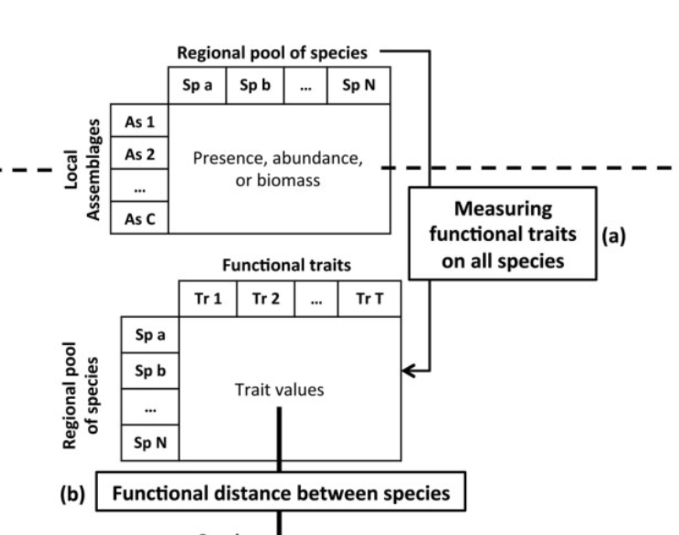
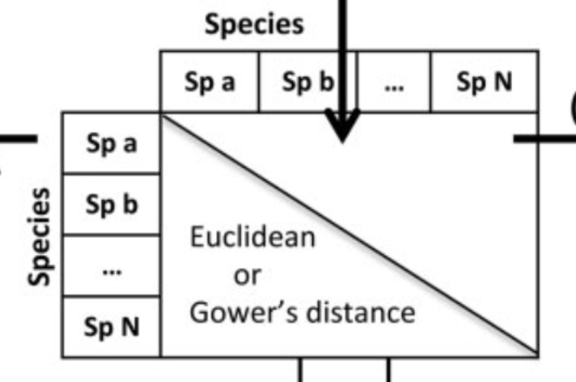
Choosing a distance metric — Euclidean · Gower · Mahalanobis
THEORY
Day 2 · Belém · 15 / 38
Trait-Based Ecology — Day 2 · CWM · FD Indices · Functional Space · Belém, Brazil

Slide 27

Choosing a distance metric — Euclidean · Gower · Mahalanobis
THEORY
All traits are considered
Trait selection
Which? Why?
Trait weight
Log ? Scale?
Trait type
Continuous? Binomial? Categorical?
Day 2 · Belém · 15 / 38
Trait-Based Ecology — Day 2 · CWM · FD Indices · Functional Space · Belém, Brazil

Slide 28
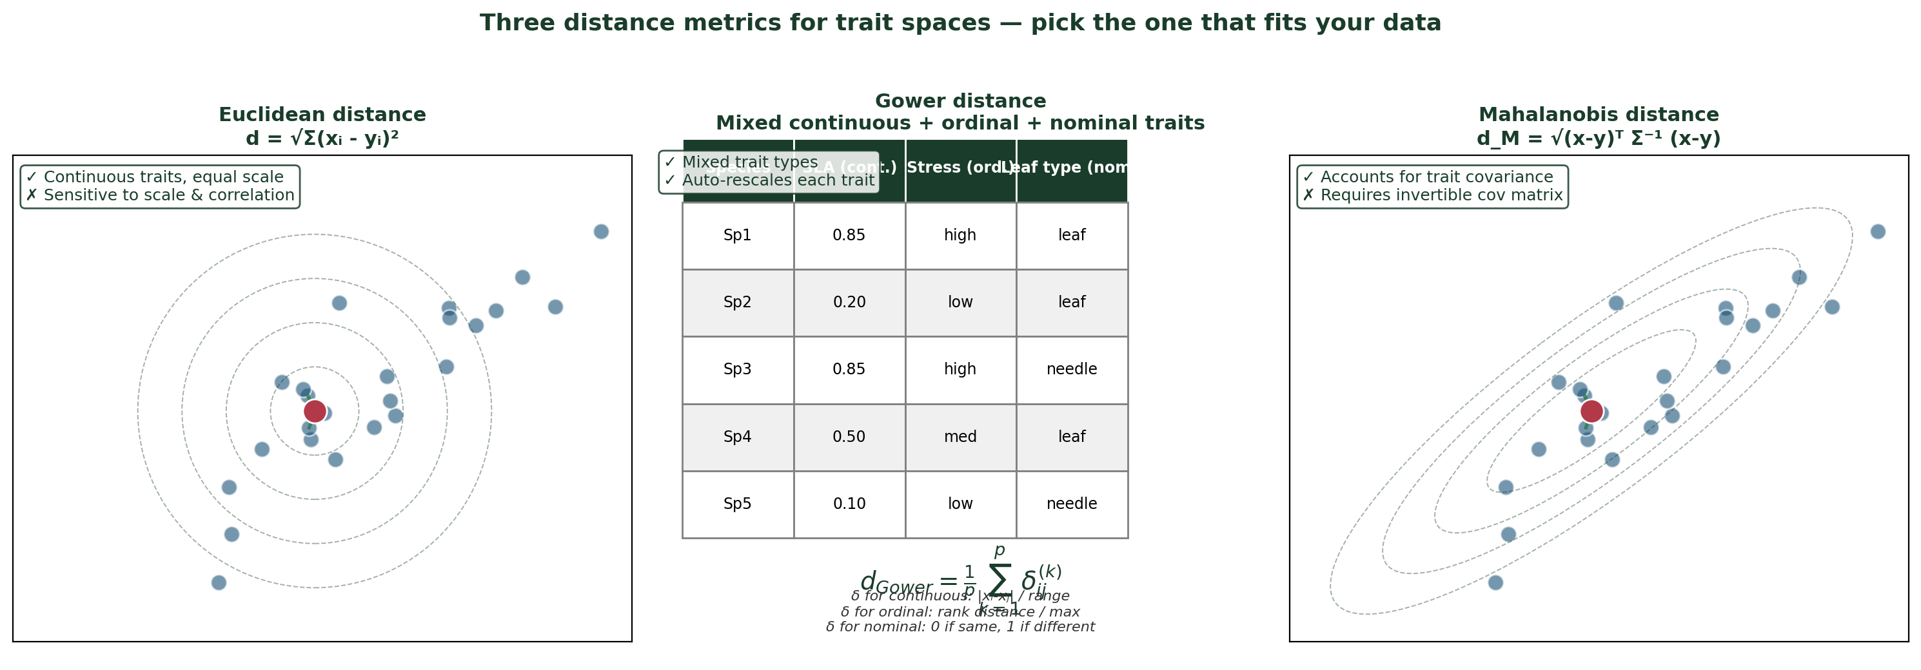
Choosing a distance metric — Euclidean · Gower · Mahalanobis
THEORY
Continuous traits, similar scales
Mixed types (cont. + ord. + nom.)
Strongly correlated traits
→ Euclidean (after scaling)
→ Gower distance
→ Mahalanobis (or PCA pre-step)
Day 2 · Belém · 15 / 38
Trait-Based Ecology — Day 2 · CWM · FD Indices · Functional Space · Belém, Brazil

Slide 29
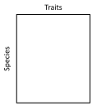
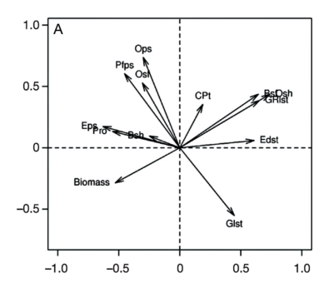
PCoA — from distance matrix to functional space
THEORY
Ordination
analysis
Day 2 · Belém · 15 / 38
Trait-Based Ecology — Day 2 · CWM · FD Indices · Functional Space · Belém, Brazil

Slide 30
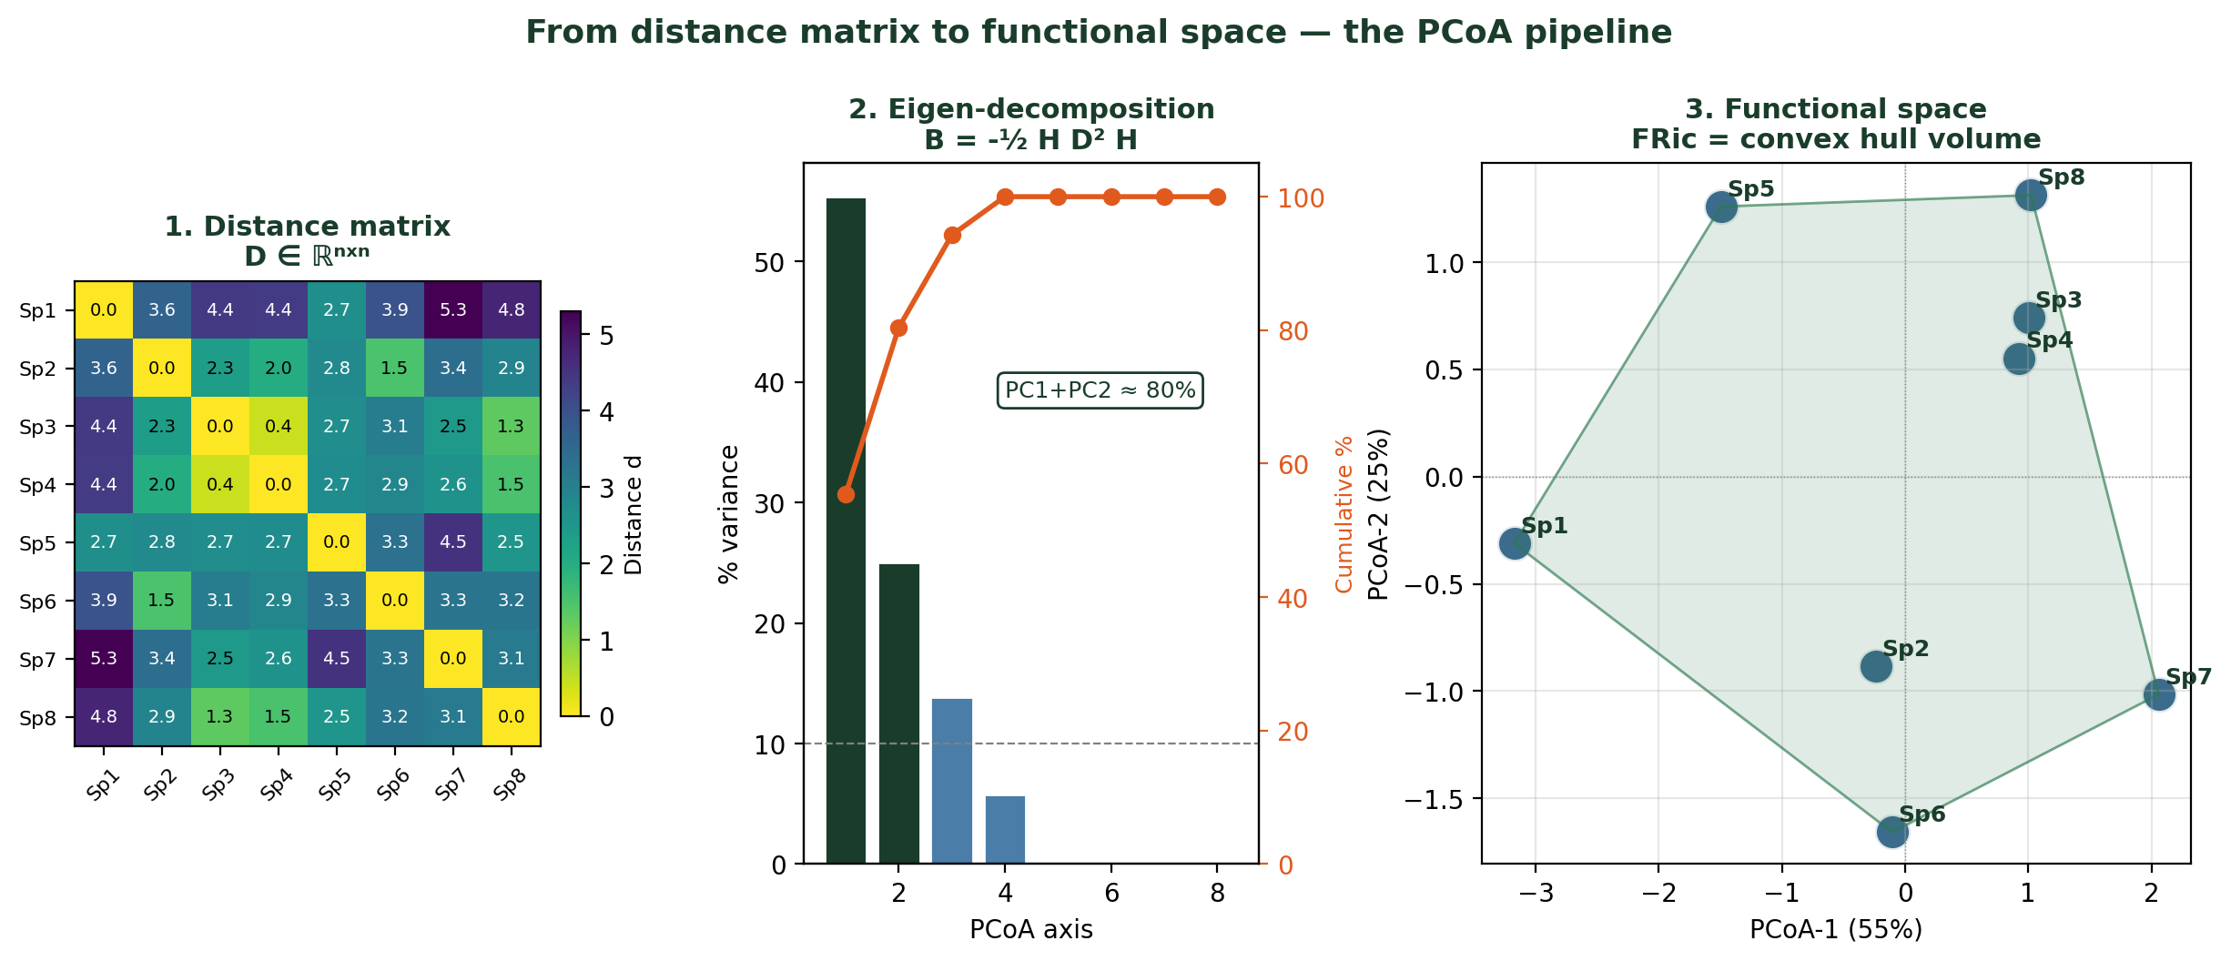
PCoA — from distance matrix to functional space
THEORY
Why PCoA (and not PCA)?
PCoA (Principal Coordinates Analysis, Gower 1966) starts from a DISTANCE MATRIX, not a raw data matrix. It works for any metric distance (Gower, Mahalanobis, …).
If you use Euclidean distance on continuous traits, PCoA gives the same axes as a standard PCA on the trait matrix — but PCoA is more general.
The eigenvalues of the doubly-centred matrix give the % variance explained per axis.
Day 2 · Belém · 15 / 38
Trait-Based Ecology — Day 2 · CWM · FD Indices · Functional Space · Belém, Brazil

Slide 31
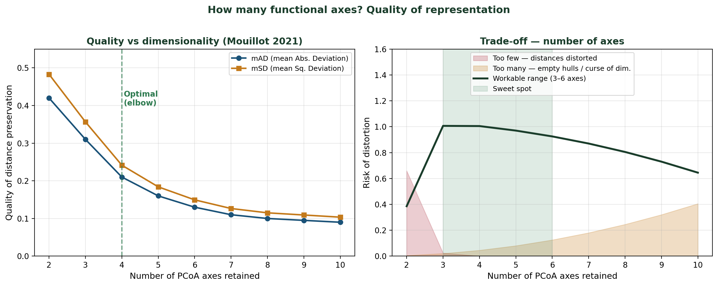
How many axes? Quality of representation
THEORY
mAD / mSD
Sweet spot: 3–6 axes
Decision rule
Mean Absolute / Squared Deviation between original distances and distances reconstructed from the first k PCoA axes. Decreases as k increases — choose where the curve flattens (elbow).
Below 3 axes: distances strongly distorted. Above 6: empty hulls, curse of dimensionality, FRic = 0 in many communities.
Pick the smallest k such that mAD < 0.15 OR cumulative variance > 80 %. Always justify the choice in the methods.
Day 2 · Belém · 15 / 38
Trait-Based Ecology — Day 2 · CWM · FD Indices · Functional Space · Belém, Brazil

Slide 32
Example on mammals
Step 1: Collect Trait Data: Gather functional trait data for the species in the community.
Step 2: Standardize Trait Data: Scale and center the data to ensure traits are comparable.
Step 3: Use Dimensionality Reduction Techniques: Apply Principal Component Analysis (PCA), Multidimensional Scaling (MDS), or PcoA to reduce the number of dimensions.
Step 4: Plot Species in the Reduced Trait Space: Each species is represented as a point in the multi-dimensional space.
REPRODUCTION
SIZE

Slide 33
The functional space of vertebrates and plants
Few dimensions
High lumpiness (hotspot)
Hotpots are close to the extremes (skewed occupation)

Slide 34
Part 3
Functional Diversity
Indices
FRic · FEve · FDiv · FDis — four facets of the same story
Day 2 · Belém · 16 / 38

Slide 35
Functional trait space and community
Species from the community “blue”
Axe 2 de l’ACP
Axe1 de l’ACP

Slide 36
Functional trait space and community
Species from the community “blue”
Axe 2 de l’ACP
Functional diversity of the community ”blue”
Axe1 de l’ACP

Slide 37
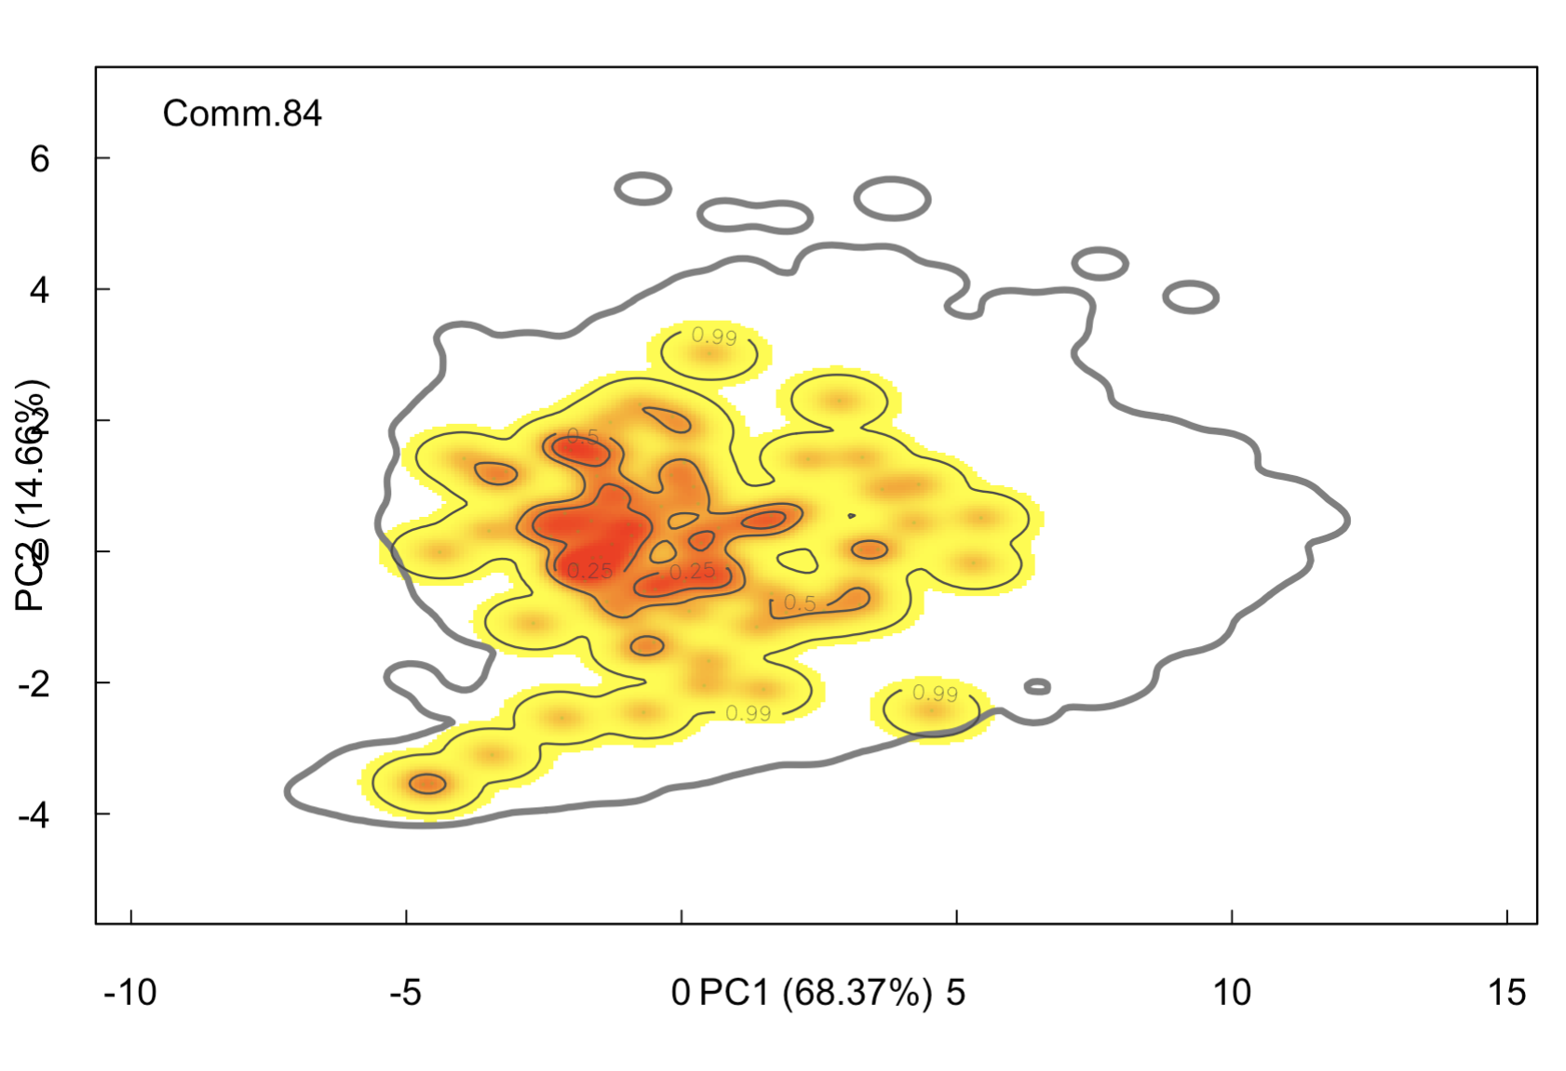
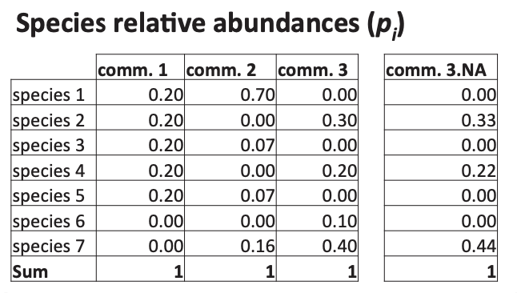
Functional trait space and community

Slide 38
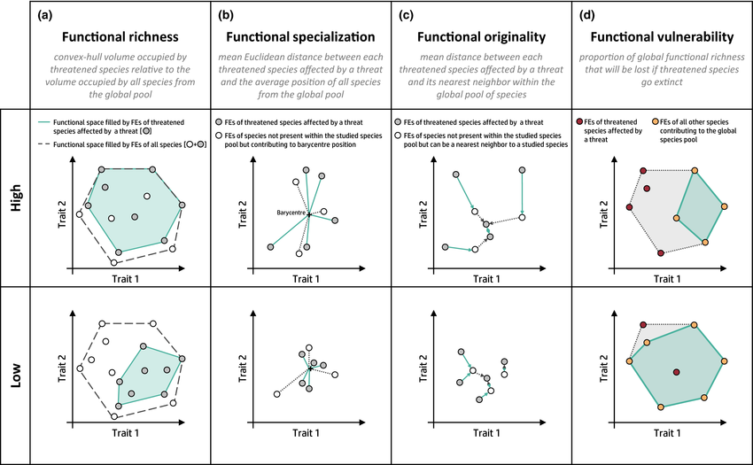
How to calculate functional diversity ?
Definition: Functional diversity (FD) measures the range of functional traits within a community and reflects how species traits are distributed across ecological space.
Importance: FD provides insight into ecosystem functioning, resilience, and stability.

Slide 39
How to calculate functional diversity ?
Functional richness (FRic)
measures the amount of trait space filled by a community. It is calculated by creating a convex hull that encompasses the trait values of all species in the community.
FRic is used to assess how much of the total possible trait space is utilized by species within an ecosystem.
• High FRic indicates that species occupy a wide range of functional roles, contributing to ecosystem processes like productivity or nutrient cycling.
• Low FRic may suggest that functional roles are limited, which can reduce ecosystem resilience and function.

Slide 40
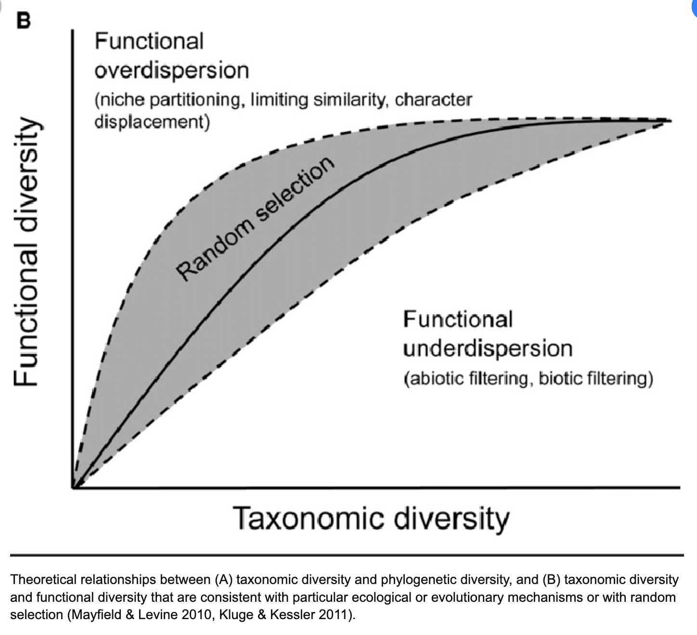
Null model
Functional richness (FRic)
Expected correlation with species richness

Slide 41
Null model
1
Observed functional diversity (FD_{Observed})
FD_{Observed}
N = 10
Species from the community “blue”
Axe 2
Functional diversity of the community ”blue”
Axe1

Slide 42
Null model
1
Observed functional diversity (FD_{Observed})
FD_{Simulated}
2
Simulation of random communities
N = 10
Species pool
Random sp.
Axe 2
Axe1

Slide 43
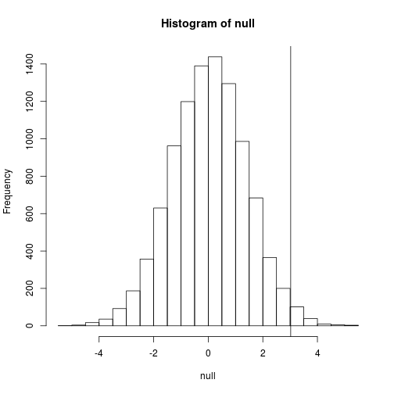
Null model
1
Observed functional diversity (FD_{Observed})
2
Simulation of random communities
3
Comparaison of the FD_{Simul} et de la FD_{Obs}
FD_{Simul}
FD_{Obs}

Slide 44
Null model
1
Observed functional diversity (FD_{Observed})
2
Simulation of random communities
3
Comparaison of the FD_{Simul} et de la FD_{Obs}
4
Standardized effect size
SES = (FD_{Obs} – Mean(FD_{Simul})/SD(FD_{Simul})
p-value = (No. FD_{Simul} > FD_{Obs} )/ No. FD_{Simulés}

Slide 45
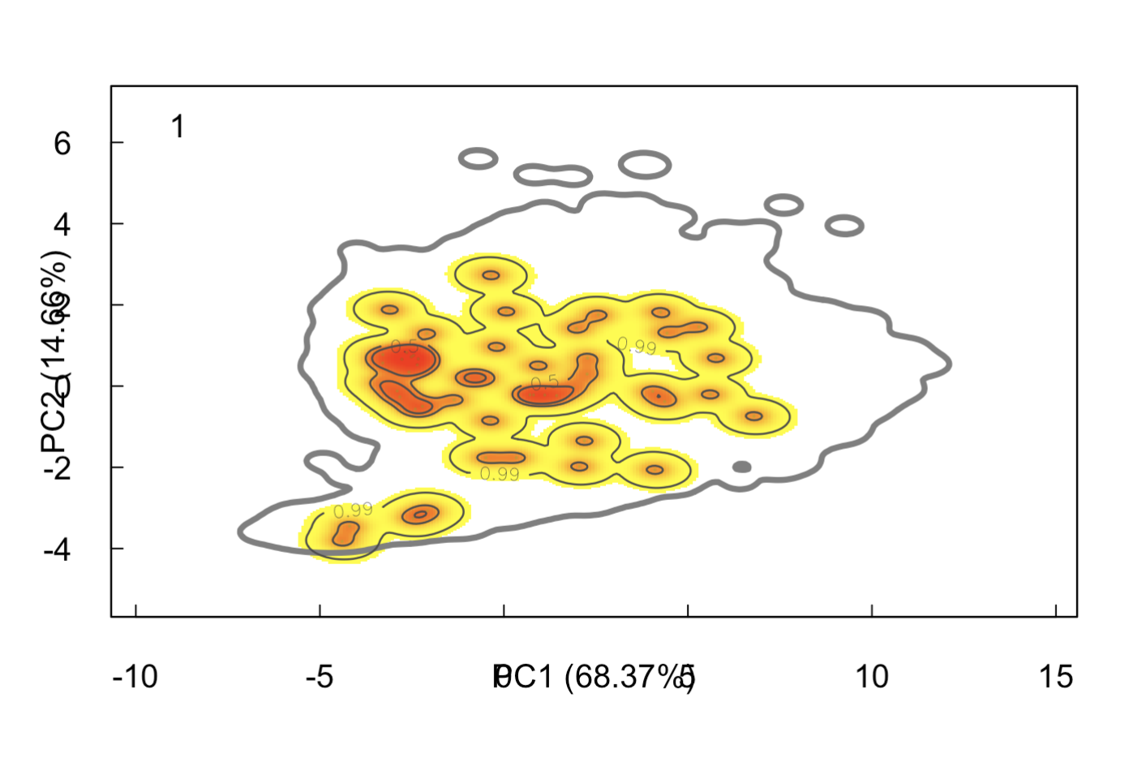
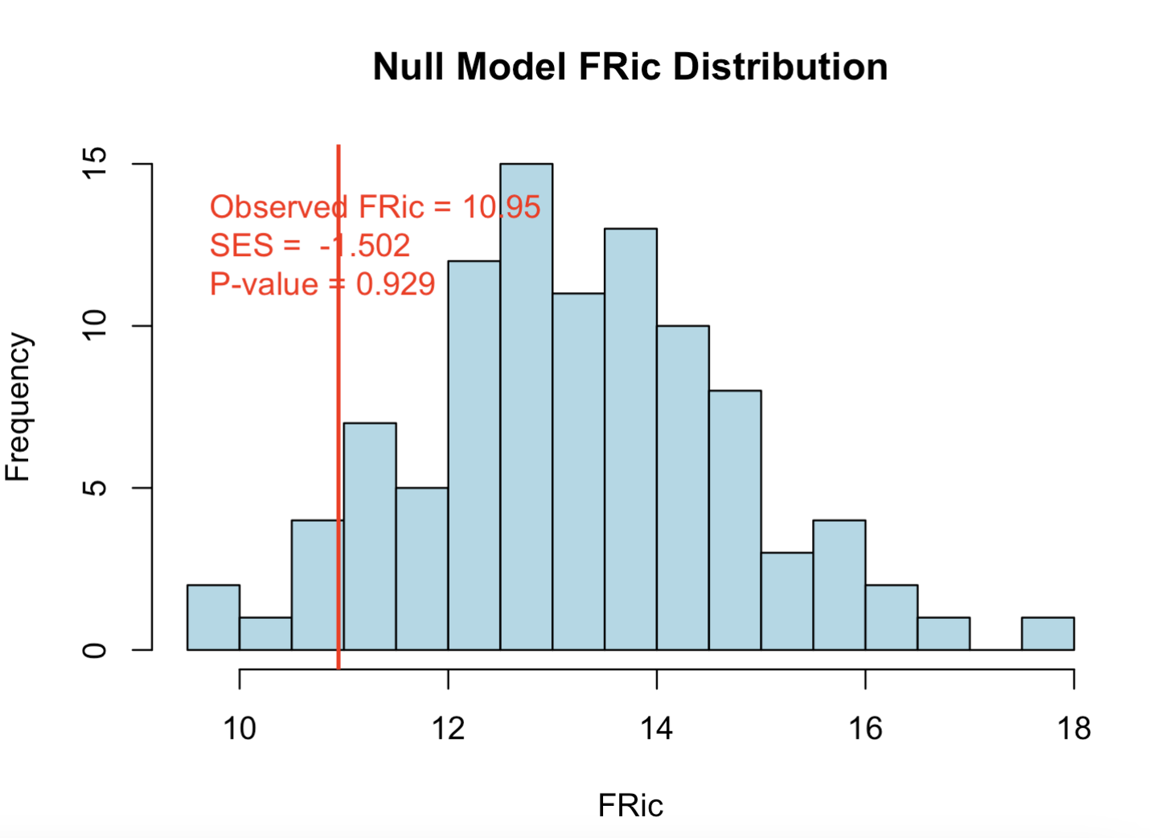
Functional trait space and community

Slide 46
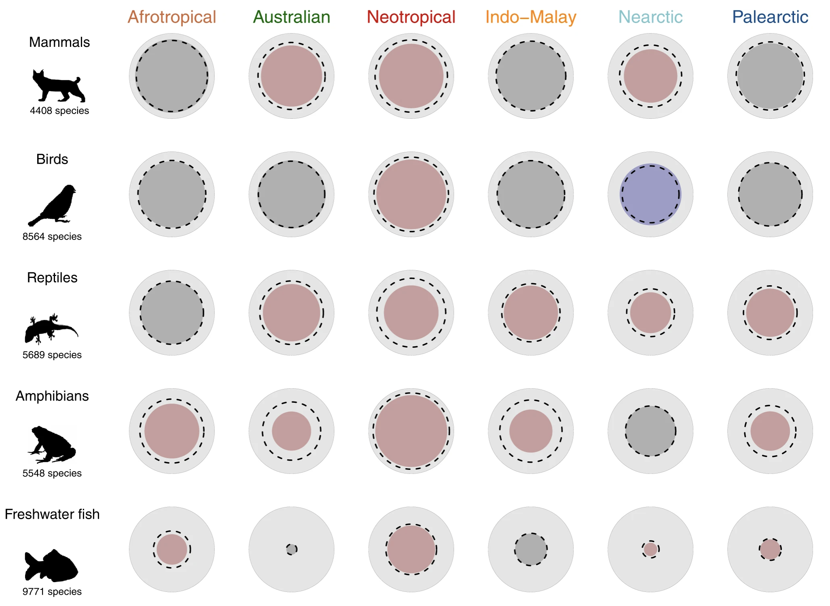
Null model

Slide 47
The four primary FD indices — Villéger et al. (2008) Ecology
THEORY
FRic
Functional Richness
FEve
Functional Evenness
FDiv
Functional Divergence
FDis
Functional Dispersion
Geometry:
Geometry:
Geometry:
Geometry:
Volume of the convex hull enclosing all species in functional space
Regularity of species distribution along the minimum spanning tree in functional space
Weighted deviation of species from the centroid of functional volume
Abundance-weighted mean distance of all species to the weighted centroid
Ecological meaning:
Ecological meaning:
Ecological meaning:
Ecological meaning:
Amount of niche space filled by the community. Reflects the range of strategies present, independently of abundances. Sensitive to extreme (rare) species.
How evenly species fill the functional space. Low FEve = species clustered in one part of trait space, large gaps elsewhere. High FEve = regular packing across the full gradient.
Degree to which abundance is spread toward the extremes of functional space. High FDiv = dominant species have extreme traits. Low FDiv = dominant species cluster near the functional centroid.
Average functional distance between species, weighted by abundance. Closely related to Rao's Q. Robust index — not correlated with SR. The most reliable single FD index.
🌿 Amazon/Brazil:
🌿 Amazon/Brazil:
🌿 Amazon/Brazil:
🌿 Amazon/Brazil:
In Amazon terra firme vs. várzea: FRic is higher in terra firme (more diverse strategies) because seasonal flooding filters out the most conservative extreme strategies in várzea.
Disturbed Cerrado communities often show low FEve: fast-growing ruderals cluster at one extreme, leaving large gaps in conservative strategy space.
Undisturbed terra firme: dominant trees have extreme wood densities (very high or very low) → high FDiv. Degraded pasture edges: dominant exotic grasses cluster in intermediate SLA space → low FDiv.
Multipurpose: can detect functional homogenisation (decrease in FDis) after deforestation even when FRic is maintained by a few rare extreme species that survive the disturbance.
⚠ Very sensitive to species richness — always compare FRic between sites with the same n species, or residualise on SR
⚠ Not correlated with FRic — measures a different facet. A community can have high FRic and low FEve (extreme species but clustered in the middle)
⚠ Measures RELATIVE deviation from centroid — can be high even with low FRic if the few species present have very different strategies
★ Recommended default: FDis is the most reliable index when comparing across communities with different SR. Always report FDis alongside FRic
Day 2 · Belém · 17 / 38
Trait-Based Ecology — Day 2 · CWM · FD Indices · Functional Space · Belém, Brazil

Slide 48
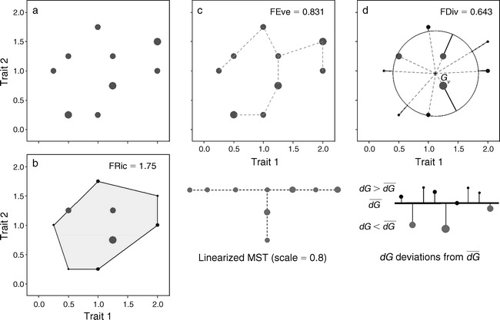
Different facets of functional diversity
Functional Richness (FRic): The range of trait values in a community, reflecting how much of the trait space is occupied.
Functional Evenness (FEve): The regularity with which species traits are distributed across trait space.
Functional Divergence (FDiv): The extent to which species traits differ from the average trait in a community, reflecting niche differentiation.

Slide 49
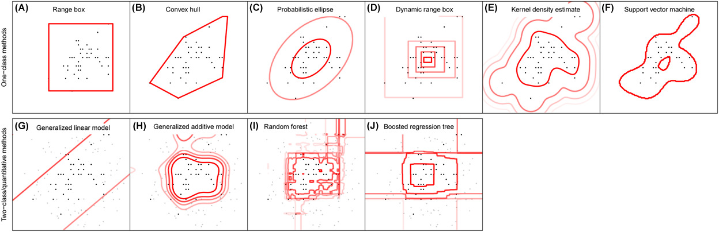
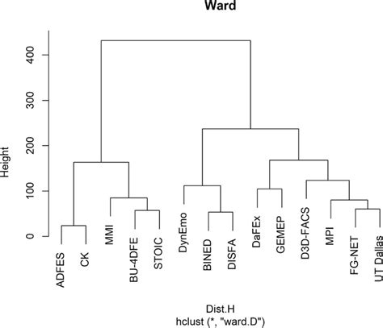
Different approaches to calculate FD
FD: Describes the variety of functional traits in a community and how these traits affect ecosystem functioning.
Common Metrics: Convex hull (functional richness), functional evenness, functional divergence.
Beyond Convex Hull: Other methods like Dendrograms, Trait Probability Density (TPD), and Hypervolumes provide alternative ways to quantify FD.

Slide 50
Different approaches to calculate FD
Dendrogram-Based Quantification of FD
Definition: A dendrogram represents species' trait similarities as hierarchical clusters, where branch lengths reflect trait differences.
FD as Branch Lengths: The sum of branch lengths in the dendrogram represents functional diversity.
Advantages: Good for hierarchical or clustered trait data, and allows visualization of trait relationships.

Slide 51
Different approaches to calculate FD
Dendrogram-Based Quantification of FD
Trait Probability Density (TPD) Approach
Definition: TPD quantifies FD by estimating the probability distribution of trait values in a community.
Probability Distribution: Each species contributes to the overall trait distribution based on its abundance and trait variation.
Advantages: Captures intra-specific trait variation and the probability of encountering different traits in the community.

Slide 52
Part 4
{funspace} — Probabilistic
Functional Trait Spaces
Kernel density · TPD · GAM mapping · Null models
Day 2 · Belém · 31 / 38

Slide 53
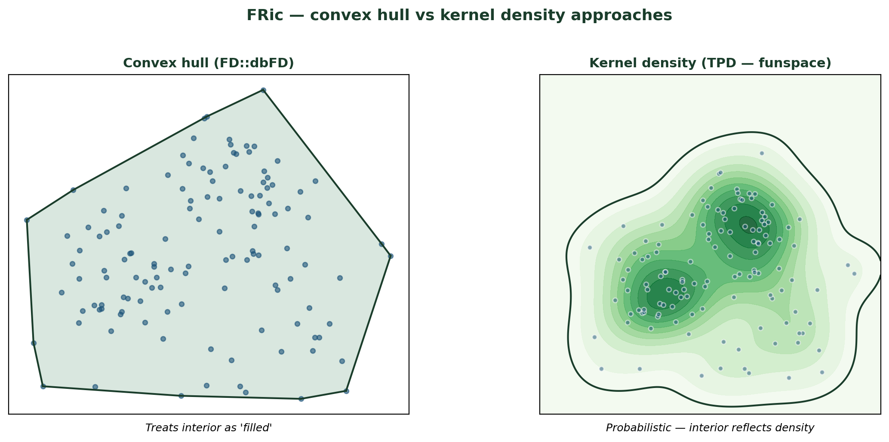
Convex hull vs Kernel density — two ways to define a functional space
THEORY
{funspace} replaces the binary convex hull by a probabilistic Trait Probability Density
Day 2 · Belém · 15 / 38
Trait-Based Ecology — Day 2 · CWM · FD Indices · Functional Space · Belém, Brazil

Slide 54
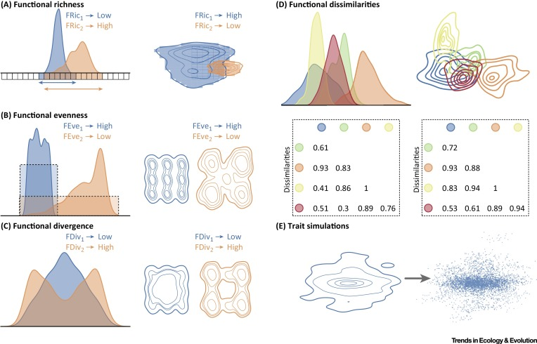
Different approaches to calculate FD

Slide 55
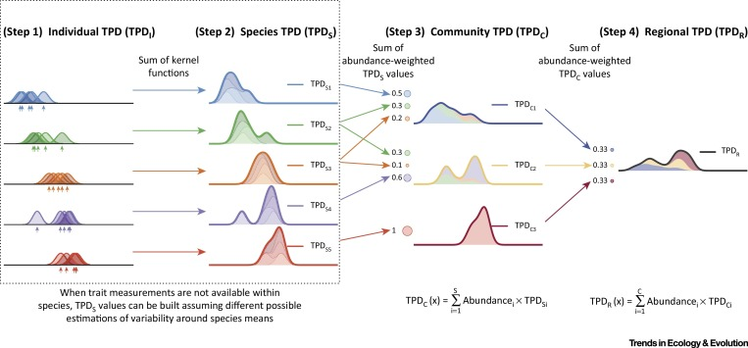
Different approaches to calculate FD

Slide 56
Different approaches to calculate FD
Convex Hull: Simple, but does not account for species abundance or trait distributions.
Dendrogram: Hierarchical, useful for visualizing trait relationships, but may oversimplify trait complexity.
Trait Probability Density: Accounts for abundance and intra-specific trait variation, but requires more complex estimation.

Slide 57
{funspace} — beyond convex hulls: probabilistic trait spaces
THEORY
Limitation of convex hull (FRic):
{funspace} solution — kernel density estimation (TPD):
• The convex hull includes ALL space inside the outer boundary — even if no species occupies the interior
Trait Probability Density (TPD): Instead of a binary 'inside/outside hull', funspace estimates the probability density of trait combinations using a kernel density estimator. The result is a continuous map of where in trait space species are most concentrated — hot spots and cold spots.
• A community with 2 extreme species and 1 interior species has the same FRic as one with species evenly filling the hull
• Sensitive to sample size and to single outlier species (one extreme individual can inflate FRic dramatically)
funspace(x, PCs, group.vec, threshold)
Builds the functional space from a PCA object or raw traits. Computes kernel density TPD for the global pool and per group (e.g. per PFT, per community, per biome). Returns FRic and FDiv based on TPD.
• Cannot visualise WHERE in trait space the community is most dense or most sparse
funspaceGAM(x, var, group.vec, family)
Maps a THIRD VARIABLE (e.g. IUCN status, extinction probability, biomass, latitude) onto the functional space using a Generalized Additive Model. The GAM surface shows how the variable relates to functional position.
funspaceNull(x, iterations, method)
Generates null model distributions of functional space by randomising species identity. Tests whether observed FRic differs from random expectation. Returns effect size and p-value. Two methods: multivariate normal or square null.
plot(x, type, quant.plot, pnt)
Flexible high-quality plotting. type='global' shows global kernel density. type='groups' shows per-group density with overlap. quant.plot=TRUE adds quantile contour lines (0.25, 0.50, 0.99). pnt=TRUE overlays raw species points.
Day 2 · Belém · 33 / 38
Trait-Based Ecology — Day 2 · CWM · FD Indices · Functional Space · Belém, Brazil

Slide 58
{funspace} — complete R workflow
R CODE
# STEP 1 — Build functional space from PCA
library(funspace)
pca_traits <- princomp(trait_mat_sc, cor = FALSE) # PCA on scaled traits
# funspace() with groups = PFT
fs_global <- funspace(
x = pca_traits, # PCA object
PCs = c(1, 2), # use axes 1 and 2
group.vec = sp_traits$PFT_label, # group membership per species
threshold = 0.95 # functional space = 95% kernel density volume
)
summary(fs_global) # FRic and FDiv per group
plot(fs_global, type = 'global') # kernel density map of global space
plot(fs_global, type = 'groups', quant.plot = TRUE, pnt = TRUE,
pnt.cex = 0.6, pnt.col = 'steelblue',
axis.title.x = 'PC1 (fast–slow gradient)',
axis.title.y = 'PC2 (size–reproduction)')
# STEP 2 — Map a third variable onto the functional space
# Map: mean IUCN weight per species onto the space
iucn_weights <- c(LC=0, NT=0.1, VU=0.1, EN=0.667, CR=0.999)
threat_vec <- iucn_weights[sp_traits$IUCN_status]
fs_gam <- funspaceGAM(
x = fs_global,
var = threat_vec, # variable to map
family = gaussian() # or binomial() for 0/1 variables
)
plot(fs_gam) # shows where in trait space species are most threatened
# STEP 3 — Null model test: is FRic different from random?
fs_null <- funspaceNull(
x = fs_global,
iterations = 999,
method = 'mvnorm' # multivariate normal null
)
summary(fs_null) # p-value and effect size
★ funspace uses KERNEL DENSITY, not convex hull. FRic from funspace ≠ FRic from dbFD(). The threshold parameter controls which proportion of trait space is considered 'occupied' (0.95 = the 95% probability volume).
Day 2 · Belém · 34 / 38
Trait-Based Ecology — Day 2 · CWM · FD Indices · Functional Space · Belém, Brazil

Slide 59
R Practical — Day 2
CWM · FD Indices · Functional Space
{FD} + {funspace}
1
CWM & FD with {FD}
2
PCoA functional space
3
funspace() — global space
cwm <- functcomp(trait_mat_sc, comm_mat)
fd <- dbFD(x=trait_mat_sc, a=comm_mat,
calc.FRic=TRUE, stand.x=FALSE)
d <- dist(trait_mat_sc,'euclidean')
pc <- cmdscale(d,k=2,eig=TRUE)
# Visualise species + PFT ellipses
pca_t <- princomp(trait_mat_sc)
fs <- funspace(pca_t, PCs=c(1,2),
group.vec=sp_traits$PFT_label)
summary(fs) ; plot(fs,'groups')
Day 2 · Belém · 36 / 38
4
funspaceGAM() — map threat
5
funspaceNull() — test FRic
6
FD vs. environment
iucn_w <- c(LC=0,NT=.1,VU=.1,
EN=.667,CR=.999)[sp_traits$IUCN_status]
fs_gam <- funspaceGAM(fs, iucn_w)
plot(fs_gam, quant.plot=TRUE)
fs_null <- funspaceNull(fs,
iterations=999, method='mvnorm')
summary(fs_null) # p-value + ES
fd_env <- left_join(fd_df, env)
ggplot(fd_env, aes(elevation,FDis))+
geom_point()+geom_smooth(method='loess')

Slide 60
Day 2 —exercises
EXERCISES
Q1 — CWM and the mass-ratio hypothesis
Q2 — FRic sensitivity and SR confounding
a) Compute CWM for all 5 traits (SLA, LDMC, LeafN, Height, SeedMass). Plot CWM(Height) vs. disturbance index. Which PFT drives the pattern?
a) Compute FRic, FEve, FDis for all 40 plots. Identify the 3 plots with highest and lowest FDis. What are their elevations and disturbance levels?
b) Compute the correlation matrix between all 5 CWMs and all 5 environmental variables. Which trait × environment pair shows the strongest CWM association?
b) Compute Pearson correlation between SR and FRic, SR and FDis. Which index is more confounded by species richness? Propose a method to separate FD from SR effects.
c) Partial regression: CWM(SLA) ~ elevation + disturbance. After controlling for elevation, does disturbance still have a significant independent effect on CWM(SLA)?
c) Re-run dbFD using only 2 traits (SLA + LDMC) vs. all 5. How much does FRic change? Visualise the sensitivity as boxplots across all trait combinations.
Q3 — {funspace} — probabilistic trait space
Q4 — Functional rarity and originality
a) Build the funspace object with group.vec = PFT_label (5 groups). Run summary() and plot(type='groups'). Which PFT occupies the largest functional space? Which the smallest?
a) Compute functional originality for each species (mean distance to ALL other species in PCoA space). Plot originality vs. IUCN threat weight. Are functionally original species more threatened?
b) Use funspaceGAM() to map IUCN extinction weight onto the functional space. Describe: where in the LES space are threatened species concentrated? Is this consistent with the FUSE results from Day 3?
b) Map functional originality onto the funspace object using funspaceGAM(). Identify the 2 regions of trait space with highest originality. Name 2 species that occupy each region.
c) Run funspaceNull() with 999 iterations. Is the observed FRic significantly different from the null expectation? What does a significant test mean ecologically?
c) Discussion (≥100 words): what is the difference between functional rarity, functional originality, and FUn (nearest-neighbour distance)? When would you use each metric?
Day 2 · Belém · 37 / 38
Trait-Based Ecology — Day 2 · CWM · FD Indices · Functional Space · Belém, Brazil

Slide 61
Take-Home Messages — Day 2
1
CWM captures the DOMINANT strategy in the community (mass-ratio hypothesis). Two communities can have the same CWM but completely different FD — always report both.
2
FRic, FEve, FDiv and FDis measure different, mathematically independent facets of functional diversity. FDis is the most robust to species richness differences and should always be reported.
3
The convex hull (FRic) assumes all interior trait space is equally filled — a known limitation. {funspace} kernel density estimation (TPD) provides a probabilistic, more realistic representation.
4
funspaceGAM() maps any third variable (extinction risk, elevation, abundance) onto the functional space — revealing WHERE in trait space threats or processes are concentrated.
5
Functionally rare and original species are disproportionately important: their loss causes irreversible erosion of functional space. In Amazonia, large-bodied species are functionally rare AND threatened.
Day 3 → Trait–Environment Relationships (RLQ + Fourth-corner) & Extinction Consequences (FUSE)
Day 2 · Belém · 38 / 38

