Slide 1







Developer Survey Results
Aurelia Julia Corvia
6/19/2024

Slide 2



OUTLINE
Executive Summary
Introduction
Methodology
Results
Visualization – Charts
Dashboard
Discussion
Findings & Implications
Conclusion
Appendix

Slide 3

EXECUTIVE SUMMARY
Introduction to Survey
Methodology
Languages Used
Visualization tools
Analysis tools
Results of the survey
Implications of the data
Summary and moving forward

Slide 4

INTRODUCTION
Stack Overflow’s survey of developers is a large and comprehensive survey
A random sample of this data was taken to draw conclusions
Includes current usage statistics and predicted language growth
Includes developer demographics
Results of education level
Gender distribution

Slide 5

METHODOLOGY
Web Scrapping and data gathering
Using Python and its module, BeautifulSoup and APIs
Data Wrangling
Cleaning data by removing duplicates and missing values
Used NumPy and Pandas – Python libraries
Data Analysis
Usage of Pandas and Seaborn – python libraries
Used these for analysis of correlation, finding outliers, trends in data
Used Python and SQL to generate charts to explore data
Data Visualization
Used Python to generate exploratory charts
Used IBM Cognos to generate dashboards for presentation of data insights

Slide 6
RESULTS

Slide 7
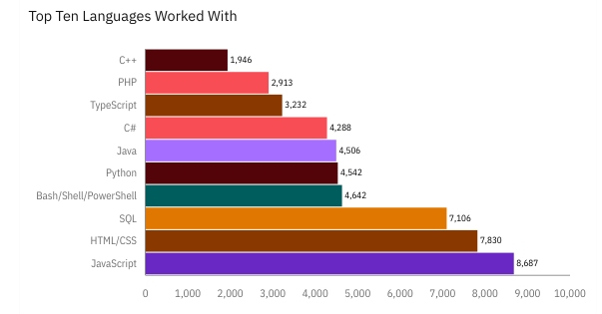
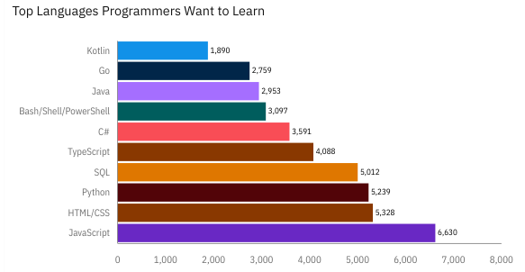
PROGRAMMING LANGUAGE TRENDS
Current Year
Next Year

Slide 8
PROGRAMMING LANGUAGE TRENDS - FINDINGS & IMPLICATIONS
Findings
JavaScript is the top language used and that programmers want to learn
Kotlin and Go are new languages showing up on the list of languages desired for use
Python, SQL, and HTML/CSS are not top languages, but solid in the amount of use and interest
Implications
JavaScript shows the potential for the most growth
Kotlin and Go – both languages in use for Google – have generated interest in programmers
Full stack development – Python, JavaScript, HTML/CSS – show consistent interest and use

Slide 9
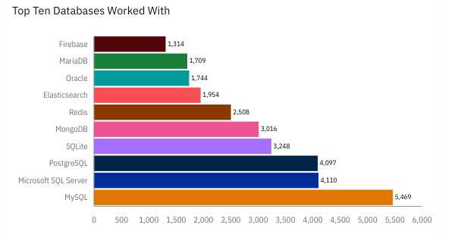
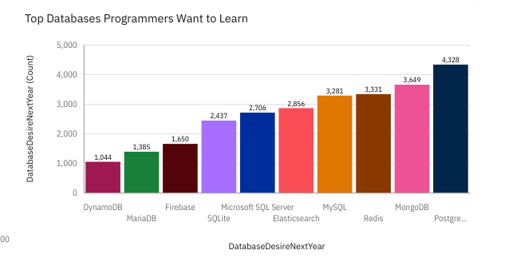
DATABASE TRENDS
Current Year
Next Year

Slide 10
DATABASE TRENDS - FINDINGS & IMPLICATIONS
Findings
MySQL is the most used database
MongoDB and Redis have interest from developers
Microsoft, Progestre, and MySQL are the top three databases used
Implications
With a lead in usage and interest, MySQL is a good choice for database use with its developer base
MongoDB and Redis show potential for growth
With interest in them, the top three databases do not seem to be in danger of changing

Slide 11

DASHBOARD
https://github.com/Aurelia-J-C/IBM_Final_Project_Corvia/blob/main/IBM%20final%20Project.pdf

Slide 12
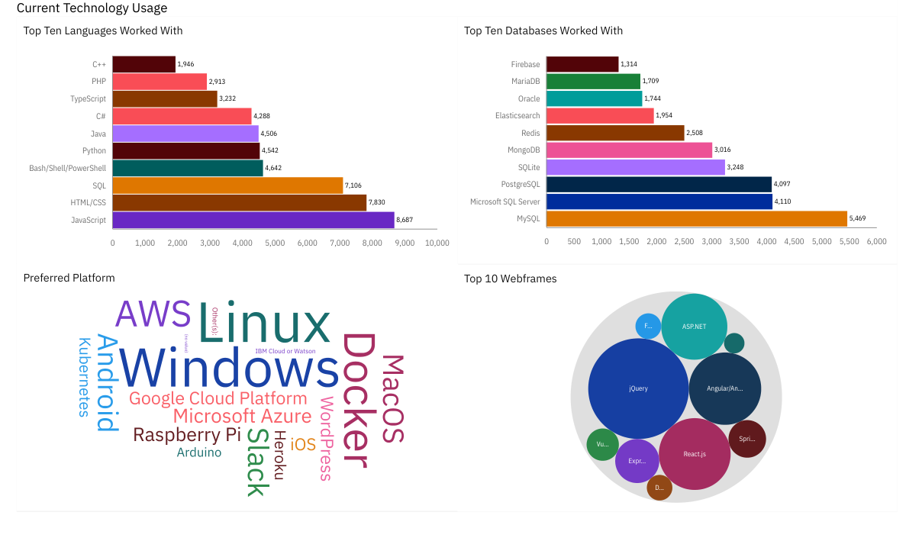
DASHBOARD TAB 1

Slide 13
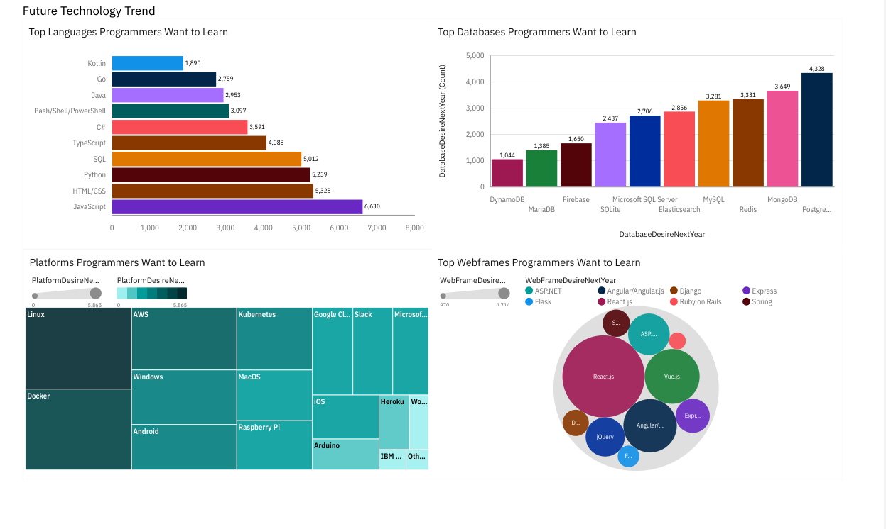
DASHBOARD TAB 2

Slide 14
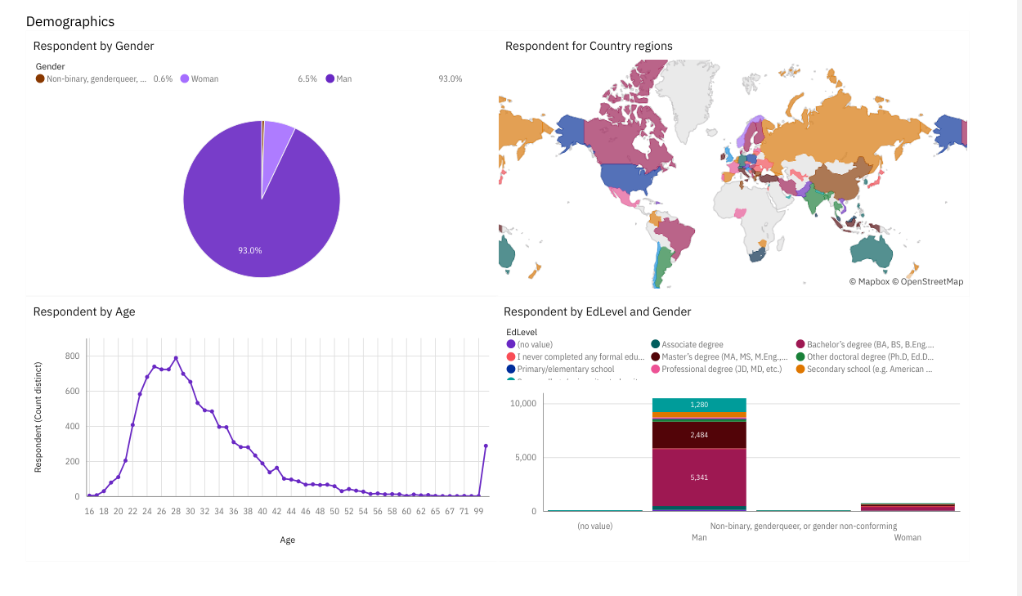
DASHBOARD TAB 3

Slide 15
DISCUSSION

Slide 16
OVERALL FINDINGS & IMPLICATIONS
Findings
The vast majority of respondents identified as male
Most developers have a formal education
Linux, Docker, and AWS are three platforms with interest
Implications
Further research could be done to see how the developer environment treats gender minorities
What space does the developer environment have for self taught programmers?
Potential for more Linux integration could drive sales

Slide 17

CONCLUSION
JavaScript shows the most potential for growth with an already solid userbase
MySQL, Microsoft SQL, and Progestre SQL show solid userbases and interest
Google languages like Kotlin and GO show increased interest
Linux integration could attract more developers

Slide 18

APPENDIX
Further insights
Major city centers show the most developer job postings
Further research into remote work could lead to more insights

Slide 19
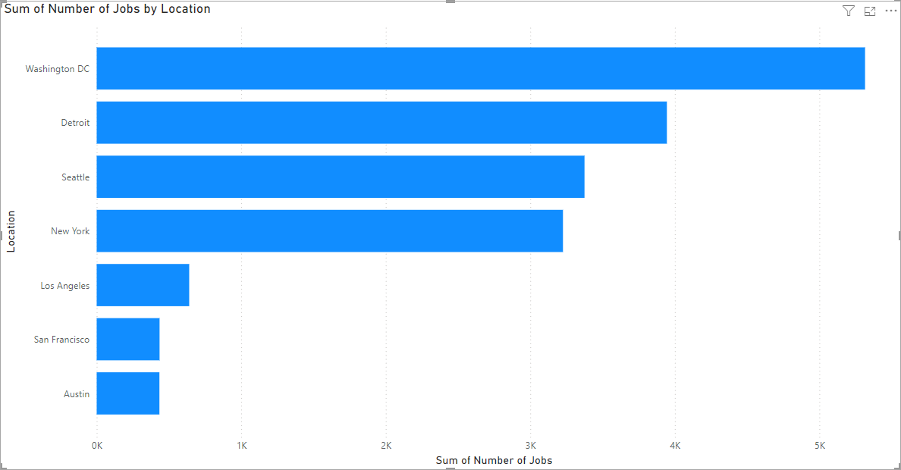
JOB POSTINGS

Slide 20
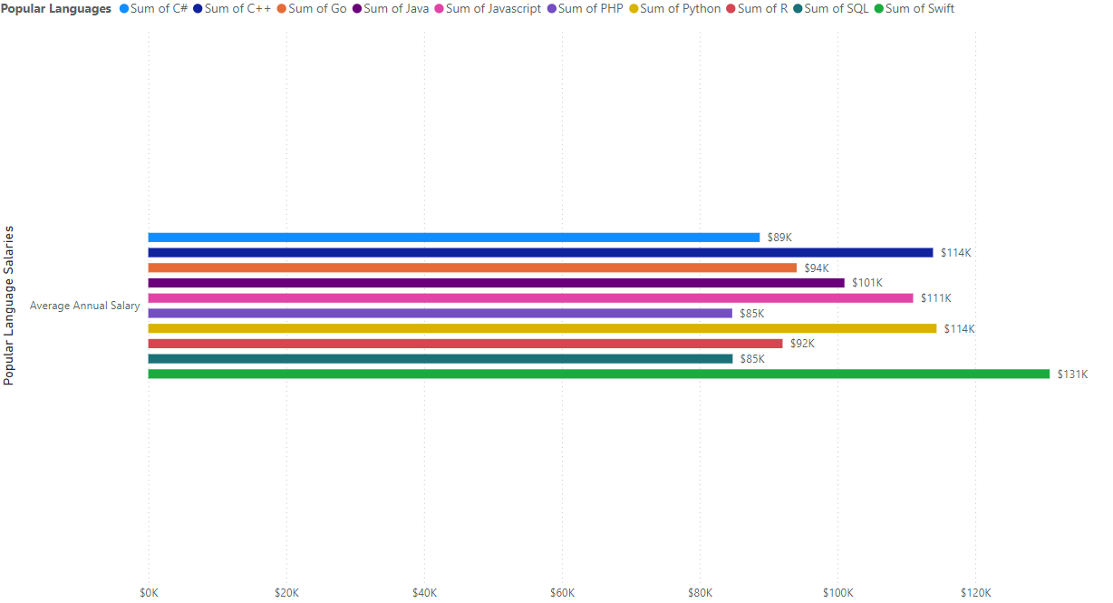
POPULAR LANGUAGES

Slide 21
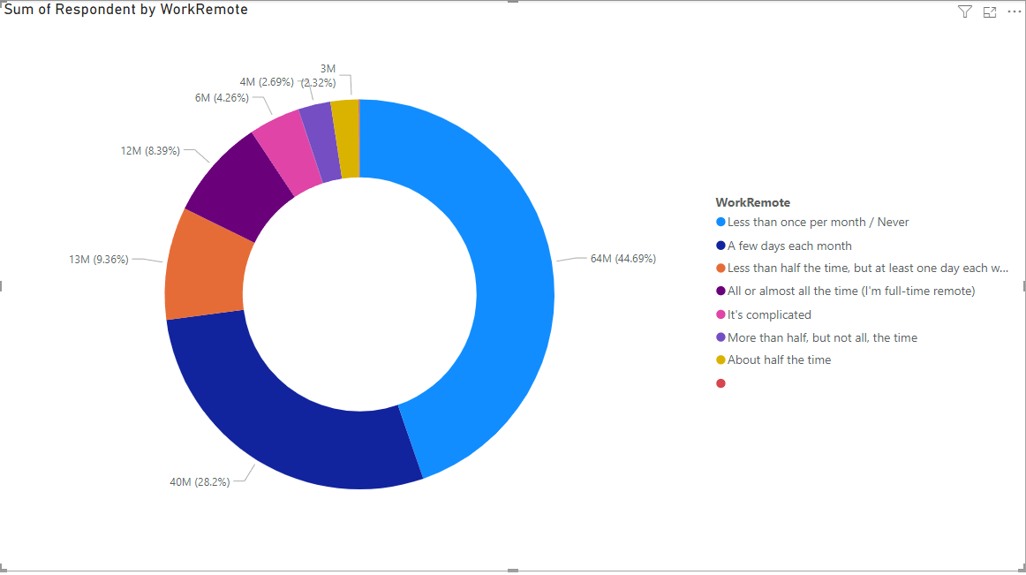
Percentage Remote

