Slide 1
NATIONAL ECONOMICS UNIVERSITY
Board of Management of Advanced Education Programs
BACHELOR THESIS
Hedonic Price Decomposition
and Promotional Erosion
A Case Study on Winmart
STUDENT
Trần Hiếu My
STUDENT ID
11224401
MAJOR
Business Administration
PROGRAM
Business Analytics 64
SUPERVISOR
Dr. Nguyễn Mạnh Thế
MENTOR
Dr. Đinh Thị Hồng Thêu
Hanoi • 2026

Slide 2
TABLE OF CONTENTS
A roadmap for the next fifteen minutes
01
INTRODUCTION
02
CHAPTER 1 — LITERATURE REVIEW
motivation · research question · objectives
hedonic theory · 4-quadrant brand typology
03
CHAPTER 2 — METHODOLOGY
04
CHAPTER 3 — EMPIRICAL APPLICATION
data · hedonic specification · dual-price design
pooled regression · per-category · promotional erosion
05
CHAPTER 4 — DISCUSSION & RECOMMENDATIONS
06
CONCLUSION
three principal findings · limitations
what did we learn · Q & A

Slide 3
01
INTRODUCTION
Motivation, Question, Objectives
Why this study · what it asks · how it goes about answering

Slide 4
SECTION A — OPENING
Two Prices, One Product
A puzzle hiding in plain sight on Vietnamese online grocery
2,286
unique products tracked
— illustrative product —
−12.5%
88
consecutive days of scraping
Sữa tươi tiệt trùng có đường — 1 lít
Marked price: 29,500 ₫
10
food categories, 40 sub-categories
Final price
25,800 ₫
Most products on Winmart show two prices — and the gap is not random.
Trần Hiếu My | Business Analytics 64 | NEU 2026

Slide 5
SECTION A — OPENING
Research Question & Objectives
RESEARCH QUESTION
What product attributes generate price premiums in Vietnamese online grocery, and to what extent do promotional pricing strategies erode those premiums?
01
02
03
IDENTIFY
MEASURE
COMPARE
Which product attributes (brand, recognition, premium tier, import, health claims, pack size) generate statistically significant price premiums.
How promotional discounts erode those premiums at checkout — exploiting the dual-price structure of Winmart listings.
How attribute premium structures vary across the ten product categories — heterogeneity beneath the pooled average.
Trần Hiếu My | Business Analytics 64 | NEU 2026

Slide 6
02
CHAPTER 1
Literature Review & Theoretical Framework
Hedonic theory · brand equity dimensions · the four-quadrant typology

Slide 7
SECTION B — THEORETICAL FRAMEWORK
Hedonic Theory — Goods as Attribute Bundles
A 50-year intellectual lineage in three steps
1966
1974
2004
LANCASTER
ROSEN
EKELAND ET AL.
Utility comes from attributes, not goods.
The implicit price ∂P/∂zᵢ is the equilibrium hedonic price.
First-stage interpretation only.
A consumer buying a bottle of milk is buying volume, calcium, brand reputation, and shelf-life — not "milk" as an indivisible unit.
In market equilibrium, each attribute carries an implicit price recoverable by regressing observed prices on attributes.
We recover the price function — not structural demand or supply parameters. This thesis respects that boundary throughout.
This thesis estimates a Rosen first-stage hedonic price function on Winmart listings.
Trần Hiếu My | Business Analytics 64 | NEU 2026

Slide 8
SECTION B — THEORETICAL FRAMEWORK
Brand Equity — The Four-Quadrant Typology
Decomposing the conventional brand premium into orthogonal dimensions
PERCEIVED QUALITY (Aaker, 1991) →
Operationalized as
HOUSEHOLD
GIANTS
PREMIUM
SPECIALISTS
is_branded
any identifiable brand name (1,581 products, 69.2%)
high recognition · low price
high recognition · high price
is_premium
BRAND RECOGNITION (Keller, 1993) ↑
price > subcategory median (452 products, 19.8%)
GENERIC
BRANDED
NICHE
PREMIUM
is_high_recognition
~30 nationally distributed brands (709 products, 31.0%)
low recognition · low price
low recognition · high price
is_house_brand
WinEco / WinMart private label (21 products, 0.9%)
low price-tier
high price-tier
Trần Hiếu My | Business Analytics 64 | NEU 2026

Slide 9
SECTION B — THEORETICAL FRAMEWORK
Online Prices as a Reliable Data Source
Why web-scraped prices are economically meaningful — four pillars of empirical validity
CAVALLO (2017)
72%
SCHIPMANN & QAIM (2011)
1 channel
Online prices ≈ offline prices
Single retailer = clean identification
56 countries · 10 multi-channel retailers. 72% of identical products carry identical prices in both channels. Online prices reflect the same pricing strategy — Winmart's scraped prices are representative, not a digital artefact.
Retail format (wet market vs supermarket vs premium) creates structural price variation that reflects rent, branding, customer base — NOT product attributes. Single-retailer design eliminates format confounding.
HÜLTEN (2002)
88 days
SINGH ET AL. (2020) · TRAN ET AL. (2025)
dual-price
Daily data captures promo dynamics
Consumers actually use these prices
Survey-based CPIs aggregate over reporting periods, smoothing out within-period promotional dynamics. The 88-day daily panel captures the full promotional trajectory — introduction, duration, removal — that monthly data averages away.
Vietnamese online grocery shoppers are price-aware and comparison-oriented; transparency drives digital adoption. The marked / final dual-price display on Winmart is not decorative — it is a deliberate signal consumers act on.
Together: web-scraped daily dual-price data on Winmart is economically meaningful, format-clean, temporally rich, and consumer-relevant.
Trần Hiếu My | Business Analytics 64 | NEU 2026

Slide 10
03
CHAPTER 2
Methodology
Data pipeline · hedonic specification · the dual-price design

Slide 11
SECTION C — METHODOLOGY
Data — Winmart, 88 days, 10 categories
15 robots scraping daily, 18 Dec 2025 → 15 Mar 2026
15 SCRAPING ROBOTS
API SERVER
RAW JSON
CLEANED CSV
PRODUCT DATASET
auto_crawl.py · daily HTTP PUT
localhost:8080 · JWT auth
run_YYYY-MM-DD_RunID.json
one file per day, per category
2,274 products · time-averaged
VARIABLE SCHEMA
TEN PARENT CATEGORIES
product_name
Vietnamese product name (NLP source)
Sữa Tươi · Dairy
Rau-Củ-Trái Cây · Fresh Produce
unit
declared selling unit
Thực Phẩm Khô · Dry Food
Mì-Thực Phẩm Ăn Liền · Instant Food
final_price
checkout price (sale / discounted) in VND
marked_price
sticker price (original) in VND
Thực Phẩm Chế Biến · Processed Food
Thực Phẩm Đông Lạnh · Frozen
product_url
product detail page
Trứng-Đậu Hũ · Eggs & Tofu
Bánh Kẹo · Confectionary
scrape_timestamp
YYYY-MM-DD HH:MM:SS · Asia/Ho_Chi_Minh
run_id
crawler run identifier
Gia Vị · Spices
Chăm Sóc Bé · Baby Products
Trần Hiếu My | Business Analytics 64 | NEU 2026

Slide 12
SECTION C — METHODOLOGY
Hedonic Specification
Log-linear OLS · 10 features · 40 sub-category fixed effects · cluster-robust SE
ln(P / unit) = α + β₁·is_branded + β₂·is_premium + β₃·is_high_recognition + β₄·is_import + β₅·is_house_brand
+ β₆·ln(pack_size) + β₇·pack_count + β₈·has_health_claim + β₉·has_freshness_claim + β₁₀·name_length
+ γ · subcategory_FE + ε
2,203
40
10
0.64
products in regression sample
sub-categories as fixed effects
product-level NLP regressors
adjusted R², both specifications
(post sparse-product filter)
(cluster level for SE)
(brand, origin, pack, health)
(marked vs final)
Why log-linear, not Box-Cox: standard in food hedonics (Malpezzi 2002; Costanigro & McCluskey 2011); preserves the percentage-premium interpretation that is the entire point of the decomposition.
Estimated TWICE — once on ln(marked_price / unit), once on ln(final_price / unit). Same regressors. Same FE. Same SE. Different dependent variable.
Trần Hiếu My | Business Analytics 64 | NEU 2026

Slide 13
SECTION C — METHODOLOGY
Dual-Price Design
The methodological contribution of this thesis
SPECIFICATION A — MARKED
SPECIFICATION B — FINAL
Dependent variable:
Dependent variable:
ln(marked_price / unit)
ln(final_price / unit)
Recovers sticker-price implicit attribute prices — what the retailer signals on the virtual shelf.
Recovers checkout-price implicit attribute prices — what the consumer actually pays.
EROSION (%) = ( β_marked − β_final ) / β_marked × 100
Positive → premium shrinks at checkout Negative → premium grows
DESCRIPTIVE, NOT CAUSAL — We document patterns; we do not identify the retailer's pricing decision.
Trần Hiếu My | Business Analytics 64 | NEU 2026

Slide 14
04
CHAPTER 3
Empirical Application
88 days · 2,286 products · pooled regression · per-category · promotional erosion

Slide 15
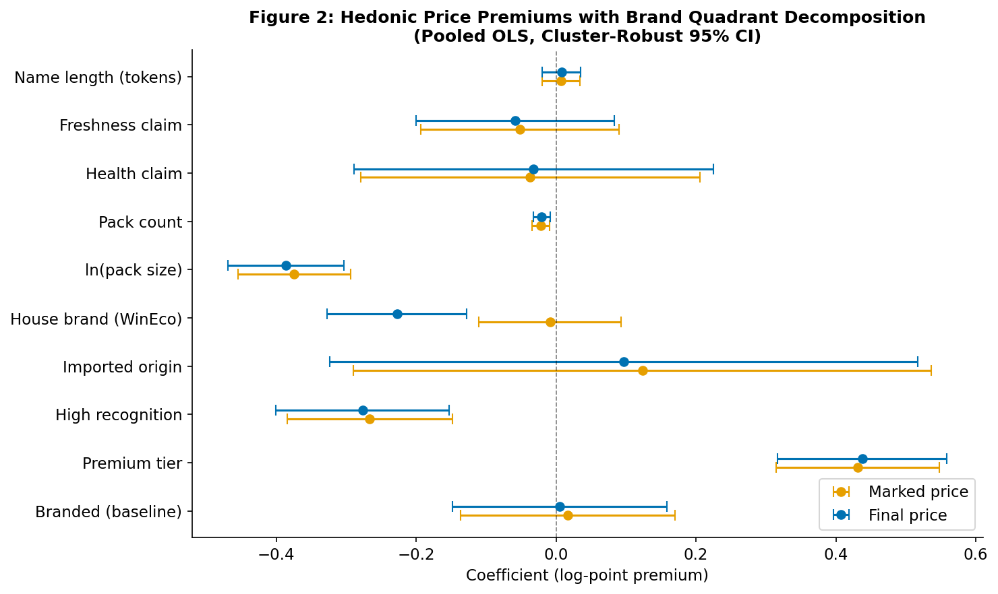
SECTION D — RESULTS
Pooled Hedonic Results
Forest plot · Marked vs Final · 95% cluster-robust CI
TOP SIGNIFICANT COEFFICIENTS
is_premium
+0.43 → +0.44
~43–44% markup over
non-premium branded
is_high_recognition
−0.255 → −0.266
Household Giants are
CHEAPER than other branded
ln_pack_size
−0.384 → −0.395
+10% pack size →
−3.8% unit price
Adj R² = 0.639 (marked) / 0.642 (final)
Note: *** p<0.001. Cluster-robust SE at sub-category level (40 clusters). N = 2,203 products.
Trần Hiếu My | Business Analytics 64 | NEU 2026

Slide 16
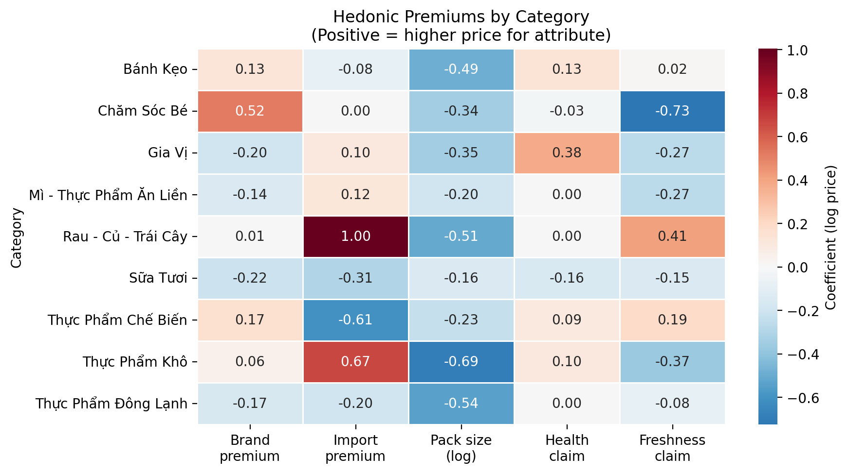
SECTION D — RESULTS
Per-Category Heterogeneity
The pooled coefficient is an average over very different markets
IMPORT PREMIUM IS NOT UNIFORM
+100.4%
Fresh Produce (p < 0.001)
−60.8%
Processed Food (p = 0.013)
HEALTH CLAIMS PAY OFF SELECTIVELY
Significant only in the two categories where Vietnamese consumers feel the strongest food-safety concerns:
• Spices +38.2% (p = 0.03)
• Fresh Produce +0.382 (p < 0.05)
Insignificant in snacks, frozen, processed.
R² band — high (>0.6): Dry Food 0.831 · Baby 0.753 · Dairy 0.688 | middle (0.5–0.6): Fresh Produce, Spices, Frozen | low (<0.5): Confectionary, Processed, Instant
Trần Hiếu My | Business Analytics 64 | NEU 2026

Slide 17
KEY FINDING
Promotional Erosion of Attribute Premiums
What changes from sticker to checkout — and what does not
ATTRIBUTE
Β MARKED
Β FINAL
EROSION
VERDICT
THE FINDING
is_premium
+0.429
+0.436
−1.7%
STABLE
Promotion erodes brand-name premiums by half — but leaves price-tier premiums fully intact.
is_branded
+0.022
+0.011
+50.6%
ERODED
is_high_recognition
−0.255
−0.266
+4.3%
STABLE
is_house_brand
−0.046
−0.266
+475.6%
WinEco — the most striking single result —
AMPLIFIED
runs near-parity sticker prices and applies deep promotional discounts only at checkout.
Note: WinEco evidence is suggestive — n = 21 products at one retailer.
Trần Hiếu My | Business Analytics 64 | NEU 2026

Slide 18
SECTION D — RESULTS
Diagnostics & Robustness
The estimates survive every standard check
VIF
MULTICOLLINEARITY
BP
HETEROSKEDASTICITY
all VIF < 2.0
BP rejects (p < 0.001)
Maximum 1.54 on is_branded. The hierarchical brand encoding does NOT introduce problematic collinearity. The three brand dimensions are separately identified.
LM = 190.77 (marked) / 192.08 (final). Cluster-robust standard errors at the sub-category level (40 clusters) are therefore the appropriate inference choice.
CD
INFLUENCE
TS
TEMPORAL STABILITY
4.2% above 4/n
R² flat across months
86 of 2,066 products exceed Cook's standard threshold; high-influence set spread across categories; coefficients re-estimated without them match within 0.01 log-points.
Pooled re-estimated on Dec / Jan / Feb monthly snapshots — adjusted R² of 0.669 / 0.669 / 0.658. Coefficient signs and magnitudes unchanged.
Trần Hiếu My | Business Analytics 64 | NEU 2026

Slide 19
05
CHAPTER 4
Discussion & Recommendations
Three principal findings · what they mean · limitations · who they help

Slide 20
SECTION E — DISCUSSION
Finding 1 — Price-tier Dominates
and survives discounting · the largest, most resilient attribute premium
IS_PREMIUM COEFFICIENT
ANSWERS OBJECTIVE 1 — IDENTIFY WHICH ATTRIBUTES GENERATE PREMIUMS
+0.43 → +0.44
DISCUSSION · WHY THIS HAPPENS
≈ 43–44% markup over non-premium branded · erosion only −1.7% · STABLE
Varian (1997) versioning: a retailer serving consumers with heterogeneous willingness-to-pay maintains distinct price tiers — the premium tier's value depends on contrast with discounted alternatives.
|β| at final price · comparison across attributes
Discounting premium products would collapse the very signal that justifies premium margins. Near-zero erosion (−1.7%) is a deliberate pricing discipline, not incidental.
is_premium
+0.436
Premium positioning reflects genuine product differentiation: imported inputs, specialised packaging, niche brand identity — not a labelling effect.
ln_pack_size
−0.395
is_high_recognition
−0.266
Companion finding — pack size: β = −0.39 (p < 0.001), erosion only 2.8%. Physical attributes are the most promotion-resistant savings of all.
is_house_brand
−0.266
is_import
+0.117
MEANING · WHAT THIS ANSWERS
"Attribute-bundle theory predicts that genuinely differentiated attributes carry stable implicit prices. Price-tier behaves exactly that way. The retailer's pricing discipline confirms Varian-style versioning at the platform level."
has_freshness_claim
−0.058
is_branded
+0.011
Thesis §4.1, paragraphs 1–2 (price-tier dominance) + §4.1 closing paragraph (pack-size economies) · Theory: Lancaster 1966 · Rosen 1974 · Varian 1997 · Costanigro & McCluskey 2011
Trần Hiếu My | Business Analytics 64 | NEU 2026

Slide 21
SECTION E — DISCUSSION
Finding 2 — Brand-name Premiums Erode
via a traffic-driving logic · the methodological payoff of the dual-price design
EROSION · IS_BRANDED
ANSWERS OBJECTIVE 2 — MEASURE HOW PROMOTION ERODES PREMIUMS
+50.6%
DISCUSSION · WHY THIS HAPPENS
sticker +0.022 → checkout +0.011 · WinEco amplifies to +475.6%
Keller (1993) customer-based brand equity: high-awareness brands work as promotional anchors. Recognition draws traffic; the premium need not be large at the shelf.
β · sticker → checkout · by attribute
Brand recognition without premium positioning lands in the "Household Giant" quadrant — well-known, widely distributed, priced at or below the subcategory median.
attribute
marked
final
Δ
is_premium
+0.429
+0.436
−1.7%
WinEco (private label) — sticker −4.6% (n.s.) → checkout −26.6% (p < 0.001). 22-pp gap avoids shelf-price stigma while delivering loss-leader checkout pricing.
Cavallo (2017): online platforms reveal pricing channels invisible to offline scanner data. Web-scraping is what makes this measurable.
is_branded
+0.022
+0.011
+50.6%
is_high_recog
−0.255
−0.266
+4.3%
MEANING · WHAT THIS ANSWERS
"The dual-price design is the methodological contribution of this thesis. It exposes an asymmetry no single-price hedonic could find: brand-name is largely a promotional vehicle, not a stable signal of quality."
is_house_brand
−0.046
−0.266
+475.6%
Δ = (β_marked − β_final) / β_marked × 100 · N = 2,203 products · cluster-robust SE
Thesis §4.1, paragraphs 3–5 (brand-name erosion + WinEco) · Theory: Keller 1993 customer-based brand equity · Aaker 1991 perceived quality · Cavallo 2017 online retail
Trần Hiếu My | Business Analytics 64 | NEU 2026

Slide 22
SECTION E — DISCUSSION
Finding 3 — Category Heterogeneity is Systematic
pooled coefficient hides structure · attribute value depends on category context
IMPORT PREMIUM · RANGE
ANSWERS OBJECTIVE 3 — COMPARE HOW PREMIUMS VARY ACROSS CATEGORIES
+100% ↔ −61%
DISCUSSION · WHY THIS HAPPENS
Fresh Produce (p < 0.001) vs Processed Food (p = 0.013) · same attribute, opposite signs
Mergenthaler et al. (2009): Vietnamese consumers express ~60% willingness-to-pay premium for low-residue attributes in fresh produce — a category where food-safety concerns are most salient.
import premium · by parent category
Imported processed food carries a NEGATIVE premium because well-established domestic brands dominate; imports signal unfamiliarity rather than quality.
0
Fresh Produce
+100%
p<0.001
Health-claim premiums significant only in Spices (+38.2%, p = 0.03) and Fresh Produce — categories where food-safety concerns are strongest.
Dry Food
+67%
Spices
+10%
Bell et al. (2021): food values in peri-urban Hanoi vary by category. Credence attributes are not uniformly valued — context determines premium.
Instant Food
+12%
Dairy
-31%
MEANING · WHAT THIS ANSWERS
Frozen
-20%
"The pooled hedonic coefficient hides economically meaningful structure. Category context is not noise — it is the substantive finding. Credence attributes (origin, health claims) are valued only where they answer a real consumer concern."
Processed Food
-61%
p=0.013
Thesis §4.1, paragraphs 6–7 (per-category heterogeneity) · Theory: Nelson 1970 search/experience/credence · Costanigro & McCluskey 2011 · Mergenthaler et al. 2009 · Bell et al. 2021
Trần Hiếu My | Business Analytics 64 | NEU 2026

Slide 23
SECTION E — DISCUSSION
Recommendations
Concrete implications for four distinct audiences
FOR CONSUMERS
FOR BUSINESSES
Price tier > brand name as a savings signal.
Premium-tier positioning is protected through the promotional cycle.
Pack size offers the most discount-resistant unit-price savings (~3.8% per +10% pack).
Household Giants are already discount targets — limited remaining margin.
Expect deeper discounts on Household Giants and WinEco at checkout.
Import positioning is category-selective: works in Fresh Produce, hurts in Processed Food.
FOR POLICY
FOR FUTURE RESEARCH
Promotional penetration (0–36%) varies far more than depth (12–19%).
Multi-retailer extension (Annam Gourmet, Bách Hóa Xanh, wet markets).
Disclosure should target where, not how much.
Transaction-volume data → demand response.
WinEco's 22-pp sticker-to-checkout gap warrants broader investigation.
IV approach using third-party brand equity surveys to address is_premium endogeneity.
Trần Hiếu My | Business Analytics 64 | NEU 2026

Slide 24
SECTION F — CLOSING
Limitations
What this thesis cannot do — and what we do about it
LIMITATION
MITIGATION / DESIGN RESPONSE
Single-retailer external validity
Design choice — holds platform fee, logistics, presentation control constant. Future research: multi-retailer comparison.
No transaction volumes
Web scraping captures listed prices only. Jevons is the CPI-manual fallback when expenditure weights are unavailable.
NLP brand-dictionary noise
310-keyword manually curated, conservative. Misclassification attenuates coefficients toward zero — biases against findings.
is_premium partial endogeneity
Variable is ordinal not cardinal; subcategory FE absorb level effects; flagged in §3.7. IV with brand equity surveys = future work.
No formal Tết event study
Confectionary cold-start (Feb 2) and Instant_food gap preclude a clean event design. Replaced with descriptive Tết-window comparison.
Trần Hiếu My | Business Analytics 64 | NEU 2026

Slide 25
06
CONCLUSION
What did we learn?
Three answers · one contribution · one open invitation

Slide 26
CONCLUSION
What did we learn?
YES.
Attribute premiums exist — and price tier (+43–44%), pack size (−3.8% per +10%), category-specific imports and health claims are the dominant ones.
AND.
Promotion erodes brand-name premiums by approximately 50% between sticker and checkout — but leaves price-tier premiums fully intact (−1.7%).
FIRST.
This is the first hedonic decomposition of Vietnamese online grocery using web-scraped daily dual-price data, contributing both a methodology and an empirical baseline.
Trần Hiếu My | Business Analytics 64 | NEU 2026

Slide 27
Thank you
Cảm ơn quý thầy cô và hội đồng
Special thanks to
Dr. Nguyễn Mạnh Thế · Supervisor
Dr. Đinh Thị Hồng Thêu · Mentor
I welcome your questions

Slide 28
A
APPENDIX
On-demand evidence for Q & A
Diagnostics · methodology deep-dives · citations · Tết treatment

Slide 29
APPENDIX A1
Q & A — on demand
Variance Inflation Factors — full table
FEATURE
VIF
All VIF < 2.0
is_branded
1.54
name_length
1.42
Conventional threshold: 5.0
is_high_recognition
1.36
pack_count
1.20
No problematic multicollinearity — despite the hierarchical brand encoding (is_branded ⊇ is_premium and is_high_recognition).
is_premium
1.17
has_freshness_claim
1.10
ln_pack_size
1.08
has_health_claim
1.08
The three brand dimensions are separately identified.
is_import
1.04
is_house_brand
1.03

Slide 30
APPENDIX A2
Q & A — on demand
Influence Diagnostics & Temporal Stability
COOK'S DISTANCE
TEMPORAL STABILITY (Adj R²)
86 / 2,066 = 4.2%
December 2025
N = 1,314
0.669
above the 4/n threshold (= 0.00194)
• Spread across categories — no single-cluster dominance
January 2026
N = 1,327
0.669
• Coefficients re-estimated without high-influence set:
match within 0.01 log-points
• No need to drop influential observations
February 2026
N = 2,053
0.658

Slide 31
APPENDIX A3
Q & A — on demand
WinEco Deep-Dive — n = 21 products
STICKER PRICE
CHECKOUT PRICE
−4.6%
−26.6%
β = −0.046 · n.s.
β = −0.266 · p < 0.001
Near-parity with competing brands on the virtual shelf — visually undifferentiated by price.
Deep checkout discounts trigger only at the point of sale — a private-label promotional strategy.
Caveat: 21 products at one retailer. Suggestive, not generalizable. Future research = multi-retailer house-brand comparison.

Slide 32
APPENDIX A4
Q & A — on demand
Per-Category R² Bands
HIGH CONFIDENCE (R² > 0.6)
MIDDLE BAND (0.5 ≤ R² ≤ 0.6)
LOW R² (R² < 0.5)
Dry Food
Fresh Produce
Confectionary
0.831
0.539
0.422
Baby Products
Spices
Processed Food
0.753
0.528
0.395
Dairy
Frozen
Instant Food
0.688
0.526
0.227
Eggs & Tofu (n=24) omitted from per-category regression owing to insufficient sample size.

Slide 33
APPENDIX A5
Q & A — on demand
Why Jevons, not Laspeyres or Törnqvist
LASPEYRES
TÖRNQVIST
JEVONS
Σ(Pₜ · Q₀) / Σ(P₀ · Q₀)
GeoMean weighted by ½(s₀ + sₜ)
∏(Pₜ/Pₜ₋₁)^(1/n)
REQUIRES
REQUIRES
REQUIRES
Base-period expenditure shares
Both periods' expenditure shares
Matched-product price relatives only
NOT FEASIBLE
NOT FEASIBLE
CHOSEN
Need quantities sold (Q₀). Web scraping does not capture quantities.
Even more demanding — needs s₀ and sₜ. Diewert (1976) shows it is superlative; not feasible here.
CPI-manual elementary aggregation when expenditure weights are unavailable. Used here.
Acknowledged in §5.2: a sales-weighted index would be theoretically superior; future research with transaction data could implement it.

Slide 34
APPENDIX A6
Q & A — on demand
NLP Feature Pipeline
Vietnamese product name
NFC normalization · lowercase
Diacritic-preserving regex
9 binary / numeric features
is_branded
is_premium
is_high_recognition
69.2%
19.8%
31.0%
is_import
is_house_brand
has_health_claim
4.3%
0.9%
5.3%
has_freshness_claim
ln_pack_size
pack_count
6.7%
continuous
integer 1–24
310-keyword brand dictionary, manually curated. Conservative by construction — misclassification attenuates coefficients toward zero (against findings).

Slide 35
APPENDIX A7
Q & A — on demand
Citations Backbone
HEDONIC THEORY
BRAND EQUITY
METHODOLOGY
Lancaster (1966)
Keller (1993)
Costanigro & McCluskey (2011)
A new approach to consumer theory
Conceptualizing & managing customer-based brand equity
Hedonic price analysis in food markets
Rosen (1974)
Aaker (1991)
Malpezzi (2002)
Hedonic prices and implicit markets
Managing brand equity
Hedonic pricing: a selective and applied review
Ekeland, Heckman & Nesheim (2004)
Cavallo (2017)
Identification & estimation of hedonic models
Are online and offline prices similar?
Diewert (1976)
Exact and superlative index numbers
Nelson (1970)
Information and consumer behavior

Slide 36
APPENDIX A8
Q & A — on demand
Decision Tree Predictor — complement, not substitute
OLS HEDONIC
PERCENTILE DECISION TREE
Goal: explanation
Goal: prediction
• Interpretable implicit prices for each attribute
• Returns p5 / p25 / p50 / p75 / p95 per sample
• Cluster-robust inference at sub-category level
• Captures non-linear interactions between features
• Used for the dual-price erosion analysis
• Useful for inventory & pricing applications
• Answers the research question
• Complement, not replacement, for the OLS
Figures available: thesis_dt_tree.png · thesis_dt_leaf_intervals.png · thesis_dt_diagnostics.png

Slide 37
APPENDIX A9
Q & A — on demand
Tết Window Treatment
18 Dec
2 Feb
17 Feb
Mid-Feb
15 Mar
Data start
Confectionary added
(no pre-period)
Tết Nguyên Đán
Instant_food gap
Data end
A formal event study would require dropping the very observations it most needs.
Replaced with descriptive Tết-window vs non-Tết brand-gap comparison (output/brand_gap_summary.csv).
Significant Tết-window deltas:
Fresh Produce
+42 pp · p = 0.021
Processed Food
−39 pp · p = 0.048

Slide 38
APPENDIX A10
Q & A — on demand
Daily Price Index — Time Series
OVERALL
STAPLES
OTHER FOOD
0.919
0.838
0.939
(−8.1%)
(−16.2%)
(−6.1%)
Disinflation in this dataset is staples-led.
Base date 18 December 2025 = 1.000 · terminal value computed at 29 March 2026.
Source: output/overall_daily_average_index.csv · produced by 05. food_index.py

