Slide 1
Data, Data, Data
JOUR479D/779D
University of Maryland
Notes:
Including some content showing power, exploratory vs communicative vs artistic, visual analytics, why it works,
Tools & Tech overview? Stuff they should familiarize with? HTML / CSS / Javascript. Get them doing the codeacademy

Slide 2
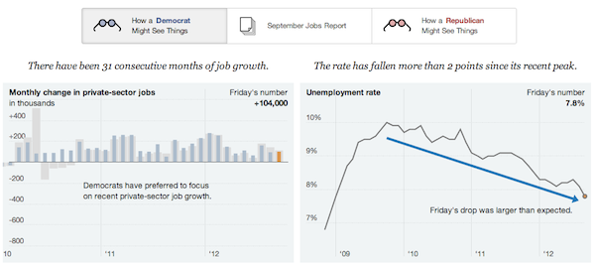
Data
From Latin, datum, dare = to give
Something given, the premise
Data are not facts; False data is still data
Notes:
It’s important to recognize and remember that data does not equal truth. It’s rhetorical by definition and can be used for truth finding or truth hiding. Being vigilant in how you develop arguments from data and showing the context that leads to the interpretation you make can only help raise the credibility of your data-driven story.

Slide 3
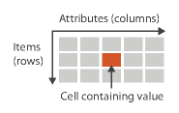
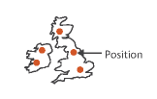
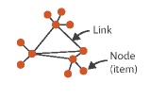



Dataset Types
Tables (items + attributes)
Geometric (2D or 3D)
Networks (graphs)
Trees (hierarchies)
Temporal + Time varying
Texts
Image Credit: T. Munzner. Visualization Analysis & Design
Notes:
Networks and trees have items (nodes), links, and attributes
Temporal is when time is an attribute (e.g. horse race and the duration of the run); time varying is where location varies which each time point

Slide 4




Data Types
Nominal or Categorical (labels)
e.g. Giraffe, Monkey, Snake; can be ordered but not intrinsically
Ordinal (ranked)
Day of week: Monday, Tuesday, Wed
Restaurant Inspection Grade: A, B, C
Small, Medium, Large
Interval (arbitrary zero point)
Only differences can be compared, but not their ratio
Temperature, e.g. 20 C is not twice as hot as 10C
Ratio (fixed zero point)
Counts
Physical measurements, e.g. 6 feet is twice as long as 3 feet
Image Credit: T. Munzner. Visualization Analysis & Design
Notes:
Cyclic e.g. is time
Diverging would be something like elevation or temperature where there is a clear zero point

Slide 5
Data Formats
JSON
Javascript Object Notation
{
“key”: value,
“array_key”: [{“key1”: value1}, {“key2”: value2}],
}
Delimited Text, e.g. CSV
Comma separated value
X , Y, Z
10, 8, 5
XML
Extensible Markup Language
Converters
http://www.convertcsv.com/json-to-csv.htm
http://shancarter.github.io/mr-data-converter/
Notes:
More practically we need to know how to store and manipulate data.
There are MANY specialized data formats. Others you might see include KML for geometry, SPSS files for gov’t datasets, or other proprietary datasets

Slide 6
Data Acquisition
Finding
https://research.google.com/tables
http://www.data.gov/
http://enigma.io/
Government Agencies; TIGER, FRED, OECD, UN
Companies
Surveys
Ask experts: officials, professors, industry insiders
Newsletter: Data is Plural (spreadsheet: http://bit.ly/1Vmw1jH)
Gathering
Programmatic: Scraping, e.g. Import.io from web; Extraction e.g. Tabula from PDFs; APIs
FOIA, knowing what to ask for to get a DB
Notes:
Point out the need to be aware of the conditions around which data was acquired especially if by someone else, and if you’re doing it yourself you need to think about the methodology.
It can be VERY time consuming looking for data.

Slide 7
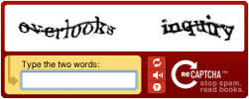
Scraping Caveats
Badly formatted webpages won’t work
Authentication systems with CAPTCHA
Be considerate (use rate)

Slide 8
APIs (Application Programming Interfaces)
What are they?
Bits of software that sit in-between other software
What are they used for?
Sharing data systematically, abstraction and component building
Why do people even have them?
Data platforms, 3rd party innovation, ease of use in sharing
What to Consider for Data Collection
Comprehensiveness, rate limits, filters, legal liability, sampling strategy
Notes:
Application Programming Interfaces – easy access to lots of data
Can also mention scraping here
Talk about how these methods relate back to the projects that were described.

Slide 9
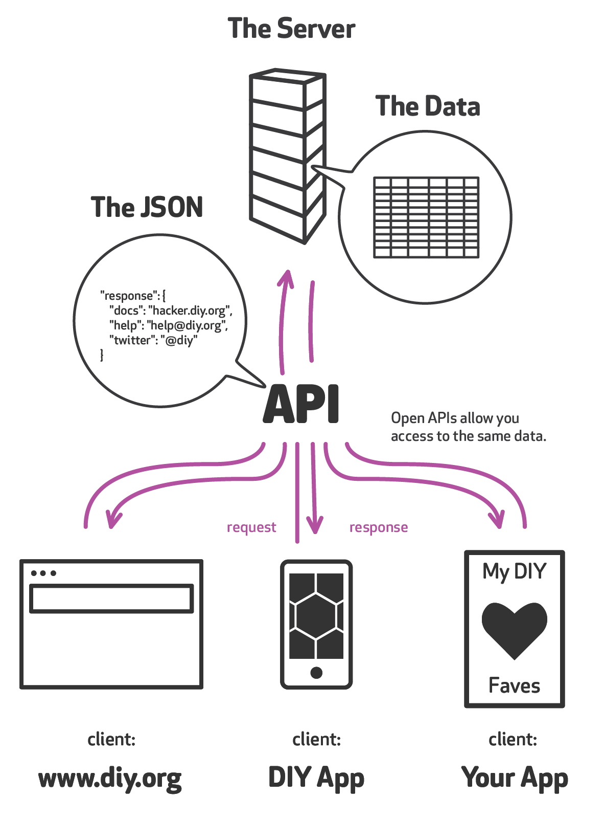
Diagramatically

Slide 10
Where are APIs?
Lots of APIs out there
Twitter: https://dev.twitter.com/rest/public
Guardian: http://open-platform.theguardian.com/
Reddit: https://www.reddit.com/dev/api/
Socrata: https://dev.socrata.com/

Slide 11
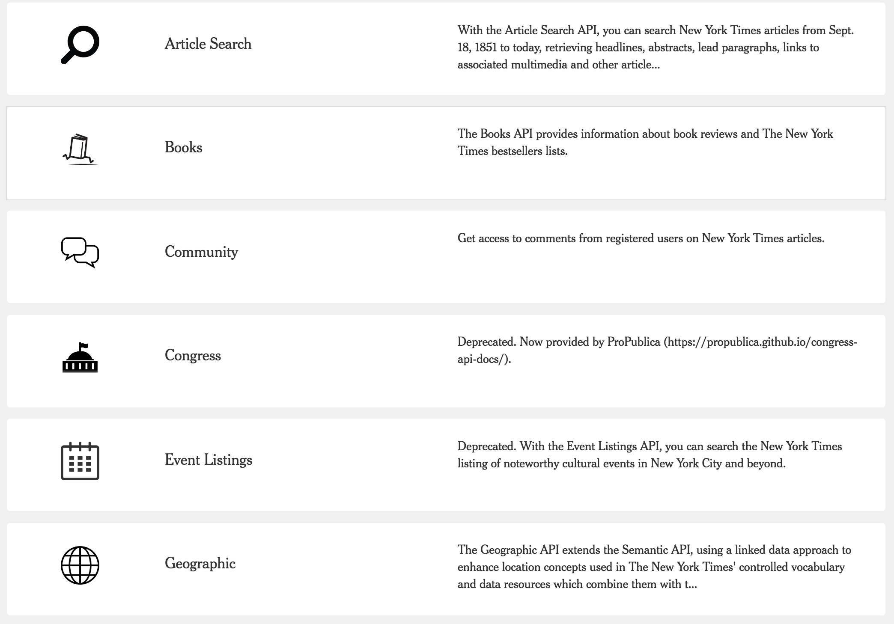
NYT APIs
http://developer.nytimes.com/

Slide 12
API Caveats
Design
Some queries are easy, others not possible at all
Tension between what’s there and what you ideally want
Sometimes can’t get enough volume due to rate limits
Combinations
Sometimes you need more than one API to get all the data you need
New stories can emerge from combining data

Slide 13
CSVKit
Command Line tool for working with data
https://csvkit.readthedocs.org
csvcut – splicing just some columns out
csvjson – output the JSON version
csvstat – basic descriptive statistics on columns (e.g. date ranges, min / max, sums, means, etc)
csvclean – can identify “bad rows”, e.g. wrong # of values
Quick tutorial
Notes:
Last point about csvclean leads right into the issue of data cleaning / wrangling, or as I call it data editing
Csvcut –n ieee_data_filtered.csv | csvcut –c 2,4
Csvstat --mean (or – freq) ieee_data_filtered.csv

Slide 14
Data Skepticism
“The wave of bullshit data is rising, and now it’s our turn to figure out how not to get swept away”
-- Jacob Harris, former NYT developer

Slide 15
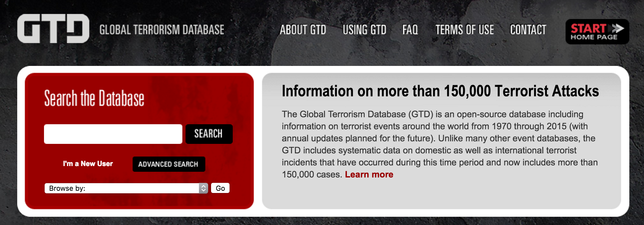
Data Editing
Data Provenance
Who collected or produced it? What was their intent? Is it a reputable source? What are motives of data producer, are they an advocate? Is this data PR? Politics involved?
Call the creator. Do additional research. Corroborate figures from multiple sources.
Notes:
Talk about wider idea of data literacy: The ability to consume, produce, and think critically about data
Even for ostensibly reputable sources like governmental or government-funded organizations it can be important to understand why the data was collected to begin with, how politics may have affected its collection, and whether then it’s still suitable to repurpose the data for your storytelling context. For instance, data journalist Nicolas Kayser-Bril suggests politics may color how the Global Terrorism Database defines and tabulates acts of violence in Eastern Ukraine as terrorism rather than as acts of war between Ukrainian and Russian militaries.

Slide 16
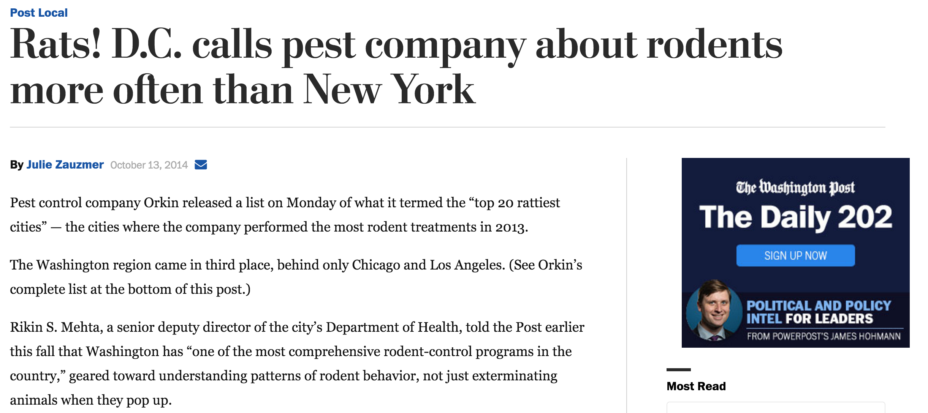

Slide 17
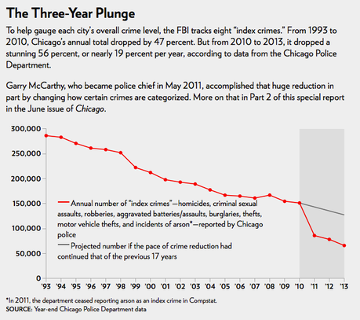
Data Editing
When was the data collected?
Measurements can change over time
Definitions or interpretations in quantification can change over time
Is the data recent, and how much does that matter to the insight you want to convey
Notes:
Great example of the chicago crime stats being redefined in 2011 which changed how certain crimes were categorized.

Slide 18
Data Editing
What is in the data, is it reliable?
What exactly is measured? Is this precisely defined? How was data sampled from the world?
Does the data actually help answer the analysis questions?
What errors or other uncertainties may have been introduced into data via data transformations? (e.g. OCR)
Has the data been aggregated or transformed by some algorithm?
Has the data been cropped or filtered? Is the data comprehensive, or missing pieces (e.g. blank rows or cells)?
Are there outliers? Inconsistencies (e.g. 311 calls in the future)? Truncations?

Slide 19
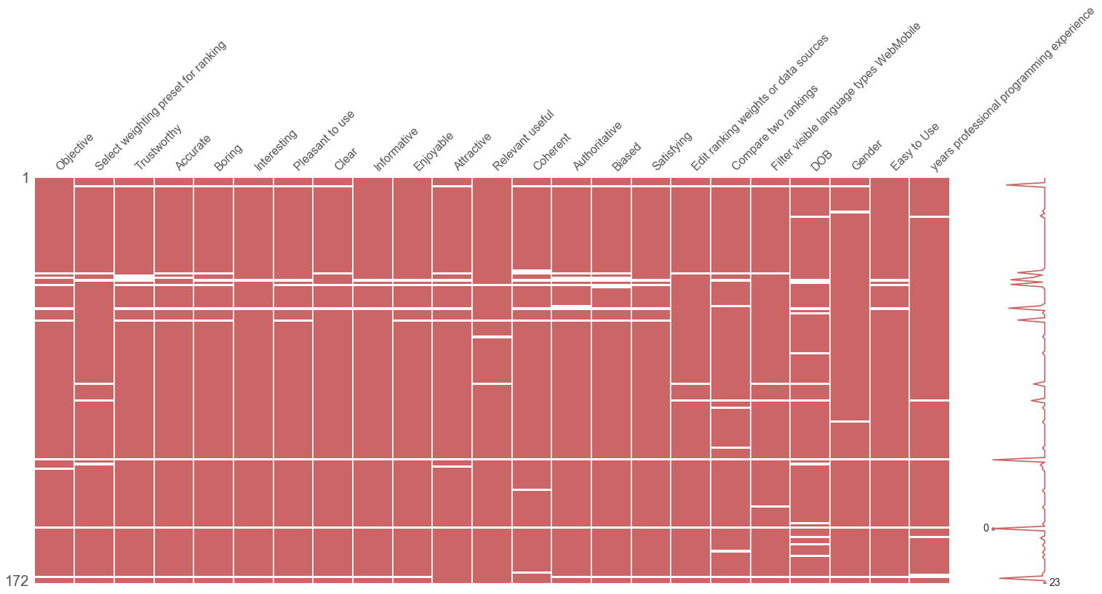
Missing Data
https://github.com/ResidentMario/missingno
Notes:
Tools for understanding missing data. MissingNo is a plugin for python that lets you quickly see missing fields within a pandas dataframe.
Otherwise, loading in a text editor can be helpful. Or loading in Excel can help you see issues too.

Slide 20
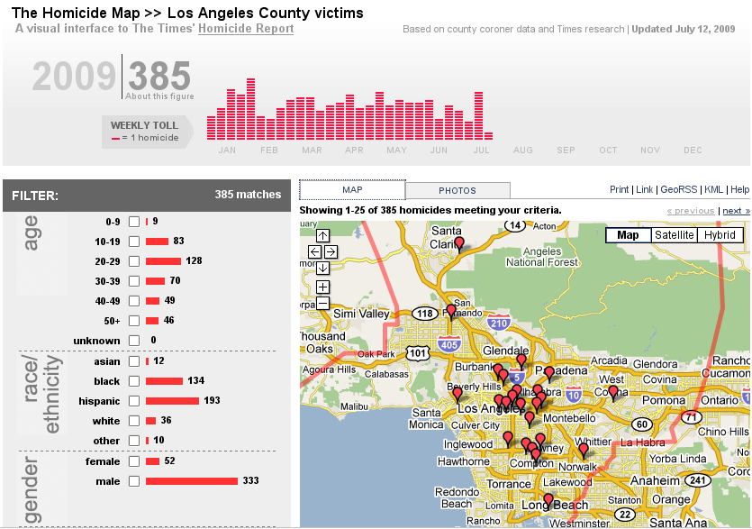
LA Times Crime Mapping
latimes.com/news/local/crime/homicidemap
Notes:
The Los Angeles Times began publishing their Homocide Map in the
Spring of 2008, along with a blog devoted to the city's murders. It
fits in the city crime genre, but doesn't cover all crime, just
murder. The New York Times debuted a murder map for New York City
earlier this year.

Slide 21
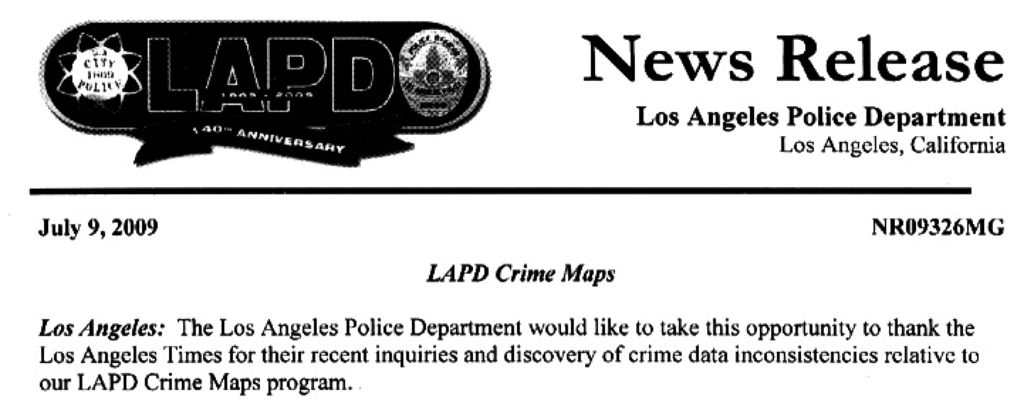
Data Transform Errors
Notes:
Over the past few months, Ben Welsh expanded the scope of crime data
collection, developing a newspaper story documenting substantial
omissions from LAPD's online public crime map. And as a result the
LAPD promised to do better, a classic newspaper success story. But the
rich interactive data presentation has been replaced by a simple
summary table constructed for print. The point: Computational
Journalism starts in the sensemaking beginning of finding a story,
then contributes to the reporting and production of journalism, and
finally extends to the public-facing presentation of the news. The LA
Times didn't pursue the full arc Computational Journalism affords. The
final work is decidely a print product. But it's also not possible for
the LA Times to develop a commercial crime map like Stamen.

Slide 22
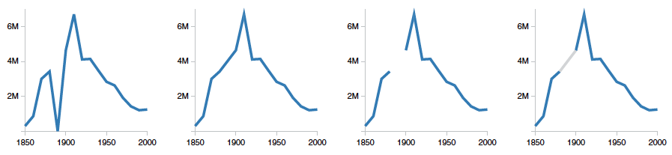
Data Cleaning / Wrangling
Missing Data Values
e.g. wrong number of columns for a given row; zero or default value; redactions (e.g. of gov’t data)
Missing context
Data dictionary, definitions, method of creation
Unresolved Duplicates
“Nicholas Diakopoulos” vs. “Nicholas A. Diakopoulos”
Image credit: Sean Kandel et al. Research Directions in data wrangling … Information Visualization. 2011.
Notes:
Graph is alternative representations of missing data: US census counts of people working as farm laborers, values from 1980 are missing to do record loss; missing data treated as zero; missing data is ignored and interpolated, missing data is omitted from chart, missing data is interpolated by rendered in gray
Data dict includes things like definitions, data types

Slide 23
Data Cleaning / Wrangling
Inconsistent Encodings
e.g. dates, ages, categorical variables like gender
Transformations
Splitting fields, normalizing date formats, merging / grouping, zip code to GPS
“Typos” in Data Entry
Or errors and drift in automated sensors
Outliers
What constitutes an outlier and should you remove it? In data you found have outliers already been removed?

Slide 24
Data Wrangling Tools
Excel
Google Refine
Tifacta

Slide 25
Readings
“Rhetoric of Data”
What is meant by data rhetoric? What can journalists do about it?
“Data Cleaning”
How much cleaning should you do in business, journalism, science? Do you think data cleaning should be repeatable?

Slide 26
Questions?

