Slide 1
QUESTION 1 : white images on screen after loading DICOM data

Slide 2
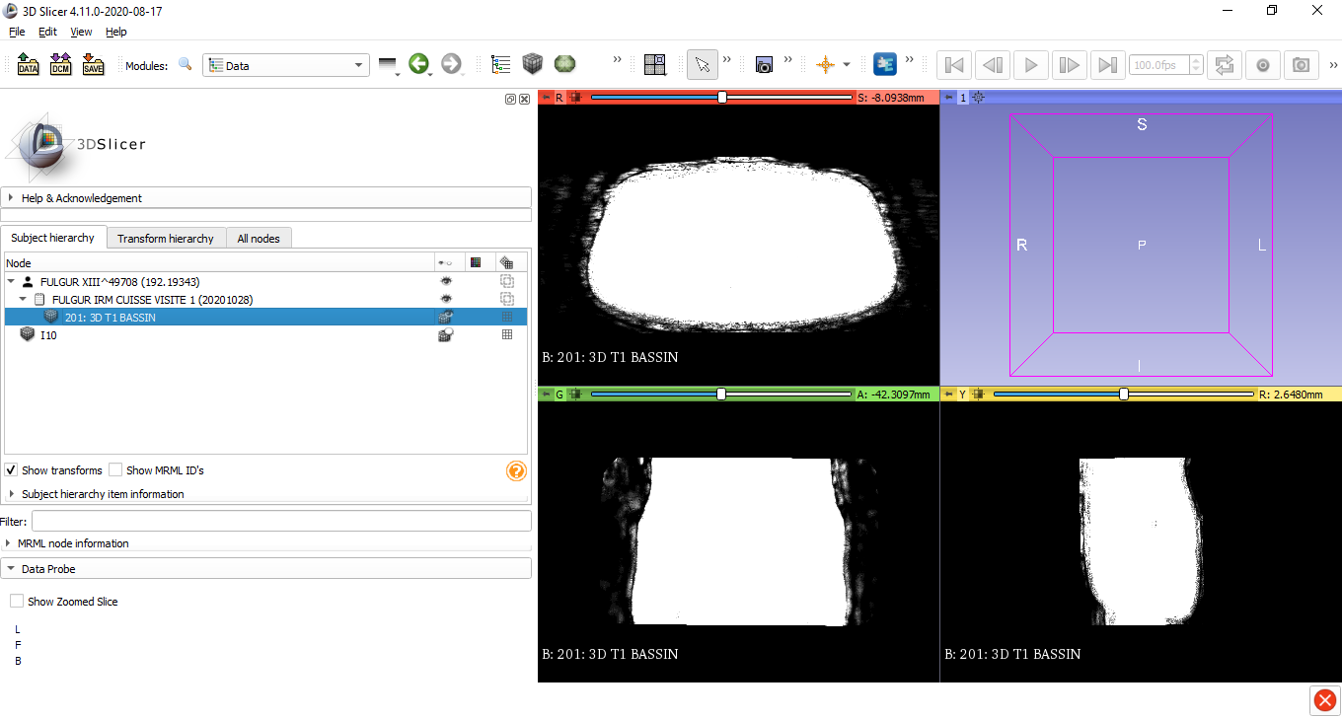
Right click on the volume then ‘edit properties…’ or directly load the module ‘Volumes’

Slide 3
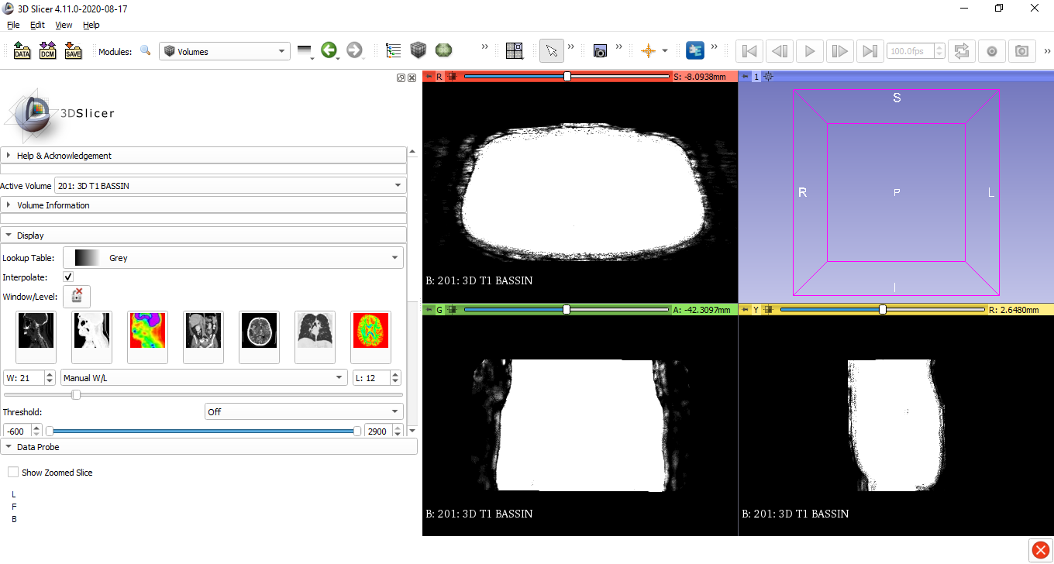
The window/level settings are not correctly set, you need to change them

Slide 4
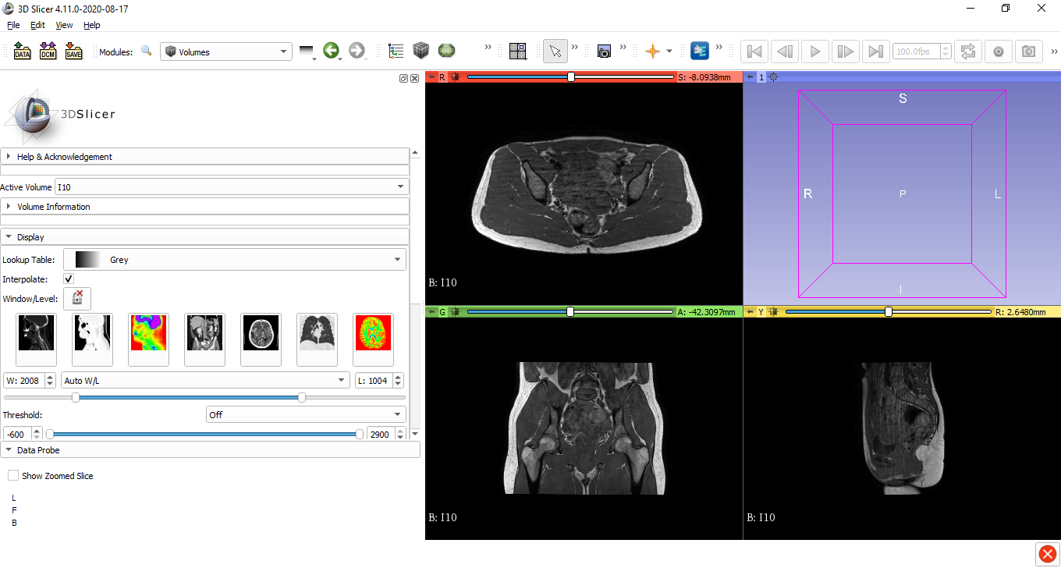
There they are correctly set.
I don’t know why the settings are correct when the volume is opened directly by clicking on ‘data’ (Andras technique), whereas they are not while loading them in the DICOM module. Either way, you can change as needed these parameters manually.

Slide 5
QUESTION 2 : adjusting the automatic slices using the ‘fill between slices’ option before validation
When loading the option ‘fill between slices’ after having segmented a few slices, click first on ‘initialize’. Then, adjust manually the slices needed. The software automatically update the slices in between.
Click on ‘apply’ only when all slices are correct !

