Slide 1
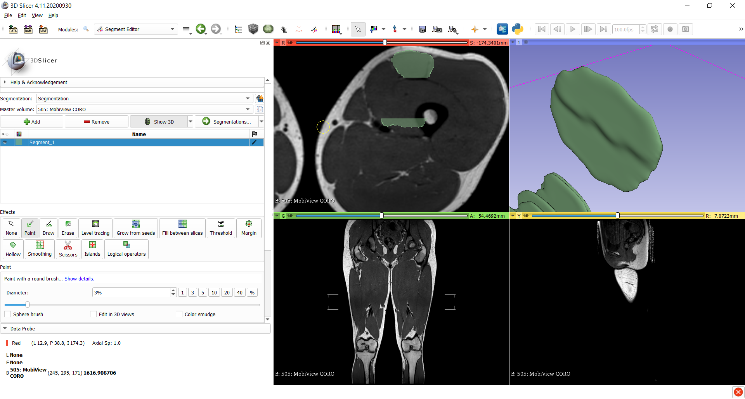
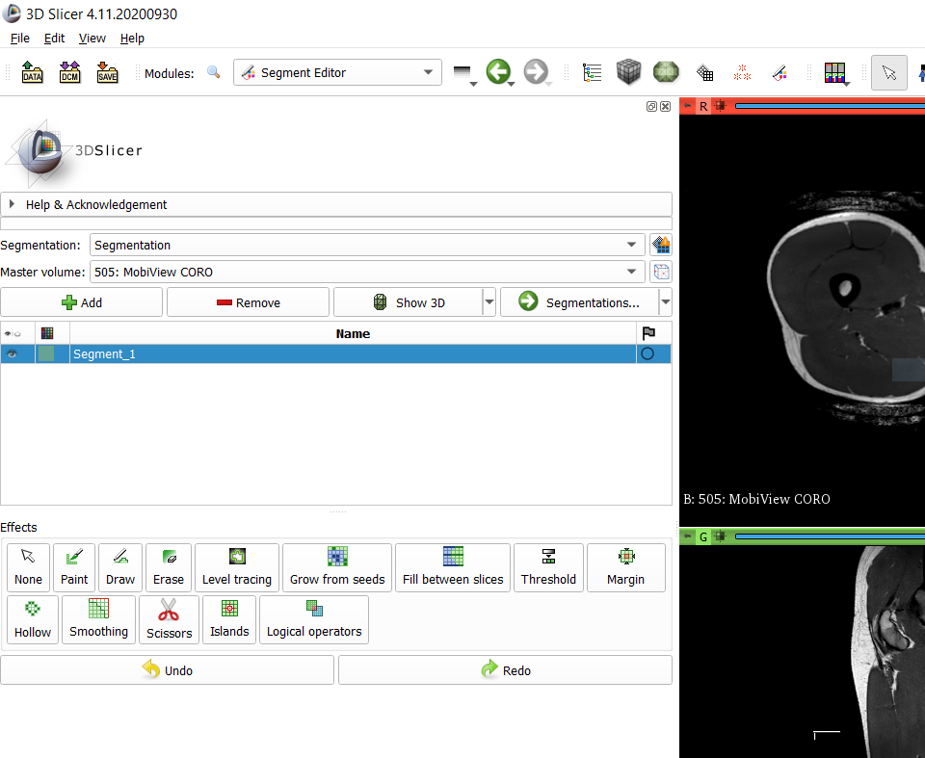
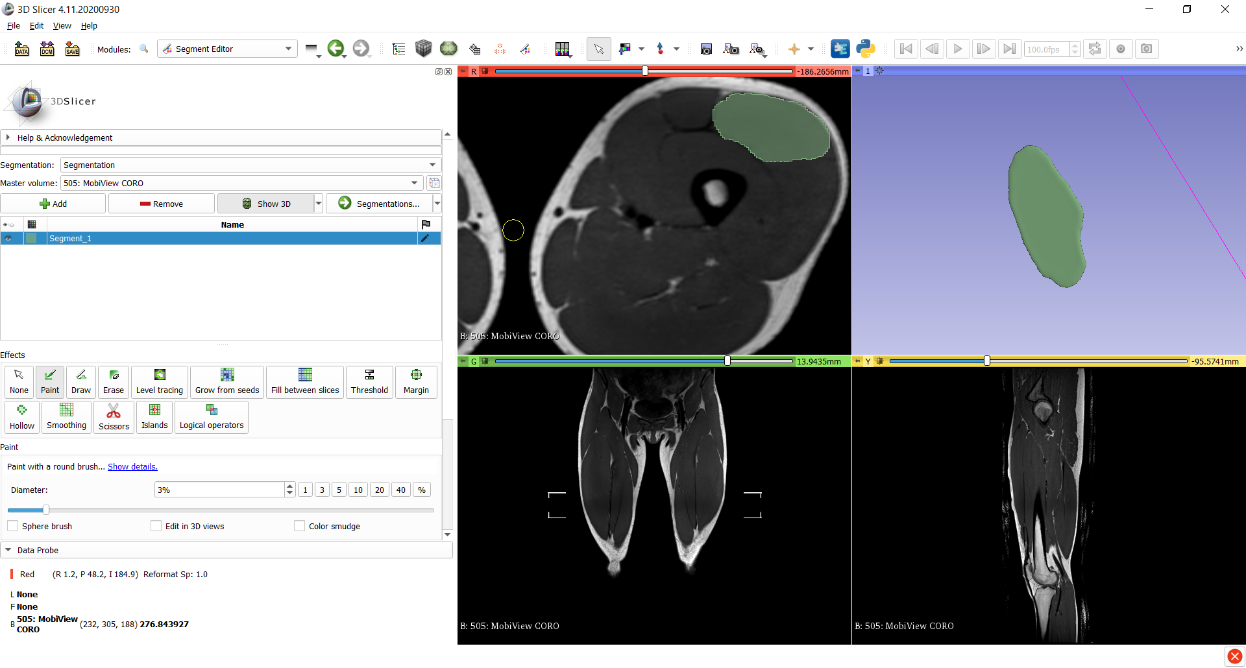
1.
Striping artefacts
2.
‘Slice views orientation are not aligned with segmentation. Striping artefacts may appear. Click to align slice views with segmentation.’
CLICK ON THAT BUTTON
OK

