Slide 1
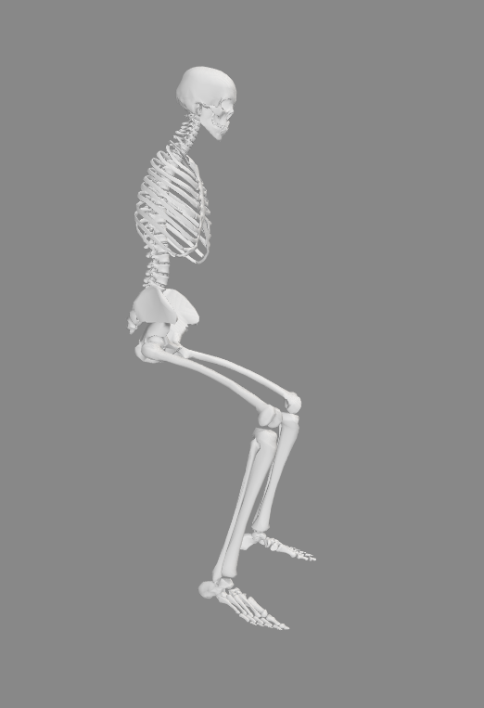
-
+
Example :
+15° of trunk flexion

Slide 2
Example :
+10° of pelvis anteversion (flexion)
-
+

Slide 3
Example :
+60° of hip flexion
+
-

Slide 4
Example :
+75° of knee flexion
-
+

Slide 5
Example :
-10° of ankle flexion
+
-

Slide 6
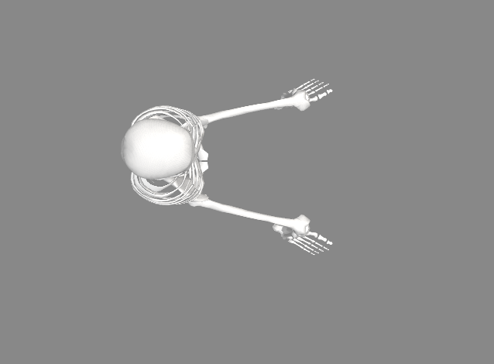
-
+
Example :
+20° of hip abduction

