Slide 1
Model design

Slide 2
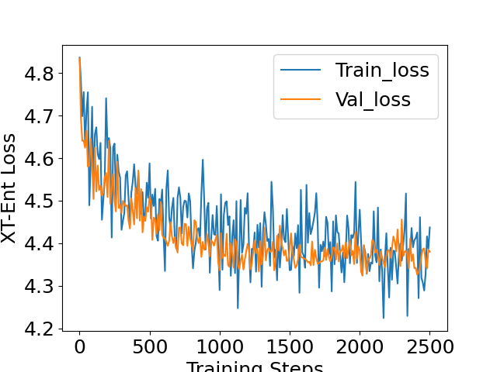
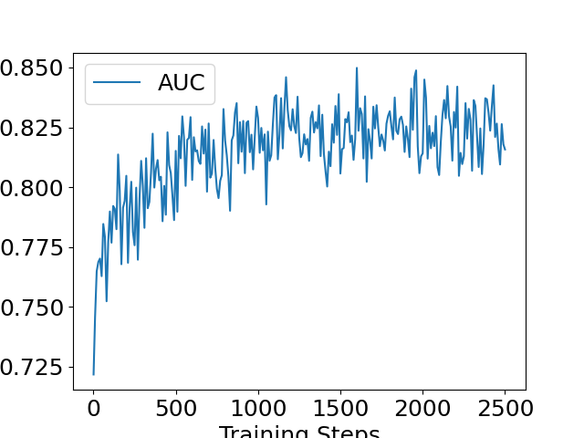
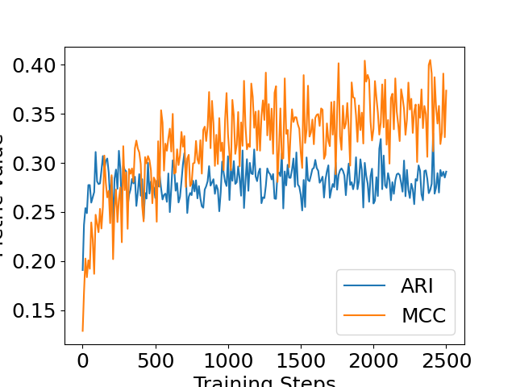

Training
Training steps
Training steps
Training steps

Slide 3
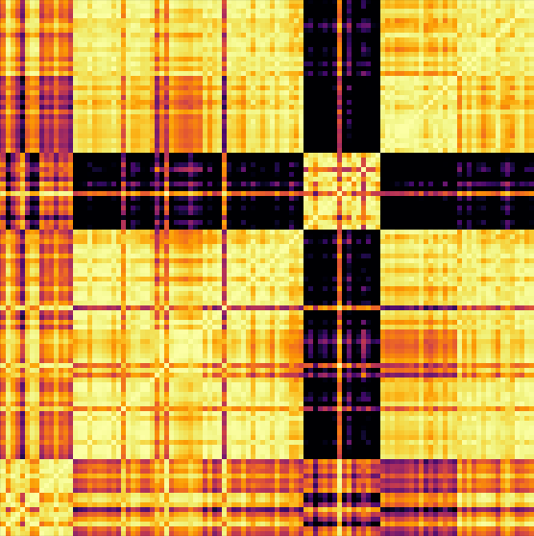
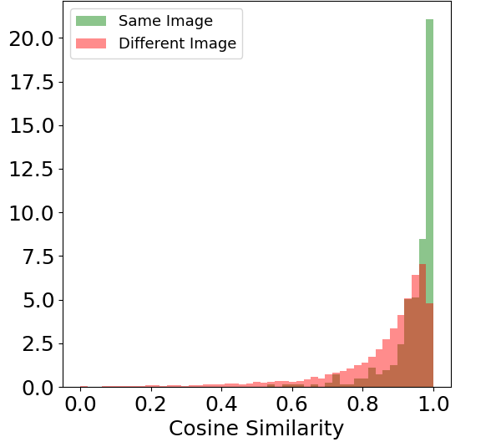
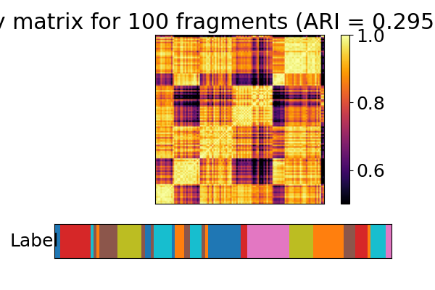
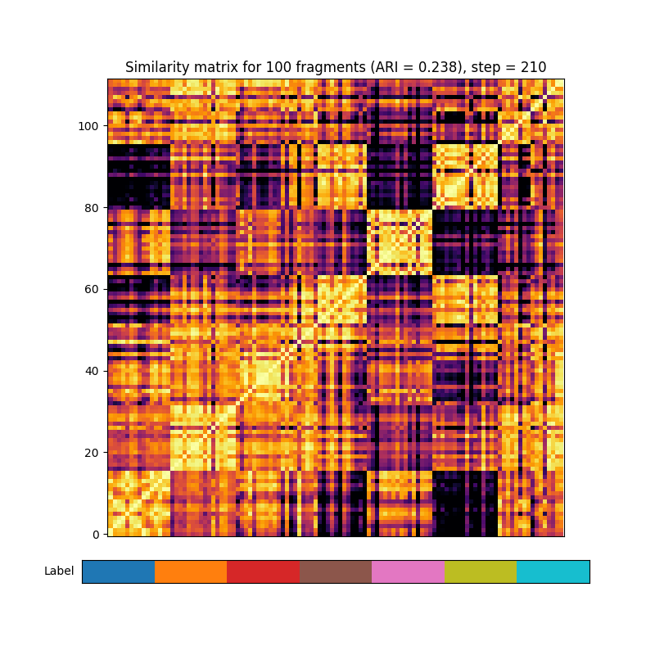
After 50 training steps
Training Visualization
Cosine similarity
True labels
ARI 0.18
Only showing for 7 representative images in validation set

Slide 4
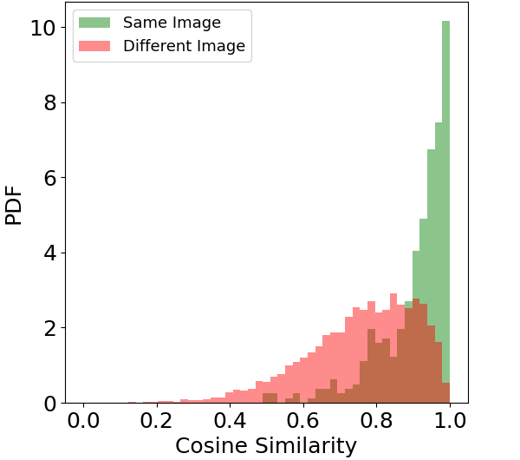
After 200 training steps
Training Visualization
Cosine similarity
True labels
ARI 0.32
Only showing for 7 representative images in validation set

Slide 5
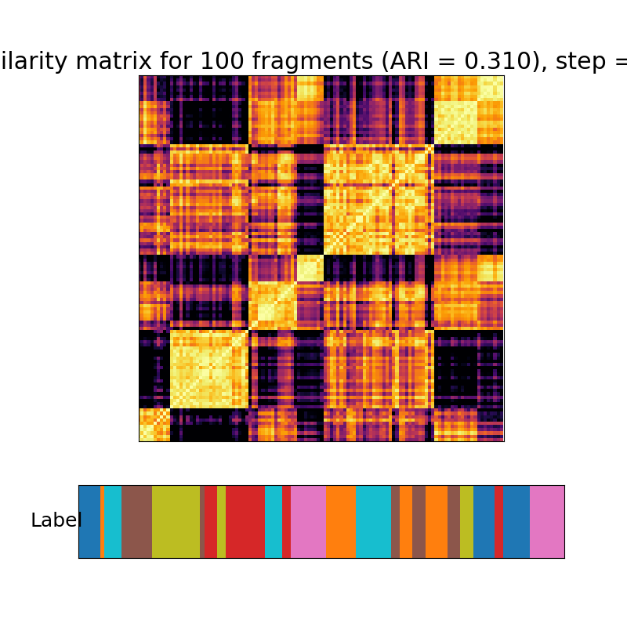
Only showing for 7 representative images in validation set
Clustering visualization
7
6
5
Cosine similarity
4
3
2
1
True labels
ARI 0.32
ARI 0.32

Slide 6
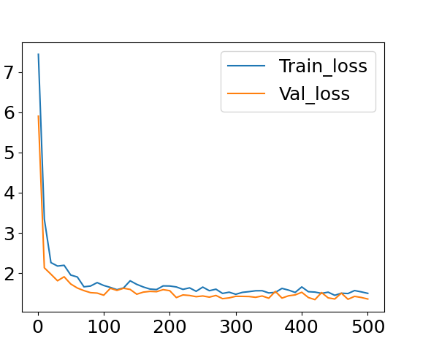

BCE vs Contrastive loss
Contrastive loss
BCE loss
Best AUC ~0.80
Best ARI ~0.3
Best AUC ~0.76
Best ARI ~0.22

Slide 7
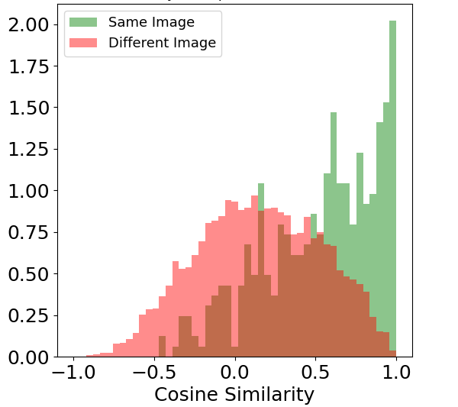
BCE vs Contrastive loss
Contrastive loss
BCE loss
AUC 0.81, MCC 0.33, ARI 0.32
AUC 0.76, MCC 0.29, ARI 0.22

Slide 8
Outlook
-> Larger fragments should lead to better performance and more complex learning

Slide 9
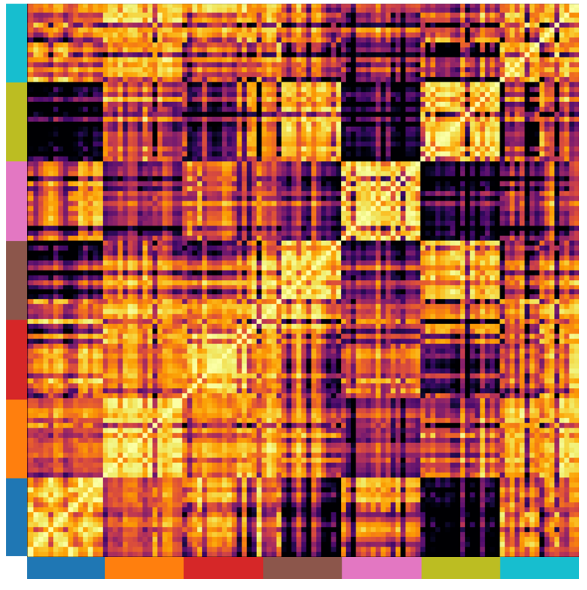
A
B
ARI 0.32 AUC:0.81 MCC:0.33
C
NT-Xent Loss
Cosine similarity
Training steps
Fragment’s labels

Slide 10
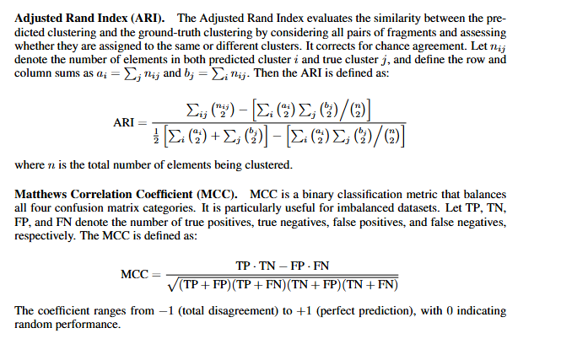

Slide 11
