Slide 1
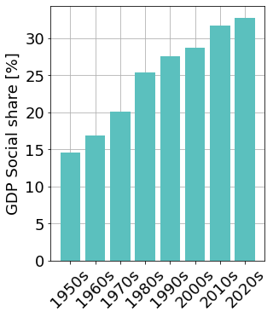
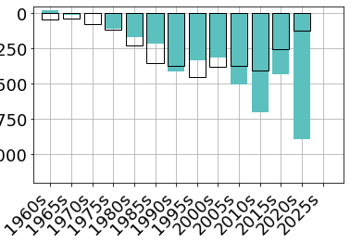
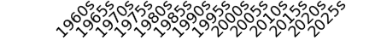
2008 crisis
2020 crisis
0
250
500
OCED average in 2025
Deficit [bn €]
750
1000
Cumulated deficit over 5 years
Projected for the period 2025-2030
Cost of interests for financing the debt

Slide 2
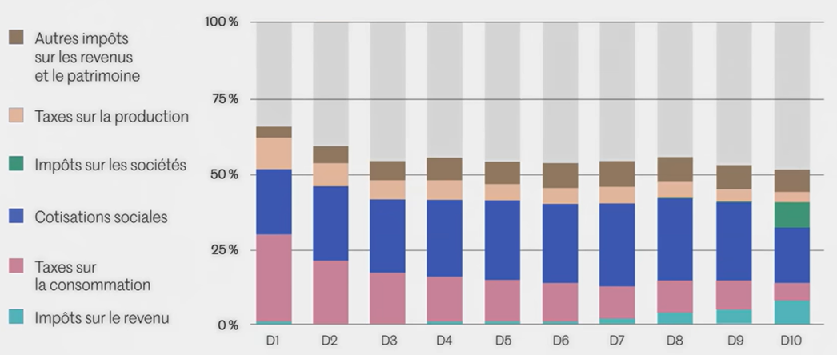
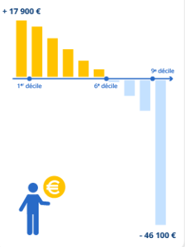
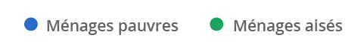
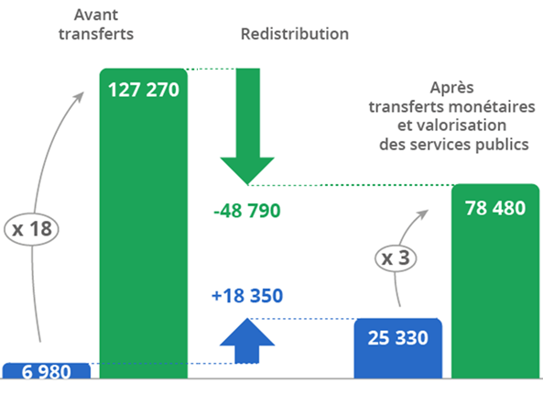

[INSEE]
“60% of the french population are net beneficiaries”
Gini 0.489
Gini 0.172

Slide 3
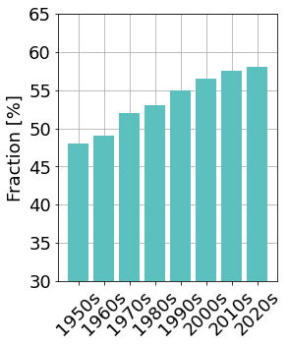
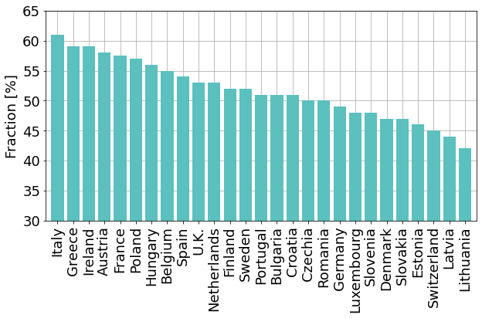
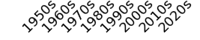

57-60% in 2022 [INSEE]
Stagnation Risk
Fraction of net beneficiaries [%]

Slide 4
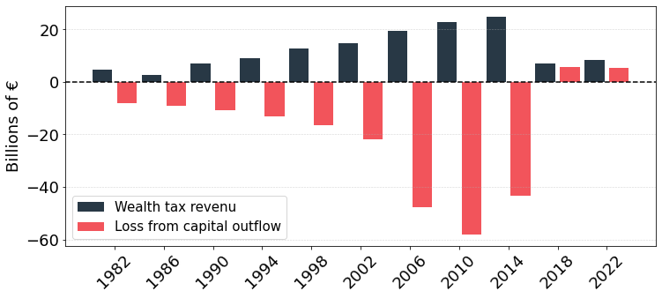
IGF / ISF
IFI

Slide 5
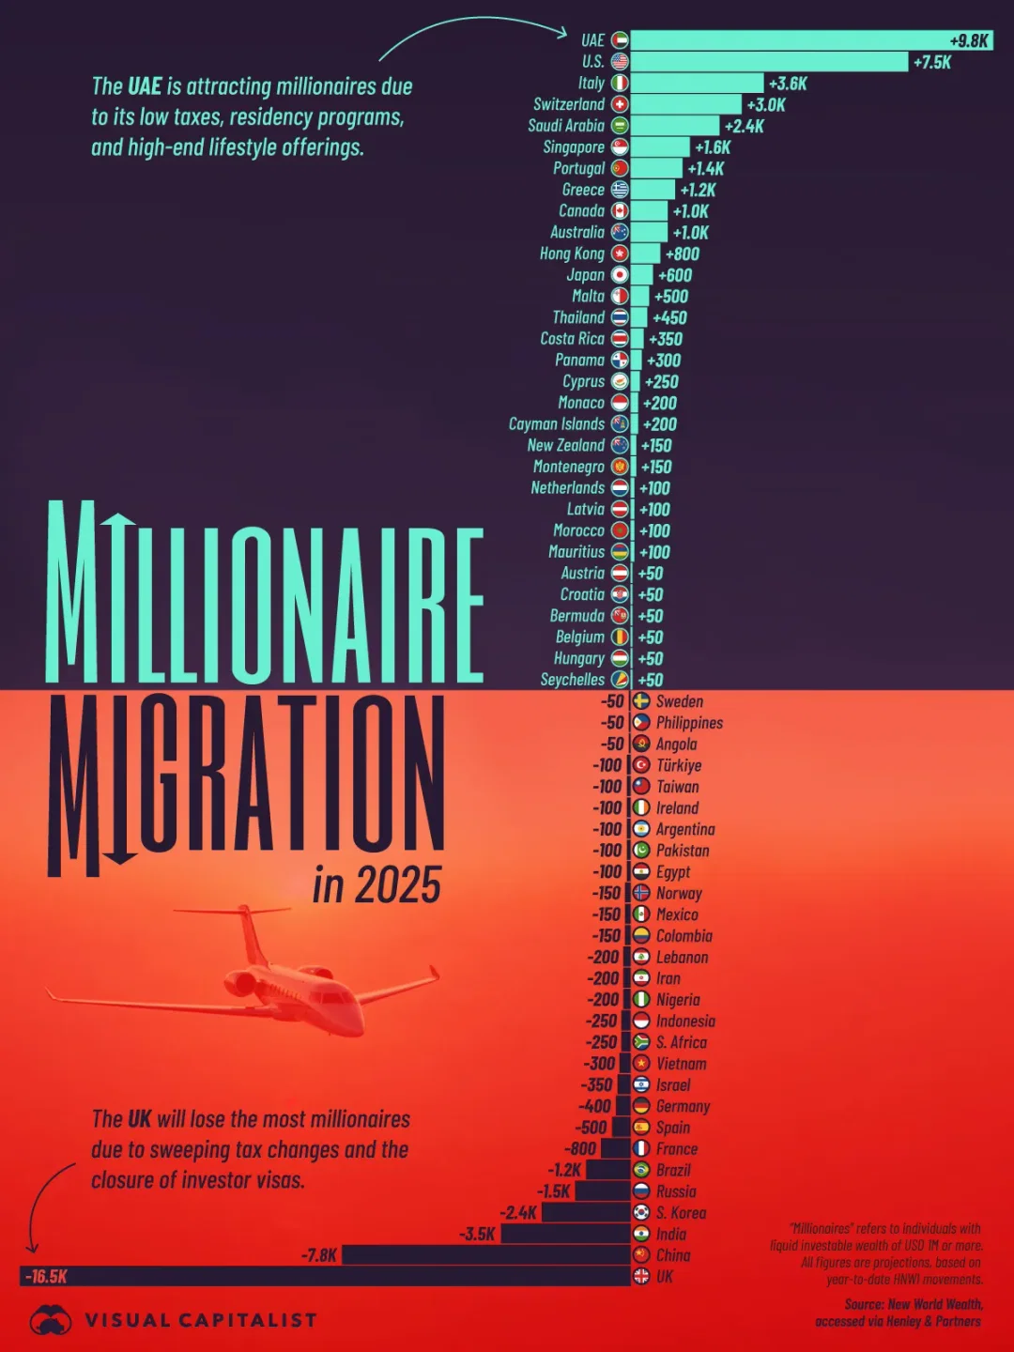

Slide 6
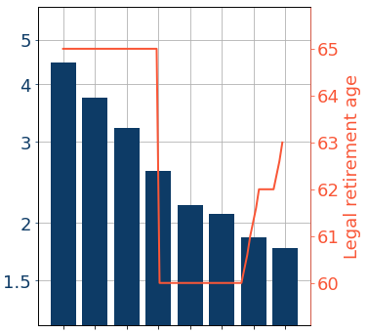
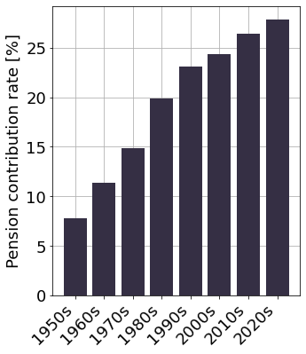
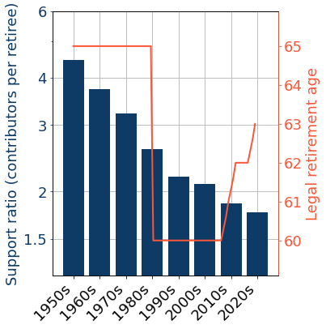
EU average
65.6
Mitterand
Macron
Sarkozy
Pension payroll contribution rate [employee + employer]
The cost of earning points has risen sharply over time

