Slide 1
Internet of things
MQTT : a communication Protocol

Slide 2
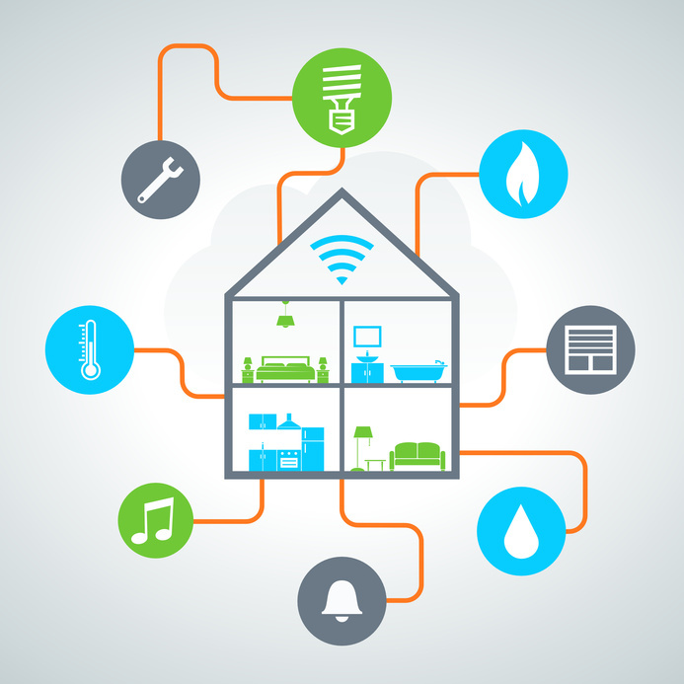
Dire ici que l’IoT sont l’avenir, on est au debut et c’est un veritable enjeu economique
Donner exemple domotique etc

Slide 3
MQTT : Message Queuing Telemetry Transport
Andy Stanford-Clark (IBM) and Arlen Nipper (Eurotec) in 1999
Used in IoT
Low energy protocol
TCP/IP protocol

Slide 4
Use of MQTT
The IoT : of course
Smart home
Wearable
Facebook Messenger

Slide 5
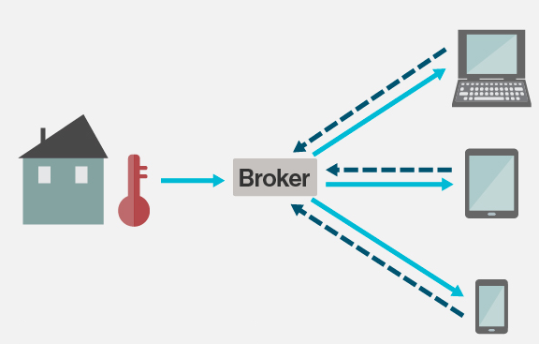
How it works
Subscriber: Device who need data
Publisher: Device who has data and share it
Broker: Intermediary between the subscriber and publisher
In our case:
Subscriber: a graphic user interface (computer/smartphone)
Publisher: a sensor (temperature, light etc..)

Slide 6
Security and MQTT
Username and password
No encryption
Crypt with SSL

