Slide 1
Template based diagram generation
Florian Noyrit
December the 2nd 2010

Slide 2
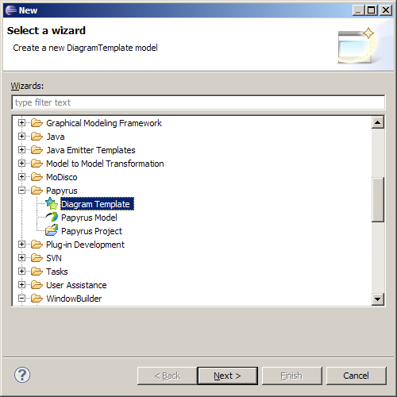
Create a new diagram template

Slide 3
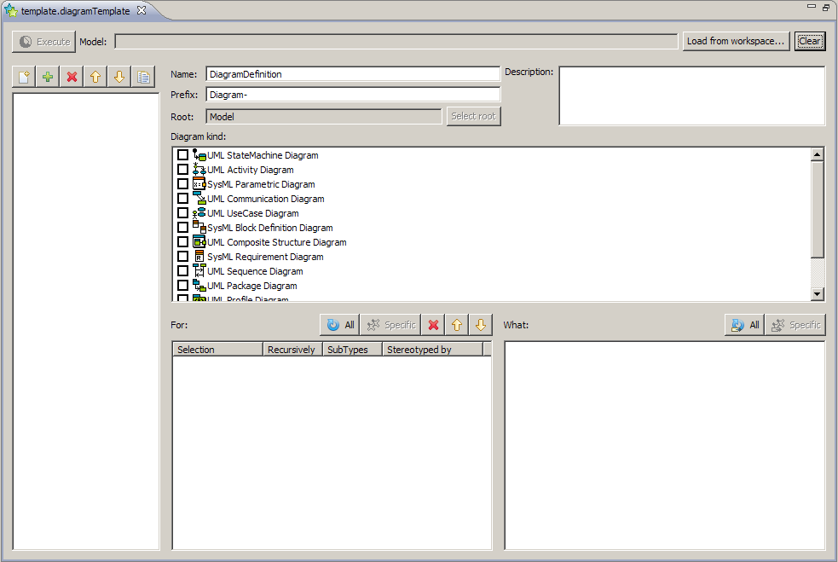
Editor overview
Name of the diagram definition
Prefix used to name the diagram: prefix+name of the owner
Root to start search
The model to apply the template on
Clear specific information: remove application on a specific model
Diagram definitions
The kind of diagram to create
For which element a diagram should be created and What should be shown in it
Recursively means that the search for elements will be done recursively from the root
Subtypes means that the search for elements will try to mach the type specified AND its subtypes
Stereotyped by is a string consisting of comma separated qualified names of stereotypes (e.g. SysML::Blocks::Block). The search will try to match this stereotype applications
Select what should be shown

Slide 4
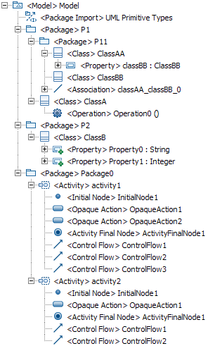
Case study
Create class diagrams for all packages
Show classes
Show attributes and operations
Show associations
Create an activity diagram for activity1
Show ControlFlows

Slide 5
Template editor
Create generic templates
Apply template to a specific model
Execute the template

Slide 6
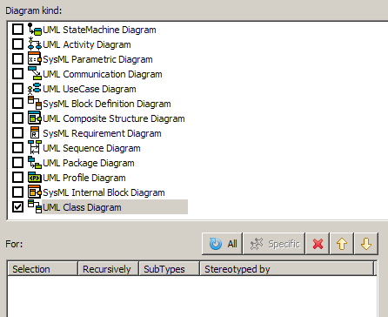
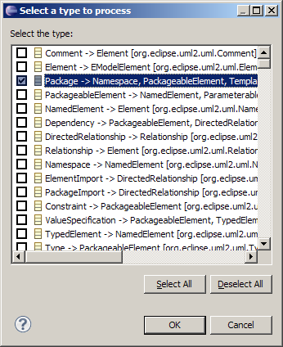
Create generic templates Create class diagrams for all packages
3-Select the type of the element you want to create diagrams for. Here, select Package
1-Select a diagram kind to create
2-Select “All”

Slide 7
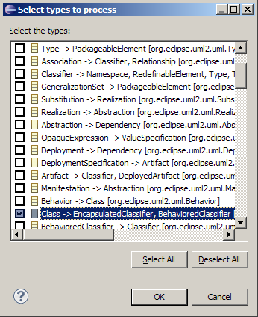
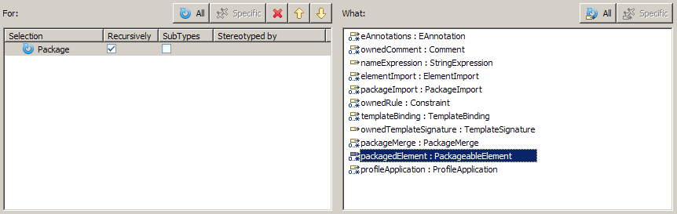
Create generic templates Show classes
1-We want to create diagrams for all packages recursively
3-We want to process all the classes
2-We want to add Classes: these are packagedElements
4-Select Class

Slide 8
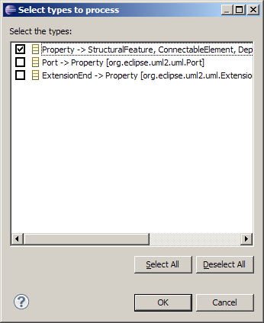
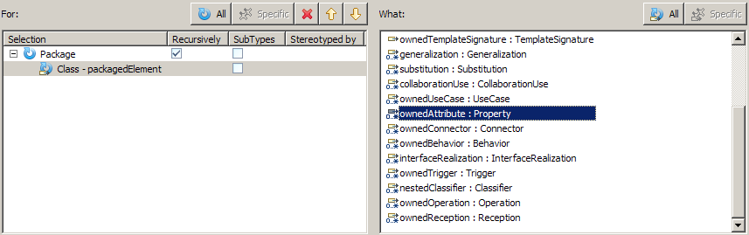
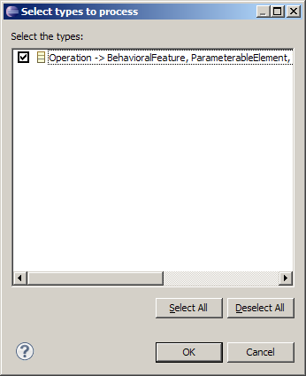
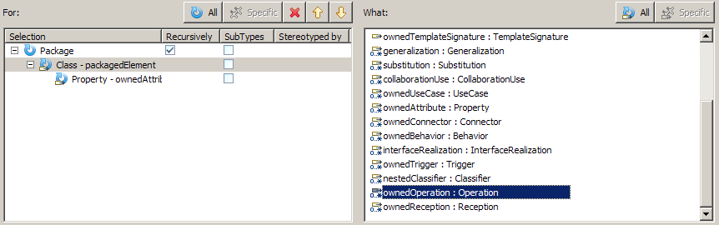
Create generic templates Show attributes and operations
1-Select the “All classes”
3-We want to process them all
4-Select Property
2-We want to add Attributes
6-Select Operation
5-We want to add Operations

Slide 9
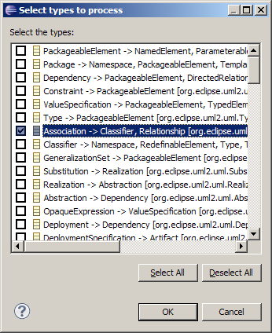
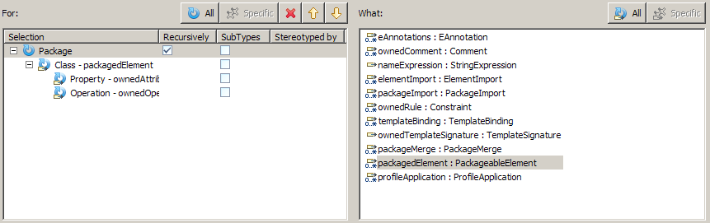
Create generic templates Show associations
3-We want to add them all
1-Select the “All packages”
2-We want to add Associations (which are packagedElements)
4-Select Association

Slide 10
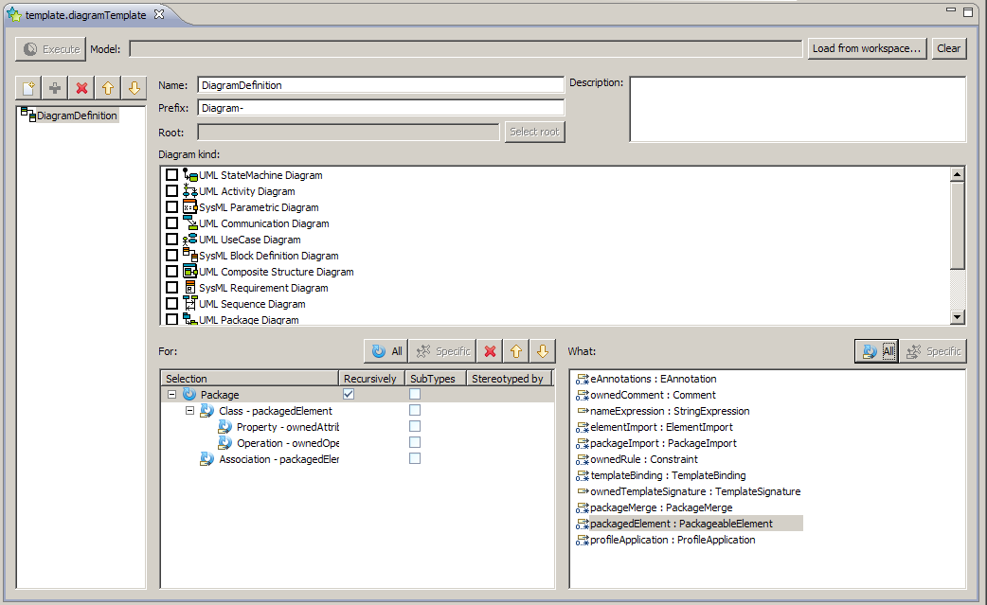
Create generic templates
Add this diagram definition
At this stage, the template is generic

Slide 11
Apply template to a specific model
1-Select a UML model to apply this template on
2-Create a new diagram definition

Slide 12
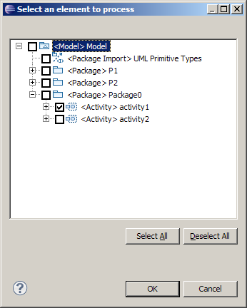
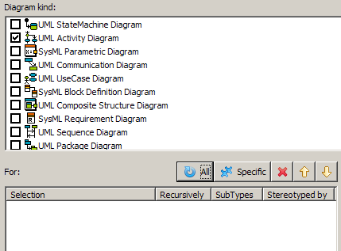
Apply template to a specific model Create an activity diagram for activity1
3-Select the element you want to create the diagram for. Here, select activity1
1-Select a diagram kind to create
2-Select “Specific”

Slide 13
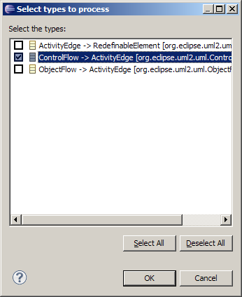
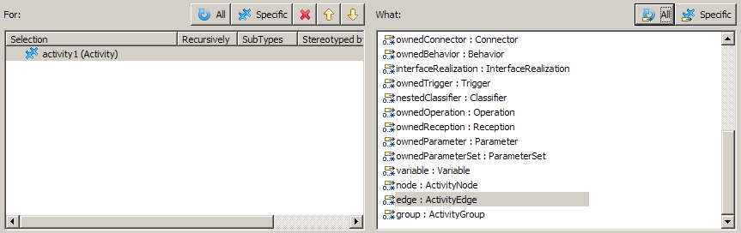
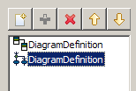
Apply template to a specific model Show ControlFlows
3-We want to add them all
1-Select the “specific activity1”
2-We want to add ControlFlows (which are edges)
4-Select ControlFlow
5-Add this diagram definition

Slide 14
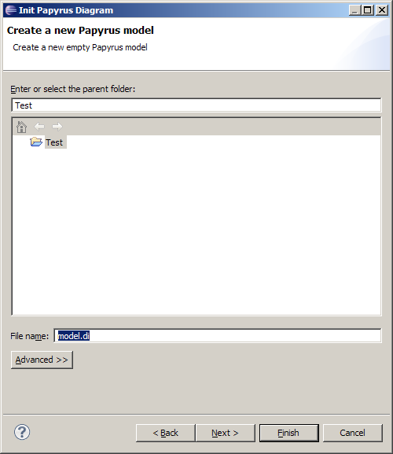
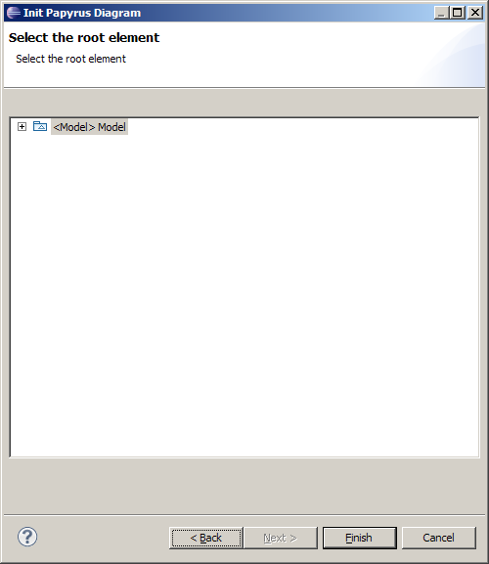
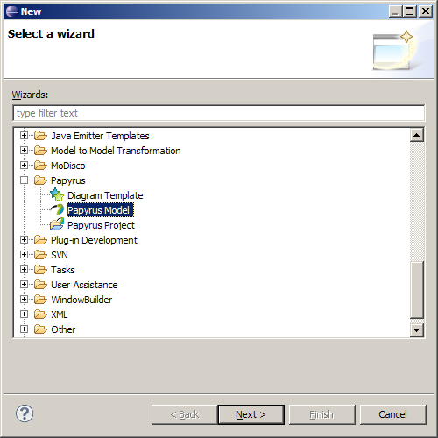
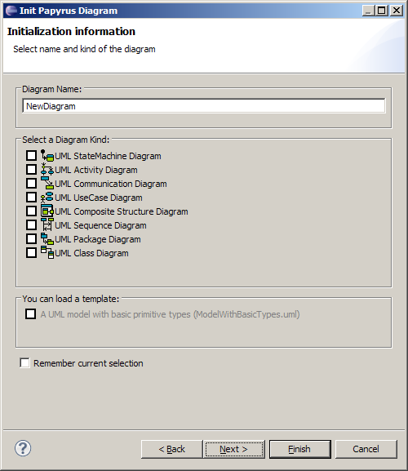
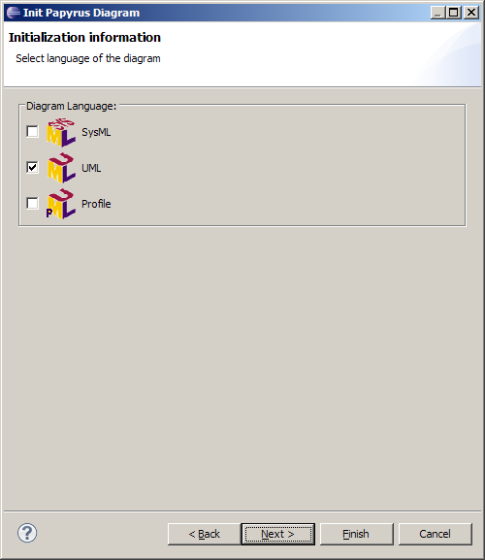
Execute the template
An empty Papyrus diagram must be created for the UML model: use the Papyrus wizard

Slide 15
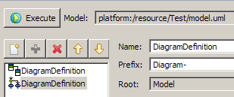
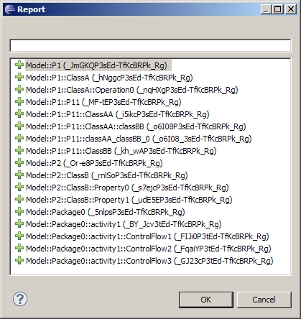
Execute the template
2-You get a report of what has been added (green +). If something matches the template definition but failed to be shown on a diagram or a diagram cannot be created, you will get a red X for it
1-When your template is defined : Execute

Slide 16
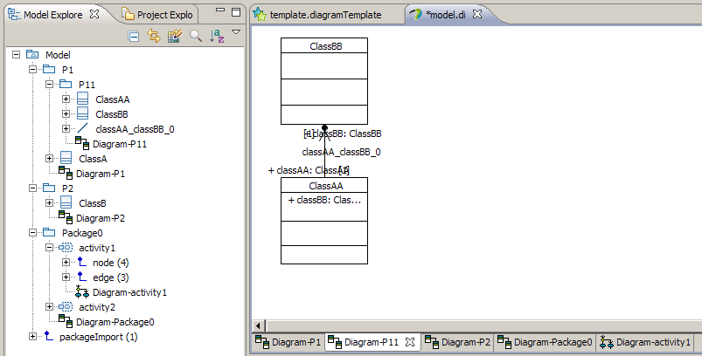
Result

Slide 17
Limitations and Future work
If the drag and drop feature is not well implemented then the diagram generation will fail
Post a bug to the developer responsible for the diagram that failed.
Expressivity is clearly not enough
Use queries (Modisco) to define :
for which elements diagrams are to be created
what to show on each diagram
Layout of generated diagrams is not always adequate
Post process generation with advanced auto layout algos
Let the template designer choose which layout to apply on a diagram definition
Report is too laconic
A verbose trace should be generated

