Slide 1
Feuille de route Projet
Dernière séance de TP le 09/05/23
Présentation des posters 30/06 (l’année passée)
Le rapport 25-30 pages

Slide 2
Instructa bles
https://www.instructables.com/search/?q=gps%20tracker&projects=all

Slide 3
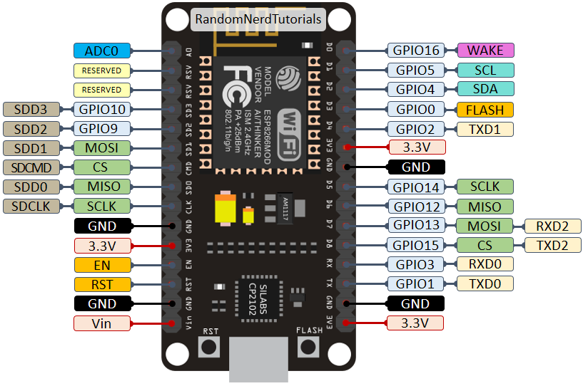
https://randomnerdtutorials.com/esp8266-pinout-reference-gpios/

Slide 4
plerup / espsoftwareserial
https://github.com/plerup/espsoftwareserial/
Pas utile finalement, on utilise plutôt SoftwareSerial inclue de base dans Arduino

Slide 5
#include <SoftwareSerial.h>
#define MYPORT_TX 12
#define MYPORT_RX 13
SoftwareSerial myPort;
[...]
Serial.begin(115200); // Standard hardware serial port
myPort.begin(38400, SWSERIAL_8N1, MYPORT_RX, MYPORT_TX, false);
if (!myPort) { // If the object did not initialize, then its configuration is invalid
Serial.println("Invalid SoftwareSerial pin configuration, check config");
while (1) { // Don't continue with invalid configuration
delay (1000);
}
}

Slide 6
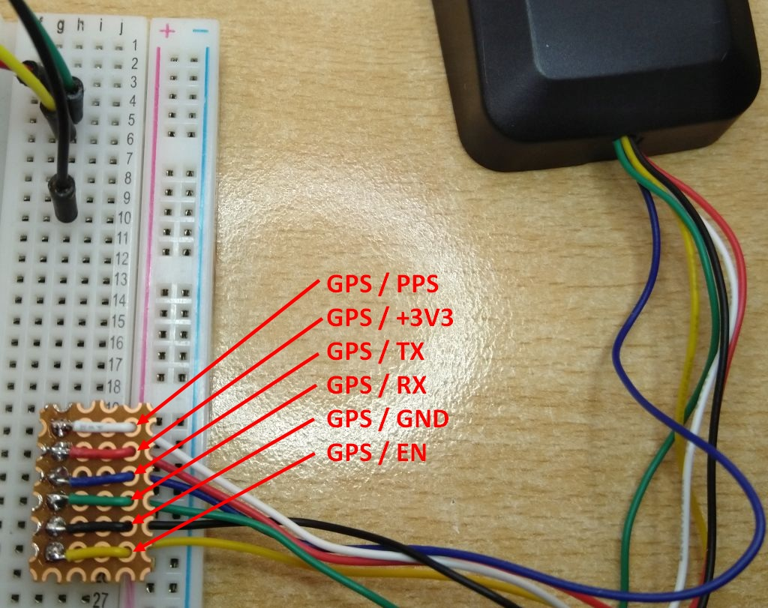
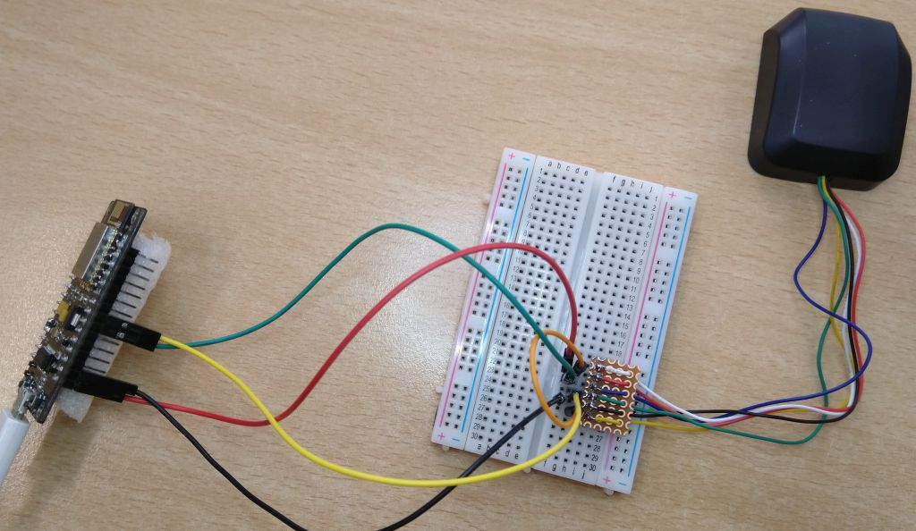
Test de l’assistant(08/02/23): branchements

Slide 7
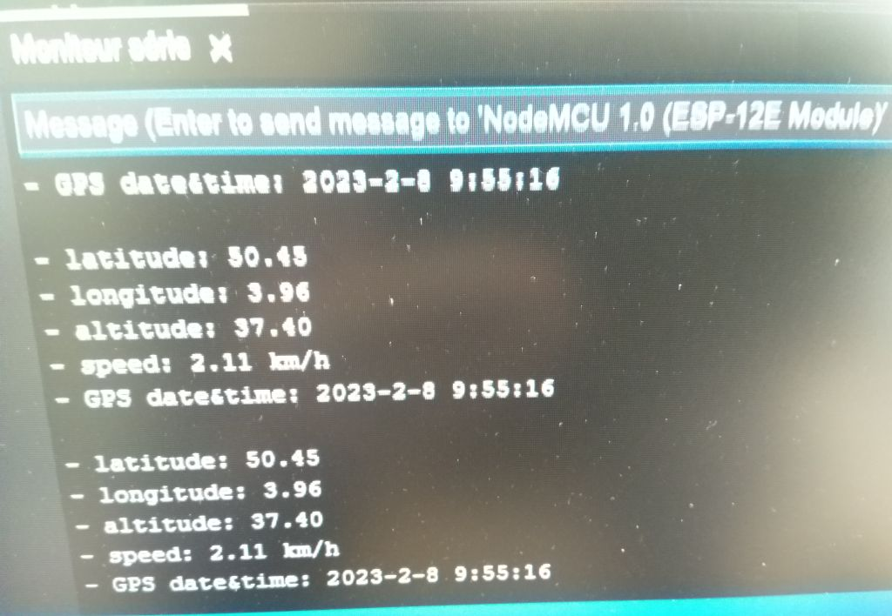
Test de l’assistant(08/02/23): Output
Output du programme « GPS_Communication.ino » Bibliothèque utilisée: https://github.com/mikalhart/TinyGPSPlus

Slide 8
TinyGPSplus
TinyGPS++ is a new Arduino library for parsing NMEA data streams provided by GPS modules.

Slide 9
TinyGPSplus: Toutes les données extractables
Serial.println(gps.location.lat(), 6); // Latitude in degrees (double)
Serial.println(gps.location.lng(), 6); // Longitude in degrees (double)
Serial.print(gps.location.rawLat().negative ? "-" : "+");
Serial.println(gps.location.rawLat().deg); // Raw latitude in whole degrees
Serial.println(gps.location.rawLat().billionths);// ... and billionths (u16/u32)
Serial.print(gps.location.rawLng().negative ? "-" : "+");
Serial.println(gps.location.rawLng().deg); // Raw longitude in whole degrees
Serial.println(gps.location.rawLng().billionths);// ... and billionths (u16/u32)
Serial.println(gps.date.value()); // Raw date in DDMMYY format (u32)
Serial.println(gps.date.year()); // Year (2000+) (u16)
Serial.println(gps.date.month()); // Month (1-12) (u8)
Serial.println(gps.date.day()); // Day (1-31) (u8)
Serial.println(gps.time.value()); // Raw time in HHMMSSCC format (u32)
Serial.println(gps.time.hour()); // Hour (0-23) (u8)
Serial.println(gps.time.minute()); // Minute (0-59) (u8)
Serial.println(gps.time.second()); // Second (0-59) (u8)
Serial.println(gps.time.centisecond()); // 100ths of a second (0-99) (u8)
Serial.println(gps.speed.value()); // Raw speed in 100ths of a knot (i32)
Serial.println(gps.speed.knots()); // Speed in knots (double)
Serial.println(gps.speed.mph()); // Speed in miles per hour (double)
Serial.println(gps.speed.mps()); // Speed in meters per second (double)
Serial.println(gps.speed.kmph()); // Speed in kilometers per hour (double)
Serial.println(gps.course.value()); // Raw course in 100ths of a degree (i32)
Serial.println(gps.course.deg()); // Course in degrees (double)
Serial.println(gps.altitude.value()); // Raw altitude in centimeters (i32)
Serial.println(gps.altitude.meters()); // Altitude in meters (double)
Serial.println(gps.altitude.miles()); // Altitude in miles (double)
Serial.println(gps.altitude.kilometers()); // Altitude in kilometers (double)
Serial.println(gps.altitude.feet()); // Altitude in feet (double)
Serial.println(gps.satellites.value()); // Number of satellites in use (u32)
Serial.println(gps.hdop.value()); // Horizontal Dim. of Precision (100ths-i32)

Slide 10
Fritzing
Pour faire les schémas électrique

Slide 11
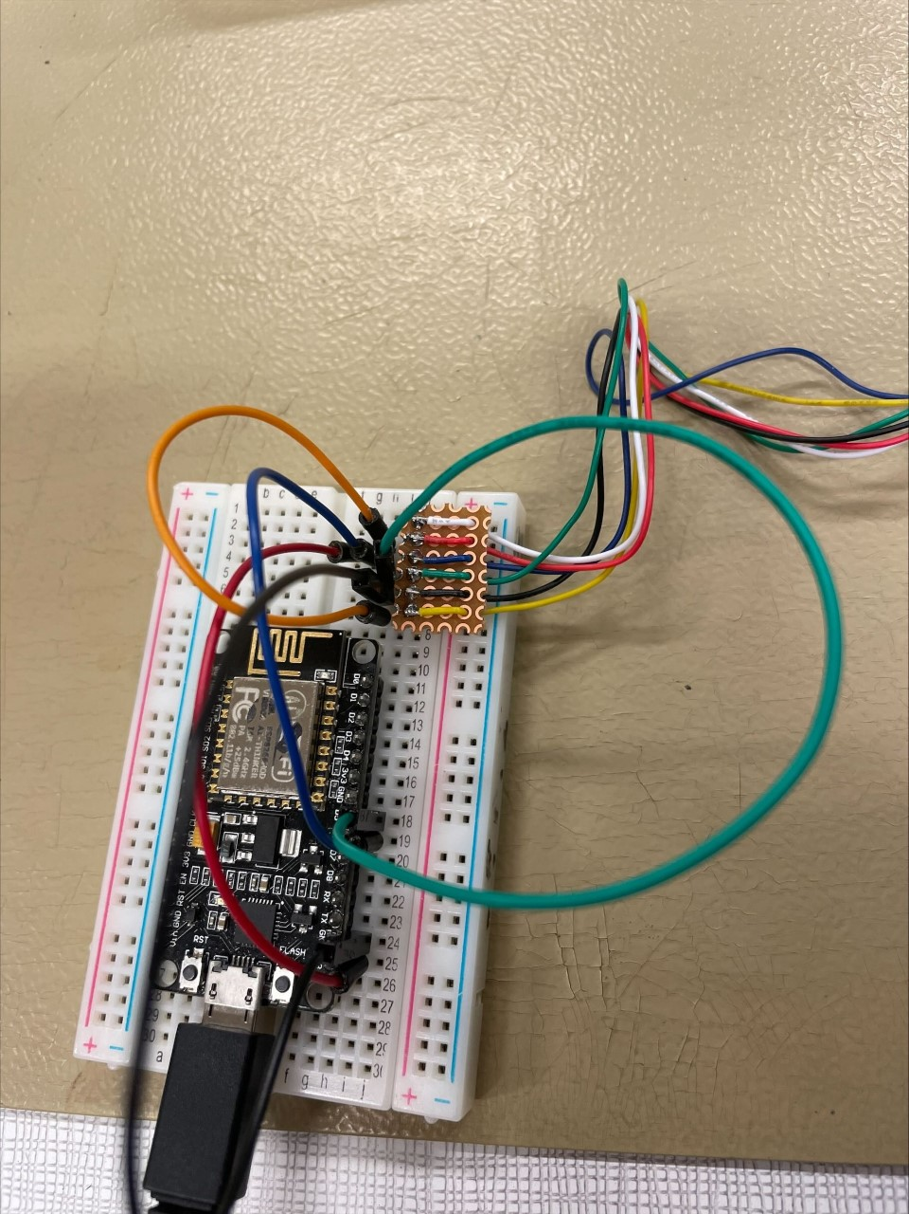
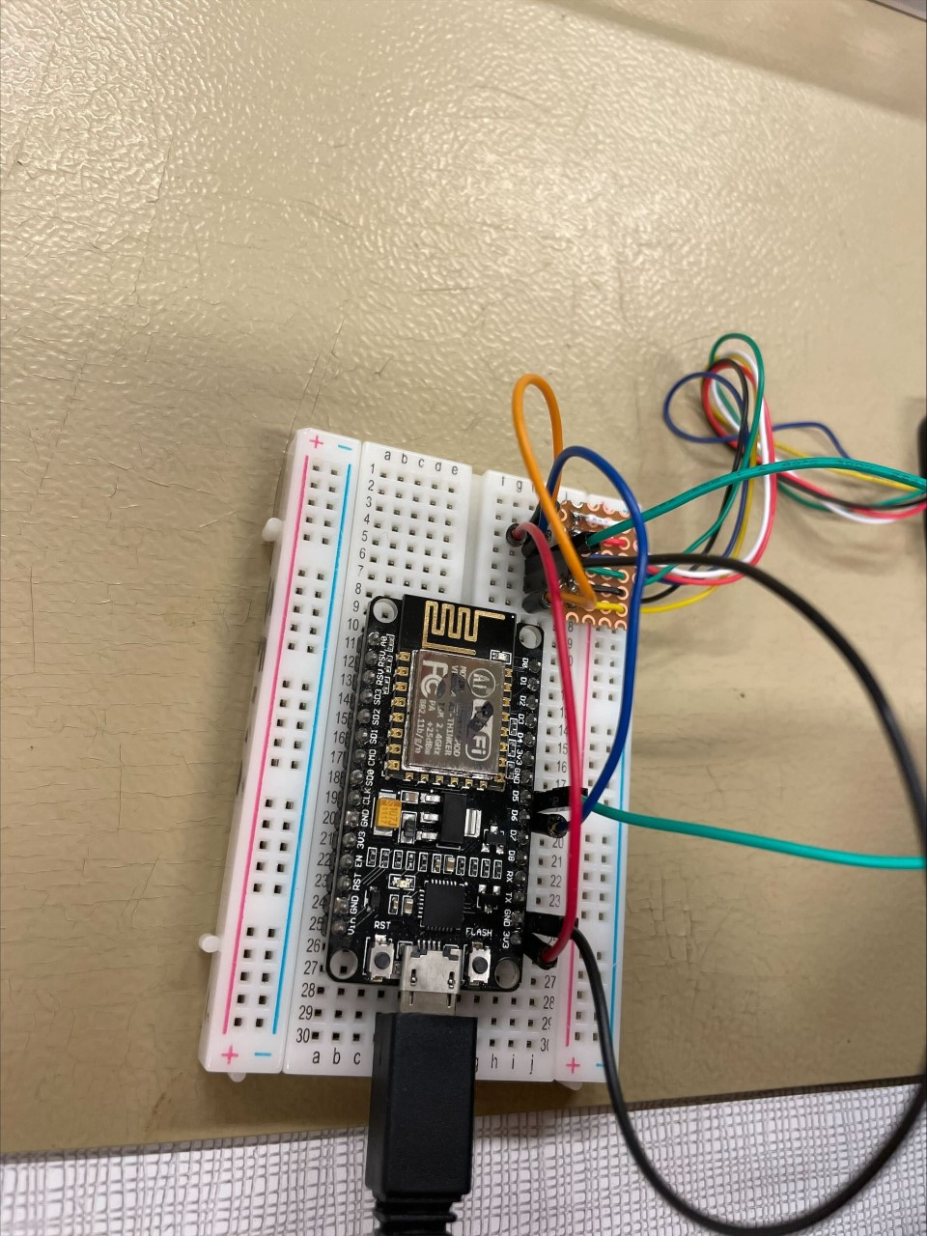
Photos branchements

Slide 12
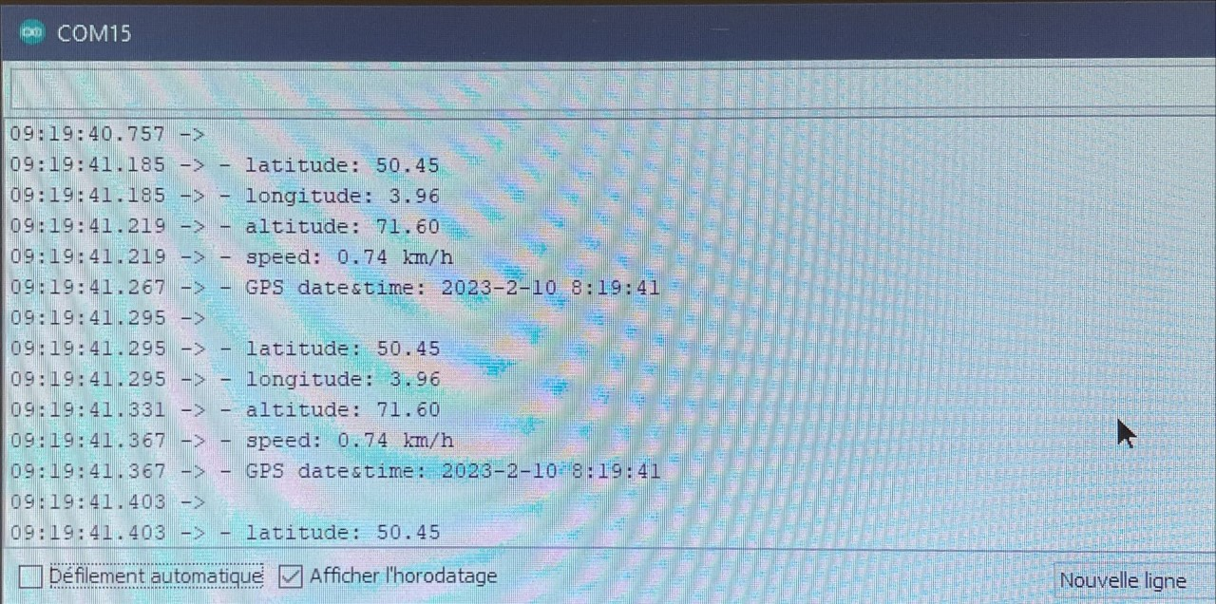
Test 10/02

Slide 13
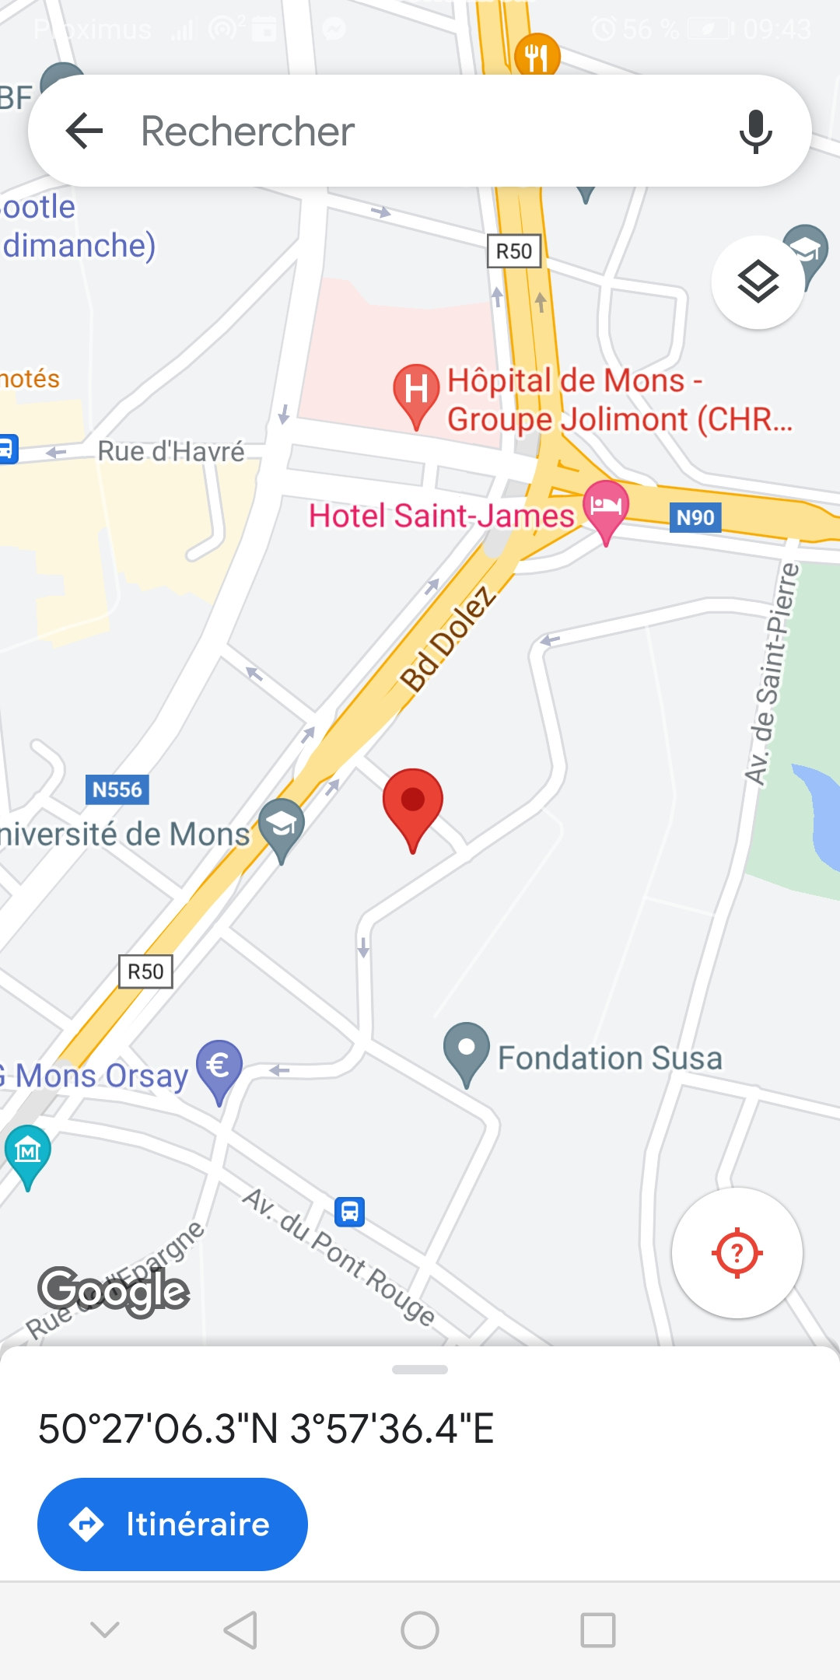
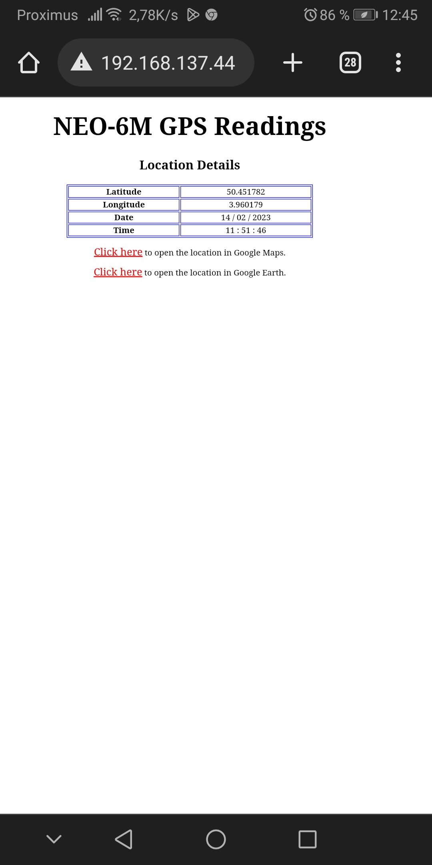
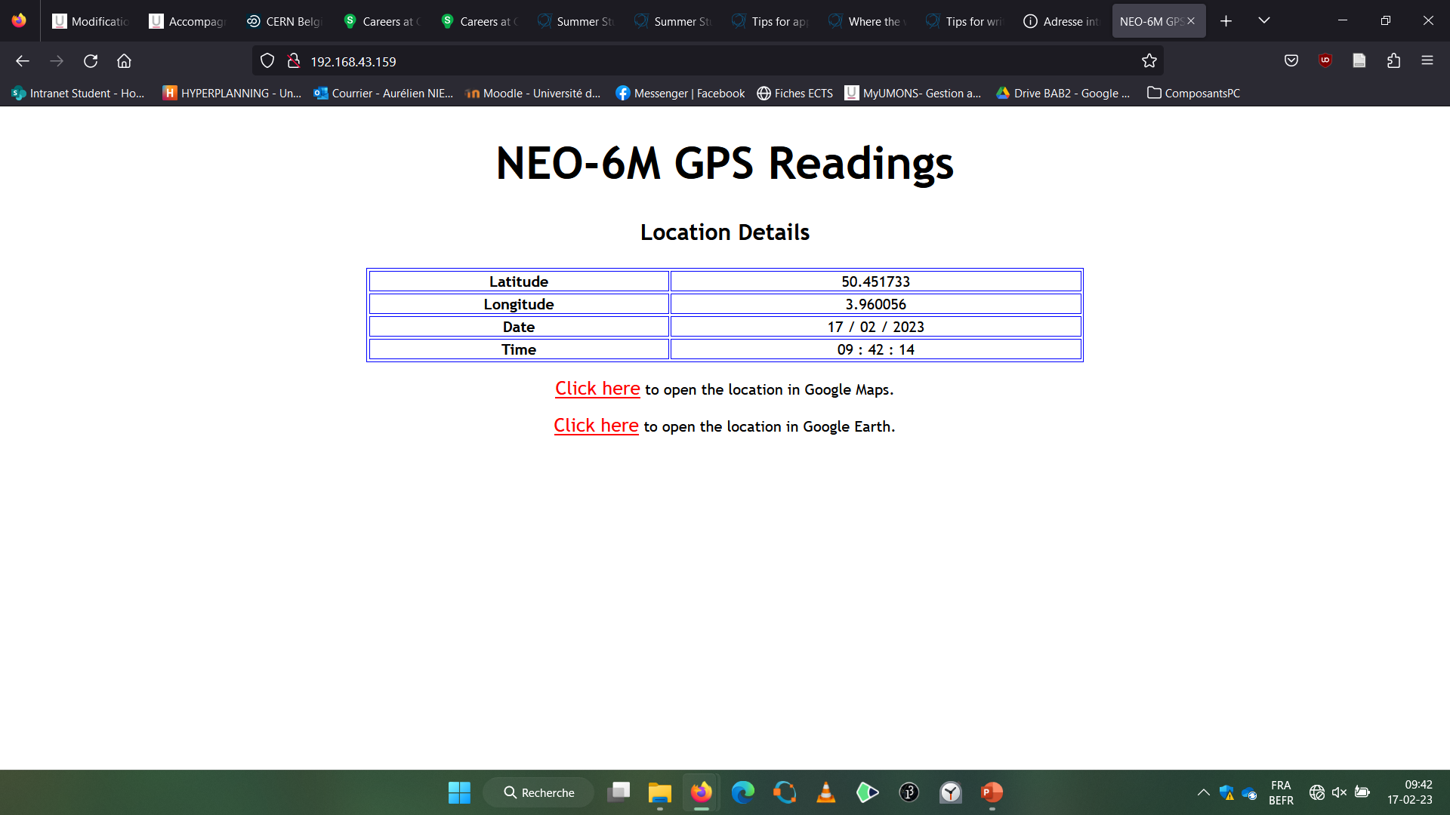
Serveur Web + lien Google Maps
https://microcontrollerslab.com/neo-6m-gps-module-esp8266-nodemcu-track-location-google-maps/

Slide 14
Adresse IP fixe
https://randomnerdtutorials.com/esp8266-nodemcu-static-fixed-ip-address-arduino/

Slide 15
Sauvegarder les données sur carte SD
https://microcontrollerslab.com/gps-data-logger-arduino-micro-sd-card/

