Slide 2
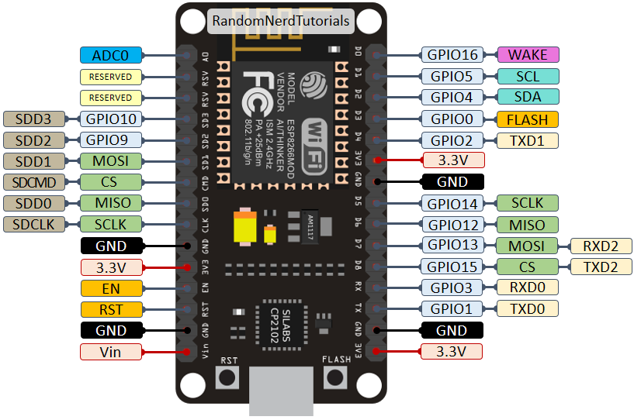

Slide 3
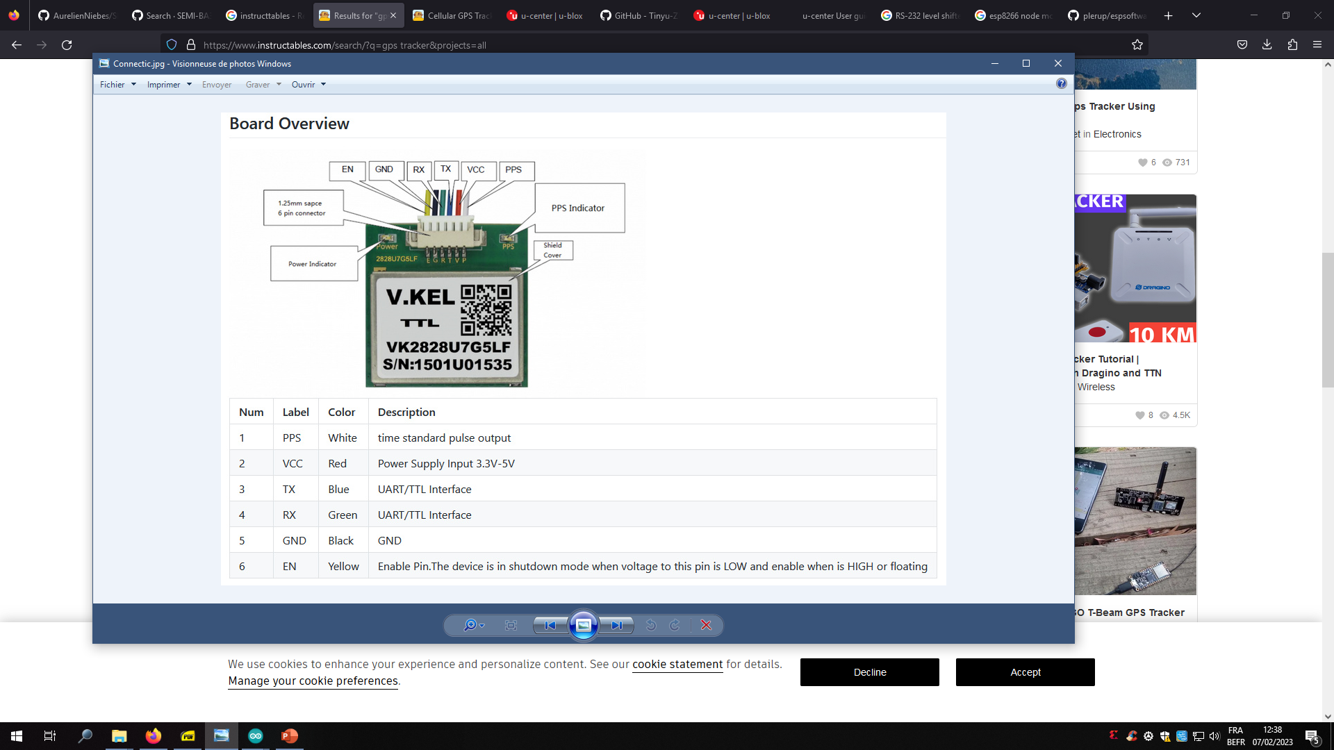

Slide 4
plerup / espsoftwareserial
https://github.com/plerup/espsoftwareserial/

Slide 5
#include <SoftwareSerial.h>
#define MYPORT_TX 12
#define MYPORT_RX 13
SoftwareSerial myPort;
[...]
Serial.begin(115200); // Standard hardware serial port
myPort.begin(38400, SWSERIAL_8N1, MYPORT_RX, MYPORT_TX, false);
if (!myPort) { // If the object did not initialize, then its configuration is invalid
Serial.println("Invalid SoftwareSerial pin configuration, check config");
while (1) { // Don't continue with invalid configuration
delay (1000);
}
}

