Slide 1
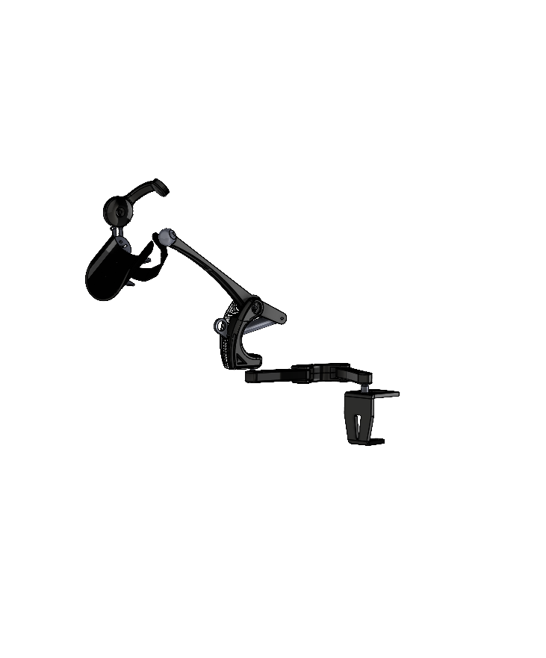



Kinova
$$z_{p}$$
$$y_{p}$$
$$x_{p}$$
Modèle dynamique

Slide 2
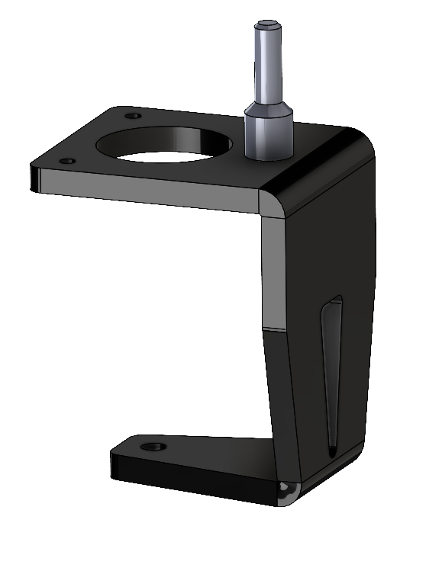










$$z_{0}$$
$$z_{1}$$
Base
« Pièce0.SLDPRT +Piece0_Axe.SLDPRT »
Denavit-Hartenberg
$$y_{1}$$
$$R_{y_{0},π/2}$$
$$x_{1}$$
$$y_{0}$$
$$z_{0^{′}}$$
$$y_{0^{′}}$$
$$x_{0}$$
$$x_{0^{′}}$$

Slide 3
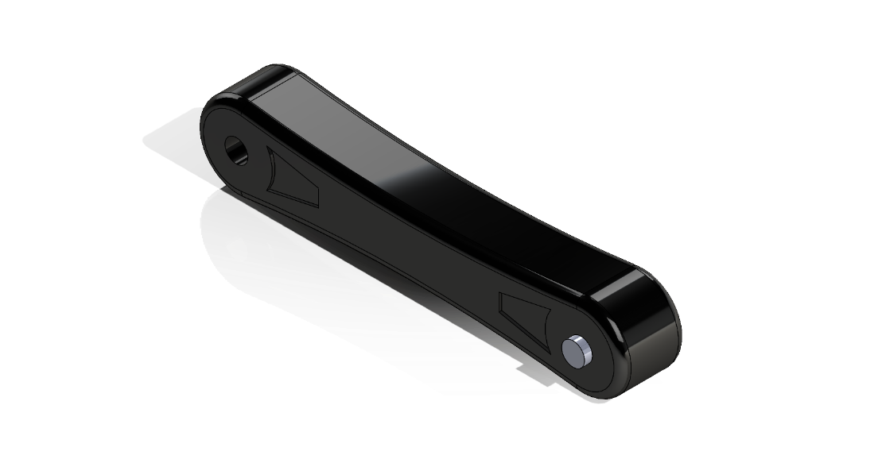
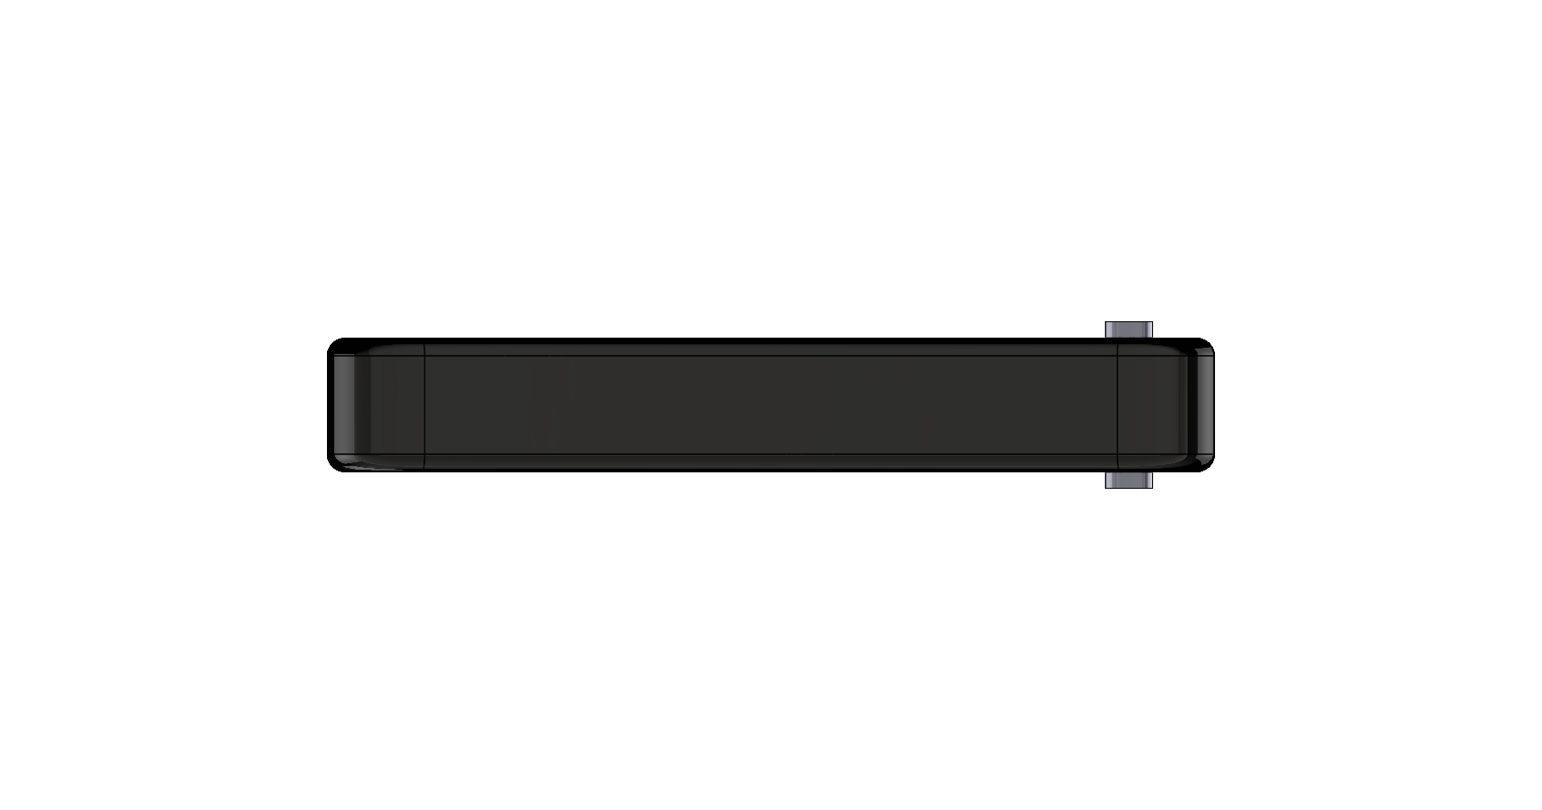





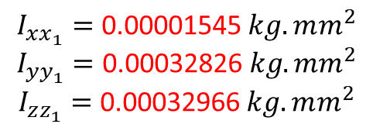


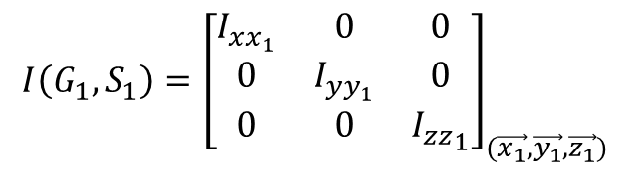




$$I\left(G_{1},S_{1}\right)={\left[\begin{matrix}I_{xx_{1}} & 0 & 0 \\ 0 & I_{yy_{1}} & 0 \\ 0 & 0 & {I_{zz}}_{1}\end{matrix}\right]}_{(\vec{x_{1}},\vec{y_{1}},\vec{z_{1}})}$$
Solide 1
$$\vec{O_{1}G_{1}}=b_{1}\vec{x_{1}}$$
$$\vec{O_{1}A_{1}}=l_{1}\vec{x_{1}}$$
$$I_{xx_{1}}=\text{0.00001545} kg.mm^{2}$$
$$I_{yy_{1}}=\text{0.00032826} kg.mm^{2}$$
$$I_{zz_{1}}=\text{0.00032966} kg.mm^{2}$$
$$b_{1}\text{=} \text{0.06110784} \text{m}$$
$$l_{1}\text{= 120 }\text{mm}$$
$$m_{1}\text{=0,172 }\text{kg}$$
$$V_{1} = 76225.68 mm^{3}$$
$$z_{1}$$
$$G_{1}$$
$$A_{1}$$
$$y_{1}$$
$$x_{1}$$

Slide 4





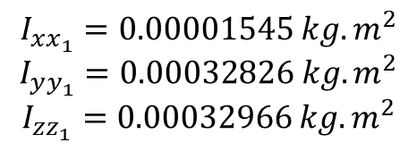




$$I\left(G_{1},S_{1}\right)={\left[\begin{matrix}I_{xx_{1}} & 0 & 0 \\ 0 & I_{yy_{1}} & 0 \\ 0 & 0 & {I_{zz}}_{1}\end{matrix}\right]}_{(\vec{x_{1}},\vec{y_{1}},\vec{z_{1}})}$$
Solide 1 Reverse
« Piece1.SLDASM »
${\vec{A_{1}G_{1}}}_{R_{2}}=b_{1}\vec{x_{1}}$ a1?
$${\vec{A_{1}O_{1}}}_{R_{2}}=l_{1}\vec{x_{1}}$$
$$I_{xx_{1}}=0.00001545 kg.m^{2}$$
$$I_{yy_{1}}=0.00032826 kg.m^{2}$$
$$I_{zz_{1}}=0.00032966 kg.m^{2}$$
$$b_{1}\text{=}\text{−0.05889216} \text{m}$$
$$l_{1}\text{= −120 }\text{mm}$$
$$m_{1}\text{=0,172 }\text{kg}$$
$$V_{1} = 76225.68 mm^{3}$$
$$z_{1}$$
$$z_{2}$$
$$z_{4}$$
$$O_{1}$$
$$G_{1}$$
$$A_{1}$$
$$y_{1}$$
$$y_{2}$$
$$x_{1}$$
$$x_{2}$$

Slide 5
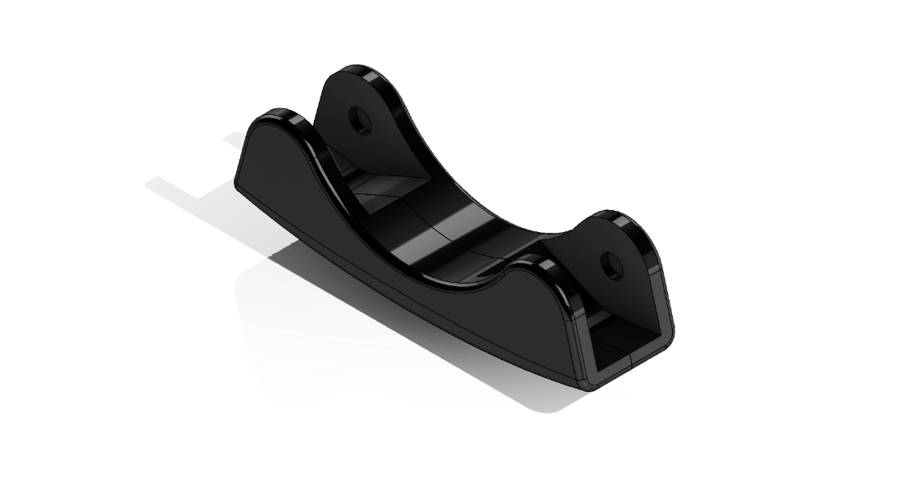
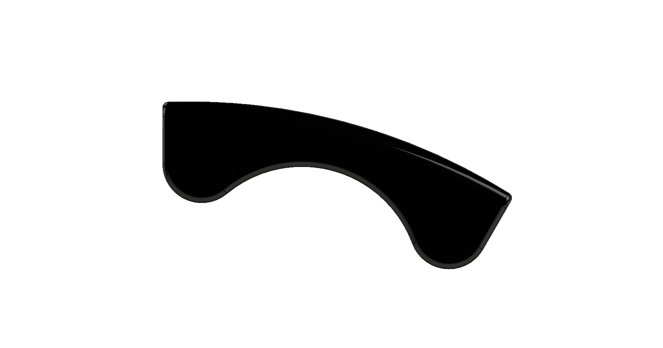
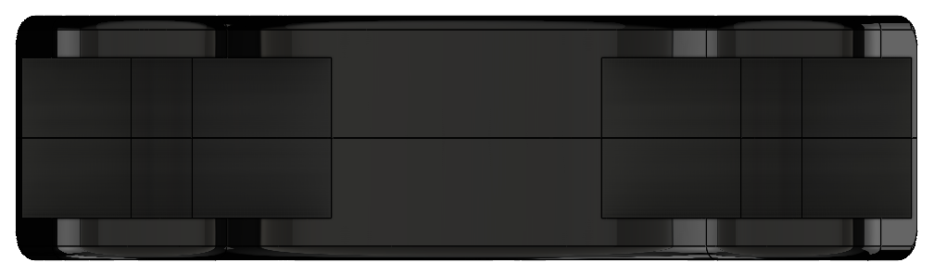

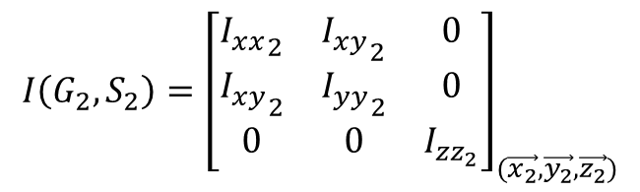
















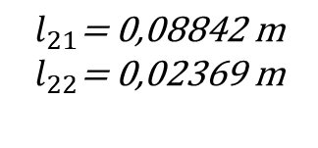

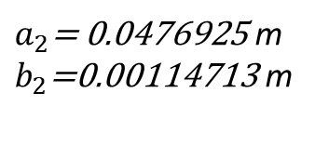
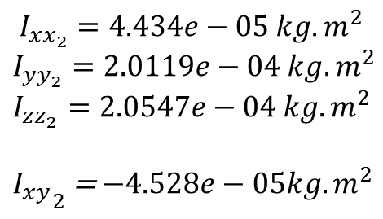


$$I\left(G_{2},S_{2}\right)={\left[\begin{matrix}{I_{xx}}_{2} & {I_{xy}}_{2} & 0 \\ {I_{xy}}_{2} & {I_{yy}}_{2} & 0 \\ 0 & 0 & I_{zz_{2}}\end{matrix}\right]}_{(\vec{x_{2}},\vec{y_{2}},\vec{z_{2}})}$$
Solide 2
check
$$\vec{O_{2}G_{2}}=a_{2}\vec{x_{2}}+b_{2}\vec{y_{2}}$$
$$\vec{O_{2}A_{2}}=l_{21}\vec{x_{2}}+l_{22}\vec{y_{2}}$$
$$I_{xx_{2}}=4.434e−05 kg.m^{2}$$
$$I_{yy_{2}}=2.0119e−04 kg.m^{2}$$
$$I_{zz_{2}}=2.0547e−04 kg.m^{2}$$
${I_{xy}}_{2}$ = $−4.528e−05kg.m^{2}$
$a_{2}\text{= }\text{0.0476925}$ m
$b_{2}\text{=}\text{0.00114713}$ m
$$y_{2}$$
$$l_{21}\text{= 0,08842 }\text{m}$$
$$l_{22}\text{= 0,02369 }\text{m}$$
$$x_{2}$$
$$m_{2}\text{=0,164 }\text{kg}$$
$$V_{2} =7.613e−05 m^{3}$$
$$y_{3}$$
$$y_{2}$$
$$x_{3}$$
$$θ$$
$$z_{2}$$
$$θ=−30°$$
$$y_{3}$$
$$G_{2}$$
$$A_{2}$$
$$x_{2}$$
$$y_{2}$$
$$θ$$
$$x_{3}$$
$$x_{2}$$

Slide 6
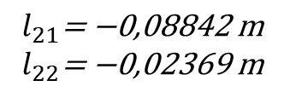
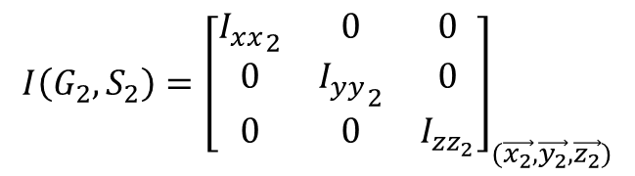


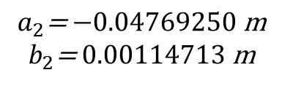








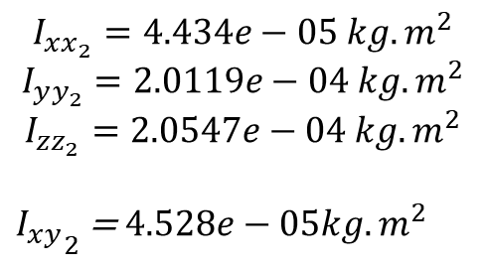



$$I\left(G_{2},S_{2}\right)={\left[\begin{matrix}{I_{xx}}_{2} & 0 & 0 \\ 0 & {I_{yy}}_{2} & 0 \\ 0 & 0 & I_{zz_{2}}\end{matrix}\right]}_{(\vec{x_{2}},\vec{y_{2}},\vec{z_{2}})}$$
Solide 2 Reverse gauche
« Piece2_gauche.SLDASM »
$${\vec{A_{2}G_{2}}}_{R_{3}}=a_{2}\vec{x_{2}}+b_{2}\vec{y_{2}}$$
${\vec{A_{2}O_{2}}}_{R_{3}}=l_{21}\vec{x_{3}}$ $+l_{22}\vec{y_{3}}$
$$I_{xx_{2}}=4.434e−05 kg.m^{2}$$
$$I_{yy_{2}}=2.0119e−04 kg.m^{2}$$
$$I_{zz_{2}}=2.0547e−04 kg.m^{2}$$
${I_{xy}}_{2}$ = $4.528e−05kg.m^{2}$
$$a_{2}\text{=} \text{−0.0}\text{4769250} \text{m}$$
$$b_{2}\text{=} \text{0.0}\text{0}\text{1}\text{14713} \text{m}$$
$$y_{3}$$
$$l_{21}\text{= −0,}\text{0}\text{8842 }\text{m}$$
$$l_{22}\text{= −0,}\text{0}\text{2369 }\text{m}$$
$$x_{3}$$
$$y_{2}$$
$$m_{2}\text{=0,164 }\text{kg}$$
$$x_{2}$$
$$V_{2} =7.613e−05 m^{3}$$
$$y_{3}$$
$$y_{2}$$
$$z_{2}$$
$$x_{3}$$
$$A_{2}$$
$$θ=−30°$$
$$G_{2}$$
$$x_{2}$$
$$y_{2}$$
$$θ$$
$$x_{2}$$

Slide 7
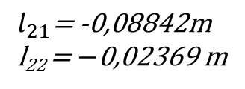


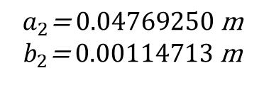


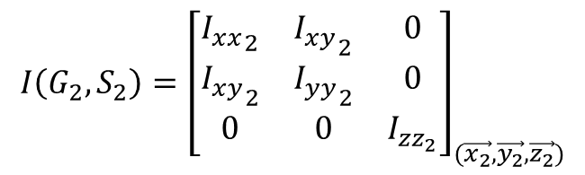


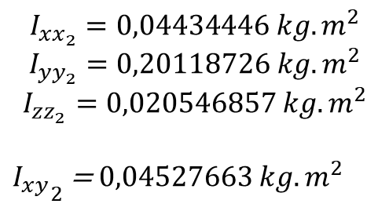






$$I\left(G_{2},S_{2}\right)={\left[\begin{matrix}{I_{xx}}_{2} & {I_{xy}}_{2} & 0 \\ {I_{xy}}_{2} & {I_{yy}}_{2} & 0 \\ 0 & 0 & I_{zz_{2}}\end{matrix}\right]}_{(\vec{x_{2}},\vec{y_{2}},\vec{z_{2}})}$$
Solide 2 V2 Reverse droite
« Piece2_droite.SLDASM »
$${\vec{A_{2}G_{2}}}_{R_{3}}=a_{2}\vec{x_{2}}+b_{2}\vec{y_{2}}$$
$${\vec{A_{2}O_{2}}}_{R_{3}}=l_{21}\vec{x_{2}}+l_{22}\vec{y_{2}}$$
$$I_{xx_{2}}=0,04434446 kg.m^{2}$$
$$I_{yy_{2}}=0,20118726 kg.m^{2}$$
$$I_{zz_{2}}=0,020546857 kg.m^{2}$$
${I_{xy}}_{2}$ = $0,04527663 kg.m^{2}$
$$a_{2}\text{=} \text{0.04}\text{769250} \text{m}$$
$$b_{2}\text{=} \text{0.0}\text{0114713} \text{m}$$
$$y_{2}$$
$$l_{21}\text{=}\text{ -}\text{0,08842}\text{m}$$
l₂₂ = $−\text{0,02369 }$m
$$x_{2}$$
$$m_{2}\text{=0,164 }\text{kg}$$
$$V_{2} =7.613e−05 m^{3}$$
$$y_{2}$$
$$y_{3}$$
$$y_{3}$$
$$θ=30°$$
$$x_{3}$$
$$θ$$
$$z_{2}$$
$$x_{2}$$
$$G_{2}$$
$$A_{2}$$
$$x_{3}$$
$$y_{2}$$
$$θ$$
$$x_{2}$$

Slide 8




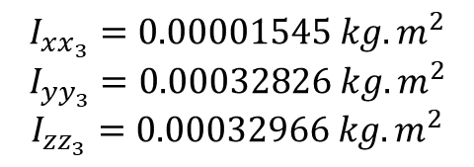


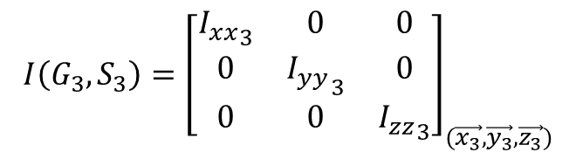





$$I\left(G_{3},S_{3}\right)={\left[\begin{matrix}{I_{xx}}_{3} & 0 & 0 \\ 0 & {I_{yy}}_{3} & 0 \\ 0 & 0 & {I_{zz}}_{3}\end{matrix}\right]}_{(\vec{x_{3}},\vec{y_{3}},\vec{z_{3}})}$$
Solide 3
$\vec{O_{3}G_{3}}=b_{3}\vec{x_{3}}$ a3?
$$\vec{O_{3}A_{3}}=l_{3}\vec{x_{3}}$$
$$I_{xx_{3}}=0.00001545 kg.m^{2}$$
$$I_{yy_{3}}=0.00032826 kg.m^{2}$$
$$I_{zz_{3}}=0.00032966 kg.m^{2}$$
$$b_{3}\text{= 0,05889216 }\text{m}$$
$$l_{3}\text{= 0,120 }\text{m}$$
$$m_{3}\text{=0,172 }\text{kg}$$
$$V_{3} = 76225.68 mm^{3}$$
$$z_{3}$$
$$G_{3}$$
$$A_{3}$$
$$y_{3}$$
$$x_{3}$$

Slide 9






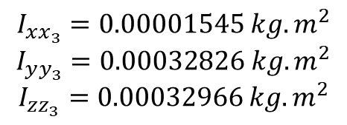



$$I\left(G_{3},S_{3}\right)={\left[\begin{matrix}{I_{xx}}_{3} & 0 & 0 \\ 0 & {I_{yy}}_{3} & 0 \\ 0 & 0 & {I_{zz}}_{3}\end{matrix}\right]}_{(\vec{x_{3}},\vec{y_{3}},\vec{z_{3}})}$$
Solide 3 Reverse
« Piece3.SLDASM »
${\vec{A_{3}G_{3}}}_{|R_{4}}=b_{3}\vec{x_{3}}$ a3?
$${\vec{A_{3}O_{3}}}_{{|R}_{4}}=l_{3}\vec{x_{3}}$$
$$I_{xx_{3}}=0.00001545 kg.m^{2}$$
$$I_{yy_{3}}=0.00032826 kg.m^{2}$$
$$I_{zz_{3}}=0.00032966 kg.m^{2}$$
$$b_{3}\text{=}\text{−}\text{0.06110784} \text{m}$$
$$l_{3}\text{= }\text{−}\text{0,120} \text{m}$$
$$m_{3}\text{=0,172 }\text{kg}$$
$$V_{3} = 76225.68 mm^{3}$$
$$z_{3}$$
$$z_{4}$$
$$z_{4}$$
$$G_{3}$$
$$A_{3}$$
$$O_{3}$$
$$y_{3}$$
$$y_{4}$$
$$x_{3}$$
$$x_{4}$$

Slide 10
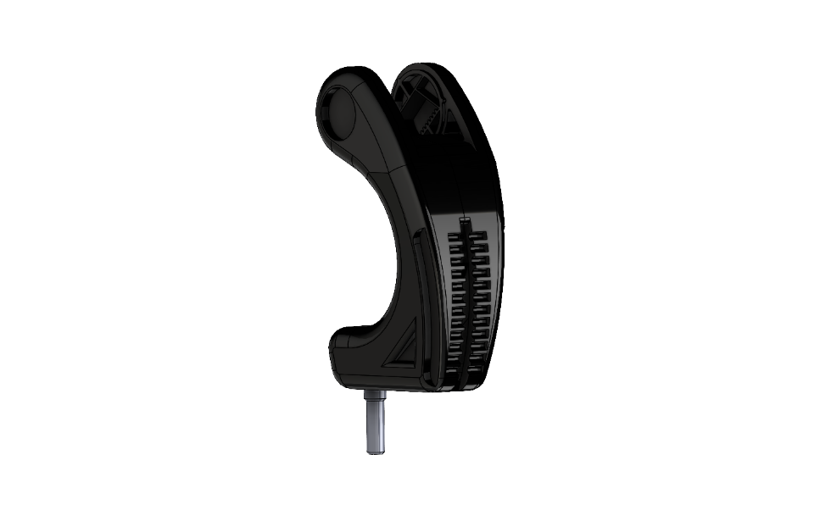
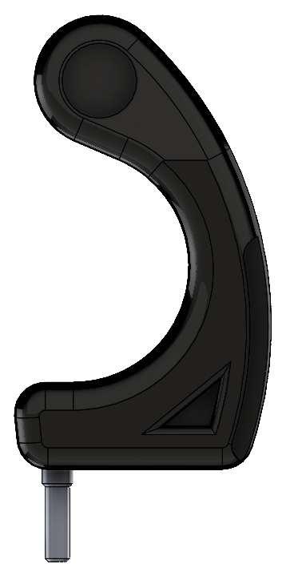



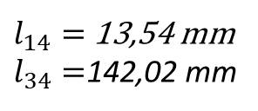

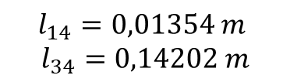
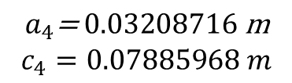
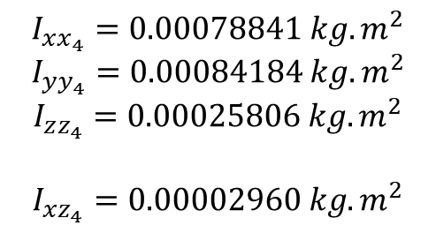


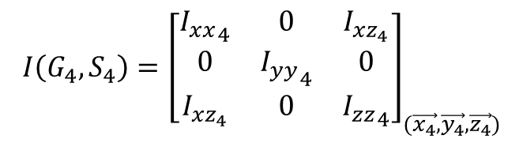



$$I\left(G_{4},S_{4}\right)={\left[\begin{matrix}{I_{xx}}_{4} & 0 & I_{xz_{4}} \\ 0 & {I_{yy}}_{4} & 0 \\ I_{xz_{4}} & 0 & {I_{zz}}_{4}\end{matrix}\right]}_{(\vec{x_{4}},\vec{y_{4}},\vec{z_{4}})}$$
Solide 4
$$\vec{O_{4}G_{4}}=a_{4}\vec{x_{4}}+c_{4}\vec{z_{4}}$$
$$\vec{O_{4}A_{4}}=l_{14}\vec{x_{4}}+l_{34}\vec{z_{4}}$$
$$A_{4}$$
$$I_{xx_{4}}=0.00078841 kg.m^{2}$$
$$I_{yy_{4}}=0.00084184 kg.m^{2}$$
$$I_{zz_{4}}=0.00025806 kg.m^{2}$$
$$I_{xz_{4}}=0.00002960 kg.m^{2}$$
$$a_{4}\text{= }\text{0.03208716} \text{m}$$
$$c_{4}=0.07885968 m$$
$l_{14}=$13,54 mm
$l_{34}=$142,02 mm
$$G_{4}$$
$$m_{4}\text{=0,338 }\text{kg}$$
$$V_{4} =0.00013636 m^{3}$$
Cas pivot
Cas liaison pignon-crémaillère.
$$l_{14}=0,01354 m$$
$$l_{34}=0,14202 m$$
$$z_{4}$$
$$y_{4}$$
Faisable dans biorbd ?
$$x_{4}$$

Slide 11




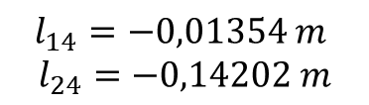


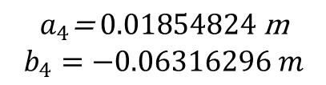
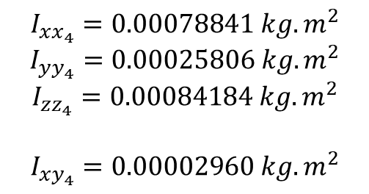


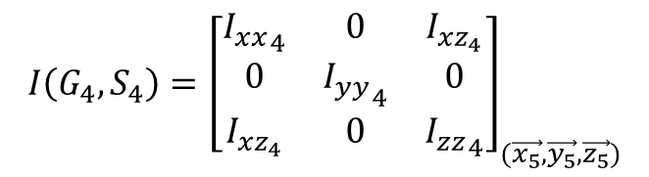




$$I\left(G_{4},S_{4}\right)={\left[\begin{matrix}{I_{xx}}_{4} & 0 & I_{xz_{4}} \\ 0 & {I_{yy}}_{4} & 0 \\ I_{xz_{4}} & 0 & {I_{zz}}_{4}\end{matrix}\right]}_{(\vec{x_{5}},\vec{y_{5}},\vec{z_{5}})}$$
Solide 4 Reverse
« Piece4.SLDASM »
$${\vec{A_{4}G_{4}}}_{|R_{5}}=a_{4}\vec{x_{4}}+b_{4}\vec{y_{4}}$$
$${\vec{{A_{4}O}_{4}}}_{|R_{5}}=l_{14}\vec{x_{4}}+l_{24}\vec{z_{4}}$$
$$A_{4}$$
$$y_{5}$$
$$x_{5}$$
$$I_{xx_{4}}=0.00078841 kg.m^{2}$$
$$I_{yy_{4}}=0.00025806 kg.m^{2}$$
$$I_{zz_{4}}=0.00084184 kg.m^{2}$$
$$I_{xy_{4}}=0.00002960 kg.m^{2}$$
$$z_{5}$$
$$a_{4}\text{= }\text{0.01854824} \text{m}$$
$$b_{4}=−0.06316296 m$$
$l_{14}=$13,54 mm
$l_{34}=$142,02 mm
$$G_{4}$$
$$m_{4}\text{=0,338 }\text{kg}$$
$$z_{4}$$
$$z_{5}$$
$$V_{4} =0.00013636 m^{3}$$
$$θ=−90°$$
Cas pivot
Cas liaison pignon-crémaillère.
$$l_{14}=−0,01354 m$$
$$l_{24}=−0,14202 m$$
$$z_{4}$$
$$θ$$
$$y_{4}$$
$$y_{4}$$
$$y_{5}$$
$$O4$$
Faisable dans biorbd ?
$$x_{4}$$

Slide 12
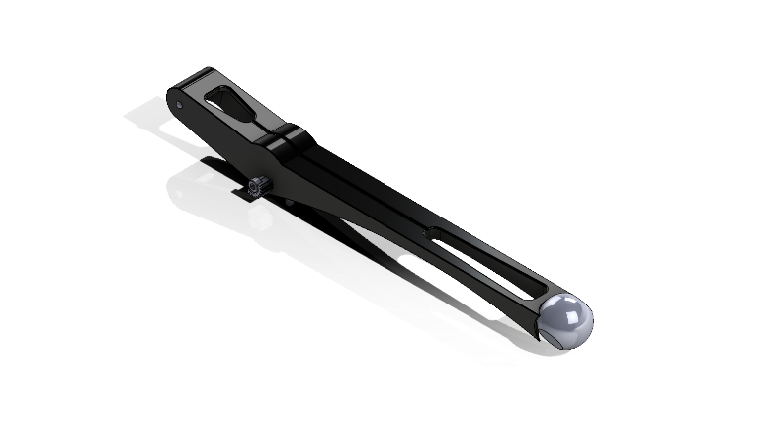
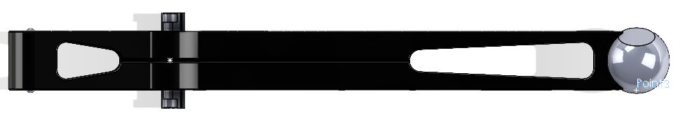




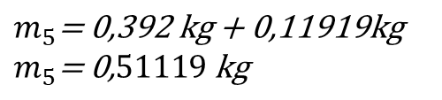



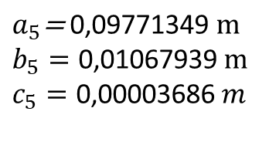


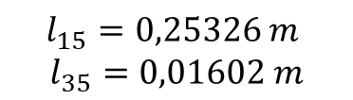
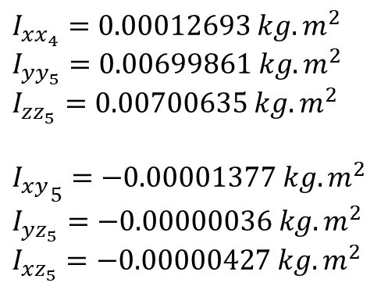

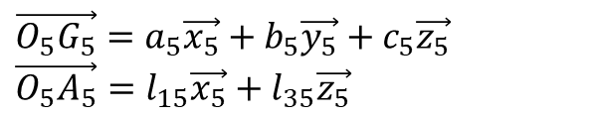
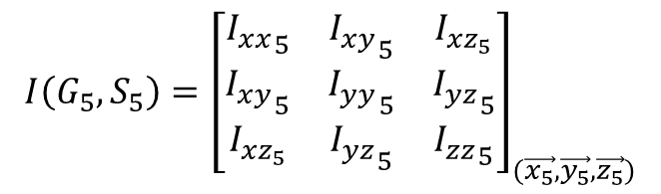

$$I\left(G_{5},S_{5}\right)={\left[\begin{matrix}{I_{xx}}_{5} & {I_{xy}}_{5} & I_{xz_{5}} \\ {I_{xy}}_{5} & {I_{yy}}_{5} & {I_{yz}}_{5} \\ I_{xz_{5}} & {I_{yz}}_{5} & {I_{zz}}_{5}\end{matrix}\right]}_{(\vec{x_{5}},\vec{y_{5}},\vec{z_{5}})}$$
$\vec{O_{5}G_{5}}=a_{5}\vec{x_{5}}+b_{5}\vec{y_{5}}+c_{5}\vec{z_{5}}$
$\vec{O_{5}A_{5}}=l_{15}\vec{x_{5}}+l_{35}\vec{z_{5}}$
Solide 5
$I_{xx_{4}}=0.00012693 kg.m^{2}$
$I_{yy_{5}}=0.00699861 kg.m^{2}$
$I_{zz_{5}}=0.00700635 kg.m^{2}$
${I_{xy}}_{5}=−0.00001377 kg.m^{2}$
$I_{yz_{5}}=−0.00000036 kg.m^{2}$
$I_{xz_{5}}=−0.00000427 kg.m^{2}$
$a_{5}\text{=} \text{0}\text{,}\text{09771349} \text{m}$
$b_{5}=\text{0}\text{,}\text{01067939} m$
$c_{5}=\text{0}\text{,}\text{00003686} m$
$$l_{15}=0,25326 m$$
$$l_{35}=0,\text{0}\text{1602} m$$
$m_{5}\text{= 0,392 }\text{kg}\text{ + 0,11919}\text{kg}$
$m_{5}\text{= 0,}51119 \text{kg}$
$$G_{5}$$
$$V_{5} =0,000\text{149287} m^{3}$$
$$z_{6}$$
$$y_{5}$$
$$z_{5}$$
$$x_{5}$$
$$θ=30°$$
$$A_{5}$$
$$θ$$
$$y_{6}$$
$$z_{5}$$
$$y_{5}$$

Slide 13
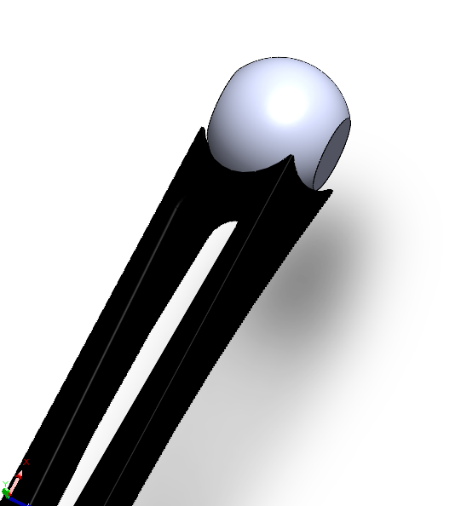





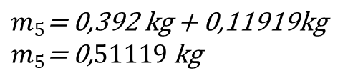















$$I\left(G_{5},S_{5}\right)={\left[\begin{matrix}{I_{xx}}_{5} & {I_{xy}}_{5} & I_{xz_{5}} \\ {I_{xy}}_{5} & {I_{yy}}_{5} & {I_{yz}}_{5} \\ I_{xz_{5}} & {I_{yz}}_{5} & {I_{zz}}_{5}\end{matrix}\right]}_{(\vec{x_{5}},\vec{y_{5}},\vec{z_{5}})}$$
${\vec{A_{5}G_{5}}}_{|R_{6}}=a_{5}\vec{x_{6}}+b_{5}\vec{y_{6}}+c_{5}\vec{z_{6}}$
${\vec{A_{5}O_{5}}}_{|R_{6}}=l_{15}\vec{x_{6}}+l_{25}\vec{y_{6}}+l_{35}\vec{z_{6}}$
Solide 5 Reverse gauche
« PIece5_calculIertiel.SLDASM »
$$x_{5}$$
$$x_{6}$$
$I_{xx_{4}}=0.00012720 kg.m^{2}$
$I_{yy_{5}}=0.00700069 kg.m^{2}$
$I_{zz_{5}}=0.00700400 kg.m^{2}$
$${I_{xy}}_{5}=0.00003720 kg.m^{2}$$
$I_{xz_{5}}=−0.00002641 kg.m^{2}$
$I_{yz_{5}}=−0.00000367 kg.m^{2}$
$a_{5}\text{=} \text{−0.15598555} \text{m}$
$b_{5}=\text{0.00009557} m$
$c_{5}=\text{−0.01851262} m$
$$y_{5}$$
$$y_{6}$$
$$z_{6}$$
$$l_{15}=−0.25360 m$$
$$l_{25}=−0.00990 m$$
$$l_{35}=−0,01278 m$$
$$z_{5}$$
$$z_{5}$$
$$z_{6}$$
$$θ=−30°$$
$m_{5}\text{= 0,392 }\text{kg}\text{ + 0,11919}\text{kg}$
$m_{5}\text{= 0,}51119 \text{kg}$
$$θ$$
y₅
x_{6,7}
$$y_{6}$$
$$G_{5}$$
$$V_{5} =0,000\text{149287} m^{3}$$
$$y_{5}$$
$$x_{5}$$
$$x_{6}$$
$$O_{5}$$
$$y_{6}$$
$$A_{5}$$
$$z_{5}$$
$$z_{6}$$

Slide 14



















$$I\left(G_{5},S_{5}\right)={\left[\begin{matrix}{I_{xx}}_{5} & {I_{xy}}_{5} & I_{xz_{5}} \\ {I_{xy}}_{5} & {I_{yy}}_{5} & {I_{yz}}_{5} \\ I_{xz_{5}} & {I_{yz}}_{5} & {I_{zz}}_{5}\end{matrix}\right]}_{(\vec{x_{5}},\vec{y_{5}},\vec{z_{5}})}$$
${\vec{A_{5}G_{5}}}_{|R_{6}}=a_{5}\vec{x_{6}}+b_{5}\vec{y_{6}}+c_{5}\vec{z_{6}}$
${\vec{A_{5}O_{5}}}_{|R_{6}}=l_{15}\vec{x_{6}}+l_{25}\vec{y_{6}}+l_{35}\vec{z_{6}}$
Solide 5 Reverse droite
« PIece5_calculIertiel_droite.SLDASM »
$$x_{6}$$
$$x_{5}$$
$$y_{6}$$
$$z_{6}$$
$I_{xx_{4}}=0.00012720 kg.m^{2}$
$I_{yy_{5}}=0.00700069 kg.m^{2}$
$I_{zz_{5}}=0.00700400 kg.m^{2}$
${I_{xy}}_{5}=−0.0002201 kg.m^{2}$
$I_{xz_{5}}=−0.00002644 kg.m^{2}$
$I_{yz_{5}}=−0.00000344 kg.m^{2}$
$a_{5}\text{=} \text{−0.15598555} \text{m}$
$b_{5}=\text{0.}00143925 m$
$c_{5}=\text{0.01851262} m$
$$y_{5}$$
$$l_{15}=−0.25360 m$$
$$l_{25}=−0.00772 m$$
$$l_{35}=0,02422 m$$
$$z_{5}$$
$$z_{5}$$
$$z_{6}$$
$$θ=−30°$$
$m_{5}\text{= 0,392 }\text{kg}\text{ + 0,11919}\text{kg}$
$m_{5}\text{= 0,}51119 \text{kg}$
y₅
$$z_{6}$$
$$θ$$
x_{6,7}
$$y_{6}$$
$$y_{6}$$
$$G_{5}$$
$$A_{5}$$
$$V_{5} =0,000\text{149287} m^{3}$$
$$y_{5}$$
$$x_{6}$$
$$x_{5}$$
$$O_{5}$$
$$z_{5}$$

Slide 15


















$$I\left(G_{6},S_{6}\right)={\left[\begin{matrix}{I_{xx}}_{6} & {I_{xy}}_{6} & I_{xz_{6}} \\ {I_{xy}}_{6} & {I_{yy}}_{6} & {I_{yz}}_{6} \\ I_{xz_{6}} & {I_{yz}}_{6} & {I_{zz}}_{6}\end{matrix}\right]}_{(\vec{x_{6}},\vec{y_{6}},\vec{z_{6}})}$$
$\vec{O_{6}G_{6}}=a_{6}\vec{x_{6}}+b_{6}\vec{y_{6}}+c_{6}\vec{z_{6}}$
$\vec{O_{6}A_{6}}=l_{16}\vec{x_{6}}+l_{36}\vec{z_{6}}$
Solide 6
$I_{xx_{6}}=0.00012751 kg.m^{2}$
$I_{yy_{6}}=0.00015371 kg.m^{2}$
$I_{zz_{6}}=0.00004567 kg.m^{2}$
$I_{xy_{6}}=0.00000695 kg.m^{2}$
$I_{yz_{6}}=0.00000686 kg.m^{2}$
$I_{xz_{6}}=0.00004329 kg.m^{2}$
$a_{6}=\text{0.03291972} \text{m}$
$b_{6}=\text{0.00776230} m$
$c_{6}=0.03895646 m$
$$z_{7}$$
$$y_{7}$$
$$A_{6}$$
$$l_{16}=0,03352 m$$
$$l_{36}=0,\text{10130} m$$
$$x_{7}$$
$$G_{6}$$
$$m_{6}\text{= }0,\text{08658000 }kg$$
$$z_{6}$$
$$V_{6} =0.00001665 m^{3}$$
$$y_{6}$$
x₆
x₇
O₆
$$θ=−120°$$
ou
$$θ=240°$$
$$x_{6}$$
z₇
$$θ$$
z₆

Slide 16







$$I\left(G_{6},S_{6}\right)={\left[\begin{matrix}{I_{xx}}_{6} & {I_{xy}}_{6} & I_{xz_{6}} \\ {I_{xy}}_{6} & {I_{yy}}_{6} & {I_{yz}}_{6} \\ I_{xz_{6}} & {I_{yz}}_{6} & {I_{zz}}_{6}\end{matrix}\right]}_{(\vec{x_{7}},\vec{y_{7}},\vec{z_{7}})}$$
${\vec{A_{6}G_{6}}}_{|R_{7}}=a_{6}\vec{x_{7}}+b_{6}\vec{y_{7}}+c_{6}\vec{z_{7}}$
${\vec{A_{6}O_{6}}}_{|R_{7}}=l_{16}\vec{x_{7}}+l_{36}\vec{z_{7}}$
Solide 6 Reverse gauche
« Pièce6_gauche.SLDPRT»
${{}_{}^{7}I}_{xx_{6}}=\text{0.00010362} kg.m^{2}$
${}_{}^{7}{I_{yy_{6}}}=\text{0.00015371} kg.m^{2}$
${{}_{}^{7}I}_{zz_{6}}=\text{0.00006956} kg.m^{2}$
$${{}_{}^{7}I}_{xy_{6}}=\text{0.00000247} kg.m^{2}$$
${{}_{}^{7}I}_{xz_{6}}=\text{−0.00005709} kg.m^{2}$
${{}_{}^{7}I}_{yz_{6}}=\text{−0.00000945} kg.m^{2}$
$a_{6}=\text{-}\text{0.05369029} \text{m}$
$b_{6}=\text{0.00776230} m$
$c_{6}=0.03169498 m$
$$z_{7}$$
$$y_{7}$$
$$A_{6}$$
$$l_{16}=− 0,07097 m$$
$$l_{36}=0,\text{07968} m$$
$$x_{7}$$
$$G_{6}$$
$$m_{6}\text{= }0,\text{08658000 }kg$$
$$z_{6}$$
$$V_{6} =0.00001665 m^{3}$$
$$y_{6}$$
x₆
x₇
O₆
z₆
$$θ=120°$$
ou
$$θ=−240°$$
$$x_{6}$$
$$θ$$
z₇
Y_{6,7}

Slide 17


















$$I\left(G_{6},S_{6}\right)={\left[\begin{matrix}{I_{xx}}_{6} & {I_{xy}}_{6} & I_{xz_{6}} \\ {I_{xy}}_{6} & {I_{yy}}_{6} & {I_{yz}}_{6} \\ I_{xz_{6}} & {I_{yz}}_{6} & {I_{zz}}_{6}\end{matrix}\right]}_{(\vec{x_{7}},\vec{y_{7}},\vec{z_{7}})}$$
${\vec{A_{6}G_{6}}}_{|R_{7}}=a_{6}\vec{x_{7}}+b_{6}\vec{y_{7}}+c_{6}\vec{z_{7}}$
${\vec{A_{6}O_{6}}}_{|R_{7}}=l_{16}\vec{x_{7}}+l_{36}\vec{z_{7}}$
Solide 6 Reverse droite
« Pièce6_droite.SLDPRT»
${{}_{}^{7}I}_{xx_{6}}=\text{0.000}10362 kg.m^{2}$
${}_{}^{7}{I_{yy_{6}}}=\text{0.00015371} kg.m^{2}$
${{}_{}^{7}I}_{zz_{6}}=\text{0.0000}6956 kg.m^{2}$
${{}_{}^{7}I}_{xy_{6}}=\text{0.00000}247 kg.m^{2}$
${{}_{}^{7}I}_{xz_{6}}=\text{0.0000}5709 kg.m^{2}$
${{}_{}^{7}I}_{yz_{6}}=\text{0.0000}\text{0}945 kg.m^{2}$
$a_{6}=\text{-}\text{0}\text{,05369029 }\text{m}$
$b_{6}=\text{0},00776230 m$
$c_{6}=−0,03169498 m$
$$z_{7}$$
$$A_{6}$$
$$l_{16}=− 0,07097 m$$
$$l_{36}=−0,\text{07968} m$$
$$x_{7}$$
$$y_{7}$$
$$G_{6}$$
$$m_{6}\text{= }0,\text{08658000 }kg$$
$$z_{6}$$
$$V_{6} =0.00001665 m^{3}$$
x₆
x₇
$$x_{6}$$
z₆
O₆
$$θ=−120°$$
ou
$$θ=240°$$
$$y_{6}$$
$$θ$$
z₇
Y_{6,7}

Slide 18













Solide 7 gauche
« Piece7_calculInertiel_gauche.SLDASM»
$$I\left(G_{7},S_{7}\right)={\left[\begin{matrix}{I_{xx}}_{7} & {I_{xy}}_{7} & I_{xz_{7}} \\ {I_{xy}}_{7} & {I_{yy}}_{7} & {I_{yz}}_{7} \\ I_{xz_{7}} & {I_{yz}}_{7} & {I_{zz}}_{7}\end{matrix}\right]}_{(\vec{x_{5}},\vec{y_{5}},\vec{z_{5}})}$$
$\vec{O_{7}G_{7}}=a_{7}\vec{x_{7}}+b_{7}\vec{y_{7}}+c_{7}\vec{z_{7}}$
$\vec{O_{7}A_{7}}=l_{17}\vec{x_{7}}+l_{37}\vec{z_{7}}$
${I_{xx}}_{7}=\text{0.00255786} kg.m^{2}$
${I_{yy}}_{7}=0.00098183 kg.m^{2}$
${I_{zz}}_{7}=\text{0.00240229} kg.m^{2}$
$${I_{xy}}_{7}=−0.00019222 kg.m^{2}$$
$I_{xz_{7}}=\text{0.000}01186 kg.m^{2}$
${I_{yz}}_{7}=\text{−}\text{0.00089959} kg.m^{2}$
$a_{7}=\text{0}\text{,}\text{02748935} \text{m}$
$b_{7}=\text{−0.03834733} m$
$c_{7}=\text{0.05151232} m$
$$l_{17}=?$$
$$l_{37}= ?$$
$$m_{7}\text{= }0,35022 kg$$
$$y_{7}$$
O₇
$$x_{7}$$
$$V_{7} =\text{200437.864} {mm}^{3}$$
$$A_{7}$$
$$z_{7}$$

Slide 19













Solide 7 droite
« Piece7_calculInertiel_droite.SLDASM»
$$I\left(G_{7},S_{7}\right)={\left[\begin{matrix}{I_{xx}}_{7} & {I_{xy}}_{7} & I_{xz_{7}} \\ {I_{xy}}_{7} & {I_{yy}}_{7} & {I_{yz}}_{7} \\ I_{xz_{7}} & {I_{yz}}_{7} & {I_{zz}}_{7}\end{matrix}\right]}_{(\vec{x_{5}},\vec{y_{5}},\vec{z_{5}})}$$
$\vec{O_{7}G_{7}}=a_{7}\vec{x_{7}}+b_{7}\vec{y_{7}}+c_{7}\vec{z_{7}}$
$\vec{O_{7}A_{7}}=l_{17}\vec{x_{7}}+l_{37}\vec{z_{7}}$
${I_{xx}}_{7}=\text{0.00}264324 kg.m^{2}$
${I_{yy}}_{7}=0.00140645 kg.m^{2}$
${I_{zz}}_{7}=\text{0.00}188114 kg.m^{2}$
$${I_{xy}}_{7}=−0.00042419 kg.m^{2}$$
$I_{xz_{7}}=\text{−0.00019}927 kg.m^{2}$
${I_{yz}}_{7}=\text{0.000}94020 kg.m^{2}$
$a_{7}=\text{0}\text{,}\text{0}\text{3432946 }\text{m}$
$b_{7}=\text{−0.0}2995415 m$
$c_{7}=−0,06284127 m$
$$l_{17}=?$$
$$l_{37}= ?$$
$$m_{7}\text{= }0,35022 kg$$
$$y_{7}$$
O₇
$$x_{7}$$
$$A_{7}$$
$$V_{7} =\text{200437.864} {mm}^{3}$$
$$z_{7}$$

Slide 20
Notes de calcul
Masse(Sphere + solide 6 + solide 7 part 1) = 274 g
V(Sphere + solide 6 + solide 7 part 1 ) = 40167.19 mm3
V(solide 6) = 16647.92 mm3
V(solide 7 part 1 ) = 13031.10 mm3
V(Sphere)= 22859.34 mm3
fracV(Sphere) = 22859.34 / (16647.92+ 13031.10+ 22859.34) = 0.435
fracV(solide 6) = 16647.92 / (16647.92+ 13031.10+ 22859.34) = 0.435
M(Sphere) = 0,435 * 274 = 119.19 g
M(Solide6) = 0.316 * 274 = 86.58 g
M(solide 7 part 1) = (1- 0.316- 0,435) * 274 = 68.22 g

