Slide 1
Evolutionary Heuristic for Tetris

Slide 2
Design and rules of Tetris
A board, usually 10x20.
Six different pieces called tetrominos.
Each piece can be rotated.
Player fills the board with pieces.
One line full => clear line and +1 score.
Piece touches the board's upper edge => Game Over.

Slide 3
Complexity of Tetris
Breukelaar, Ron, et al. "Tetris is hard, even to approximate."(2004).
  « Tetris is NP-Complete » and « deterministic Tetris is NP-Complete ».
Burgiel, Heidi. "How to lose at Tetris." (1997).
  « There exists a sequence of tetrominos that forces the player to lose.»
  There is no optimal agent for Tetris.

Slide 4
Definitions
The state of the game at time t is the board's situation.
Actions : move left, move right, rotate.
Look-ahead : Information regarding the next piece.

Slide 5
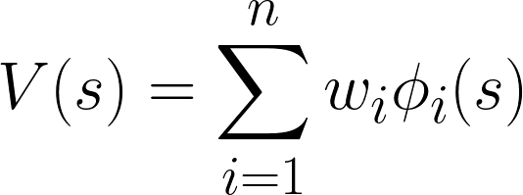
Linear approximation of a state
Issue : Number of states ~ 10⁶¹.
We need a way to rate a given state.
Solution : Use a linear combination of feature functions.

Slide 6
Learning Model
Sample : A game of tetris.
Variables : Weights wi of the heuristic rating function.
Reward : score obtained.
Objective : Find the weights that maximize the score.

Slide 7
Evolutionary Heuristic
n = 4 features : Sum of heights, Holes, Complete Lines and sum of delta heights.
Search space
Individual = weight vector.
Fitness = game's final score.

Slide 8
Evolutionary Heuristic
Initial population : weights uniformly taken -1, 1.
Selection for reproduction : Tournament Selection.
Crossover : One-point Crossover.
Mutation : Gaussian (1;0,2) noise added to one weight.
Selection for replacement : Kill 30% least-fit individuals.
Fixed termination criterion : number of generations.

Slide 9
Evolutionary Heuristic, parameters
Fixed mutation rate = 0.1.
Population size = 100.
Tournament size = 10.
Offspring size = 30.
Fitness averaged on 5 games, 200 moves each.
Number of gen. = 30.

Slide 10
Demo Time !

