Slide 1

Churn analysis swan teleco
Swanning About Solutions

Slide 2
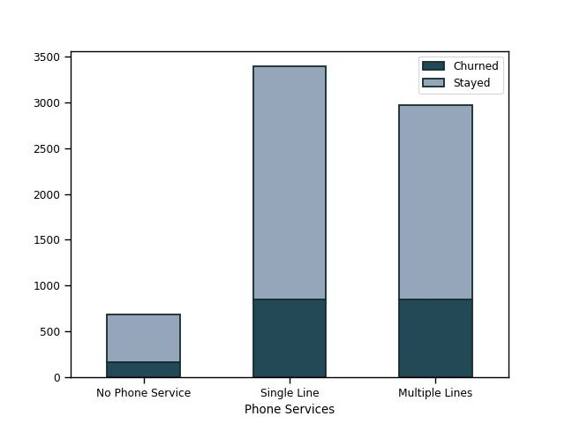
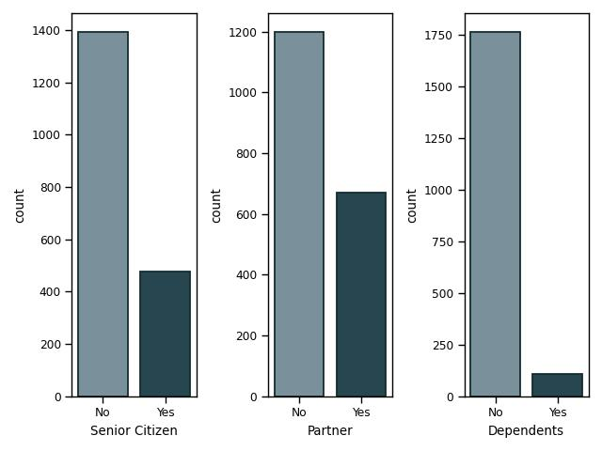
Exploratory data analysis
Demographic of Churners
- Who are our churners?
- Approximately even split between genders:
50.2% Female, 49.8% Male
- 25.5% Senior Citizens
- 35.8% Have a partner
- 5.7% Have a dependent
Services Provided Breakdown
- What products do churners buy?
- 25.0%

