Slide 1
Selection Statement
Chul Min Yeum
Assistant Professor
Civil and Environmental Engineering
University of Waterloo, Canada
AE121: Computational Method
Last updated: 2019-04-12

Slide 2
Recall Relational Expressions
The relational operators in MATLAB are:
> greater than
< less than
>= greater than or equals
<= less than or equals
== equality
~= inequality
The resulting type is logical 1 for true or 0 for false
The logical operators are:
|| or for scalars (and)
&& and for scalars (or)
~ not
Also, xor function which returns logical true if only one of the arguments is true

Slide 3
If Statement
The if statement is used to determine whether or not a statement or group of statements is to be executed
General form:
if condition
action
end
the condition is any relational expression
the action is any number of valid statements (including, possibly, just one)
if the condition is true, the action is executed – otherwise, it is skipped entirely

Slide 4
Exchanging (Swapping) Values of Variables
Useful, for example, when the value of one variable is supposed to be less than another – if that is not the case, exchange their values (so, an if statement is used to determine whether this is necessary or not)
A temporary variable is necessary
Algorithm to exchange values of variables a and b:
Assign the value of a to temp
Assign the value of b to a
Assign the value of temp to b
-

Slide 5
Representing True/False Concepts
Note: to represent the concept of false, 0 is used. To represent the concept of true, any nonzero value can be used – so expressions like 5 or ‘x’ result in logical true
This can lead to some common logical errors
For example, the following expressions are always true (because the “relational expressions” on the right, 6 and ‘N’, are nonzero so they are true; therefore, it does not matter what the results of the others are):
(number < 5) || 6
(letter == ‘n’) || ‘N’

Slide 6
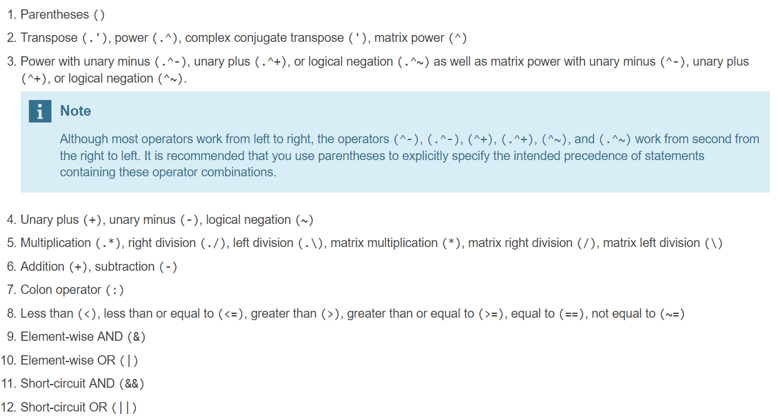
Operator Precedence
https://www.mathworks.com/help/matlab/matlab_prog/operator-precedence.html

Slide 7
Nested if-else Statements
Simplify this statement:
if num < 0
num = 0;
else
num = num;
end
Answer:
if num < 0
num = 0;
end
The point is that the else clause does not accomplish anything, so it is not necessary … sometimes just an if statement is all you need!

Slide 8
Throwing an Error
MATLAB has an error function that can be used to display an error message in red, similar to the error messages generated by MATLAB
if radius <= 0
error('Sorry; %.2f is not a valid radius\n', radius)
else
% carry on
end
When an error is thrown in a script, the script stops executing

Slide 9
Nested if-else Statements
To choose from more than two actions, nested if-else statements can be used (an if or if-else statement as the action of another)
General form:
if condition1
action1
else
if condition2
action2
else
if condition3
action3
% etc: there can be many of these
else
actionn % the nth action
end
end
end

Slide 10
The elseif Clause
MATLAB also has an elseif clause which shortens the code (and cuts down on the number of ends)
General form:
if condition1
action1
elseif condition2
action2
elseif condition3
action3
% etc: there can be many of these
else
actionn % the nth action
end

Slide 11
The elseif Clause is Not Always Necessary!
Simplify this statement:
if val >= 4
disp('ok')
elseif val < 4
disp('smaller')
end
Answer:
if val >= 4
disp('ok')
else
disp('smaller')
end
The point is that if you get to the else clause, you know that the expression val >= 4 is false – so, val must be less than 4 so there is no need to check that.

Slide 12
The Switch Statement
The switch statement can frequently be used in place of a nested if-else statement
General form:
switch switch_expression
case caseexp1
action1
case caseexp2
action2
case caseexp3
action3
% etc: there can be many of these
otherwise
actionn
end
this can be used when comparing the switch_expression to see if it is equal to the values on the case labels (the otherwise clause handles all other possible values)

Slide 13
The “is” functions
There are many “is” functions in MATLAB that essentially ask a true/false question, and return logical 1 for true or 0 for false
isletter returns 1 or 0 for every character in a string – whether it is a letter of the alphabet or not
isempty returns 1 if the variable argument is empty, or 0 if not
iskeyword returns 1 if the string argument is a keyword, or 0 if not
isa determines whether the first argument is a specified type

Slide 14
Common Pitfalls
Some common pitfalls have been pointed out already; others include:
Using = instead of == for equality in conditions
Putting a space in the keyword elseif
Not using quotes when comparing a string variable to a string, such as
letter == y
instead of
letter == 'y'
Writing conditions that are more complicated than necessary, such as
if (x < 5) == 1 instead of just if (x < 5)

Slide 15
Programming Style Guidelines
Use indentation to show the structure of a script or function. In particular, the actions in an if statement should be indented.
When the else clause isn’t needed, use an if statement rather than an if-else statement

Slide 16
Slide Credits and References
Stormy Attaway, 2018, Matlab: A Practical Introduction to Programming and Problem Solving, 5th edition
Lecture slides for “Matlab: A Practical Introduction to Programming and Problem Solving”
Holly Moore, 2018, MATLAB for Engineers, 5th edition

