Slide 1
Vectors and Matrices
Chul Min Yeum
Assistant Professor
Civil and Environmental Engineering
University of Waterloo, Canada
AE121: Computational Method
Last updated: 2019-04-10

Slide 2
Matrices
A matrix is used to store a set of values of the same type; every value is stored in an element
MATLAB stands for “matrix laboratory”
A matrix looks like a table; it has both rows and columns
A matrix with m rows and n columns is called m x n; these are called its dimensions;
A vector is a special case of a matrix in which one of the dimensions is 1
The term array is frequently used in MATLAB to refer generically to a matrix or a vector
a row vector with n elements is 1 x n, e.g. 1 x 4:
a column vector with m elements is m x 1, e.g. 3 x 1:
A scalar is an even more special case; it is 1 x 1, or in other words, just a single value

Slide 3
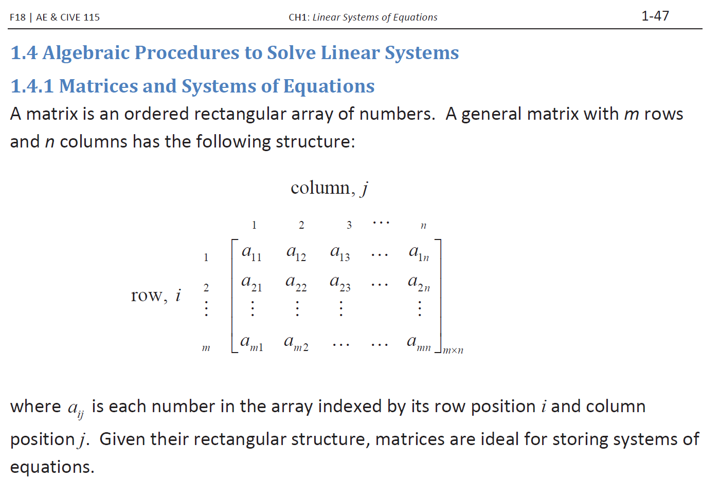
Remind: Matrices

Slide 4
Creating Row Vectors
Direct method: put the values you want in square brackets, separated by either commas or spaces
>> v = [1 2 3 4]
v =
1 2 3 4
>> v = [1,2,3,4]
v =
1 2 3 4
Colon operator: iterates through values in the form first:step:last e.g. 5:3:14 returns vector [5 8 11 14]
If no step is specified, the default is 1 so for example 2:4 creates the vector [2 3 4]
Can go in reverse e.g. 4:-1:1 creates[4 3 2 1]
Will not go beyond last e.g., 1:2:6 creates [1 3 5]

Slide 5
Creating Column Vectors
A column vector is an m x 1 vector
Direct method: can create by separating values in square brackets with semicolons e.g. [4; 7; 2]
You cannot directly create a column vector using methods such as the colon operator, but you can create a row vector and then transpose it to get a column vector using the transpose operator ’e.g., [4 7 2]’
Referring to elements: same as row vectors; specify indices in parentheses

Slide 6
Concatenation
Vectors can be created by joining together existing vectors, or adding elements to existing vectors
This is called concatenation
For example:
>> v = 2:5;
>> x = [33 11 2];
>> w = [v x]
w =
2 3 4 5 33 11 2
>> newv = [v 44]
newv =
2 3 4 5 44

Slide 7
Referring to Elements
The elements in a vector are numbered sequentially; each element number is called the index, or subscript and are shown above the elements here:
Refer to an element using its index or subscript in parentheses, e.g. vec(4) is the 4th element of a vector vec (assuming it has at least 4 elements)
Can also refer to a subset of a vector by using an index vector which is a vector of indices e.g. vec([2 5]) refers to the 2nd and 5th elements of vec; vec([1:4]) refers to the first 4 elements
1 | 2 | 3 | 4 | 5
5 | 33 | 11 | -4 | 2
The index in MATLAB starts from 1

Slide 8
Modifying Vectors
Elements in a vector can be changed e.g.
vec(3) = 11
A vector can be extended by referring to elements that do not yet exist; if there is a gap between the end of the vector and the new specified element(s), zeros are filled in, e.g.
>> vec = [3 9];
>> vec(4:6) = [33 2 7]
vec =
3 9 0 33 2 7
Extending vectors is not recommended
Refereeing: Error
Assigning : Okay
vec = zeros(1,6);
vec(1:2) = [3 9];
vec(4:6) = [33 2 7];
vec

Slide 9
Modifying Vectors
Elements in a vector can be changed e.g.
vec(3) = 11
A vector can be extended by referring to elements that do not yet exist; if there is a gap between the end of the vector and the new specified element(s), zeros are filled in, e.g.
>> vec = [3 9];
>> vec(4:6) = [33 2 7]
vec =
3 9 0 33 2 7
Extending vectors is not recommended
Refereeing: Error
Assigning : Okay
vec = zeros(1,6);
vec(1:2) = [3 9];
vec(4:6) = [33 2 7];
vec

Slide 10
Creating a Matrix
Separate values within rows with blanks or commas, and separate the rows with semicolons
Can use any method to get values in each row (any method to create a row vector, including colon operator)
>> mat = [1:3; 6 11 -2]
mat =
1 2 3
6 11 -2
There must ALWAYS be the same number of values in every row!!

Slide 11
Functions that create matrices
There are many built-in functions to create matrices
rand(n) creates an nxn matrix of random reals
rand(n,m) create an nxm matrix of random reals
randi([range],n,m) creates an nxm matrix of random integers in the specified range
zeros(n) creates an nxn matrix of all zeros
zeros(n,m) creates an nxm matrix of all zeros
ones(n) creates an nxn matrix of all ones
ones(n,m) creates an nxm matrix of all ones
Note: there is no twos function – or thirteens – just zeros and ones!

Slide 12
Matrix Elements
To refer to an element in a matrix, you use the matrix variable name followed by the index of the row, and then the index of the column, in parentheses
>> mat = [1:3; 6 11 -2]
mat =
1 2 3
6 11 -2
>> mat(2,1)
ans =
6
ALWAYS refer to the row first, column second
This is called subscripted indexing
Can also refer to any subset of a matrix
To refer to the entire mth row: mat(m,:)
To refer to the entire nth column: mat(:,n)

Slide 13
Matrix Indexing
To refer to the last row or column use end, e.g. mat(end,m) is the mth value in the last row
Can modify an element or subset of a matrix in an assignment statement
Linear indexing: only using one index into a matrix (MATLAB will unwind it column-by column)
Note, this is not generally recommended

Slide 14
Modifying Matrices
An individual element in a matrix can be modified by assigning a new value to it
Entire rows and columns can also be modified
Any subset of a matrix can be modified, as long as what is being assigned has the same dimensions as the subset being modified
Exception to this: a scalar can be assigned to any size subset; the same scalar is assigned to every element in the subset

Slide 15
Matrix Indexing
To refer to the last row or column use end, e.g. mat(end,m) is the mth value in the last row
Can modify an element or subset of a matrix in an assignment statement
Linear indexing: only using one index into a matrix (MATLAB will unwind it column-by column)
Note, this is not generally recommended

Slide 16
Matrix Indexing
To refer to the last row or column use end, e.g. mat(end,m) is the mth value in the last row
Can modify an element or subset of a matrix in an assignment statement
Linear indexing: only using one index into a matrix (MATLAB will unwind it column-by column)
Note, this is not generally recommended

Slide 17
Matrix Indexing
There are several functions to determine the dimensions of a vector or matrix:
length(vec) returns the # of elements in a vector
length(mat) returns the larger dimension (row or column) for a matrix
size returns the # of rows and columns for a vector or matrix
Important: capture both of these values in an assignment statement
[r c] = size(mat)
numel returns the total # of elements in a vector or matrix
Very important to be general in programming: do not assume that you know the dimensions of a vector or matrix – use length or size to find out!

Slide 18
Matrix Dimensions
To refer to the last row or column use end, e.g. mat(end,m) is the mth value in the last row
Can modify an element or subset of a matrix in an assignment statement
Linear indexing: only using one index into a matrix (MATLAB will unwind it column-by column)
Note, this is not generally recommended

Slide 19
Functions that change dimensions
Many function change the dimensions of a matrix:
reshape changes dimensions of a matrix to any matrix with the same number of elements
rot90 rotates a matrix 90 degrees counter-clockwise
fliplr flips columns of a matrix from left to right
flipud flips rows of a matrix up to down
flip flips a row vector left to right, column vector or matrix up to down

Slide 20
Replicating matrices
repmat replicates an entire matrix; it creates m x n copies of the matrix
repelem replicates each element from a matrix in the dimensions specified
>> mymat = [33 11; 4 2]
mymat =
33 11
4 2
>> repmat(mymat, 2,3)
ans =
33 11 33 11 33 11
4 2 4 2 4 2
33 11 33 11 33 11
4 2 4 2 4 2
>> repelem(mymat,2,3)
ans =
33 33 33 11 11 11
33 33 33 11 11 11
4 4 4 2 2 2
4 4 4 2 2 2

Slide 21
Empty Vectors
An empty vector is a vector with no elements; an empty vector can be created using square brackets with nothing inside [ ]
to delete an element from a vector, assign an empty vector to that element
delete an entire row or column from a matrix by assigning [ ]
Note: cannot delete an individual element from a matrix
Empty vectors can also be used to “grow” a vector, starting with nothing and then adding to the vector by concatenating values to it (usually in a loop, which will be covered later)
This is not efficient, however, and should be avoided if possible

Slide 22
3D Matrices
A three dimensional matrix has dimensions m x n x p
Can create using built-in functions, e.g. the following creates a 3 x 5 x 2 matrix of random integers; there are 2 layers, each of which is a 3 x 5 matrix
>> randi([0 50], 3,5,2)
ans(:,:,1) =
36 34 6 17 38
38 33 25 29 13
14 8 48 11 25
ans(:,:,2) =
35 27 13 41 17
45 7 42 12 10
48 7 12 47 12

Slide 23
Arrays as function arguments
Entire arrays (vectors or matrices) can be passed as arguments to functions; this is very powerful!
The result will have the same dimensions as the input
For example:
>> vec = randi([-5 5], 1, 4)
vec =
-3 0 5 1
>> av = abs(vec)
av =
3 0 5 1

Slide 24
Scalar operations
Numerical operations can be performed on every element in a vector or matrix
For example, Scalar multiplication: multiply every element by a scalar
>> [4 0 11] * 3
ans =
12 0 33
Another example: scalar addition; add a scalar to every element
>> zeros(1,3) + 5
ans =
5 5 5

Slide 25
Array Operations
Array operations on two matrices A and B:
these are applied term-by-term, or element-by-element
this means the matrices must have the same dimensions
In MATLAB:
matrix addition: A + B
matrix subtraction: A – B or B – A
For operations that are based on multiplication (multiplication, division, and exponentiation), a dot must be placed in front of the operator
array multiplication: A .* B
array division: A ./ B, A .\ B
array exponentiation A .^ 2
matrix multiplication: NOT an array operation

Slide 26
Common Pitfalls

Slide 27
Logical Vectors
Using relational operators on a vector or matrix results in a logical vector or matrix
>> vec = [44 3 2 9 11 6];
>> logv = vec > 6
logv =
1 0 0 1 1 0
can use this to index into a vector or matrix (only if the index vector is the type logical)
>> vec(logv)
ans =
44 9 11

Slide 28
True/False
false equivalent to logical(0)
true equivalent to logical(1)
false and true are also functions that create matrices of all false or true values
As of R2016a, this can also be done with ones and zeros, e.g.
logzer = ones(1,5, 'logical')

Slide 29
Logical Built-in Functions
any returns true if anything in the input argument is true
all returns true only if everything in the input argument is true
find finds locations and returns indices
>> vec
vec =
44 3 2 9 11 6
>> find(vec>6)
ans =
1 4 5

Slide 30
Comparing Arrays
The isequal function compares two arrays, and returns logical true if they are equal (all corresponding elements) or false if not
>> v1 = 1:4;
>> v2 = [1 0 3 4];
>> isequal(v1,v2)
ans =
0
>> v1 == v2
ans =
1 0 1 1
>> all(v1 == v2)
ans =
0

Slide 31
Element-wise operators
| and & are used for matrices; go through element-by-element and return logical 1 or 0
|| and && are used for scalars

Slide 32
Programming Style Guidelines

Slide 33
Matrix Multiplication: Dimensions
Matrix multiplication is NOT an array operation
it does NOT mean multiplying term by term
In MATLAB, the multiplication operator * performs matrix multiplication
Matrix multiplication has a very specific definition
In order to be able to multiply a matrix A by a matrix B, the number of columns of A must be the same as the number of rows of B
If the matrix A has dimensions m x n, that means that matrix B must have dimensions n x something; we’ll call it p
In mathematical notation, [A]m x n [B]n x p
We say that the inner dimensions must be the same
The resulting matrix C has the same number of rows as A and the same number of columns as B
in other words, the outer dimensions m x p
In mathematical notation, [A]m x n [B]n x p = [C]m x p.
This only defines the size of C; it does not explain how to calculate the values

Slide 34
Matrix Multiplication
The elements of the matrix C are found as follows:
the sum of products of corresponding elements in the rows of A and columns of B, e.g.

Slide 35
Matrix Multiplication Example
The 35, for example, is obtained by taking the first row of A and the first column of B, multiplying term by term and adding these together. In other words, 3*1 + 8*4 + 0*0, which is 35.

Slide 36
Vector Operations
Since vectors are just special cases of matrices, the matrix operations described including addition, subtraction, scalar multiplication, multiplication, and transpose work on vectors as well, as long as the dimensions are correct
Specific vector operations:
The dot product or inner product of two vectors a and b is defined as a₁b₁ + a₂b₂+ a₃b₃ + … + a_{n}b_{n}
built-in function dot to do this
Also, cross for cross product

Slide 37
Common Pitfalls
Attempting to create a matrix that does not have the same number of values in each row
Confusing matrix multiplication and array multiplication. Array operations, including multiplication, division, and exponentiation, are performed term by term (so the arrays must have the same size); the operators are .*, ./, .\, and .^. For matrix multiplication to be possible, the inner dimensions must agree and the operator is *.
Attempting to use an array of double 1s and 0s to index into an array (must be logical, instead)
Attempting to use || or && with arrays. Always use | and & when working with arrays; || and && are only used with scalars.

Slide 38
Programming Style Guidelines
If possible, try not to extend vectors or matrices, as it is not very efficient.
Do not use just a single index when referring to elements in a matrix; instead, use both the row and column subscripts (use subscripted indexing rather than linear indexing)
To be general, never assume that the dimensions of any array (vector or matrix) are known. Instead, use the function length or numel to determine the number of elements in a vector, and the function size for a matrix:
len = length(vec);
[r, c] = size(mat);
Use true instead of logical(1) and false instead of logical(0), especially when creating vectors or matrices.

Slide 39
Slide Credits and References
Lecture notes: Robert Collins
Hartley, Richard, and Andrew Zisserman. Multiple view geometry in computer vision. Cambridge university press, 2003.

