Slide 1
Introduction
Chul Min Yeum
Assistant Professor
Civil and Environmental Engineering
University of Waterloo, Canada
AE121: Computational Method
Last updated: 2019-04-12

Slide 2
Introduction to MATLAB
Very powerful software package
Many mathematical and graphical applications
Has programming constructs
Also has many built-in functions
Can use interactively in the Command Window, or write your own programs
In the Command Window the >> is the prompt
At the prompt, enter a command or expression
MATLAB will respond with a result

Slide 3
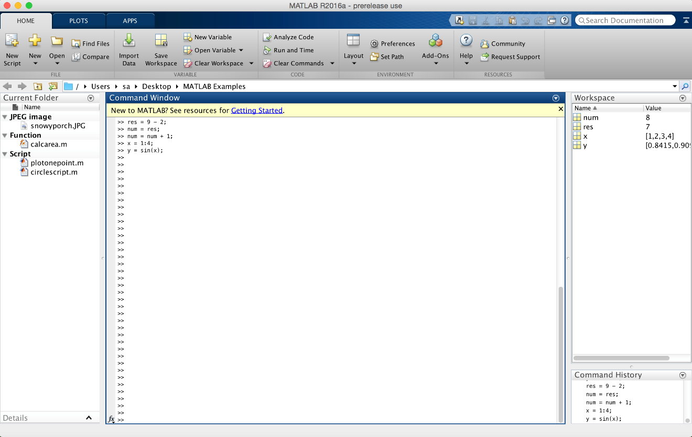
MATLAB Desktop Environment
Command Window is large window in middle; Current Folder Window to left, Workspace and Command History to right

Slide 4
Doc function !!!!

Slide 5
Grading

Slide 6
Desktop Environment
Current Folder window shows files; the folder set as the Current Folder is where files will be saved
Workspace Window: shows variables (discussed next)
Command History Window: shows commands that have been entered and on what date
Toolstrip on top has tabs for HOME (the default), PLOTS, and APPS
HOME tab is divided into functional sections FILE, VARIABLE, CODE, ENVIRONMENT, RESOURCES
Under ENVIRONMENT, Layout allows for customization of the Desktop Environment

Slide 7
Live Scripts
Live scripts are created using the Live Editor
Can embed equations, images, formatted text, and hyperlinks
Equations can be created using LaTex notation or using equation editors
Plots are shown in the live script instead of in separate Figure Windows
Functions can be in live scripts
Live scripts are stored in .mlx files
Can be converted to PDF or HTML format

Slide 8
Code Cells and Publishing
Code in scripts can be broken into sections called code cells
You can run one code cell at a time
Code cells are created with comments that start with two %%
Code in code cells can also be published in HTML format with plots embedded and with formatted equations
Do this from the Publish tab in the Editor

Slide 9
Shortcut (Midterm Exam)
If arguments are passed to a function in the function call, do not replace these values by using input in the function itself.
Functions that calculate and return value(s) will not normally also print them.
Functions should not normally be longer than one page in length
Do not declare variables in the Command Window and then use them in a script, or vice versa.
Pass all values to be used in functions to input arguments in the functions.

Slide 10
Color Scheme for Eye Strain

Slide 11
Slide Credits and References
Stormy Attaway, 2018, Matlab: A Practical Introduction to Programming and Problem Solving, 5th edition
Lecture slides for “Matlab: A Practical Introduction to Programming and Problem Solving”
Holly Moore, 2018, MATLAB for Engineers, 5th edition

